Slide 1
GENERIC PROGRAMMING<METHODS>
MAJEED ALHASSAN

Slide 2
SCENARIO
You have been tasked with writing a utility method:
takes an array and an item of the array’s type as inputs
throws IllegalArgumentException if number of array items not 5
returns a Boolean to indicate if array contains item or not

Slide 3
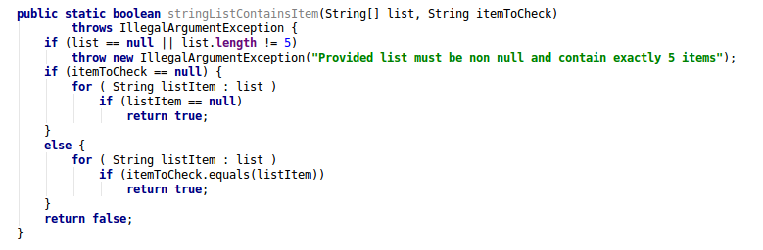
First Approach
Write the utility method for arrays that hold string

Slide 4
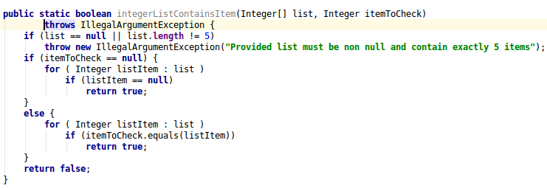
First Approach (Cont.)
Write the utility method for arrays that hold string
And then a separate class for a array of Integers

Slide 5
First Approach (Cont.)
Write the utility method for arrays that hold string
And then a separate class for a list of Integers
And write one each for all other types….
public static boolean anObjectListContainsItem(IanObject[] list, anObject itemToCheck)
...
return false;
}

Slide 6
Reuse/Flexibility Defeated
One of the main benefits of OOP is reuse and flexibility of our codes
First approach runs counter to that

Slide 7
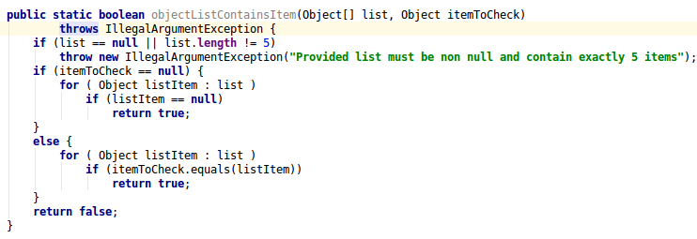
Second Approach
Write the utility method for arrays that hold objects

Slide 8
Second Approach(Cont.)
Write the utility method for arrays that hold objects
Array can contain a mixture of types

Slide 9
Second Approach(Cont.)
Write the utility method for arrays that hold objects
Array can contain a mixture of types
Type to check may not match types in the list

Slide 10
Requirement<s> Not Satisfied
Second approach does not satisfy a major requirement of the utility method:
-takes an array and an item of the array’s type as inputs

Slide 11
A viable Solution: Generic programming
Generic programming allows writing of algorithms that allows deduction of types at later times

Slide 12
A viable Solution: Generic programming
Generic programming allows writing of algorithms that allows deduction of types at later times
Generic methods also known as parameterized methods lets us write codes that leave open the types to be used in such methods

Slide 13
A viable Solution: Generic programming
Generic programming allows writing of algorithms that allows deduction of types at later times.
Generic methods also known as parameterized methods lets us write codes that leave open the types to be used in such methods
Very useful when writing abstract /interface methods

Slide 14
A viable Solution: Generic programming
Generic programming allows writing of algorithms that allows deduction of types at later times.
Generic methods also known as parameterized methods lets us write codes that leave open the types to be used in such methods
Very useful when writing abstract /interface methods
And in template/ framework patterns

Slide 15
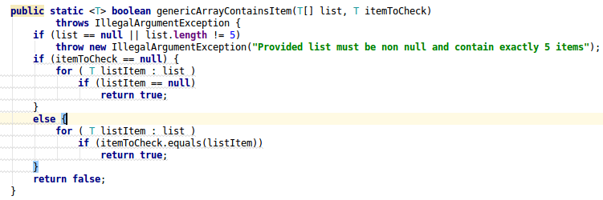
Generic Approach
Write a generic utility method to solve the problem

Slide 16
A persistent problem
The generic solves the problem of mixing different types in an array
Allows us to use the method with arrays that hold different types
But, still, does not enforce the type of item to check

Slide 17
Wildcards
A list of fruits is not same as a list of an object that subclasses fruits
Example, method renderAll(List<fruits>){} cannot be used with renderAll(oranges){} where oranges is of type List<oranges>
Hence wildcards: renderAll(List<? extends fruits>)

Slide 18
A Minor Detour

Slide 19
Wildcard (cont.)
Wildcard lets us write methods that can work with collections of objects of various types; but:
They do no provide mechanism to restrict what types we can use in class or method definition.
Hence , bounded types.

Slide 20
Wildcard Syntax
List<? extends object>: list of object or any of its subclasses
List<? super object>: list of object or any of its parents
List<?>: list of any object. Same as List<? extends object>

Slide 21
Bounded Types
Bounded types are just like wildcards, except , they are used directly as formal parameters in a method, class or interface
Thus, they help provide restrictions for the type of arguments allowed in a method call

Slide 22
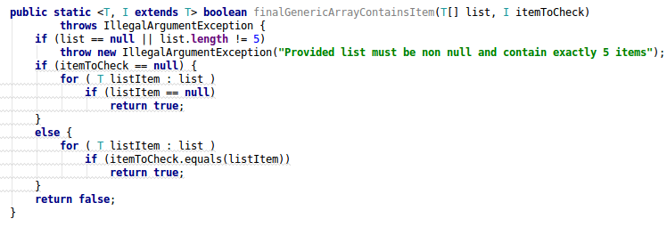
Final Approach (Solution)
Write a generic utility method to solve the problem using the bounded type parameter

Slide 23
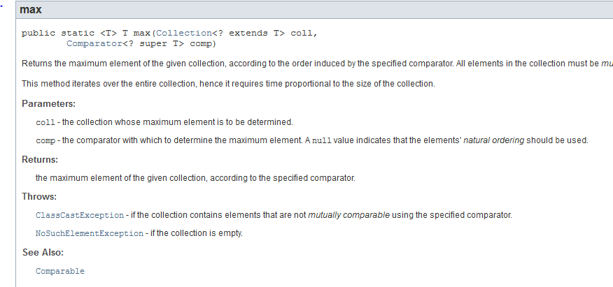
A generic method in Java
A static method of collection class

Slide 24
References
Eck, J. David:
Introduction to Programming Using Java, Seventh Edition,
Ch10, Section 5

