Slide 1
DATABASE MANAGEMENT SYSTEMS (DBMS) COURSE PROJECT
IT Helpdesk & Asset Support
Management System
Presentation-II: Relational Schema Design, 3NF Normalization, ER Diagram & SQL Query Implementation
STUDENT DETAILS
Md Aali Rahman
Roll Number: 25WU0102156
Section: AIML Panthers | Year: 2026
Woxsen University, School of Technology
ACADEMIC MENTORSHIP
Faculty Guide: Dr. Kiranmayee Adavala
Department: Computer Science & Engineering
Database Engine: MySQL 8.0+ / 9.x (InnoDB)
Evaluated Deliverables: DDL, Seed DML, ERD, Queries

Slide 2
SYSTEM ARCHITECTURE
Problem Recap & Relational Database Scope
CORE PROBLEM
IT Service Coordination
• Manual, email-driven support causes lost tickets, delayed resolutions, and missing asset records.
• No relational correlation between hardware equipment, warranties, and cumulative maintenance costs.
• Need for a robust relational back-end to enforce data consistency and historical audit trails.
DATABASE SCOPE
Centralized it_helpdesk Schema
• Centralized MySQL relational database managing 14 distinct tables in 3rd Normal Form (3NF).
• Dual-path ticket classification: Incidents (faults) and Service Requests (access & allocations).
• Full lifecycle tracking with assignments, status histories, and resolution logging.
IT Helpdesk & Asset Support Management System | Presentation-II: Schema Implementation & SQL Queries | Slide 2 of 14

Slide 3
ENGINEERING GOALS
Relational Database Design Objectives
INTEGRITY & RELIABILITY
Data Governance Objectives
• Eliminate Data Redundancy: Apply 1NF, 2NF, and 3NF across all entities to achieve single-source data storage.
• Enforce Referential Integrity: Implement foreign key actions (RESTRICT, CASCADE, SET NULL) matching real-world lifecycle semantics.
• Domain Constraints: Enforce CHECK constraints on priority levels (1-5), status enums, and non-negative maintenance costs.
PERFORMANCE & AUDITING
Analytical & Operational Goals
• Audit Trail Accountability: Automatically capture old vs new states with timestamps in status_histories.
• High-Performance Queries: Support multi-table JOINs and GROUP BY aggregation for technician workloads and expenditure.
• Production Readiness: Ensure InnoDB ACID compliance and crash resilience.
IT Helpdesk & Asset Support Management System | Presentation-II: Schema Implementation & SQL Queries | Slide 3 of 14

Slide 4
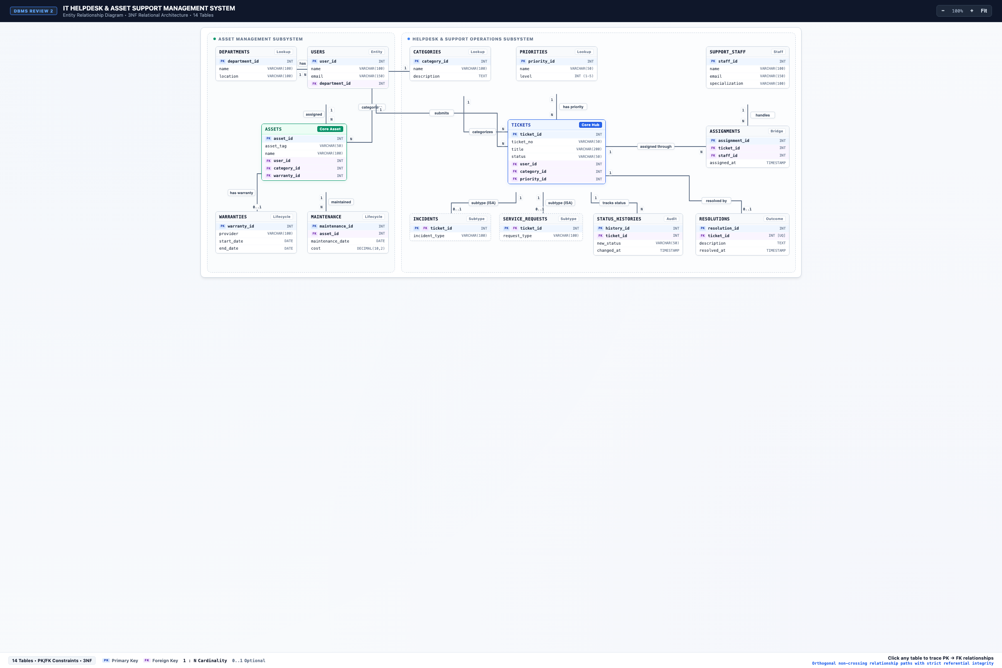
CONCEPTUAL MODEL
Entity-Relationship (ER) Diagram Overview
KEY RELATIONSHIPS
• 14 Entities in 3NF
• 14 Foreign Key relations
• departments 1:N users
• users 1:N tickets
• tickets 1:1 incidents
• tickets 1:1 service_requests
• tickets 1:1 resolutions
• tickets 1:N assignments
• tickets 1:N status_histories
• assets 1:N maintenance
IT Helpdesk & Asset Support Management System | Presentation-II: Schema Implementation & SQL Queries | Slide 4 of 14

Slide 5
PHYSICAL SCHEMA
Relational Schema Architecture (14 Tables)
CORE MASTER TABLES
Master & Reference Tables
• departments(department_id PK, name UNIQUE, location)
• users(user_id PK, name, email UNIQUE, department_id FK)
• categories(category_id PK, name UNIQUE, description)
• priorities(priority_id PK, name UNIQUE, level CHECK)
• support_staff(staff_id PK, name, email UNIQUE, specialization)
• warranties(warranty_id PK, start_date, end_date, provider)
OPERATIONAL & TRANSACTIONAL
Transactional & Audit Tables
• assets(asset_id PK, asset_tag, serial_no, user_id FK, category_id FK, warranty_id FK)
• tickets(ticket_id PK, ticket_no UNIQUE, user_id FK, category_id FK, priority_id FK, status)
• incidents(ticket_id PK/FK, incident_type)
• service_requests(ticket_id PK/FK, request_type)
• assignments(assignment_id PK, ticket_id FK, staff_id FK, assigned_at)
• status_histories(history_id PK, ticket_id FK, old_status, new_status, changed_at)
• resolutions(resolution_id PK, ticket_id FK UNIQUE, description, resolved_at)
• maintenance(maintenance_id PK, asset_id FK, maintenance_date, cost, description)
IT Helpdesk & Asset Support Management System | Presentation-II: Schema Implementation & SQL Queries | Slide 5 of 14

Slide 6
REFERENTIAL INTEGRITY
Foreign Key Semantics & Cascading Rules
RESTRICT ACTIONS
Master Data Protection
• departments -> users (ON DELETE RESTRICT): Prevents deleting a department while active employees exist.
• categories -> tickets / assets (ON DELETE RESTRICT): Protects operational categories from accidental deletion.
• priorities -> tickets (ON DELETE RESTRICT): Guarantees priority integrity for active queues.
• support_staff -> assignments (ON DELETE RESTRICT): Preserves technician service records.
CASCADE & SET NULL
Lifecycle Synchronized Rules
• tickets -> incidents / service_requests / assignments / status_histories / resolutions (ON DELETE CASCADE): Deleting a ticket cleanly purges sub-entities without leaving orphan rows.
• assets -> maintenance (ON DELETE CASCADE): Removing an asset purges historical maintenance receipts.
• users -> assets (ON DELETE SET NULL): Removing an employee safely unassigns hardware back into general inventory.
IT Helpdesk & Asset Support Management System | Presentation-II: Schema Implementation & SQL Queries | Slide 6 of 14

Slide 7
DATABASE THEORY
Normalization Analysis (1NF to 3NF)
1NF & 2NF
First & Second Normal Form
• 1NF (First Normal Form): All table attributes are atomic. No multi-valued attributes, comma-separated lists, or repeating groups. Every column has defined scalar data types.
• 2NF (Second Normal Form): Satisfies 1NF, and all non-key attributes are fully functionally dependent on the entire primary key. Composite keys eliminated in favor of surrogate integer PKs, preventing partial functional dependencies.
3NF
Third Normal Form Compliance
• 3NF (Third Normal Form): Satisfies 2NF and eliminates all transitive functional dependencies (X -> Y and Y -> Z).
• Departments are decoupled from users (users store only department_id, not department location).
• Warranties are isolated into a separate entity (assets store warranty_id rather than repeating provider and dates).
• Categories and priorities are independent reference tables.
IT Helpdesk & Asset Support Management System | Presentation-II: Schema Implementation & SQL Queries | Slide 7 of 14

Slide 8
IMPLEMENTATION
Data Definition Language (DDL) Architecture
SCHEMA CONSTRUCTION
Table Creation & Data Types
• Engineered with MySQL InnoDB storage engine for transactional safety and row-level locking.
• Character set configured to utf8mb4 with utf8mb4_unicode_ci collation for universal Unicode text support.
• AUTO_INCREMENT surrogate primary keys for high-efficiency B-Tree indexing.
• Appropriate sizing: VARCHAR(100), VARCHAR(150), TEXT for narratives, TIMESTAMP for audit precision.
CONSTRAINTS ENFORCEMENT
DDL Constraints Verification
• CHECK (level BETWEEN 1 AND 5) on table priorities.
• CHECK (status IN ('Open', 'In Progress', 'Pending', 'Resolved', 'Closed', 'Cancelled')) on table tickets.
• CHECK (end_date >= start_date) on table warranties.
• CHECK (cost >= 0) on table maintenance.
• UNIQUE constraints on emails, ticket numbers, asset tags, and serial numbers.
IT Helpdesk & Asset Support Management System | Presentation-II: Schema Implementation & SQL Queries | Slide 8 of 14

Slide 9
DATA MANIPULATION
DML Seed Dataset Implementation
SEED DATASET
55 Relational Seed Records
• Structured seed dataset in seed.sql establishing realistic operational baseline across 14 tables.
• 4 Departments: Engineering, Human Resources, Finance, Marketing.
• 5 Registered Corporate Users across all departments.
• 5 Ticket Categories & 4 Priority Levels (Low, Medium, High, Critical).
• 4 Support Staff Technicians with distinct specializations (Network, Hardware, Software, IAM).
REFERENTIAL LINKING
Integrated Relational Records
• 4 Manufacturer Warranties (Dell ProSupport, AppleCare, Lenovo Premier, HP Care Pack).
• 5 Computing Assets linked to user custodians and warranty providers.
• 5 Base Tickets spanning Incidents and Service Requests with initial status histories.
• Active technician assignments and recorded maintenance repairs.
IT Helpdesk & Asset Support Management System | Presentation-II: Schema Implementation & SQL Queries | Slide 9 of 14

Slide 10
QUERY OPTIMIZATION
Representative SELECT & Multi-Table JOIN Queries
RELATIONAL JOINS
Multi-Table Ticket Queue Query
• Joins tickets, users, departments, categories, priorities, incidents, and service_requests.
• Utilizes CASE expressions to determine ticket subtype dynamically (Incident vs Service Request).
• Extracts human-readable status queues ordered by priority level descending.
• Preserves NULL values using LEFT OUTER JOINs for unassigned subtypes.
AGGREGATE ANALYTICS
Workload & Expenditure Aggregation
• Technician Workload Query: Uses GROUP BY with COUNT and conditional SUM(CASE...) to calculate active vs resolved tickets per engineer.
• Department Maintenance Spend: Aggregates total equipment repair cost per department using SUM(m.cost) and FORMAT().
• Status Distribution: Calculates real-time percentage distribution across ticket lifecycle states.
IT Helpdesk & Asset Support Management System | Presentation-II: Schema Implementation & SQL Queries | Slide 10 of 14

Slide 11
EVALUATION REVIEW
Presentation-II Assigned Viva Query
EVALUATION STATUS
Assigned Query Notice
• During Presentation-II evaluation, each learner was assigned a specific SQL problem statement to solve live.
• The official template in Presentation-II/Presentation-II-Query-Solution.sql archives the query, explanation, and output.
• Repository status: Ready for student viva query parameters as reviewed by faculty.
• System provides the live SQL Execution Playground to test and demonstrate any complex query.
CORE PROBLEM PATTERN
Analytical Helpdesk Requirements
• Focuses on multi-table joins combining operational tickets with technician workloads.
• Filtering on date ranges, ticket statuses, or departmental asset allocations.
• Demonstrates aggregate grouping (GROUP BY) and conditional aggregation (HAVING).
IT Helpdesk & Asset Support Management System | Presentation-II: Schema Implementation & SQL Queries | Slide 11 of 14

Slide 12
QUERY EXECUTION
Query Output Verification & Performance
LIVE EXECUTION
Verified Database Output
• Technician Workload Summary Output:
• • Sneha Rao (Network & Security): 1 Total, 1 Active, 0 Completed
• • Karan Malhotra (Hardware & Peripherals): 2 Total, 2 Active, 0 Completed
• • Amit Joshi (OS & Software): 1 Total, 1 Active, 0 Completed
• • Divya Nair (IAM): 1 Total, 0 Active, 1 Completed
COST OUTPUT
Departmental Maintenance Spend
• • Finance & Accounts: 1 Asset | $1,200.00 Maintenance Spent
• • Engineering: 2 Assets | $750.00 Maintenance Spent
• • Marketing & Sales: 1 Asset | $450.00 Maintenance Spent
• • Human Resources: 1 Asset | $0.00 Maintenance Spent
IT Helpdesk & Asset Support Management System | Presentation-II: Schema Implementation & SQL Queries | Slide 12 of 14

Slide 13
SYSTEM SUMMARY
Database Architecture Metrics & Implementation Summary
SCHEMA METRICS
14 Normalized Tables
• Tables: departments, users, categories, priorities, support_staff, warranties, assets, tickets, incidents, service_requests, assignments, status_histories, resolutions, maintenance.
• Relationships: 14 Foreign Keys enforcing strict referential integrity.
• Constraints: 4 Domain CHECK constraints, 8 UNIQUE constraints, 14 Primary Keys.
STORAGE & ENGINE
MySQL InnoDB Implementation
• 55 Relational seed records ensuring immediate operational verification.
• Terminal CLI interface implemented in main.py (--cli mode) with full tabular views.
• Live MySQL connectivity verified on port 3306.
IT Helpdesk & Asset Support Management System | Presentation-II: Schema Implementation & SQL Queries | Slide 13 of 14

Slide 14
CONCLUSION
Presentation-II Conclusion & Transition to UI Demo
MILESTONES ACHIEVED
Presentation-II Deliverables Finalized
• Robust, 3NF-compliant relational database fully implemented in MySQL.
• Complete DDL schema (schema.sql) and seed dataset (seed.sql) operational.
• Interactive ER diagram and high-resolution exports generated.
• Analytical SQL queries tested and documented.
NEXT PHASE
Presentation-III (UI Demonstration)
• Development of interactive Web User Interface connected to MySQL.
• Live demonstration of INSERT, DELETE, and VIEW operations with real-time database reflection.
• Preparation of complete 16-chapter Project Report PDF.
IT Helpdesk & Asset Support Management System | Presentation-II: Schema Implementation & SQL Queries | Slide 14 of 14

