Slide 1
DATABASE MANAGEMENT SYSTEMS (DBMS) COURSE PROJECT
IT Helpdesk & Asset Support
Management System
Presentation-III: Live User Interface Demonstration & MySQL Relational CRUD Operations
STUDENT DETAILS
Md Aali Rahman
Roll Number: 25WU0102156
Section: AIML Panthers | Serial No: 39
Slot: Wednesday, 7 October 2026 | 9:30 AM
ACADEMIC MENTORSHIP
Faculty Guide: Dr. Kiranmayee Adavala
Department: Computer Science & Engineering
Institution: Woxsen University, School of Technology
Live Stack: MySQL + Python Flask + Vanilla SPA

Slide 2
PROBLEM CONTEXT
Enterprise IT Support & Asset Tracking Dilemma
OPERATIONAL BOTTLENECKS
Fragmented Channels
• Enterprises manage hundreds of devices and support requests via chaotic emails and spreadsheets.
• Untracked tickets lead to missed SLAs and zero technician accountability.
• Hardware relocations occur without updating ownership or tracking warranty expiries.
• Lack of immutable audit logging leads to untracked status modifications.
RELATIONAL SOLUTION
Normalized Database
• A centralized MySQL 8.0+ relational back-end (it_helpdesk) enforcing 3NF normalization.
• Clear subtype separation into Incidents vs Service Requests.
• Complete audit trail of status progressions and technician assignments.
• Real-time responsive web UI connected to MySQL demonstrating live CRUD.
IT Helpdesk & Asset Support Management System | Presentation-III: Live UI & Database Demo | Slide 2 of 12

Slide 3
PROJECT GOALS
Objectives & Scope of Presentation-III
CORE OBJECTIVES
Core System Objectives
• Deliver a fully working User Interface connected directly to MySQL (no mock data).
• Demonstrate real-time INSERT of ticket records reflected in database tables.
• Demonstrate permanent DELETION of records with referential cascade.
• Demonstrate multi-table VIEW of records with dynamic filtering and audit timelines.
TECHNICAL SCOPE
Scope & Verified Deliverables
• 14 Relational tables managed with foreign key cascades and restrict constraints.
• Live system health monitoring with active connection verification.
• Interactive 3D database visualizer inspecting schema nodes and relationships.
• SQL verification playground executing live analytical queries for faculty.
IT Helpdesk & Asset Support Management System | Presentation-III: Live UI & Database Demo | Slide 3 of 12

Slide 4
SCHEMA ARCHITECTURE
Database Architecture & 3NF Relational Model
SCHEMA STRUCTURE
14 Normalized Tables
• Master Entities: departments, users, categories, priorities, support_staff, warranties.
• Operational Entities: assets, tickets, incidents, service_requests, assignments.
• Audit & Service Entities: status_histories, resolutions, maintenance.
• Storage Engine: MySQL InnoDB with ACID transaction support and foreign keys.
INTEGRITY CONSTRAINTS
Enforced Relational Rules
• ON DELETE RESTRICT: departments -> users, categories -> tickets, priorities -> tickets.
• ON DELETE CASCADE: tickets -> incidents, service_requests, assignments, status_histories, resolutions.
• ON DELETE SET NULL: users -> assets, warranties -> assets.
• CHECK constraints on priority levels (1-5), status enums, and positive maintenance costs.
IT Helpdesk & Asset Support Management System | Presentation-III: Live UI & Database Demo | Slide 4 of 12

Slide 5
TECHNOLOGY ARCHITECTURE
Full-Stack System Architecture & Decoupled Design
BACK-END & DATABASE
MySQL & Python REST API
• Database Server: MySQL 8.0+ / 9.x running locally on port 3306.
• Driver: mysql-connector-python with parameterized queries (zero SQL injection).
• Backend: Python Flask REST API server exposing CRUD endpoints.
• Transaction Management: Explicit autocommit=False with atomic commits and rollbacks.
FRONT-END PRESENTATION
Modern Single-Page Application
• Vanilla HTML5 / CSS3 / ES6+ JavaScript client using the native Fetch API.
• Zero heavy frontend framework dependencies for high performance.
• Three.js 3D WebGL database relationship visualizer.
• Live SQL verification playground for faculty evaluation.
IT Helpdesk & Asset Support Management System | Presentation-III: Live UI & Database Demo | Slide 5 of 12

Slide 6
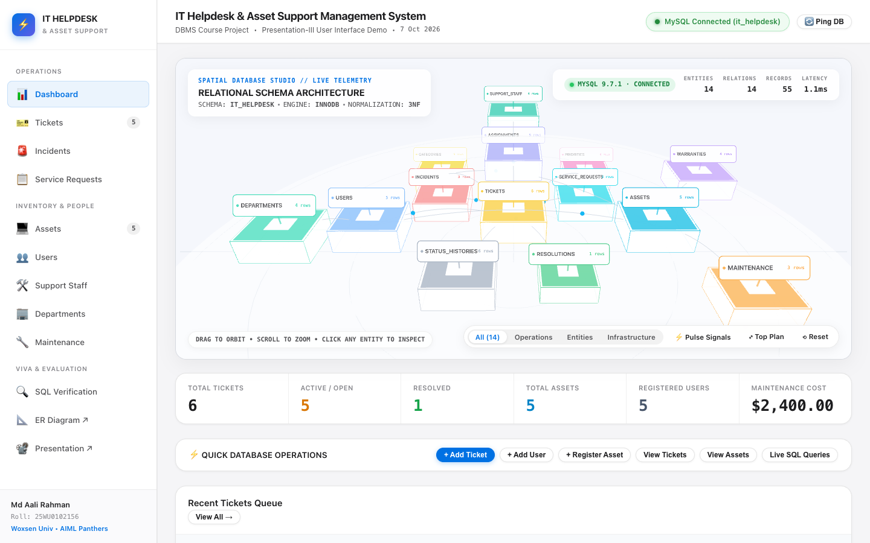
UI ARCHITECTURE
Operational Command Dashboard
OPERATION HIGHLIGHTS
• Real-time MySQL connectivity pill: ● MySQL Connected (it_helpdesk).
• Dynamic aggregate counters: Total Tickets, Open vs Resolved, Hardware Assets, Users, Maintenance Spend.
• Interactive 3D database visualizer mapping tables and relationships.
• Live quick-action shortcuts to create tickets, view queues, and run SQL queries.
IT Helpdesk & Asset Support Management System | Presentation-III: Live UI & Database Demo | Slide 6 of 12

Slide 7
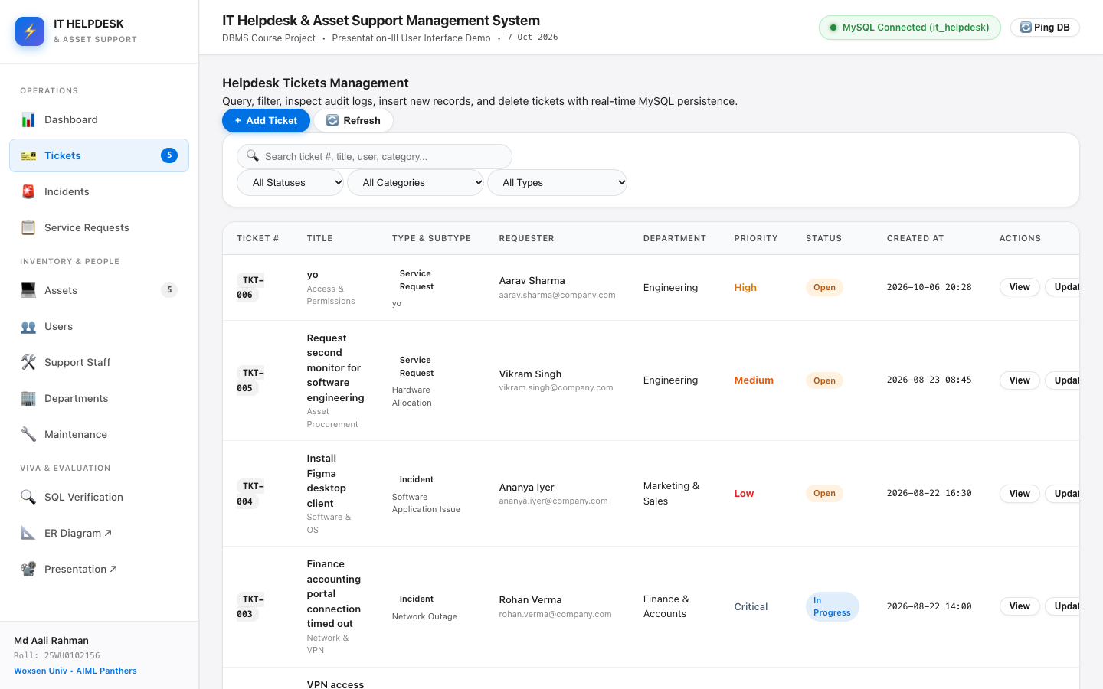
CRUD OPERATION 1
VIEW: Multi-Table Relational Ticket Queue
OPERATION HIGHLIGHTS
• Executes multi-table SQL JOIN across tickets, users, departments, categories, and priorities.
• Dynamic filtering by Status, Category, and Subtype (Incident vs Service Request).
• Real-time search across ticket number, title, requester name, and category.
• Detail modal displays full relational graph: requester details, assigned technicians, and chronological status history.
IT Helpdesk & Asset Support Management System | Presentation-III: Live UI & Database Demo | Slide 7 of 12

Slide 8
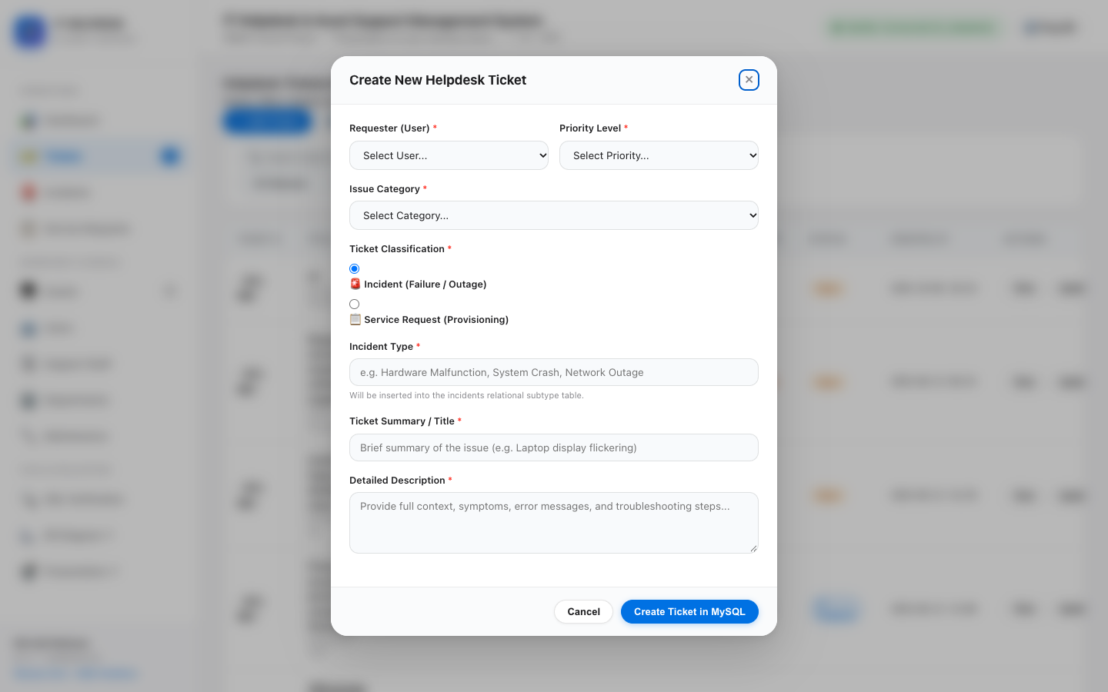
CRUD OPERATION 2
INSERT: Form-Driven Record Creation & Subtyping
OPERATION HIGHLIGHTS
• Dynamic foreign key dropdowns populated from live database tables.
• Automated sequential ticket tracking number generation (TKT-006).
• Atomic multi-table transaction inserting into tickets, subtypes (incidents/service_requests), and status_histories.
• Immediate UI reflection: new row appears instantly in the table without page reload.
IT Helpdesk & Asset Support Management System | Presentation-III: Live UI & Database Demo | Slide 8 of 12

Slide 9
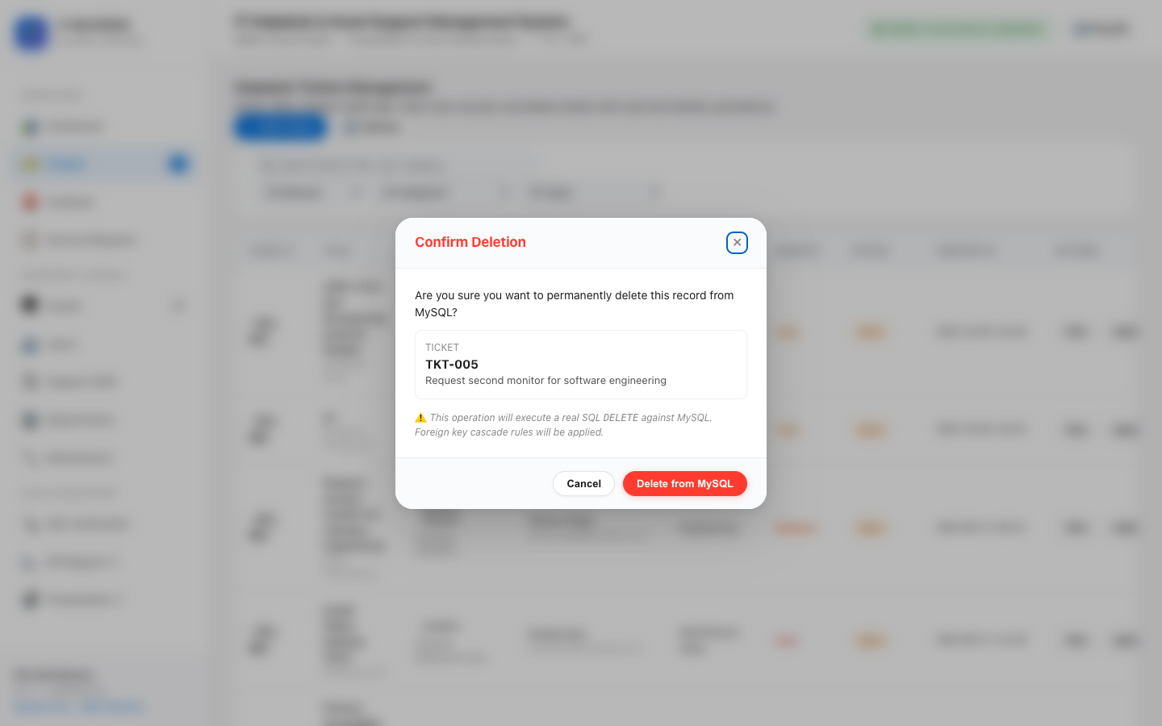
CRUD OPERATION 3
DELETE: Permanent Removal with Foreign Key Cascades
OPERATION HIGHLIGHTS
• Confirmation dialog displaying exact record ID prevents accidental deletions.
• Executes DELETE FROM tickets WHERE ticket_id = %s directly in MySQL.
• ON DELETE CASCADE automatically purges sub-entities without leaving orphan rows.
• ON DELETE RESTRICT safely protects users and categories with active dependencies.
IT Helpdesk & Asset Support Management System | Presentation-III: Live UI & Database Demo | Slide 9 of 12

Slide 10
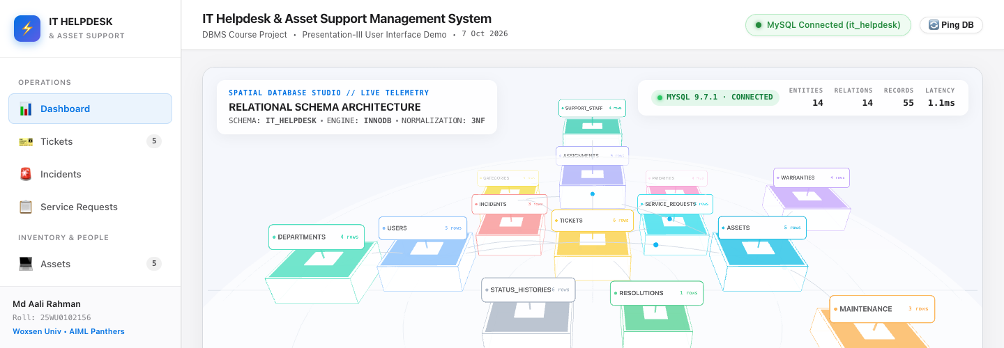
INTEGRITY VERIFICATION
Live Database Persistence & Refresh Verification
OPERATION HIGHLIGHTS
• State persistence verified across browser refreshes (Cmd+R / F5).
• Direct terminal verification via MySQL client confirms record existence in InnoDB storage.
• Zero mock data, fake arrays, or localStorage used — 100% real database transactions.
• Demonstrates end-to-end ACID consistency.
IT Helpdesk & Asset Support Management System | Presentation-III: Live UI & Database Demo | Slide 10 of 12

Slide 11
QUALITY ASSURANCE
Automated DBMS Test Suite Execution (TC01 - TC10)
CORE CRUD TEST CASES
CRUD & Persistence Tests
• TC01: Database Connection to MySQL — PASS
• TC02: View Tickets Relational Query — PASS
• TC03: Insert New Ticket Record — PASS
• TC04: Refresh & Persistence Verification — PASS
• TC05: Delete Ticket from MySQL — PASS
• TC06: Refresh After Delete (Remains Absent) — PASS
CONSTRAINT TESTS
Relational Constraints & Error Handling
• TC07: Form Input Validation (Missing Required Fields) — PASS
• TC08: Unique Constraint Enforcement (Duplicate Email) — PASS
• TC09: Foreign Key Deletion Violation (RESTRICT) — PASS
• TC10: MySQL Offline Error Handling (Safe User Message) — PASS
• Overall Test Result: 10/10 Test Scenarios Passed (100% Success Rate)
IT Helpdesk & Asset Support Management System | Presentation-III: Live UI & Database Demo | Slide 11 of 12

Slide 12
SUMMARY & FUTURE SCOPE
Conclusion & Future System Enhancements
SUMMARY OF OUTCOMES
Presentation-III Accomplishments
• Successfully delivered an enterprise-grade IT Helpdesk and Asset Support Management System.
• Live MySQL database connectivity verified with real-time INSERT, DELETE, and VIEW operations.
• Strict 3NF normalization and foreign key integrity constraints maintained throughout.
• All official presentation requirements fulfilled.
FUTURE ROADMAP
Future Enhancements
• Automated SLA escalation triggers and email notification webhooks.
• Multi-factor authentication (MFA) and Role-Based Access Control (RBAC).
• Predictive hardware maintenance forecasting using machine learning models on servicing history.
IT Helpdesk & Asset Support Management System | Presentation-III: Live UI & Database Demo | Slide 12 of 12

