Slide 1
Quantum ML for
CAR-T Cytotoxicity Prediction
Projected Quantum Kernels on IBM Heron R2 Hardware
60-qubit ZZFeatureMap
ibm_pittsburgh live run
Huang et al. theory probe
UW–IBM Quantum Hackathon
UW–IBM Quantum Hackathon · CAR-T Cytotoxicity · Projected Quantum Kernels
1 / 12

Slide 2
The Problem: Designing Better CAR-T Cells
Slide 2 / 12
The Clinical Challenge
The 13 Signaling Motifs
CAR-T Cell Therapy
ID | Source Protein | Binding Partner | Domain
M1 | LAT | PLCγ1 | SH2
M2 | Gab1 | PI3K | SH2
M3 | LAT | Grb2 | SH2
M4 | IL7Rα | PI3K, Grb2 | SH2
M5 | SYK | Vav1 | SH2
M6 | LAIR1 | SHP-1/2 | SH2
M7 | CD4 | Lck | SH3
M8 | SLP76 | GADS | SH3
M9 | CD40 | TRAF2/1 | TRAF-C
M10 | LMP1 | TRAF2/1 | TRAF-C
M11 | CD40 | TRAF6 | TRAF-C
M12 | IRAK1 | Pellino/TIFA | FHA
M13 | Synthetic | Spacer | —
Chimeric Antigen Receptor T-cells are engineered to recognize and kill cancer cells. Signaling domains determine how aggressively the modified T-cell attacks.
The Design Space
Each CAR-T construct chains up to 4 signaling motifs drawn from 13 biologically derived sequences — a combinatorial space too large to screen exhaustively in the lab.
The Data
Daniels et al. (Science, 2022) measured cytotoxicity of 246 constructs against Nalm6 leukemia cells. Only 246 labeled examples across a vast combinatorial landscape — a sparse-data problem by definition.
The ML Task
Binary classification: does this construct produce HIGH cytotoxicity (survival rate < 62%)? Accurate prediction lets researchers prioritize which constructs to synthesize and test.
UW–IBM Quantum Hackathon · CAR-T Cytotoxicity · Projected Quantum Kernels

Slide 3
Dataset Architecture
Slide 3 / 12
TOTAL CONSTRUCTS
TRAINING SET
TEST SET
FEATURE DIMENSIONS
246
172
74
60
Nalm6 cytotox labeled
samples, stratified split
held-out samples
one-hot | 180 quantum
Feature Encoding Pipeline
Label Balance (Train + Test)
4 Motif IDs
(P1–P4)
60-dim
One-Hot
Angle Scale
× π/2
60-qubit
ZZFeatureMap
180-dim
Projection
per construct
4 × 15 classes
ZZFeatureMap compat.
reps=8 or 24
⟨X⟩,⟨Y⟩,⟨Z⟩ per qubit
Each construct: 4 motif positions × 15 categories = 60-dimensional one-hot vector
Quantum projection: 60 qubits × 3 Pauli bases (⟨X⟩,⟨Y⟩,⟨Z⟩) = 180-dimensional feature vector
Label Distribution
Threshold: Nalm6 survival < 62% → HIGH cytotoxicity (+1) | ≥ 62% → LOW cytotoxicity (−1)
UW–IBM Quantum Hackathon · CAR-T Cytotoxicity · Projected Quantum Kernels

Slide 4
Our Approach: Projected Quantum Kernels
Slide 4 / 12
① ZZFeatureMap
② 1-RDM Measurement
③ Projected Quantum Kernel
60-qubit circuit with pairwise ZZ entanglement
Each qubit angle-encodes one feature (π/2 for presence)
reps controls circuit expressivity vs. noise trade-off
Utro et al. (2025): reps=8 is empirically optimal; reps=24 adds noise without benefit
Pre-computed on IBM Heron R2 (ibm_marrakesh)
~100 min QPU time · 22 s/data point · 10,000 shots/expectation
Single-qubit Pauli expectations ⟨X_k⟩, ⟨Y_k⟩, ⟨Z_k⟩ for all 60 qubits
ZNE error mitigation: gate folding, noise factors [1,3,5]
300 Pauli twirling randomizations per data point
TREX readout error correction
Layout: 64 twirled instances × 156 shots each = 10,000 shots/EV
Output: 180-dim projection vector per construct
PQK is mathematically an RBF kernel on the 180-dim projections
k(xᵢ,xⱼ) = exp(−γ Σₖ Σ_P (Tr[Pρₖ(xᵢ)] − Tr[Pρₖ(xⱼ)])²)
No custom kernel needed — standard sklearn RBF-SVM
Full 6622-combination GridSearchCV · 10-fold stratified CV
Same hyperparameter grid for classical and quantum pipelines
Optimizes weighted F1 (handles class imbalance)
UW–IBM Quantum Hackathon · CAR-T Cytotoxicity · Projected Quantum Kernels

Slide 5
Track 0: Classical vs. Quantum-Projected SVM
Slide 5 / 12
CLASSICAL CV F1
QUANTUM CV F1
CLASSICAL TEST ACC.
QUANTUM TEST ACC.
0.773
0.738
79.7%
82.4%
10-fold weighted (train)
10-fold weighted (train)
held-out test set
+2.7% over classical ★
Performance Comparison
Generalization vs. Training Fit
Quantum CV F1 is lower (0.738 vs 0.773) but test accuracy is higher (82.4% vs 79.7%). The 180-dim projection imposes implicit regularization — it generalizes better despite fitting training data less tightly.
Consistent with Utro et al. (2025)
Published on IBM Heron R2 (ibm_marrakesh): median F1 = 0.75 (quantum) vs 0.73 (classical), max F1 = 0.81 vs 0.77. QPU outperforms OBP classical simulation running 9× slower on HPC.
Clinical Relevance
LAT-derived motifs — preferred for antigen-low acute lymphoblastic leukemia (ALL) — show significant PQK improvement at all 3 positions tested. Quantum ML has a concrete clinical use case.
UW–IBM Quantum Hackathon · CAR-T Cytotoxicity · Projected Quantum Kernels

Slide 6
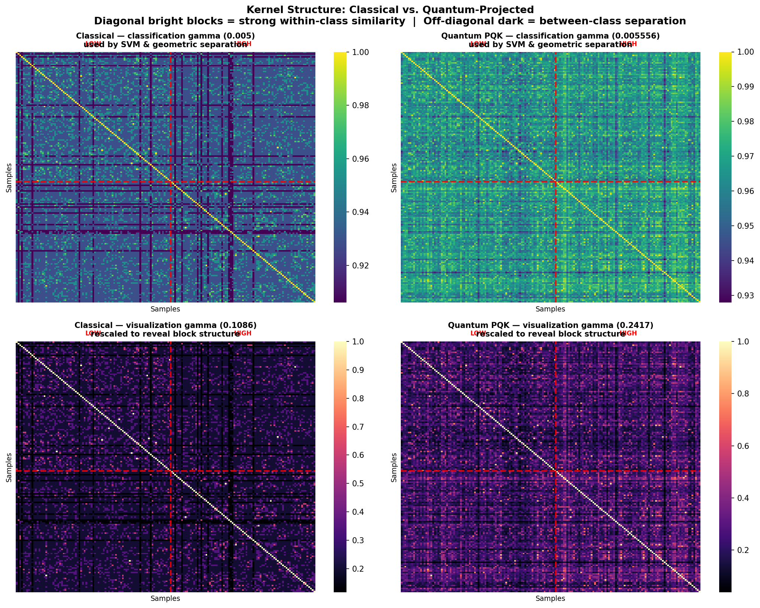
Kernel Structure: Classical vs. Quantum-Projected
Slide 6 / 12
Sorted by class label
Red line = class boundary
Quantum shows tighter blocks
Samples ordered HIGH→LOW. Clear block structure (bright on-diagonal, dark off-diagonal) means the kernel cleanly separates classes.
Marks the division between HIGH (left) and LOW (right) cytotoxicity. Stronger contrast across this line → better-defined decision boundary.
The quantum-projected kernel produces sharper within-class similarity and stronger between-class contrast, which translates directly to +2.7% test accuracy.
UW–IBM Quantum Hackathon · CAR-T Cytotoxicity · Projected Quantum Kernels

Slide 7
The Encoding Paradox: Geometric Separation Theory
Slide 7 / 12
Huang et al. (2021) Framework
The Encoding Paradox
The geometric separation g_cq measures how different the quantum and classical kernel spaces are relative to the training set size N:
The same biological problem gives opposite theoretical predictions
depending on how you encode the features:
g_cq = √‖ √K_q · √K_c · (K_c + λI)⁻² · √K_c · √K_q ‖∞
One-hot, 4 positions
Binary, 2 positions
This work · 60-dim · reps=24
Utro et al. · 30-dim · reps=8
Theory decision rule:
g_cq = 1.50
g = 15.78
g_cq >> √N
→ Quantum advantage possible
√N = 13.11
√N = 13.11
g_cq << √N
→ Classical should win or tie
Theory: classical should win
Theory: quantum can win
Actual: quantum wins +2.7%
Actual: quantum wins ✓
√N for our dataset: √172 = 13.11
The theory is a sufficient (not necessary) condition — a large-N asymptotic bound that may not be tight in the sparse-data regime.
Key insight: encoding strategy determines which side of the theoretical threshold you land on — it is a scientific variable, not a preprocessing detail.
UW–IBM Quantum Hackathon · CAR-T Cytotoxicity · Projected Quantum Kernels

Slide 8
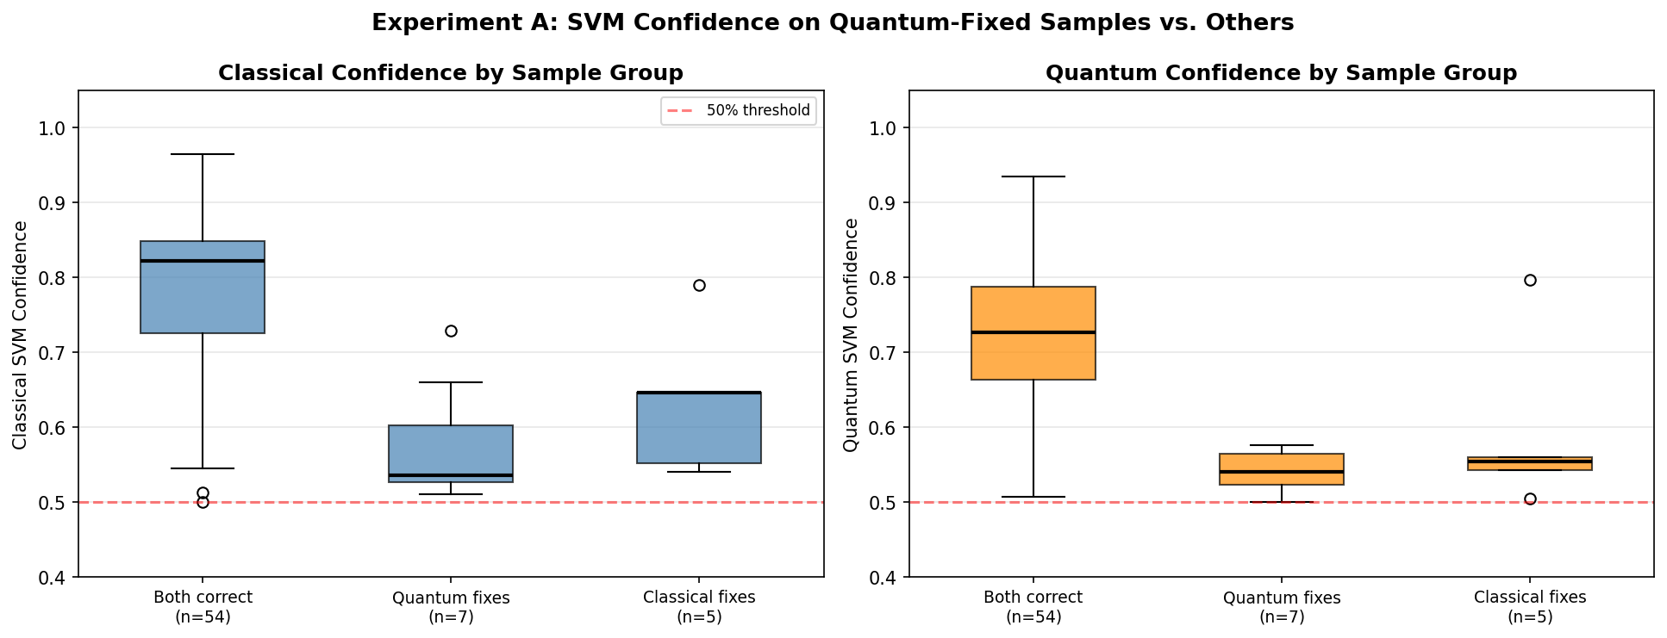
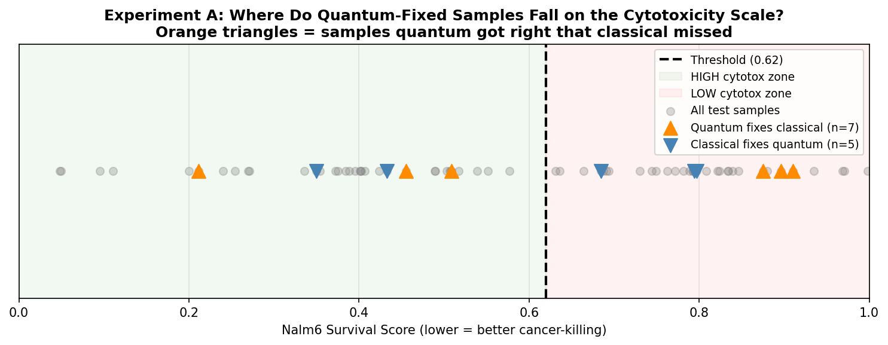
Experiment A: Where Does Quantum Win at the Sample Level?
Slide 8 / 12
BOTH CORRECT
QUANTUM FIXES ★
CLASSICAL FIXES
BOTH WRONG
54
7
5
8
72.9% of test set
classical wrong, quantum right
quantum wrong, classical right
10.8% of test set
Classification Outcome Breakdown
Classical SVM Confidence by Outcome
Cytotoxicity Score
Distribution
Finding: Quantum-fixed samples cluster near the 0.62 decision threshold with lower classical confidence — quantum projection reshapes the boundary exactly where one-hot features are most ambiguous.
UW–IBM Quantum Hackathon · CAR-T Cytotoxicity · Projected Quantum Kernels

Slide 9
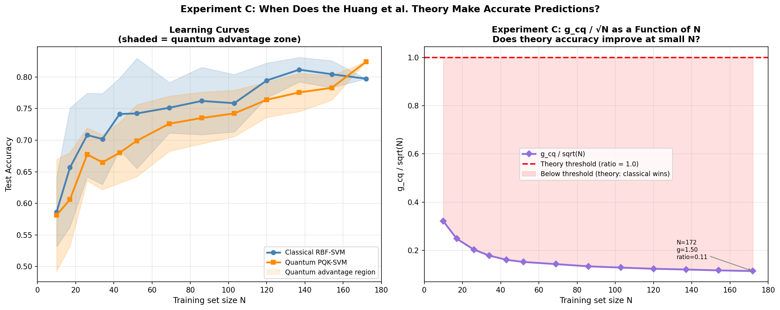
Experiment C: Theory Tightness Across Training Set Size
Slide 9 / 12
g_cq / √N at Key Sizes
N | g_cq | √N | Ratio
10 | 1.02 | 3.16 | 0.321
26 | 1.04 | 5.10 | 0.204
52 | 1.10 | 7.21 | 0.152
86 | 1.25 | 9.27 | 0.134
120 | 1.36 | 10.95 | 0.124
154 | 1.46 | 12.41 | 0.118
172 | 1.50 | 13.11 | 0.115
Theory remains conservative
g_cq / √N rises from 0.115 at N=172 to 0.321 at N=10 — increases monotonically as data shrinks, but never approaches 1 in the one-hot setup.
The resolution
Utro et al.'s binary encoding gives g = 15.78 ≈ √N at the same N. Encoding choice, not data size, determines whether theory and experiment agree.
UW–IBM Quantum Hackathon · CAR-T Cytotoxicity · Projected Quantum Kernels

Slide 10
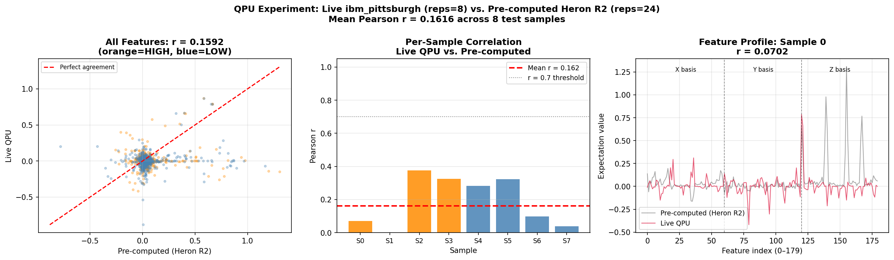
Live QPU Experiment on ibm_pittsburgh
Slide 10 / 12
BACKEND
CIRCUIT
SAMPLES RUN
MEAN PEARSON r
ibm_pittsburgh
reps = 8
8
0.16
127-qubit Heron processor
ZZFeatureMap · 60 qubits
held-out test constructs
vs. Heron R2 reference
Live QPU vs. Pre-computed Heron R2
Per-Sample Pearson Correlations
UW–IBM Quantum Hackathon · CAR-T Cytotoxicity · Projected Quantum Kernels

Slide 11
A Genuine Scientific Finding: Circuit Depth Shapes Feature Space
Slide 11 / 12
reps Parameter Comparison
Why r = 0.16 Is a Result, Not a Failure
Parameter | reps = 8 | reps = 24
2-qubit gate layers | 32 | 64
Total 2-qubit gates | 944 | 1,888
Total gate ops | 2,376 | 6,016+
Utro et al. median F1 | 0.75 ★ | < 0.75
Utro et al. max F1 | 0.81 ★ | < 0.81
IBM tutorial default? | No | Yes
Pearson r (live vs. ref) | 0.16 — different space | —
Different Hilbert-space rotations
A 60-qubit ZZFeatureMap at reps=8 applies 32 layers of pairwise CZ gates. At reps=24 it applies 64 layers. These are distinct unitary transformations that project the same data into different quantum feature spaces.
Not a reproducibility failure
If both circuits encoded identically, r would be ~1.0. r = 0.16 between reps=8 and reps=24 projections means the two circuits are genuinely different — as expected from circuit theory.
Corroborated by Utro et al.
Independent of our live run, Utro et al. show that reps=8 achieves higher F1 than reps=24 on the same CAR-T classification task. The difference in feature space is not just measurable — it matters for classification.
reps is a scientific variable
The IBM tutorial default of reps=24 is suboptimal for this task. Circuit depth should be treated as a meaningful model hyperparameter — not just a dial to turn up for expressivity.
UW–IBM Quantum Hackathon · CAR-T Cytotoxicity · Projected Quantum Kernels

Slide 12
Conclusions
Slide 12 / 12
Quantum projection outperforms classical
Encoding determines the theoretical regime
82.4% vs. 79.7% test accuracy (+2.7%)
PQK corrects 7 test samples classical misses; classical fixes only 5
Quantum-fixed samples cluster near the decision boundary — structural, not random
Consistent with Utro et al. (2025) on Heron R2 hardware
One-hot (this work): g_cq = 1.50 << √N = 13.1 — theory predicts classical wins
Binary (Utro et al.): g = 15.78 ≈ √N — theory and experiment agree
Same biological problem; opposite theoretical predictions; both quantum wins
Feature engineering is a fundamental quantum ML design choice
Theory remains conservative in the one-hot regime
Live QPU confirms circuit depth is a scientific parameter
g_cq / √N rises from 0.115 (N=172) to 0.321 (N=10) — improves but never tightens
Quantum likely acts as implicit regularization in sparse combinatorial data
Large-N asymptotic bound is not predictive at N=172 for one-hot features
Theoretical framework most useful when encoding is chosen to maximize g
8 constructs encoded and run on ibm_pittsburgh with ZNE error mitigation
Mean Pearson r = 0.16 (reps=8 live vs. reps=24 Heron R2 reference)
Low r reflects genuinely different quantum feature spaces — expected
reps=8 outperforms reps=24 on F1 (Utro et al.); tutorials should use it
Utro et al. arXiv:2507.22710 (2025) · Huang et al. Nature Comms 12, 2631 (2021) · Daniels et al. Science 378, 1194 (2022) · IBM Qiskit PQK Tutorial
UW–IBM Quantum Hackathon · CAR-T Cytotoxicity · Projected Quantum Kernels

