Slide 1

A PROPOSAL FOR THE TELECOM FOUNDATION EDUCATION SYSTEM
The notebook
that teaches back.
A QR code on every subject notebook turns a finished chapter into a quiz, a rank, and a merit bursary — across all 16 TEFOS schools.
Chapter quizzes
Merit bursaries
Inter-school championship
TEFOS QUIZ · NOTEBOOK QR PROGRAMME · 2026
Transforming Communities

Slide 2
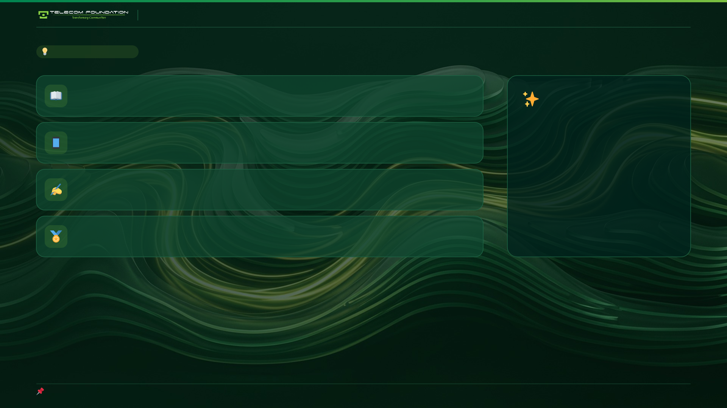
TEFOS QUIZ · NOTEBOOK QR PROGRAMME
THE IDEA IN ONE BREATH
01
A student finishes Chapter 1.
No app.
No signup.
No form.
No behaviour change.
02
They scan the book they are already holding.
03
They answer four questions.
04
They earn points toward next month's bursary.
— which is precisely why it will work.
Everything in this deck exists to protect those four steps.

Slide 3
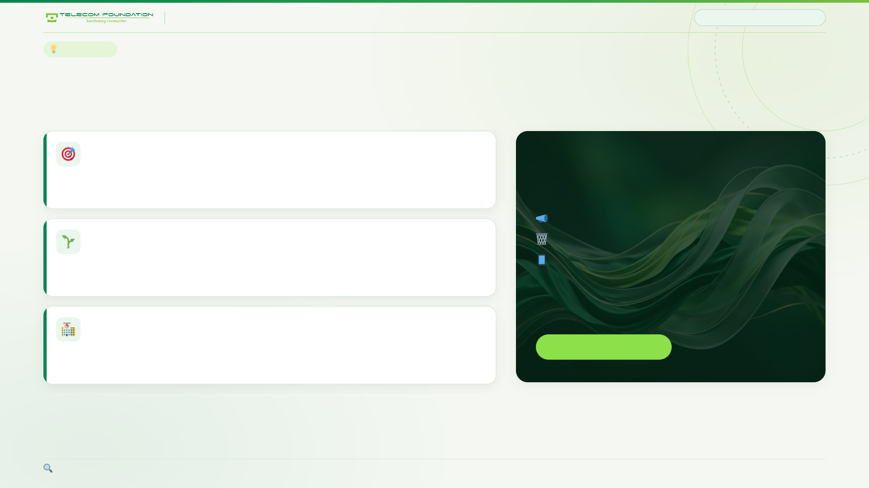
TEFOS QUIZ · NOTEBOOK QR PROGRAMME
THE INSIGHT
03 / 22
THE INSIGHT
The QR code is already in the book
This is the only marketing surface a school owns that the student touches voluntarily, every day.
It meets the student at peak attention
Every other school channel is a push.
They have just finished the chapter. The book is open. The page is right there.
Newsletters get ignored.
It requires zero new behaviour
Flyers get binned.
No app to download, no code to memorise, no website to visit, no reminder to send.
Apps get deleted.
It travels home and gets photographed
It sits open on a desk where visitors see it, and ends up in photos, on desks, in parents' houses.
✦ This one is a pull.
Compare: a school newsletter competes with everything. A QR in a textbook competes with nothing.

Slide 4
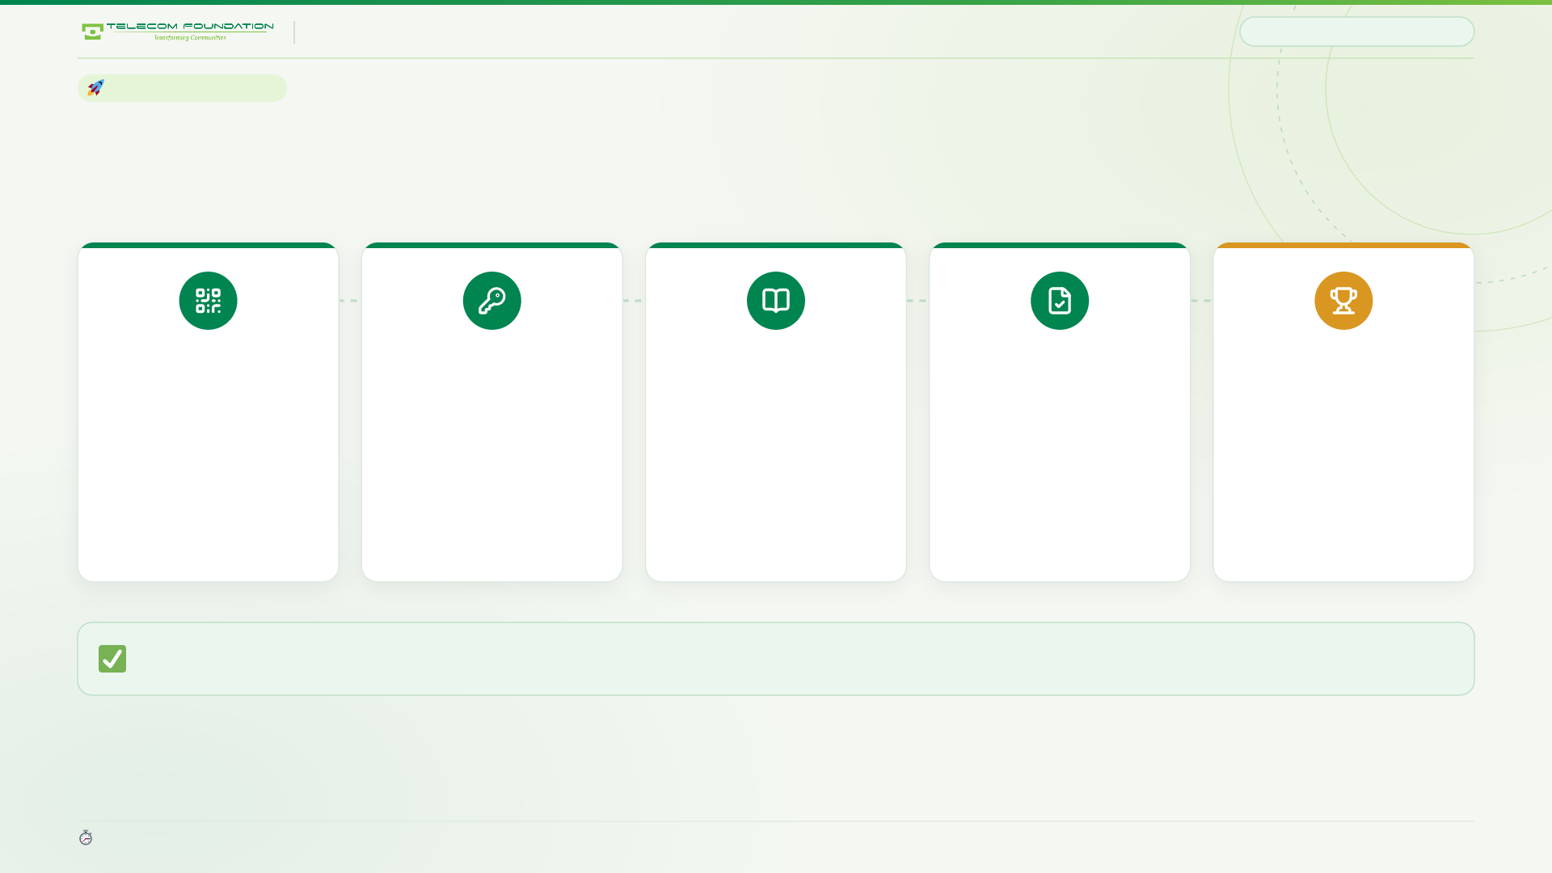
TEFOS QUIZ · NOTEBOOK QR PROGRAMME
STUDENT JOURNEY
04 / 22
THE STUDENT JOURNEY
Five steps. About ninety seconds.
01
02
03
04
05
Scan
Enter code
Pick chapter
Answer
Rank up
The QR on the cover of any subject notebook.
Six characters printed inside the front cover.
The one they just finished. Tap Go.
Five questions, mostly about their own class.
Points, a rank tier, and a place on the board.
There is no step six. That is the entire design. Everything in this proposal exists to keep students at step five.
Average completion in the prototype: 1 minute 32 seconds, on a five-year-old Android over 3G.

Slide 5
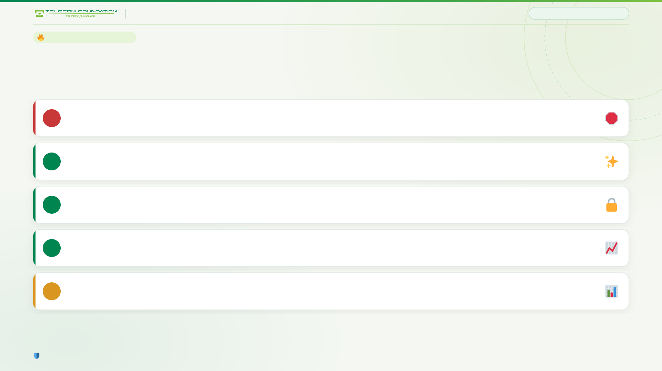
TEFOS QUIZ · NOTEBOOK QR PROGRAMME
PARTICIPATION ENGINE
05 / 22
THE PARTICIPATION ENGINE
Five non-negotiable rules
Break any one of these and the programme dies quietly within a term.
Points are never negative
A student who tries and gets it wrong must never end up worse off than one who never scanned.
1
Participation earns the first rank
A student who takes part always has an identity, even at zero percent.
2
Only a first attempt moves the board
Retries pay a little, so nobody is locked out — but nobody can farm the board.
3
Show growth, not distance
“You gained 180 points”, not “you are 2,400 short” — unless the gap is genuinely reachable.
4
Never publish only the top
Champions, most improved, and participation rate. Always all three.
5
Each rule is enforced in code, not in policy — the database refuses to break them.

Slide 6
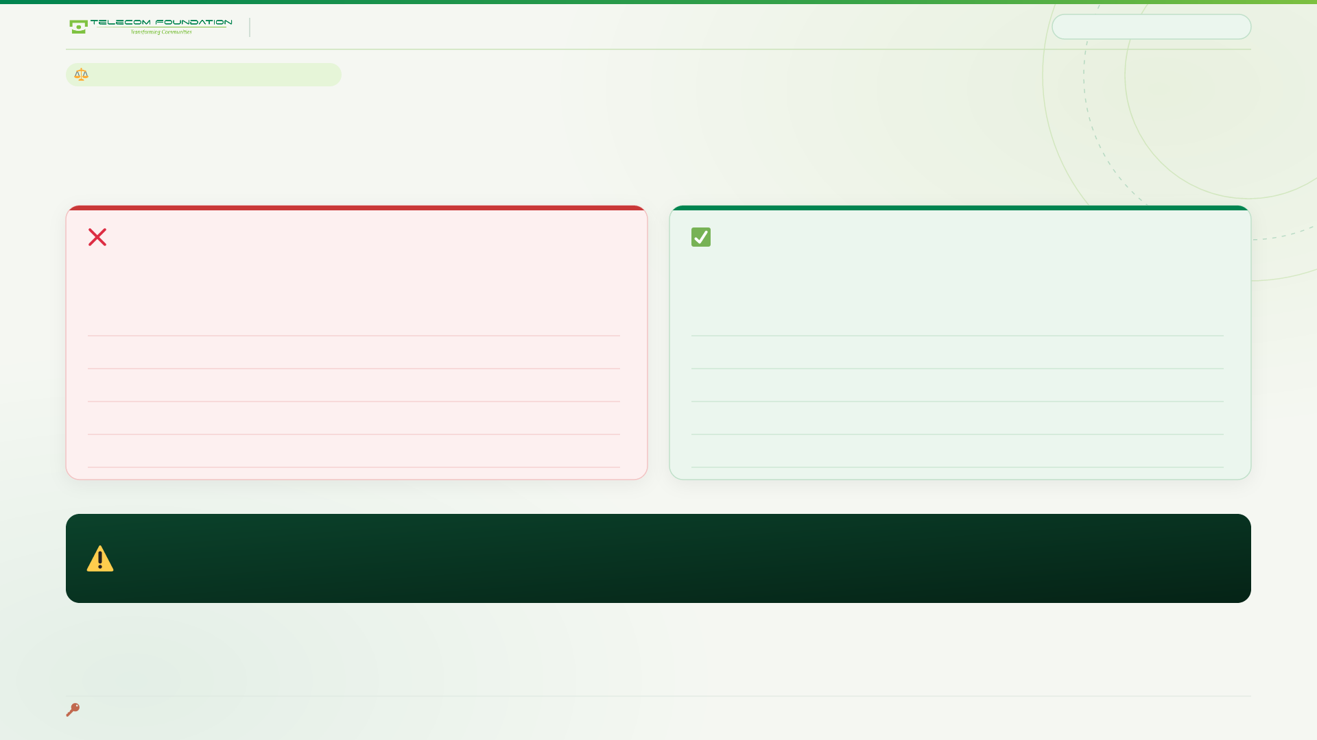
TEFOS QUIZ · NOTEBOOK QR PROGRAMME
THE ARITHMETIC
06 / 22
THE ONE NUMBER THAT MATTERS MOST
Punishing a wrong answer kills participation
The arithmetic below is the single most important line in this proposal.
AS ORIGINALLY SPECIFIED
AS BUILT
+10 correct · −5 wrong
+10 · 0 · +3 retry · +25 perfect
5 of 5 right
+50
All right
+75
3 of 5 right
+5
Half right
+25
2 of 5 right
−5
Two of five
0
All wrong
−25
All wrong
0
Never scanned
0
Never scanned
0
With negatives, a student who scans and does badly is worse off than one who ignores the book entirely. The programme punishes exactly the behaviour it needs most.
The floor is 0. Scanning always beats not scanning — and the only route to the top is accuracy on first tries.

Slide 7
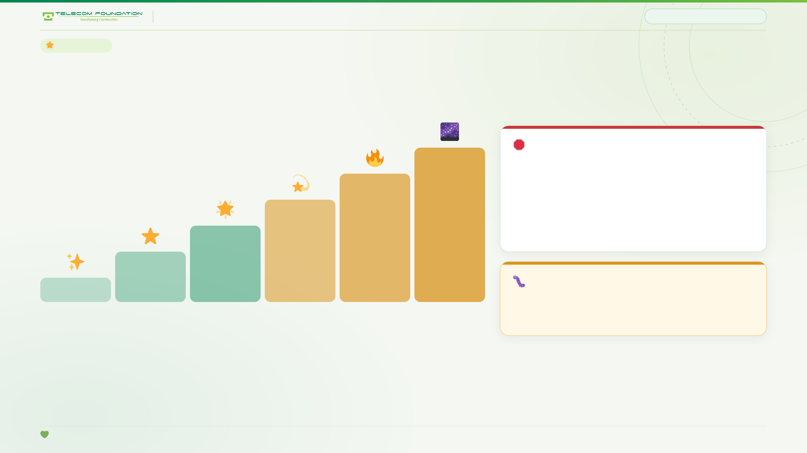
TEFOS QUIZ · NOTEBOOK QR PROGRAMME
RANK LADDER
07 / 22
RANK LADDER
Spark to Galaxy
Every student has an identity. Nobody sits in a dead zone below the first rung.
THE ACTIVITY FLOOR
Galaxy
Rank is points earned ÷ points available — never a raw average — and only appears after 5 chapters attempted.
95%+
Supernova
85%+
Bright Star
Without the floor, a student sits one easy quiz, scores 95% and quits — and out-ranks the student who showed up every week.
70%+
Star
50%+
Rising Star
30%+
Bug we found and fixed: the floor applied to the data but not to the screen — a one-quiz student still read “Galaxy” on their own result. Now the displayed tier is clamped too.
Spark
Any points
Rank = points earned ÷ points available. Tier appears after 5 chapters attempted.
Participation alone earns the first rank. The programme dies if the bottom half decides there is nothing to play for.

Slide 8
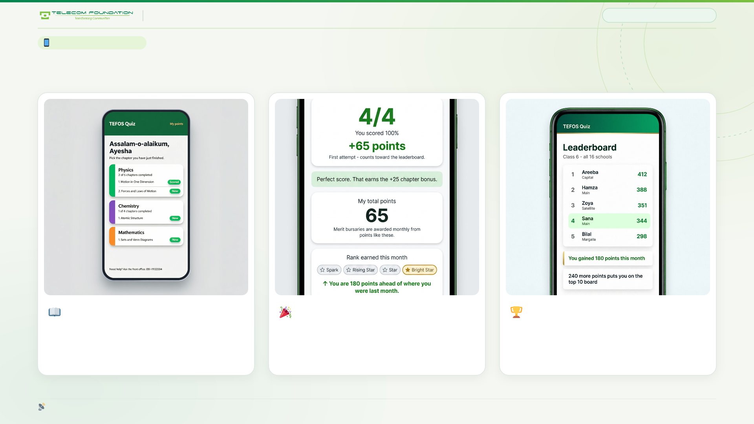
TEFOS QUIZ · NOTEBOOK QR PROGRAMME
WHAT STUDENTS SEE
08 / 22
WHAT THE STUDENT SEES
Three screens, ninety seconds
The chapter hub
The payoff
The 16-school board
Every subject, every chapter, one tap to start.
Points, rank tier, and how far they have come this month.
All campuses together — plus the reach line, shown only when close.
Server-rendered HTML, ~40 lines of JavaScript, 2.5 KB per quiz page. Works on any phone.

Slide 9
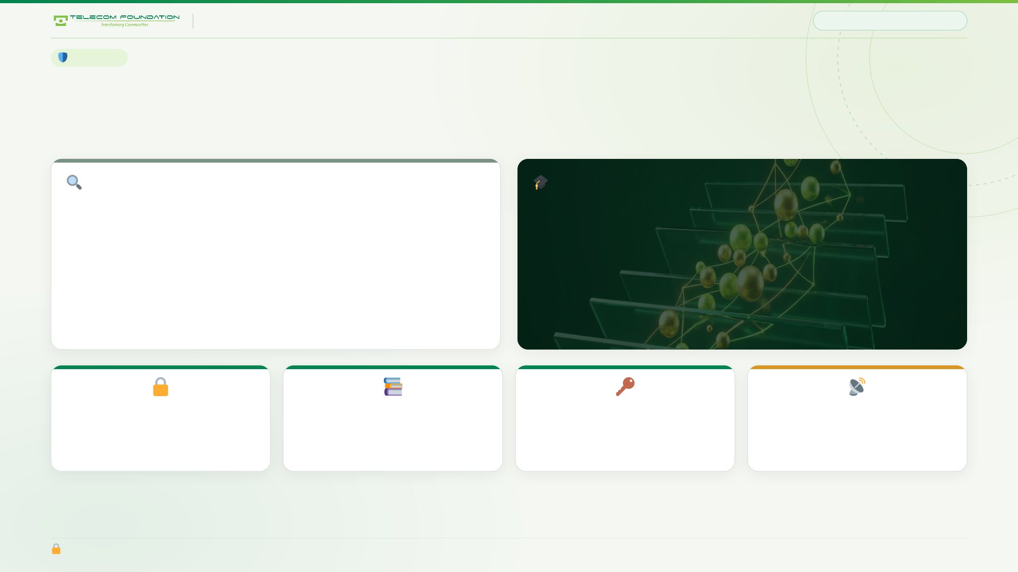
TEFOS QUIZ · NOTEBOOK QR PROGRAMME
INTEGRITY
09 / 22
INTEGRITY
A quiz nobody can google
Half the questions are about things that happened in that specific classroom, that week.
THE USUAL KIND
THE KIND WE USE
“A body travels 120 m in 15 s at constant speed. What is its speed?”
“On the first day of the Motion unit, which classroom activity did we do?”
“Our lab report was due on which date?”
Searchable in four seconds. The prize goes to whoever has the fastest internet connection and the most willing relatives.
Nobody can search these. Only a student who was there can answer — we are paying for attention, not for guessing.
0
5
1
2.5 KB
answer keys sent to any device
chapters before a rank shows
first attempt per chapter, enforced
per quiz page, gzipped
Options are shuffled server-side on every request; the start time is HMAC-signed so the timer cannot be dodged.

Slide 10
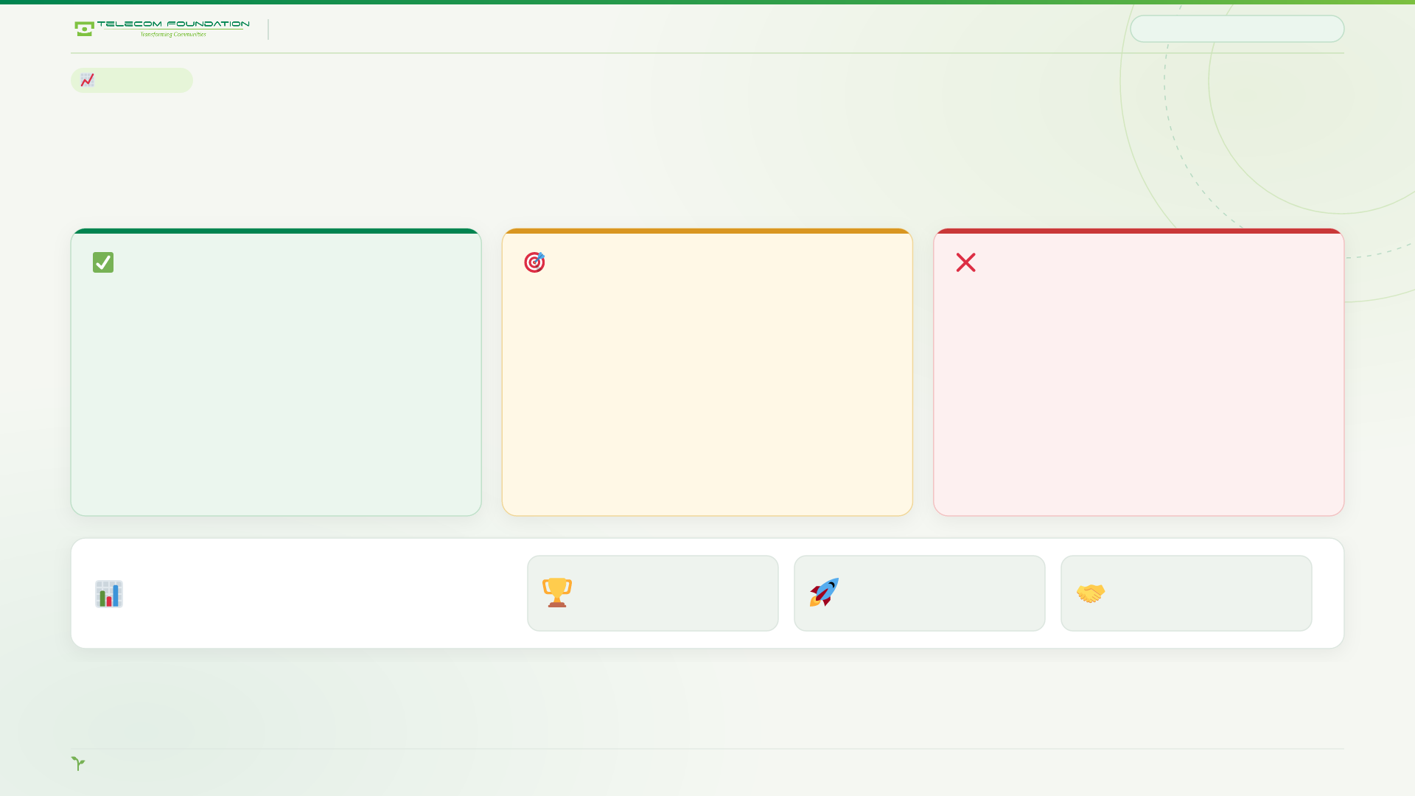
TEFOS QUIZ · NOTEBOOK QR PROGRAMME
MOTIVATION
10 / 22
MOTIVATION
Show growth. Show the gap only when it is reachable.
The most common mistake in school gamification is telling a child exactly how far they are from winning.
ALWAYS
ONLY IF REACHABLE
NEVER
“You are 180 points ahead of where you were last month.”
“240 more points puts you on the top 10 board.”
“You are 2,400 points short of the board.”
Progress against yourself. This is what sustains effort.
A real nudge, shown only to students within striking distance.
The gap is too big to close, so the rational move is to stop trying.
Publish three boards, always.
Champions
Most improved
Participation rate
Top scorers
Biggest monthly gain
How many took part
The third board is scored on participation, not scores — which gives smaller and weaker campuses a genuine way to win.

Slide 11
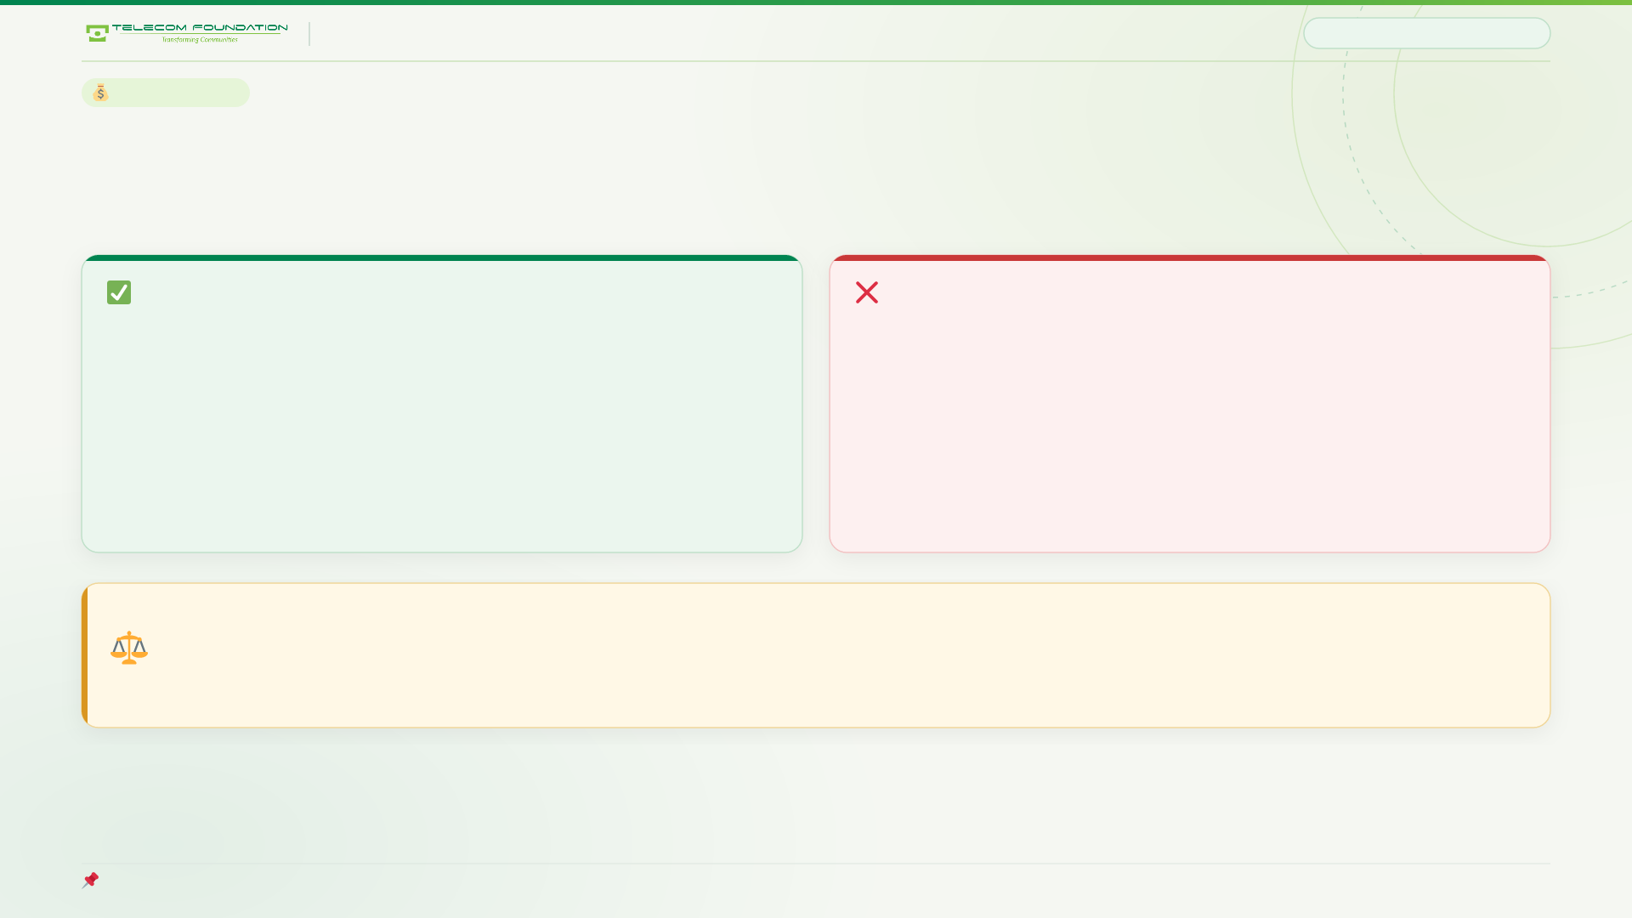
TEFOS QUIZ · NOTEBOOK QR PROGRAMME
THE ECONOMICS
11 / 22
THE ECONOMICS
The school pays in tuition credit, not cash
This is the trick that makes the whole programme affordable at scale.
WHAT IT IS
WHAT IT MUST NOT BE CALLED
Merit bursary
“Students earn their own fee.”
Up to 10 bursaries a month, each worth up to 10% of one month's tuition fee, awarded on points earned.
Identical budget. But it replaces a student election with a leaderboard, invites fee-regulation scrutiny, and reads badly in a newspaper.
Cost to the school: foregone revenue on a student who already pays. Budgetable, capped, predictable.
Same money, completely different posture.
The honest caveat: a bursary helps a wealthy family more than a poor one, because a rich family can absorb the fee. Keep a small, separately-funded need-based component — and let sponsors underwrite that, because it is the strongest education-access outcome report available.
Cap the total value at 0.5–1% of annual fee revenue. Publish the cap.

Slide 12
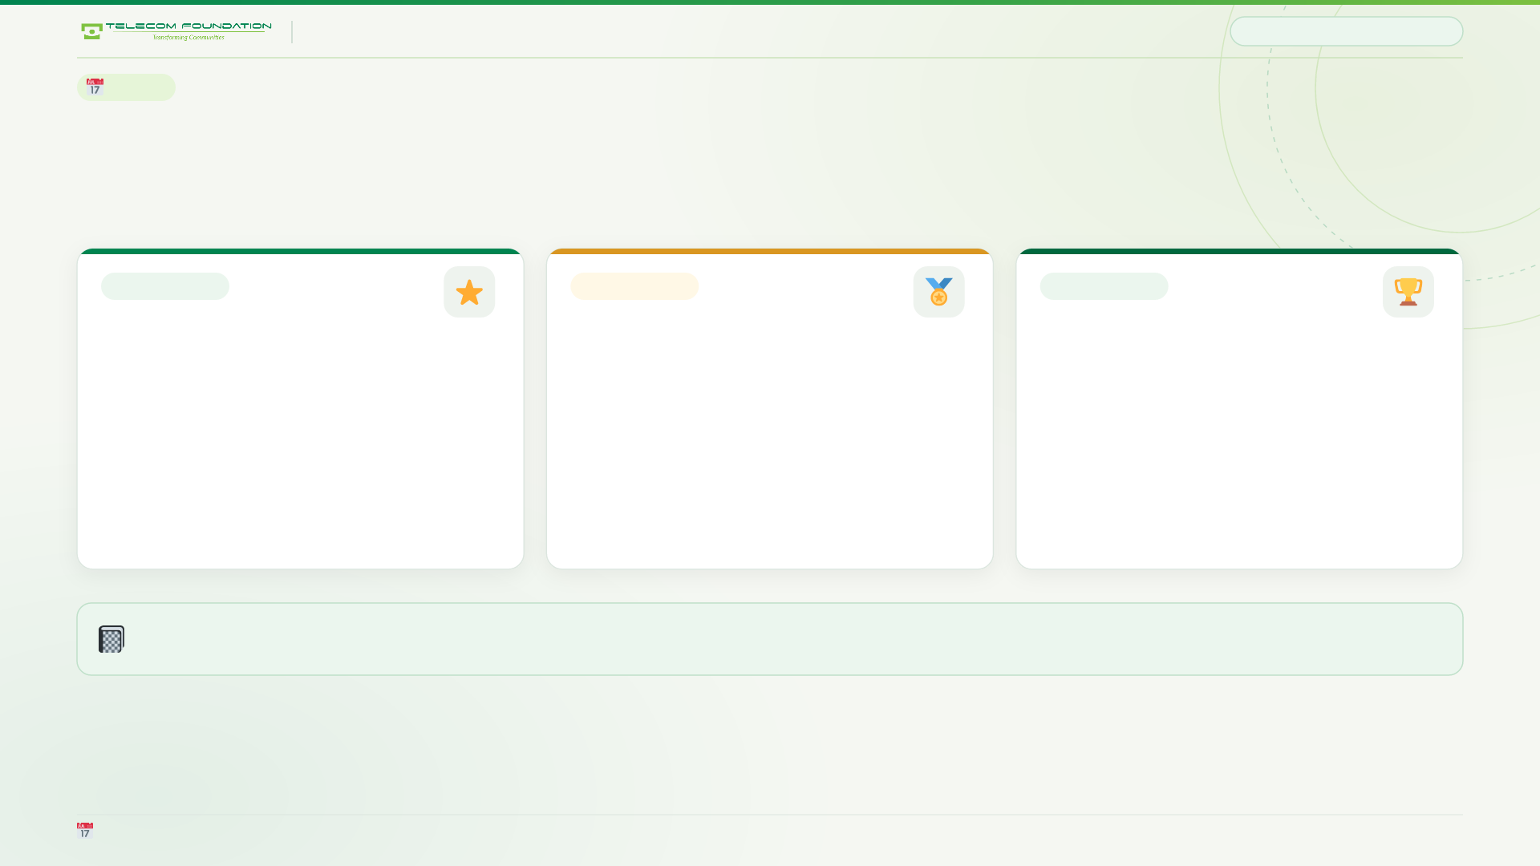
TEFOS QUIZ · NOTEBOOK QR PROGRAMME
RHYTHM
12 / 22
RHYTHM
Three cadences, three different jobs
A yearly reward attached to a daily habit is how engagement dies around week six.
WEEKLY
MONTHLY
EVERY 2 MONTHS
Star of the Week
The merit bursary
The inter-school championship
Recognition only. House points, a name on the school board, and nothing else. Theatre, and that is fine — as long as nobody expects cash.
The real reward. Fee credit, published, capped, and actually paid. This is the one that parents care about.
The big one. Sixteen campuses, trophies, a ceremony, and a camera. This is what sponsors pay for.
The monthly rhythm is what keeps the notebook open. The championship is the photo opportunity. Neither replaces the other.
Weekly = habit. Monthly = reward. Bi-monthly = story.

Slide 13
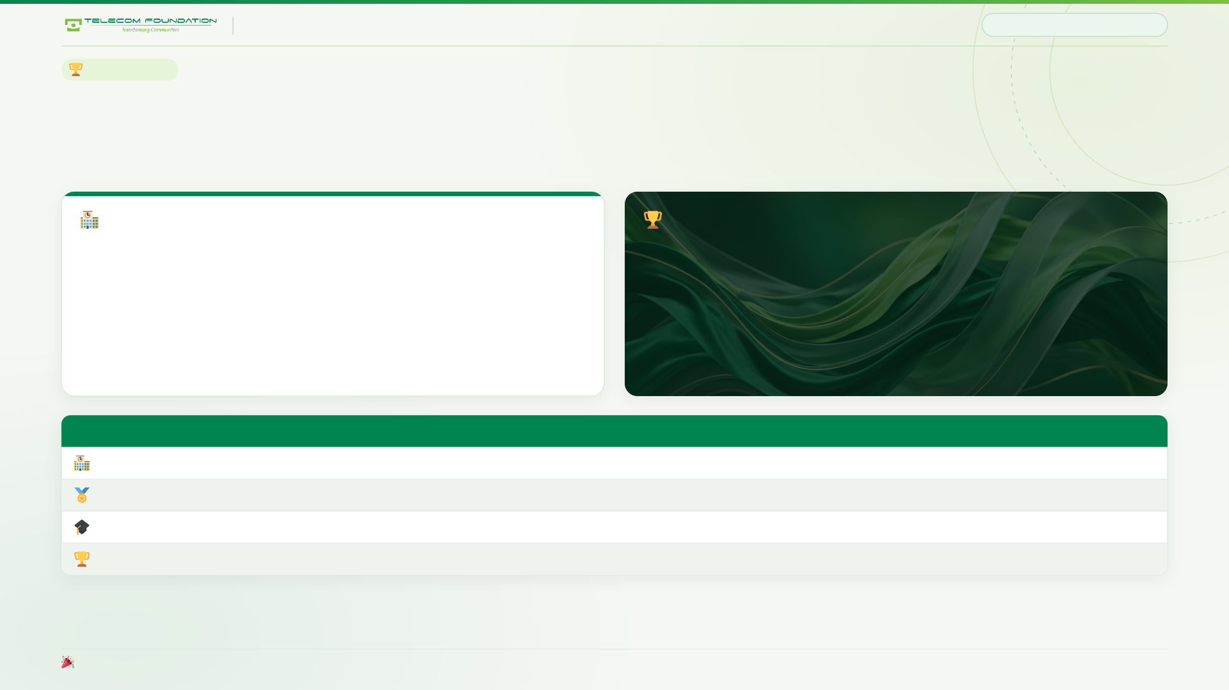
TEFOS QUIZ · NOTEBOOK QR PROGRAMME
THE BIG EVENT
13 / 22
THE BIG EVENT
Sixteen school champions, not five finalists
A live online final for 48 finalists is how you end up with a cheating scandal and a dead programme.
PHASE 1 · SCHOOL HEAT
PHASE 2 · CITY FINAL
Two weeks, asynchronous, in the app.
Sixteen students. One afternoon.
Every student in the class can enter. Same questions, done in their own time inside a two-week window. No timing pressure, no dropped connections, no proctoring — and participation stays near total.
One champion per school. Live, but sixteen people, all on campus, on good connections, with staff in the room. Genuinely manageable — and it makes a real ceremony worth filming.
Place
Reward
How many
School champion
Bursary + trophy + name on the school banner + a slot in the final
16
City winner 1–3
Laptop or tablet
3
City 4–5
Fee waiver
2
Top school of the term
Inter-school trophy and banner
1
Sixteen champions means sixteen proud schools — and sixteen ceremonies' worth of photographs.

Slide 14
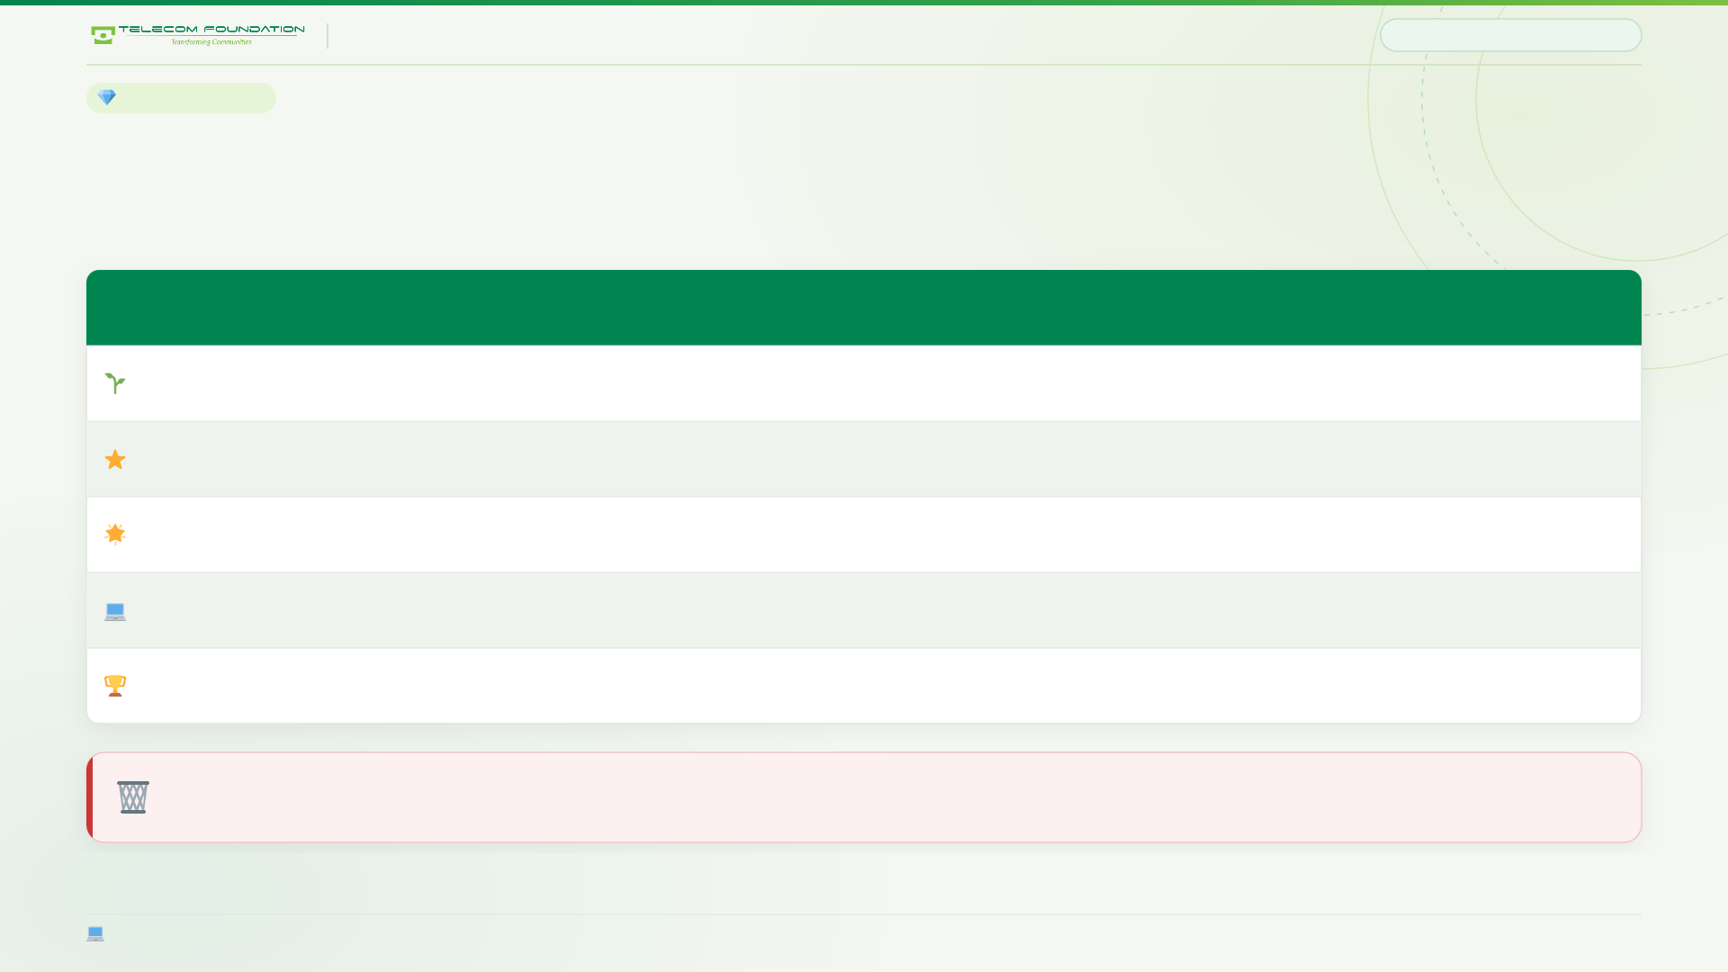
TEFOS QUIZ · NOTEBOOK QR PROGRAMME
THE PRIZE LADDER
14 / 22
THE PRIZE LADDER
Rewarding the middle, not just the peak
The top 20% are already motivated by grades. The programme lives or dies in the middle.
Band
Reward
Cadence
Why
Anyone taking part
Badge, name on the monthly board, a branded bookmark
Monthly
Participation is the goal, so reward the act of participating
50%+ (the middle half)
Merit bursary — real money off the fee
Monthly
The largest group, the biggest family impact, easiest for sponsors to fund
70%+
Certificate and merit gear
Monthly
Recognition, not material
Top 1 per year group
Laptop
Annual
A real trophy — eight winners, not one, which removes the incentive to cheat
House champion
Trophy at the ceremony
Annual
The photo opportunity, and the sponsor's logo
Removed: “a branded pen for 40%.” It tells a child they did badly and hands them a consolation prize. That is worse than giving nothing.
Eight laptops, not one. Spreading the top prize across year groups is what makes cheating pointless.

Slide 15
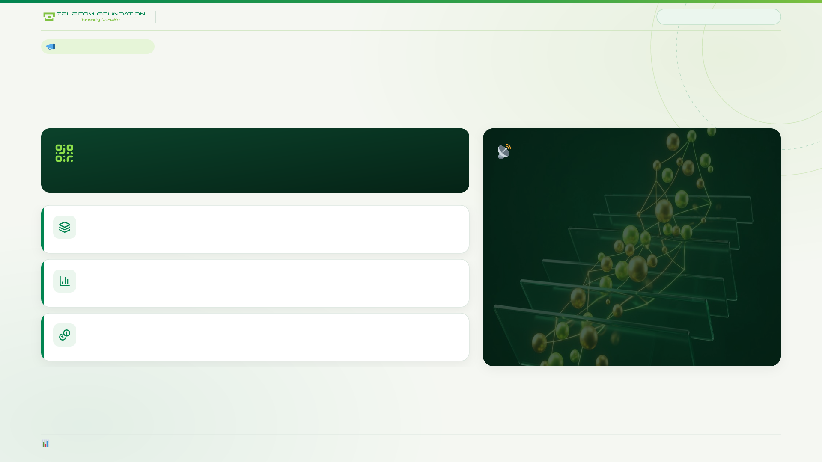
TEFOS QUIZ · NOTEBOOK QR PROGRAMME
MARKETING ENGINE
15 / 22
THE MARKETING ENGINE
Every printed batch carries its own tracked link
This is how the school answers the only question that matters: which notebooks actually worked?
https://<host>/t/{batch}/{subject}
AND THE BIGGEST LEVER
→ redirects to the code entry screen, and records the scan
Zero-rated data
Students are on metered mobile data. If the operator zero-rates this host, participation does not improve slightly — it changes order of magnitude.
One link per print run
Main campus Physics vs Capital campus Maths are separately attributable from day one.
Measured, not guessed
A full quiz page already costs 2.5 KB gzipped, so this is a cheap ask with an enormous ceiling. It is the single most valuable thing an affiliated operator can contribute.
Scans, participation and average score per batch, per campus, per subject — the real marketing number.
Zero cost
The tracking is a line of code. There is no extra spend to attribute it.
report.js prints scans and participation by print batch — the question marketing has never been able to answer.

Slide 16
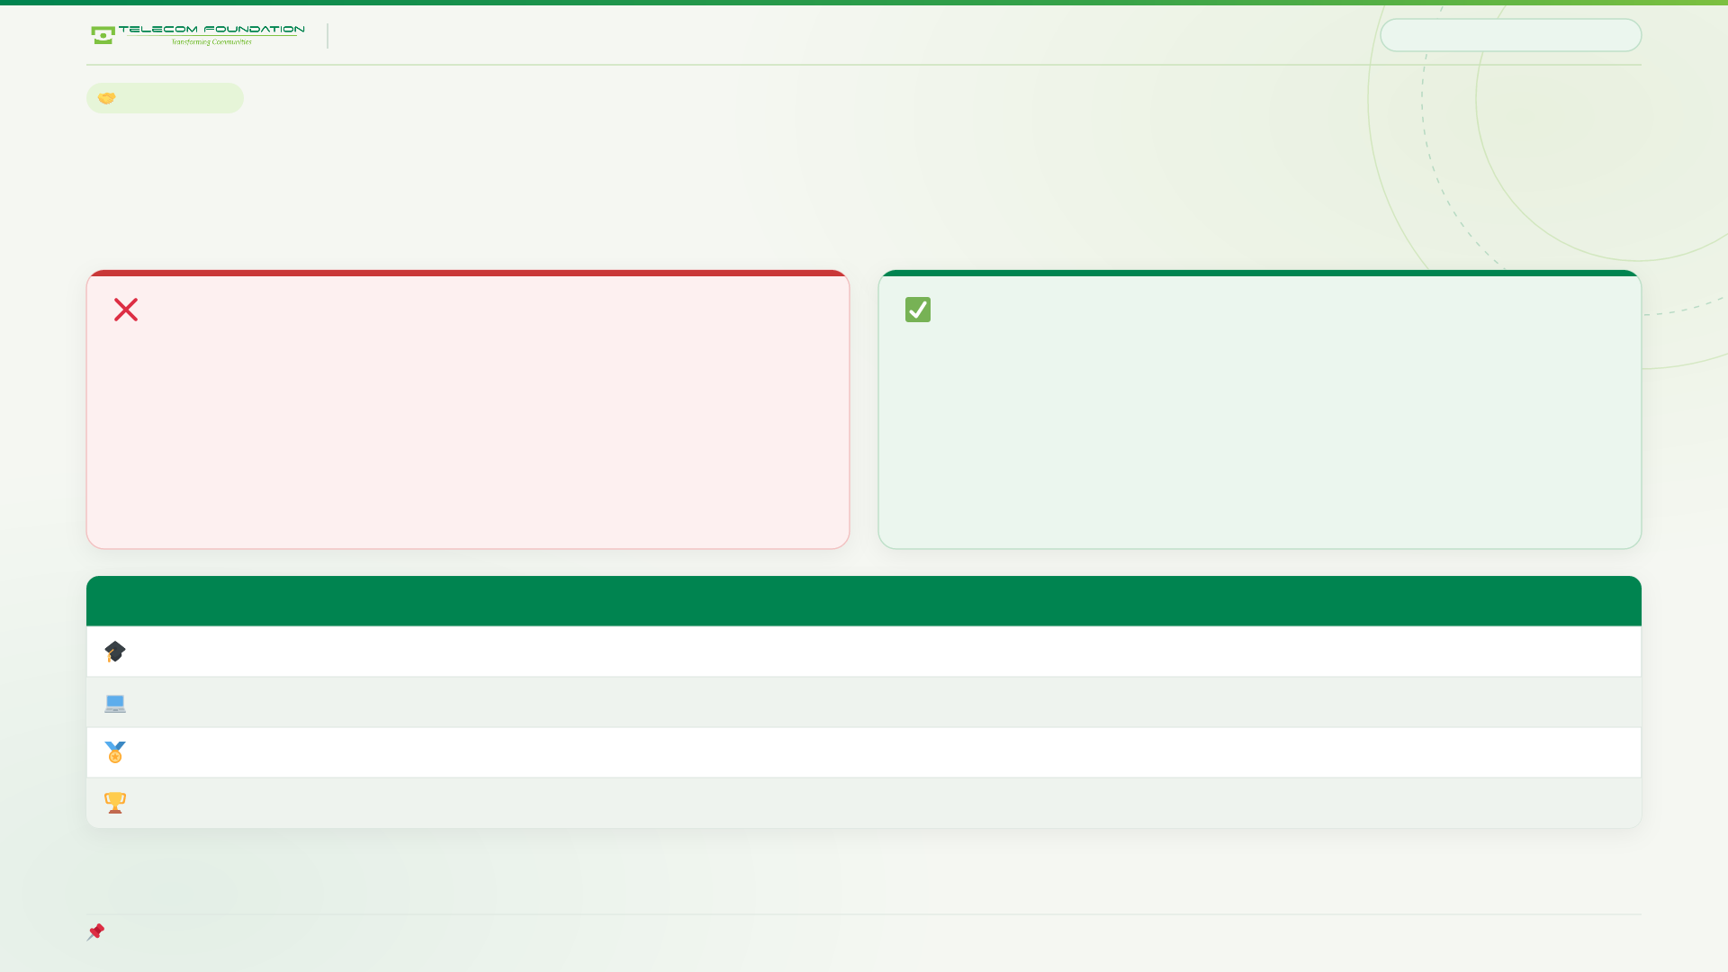
TEFOS QUIZ · NOTEBOOK QR PROGRAMME
SPONSORSHIP
16 / 22
SPONSORSHIP
Sixteen schools changes the conversation
Stop selling “logo on a quiz”. Sell the championship.
WHAT DOES NOT SELL
WHAT SELLS
“Put your logo on our quiz.”
“Title sponsor of a 16-school championship.”
This is a marketing sponsorship. Education CSR budgets are earmarked for scholarships, infrastructure and teaching — a completely different budget line at most corporates.
16 campuses, 2,000+ students, a recurring streamed event, trophies, media coverage, and a clean education-access outcome story. That is a headline CSR asset.
Tier
What they buy
How easy
Scholarship fund
“We underwrite N merit bursaries” — maps perfectly to education-access outcomes
Easiest
In-kind prizes
Printers, tablets, ISP kit, local vouchers — hugely valuable, almost no cash
Very easy
Named prize
“This month's top scorer wins a [brand] kit”
Moderate
Presented by
Title sponsor of the biennial championship ceremony
Moderate
Rule: run phase 1 with zero sponsors. The bursary model already funds the core. Sponsors are upside, not the business case.

Slide 17
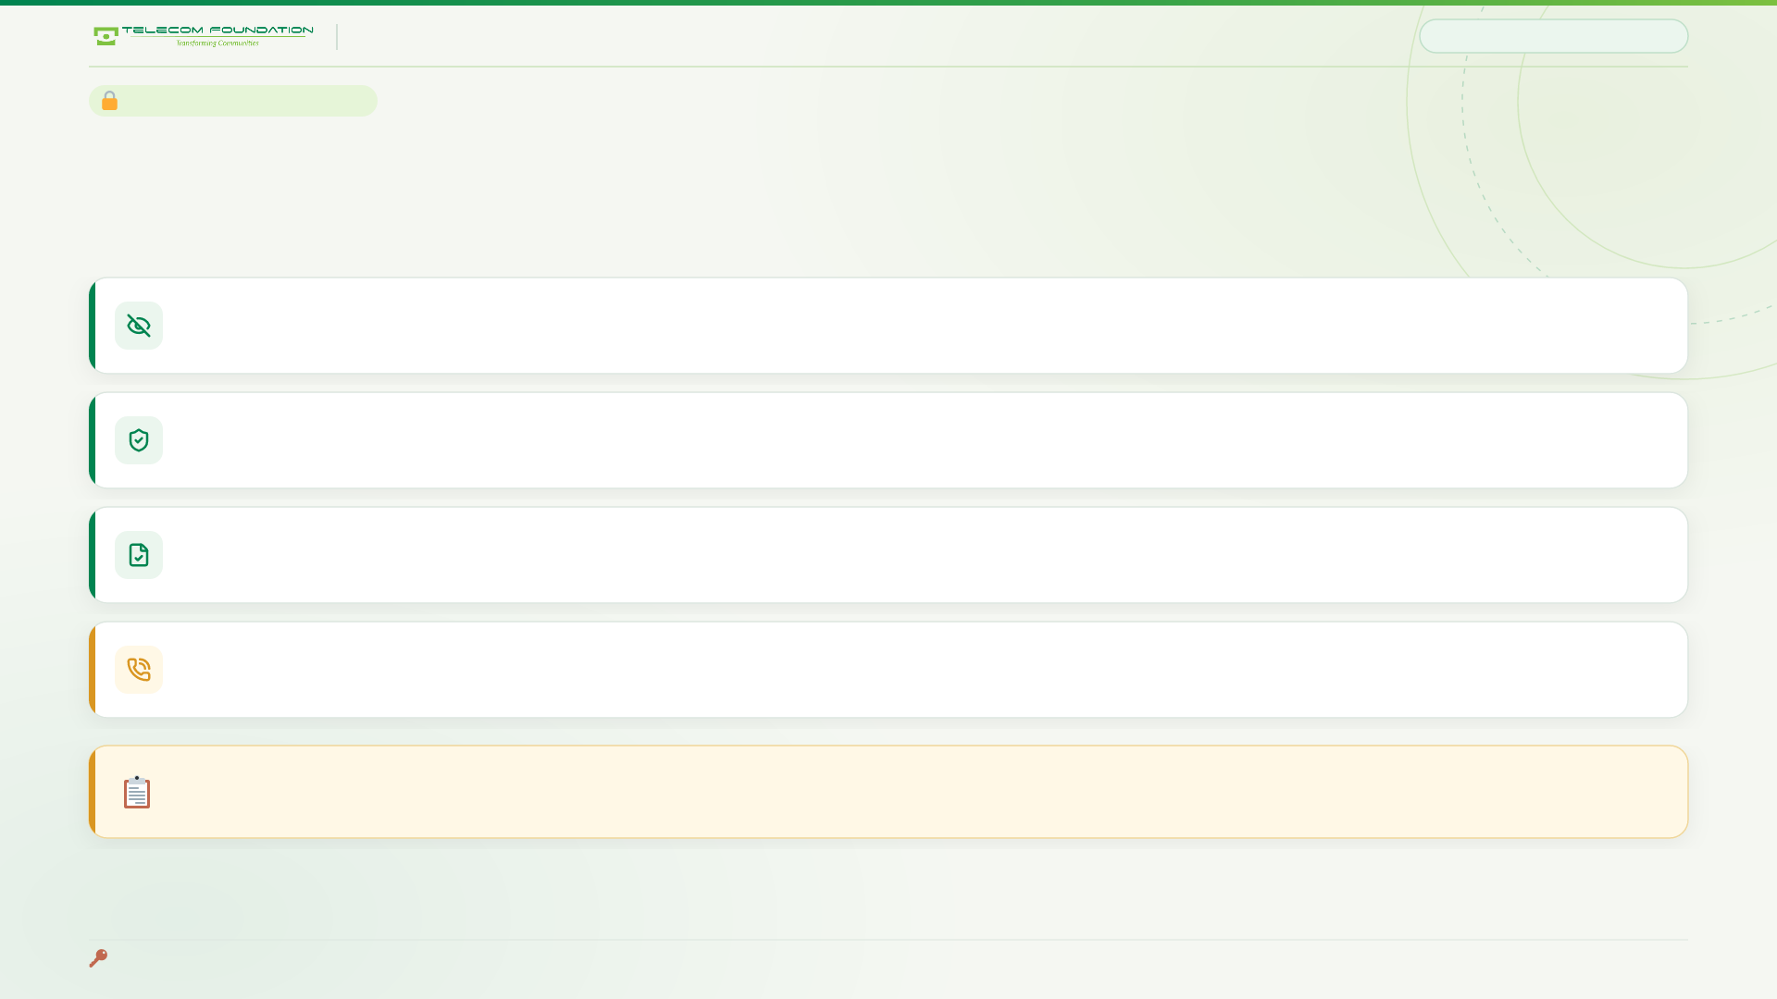
TEFOS QUIZ · NOTEBOOK QR PROGRAMME
PRIVACY & SAFEGUARDING
17 / 22
PRIVACY AND SAFEGUARDING
Built GDPR-K grade, by default
Pakistan has no enacted statute comparable to GDPR or COPPA. That is not a licence to collect loosely.
Nothing personal is ever typed in
No signup form. No name, no father's name, no class, no roll number. The student enters a 6-character printed code.
Nothing identifying is ever shown
Public boards show first name and campus only. No guardian names, no student numbers, no photographs.
Every point is traceable
The points ledger is append-only. A parent can audit every single point their child has ever been awarded.
A child can always reach an adult
The front office number is printed inside the front cover, permanently, regardless of what the server is doing.
Before launch: obtain parental consent at enrolment, publish a plain-language privacy notice inside the front cover, and confirm ICT Directorate guidance with local counsel.
Login is rate-limited to 10 tries per 15 minutes per IP; codes are rotatable per student.

Slide 18
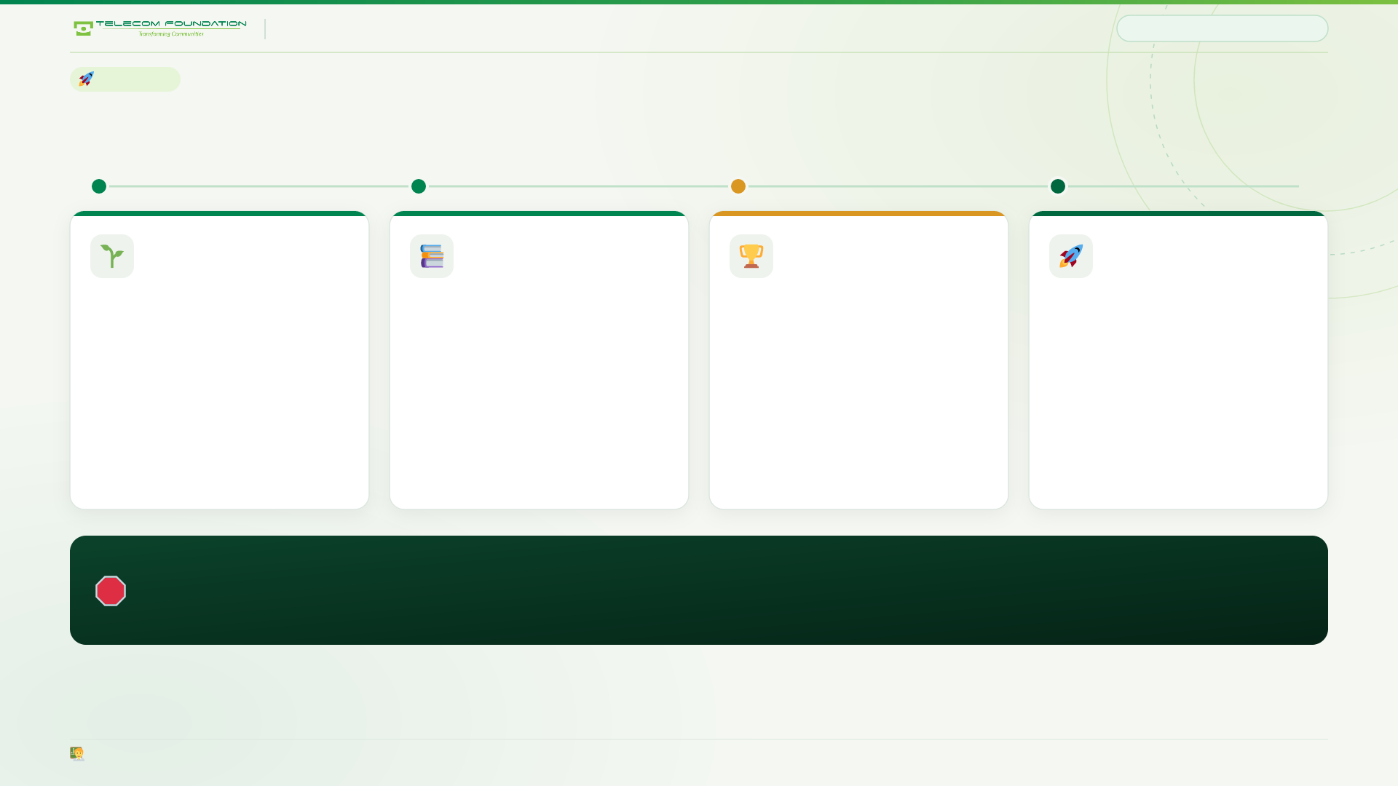
TEFOS QUIZ · NOTEBOOK QR PROGRAMME
EXECUTION
18 / 22
EXECUTION
Four phases, and a kill switch at every step
PHASE 1
PHASE 2
PHASE 3
PHASE 4
4–6 weeks
Months 2–3
Months 4–6
Year 2
One subject, one chapter, one class. No sponsors, no ceremony, no bursary. The only question: will they scan?
All subjects. Weekly house boards. First merit bursary actually paid out. Teacher dashboard switched on.
First inter-school championship. Ceremonies, trophies, and the first sponsorship conversation.
Championship becomes a fixture. Sponsor renews. New campus cohorts onboarded.
The kill switch. If monthly participation is below 50% at the end of phase 1, stop and fix it. Do not scale a weak programme across 16 campuses — that is how a good idea dies of bad management rather than bad design.
Phase 1 needs one volunteer science teacher — not the most eager head of department.

Slide 19
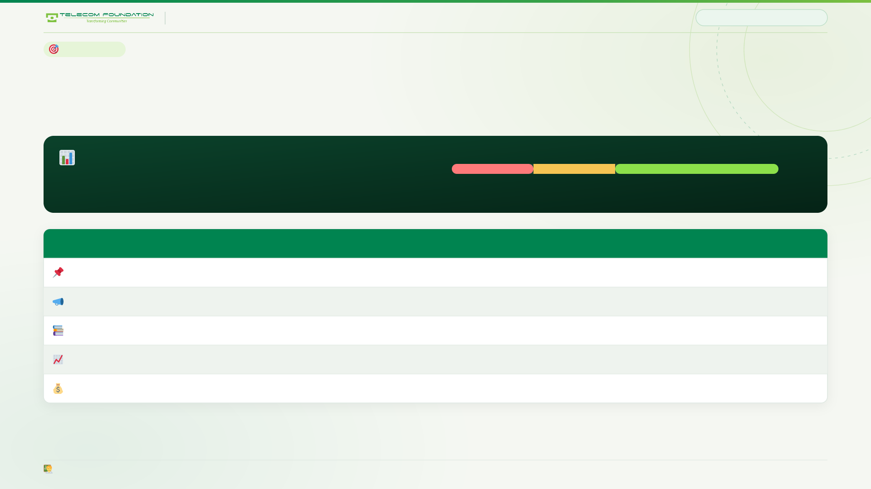
TEFOS QUIZ · NOTEBOOK QR PROGRAMME
MEASUREMENT
19 / 22
MEASUREMENT
One number decides whether this lives
Track it weekly. Everything else is diagnostic.
MONTHLY PARTICIPATION
0% 25% 50% 100%
Share of enrolled students who opened at least one chapter this month
Below 25%
At risk — stop and fix
Above 50%
On track — scale
What we also watch
Why it matters
Who acts on it
Participation rate per campus
Which campuses are engaged, and which need a teacher's nudge
Campus principal
Scans per printed batch
Which notebook print run actually worked — the marketing number
Marketing / HQ
Average score per chapter
Which chapters the cohort actually struggles with
Subject teacher
Share of students reaching 50%+
Whether the programme is lifting the middle, not just the top
Head of school
Points redeemed as bursary
Actual cost to the school, against the 0.5–1% cap
Finance
The teacher-facing report is not a by-product. It is the reason teachers support the programme instead of quietly resenting it.

Slide 20
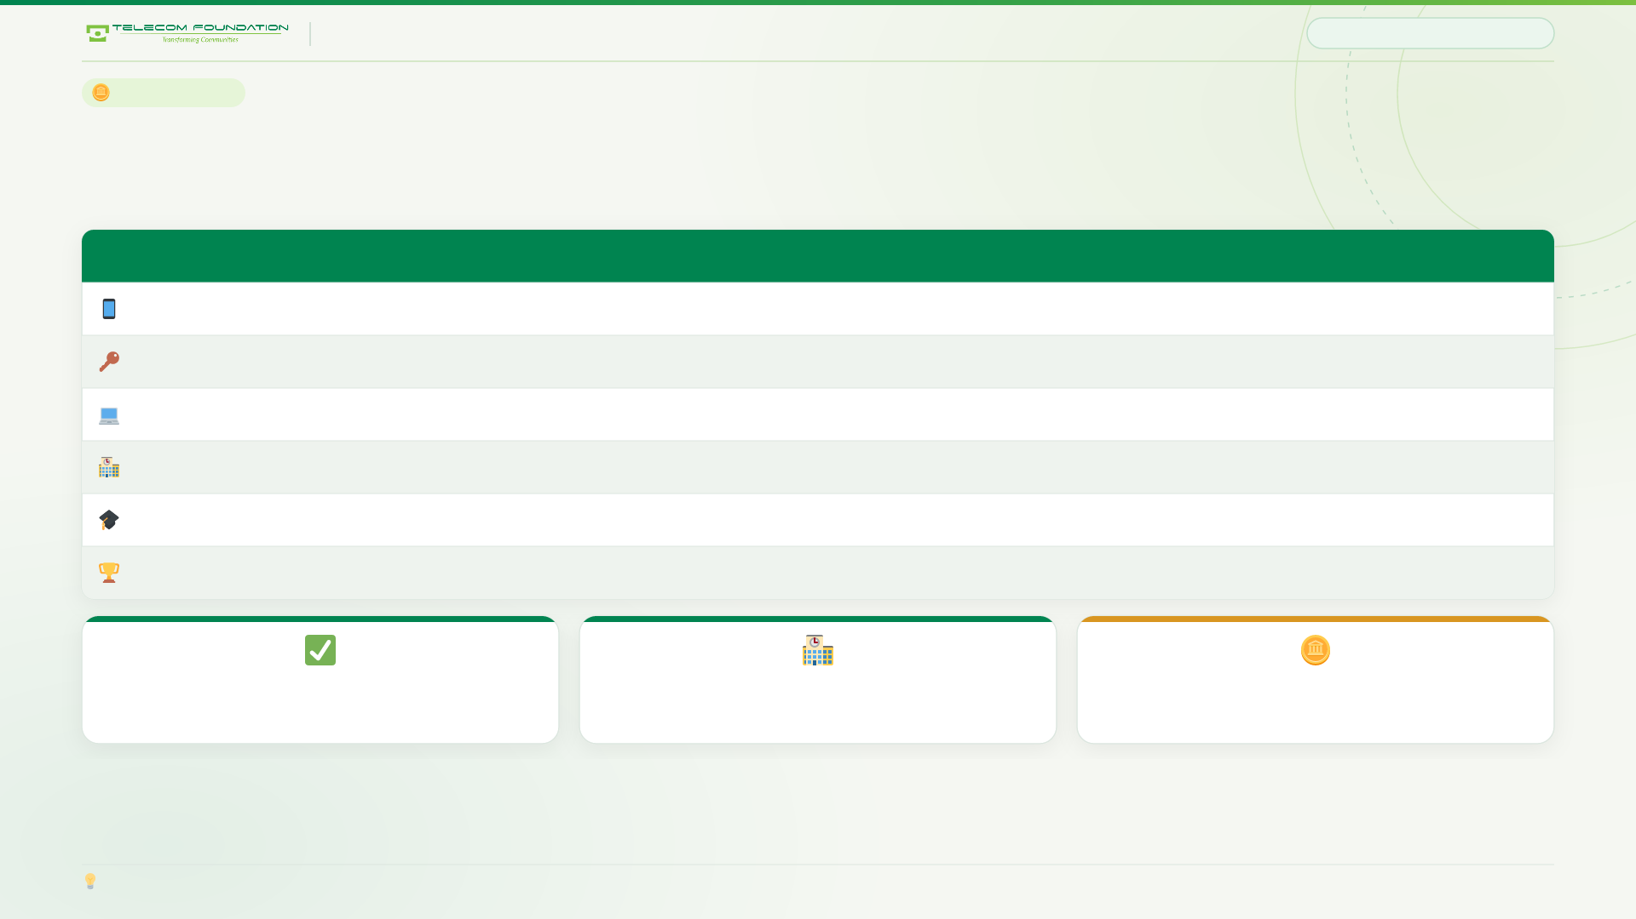
TEFOS QUIZ · NOTEBOOK QR PROGRAMME
WHAT IT COSTS
20 / 22
WHAT IT COSTS
Almost nothing to start
Item
Cost
Note
QR code printed on the notebook cover
~PKR 0
You are already printing these. This is a design change.
Access code inside the front cover
~PKR 0
Printed by the school alongside the class list.
The application
PKR 0
No licences, no hosting minimum, no vendor. Runs on one small server.
Deployment to 16 campuses
Minimal
Server-side software update, not a campus-by-campus installation.
Merit bursary pool
0.5–1% of fee revenue
Capped, published, and the real cost. Budget it deliberately.
Inter-school championship
Per-event
Sponsorship-funded. Do not run phase 1 on sponsor money.
0
16
≤1%
new vendors or licences
campuses from one server update
of fee revenue — the entire real cost
The expensive part is not software — it is teacher adoption, solved by giving teachers a live picture of their class's weak chapters.

Slide 21

TEFOS QUIZ · NOTEBOOK QR PROGRAMME
WHAT WE NEED
21 / 22
WHAT WE NEED
Three decisions
Nothing here needs a new budget line. All three are policy choices.
01
Name a pilot
One class, one subject, one campus. Six weeks. A science teacher who volunteers, not the most eager head of department.
02
Agree the framing
“Merit bursary”, never “earn your own fee”. And quiz points never decide Head Boy, monitors or prefects — that stays exactly as it is today.
03
Open the operator conversation
Zero-rated data on the quiz host, and a first look at sponsoring the inter-school championship. Both are worth more than the software.
Total cost to pilot: the price of six weeks of one teacher's goodwill.
All three can be decided in this meeting.

Slide 22

THE POINT
It is not a quiz app.
It is a reason to
open the notebook.
Every other school initiative asks a student to do something extra. This one pays them for what they were already doing — which is why it will still be running in March.
TELECOM FOUNDATION EDUCATION SYSTEM · TEFOS QUIZ
Transforming Communities
Thank you · Questions welcome

