Slide 2
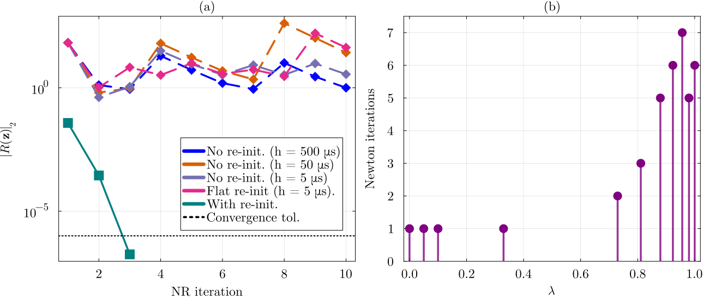
Case39 with flat start (bus 20)

Slide 3
Case39 with flat start (bus 16)
The Euclidean distance between the initial condition and the converged solution in the ZIP load model without
Reinit is 27.17 (NR fails) . This distance then reduces to 14.325 after re-init. When the model conversion is used the distance is 13.53 (NR converges).
ZIP model: initial cond = 476107; fault cond=3.7e6
I model: initial 476092; fault = 3.77e6
This shows that the problem is not the condition number but the Euclidean distance between the solution and the guess

