Slide 1
JAIN LITERATURE
The Ādi Purāṇa
A Sanskrit epic of the first Tirthankara, Rishabhanatha, and the dawn of civilisation
9th
47
63
century CE, when Acharya Jinasena began the work
chapters (parvas): 42 by Jinasena, 5 by Gunabhadra
great figures told in the full Mahāpurāṇa
Notes:
The Adi Purana is the first part of the Mahapurana, the great Jain narrative of the 63 illustrious persons. It was begun by Acharya Jinasena in the ninth century and completed after his death by his disciple Gunabhadra.

Slide 2




What the Ādi Purāṇa teaches
2
Life of Rishabhanatha
The birth of civilisation
His past births, his rule at Ayodhya, renunciation and liberation.
He taught six occupations: warfare, writing, farming, learning, trade and craft.
Bharata and Bahubali
A lasting literary legacy
The tale of two brothers that shows ego, humility and renunciation.
Retold in Kannada by Pampa in 941 CE and studied across Jain tradition.
Notes:
The Adi Purana tells of Rishabhanatha's past lives, his rule, and how he taught society the six occupations. It also holds the story of Bharata and Bahubali. Pampa's Kannada Adipurana of 941 CE is a celebrated later retelling.

Slide 3
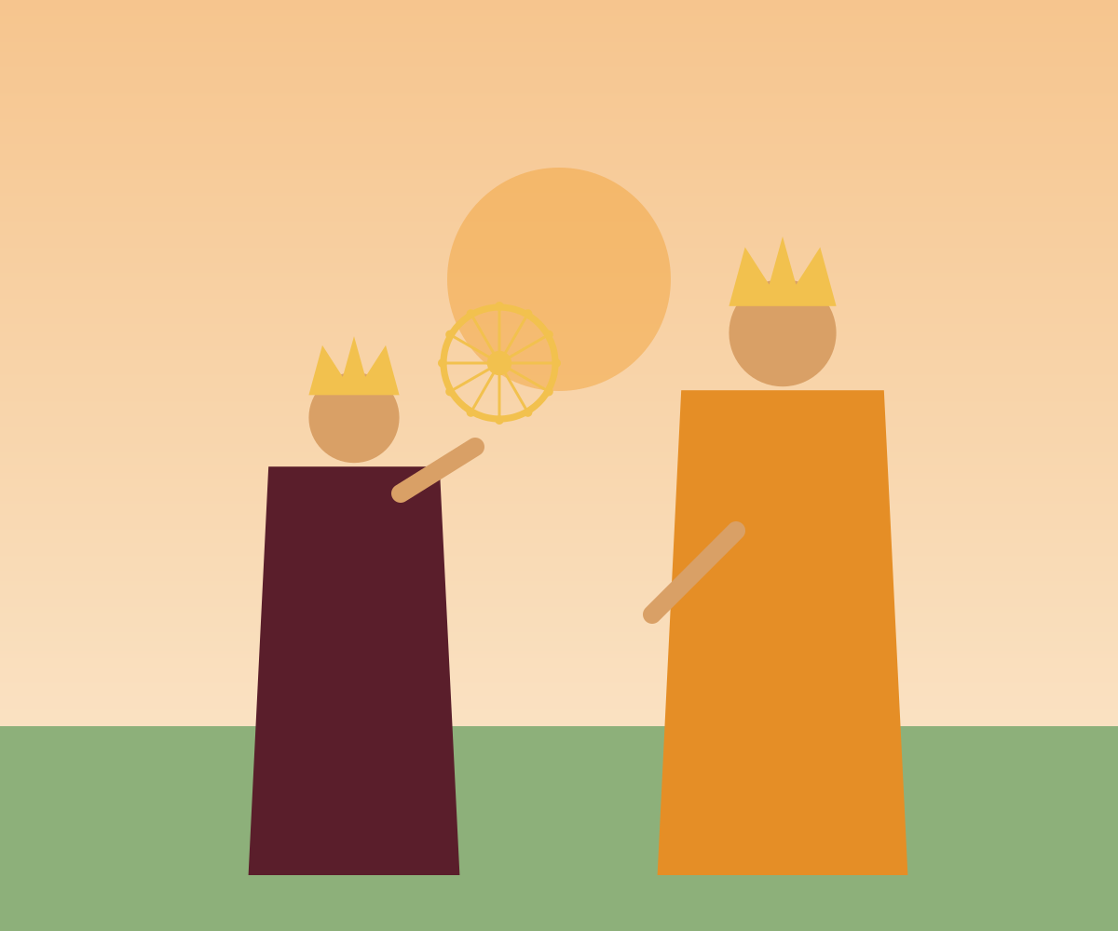
ĀDI PURĀṆA
Bharata
& Bahubali
Two brothers, one kingdom, and a lesson on ego, victory and letting go
Notes:
This story comes from the Adi Purana of Acharya Jinasena, the Jain account of the first Tirthankara Rishabhanatha and his family. It follows two brothers, Bharata and Bahubali, and asks what victory really means.

Slide 4
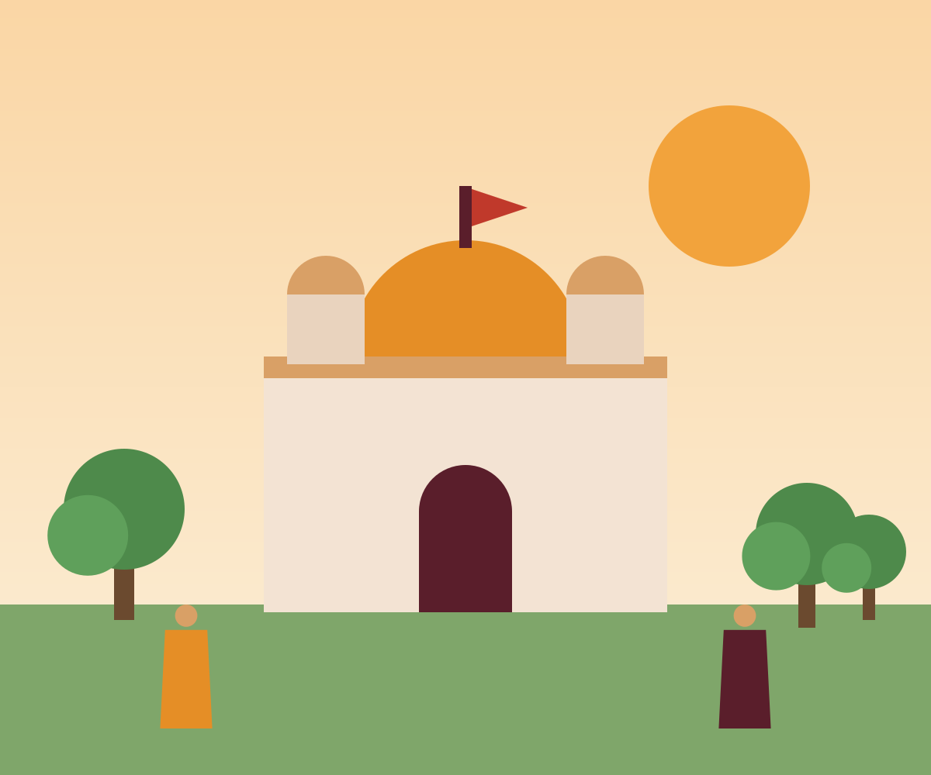
Ayodhya and the family of Rishabhanatha
2
King Rishabhanatha ruled Ayodhya and taught his people farming, crafts and letters.
He had one hundred sons. Bharata, the eldest, was born to Queen Yashasvati.
Bahubali, born to Queen Sunanda, was famed for strength and beauty.
When Rishabha renounced the world, he divided the kingdom among his sons.
Notes:
Rishabhanatha, also called Adinatha, is the first Tirthankara. He ruled Ayodhya, taught people farming, crafts and writing, and later renounced the throne.

Slide 5


Two brothers, two temperaments
3
Bharata
Bahubali
Ayodhya · first chakravartin
Podanpur · the mighty one
The eldest, and destined to be an emperor.
The divine chakra wheel appeared in his armoury.
His ambition: rule the whole earth.
Famed for matchless strength and beauty.
Told to be the very image of manly grace.
His pride: he bows to no one.
Notes:
Bharata received Ayodhya and Bahubali received Podanpur. Both were great, but in different ways.

Slide 6
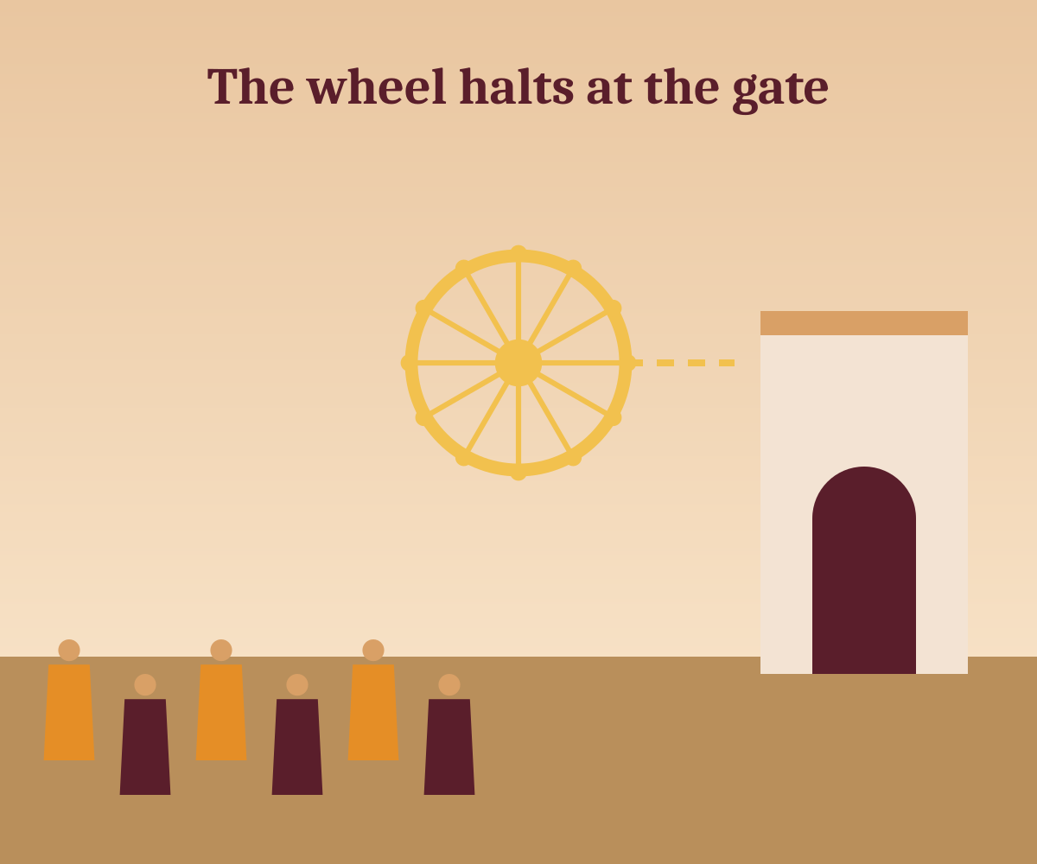
The wheel that would not enter
4
Bharata's divine chakra-ratna led his armies in a conquest of all directions.
Kings across the land accepted his rule, and he returned to Ayodhya as emperor.
But the chakra stopped at the city gate and would not enter.
The ministers explained: his own brothers had not yet accepted his authority.
Notes:
The chakra-ratna leads the emperor across the earth. It stops at the city gate because some of Bharata's brothers have not yet accepted his rule.

Slide 7
Ninety-eight brothers choose renunciation
5
98 brothers
Left their kingdoms and became monks.
Bahubali
Refused to submit to his brother.
Bharata
Demanded submission from every brother.
Notes:
Confronted with the demand to submit, ninety-eight brothers renounced the world and became monks under their father. Bahubali refused to bow.

Slide 8
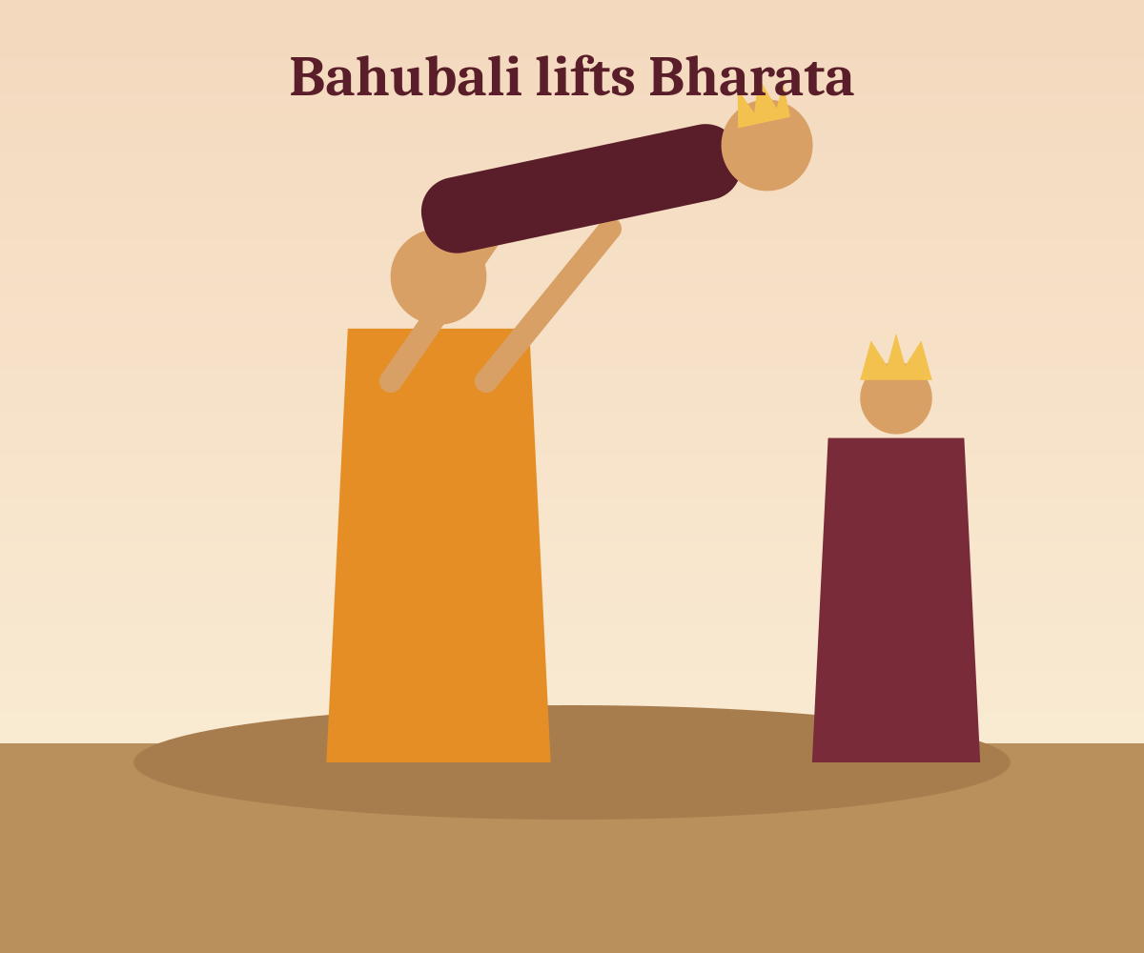



Three contests instead of a war
6
Eye contest
Whoever blinks first loses. Bahubali's gaze held.
Water contest
The brothers splashed water at one another. Bahubali's strength prevailed.
Wrestling
Bahubali lifted Bharata high and set him down gently.
Notes:
Ministers of both sides advised that thousands should not die for the quarrel of two brothers, so the two agreed to settle it by three contests. Bahubali won all three.

Slide 9
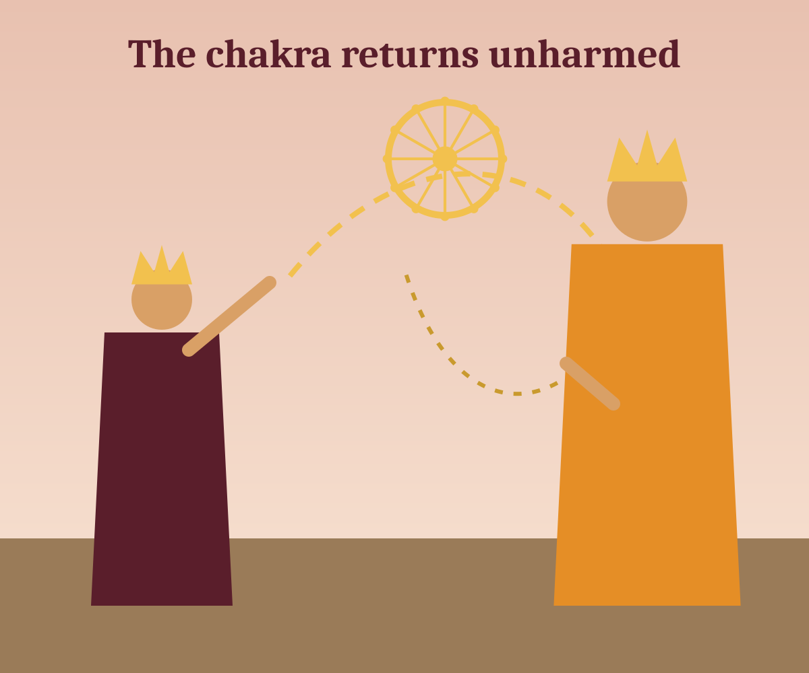
Anger, and the chakra that turned back
7
Defeated three times, Bharata was blinded by anger and hurled the chakra at his brother.
The wheel circled Bahubali and returned. It cannot harm one of the emperor's own blood.
Bahubali could have struck back, but he saw the folly of it all.
His victory felt empty. He wondered: why fight for a kingdom that no one keeps?
Notes:
Bharata, humiliated, forgot his duty as an elder brother and threw the chakra. It circled Bahubali and returned, because the chakra cannot harm one of the same family. Bahubali then saw the folly of the struggle.

Slide 10
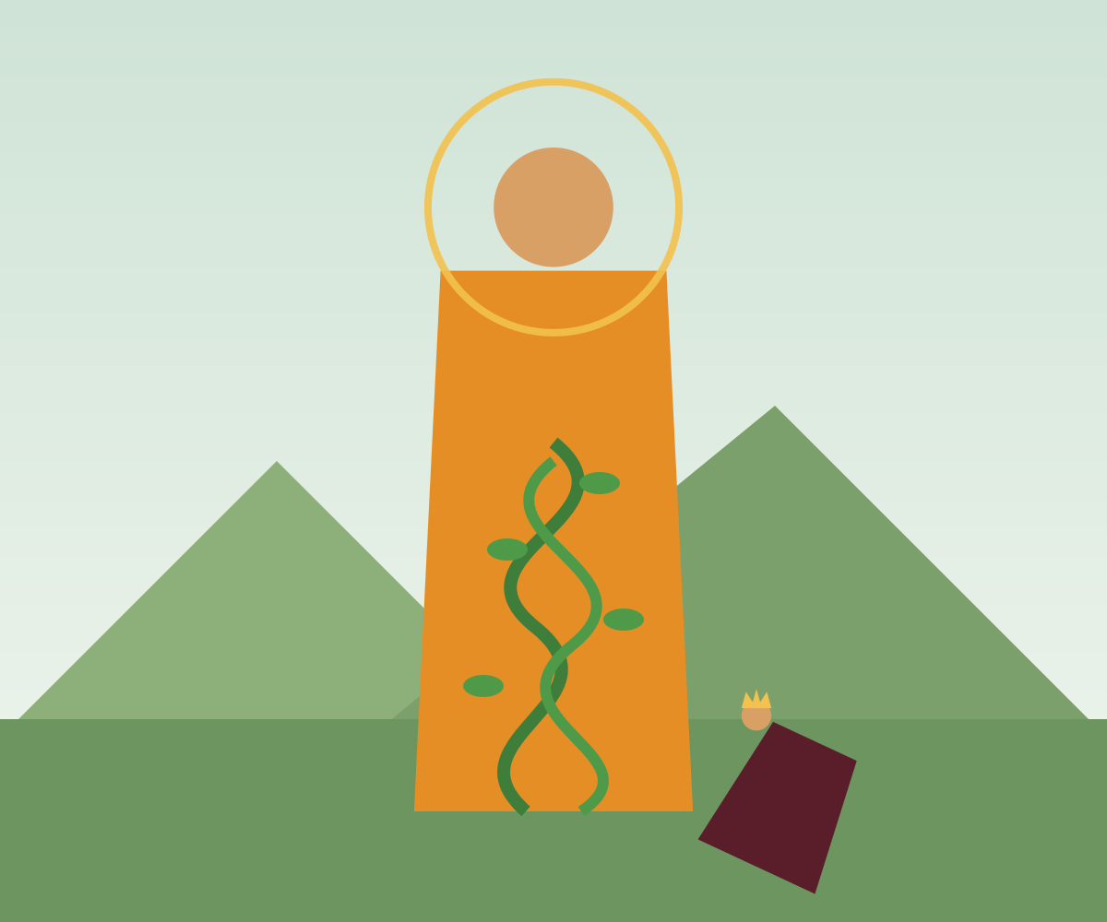
A year of stillness
8
Bahubali gave his kingdom to his son and became a monk.
He stood in kayotsarga, motionless, for a full year. Vines climbed his limbs.
One thought remained: “I stand on my brother's land.” That subtle pride delayed liberation.
Bharata came, bowed and reminded him that all land belongs to no one. Then Bahubali attained kevala jñāna.
Notes:
Bahubali handed the kingdom to his son and stood in kayotsarga meditation. Vines grew around him. A subtle pride, the thought that he stood on Bharata's land, kept him from omniscience until Bharata bowed to him.

Slide 11




Moral lessons
9
Power is not the same as victory
Anger clouds judgement
Bharata's empire meant little while it cost him his brothers.
In rage, Bharata threw a weapon at his own brother.
Ego is subtle
Humility and forgiveness heal
Even a saintly year of meditation held one last trace of pride.
Bharata's bow ended the quarrel and helped liberate Bahubali.
Notes:
Each lesson ties back to a moment in the story.

Slide 12
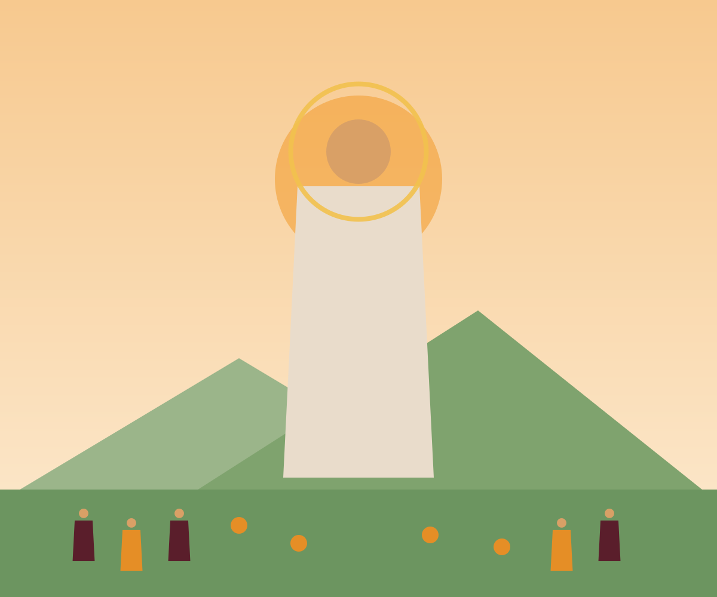
Legacy and reflection
Bahubali is honoured across Jain tradition. His statue at Shravanabelagola, consecrated in 981 CE, is one of the tallest free-standing monolithic statues.
Every twelve years, devotees pour milk, water and flowers over it in the Mahamastakabhisheka.
Tradition says Bharata gave India its ancient name, Bharatavarsha.
Ask yourself: where am I winning a quarrel but losing a relationship?
Notes:
The gigantic monolithic statue of Bahubali, also called Gommateshwara, stands at Shravanabelagola in Karnataka. It was consecrated in 981 CE. Every twelve years, devotees perform the Mahamastakabhisheka. According to tradition, the land of Bharata is named Bharatavarsha after the emperor.

