Slide 1

THE JĀTAKA TALES
Sasa Jātaka
& Mahākapi Jātaka
The Hare who gave himself, and the Monkey King who became a bridge
Notes:
Welcome. This talk retells two Jataka stories in which the Bodhisatta, the future Buddha, is born as an animal and gives everything for others.

Slide 2



What is a Jātaka?
2
Birth stories
Tales of the Buddha's previous lives, told to illustrate a lesson.
547
The Bodhisatta
The future Buddha appears as a human, deity or animal in each tale.
stories in the Pali Jātaka collection, part of the Khuddaka Nikāya
The pāramīs
Each life perfects a virtue: generosity, patience, compassion and more.
Notes:
Jatakas are birth stories of the Buddha. Each story ends with the Buddha identifying who in the story was who.

Slide 3


Two stories at a glance
3
Sasa Jātaka
Mahākapi Jātaka
Jātaka No. 316
Jātaka No. 407
Bodhisatta: a wise hare
Virtue: perfect generosity (dāna)
Sacrifice: offers his own body as food
Bodhisatta: the Great Monkey king
Virtue: compassion and selfless leadership
Sacrifice: becomes a bridge over the river
Notes:
Both stories show the Bodhisatta offering his own body for others, one to a hungry stranger and one to his troop.

Slide 4



Sasa: four friends in the forest
4
Hare
Monkey
Jackal
Otter
The wise one, the Bodhisatta
Lived in the mango trees
Foraged on the plains
Hunted along the river
They lived in harmony, and the hare taught them to give alms and keep the moral precepts.
Notes:
Four animals lived together near a wooded hillside and a river. The hare was the wisest and taught the others.

Slide 5

The hare's teaching
5
On each Uposatha day, the hare urged his friends to fast and keep the precepts.
He asked them to prepare food to give, so that a guest would never go away hungry.
Each friend promised to share what they could find.
Giving begins with a promise
Notes:
On the Uposatha (observance day) the hare reminded his friends to prepare food to give to any beggar who came.

Slide 6



What each friend prepared
6
Otter
Jackal
Found seven fish left on the riverbank
Found a lizard, a bowl of curd and roasted meat
Monkey
Hare
Gathered ripe mangoes from the trees
Had only grass, so he resolved to give himself
Notes:
The hare had only grass, which is no food for a guest, so he decided to offer his own body.

Slide 7
Sakka comes to test them
7
1
2
3
4
Sakka disguises himself
Otter, jackal, monkey
He turns to the hare
A fire is lit
He appears as a hungry brahmin.
Each offers food and is praised.
The hare has no food to give.
The hare asks for a bed of coals.
Notes:
Sakka, king of the gods, heard of their virtue and came disguised as a wandering brahmin to test it.

Slide 8

The leap
The hare shook his coat three times, so no small creature would burn with him.
He leapt into the blaze, ready to give his life.
The fire felt as cold as snow. Sakka revealed himself and praised him.
He drew the hare's form on the moon, so it is remembered for all ages.
Notes:
The hare shook his fur three times so no living creature would be harmed, then leapt into the fire. The flames felt as cold as snow.

Slide 9
Sasa: the moral and the cast
9
True giving holds nothing back. The hare gave without expecting reward, and even fear of pain did not stop him.
In the story | In the Buddha's time
The hare | The Buddha himself
The monkey | Sāriputta
The jackal | Moggallāna
The otter | Ānanda
Sakka in disguise | Anuruddha
Notes:
At the end of the tale the Buddha explains who each animal was in that life.

Slide 10
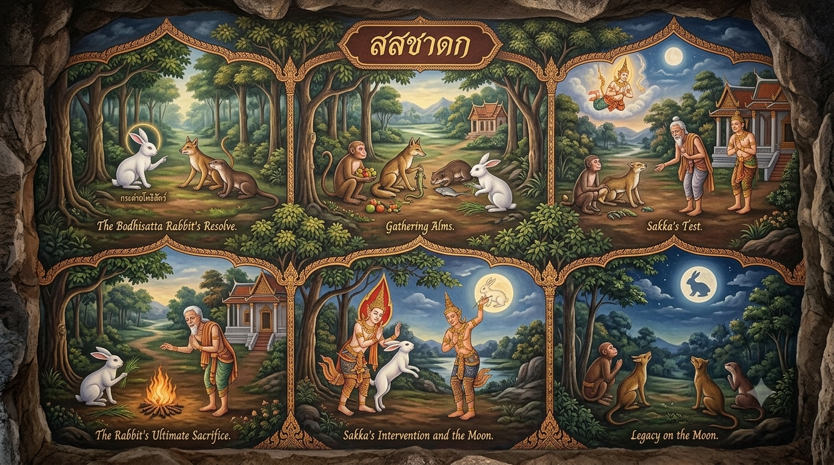

Slide 11
Mahākapi: the monkey king’s tree
10
The Bodhisatta was king of 80,000 monkeys in the Himalayan foothills.
They lived on a huge mango tree beside the Ganges.
The king ordered them to eat every fruit that hung over the water.
One hidden mango, caught in a bird's nest, fell into the river and floated away.
80,000
monkeys followed their king
Notes:
The Bodhisatta was a monkey king living by the Ganges, guarding a huge mango tree.

Slide 12



The king's mango and the archers
11
A mango reaches Benares
The fruit lodges in a net downstream, and King Brahmadatta tastes it.
He tracks it upriver
He finds the great tree and the monkeys feasting.
He orders them shot
Archers surround the tree, and the monkeys have nowhere to flee.
Notes:
King Brahmadatta of Benares tasted the fruit, followed the river upstream, and found the tree full of monkeys.

Slide 13
The monkey becomes a bridge
12
Tree bank
(danger)
Far bank
(safety)
The Monkey King's body
River Ganges
He leapt to the far bank and tied a bamboo shoot to himself, but it fell short.
He held the tree with his hands, and his troop crossed over his back.
Every monkey escaped, and the king held on through the pain.
Notes:
The bamboo he tied was too short, so he held it with his hands and stretched across the river as a living bridge.

Slide 14
Betrayal and compassion
13
Devadatta, the jealous monkey
King Brahmadatta
A rival in the troop saw a chance to kill the king. He jumped hard on the king's back, and broke it.
He watched from below, lowered his bow, and had the king brought down and tended with care.
As he lay dying, the monkey king taught: a ruler lives for the welfare of his people, and gives his own life first.
Notes:
Devadatta, then a jealous monkey, jumped so hard on his back that the king's heart broke. The human king watched and was moved.

Slide 15
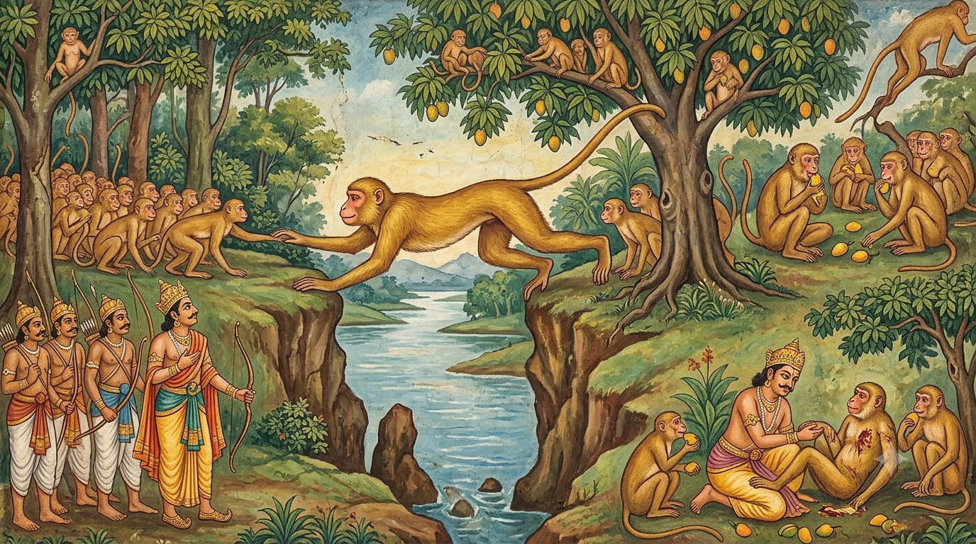

Slide 16
Comparing the two Jātakas
14
 | Sasa Jātaka | Mahākapi Jātaka
Bodhisatta as | A hare | A monkey king
Who is helped | A hungry stranger | His whole troop
The test | Sakka in disguise | A king with archers
The sacrifice | Leaps into the fire | Becomes a bridge
Outcome | Image placed on the moon | The king is moved to compassion
Virtue | Generosity | Compassionate leadership
Notes:
Both stories teach that real virtue is shown when someone is willing to give up what is most precious.

Slide 17

Lessons and legacy
Generosity is measured by willingness, not by how much one has.
A good leader protects others before himself.
Compassion can change even those who mean harm.
Many Asian traditions see a hare in the moon, and the tales live on in art and storytelling across Buddhist cultures.
Thank you
Notes:
Close by inviting the audience to reflect on which of these lessons speaks to them most.

