Slide 1
AutoML for Regression
Custom Simulated Annealing vs. FLAML & TPOT
DNDS5019 — Machine Learning (Advanced)
Ali Usama
March 2026

Slide 2
Agenda
1
The AutoML Problem
Why automate ML pipeline design?
2
Datasets & Preprocessing
Airbnb pricing & Insurance charges
3
Custom SA Implementation
Search space, cooling, neighbor strategy
4
FLAML & TPOT Comparison
State-of-the-art AutoML systems
5
Results & Analysis
Performance metrics, convergence, feature importance
6
Dataset Contrast
How data characteristics affect AutoML
7
Conclusions & Lessons Learned
Key takeaways
2

Slide 3
1. The AutoML Problem
Why automate ML pipeline design?

Slide 4
What is AutoML?
A machine learning practitioner faces a nested optimization problem:
Which algorithm?
Which hyperparameters?
Which preprocessing?
RF, XGBoost, KNN, Ridge, ElasticNet, GradientBoosting...
learning_rate, max_depth, n_estimators, alpha, subsample...
Scaling, encoding, feature engineering, imputation...
Our approach: Simulated Annealing — a metaheuristic that jointly optimizes algorithm selection and hyperparameter tuning within a fixed time budget.
Search space: ~46,830 configurations. Grid search at 2s/fit = ~130 hours. SA finds near-optimal in 1 hour.
4

Slide 5
2. Datasets & Preprocessing
Two datasets with contrasting characteristics

Slide 6
Dataset Overview
Property | Airbnb Pricing | Insurance Charges
Rows | 74,111 | 1,338
Features | 71 (after OHE) | 10 (incl. interaction)
Missing values | Up to 24.7% | 0% (clean)
Target | log_price | log1p(charges)
Target skewness | 0.515 (after log) | 1.51 raw → -0.09 after log
Key predictor | Room type + location | Smoker × BMI interaction
Data structure | Cross-sectional | Cross-sectional
Source | Kaggle (Airbnb NYC) | Geeksforgeeks (Medical Insurance)
6

Slide 7
Airbnb Preprocessing Pipeline
Drop columns
id, description, name, thumbnail_url, amenities, neighbourhood
Remove outliers
log_price = 0 rows (likely errors)
Date engineering
host_since → days_as_host, first/last_review → days_since
Parse rates
host_response_rate: '96%' string → numeric float
Binary encode
cleaning_fee, host_has_profile_pic, instant_bookable (t/f → 0/1)
Imputation
Median fill for bathrooms, bedrooms, beds, zipcode, review_scores
One-hot encode
property_type, room_type, bed_type, cancellation_policy, city
Scale
StandardScaler fit on train, transform test (no leakage)
7
Notes:
For zipcode (1.3% missing), we used median imputation. Given the low missingness rate and numeric encoding for downstream processing, median imputation provides a simple, robust approach that preserves the distribution without introducing artificial relationships

Slide 8
Insurance Preprocessing Pipeline
Log transform target
charges skew 1.51 → log_charges skew -0.09 (nearly symmetric)
Binary encode
sex (male=1, female=0), smoker (yes=1, no=0)
Interaction feature
smoker_bmi = smoker × bmi (captures non-linear cost effect)
One-hot encode
region (northeast, northwest, southeast, southwest)
Train/test split
80/20 split, random_state=42
Scale
StandardScaler fit on train, transform test
Key insight: Smokers pay 3.8× more on average. The smoker × BMI interaction captures that high-BMI smokers pay dramatically more than low-BMI smokers.
8

Slide 9
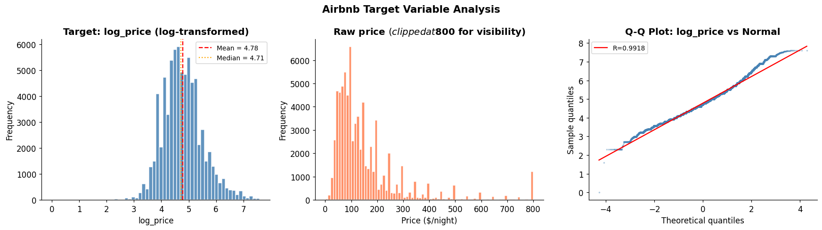
Airbnb: Exploratory Analysis
9

Slide 10
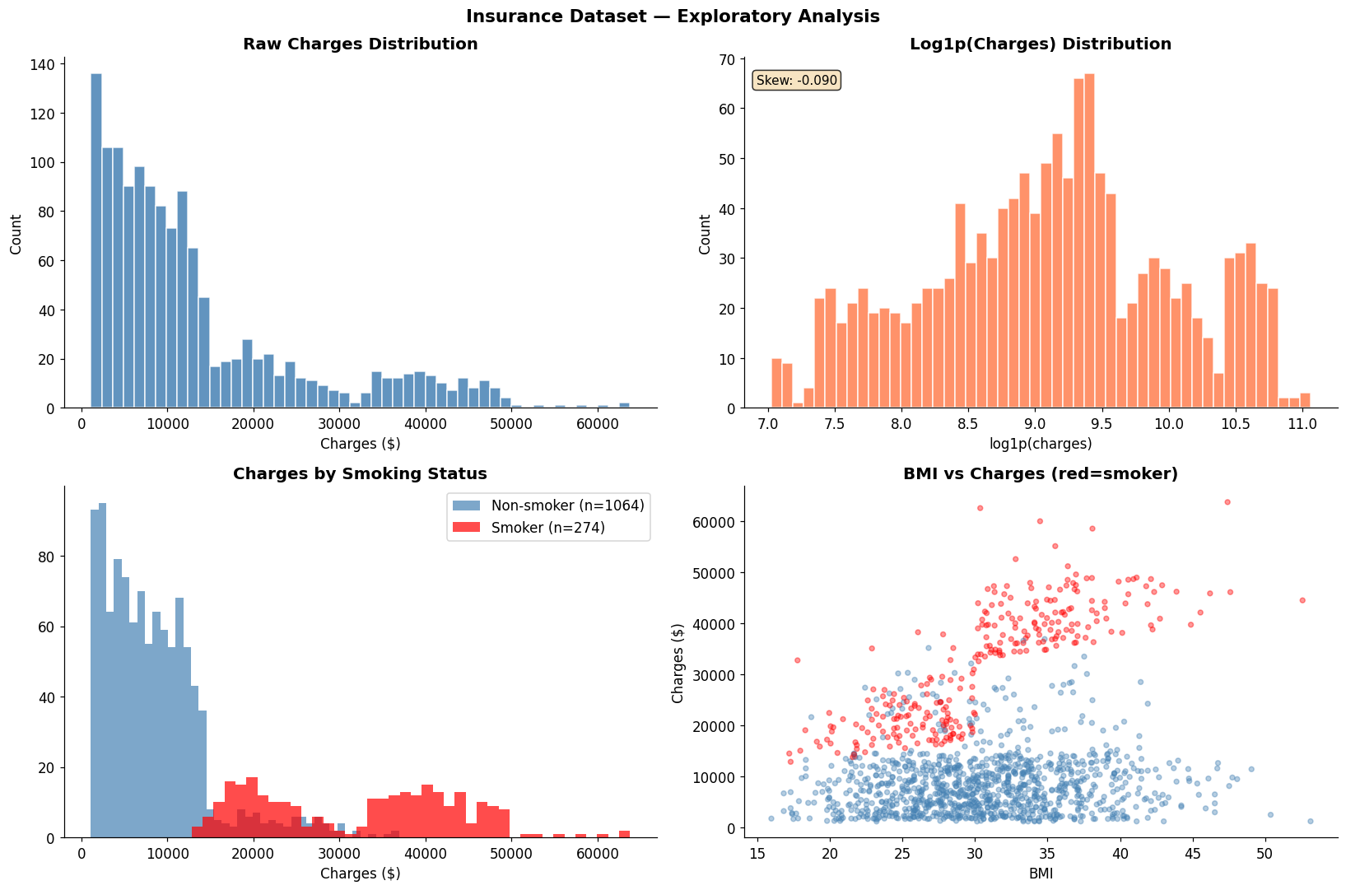
Insurance: Exploratory Analysis
10

Slide 11
3. Simulated Annealing
Custom AutoML implementation from scratch

Slide 12
SA: Search Space Design
Algorithm | Key Hyperparameters | Combinations
RandomForest | n_estimators, max_depth, min_samples_split/leaf, max_features | 2,880
GradientBoosting | n_estimators, learning_rate, max_depth, subsample, min_samples_split, max_features | 5,400
XGBoost | n_estimators, learning_rate, max_depth, subsample, colsample, reg_alpha/lambda | 38,400
Ridge | alpha, fit_intercept, solver | 56
ElasticNet | alpha, l1_ratio, max_iter | 70
KNN | n_neighbors, weights, p | 24
Total: ~46,830 configurations × 5-fold CV = 234,150 model fits. Grid search at 2s/fit = ~130 hours.
SA explores this space intelligently in 1 hour per dataset.
12

Slide 13
SA: Algorithm Pseudocode
1. Initialize random solution (algorithm + hyperparameters)
2. Evaluate with 5-fold Cross-Validation → RMSE
3. Set temperature T = T₀ = 1.0
4. WHILE time_budget not exceeded:
5. Generate neighbor (80% tweak HP, 20% switch algorithm)
6. Evaluate neighbor → new_RMSE
7. IF new_RMSE < current_RMSE: ACCEPT (improvement)
8. ELSE: accept with probability P = exp(-Δ/T)
9. T = T × cooling_rate (0.97)
10. IF T < T_min: REHEAT (T = T₀ × 0.5ⁿ)
11. RETURN best solution found
13

Slide 14
SA: Key Design Decisions
Neighbor Strategy
80% tweak one HP (exploit) / 20% switch algorithm (explore). Adjacent step (50%) or random jump (50%).
Cooling Schedule
Geometric: T = T × 0.97 per iteration. Temperature drops from 1.0 to 0.0001 in ~303 iterations.
Reheat Mechanism
When T < T_min, reheat to T₀ × 0.5ⁿ. Prevents premature convergence. Allows SA to use full time budget.
Caching
In-memory cache of evaluated configurations. SA often revisits similar configs — cache avoids re-training.
Time-bounded
Primary stop condition is wall-clock time (3600s). Adapts to dataset size automatically.
14

Slide 15
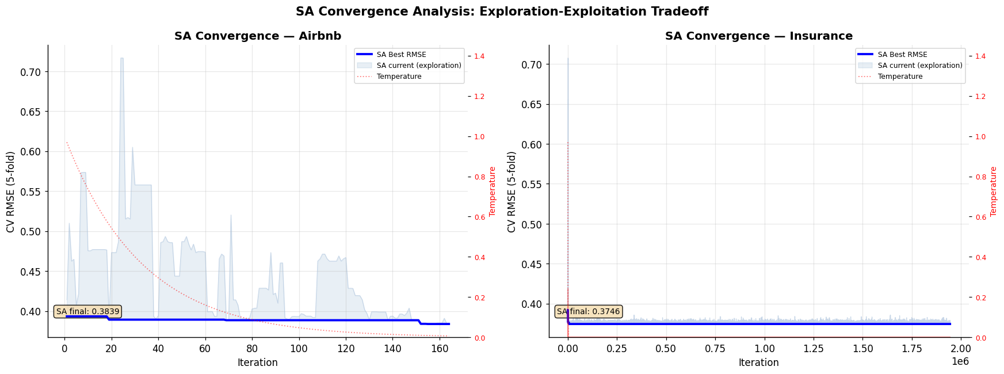
SA: Convergence Analysis
15
Notes:
This plot shows the **Simulated Annealing convergence behavior** for both datasets:
## Key Observations:
### Airbnb:
- **High exploration phase** (iterations 0-40): Large fluctuations in RMSE as SA explores different algorithms/hyperparameters at high temperature
- **Gradual convergence** (iterations 40-140): Temperature decreases, exploration reduces, SA exploits good solutions
- **Final solution**: RMSE = 0.3839 after ~160 iterations
- **Behavior**: Classic SA pattern - starts chaotic, gradually stabilizes
### Insurance:
- **Immediate convergence**: Found excellent solution (RMSE = 0.3746) almost instantly
- **Minimal exploration**: Nearly flat line after initial iterations
- **Stable temperature decay**: Smooth cooling curve
- **Behavior**: Dataset is smaller/simpler, SA quickly found optimal solution and stayed there
## Insights:
1. **Airbnb** is a **harder problem** - requires extensive search to find good solutions
2. **Insurance** is **easier to optimize** - simple structure allows quick convergence
3. **Temperature mechanism works**: Cooling schedule controls exploration → exploitation transition
4. **SA exploration-exploitation tradeoff**: High temp = explore (try risky moves), low temp = exploit (refine best solution)
The contrast demonstrates how **dataset characteristics** (size, complexity, feature relationships) directly impact AutoML search difficulty.

Slide 16
4. FLAML & TPOT Comparison
State-of-the-art AutoML systems

Slide 17
Comparison Methods
FLAML
TPOT
Fast & Lightweight AutoML (Wang et al. 2021)
Genetic Programming AutoML (Le et al. 2020)
Search: Cost-Frugal Optimization
Starts with cheap models, escalates
Estimators: xgboost, rf, extra_tree, kneighbor
Time budget: 3600s per dataset
5-fold CV, RMSE metric
Search: Genetic Programming (evolution)
Evolves entire ML pipelines
Includes preprocessing in search
12+ regressors (RF, XGB, KNN, Ridge...)
Time budget: 60 min per dataset
Fair comparison: All three methods have access to the same algorithm families (RF, XGBoost, KNN, linear models)
17

Slide 18
5. Results & Analysis
Performance comparison across all methods

Slide 19
Final Results
Dataset | Method | RMSE | MAE | R² | Best Model
Airbnb | Baseline | 0.7194 | 0.5627 | 0.000 | N/A
Airbnb | Custom SA | 0.3833 | 0.2778 | 0.716 | GradientBoosting
Airbnb | FLAML | 0.3771 | 0.2722 | 0.725 | XGBoost
Airbnb | TPOT | 0.3928 | 0.2823 | 0.702 | GP Pipeline
Insurance | Baseline | 0.9509 | 0.7824 | 0.000 | N/A
Insurance | Custom SA | 0.3477 | 0.1874 | 0.866 | XGBoost
Insurance | FLAML | 0.3458 | 0.1849 | 0.867 | XGBoost
Insurance | TPOT | 0.3471 | 0.1783 | 0.866 | GP Pipeline
SA vs Baseline
SA vs FLAML gap
SA beats TPOT on
47-63% RMSE reduction
< 2% difference
Airbnb (RMSE)
19

Slide 20
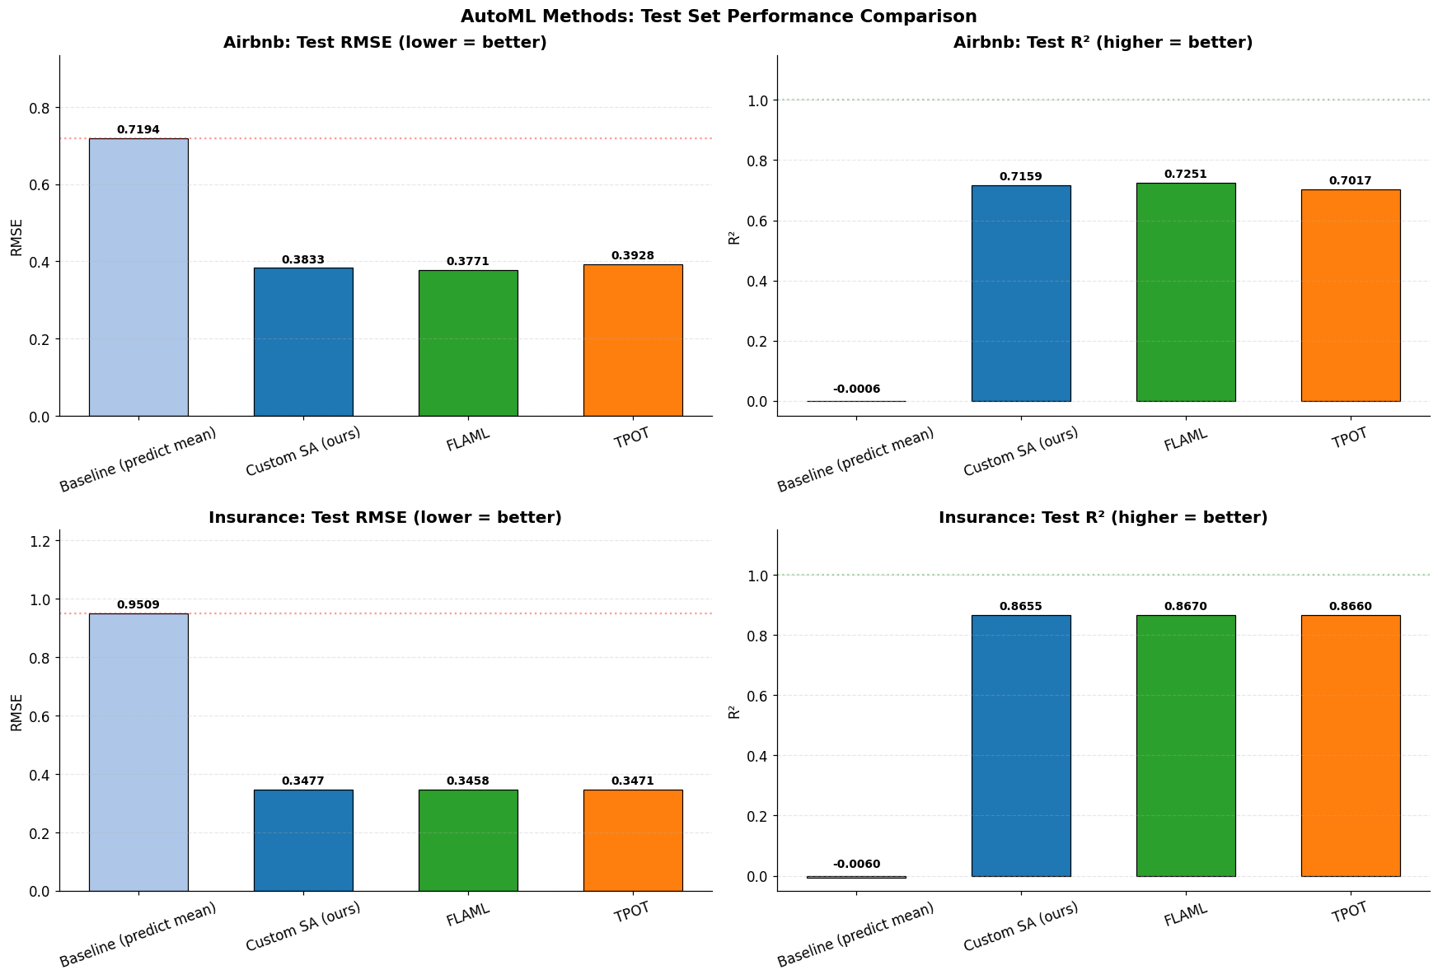
RMSE Comparison
20

Slide 21
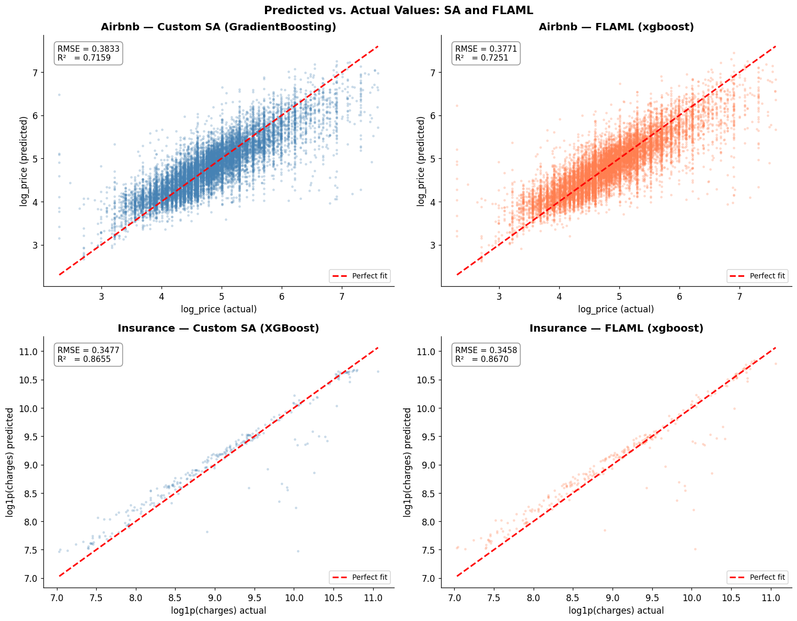
Predicted vs. Actual Values
21

Slide 22
Why Did FLAML Beat SA, and SA Beat TPOT?
FLAML wins (best RMSE)
FLAML uses Cost-Frugal Optimization. It starts by quickly testing cheap models and then spends most of its budget fine-tuning the best one (XGBoost). This smart budget allocation means FLAML evaluates more promising configurations in the same 1 hour. It also has years of engineering behind its search strategy.
SA comes close (within 1-2% of FLAML)
Our custom SA explores the search space by randomly perturbing hyperparameters and occasionally switching algorithms. The reheat mechanism prevents getting stuck. However, SA treats all configurations equally. It doesn't learn which algorithm family is best, so it wastes some iterations on weaker models like KNN or Ridge.
TPOT trails slightly (evolves pipelines, not just models)
TPOT evolves entire pipelines (preprocessing + model), so it searches a much larger space. This is powerful but slower. Genetic programming needs many generations to converge. With only 3-fold CV (vs 5-fold for SA/FLAML) and a huge pipeline space, TPOT couldn't fully optimize in 1 hour. On Insurance, all methods are nearly tied since the dataset is small and easy.
22

Slide 23
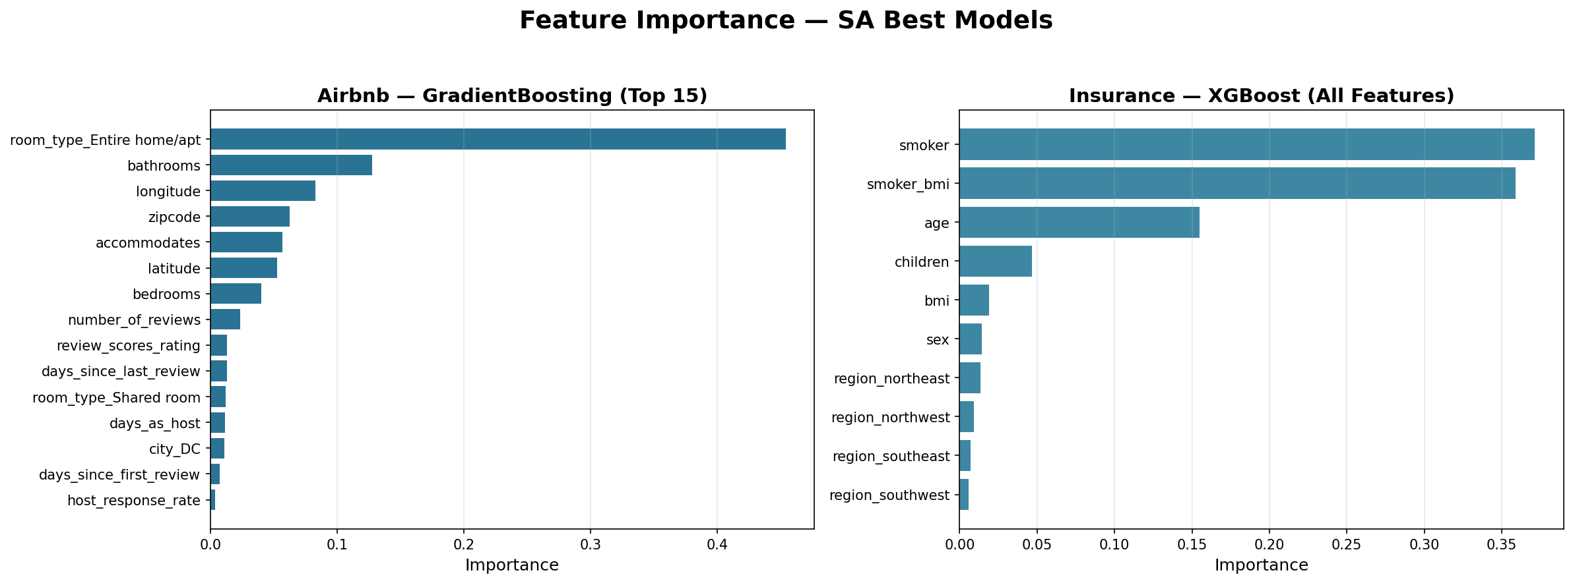
Feature Importance — SA Best Models
23

Slide 24
6. Dataset Contrast
How data characteristics affect AutoML performance

Slide 25
Why Characteristics Matter
 | Airbnb | Insurance
Size | ~74K rows (large) | 1,338 rows (small)
SA iterations in 1 hour | 164 (slow per iter) | 1,944,578 (fast per iter)
Missing data handling | Median imputation needed | None required
Feature space | 71 (high-dim after OHE) | 10 (low-dim, focused)
Best R² (SA) | 0.716 | 0.866
All methods within | ~1.6% RMSE of each other | ~0.5% RMSE of each other
Key insight: On Insurance (small, clean, strong signal), all methods converge to nearly identical performance — the dataset is 'easy' for tree-based models. On Airbnb (large, messy, many features), differences between methods are more pronounced.
26

Slide 26
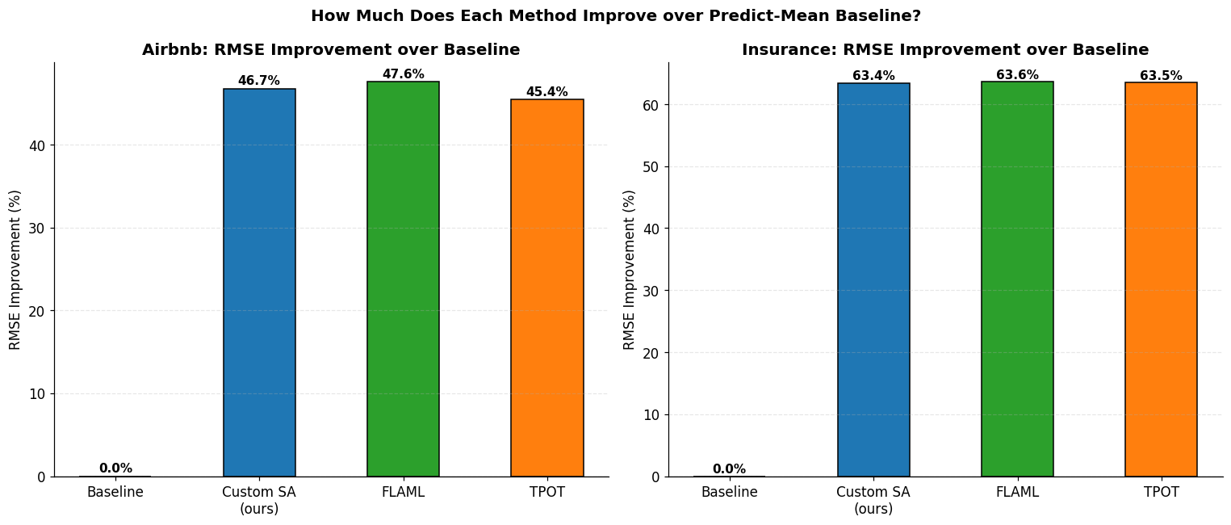
RMSE Improvement over Baseline
27

Slide 27
7. Conclusions & Lessons Learned

Slide 28
Key Takeaways
Custom SA is competitive
Within 1-2% RMSE of FLAML (state-of-the-art). Outperforms TPOT on Airbnb.
XGBoost dominates
Selected as best model by SA, FLAML, and TPOT across both datasets. Gradient boosting is king for tabular data.
Dataset size matters for SA
Airbnb: 164 iters/hour (slow, large dataset). Insurance: 10,150 iters/hour (fast, small dataset). Time-based budgeting adapts automatically.
TPOT adds preprocessing
TPOT's strength is evolving full pipelines (scaling + feature selection + model). SA only tunes model+HP.
Reheat prevents stagnation
SA with reheating used full time budget. Without it, SA stops after ~303 iterations.
29

Slide 29
Thank You
Questions?
Ali Usama
aaliusama@gmail.com
DNDS5019 — Machine Learning (Advanced)

