Slide 1
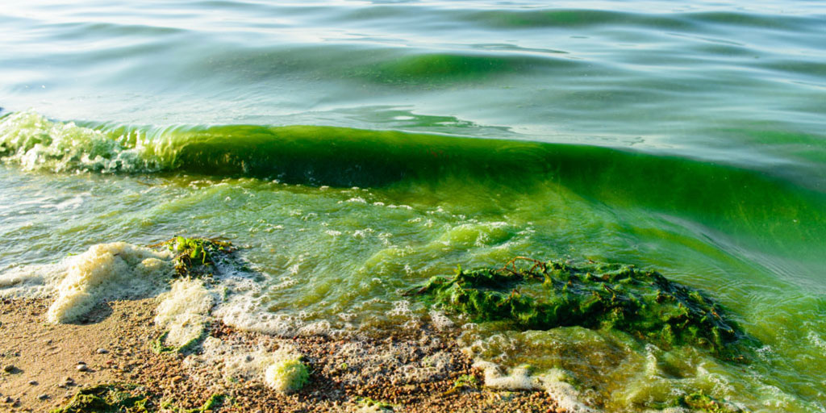
Using a facet grid to visualize the effects of microcystin production on
amoebic grazing
Aaliyah Gutierrez-Cano

Slide 2
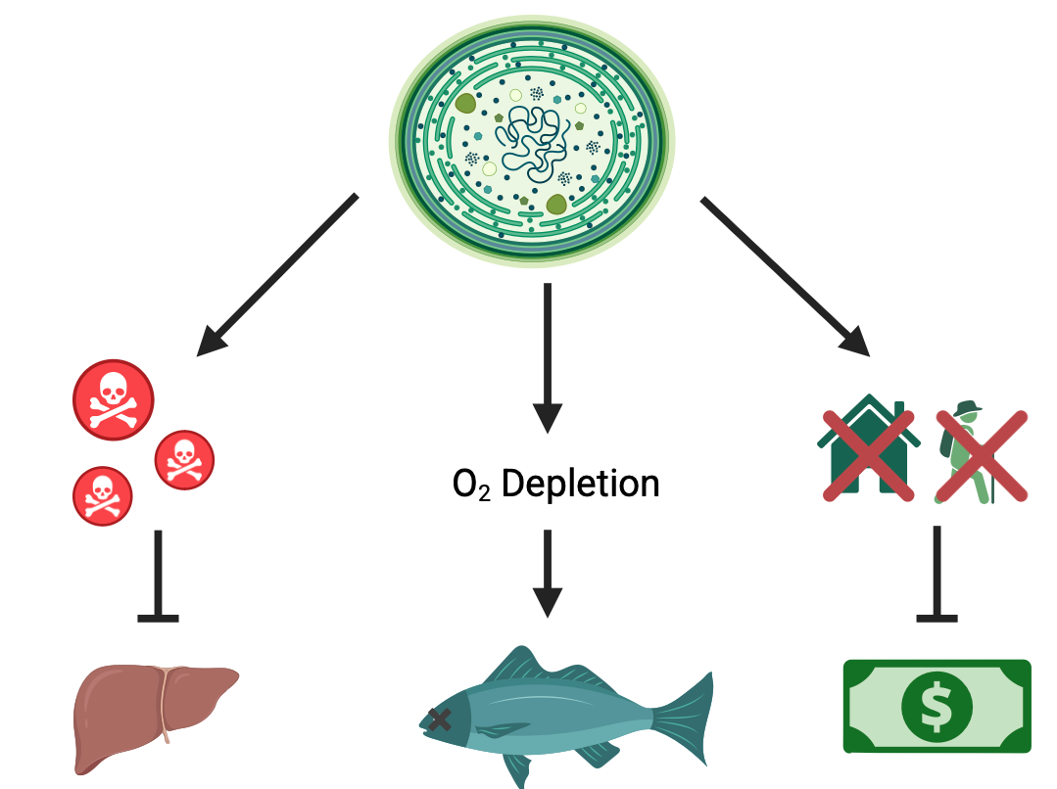
Microcystis Algal Blooms
Notes:
“Cyanobacterial blooms are a common phenomenon in lentic
freshwater bodies all over the world. Due to their widespread
toxicity, high biomass build-up and negative impacts on aquatic
food webs and human use of freshwaters (Codd et al., 2005),
bloom-forming cyanobacteria are generally considered as pest
species (Chorus and Bartram, 1999). As these organisms are
favored by hypertrophic conditions and high temperatures, the
frequency of bloom formation is expected to further increase due
to cultural eutrophication and climate change (Jo ̈hnk et al., 2008;
Paerl and Huisman, 2008; Kosten et al., 2012).” (Wichelen et al. 2016)

Slide 3
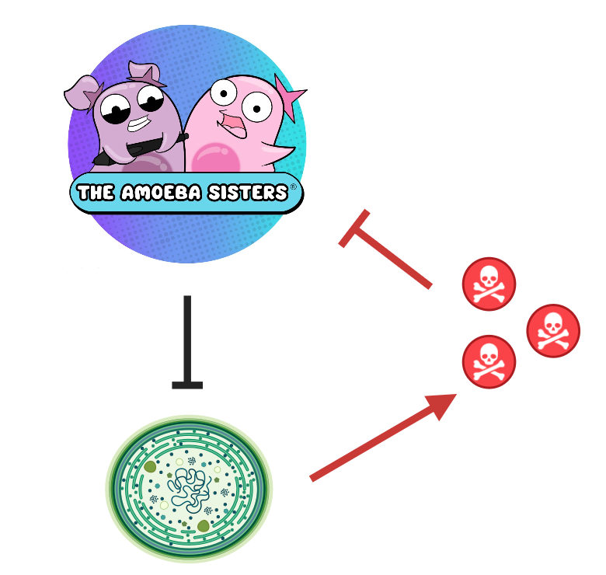
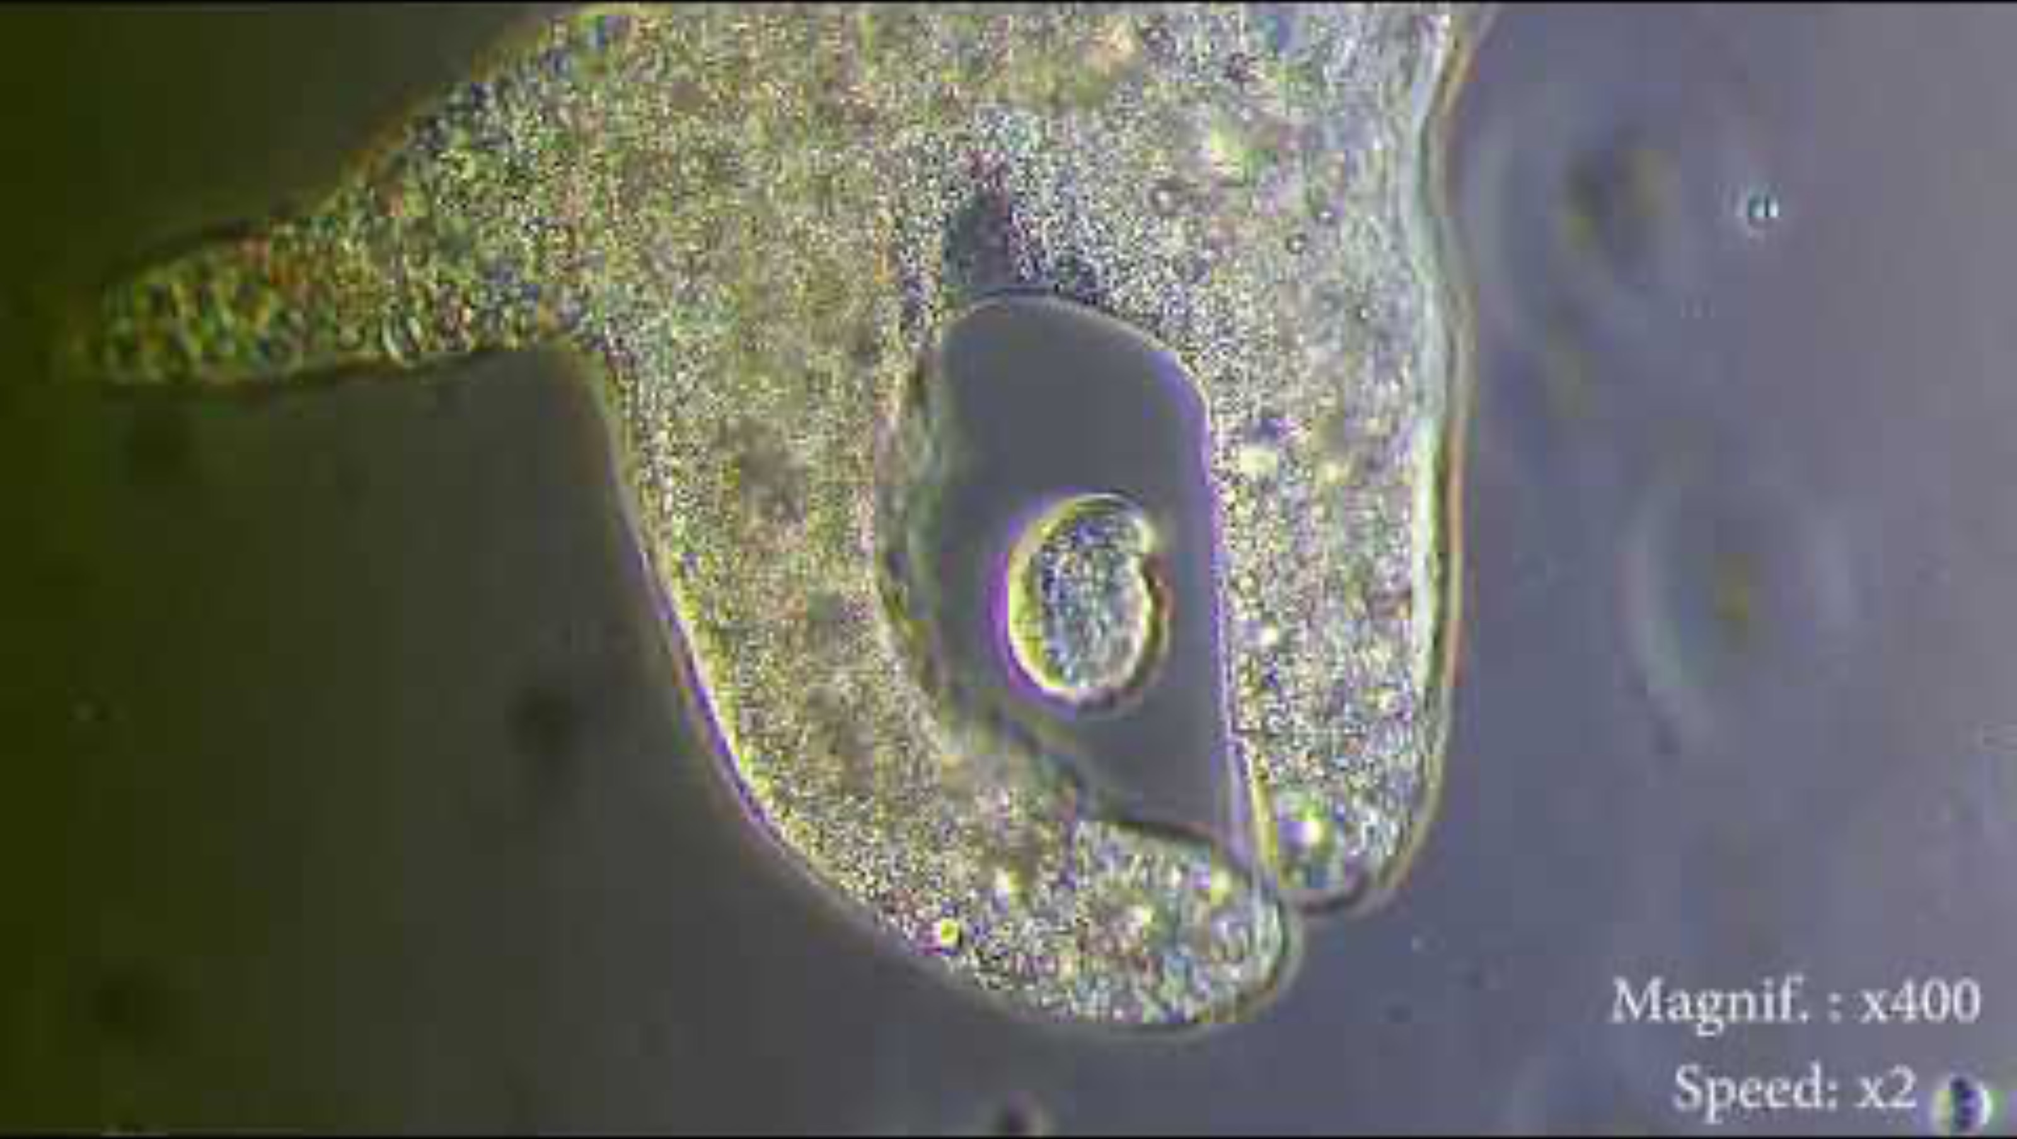
Amoebic Grazing
Notes:
Free-living planktonic amoebae, mainly associated with sus-
pended mineral particles or detritus (Caron et al., 1982; Rogerson
et al., 2003), use colonies of planktonic cyanobacteria as an
appropriate habitat (Whitton, 1973; Anderson, 1977; Rodrı ́guez-
Zaragoza, 1994) where they can feed on associated micro-
organisms or on the cyanobacteria themselves (Dryden and
Wright, 1987). Whitton (1973) was the first to report the existence
of Microcystis-grazing amoebae (MGA) but until recently, only a
few other amoeboid organisms ingesting Microcystis in natural
samples were observed (Suppl. Table 6). The lack of observations
suggests that Microcystis is not a favorable food item for many
planktonic amoebae. This is indeed the case for the percolozoan
Naegleria sp. and the amoebozoan Acanthamoeba castellanii which
egested grazed Microcystis cells immediately upon ingestion (Liu
et al., 2006; Urrutia-Cordero et al., 2013). The presence of toxic
secondary metabolites in the ingested Microcystis cells may be the
culprit, since these can cause alterations in the cytoskeleton
structure leading to irreversible cell damage of the amoebae
(Urrutia-Cordero et al., 2013). The recent description of 8 new MGA
of which some displayed strong bloom-reducing capacities,
irrespective of the presence of microcystins, however indicates
that their biodiversity and ecological significance are much higher
than previously appreciated (Van Wichelen et al., 2010, 2016;
Berney et al., 2015).
(Wichelen et al. 2016)

Slide 4
Does microcystin production impact amoebic grazing?

Slide 5

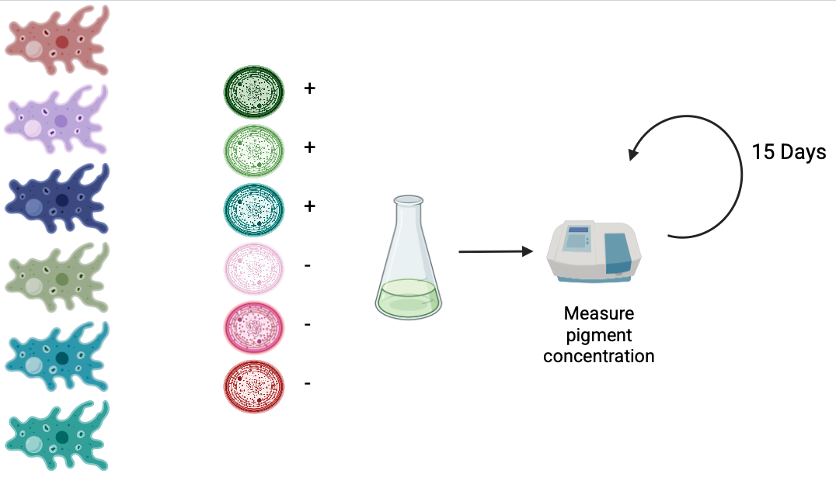
Data Collection
Amoeba
MC

Slide 6
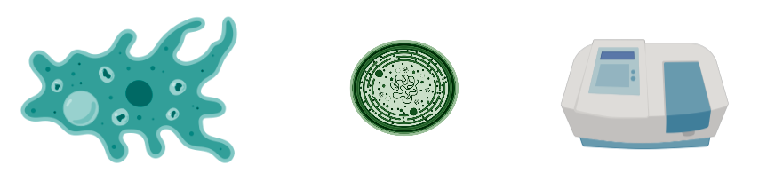
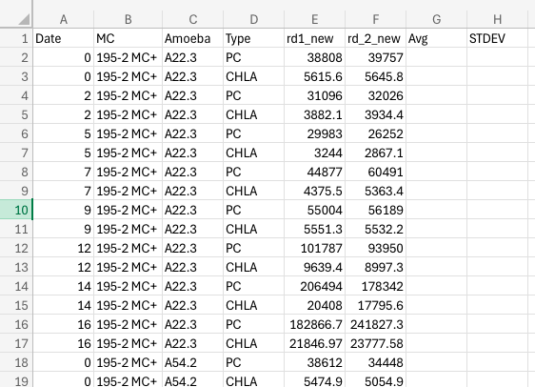
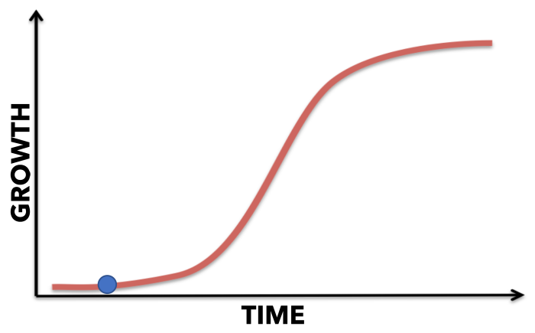
Data Collection
Beach
?

Slide 7

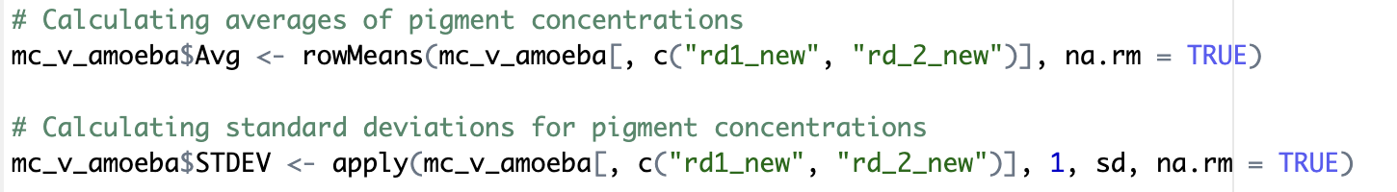
Data Analysis
Beach
Loading libraries and reading csv file
Summary Data

Slide 8
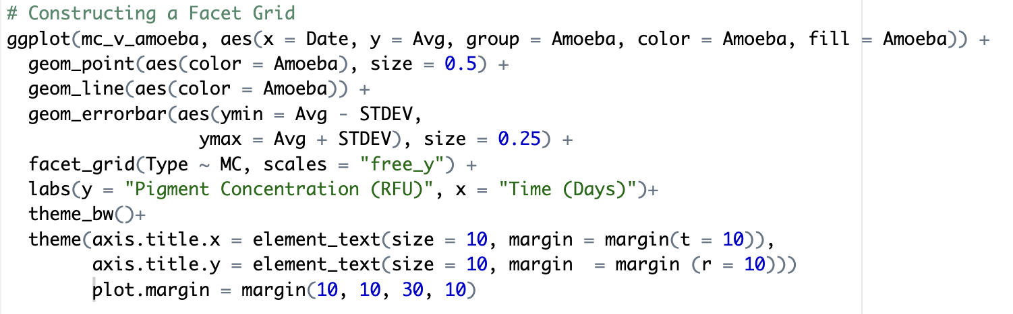
Generating a Figure
To sum up
Pigment Concentration
Date
Amoeba 1
Amoeba 2

Slide 9
Generating a Figure
To sum up
Pigment Concentration
Pigment Concentration
Chl-a
(Pigment type 1)
Pigment Concentration
Pigment Concentration
PC
(Pigment type 2)
Date
Date
Amoeba 1
Amoeba 2

Slide 10
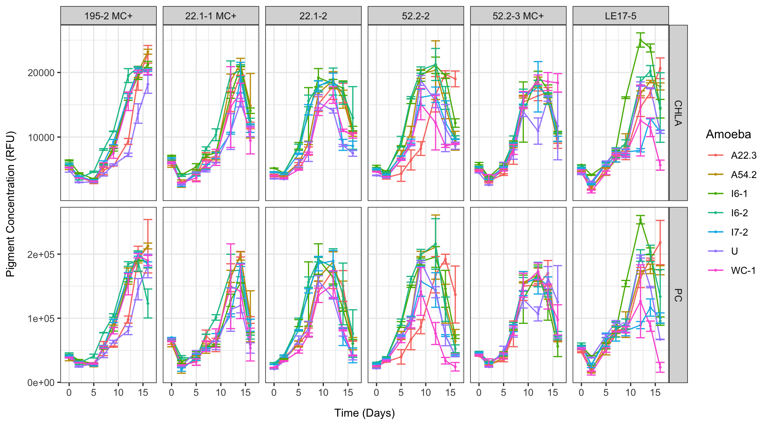
No Amoeba
More Growth
Less Growth

Slide 11
Discussion
Overall…
Very cluttered
Comparison to control?
Further Analysis Needed
Notes:
“Cyanobacterial blooms are a common phenomenon in lentic
freshwater bodies all over the world. Due to their widespread
toxicity, high biomass build-up and negative impacts on aquatic
food webs and human use of freshwaters (Codd et al., 2005),
bloom-forming cyanobacteria are generally considered as pest
species (Chorus and Bartram, 1999). As these organisms are
favored by hypertrophic conditions and high temperatures, the
frequency of bloom formation is expected to further increase due
to cultural eutrophication and climate change (Jo ̈hnk et al., 2008;
Paerl and Huisman, 2008; Kosten et al., 2012).” (Wichelen et al. 2016)

Slide 12
Bibliography
Lai J, Cui D, Zhu W, Mao L. 2023. The Use of R and R Packages in Biodiversity Conservation Research. Diversity 15(12): 1202.
Mou H, Liu L, Xu Y. 2023. Panel Data Visualization in R (panelView) and Stata (panelview). J Stat Software 107(7).
Nishibe Y, Manage PM, Kawabata Z, Nakano S. 2004. Trophic coupling of a testate amoeba and Microcystis species in a
hypertrophic pond. Limnology 5: 71-76.
Van Wichelen J, Van Gremberghe I, Vanormelingen P, Debeer AE, Leporcq B, Menzel D, Codd GA, Descy JP, Vyverman W. 2010. Strong effects of amoebae grazing on the biomass and genetic structure of a Microcystis bloom (Cyanobacteria). Environ Microbiol 12(10): 2797–2813.
Van Wichelen J, D’Hondt S, Claeys M, Vyverman W, Berney C, Bass D, Vanormelingen P. 2016. A Hotspot of Amoebae Diversity: 8 New Naked Amoebae Associated with the Planktonic Bloom-forming Cyanobacterium Microcystis. Acta Protozool 55(2): 61-87+ap1.
Xinyao L, Miao S, Yonghong L, Yin G, Zhongkai Z, Donghui W, Weizhong W, Chencai A. 2006. Feeding Characteristics of an Amoeba (Lobosea: Naegleria) Grazing upon Cyanobacteria: Food Selection, Ingestion and Digestion Progress. Microb Ecol 51(3): 315 – 325.

Slide 13
QUESTIONS?

