Slide 1

Art of Communication
Creative Writing and Public Speaking
Level 5 Session 6
Notes:
Note for Teachers:
Stay on this slide until the student joins the class.
Teacher will tell the student that there is an assessment form that you have to fill before leaving the class. The questions will be from the lesson taught today.

Slide 2

Docket
30 secs
Post-class Assignment
Policy Debate: Class
Student Template
Notes:
Time: 30 secs

Slide 3






Unlock Concept:
Policy Debate
30 secs
Building strong arguments
Scripting and delivering techniques
Policy Debate
Structure of a Debate
Building a strong opposition
Lincoln- Douglas
Debate
Notes:
Time: 30 secs
Teacher-
Today you will unlock the concept of.. Policy debate.
No explanation required.

Slide 4
Word of the day
3 mins
Word: Presumption
Meaning: the act of believing that something is true without having any proof
Part of speech: Noun
Usage: The decision is based on the presumption that all information must be freely available.
©
©
Notes:
Time: 3 mins
Interaction: student individually
Teacher:
Write this word in your online dictionary.
Make a sentence in the chat.
Try to use this word in your lesson when you write.
You can also think of one new word and come to class next time.
If your word is interesting and creative, you will get 2 coins.

Slide 5
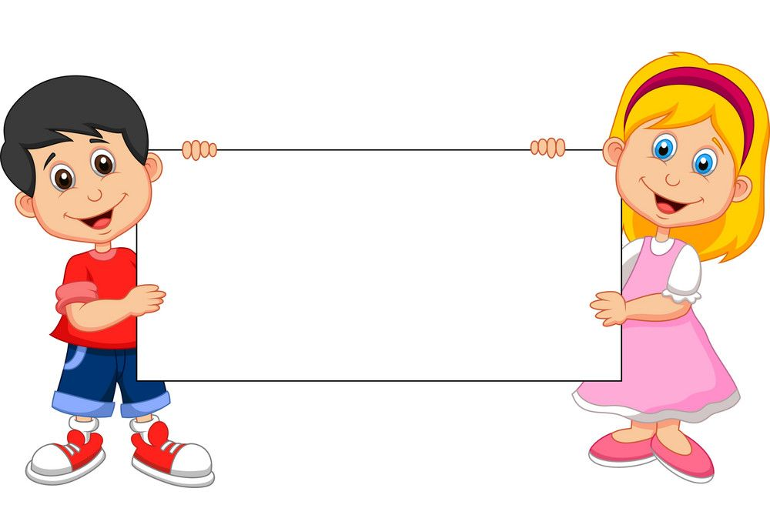
Start Ritual:
Recap Trivia!
2 mins
Link: https://wordwall.net/play/34890/815/618
©
Notes:
https://wordwall.net/play/34890/815/618
Time: 2 mins
Pace: Energetic
Interaction: S-T and T-S
Teacher:
Let us check your understanding with an activity. This is a recap of the previous sessions.
You learned about these terms in the previous sessions. Let's see how much do you remember.
Teacher shares the link with the student.
Let the student the screen before starting the activity.
You have to use the arrow keys and move the airplane to the correct answer.
All these terms will be used in our today’s session.
You will get 20 coins if you give all correct answers.
Answer for teacher’s reference:
Resolution: A statement of fact, value, or policy that will be debated. Also known as the topic of debate.
Affirmative Team: The team which argues for the topic.
Negative Team: The team arguing against the topic.
Rebuttal Speech: The second set of speeches in which both sides focus on comparing and contrasting arguments already presented in the debate round.

Slide 6
Activity
You are your school’s prefect and you are responsible to maintain the discipline of the students.
You saw two students fighting during the recess. Being fair is very important as a prefect, you have to make some decisions to maintain the discipline of the school.
What policies you will make to maintain the discipline of your school?
3 mins
©
Notes:
ORAL DISCUSSION!
Time: 3 mins
Pace: Steady
Interaction: S-T and T-S
Teacher:
Teacher reads the situation and takes a response from the student.

Slide 7
What is a policy debate?
1 min
It is a debate where an affirmative team proposes a plan and the negative team argues why that plan should not be adopted.
It is also referred to as a cross-examination debate.
These debates put an emphasis upon logical consistency, factual accuracy, and emotional appeal to an audience.
©
Notes:
Time: 1 min
Pace: Steady
Teacher:
Let us learn about policy debate.
Let the student read the points and explain.
Let us understand this type of debate with an example.

Slide 8
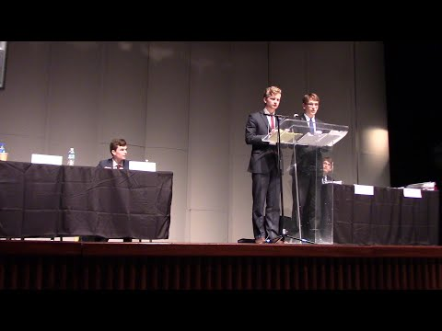
Test your understanding!
3 mins
Watch the video, and answer the following questions:
What is the topic of discussion in the video?
Do you think this is an important topic for discussion? Give reason for your answer.
Do we need any policies to be implemented for this issue?
©
Notes:
Link: https://www.youtube.com/watch?v=TvhNvumnZ1U Time Stamp- 0:22 - 1:18
Time: 3 mins
Pace: Steady
Teacher:
Teacher plays the video.
Let the student observe the video carefully and answer the following questions.
Q. What is the topic of discussion in the video?
Ans: People not wearing seat belts.
Q. Do you think this is an important topic for discussion? Give reason for your answer.
Ans: Answer may vary from student to student.
Q. Do we need any policies to be implemented for this topic?
Ans: Answer may vary from student to student.

Slide 9
Elements of a policy
debate
1 min
A policy debate is made up of 3 different components. They are:
Constructive Speeches: It is used to construct the case in a debate.
Cross-Examination: Here you clarify your doubts by asking questions.
Rebuttal Speeches: When you try to prove your opponent’s argument wrong.
©
Notes:
Time: 1 min
Pace: Steady
Teacher:
Ask the student to read the points and then tell the student you already learned about cross examination and rebuttal speeches in the previous sessions. Today, we will learn about the other two new concepts.

Slide 10
Format of a Policy debate
1 min
Affirmative Constructive Speeches
Cross-Examination
Negative Constructive Speeches
Cross Examination
Rebuttal Speeches
  Affirmative
  Negative
©
Notes:
Time: 1 min
Pace: Steady
Teacher:
Now let us understand the format of a policy debate.
Just like each debate has its format, policy debate has 5 steps.
Let the student read the points and explain. Tell the student you know what is a rebuttal, and cross examination.
Policy debate starts with a constructive speech. They are of two types. You will learn about both the types today.
Cross examination is done to get more clarity on the speech of the affirmative/ negative side. It is done by asking clarification questions.
Rebuttal is evidence or arguments introduced to counter, disprove, or contradict the opposing party's evidence or argument,
Preparation time, also called “prep” or “prep time” is given to each team at the start of each debate round. This time can be used over the course of a debate round to prepare for speeches.
Let us understand each step in detail with examples.

Slide 11
What is a constructive speech?
2 mins
The first speeches in a debate, where the debaters “construct” their cases by presenting initial positions and arguments.
Affirmative
This team AFFIRMS the Resolution.
*BURDEN OF PROOF*
In order to affirm the Resolution, the Affirmative team will present a plan explaining how they propose to do what the Resolution calls for. This is called the Affirmative Case.
Negative
This team NEGATES the Resolution.
*BURDEN OF REFUTATION*
In order to negate the Resolution, the Negative team will present reasons why the Affirmative plan will not work and disadvantages to the proposal.
©
Notes:
Time: 2 mins
Pace: steady
Teacher:
Constructive speech is the first step of policy debate.
There are two types of constructive speeches- Affirmative, and Negative.
Let us see what is a constructive speech. Let the student read and then explain.

Slide 12

Example of constructive Speech
Topic: Unemployment in the world
Policy: All people should have universal basic income.
3 mins
Affirmative case!
Your turn to cross examine the affirmative case. Can you do it?
©
Notes:
Time: 3 mins
Pace: Steady
Interaction: S-T and T-S
Teacher:
Here is an example of affirmative constructive speech.
The topic of discussion is, “All people should have universal basic income.”
Let the student read the example. After reading the example, ask the student to cross examine the affirmative case.
Cross examination is done by asking clarification questions to get more information about the topic/ argument.

Slide 13
Activity
Refute the policy!
3 mins
Topic: Unemployment in the world
Think of a policy that you would like to implement?
©
Notes:
ORAL DISCUSSION!
Time: 3 mins
Pace: steady
Teacher:
You just heard the affirmative case. She implemented a policy of Universal basic income to reduce unemployment rate.
ASK: What policy you would like to implement for this problem?
Elicit response from the student.

Slide 14
Activity
Thought bubble!
2 mins
Topic: Students spend too much time on social media, think of a policy that could help.
©
Notes:
Time: 2 mins
Pace: steady
Teacher:
Tell the students this is your topic for today’s debate.
Give a minute to the student think of a policy on the given topic.
Let the student think about the topic and come up with a policy/ solution.
Elicit response from the student, help the student if he/she can’t think of something.
Give points like, limit the use of mobile phones, create a social media schedule , screen time measuring apps can be used, etc.

Slide 15
Student Template
Write your Affirmative case!
5 mins
Topic: Students spend too much time on social media, think of a policy that could help.
Write 2 points to support your side.
©
Notes:
Time: 5 mins
Pace: Detailed
Interaction: S independently
Teacher:
Open your student template.
You already know the topic, think of two points to support your side.
You have 5 mins to write two points.

Slide 16
Activity
Cross Examinia Role-play!
20 secs
Let’s play Cross-Examinia Role-Play.
Teacher reads an argument. You have to cross- examine to get more clarity on the argument.
You will get 2 mins to cross examine.
©
Notes:
Time: 20 secs
Pace: Steady
Interaction: S-T and T-S
Teacher:
Now here is the time for an activity.
Let us play cross examination role play.
Teacher reads out the rules for the student. The rules are given on the slide.
Teacher tells the student that he/she will read an argument. Student has to listen to the argument very carefully and then has to cross examine the teacher based on the argument.
FOR TEACHER: This is just a cross-examination activity. The teacher doesn't have to clarify the question asked by the student. This activity is just to test the student’s cross examination skills.

Slide 17
Cross Examinia Role-play!
Activity
3 mins
Research has shown that over 95% of students have access to mobile device that connects to the internet. In the digital age, social media has become an important tool in the life of a student. The lockdown phase during Covid 19 has witnessed the closure of various educational institutes, leaving social media the only place for students to interact. This has led students to depend on social media more, and they have stopped interacting with each other face-to-face. I would like to implement a policy for the students where schools give students group projects so that they start interacting with each other more and use social media less to interact. This will help the dependency on social media.
©
Notes:
Time: 3 mins
Pace: steady
Teacher:
Teacher reads out the slide and then let the student cross examine based on the argument made by the teacher.
FOR TEACHER: This is just a cross-examination activity. The teacher doesn't have to clarify the question asked by the student. This activity is just to test the student’s cross examination skills.

Slide 18
Activity
Example: Negative case Study!
Topic: Unemployment in the world
Policy: By creating more job opportunities
3 mins
Universal Basic Income (UBI) removes the incentive to work, adversely affecting the economy and leading to a labor and skills shortage. Earned income motivates people to work, be successful, work cooperatively with colleagues, and gain skills. However, “if we pay people, unconditionally, to do nothing, they will do nothing”, and this leads to a less effective economy. I agree with the rising population we need to think about employment in the world and for that, I would like to implement a policy where we get to create more job opportunities for people. No work is big or small, people should get a job based on their skills and need, and they should get paid for the work and not just sit and wait for the money.
Reason why the policy suggested by the opponent should not be implemented
New policy by the debater
Can you cross-examine the opponent?
©
Notes:
Time: 3 mins
Teacher:
Let us now watch a negative case study.
Tell the student this is your opponent’s point of view.
Play the video and ask the student to observe it carefully.
Once the video is over, let the student cross examine the opponent by asking a question.
For teacher: This cross examination is just for the student to understand how they can actually cross examine their opponents. Let the student just come up with a question to ask the opponent.

Slide 19
20 secs
Let us now move to the third step, the rebuttal. You already know what is rebuttal, let us have a look at an example of rebuttal.
©
Notes:
Time: 20 secs
Teacher:
Teacher reads the slide and moves to the next slide.

Slide 20
Example of rebuttal
Topic: All people should have universal basic income.
1 min
Rebuttal (Affirmative side) | The first and foremost reason for poverty is that people don’t have good job opportunities. Identifying a skill in a person can take a lot of time and until identifying the skill the person can die of hunger if not paid. A man with a family would not be able to take care of the family if not given a universal basic income. It would not improve the problem of poverty but rather will lead to greater poverty.
©
Notes:
Slide 22+23 together can take 3 mins
Time: 1 min
Pace: Steady
Teacher:
Let the student read the example and then explain.

Slide 21
Example of rebuttal
Topic: All people should have universal basic income.
1 min
Rebuttal (Negative side) | I agree with the point that universal basic income reduces poverty but I do not agree with the point raised by my opponent that it improves physical and mental health. It would devalue work as such and reward sloth. People would not bother to work because they know they’ll get the basic income for their survival, free money makes people lazy and affects their physical and mental health in many ways.
©
Notes:
Slide 22+23 together can take 3 mins
Time: 1 min
Pace: Steady
Teacher:
Rebuttal is also done by both the teams. It is basically when you try to prove the other team wrong.
Let the student read the example and then explain.

Slide 22
Activity
3 mins
Your Turn: Negative case Study!
Watch the video and write down the points for your rebuttal.
©
Notes:
Time: 3 mins
Teacher:
Let us now watch a negative case study.
Tell the student this is your opponent’s point of view.
Play the video and ask the student to observe it carefully.
Once the video is over, let the student write their rebuttal script.

Slide 23
Student Template
Write your rebuttal script!
5 mins
Topic: Students spend too much time on social media, think of a policy that could help.
You just saw your opponent’s view, now write a rebuttal script for the same.
©
Notes:
Time: 5 mins
Pace: Detailed
Interaction: S independently
Teacher:
Open your student template.
You have to write a rebuttal script based on the video that you watched of your opponent’s negative speech.
Write your rebuttal speech and try to prove your opponent wrong.

Slide 24
20 secs
Your script is ready but how you deliver it is equally important in a debate. Let us look at some speech techniques required for a policy debate.
©
Notes:
Time: 20 secs
Teacher:
Teacher reads the slide and moves to the next slide.

Slide 25
Techniques and tips required for a policy debate
2 mins
Look at the judge, never your opponent.
Stay professional and calm.
Don’t make arguments in Cross examination, just ask questions.
Don’t be afraid to ask about anything you don’t understand.
Stress on the important words.
©
Notes:
Time: 2 mins
Pace: Steady
Teacher:
You are going to present your speech today.
Here are some tips for you before presenting your speech.

Slide 26
Presentation
4 mins
Deliver your script!
©
Notes:
Time: 4 mins
Teacher:
You have already prepared your script for the debate, now you have to present your script using the delivery technique that you learned today.
You will be getting 30 coins if you present yourself beautifully.
Teacher will give a feedback based on the following criteria-
Look at the judges (into the camera)
Stay calm and professional.
Stress on the important words.

Slide 27
Homework!
1 min
Think of a policy for the topic given to you.
Use the concept of claim, warrant, and impact to support your argument.
TOPIC: By cutting trees for making industries and roads, we are cutting down our oxygen supply. Think of a policy that could help.
Do some research before writing your argument.
©

Slide 28
Recap
3 mins
What is a Debate?
Di
Policy Debate
Format of a policy Debate
Mercury
Exit Ticket: https://forms.gle/63Dt9a335JErfTDE7
Writing a Script for policy Debate
Notes:
Time: 3 mins
It is mandatory for both students and teachers to fill the exit slip.
EXIT SLIP for students.
Link: https://forms.gle/63Dt9a335JErfTDE7
Share the link with students and ask them to fill it in class before they leave.
EXIT SLIP for teachers:
While the students are filling their exit slips, teachers will fill the one given below.
Link: https://forms.gle/sGd9o4KYu7t7oi9p6

