Slide 1
PHP and CSV,Zip,cURL
Lecture-10-11-12
By: Ashiqullah Alizai
Herat University
Computer Science Faculty
Alizai.csf@hotmail.com

Slide 2
What is CSV
A CSV is a comma separated values file, which allows data to be saved in a table structured format.
CSVs look like a garden-variety spreadsheet but with a .csv extension (Traditionally they take the form of a text file containing information separated by commas, hence the name).
CSV files can be used with any spreadsheet program, such as Microsoft Excel, Open Office Calc, or Google Spreadsheets.
They differ from other spreadsheet file types in that you can only have a single sheet in a file,
they can not save cell, column, or row styling, and can not save formulas.

Slide 3
What is CSV con..
A comma-separated values (CSV) file stores tabular data (numbers and text) in plain-text form.
A CSV file consists of any number of records , separated by line breaks of some kind;
each record consists of fields, separated by some other character or string, most commonly a literal comma or tab.
Usually, all records have an identical sequence of fields.

Slide 4
The usage of CSV Files
CSV files are used to add or change information in lots of places in an application:
Exporting and importing data to and from a database
Example E-Commerce
Products
  Adding new products
  Editing existing products
Customers
  Adding new customers
  Editing existing customers
Stock Management

Slide 5
PHP functions for CSV
The fgetcsv() function parses a line from an open file, checking for CSV fields.
The fgetcsv() function stops returning on a new line, at the specified length, or at EOF, whichever comes first.
This function returns the CSV fields in an array on success, or FALSE on failure and EOF.
Syntax
fgetcsv(file,length,separator,enclosure)
Parameter | Description
File | Required. Specifies the file to check
Length | Optional. Specifies the maximum length of a line. Must be greater than the longest line (in characters) in the CSV file. Omitting this parameter (or setting it to 0) the line length is not limited, which is slightly slower. Note: This parameter is required in versions prior to PHP 5
separator | Optional. A character that specifies the field separator. Default is comma ( , )
enclosure | Optional. A character that specifies the field enclosure character. Default is "

Slide 6
Fputcsv()
This function is for putting data to a CSV file, It take two parameter file handler and fields to be inserted in that file.
fputcsv($fp, $fields);

Slide 7
Example
<?php
$file = fopen("contacts.csv","r");
print_r(fgetcsv($file));
fclose($file);
?>
The CSV file:
Ahmad Ali, Marjan , Student, Bamyan
Sharafudin , Ashraf, Student, Herat
The output of the code above will be:
Array
(
[0] => Ahmad Ali
[1] => Marjan
[2] => Student
[3] => Bamyan )

Slide 8
Example-2 saving to Database
<?php
function readCSV($csvFile){
$file_handle = fopen($csvFile, 'r');
while (!feof($file_handle) ) {
$line_of_text[] =
fgetcsv($file_handle, 1024);
}
fclose($file_handle);
return $line_of_text;
}
// Set path to CSV file
$csvFile = 'test_data.csv';
//calling the function
$csv = readCSV($csvFile);
if(!empty($csv)){
foreach($csv as $file){
//inserting into database
$query_insert = "insert into csv_data_upload set
name = '".$file[0]."',
Lname = '".$file[1]."'";
Ocapation = '".$file[2]."'";
province='".$file[3]."'";
echo $query_insert;
$insert = mysql_query($query_insert);
}
}else{
echo 'Csv is empty';
}
?>

Slide 9
Example-3 Writing to CSV
<?php
$list = array (
array('aaa', 'bbb', 'ccc', 'dddd'),
array('123', '456', '789'),
array('"aaa"', '"bbb"')
);
$fp = fopen('file.csv', 'w');
foreach ($list as $fields) {
fputcsv($fp, $fields);
}
fclose($fp);
?>

Slide 10
Writing from database to downloadble CSV
$conn = mysqli_connect("localhost","root","”, “forum”);
if (!$conn) {die("connection has been not esablished");}
$table = ”posts"; // Enter Your Table Name
// output headers so that the file is downloaded rather than displayed
  header('Content-Type: text/csv; charset=utf-8');
  header('Content-Disposition: attachment; filename=data.csv');
// create a file pointer connected to the output stream
$output = fopen('php://output', 'w');
// output the column headings
$sql = mysqli_query("select * from $table");

Slide 11
Writing from database to downloadble CSV
// Get The Field Name
$data= mysqli_fetch_fields($sql);
foreach ($data as $da) {
$headings[]= $da->name; }
// put the heading to CSV
fputcsv($output, $headings);
// fetch the data
// Putting the values to the CSV file
while ($row = mysqli_fetch_assoc($sql))
fputcsv($output, $row);

Slide 12
PHP And Zip Files

Slide 13
PHP and Zip
Zip files (.zip and .zipx) have been referred to as compressed folders, packages, containers, and archives.
Zip files are the most common type of archive files that also compress data.
Zip files were originally created for use with computers running DOS and then Windows operating systems.
Today Zip files are also commonly used on other operating systems, such as the Mac and Unix operating systems.
the files archived in a Zip file are usually, but not always, compressed.
This saves space and also makes it easier to send them as email attachments.
Zip files are also convenient for grouping data files.

Slide 14
Creating Zip Files
Creating .ZIP archives using PHP can be just as simple as creating them on your desktop.
PHP's ZIP class provides all the functionality you need!

Slide 15
Example
<?php
$zip = new ZipArchive();
$filename = "./test112.zip";
if ($zip->open($filename, ZipArchive::CREATE)!==TRUE) {
exit("cannot open <$filename>\n");
}
// add string to testfilephp.text
$zip->addFromString("testfilephp.txt" . time(), “-#1 This is a test string added as testfilephp.txt.\n");
// add second file
$zip->addFromString("testfilephp2.txt" . time(), “-#2 This is a test string added as testfilephp2.txt.\n");
$zip->addFile( "/too.php","/testfromfile.php");
echo "numfiles: " . $zip->numFiles . "\n";
echo "status:" . $zip->status . "\n";
$zip->close();
?>

Slide 16
Example #2 Dump the archive details and listing
<?php
$za = new ZipArchive();
$za->open('test112.zip');
print_r($za);
var_dump($za);
echo "numFiles: " . $za->numFiles . "<br />";
echo "status: " . $za->status . "<br />";
echo "statusSys: " . $za->statusSys . "<br />";
echo "filename: " . $za->filename . "<br />";
echo "comment: " . $za->comment . "<br />";
for ($i=0; $i<$za->numFiles;$i++) {
echo "index: $i<br/>";
print_r($za->statIndex($i)); echo"<br/>";}
echo "numFile:" . $za->numFiles . "<br />";
?>

Slide 17
Extracting Zip to a directory
<?php
$zip = new ZipArchive;
$zip->open('teste.zip');
$zip->extractTo('./');
$zip->close();
echo "Ok!";
?>

Slide 18
Zip functions
zip_close | Close a ZIP file archive
zip_entry_close | Close a directory entry
zip_entry_compressedsize | Retrieve the compressed size of a directory entry
zip_entry_compressionmethod | Retrieve the compression method of a directory entry
zip_entry_filesize | Retrieve the actual file size of a directory entry
zip_entry_name | Retrieve the name of a directory entry
zip_entry_open | Open a directory entry for reading
zip_entry_read | Read from an open directory entry
zip_open | Open a ZIP file archive
zip_read | Read next entry in a ZIP file archive

Slide 19
Zip Class
ZipArchive::addEmptyDir | Add a new directory
ZipArchive::addFile | Adds a file to a ZIP archive from the given path
ZipArchive::addFromString | Add a file to a ZIP archive using its contents
ZipArchive::addGlob | Add files from a directory by glob pattern
ZipArchive::addPattern | Add files from a directory by PCRE pattern
ZipArchive::close | Close the active archive (opened or newly created)
ZipArchive::deleteIndex | delete an entry in the archive using its index
ZipArchive::deleteName | delete an entry in the archive using its name
ZipArchive::extractTo | Extract the archive contents
ZipArchive::getArchiveComment | Returns the Zip archive comment
ZipArchive::getCommentIndex | Returns the comment of an entry using the entry index
ZipArchive::getCommentName | Returns the comment of an entry using the entry name
ZipArchive::getExternalAttributesIndex | Retrieve the external attributes of an entry defined by its index
ZipArchive::getExternalAttributesName | Retrieve the external attributes of an entry defined by its name
ZipArchive::getFromIndex | Returns the entry contents using its index
ZipArchive::getFromName | Returns the entry contents using its name
ZipArchive::getNameIndex | Returns the name of an entry using its index

Slide 20
Zip Functions
ZipArchive::getStatusString | Returns the status error message, system and/or zip messages
ZipArchive::getStream | Get a file handler to the entry defined by its name (read only).
ZipArchive::locateName | Returns the index of the entry in the archive
ZipArchive::open | Open a ZIP file archive
ZipArchive::renameIndex | Renames an entry defined by its index
ZipArchive::renameName | Renames an entry defined by its name
ZipArchive::setArchiveComment | Set the comment of a ZIP archive
ZipArchive::setCommentIndex | Set the comment of an entry defined by its index
ZipArchive::setCommentName | Set the comment of an entry defined by its name
ZipArchive::setCompressionIndex | Set the compression method of an entry defined by its index
ZipArchive::setCompressionName | Set the compression method of an entry defined by its name
ZipArchive::setExternalAttributesIndex | Set the external attributes of an entry defined by its index
ZipArchive::setExternalAttributesName | Set the external attributes of an entry defined by its name
ZipArchive::setPassword | Set the password for the active archive
ZipArchive::statIndex | Get the details of an entry defined by its index.
ZipArchive::statName | Get the details of an entry defined by its name.
ZipArchive::unchangeAll | Undo all changes done in the archive
ZipArchive::unchangeArchive | Revert all global changes done in the archive.
ZipArchive::unchangeIndex | Revert all changes done to an entry at the given index
ZipArchive::unchangeName | Revert all changes done to an entry with the given name.

Slide 21
PHP And cURL

Slide 22
What is CURL?
cURL is the name of the project. The name is a play on 'Client for URLs', originally with URL spelled in uppercase to make it obvious it deals with URLs. The fact it can also be pronounced 'see URL' also helped, it works as an abbreviation for "Client URL Request Library”.
According to Daniel Stenberg (the creator of the libcurl library) CURL is a library "...that allows you to connect and communicate to many different types of servers with many different types of protocols."
In other words, CURL is a browser for scripting languages (such as PHP) or server functions.

Slide 23
What is CURL?
The cURL project produces two products:
  libcurl :A free and easy-to-use client-side URL transfer library, supporting DICT, FILE, FTP, FTPS, GOPHER, HTTP, HTTPS, IMAP, IMAPS, LDAP, LDAPS, POP3, POP3S, RTMP, RTSP, SCP, SFTP, SMB, SMBS, SMTP, SMTPS, TELNET and TFTP.
    libcurl supports HTTPS certificates, HTTP POST, HTTP PUT, FTP uploading, Kerberos, SPNEGO, HTTP form based upload, proxies, cookies, user+password authentication, file transfer resume, http proxy tunneling and more!
  curl: A command line tool for getting or sending files using URL syntax.
    Since curl uses libcurl, curl supports the same wide range of common Internet protocols that libcurl does.

Slide 24
What does CURL allow me to do?
CURL currently supports connections to remote systems over http, https, gopher, telnet, dict, file, and ldap protocols allowing a script to access information from a remote system as if it were a local file / data stream.
This is important for developers who would like to acquire information from a remote system and present it as if they had the data locally.

Slide 25
How to use CURL?
The idea behind CURL is that a CURL session is first opened then options are passed though the open session then once finished the CURL session is closed. Below is a PHP example script that will create a CURL session, obtain a file, and include the transport headers from the transfer, and finally write the file to a local file.
$ch = curl_init("http://www.example.com/");
$fp = fopen("example_homepage.txt", "w");
curl_setopt($ch, CURLOPT_FILE, $fp);
curl_setopt($ch, CURLOPT_HEADER, 0);
curl_exec($ch);
curl_close($ch);
fclose($fp);
?>

Slide 26
Curl_exec
The curl_exec command in PHP is a bridge to use curl from console.
curl_exec makes it easy to quickly and easily do GET/POST requests, receive responses from other servers like JSON and download files.

Slide 27
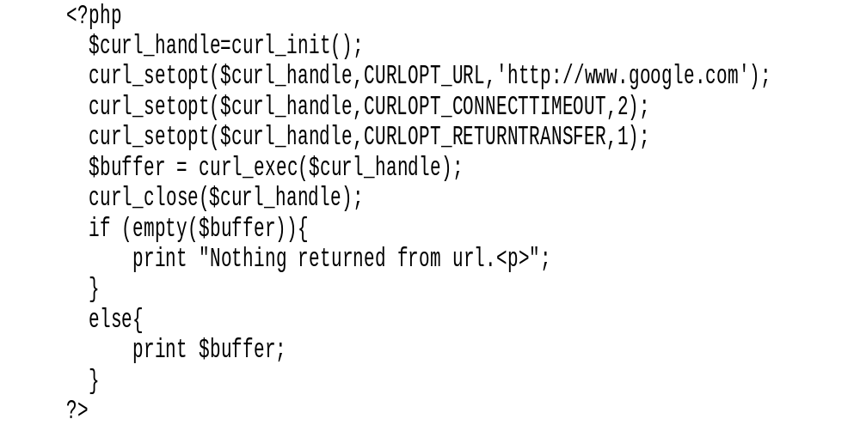
Example

Slide 28




