Slide 1
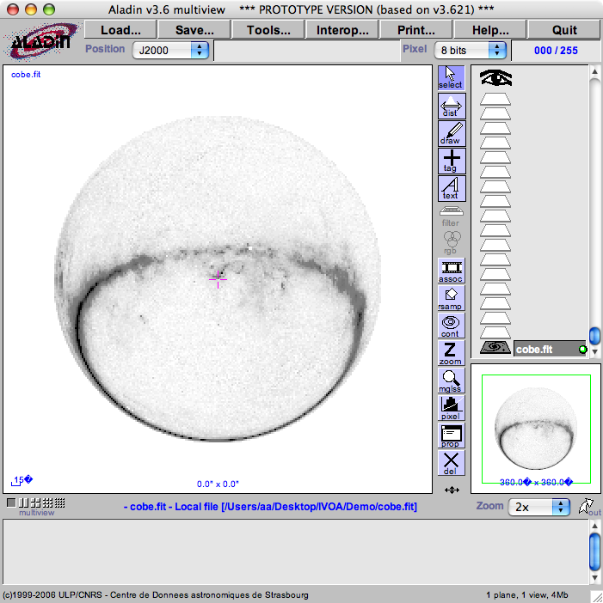
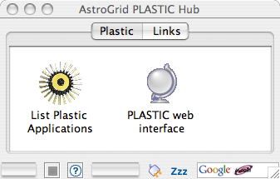
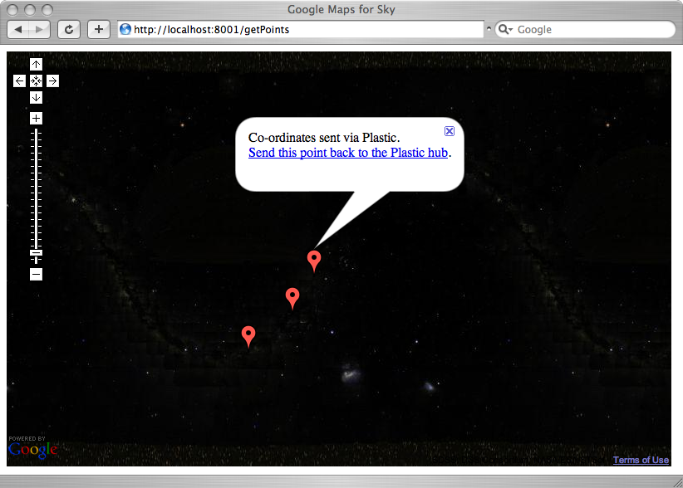
Java RMI
XML-RPC
Plastic
Application
XML-RPC
Java RMI
XML-RPC
_x0003_
_x0003_
AstroGrid Plastic Hub
HTTP GET
HTTP GET
CDS Aladin
Google Maps for Sky

