Slide 1
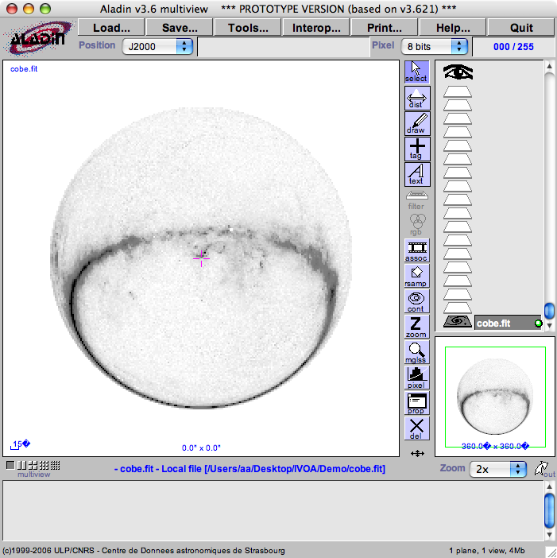
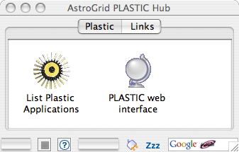
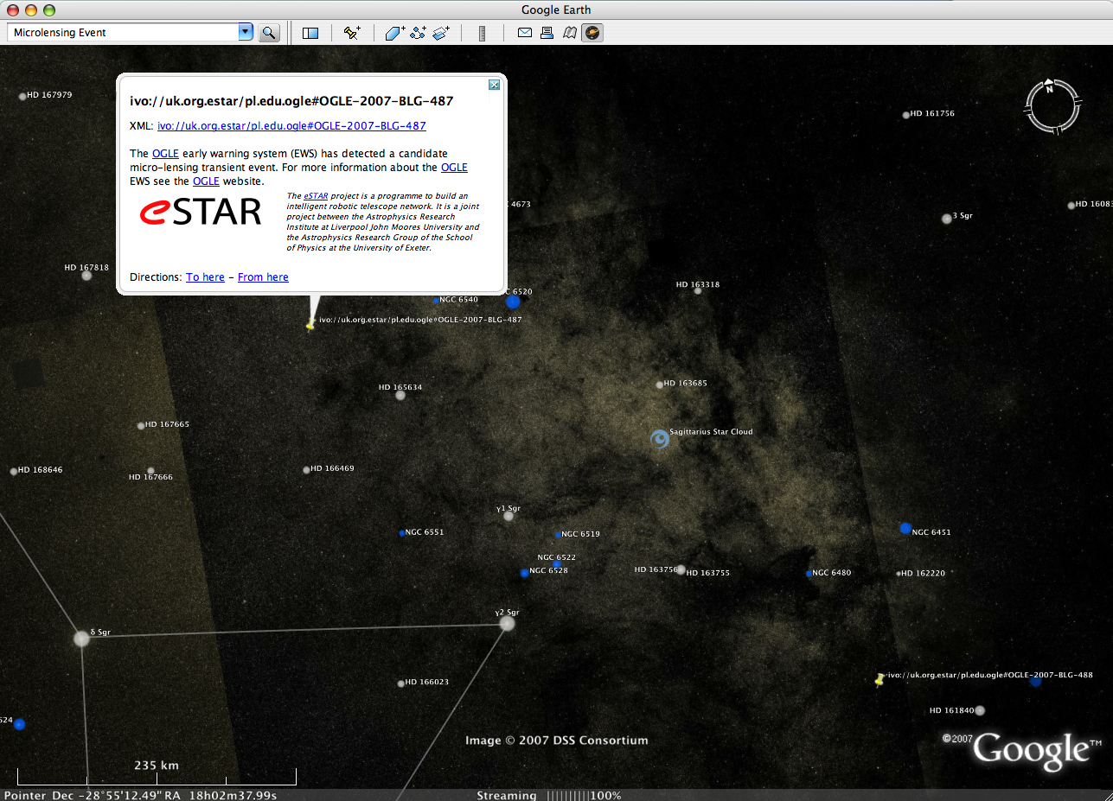
Java RMI
XML-RPC
Plastic
Application
XML-RPC
Java RMI
XML-RPC
KML
AstroGrid Plastic Hub
HTTP GET
CDS Aladin
Google Sky

