Slide 1

Aqar Historic Data
“Case study”
Abdulaziz Almalki
aalmalky88@gmail.com

Slide 2
Introduction
This project represents case study of analyzing historical real estate data in Saudi Arabia provided by Open Data Platform and Real Estate General Authority.

Slide 3
Data
historical data for sales transaction indicators, including the number of sales transactions, their total values, and the average price per meter according to location and property classification

Slide 4
Objectives:
EDA which exploring the data examining and understanding the characteristics of your dataset
Cleaning the data and make it more ready for the analysis and visualization
visualizing the data for gaining insights, identifying patterns, and communicating findings in a clear and effective manner
applying a regression technique for to more understanding of the relationship between prices and time

Slide 5




Tools:

Slide 6
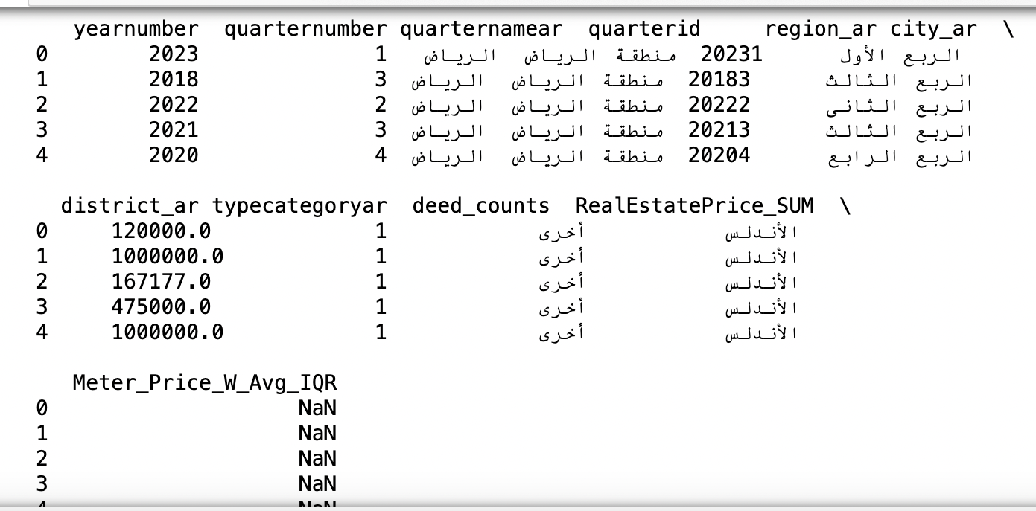
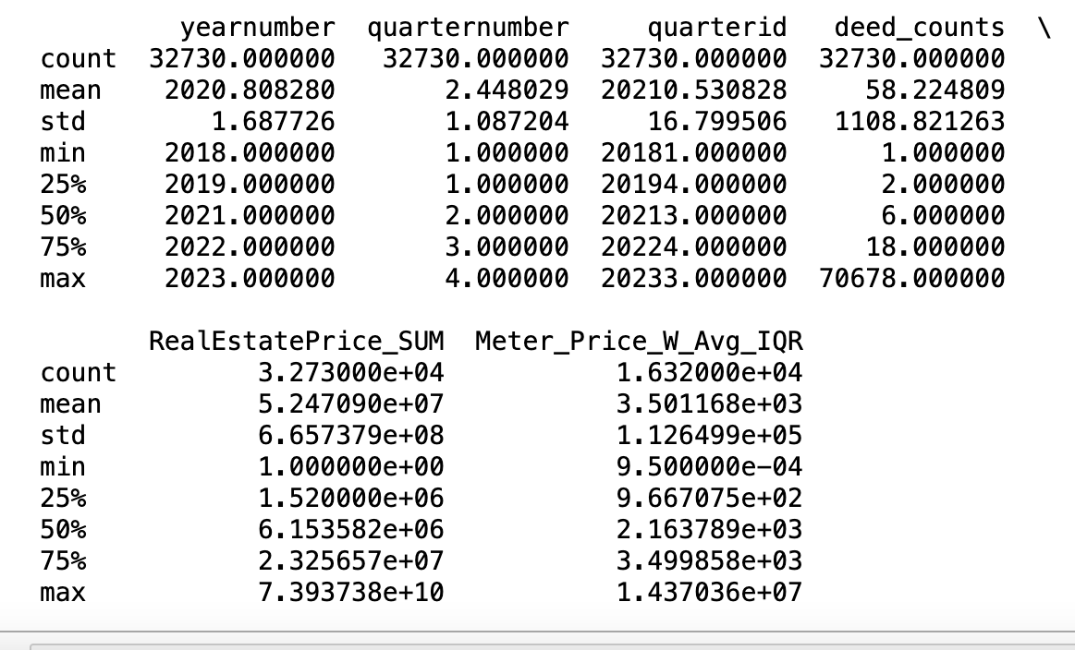
EDA
Basic Information about the Dataset:
few rows of the dataset to get an overview.
the data types of each column.
missing values.
Summary of the dataset

Slide 7
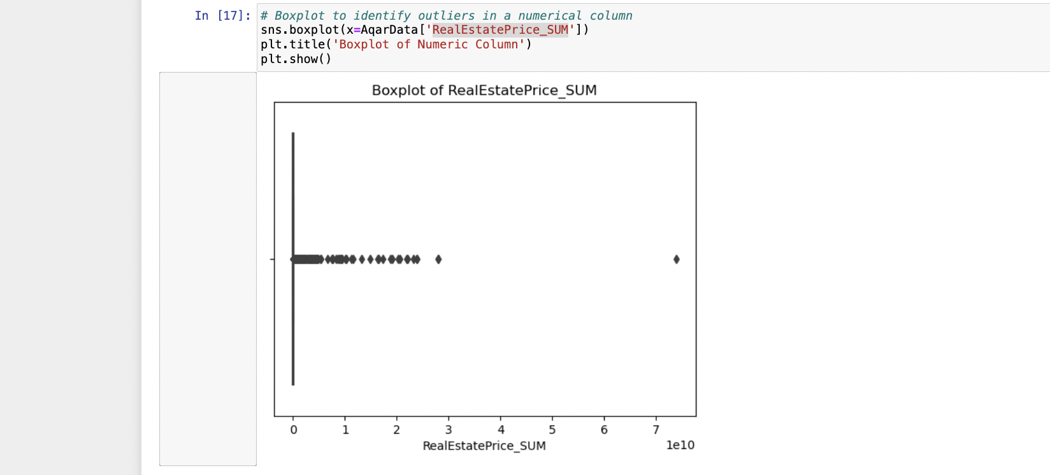
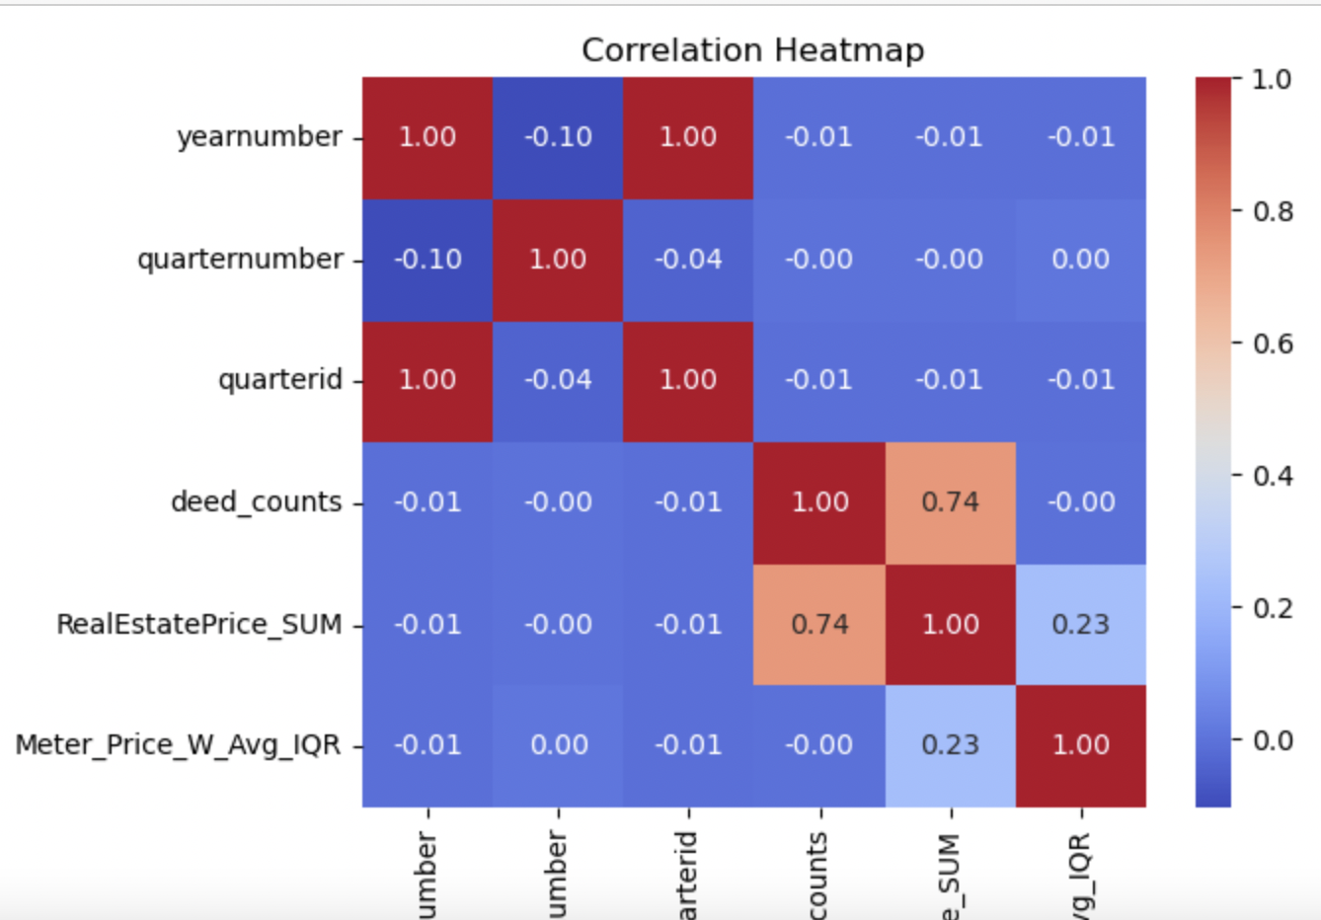
EDA visualization
Histogram.
Correlation Heatmap.
Boxplot to identify outliers.

Slide 8
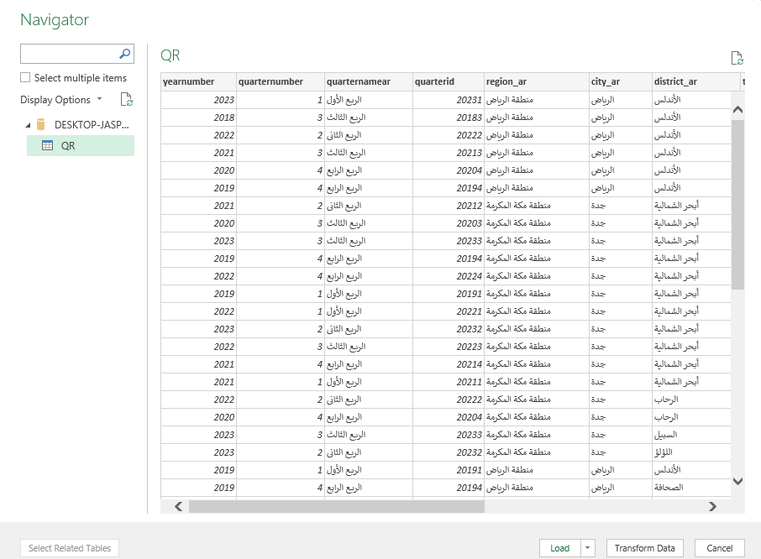
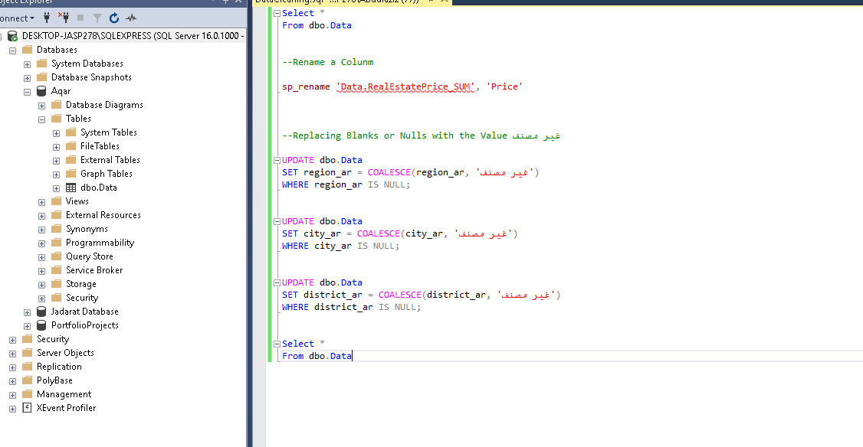
Data Cleaning and Exporting
Data Cleaning : ● Rename some columns.
● Replacing blanks and nulls.
Exporting data into Excel

Slide 9
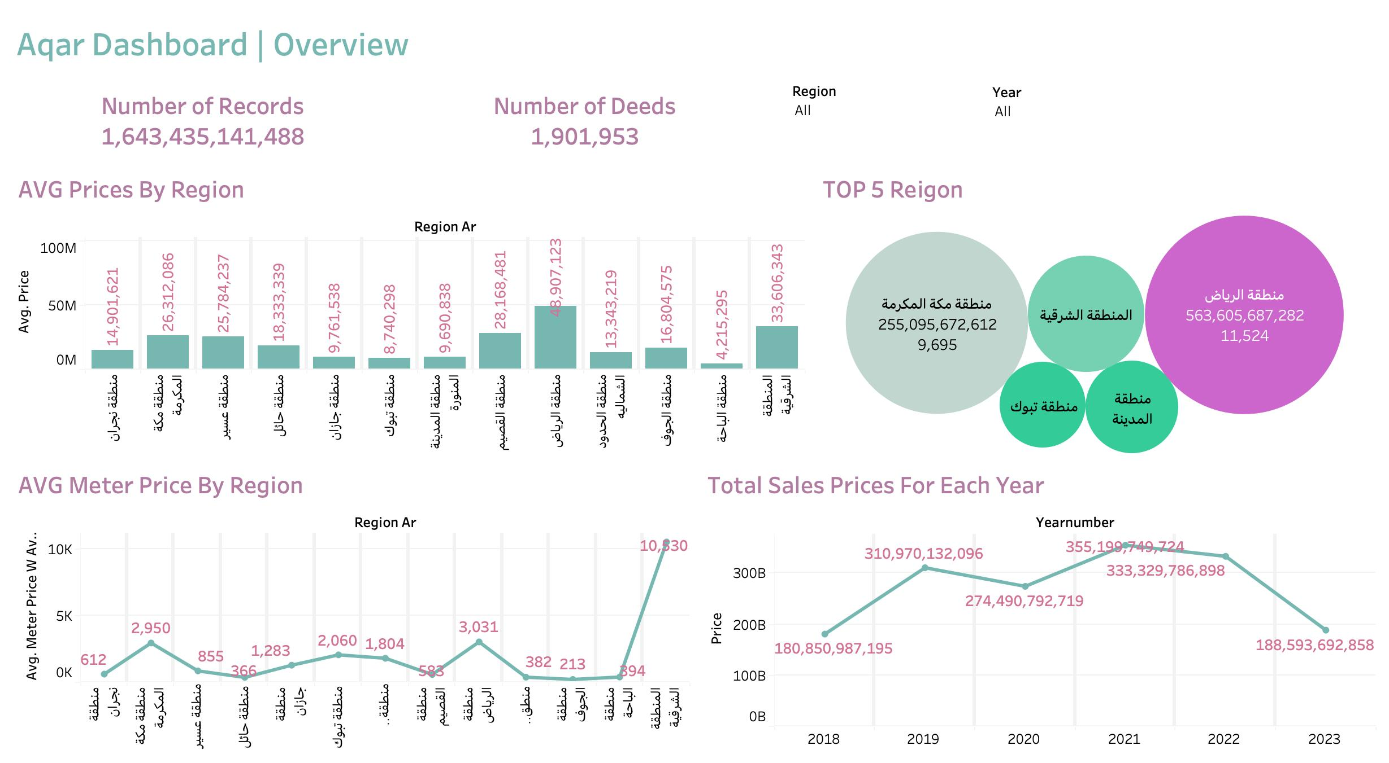
Creating the Dashboard Using Tableau:
Number of total Records and Deeds.
AVG for Prices by Region and Meter Price by Region.
Total sales Prices by Regions and top 5 Regions.
Access the live Dashboard By Clicking Here

Slide 10
Thanks for your attention

