Slide 1

INSIGHT TRACKER
AI-powered
project operations
A bilingual system that combines delivery workflows, structured RAG, agentic planning and secure automation.
Django + PostgreSQL
Groq + GPT-OSS
n8n + Telegram
Built and tested as one integrated product
Notes:
Opening: Insight Tracker started as a complete operational system, then AI was added where it creates real value. The key idea is that the AI never replaces the system's permissions or business rules.
[Sources]
- Repository scope and architecture documents
- Insight Tracker logo supplied by the project owner

Slide 2
PRODUCT MODEL
One system connects strategy to daily work
Leaders need one view. Teams need clear ownership. The data model connects both without relying on spreadsheets and chat follow-ups.
1
2
3
4
5
University program
Project
Milestone
Task
Assigned people
A
Shared structure
KAU, KSU and KKU programs contain their own projects while shared staff can work across programs.
B
Single source
Progress, approvals, attendance and reports use the same PostgreSQL records and business services.
C
Role visibility
Each user sees only the programs, projects and actions allowed by the current role and membership.
INSIGHT TRACKER
02
Notes:
Explain the hierarchy from program to project to task. The showcase data uses three Saudi universities and includes both dedicated and shared workers so permissions and workload are easy to demonstrate.
[Sources]
- docs/SCOPE.md
- docs/USER_ROLES.md
- docs/RUNBOOKS/UNIVERSITY_SHOWCASE.md

Slide 3
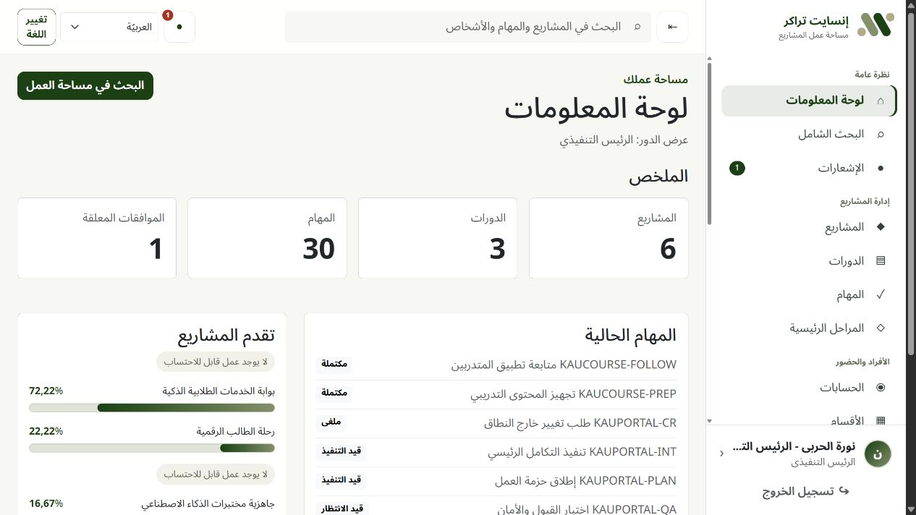
OPERATIONAL WORKFLOW
Daily work is visible and controlled end to end
The same record moves through the full delivery cycle:
1
Create and assign
Owner, priority, dates and dependencies
2
Work and collaborate
Comments, evidence and blockers
3
Request completion
Supervisor and manager approval
4
Measure automatically
Task, course and project progress
Arabic / English
RTL / LTR
Mobile
The executive dashboard and team workspace read from the same controlled state.
INSIGHT TRACKER
03
Notes:
Walk through one task from creation to assignment, collaboration, completion approval and progress calculation. Stress that progress is calculated once in services so the dashboard and reports cannot disagree.
[Sources]
- docs/BUSINESS_RULES.md
- docs/WORKFLOWS.md
- Local fictional dashboard screenshot

Slide 4
COMPLETE FEATURE SET
The product covers delivery, training and control
Plan and deliver
Run training
Control work
Operate safely
Departments and programs
Trainee records and imports
Two-stage approvals
Role permissions
Projects and teams
Training sessions
Progress engine
Audit history
Courses and trainers
Trainer attendance links
Dashboards and search
Archive and restore
Tasks, comments and files
Attendance approvals
PDF and Excel reports
Admin operations
Milestones and dependencies
Corrections with evidence
Notifications and reminders
Arabic and English UI
01
02
03
04
INSIGHT TRACKER
04
Notes:
Use this slide to prove that AI is not a disconnected demo. It sits on top of a complete application covering planning, delivery, training, reporting, administration and audit.
[Sources]
- docs/SCOPE.md
- docs/WORKFLOWS.md
- docs/ACCEPTANCE_CRITERIA.md

Slide 5
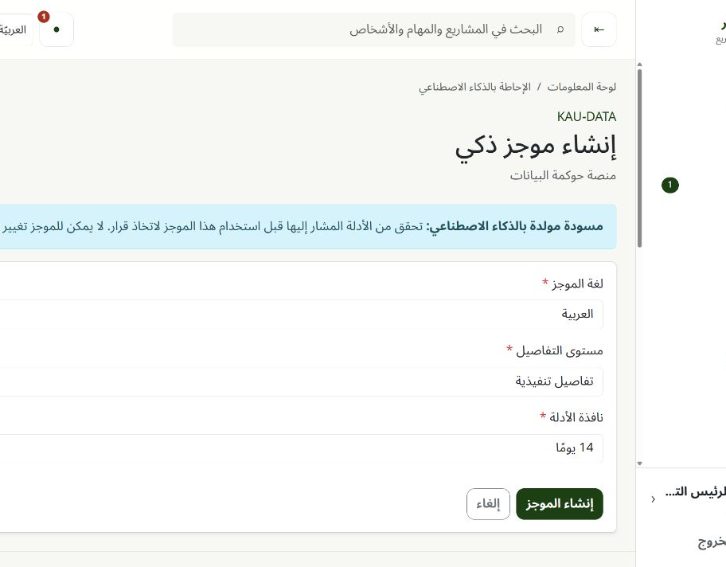
AI LAYER 1
Structured RAG turns live records into cited briefings
The model receives a small permission-scoped evidence packet, not the whole database.
1
2
3
4
5
Select
Data
Groq
Check
Review
Why it is RAG
• Retrieval happens from current PostgreSQL records
• Generation uses Groq and GPT-OSS
• Every factual item must cite an allowed source
• The result is read-only and reviewable
Read-only
Strict JSON Schema
Citations
INSIGHT TRACKER
05
Notes:
Define RAG in plain language: retrieve approved live evidence, ask the model to explain it, then validate the answer. This implementation uses structured database retrieval rather than a vector database because project records already have clear relationships and filters.
[Sources]
- docs/PHASES/PHASE_15_AI_PROJECT_BRIEFINGS.md
- Local deterministic AI briefing screenshot

Slide 6
EVIDENCE ENGINEERING
Most AI safety happens before and after the model
1
Before Groq
2
Inside Groq
3
After Groq
Recheck user and project scope
Approved GPT-OSS model only
Validate every citation
Exclude sensitive domains
Strict JSON Schema
Reject unknown source IDs
Rank and cap evidence
No tools or web access
Escape output
Label database text as untrusted
Bounded output tokens
Store safe metrics, not raw errors
The model explains evidence; the application decides what evidence is allowed and whether the answer is valid.
INSIGHT TRACKER
06
Notes:
This is the main AI engineering lesson: model choice alone does not make the feature safe. Selection, schemas, citation checks, output escaping and bounded storage are application responsibilities.
[Sources]
- docs/PHASES/PHASE_15_AI_PROJECT_BRIEFINGS.md
- docs/SECURITY.md

Slide 7
AI LAYER 2
The recovery agent plans, observes, pauses and verifies
This is agentic because the next step depends on tool observations, not on a fixed prompt sequence.
1
2
3
4
5
6
7
8
Goal
Plan
Read tools
Observation
Proposal
Human approval
Execute
Verify
Dynamic read tools
Proposal-only actions
Observation
• Project snapshot
• Overdue and blocked tasks
• Upcoming milestones
• Pending approvals
• Team workload
• Project progress
• Reviewed memory
• Task update
• Task assignment
• Task comment
• Deadline change
• Team notification
No direct model writes
12 overdue tasks · 2 blocked approvals
↓
Next tool selected
get_team_workload
INSIGHT TRACKER
07
Notes:
Explain the agent loop. At least two distinct read tools must succeed. An observation is returned to the model and changes the next decision. Write intentions are stored only as proposals and the run pauses.
[Sources]
- docs/PHASES/PHASE_17_AGENTIC_PROJECT_RECOVERY.md
- Local deterministic project-agent screenshot

Slide 8
CONTROLLED EXECUTION
Human approval remains the write boundary
The model can propose a change. It cannot approve or execute it.
Proposed change
Human decision
Execution checks
Task status
Blocked
Reviewer sees the reason, evidence and before/after state.
✓
Permission still valid
✓
Object still in scope
New deadline
+ 3 days
✓
Before-state unchanged
Approve
Reject
✓
Idempotency key unused
Evidence
✓
Business service accepts change
TASK-42 · APPROVAL-7
After-state verified
✓
Stale state = no write
INSIGHT TRACKER
08
Notes:
Show how Human-in-the-Loop works. Approval is not enough by itself: execution rechecks permission and the original state, uses the existing domain service, applies the action transactionally once, then verifies the result.
[Sources]
- docs/PHASES/PHASE_17_AGENTIC_PROJECT_RECOVERY.md
- docs/BUSINESS_RULES.md

Slide 9
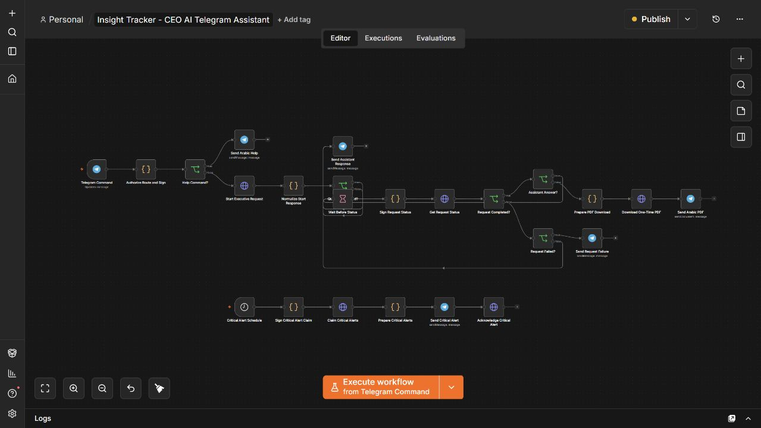
AI LAYER 3 + AUTOMATION
Telegram makes the AI available where leaders already work
One private CEO chat
/tasks
Current tasks PDF
/overdue
Overdue tasks PDF
/attendance
Attendance PDF
Natural question
Cited AI answer
Critical trigger
Automatic alert
n8n handles routing, polling, PDF delivery and alert schedules. Django remains the source of permission and data decisions.
INSIGHT TRACKER
09
Notes:
Explain why n8n is used: it is a visual automation layer for Telegram events, waits, polling, PDF delivery and schedules. It does not receive database access and it does not decide permissions. Natural-language questions use the separate read-only executive assistant.
[Sources]
- docs/PHASES/PHASE_16_CEO_TELEGRAM_N8N.md
- docs/PHASES/PHASE_19_TELEGRAM_AI_ASSISTANT.md
- Local n8n workflow screenshot

Slide 10
INTEGRATION SAFETY
Automation is useful only when its boundary is secure
Exact chat binding
1
Only the configured CEO and private chat are accepted.
What n8n cannot do
HMAC signatures
×
No PostgreSQL access
2
Every n8n request includes a body hash, timestamp and nonce.
×
No Redis exposure
×
No API key in workflow JSON
Replay protection
No arbitrary URLs or web search
3
A signed request cannot be reused.
×
×
No write authority from model text
Idempotency
×
No raw execution-data retention
4
Repeated Telegram updates do not create duplicate work.
Secrets stay in environment variables and native credentials.
INSIGHT TRACKER
10
Notes:
Describe the trust boundary. Telegram events are filtered, requests are signed, old or repeated requests fail, and n8n is not allowed to access PostgreSQL or Redis. Secrets are supplied at runtime and never committed.
[Sources]
- docs/RUNBOOKS/PHASE_16_CEO_TELEGRAM_N8N.md
- docs/SECURITY.md

Slide 11
ENGINEERING ARCHITECTURE
The stack is simple, modular and replaceable
Web layer
Django 5.2 · Templates · Bootstrap 5 · HTMX
Data layer
PostgreSQL · constraints · indexes · transactions
Async layer
Celery · Redis · retries · scheduled maintenance
AI layer
Groq Chat Completions · openai/gpt-oss-120b · strict schemas
Automation
n8n · Telegram Trigger · signed HTTP · PDF delivery
Runtime
Docker Compose · Gunicorn-ready settings · S3-compatible storage
Why these choices
One maintainable monolith for business rules; separate workers for slow AI and report jobs; replaceable provider and automation boundaries.
INSIGHT TRACKER
11
Notes:
Explain the tool choices. Django keeps permissions and business rules together. PostgreSQL provides durable constraints and transactions. Celery and Redis keep slow work outside web requests. Groq provides hosted GPT-OSS inference. n8n connects Telegram without embedding bot logic into every business service.
[Sources]
- AGENTS.md required stack
- docs/DEPLOYMENT.md
- docs/PHASES/PHASE_18_DEPLOYMENT_READINESS.md

Slide 12
LOCALIZATION
Arabic support is part of the architecture
Designed for Arabic and English
RTL / LTR
Layouts mirror correctly for each language.
Hijri + Gregorian
Dates appear in operational and report views.
Stable codes
Business logic uses codes, not translated labels.
Arabic search
Approved normalization supports identity and search.
Mobile
Critical workflows are tested at narrow widths.
First-class, not translated later
INSIGHT TRACKER
12
Notes:
Mention that Arabic is not only translated text. Direction, dates, search normalization, report layouts, mixed-direction model IDs and mobile behavior are part of implementation and testing.
[Sources]
- docs/LOCALIZATION.md
- Local Arabic dashboard screenshot

Slide 13
VERIFICATION
Tests target failure paths, not only happy paths
244
33
Quality tools
pytest · Playwright · Ruff · mypy
Django checks · migration checks · browser QA
automated tests in the latest full quality gate
focused Telegram regressions after fixes
Security cases exercised
✓
Unauthorized and forged IDs
✓
Prompt injection and secret requests
✓
Stale proposals and revoked access
✓
Duplicate execution and replay
✓
Provider timeout and invalid schema
✓
Arabic RTL and responsive browser flow
INSIGHT TRACKER
13
Notes:
Do not only say that tests passed. Explain what was tested: object permissions, prompt injection, replay, stale state, idempotency, provider failures, Arabic, English and mobile browser workflows. The 244 figure is the documented Phase 19 gate: 228 unit/integration plus 16 browser tests.
[Sources]
- docs/PHASES/PHASE_19_VERIFICATION.md
- Local focused regression run on 2026-08-06

Slide 14
WHAT MATTERS
The project demonstrates applied AI engineering
1
Grounded AI
Live evidence, strict schemas and citations
2
Agentic behavior
Dynamic tools, observation and reviewed memory
3
Safe action
Human approval, stale checks and idempotent execution
4
Automation
Telegram, n8n, scheduled alerts and PDF delivery
5
Production thinking
Permissions, privacy, tests, retries and deployment boundaries
Next step: replace the temporary tunnel with stable HTTPS, add monitoring, and run a controlled pilot with fictional or approved data.
Notes:
Close by connecting the product to the training goals. The result is not only an LLM call: it combines data engineering, retrieval, agent design, automation, security, testing and deployment thinking. The remaining step for real use is a stable HTTPS deployment and controlled pilot.
[Sources]
- docs/PHASES/PHASE_18_DEPLOYMENT_READINESS.md
- docs/PHASES/PHASE_19_VERIFICATION.md

