Slide 1
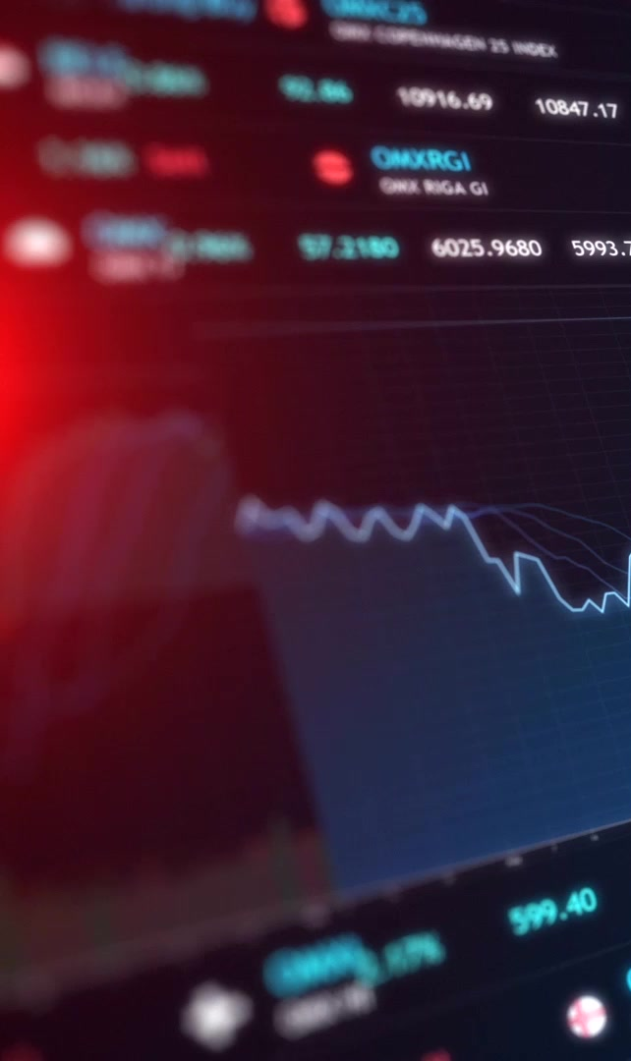
Stock Analysis Tool
Technical Stock Analysis & Strategy Simulation Desktop App
Built with Python & PyQt5
By Abdulmajeed Almaweri, Sami, and Almo

Slide 2

Introduction
Desktop app for real-time stock analysis
Offers investment recommendations & strategy backtesting
Designed for educational and analytical use
Combines finance, data visualization, and interactivity

Slide 3

Key Features
Technical Indicators: MA, RSI, MACD, Bollinger Bands
Interactive UI with multiple tabs
Investment strategy simulation (Buy & Hold, RSI, MA Crossover)
Custom date range selection
Risk profiles: Low, Moderate, High

Slide 4

Data & Charts
Real-time stock data using yfinance
Candlestick and line charts via matplotlib and mplfinance
Interactive indicator visualizations
Multiple chart views: Summary, Technical, Simulations

Slide 5

Strategy Backtesting
Simulate
Simulate different investment strategies
Analyze
Analyze historical performance
Compare
Compare strategies with adjustable inputs
Learn
Learn how technical signals affect returns

Slide 6
User Interface Design
Built using PyQt5
Organized into multiple tabs:
- Main Window
- Analysis Tab
- Charts Tab
- Indicators Tab
- Simulation Tab
Custom styling support (dark mode available)

Slide 7

Project Architecture
Main Layers:
- Models – Handles stock data processing
- Views – User interface components
- Controllers – Manages logic and data flow
- Utils – Charting tools & theme settings

Slide 8
How to Install
1. Clone the repo
2. Set up a virtual environment
3. Install dependencies using requirements.txt
4. Launch using python main.py
All setup instructions included in the README.

Slide 9
Technologies Used
Python 3.8+
PyQt5 (GUI)
Matplotlib & mplfinance (charts)
yfinance (data fetching)
Pandas, NumPy
TA-Lib (ta) – technical analysis indicators

Slide 10
Team & Credits
Contributors:
- Abdulmajeed: UI Design, Simulation Tools
- Sami: Indicators Logic, Backend Models
- Almo: Chart Components, Styling, Data Controllers
MIT Licensed | Educational Use Only
"Always do your own research before investing."

