Slide 1
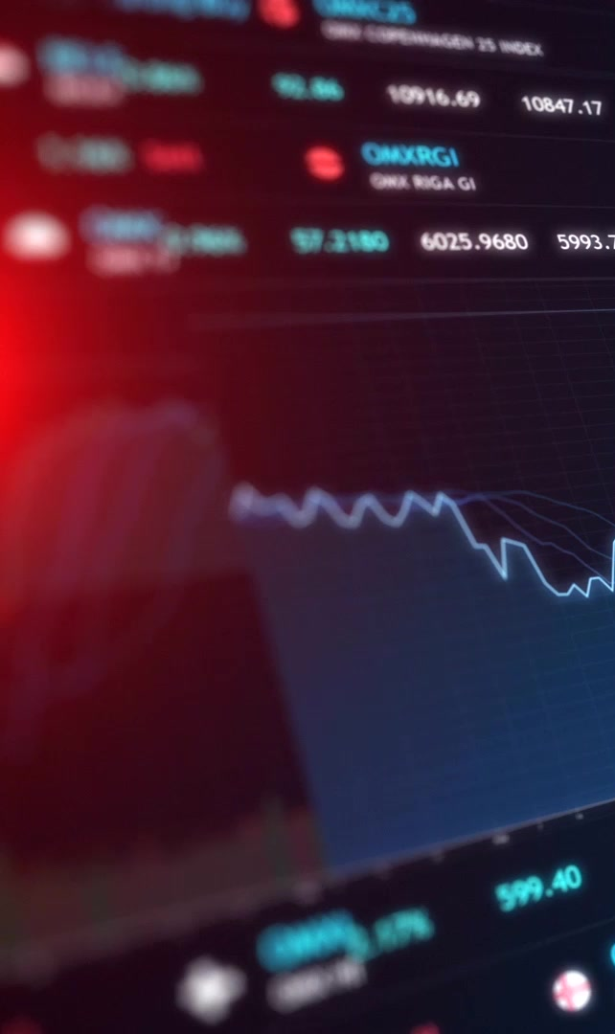
Stock Analysis Tool
Technical Stock Analysis & Strategy Simulation Desktop App
Built with Python, PyQt5, and more.
By Abdulmajeed Almaweri, Sami, and Almoatasam Alkatabi

Slide 2

What it Does
This app helps you analyze stocks using real-time and past data, with tools for things like Moving Averages and RSI
It gives you investment advice based on what the stock data says
You can see cool charts like candlestick and line graphs to visualize the stock trends.
It lets you test out different investment strategies, like "Buy and Hold" or "Moving Average Crossover," to see how they might have worked in the past.
Designed for educational and analytical use

Slide 3

Libraries used
PyQt5 – Used for creating desktop applications
Matplotlib – create interactive visualizations
yfinance – access stock market data
Pandas – data manipulation
Ta – technical analysis for stock market

Slide 4
How to Install
1. Clone the repo
2. Set up a virtual environment
3. Install dependencies using requirements.txt
4. Launch using python main.py
All setup instructions included in the README.

Slide 5
Team & Credits
Contributors:
- Abdulmajeed: UI Design, Simulation Tools
- Sami: Indicators Logic, Backend Models
- Almo: Chart Components, Styling, Data Controllers
MIT Licensed | Educational Use Only
"Always do your own research before investing."

