Slide 1
Zero Trust Architecture with Blockchain Capabilities
Project Provided by NUWC
MVP Presentation
Team: Aaron Almeida, Tuan-Son Le, David Atunlute, and Erica Gomes

Slide 2

Abstract
Our project aims to demonstrate the improvements Zero Trust Architecture and Blockchain can have on the security of a network.
In order to do this we need to create a network and user interface that will emulates network traffic.

Slide 3
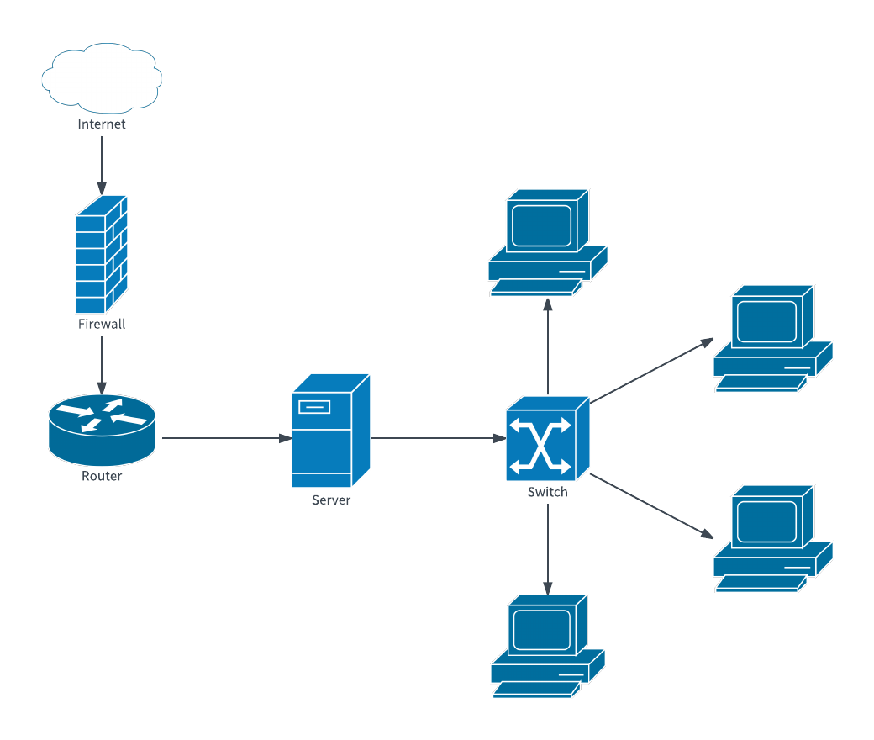
Network Fundamentals
Topology: the physical and inner connections of nodes in a network
Hubs, switches, servers, printers, etc.
Router: receives, analyzes, and sends data among connected computers
Authentication
Passwords, biometrics, Multi-factor authentication, etc
Authorization
User accessibility, Network access control
Firewalls: security system that monitors and controls network traffic by blocking unauthorized access into the network

Slide 4
Zero Trust Architecture

Slide 5
Zero Trust Concepts
Principles that guide Zero Trust
Remove the concept of trust from the network (Never trust, always verify)
Least Privilege Access Policy
Microsegmentation
Always monitor
Software Defined Networking (SDN)
Enables the configuration of network devices on the software level instead of the hardware level
Notes:
https://wentzwu.com/2020/10/21/what-is-zero-trust/

Slide 6
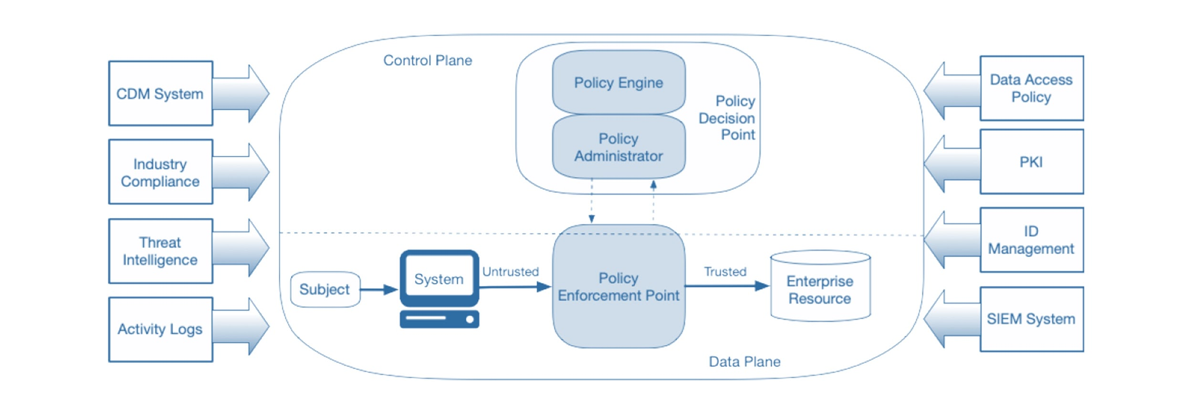
Implementation of Zero Trust Architecture
Source: https://nvlpubs.nist.gov/nistpubs/SpecialPublications/NIST.SP.800-207.pdf

Slide 7
Blockchain Technology

Slide 8
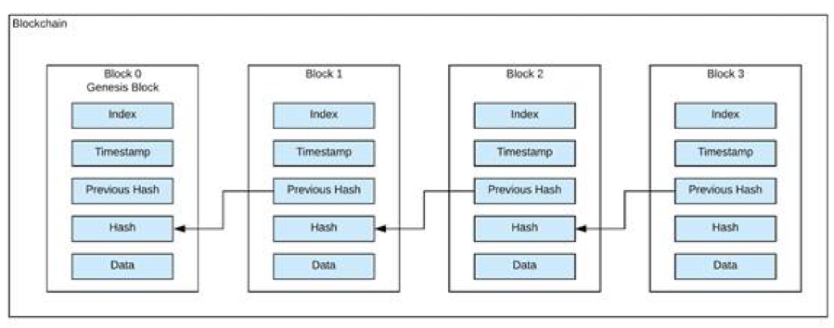
Blockchain
What is distributed ledger technology?
Basically a distributed database that stores information as blocks and each new block will be chained to the previous block.
Each block contains hashed information.
Data stored on the blockchain can’t be tampered with without disrupting the entire blockchain
Notes:
https://www.spheregen.com/blockchain-technology-basics/

Slide 9
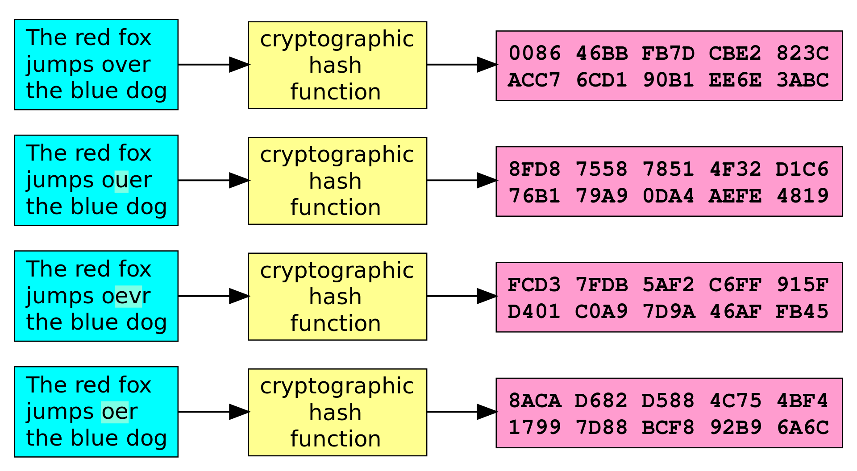
Hashing in Effect
Source: https://tykn.tech/identity-management-blockchain/
Notes:
Example of the hash in use. (Avalanche effect)
The diagram shows how the blockchain is implemented and inputs stored as hash digest.

Slide 10
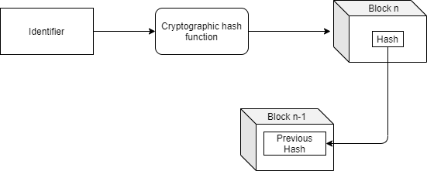
Blockchain for Identity Management
Identify, authenticate and authorize.
Zero-knowledge proof as a method of authentication.
Removes the need for a centralized authority.
Notes:
identity and access management”, or IAM, identity management comprises all the processes and technologies within an organisation that are used to identify, authenticate and authorize someone to access services or systems in that said organisation or other associated ones.
A Zero-Knowledge Proof is a method of authentication that, through the use of cryptography, allows one entity to prove to another entity that they know a certain information or meet a certain requirement without having to disclose any of the actual information that supports that proof.
A centralized authority is in charge of verifying data that goes through it but blockchain eliminates the need for that.

Slide 11
Our Approach

Slide 12
Our Approach
Virtual Machine with scripts to enable reproducibility
Network Emulator to simulate different network topologies
Software Defined Networking to build the foundation for Zero Trust
Local blockchain solution for hosting data relevant to authentication
Web Server to connect Blockchain and SDN APIs

Slide 13






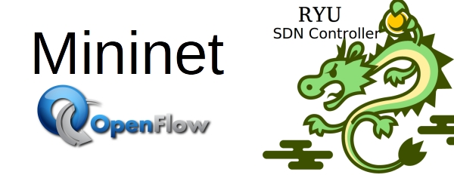
Tools used

Slide 14
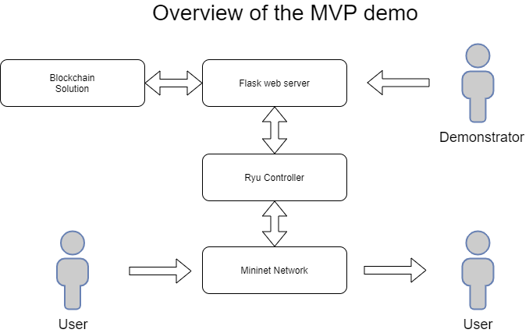
Implementation of Systems
Web server acts as a hub of communication for current and future systems
Blockchain currently holds placeholder data for authentication
Ryu controller handles network access control with the help of OpenFlow

Slide 15
Future Improvements
Expand network topology to provide more use cases
Additional types of users
VLAN/Subnet
Network wide encryption
Asymmetric Encryption
Public Key Infrastructure
Improved Authentication
Single Sign-On
Single Packet Authorization
Intrusion Detection System
Handles suspicious behavior that other systems miss
Integration with Ryu, Snort
Improvements to Blockchain solution
Better Identifiers
Alternative consensus algorithm
Permissions

Slide 16
Questions?

