Slide 1






EDA Project
Abdulrahman

Slide 2
Outline
Dataset
Cleaning Dataset
Hypotheses
The Client
Recommendations For The Client
2/21

Slide 3
Dataset
df.duplicated().value_counts()
df.isnull().sum()
The dataset contains (21597, 23)
The columns : ['id', 'bedrooms', 'bathrooms', 'sqft_living', 'sqft_lot', 'floors', 'waterfront', 'view', 'condition', 'grade', 'sqft_basement', 'sqft_above', 'yr_built', 'yr_renovated', 'zipcode', 'lat', 'long', 'sqft_living15', 'sqft_lot15', 'date', 'price', 'house_id', 'id.1']
2391…... 11.07%
3848…... 17.81%
63…... 0.29%
452 …... 2.1%
3/21

Slide 4
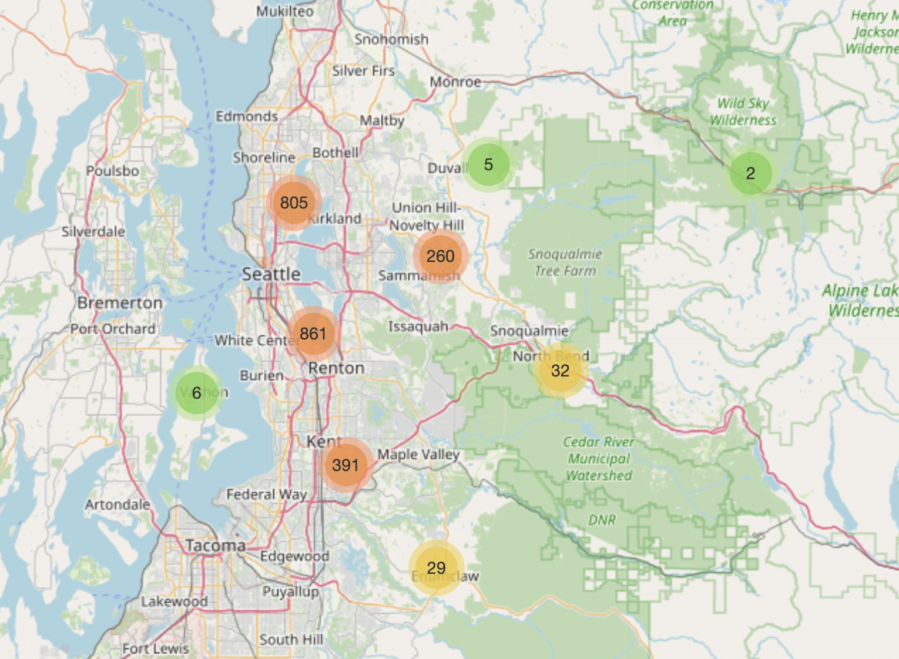
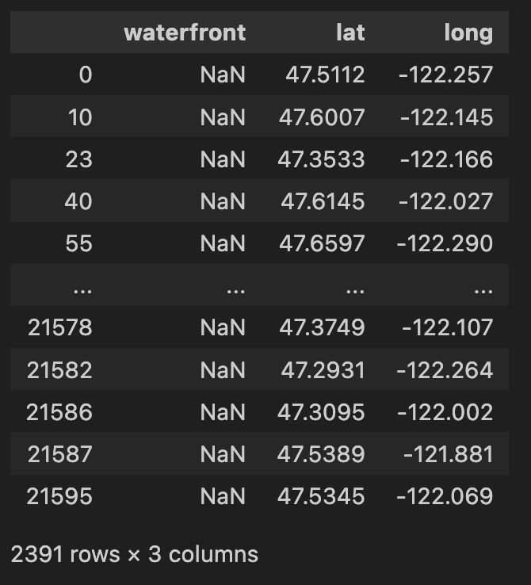
Impute missing values in waterfront column
df['waterfront'].fillna(0, inplace=True)​
4/21

Slide 5
Impute missing values in view column
array([ 0., nan, 3., 4., 2., 1.])
mode_view = df['view'].mode()
df['view'].fillna(mode_view, inplace=True)
df['view'].fillna(0, inplace=True)
5/21

Slide 6
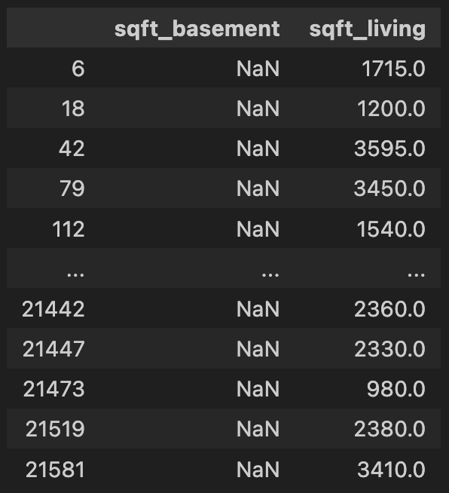

Impute missing values in sqft_basement column
df['sqft_basement'] = df.apply(lambda row: 0
if row['sqft_living'] == row['sqft_above']
else row['sqft_living'] - row['sqft_above'], axis=1)
6/21

Slide 7
Impute missing values in yr_renovated column
Missing values in yr_renovated likely indicate that the house was never renovated.
df['yr_renovated'].fillna(df['yr_built'], inplace=True)
7/21

Slide 8
Check all columns that should not be zero
check_for_zero = ['bedrooms', 'bathrooms', 'sqft_living', 'sqft_lot', 'floors', 'sqft_above','yr_built', 'yr_renovated', 'zipcode', 'lat', 'long','sqft_living15', 'sqft_lot15', 'price']
8/21

Slide 9
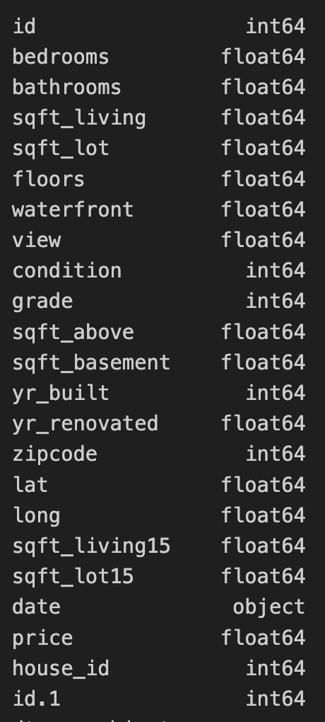
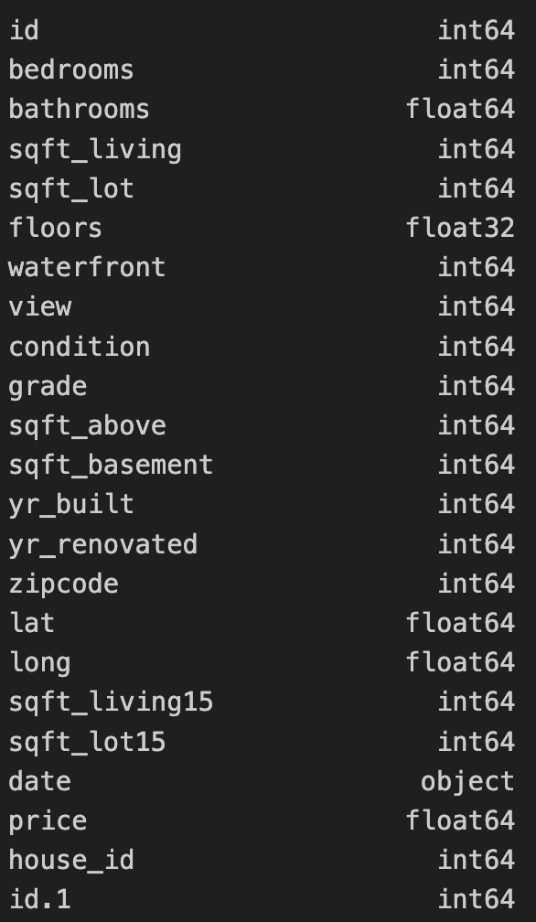
Columns Data Types
9/21

Slide 10
Hypothesis
Older built/renovated houses are higher prices.
More bedrooms does not mean higher price.
The price of a house does not depend significantly on whether it is located near other expensive houses
10/21

Slide 11
The price of a house does not depend significantly on whether it is located near other expensive houses
sqft_lot15: square footage of the lots of the nearest 15 neighbors. sqft_living15: square footage of living space for the nearest 15 neighbors.
To test the hypothesis, calculate correlations between:
price and sqft_living15.
price and sqft_lot15.
Pearson's Correlation
Corr price and sqft_living15 = 0.59
Corr price and sqft_lot15 = 0.08
11/21

Slide 12
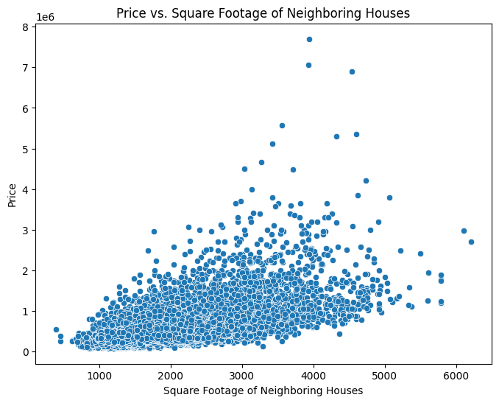
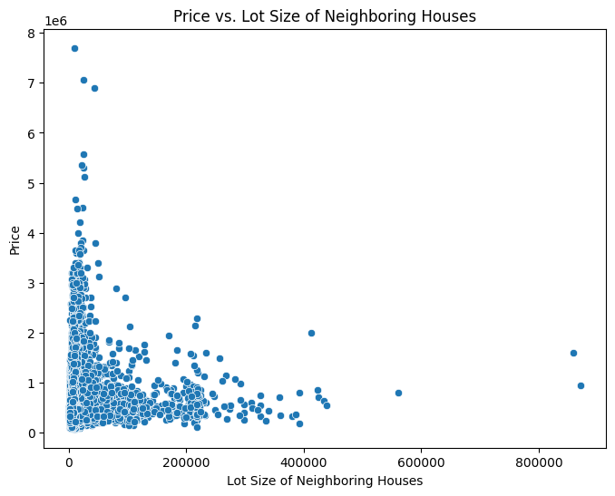
The price of a house does not depend significantly on whether it is located near other expensive houses
12/21

Slide 13
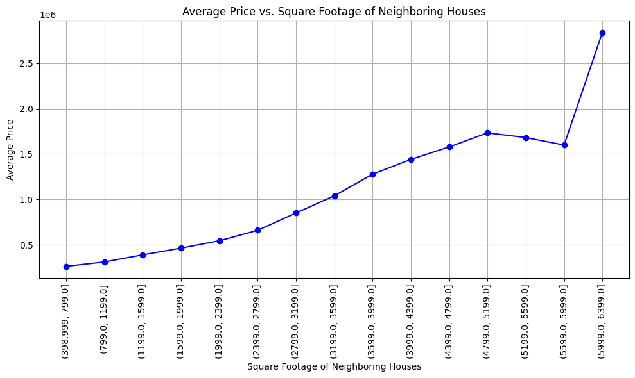
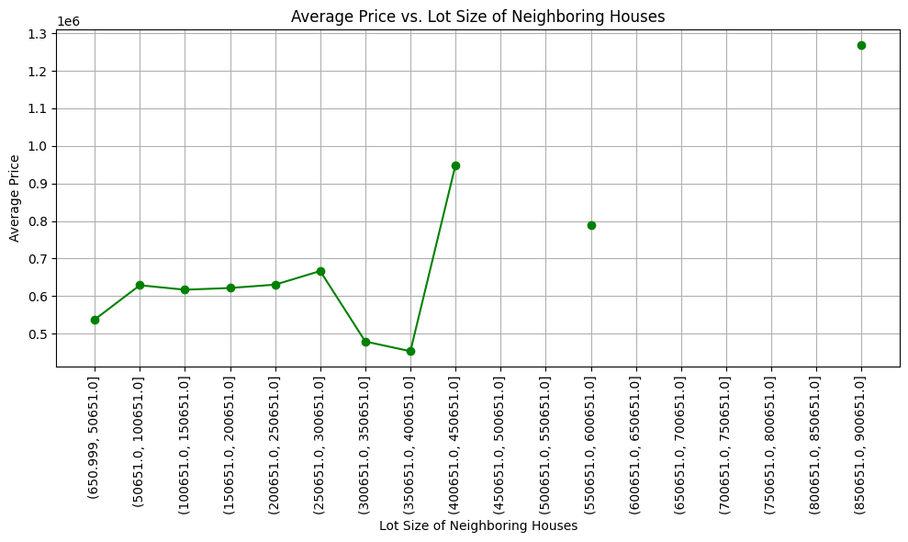
The price of a house does not depend significantly on whether it is located near other expensive houses
13/21

Slide 14
2. Older built/renovated houses are higher prices.
yr_built: The year the hous was built. yr_renovated: The year the hous was renovated.
To test the hypothesis, calculate correlations between:
price and yr_built.
price and yr_renovated.
Pearson's Correlation
Corr price and yr_built = 0.05
Corrprice and yr_renovated = 0.10
14/21

Slide 15
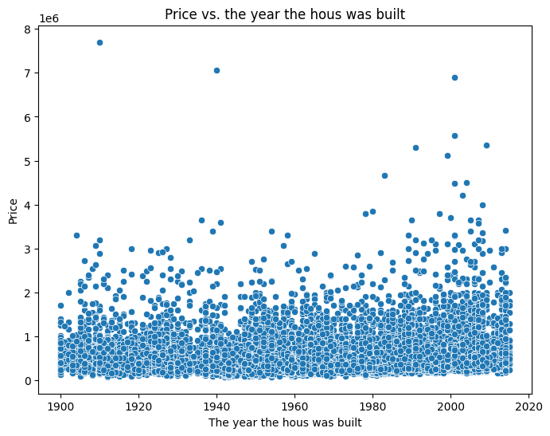
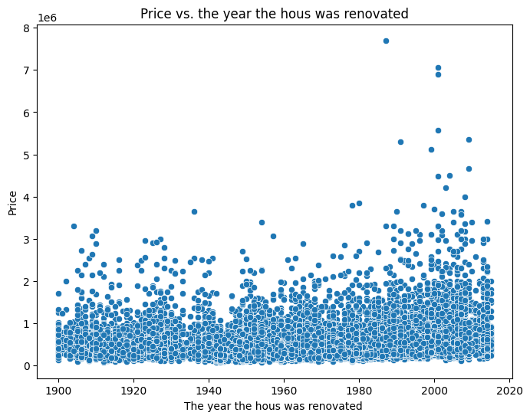
2. Older built/renovated houses are higher prices.
15/21

Slide 16
3. More bedrooms does not mean higher price.
Bedrooms: Number of bedrooms in the hous.
To test the hypothesis, calculate correlations between:
price and yr_bedrooms.
Pearson's Correlation
Corr price and bedrooms = 0.59.
Moderate positive linear relationship.
16/21

Slide 17
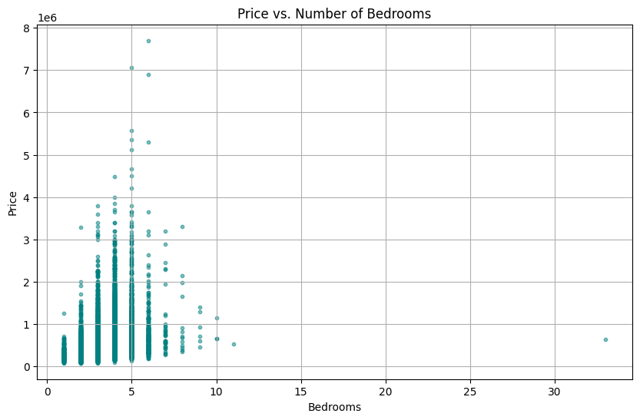
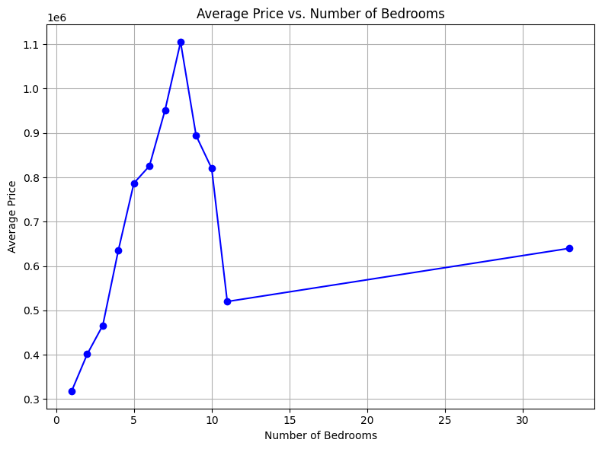
3. More bedrooms does not mean higher price.
17/21

Slide 18
The client
Thomas has 5 kids.
We need to figure out what is the best time to buy and where (location)?
He wants a nice (social) neighborhood.
However, he does not have money.
18/21

Slide 19
Recommendations for The client
df[(df['bedrooms'] >= 4)] &
(df['price'] < df['price'].quantile(0.25) &
(df['waterfront'] == 0) &
(df['condition'] == 2) &
(df['sqft_lot15'] > df['sqft_lot15'].median())] # not sqft_living15
19/21

Slide 20
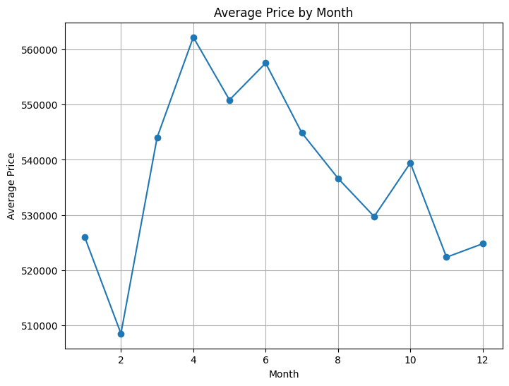
Recommendations for The client
20/21

Slide 21
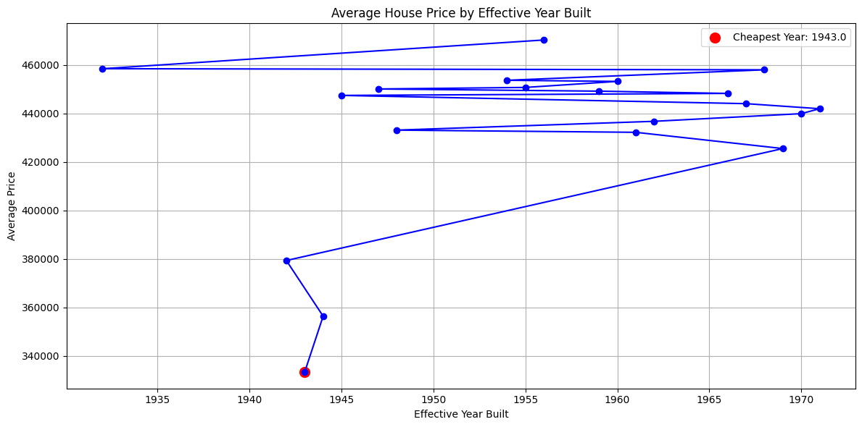
Recommendations for The client
21/21

Slide 22
The End
Time for questions

