Slide 1
Team #04 - CONSORTIUM
Group Members –
Sudhanshu Bhardwaj(201551076)
Kriti Singhal(201551024)
Shweta Kumari(201552042)
Aalok Kumar(201551012)
Jaya Sharma(201551021)

Slide 2
Project Name For The Hackathon “Entrust “
Problem Statement –
Mankind has no control over natural calamities we cant stop these natural calamities but we can help the victims to recover from such conditions. So our idea is to support the victims by providing financial aids through a digitized platform.
Many people want to help the victims but either they don’t get a platform or the platform is not reliable and authorized. Even though people come up for the cause and donate but most of the time these financial aids doesn’t reach the needy on time.

Slide 3
Solution –
Our team Consortium is set to develop a Chrome Extension to donate as Chrome is widely used by internet users all over the world. Here our objective is to provide a digitized, reliable and authorized platform for giving contribution to the cause. This extension will provide information about the ongoing natural calamities with the option to donate.

Slide 4
Societal Impacts-
Our project will provide an online platform making the donars donate any amount of money just by clicking a button.
The victims will get help very easily and within time.
This idea will support the concept of digitalization.
There will be no mediator interface. The whole process of donation will be solely managed and supervised by the government.

Slide 5
Technical Working –
We have mainly used Web Scrapping in Python to extract news.
Then we have prepared a list of words from the analysis of around 200 news articles related to natural disasters for distinguishing the news of natural calamities from the other news.
For these above processes of extraction, we have python modules nltk,bs4(BeautifulSoup),requests etc.
HTML , CSS and Javascript are used for front-end development.
For payment gateway, we have used api of payumoney.
We have tried to deploy our project using php and Django server, but there was problem in linking these two.

Slide 6
Current working conditions -
Currently all our files are in working conditions and they are functioning correctly but individually.
Due to the problem of the server required for the payment process, we were not able to execute the whole process of payment.
But the news extraction and display and getting the user details for the donation process and working correctly.

Slide 7
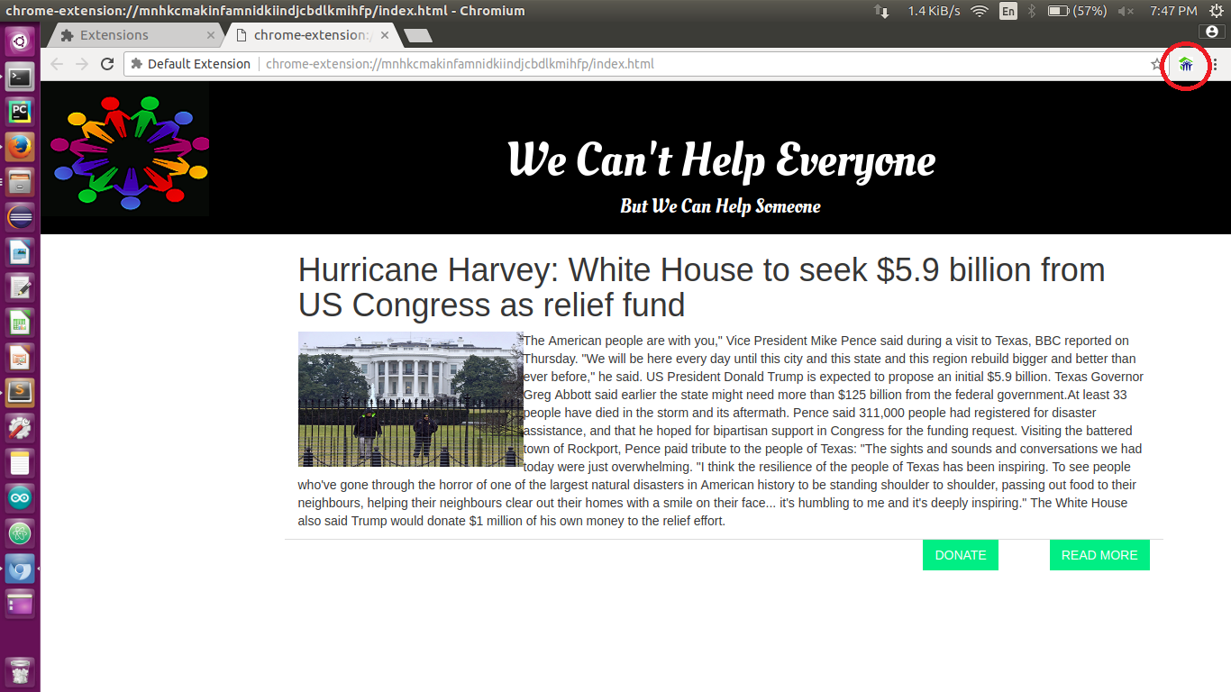
Working Process -

Slide 8
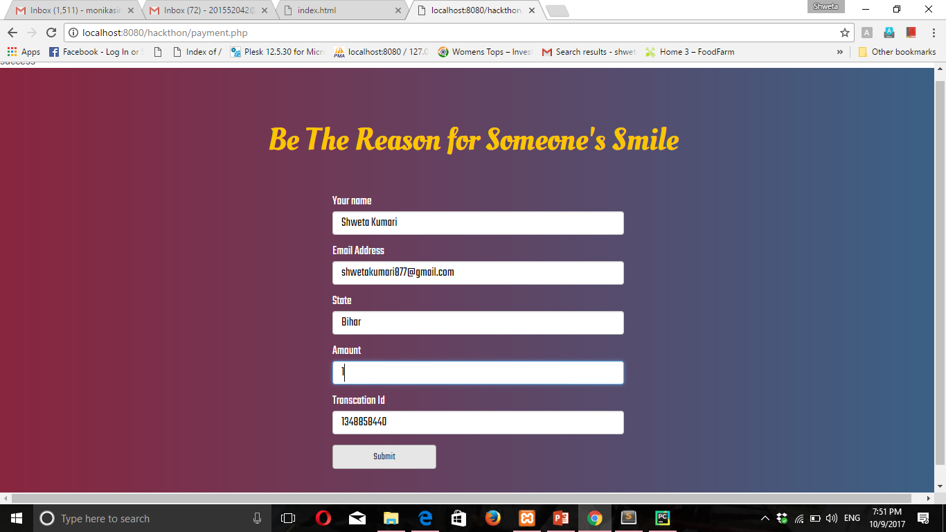

Slide 9
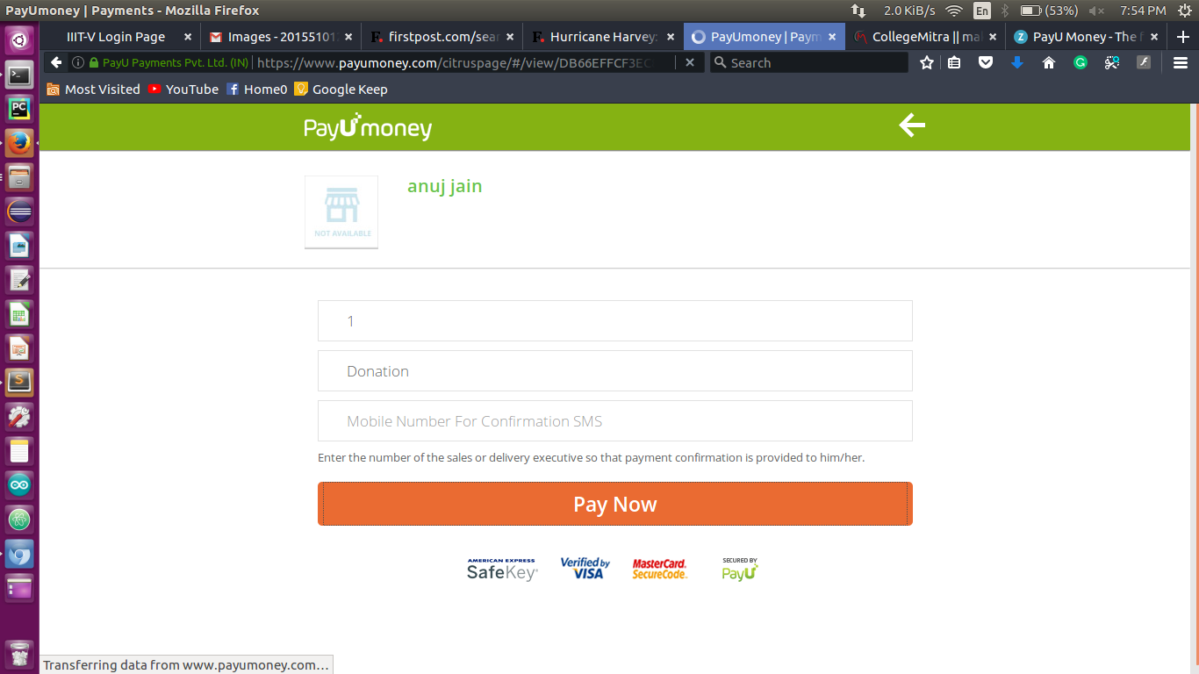

Slide 10
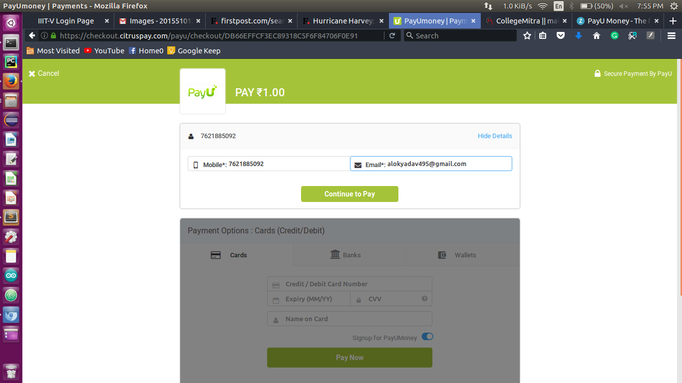

Slide 11
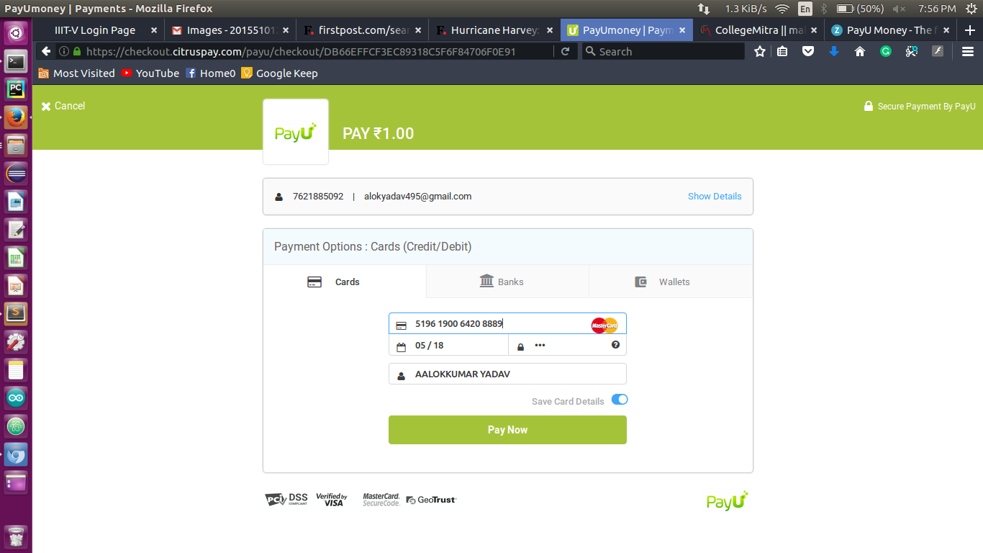

Slide 12
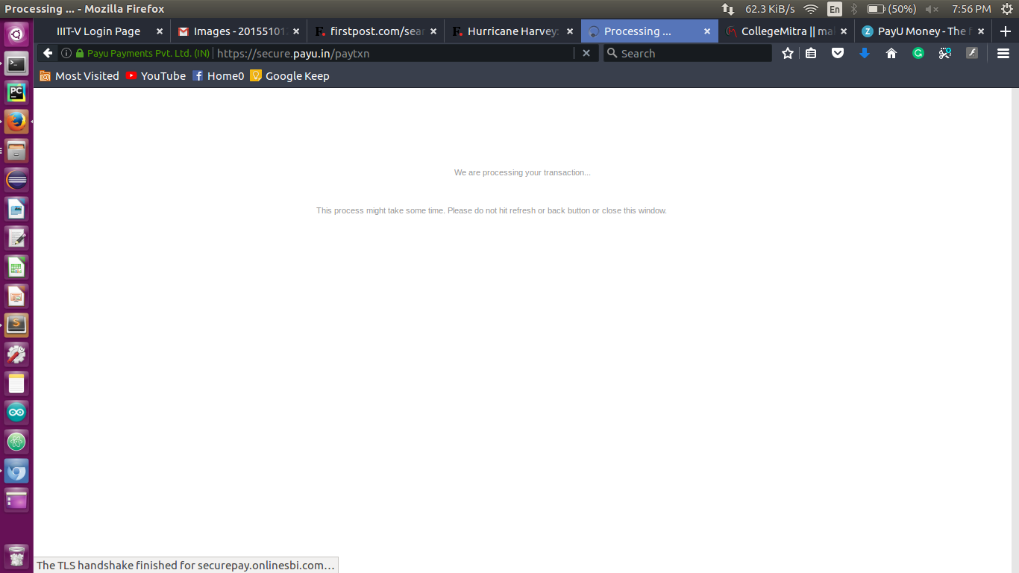

Slide 13
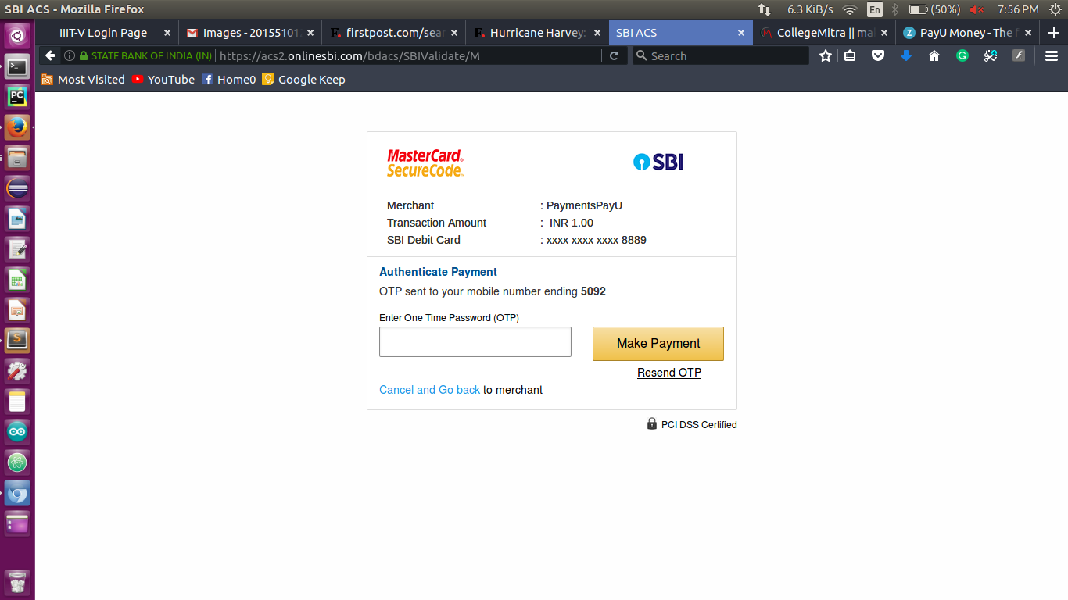

Slide 14
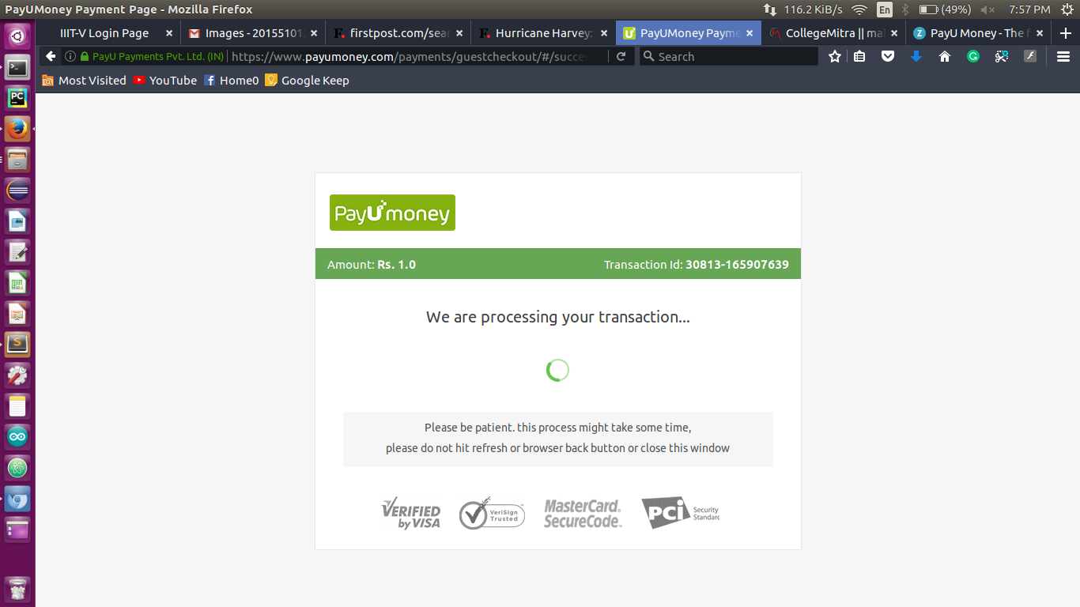

Slide 15
THANK YOU!!!

