Slide 1

Institution with a difference!

Slide 2
Vishwaniketan Story
‘Vishwaniketan’ is an outcome of a European Commission project under the ERASMUS MUNDUS program titled ‘Mobility for Life’ (2008-2011). This project was in partnership with Center for TeleInfrastruktur (CTIF), a global R and D center working in more than 22 countries led by Dr. Ramjee Prasad, a highly eminent European scientist. This project offered PhD fellowships to 42 Indian teachers across 14 European Universities. These teachers earned their PhDs in Project Based Learning (PBL) environment. This was a completely new learning experience for the teachers who understood the impact of PBL on ‘product development’ based education, creating startups and entrepreneurship
These teachers along with engineers, entrepreneurs and professionals came together in 2012 to create Vishwaniketan as an institution to transform Indian education by making it more ‘Product Development and Entrepreneurial based’.

Slide 3
In the year 2012, a public charitable trust ‘Vishwaniketan’ was formed under the Mumbai Public Trust Act of 1956. This trust has adopted the principles of transparent and ethical administration, the principle of ‘not for profit’ and a character to match global standards in the field of education.
In the year 2013, we made a modest beginning with ‘Vishwaniketan’s Institute of Management, Entrepreneurship and Engineering Technology’ (Vimeet) ,
(an engineering college affiliated to Mumbai University and approved by the All India Council for Technical Education (AICTE) , HRD Ministry, Government of India)

Slide 4
Our Philosophy
Vishwaniketan believes that future entrepreneurs can be created by inculcating technical skills, life skills, innovation and creativity and by adding a design perspective in the teaching and learning process. We also believe that this is possible only with global exposure.
Our philosophy is to empower our teachers and students by providing them with such global exposure in order to fulfill our objectives of academic excellence leading to creation of Industry Ready Professionals.
We believe that this is possible with our commitment to Internationalize Education through collaborations with right Global Partners.

Slide 5
People
Dr.Ramjee Prasad: Honorary President of Vishwaniketan. He is a full Professor in Aarhus University, Denmark with over 50 years of experience in academics, technology development and commercialization in the telecom sector. He has more than 18 internationally acclaimed books, has guided over 100 PhD scholars and contributed over 2000 technical papers. He is founder President of CTIF Global Capsule (CGC) and founding Director of CTIF. He is a recipient of Knight of the Dannebrog from the Danish Queen in 2010.
Dr.Sandeep Inamdar: Eminent educationist with 30 years of teaching and administrative experience. He is the managing trustee of the Vishwaniketan. He is also the Director of CTIF India.
Mr.Sudhanshu Shevade: First generation industrialist who runs a factory that does electroplating of precious metals and another that builds Special Purpose Machines, with combined turnover of over 3 billion rupees. He is the Executive President of Vishwaniketan.
Mr. Anilkumar Gupta: Chairperson of HMRITM, an Engineering College affiliated to IP University, Delhi. He has over 40 years experience in business and education.
Mr. Manoj Shah: Entrepreneur, owner of Newtek Electricals, a manufacturer and exporter of Current Transformers and digital instruments, based in the city of Aurangabad.
Mr. Atul Bhirangi: He is currently Managing Director and CEO with the Bangalore based Pragati Engineering, a leading manufacturer and exporter of CNC machines and equipment across the world.

Slide 6
People
Mr. Karunakar Naidu: He is an electrical engineer and is currently working as Vice President with ABB Limited with over 28 years in the electrical industry.
Mr. Abizar Shaikh: a Mechanical Engineer and MBA has built start ups in the financial services and life insurance industries and is currently in the media business. He brings over 25 years of experience in PnL management.
Mrs. Aparna Bhirangi, Mrs. Manoj Jadhav and Mr.A.B. Pawar are well known teachers in their respective fields
Mr. Madhu Bhatija: He is one of the top real estate developers in New Mumbai and Chairman of ‘Paradise Group’. His company has developed over 2.5 million sq. ft. of residential projects in the city and is currently in process of developing a further 12.5 million sq. ft.
Mr. A.K. Jain: He is a professional cost accountant. He also works in finance education through his institutes.
Mr. Vidyadhar Naidu: A software engineer by training, he is currently with IBM in New Jersey as a software consultant with a total of 25 years’ experience in consulting and IT.

Slide 7
Vision
To Create Centers of Learning in various verticals of
Higher and Professional Education with
‘Project Based learning (PBL)’ methodology in order to create the problem solvers of tomorrow.

Slide 8
Locational Advantage
Vishwaniketan is located in the biggest development hub of India at a fifty minute drive from Mumbai, India’s financial capital.
We are situated along the Mumbai-Pune express way, at a twenty minute drive from the proposed Navi Mumbai International Airport (expected to be operational by 2019).
We are surrounded by following business and industrial hubs, each located at a distance of between 30 and 90 minutes from the campus:
Thane-Belapur
Patalganga
Nagothane
Taloja
SEEPZ
Hinjewadi
(Each of the above hubs has a very large number of manufacturing and software companies with financial investments running into multiple billions of dollars.)

Slide 9
We are 20 minutes away from Lonavala and Khandala (internationally known tourism locations in the Western Ghats)
Following residential and commercial developments are in the close vicinity:
‘Indiabulls’ Golf City,‘Godrej’ City, ‘Hiranandani’ township and the upcoming National Institute of Securities Management.
We are on the immediate outskirts of ‘New-Mumbai Airport Influenced Area’ (NAINA), a completely new city spread over 640 sq. km. ( twice the size of Navi Mumbai) planned by the Government of Maharashtra
We are 45 minutes way from JNPT, India’s largest and most modern port facility.

Slide 10
Present Status
Vishwaniketan is completing 4 years of its existence with ‘Vimeet’, and our School of Architecture will soon complete its first year.
There are 1500 students learning on campus with faculty strength of about 150.
As of now we have collaborated with 9 universities from the USA and Europe.
Our flagship UG fellowship program (spanning 42 days) has seen phenomenal growth from 28 students in the first year (2013) to over 400 students who have confirmed participation in the current academic year (2017).
More than 70 teachers are pursuing / completed PhD with our partner Universities. This is one of the largest PhD collaboration in the country. Students and faculty members who have undergone UG and PhD fellowship have become very strong ambassadors for PBL.
We have initiated the work on creating startups involving both teachers as well as students. Three such startups are expected to role out over the next 3 to 4 months.
We are also working on joint ventures with startups / existing companies who are working with our partner universities in order to expand their footprint in the Indian market.

Slide 11
Present Collaborations for UG and PhD fellowship
Aalborg University, Denmark
Technical University Sofia, Bulgaria
Athens Institute of Technology, Greece
European Commission/ UNESCO Chair for PBL
University of Rome Tor Vergata, Italy
Ural Federal University, Yekaterinburg
Stevens Institute of Technology, New Jersey, USA
Arkansas University, USA
National Technical University, Ukraine
Aarhus University, Denmark
We are in active discussion with the following universities for UG/ PG tie up
Rutgers, USA
University of Bucharest, Romania

Slide 12
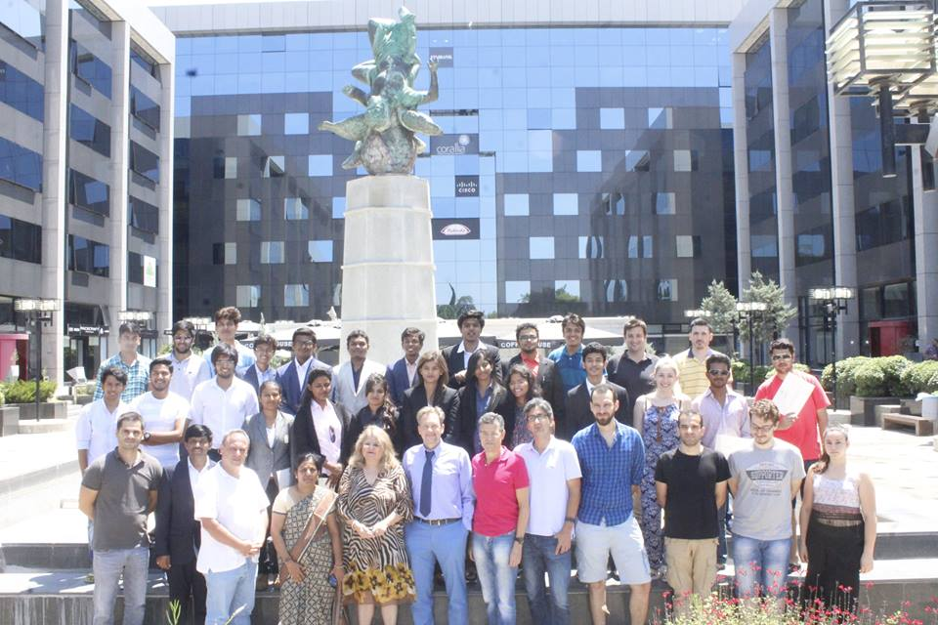
Photo Gallery UG Fellowship program

Slide 13
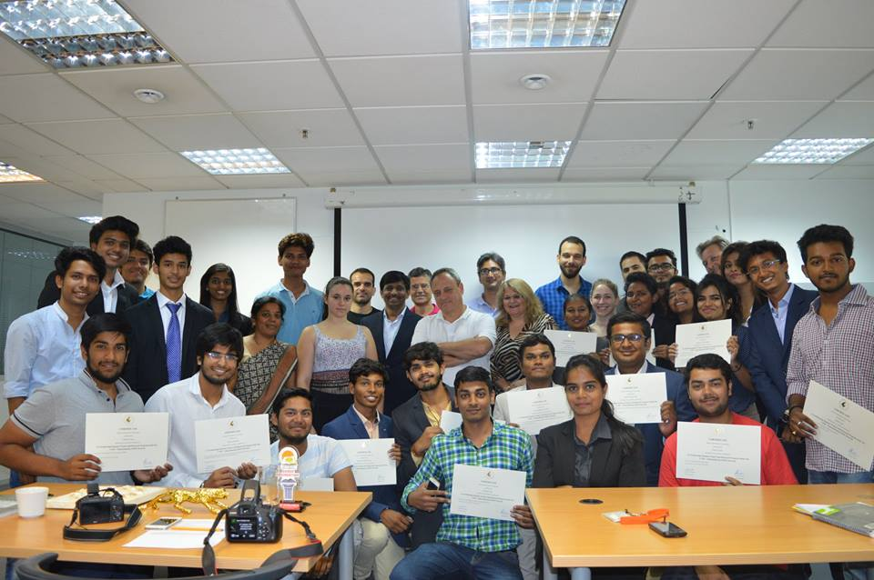
Photo Gallery

Slide 14
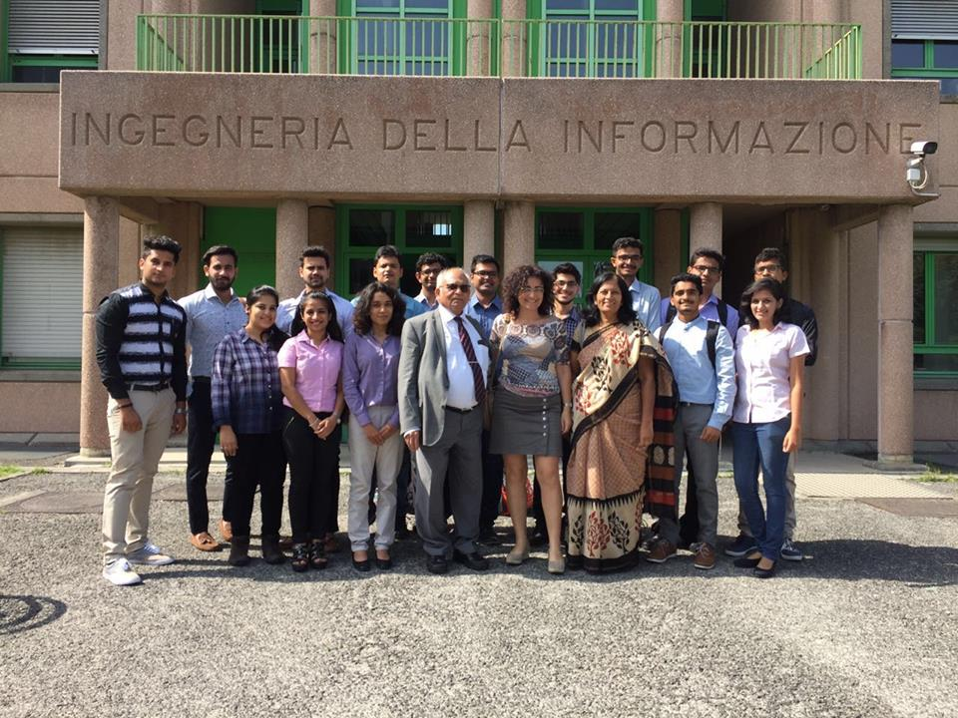
Photo Gallery

Slide 15
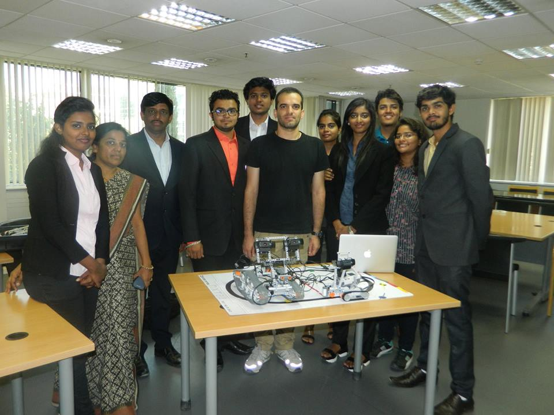
Photo Gallery

Slide 16
Look forward to enriching our eco-system with your esteemed institution!! Thanks….

