Slide 1


Angular JS
Presented by: Kanika Agarwal
This document and all its contents contain information from Cybage Software Private Limited which may be privileged, confidential, or otherwise protected from disclosure. The information is intended to be for the addressee(s) only. Any unauthorized disclosure, copy, distribution, or use of the contents of this message is strictly prohibited.

Slide 2
Agenda
Overview on Frontend MVC
What is Angular JS?
Key Features
Bootstrapping
Event loop
Helper Functions
HTTP, Filters
Directives, Controllers
Modules
Dependency Injection
Controller communication
References & Examples

Slide 3
When to use a JS MV* framework
Your application needs an asynchronous connection to the backend.
Your application has functionality that shouldn’t result in a full page reload (i.e. adding a comment to a post, infinite scrolling)
Much of the viewing or manipulation of data will be within the browser rather than on the server.
The same data is being rendered in different ways on the page.
Your application has many trivial interactions that modify data (buttons, switches)

Slide 4
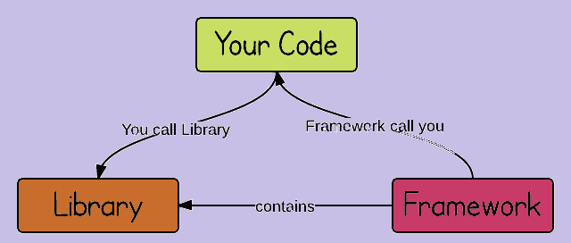

Slide 5
Quick Definitions
Backbone.js: Provides models with key-value binding and custom events, collections, and connects it all to your existing API over a RESTful JSON interface.
AngularJS: A toolset based on extending the HTML vocabulary for your application.
Ember.js: Provides template written in the Handlebars templating language, views, controllers, models and a router.
Knockout: Aims to simplify JavaScript UIs by applying the Model-View-View Model (MVVM) pattern.
CanJS: Focuses on striking a balance between size, ease of use, safety, speed and flexibility.
ExtJS: Amongst other things offers plugin-free charting, and modern UI widgets.

Slide 6
Framework Size
Framework | Net Size | Size with required dependencies
AngularJS 1.2.22 | 39.5kb | 39.5kb
Backbone.js 1.1.2 | 6.5kb | 43.5kb (jQuery + Underscore) 20.6kb (Zepto + Underscore)
Ember.js 1.6.1 | 90kb | 136.2kb (jQuery + Handlebars)
Knockout JS | 15.7kb | 43kb (sammy.js + knockout.mapping.js + jquery.js)

Slide 7
Apple to Apples
A more fair comparison might be to compare full frameworks like AngularJS and EmberJS with MV* Stacks that include great but less broad libraries like Backbone and KnockoutJS.
To be more specific, the following comparisons would be more “apples to apples”:
AngularJS
EmberJS
Backbone with Marionette
KnockoutJS with DurandalJS, and HistoryJS or SammyJS
CanJS

Slide 8
What is AngularJS?
An open source JavaScript MVC/MVVM/“MVW” (model-view-whatever) framework for building single-page web apps
Maintained by Google & development community
Licensed under the MIT license
Supports modern browsers including Internet Explorer IE 9+ as of AngularJS 1.3

Slide 9
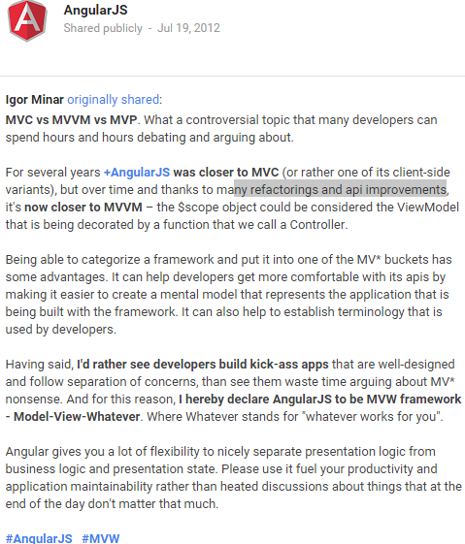
MVW

Slide 10
Downloading the libraries
Download AngularJS from:
http://angularjs.org/
We’ll need angular.min.js
Download Twitter Bootstrap from:
http://getbootstrap.com/
We’ll need bootstrap.min.css

Slide 11
Why choose Angular JS Framework for front-end web development?
Angular JS Framework is developed by Google.
Write less code to do more.
Angular JS is equipped with a lot of features :
HTTP calls
Data Binding and Dependency Injection.
Extends HTML
Client-side form validation.

Slide 12
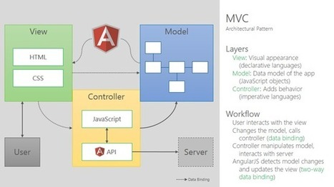
Architecture

Slide 13
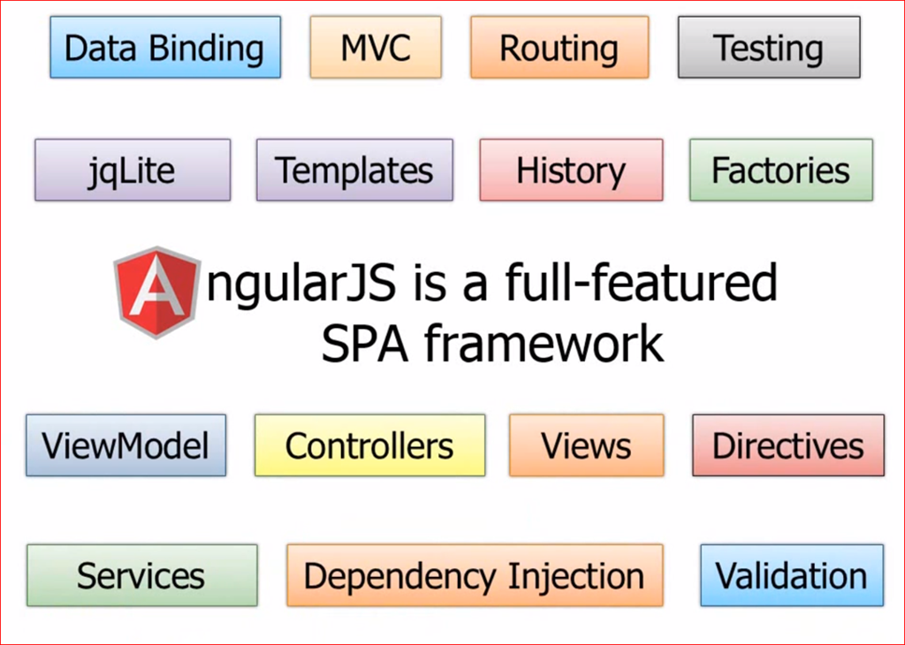
Key Features of AngularJS

Slide 14
Key AngularJS Concepts
Directive: View construction & DOM manipulation
Controller: Application logic (model)
Scope: “Glue” between the controller and the view
Module: Code organization and unit of re-use
Dependency Injection: Automatically manage object dependencies
Filters: Declare how to transform data for display to the user
Template
Data-Binding

Slide 15
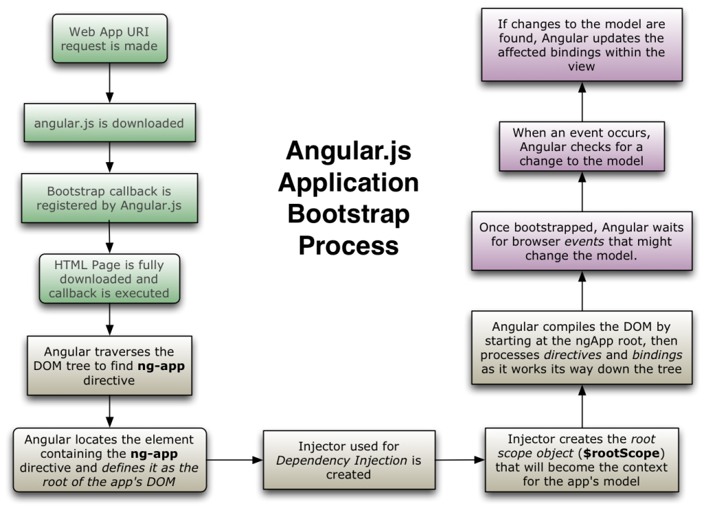

Slide 16
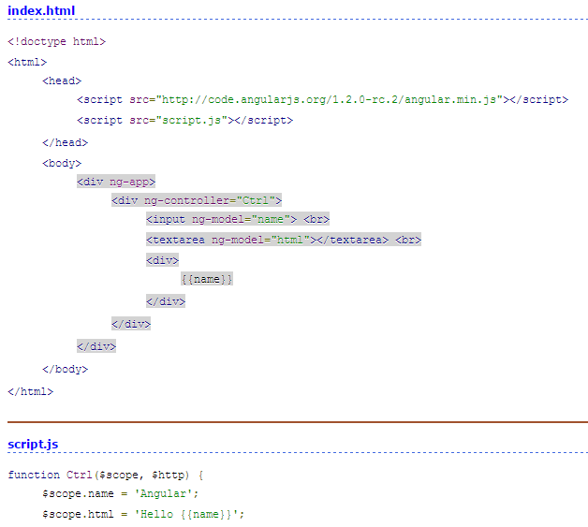

Slide 17
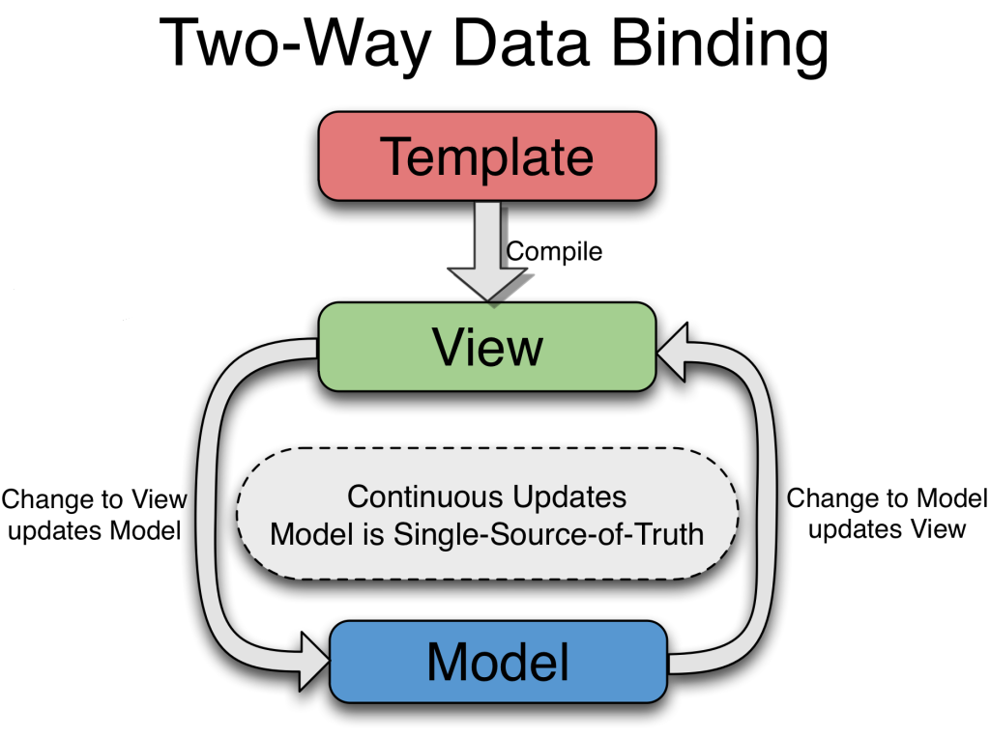

Slide 18
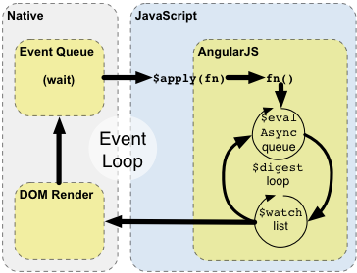
Angular Event Loop
$watch: http://jsbin.com/ucaxan/1/edit
$apply: http://jsbin.com/tuguza/1/edit

Slide 19
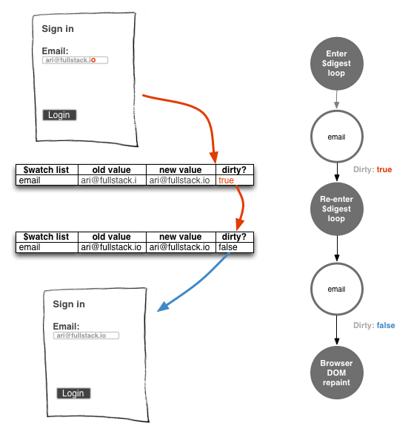
Dirty Checking

Slide 20
Function components in ng
angular.bind
angular.bootstrap
angular.copy
angular.element
angular.equals
angular.extend
angular.forEach
angular.fromJson
angular.identity
angular.injector
angular.isArray
angular.isDate
angular.isDefined
angular.isElement
angular.isFunction
angular.isNumber
angular.isObject
angular.isString
angular.isUndefined
angular.lowercase
angular.merge
angular.module
angular.noop
angular.toJson
angular.uppercase

Slide 21
Form validation
$pristine : True if user has not interacted with the form yet.
$dirty : True if user has already interacted with the form.
$valid : True if all of the containing forms and controls are valid.
$invalid : True if at least one containing control or form is invalid.
$submitted: True if user has submitted the form even if its invalid.
$error : Is an object hash, containing references to controls or forms with failing validators
Built-in validation tokens:
Email, max, maxlength, min, minlength, number, pattern, required, url, date, time, week, month

Slide 22
Scopes
Think “ViewModel” in MVVM architecture
Expose the domain model to the view
Provide both data and functionality
The domain model is just POJO (plain old JavaScript objects)
There are many scopes in an AngularJS application, arranged in a hierarchy

Slide 23
Controllers
Responsible for initializing the scope object
Populate the scope with initial model values
Augment the scope with functions that can be called by the UI

Slide 24
Directives
Declarative UI construction – the “V” in MVW
Appear in HTML as new elements & attributes
Attach functionality to DOM elements
Provide two-way data binding
Provide for DOM manipulation (for example, repetition and conditional inclusion of DOM elements)

Slide 25
Directives
Conditional Rendering Directives
ng-show
ng-hide
ng-switch
ng-if
ng-include
ng-repeat

Slide 26
Directives
Event Listener Directives
ng-click
ng-dbl-click
ng-mousedown
ng-mouseup
ng-mouseenter
ng-mouseleave
ng-mousemove
ng-mouseover
ng-keydown
ng-keyup
ng-keypress
ng-change

Slide 27
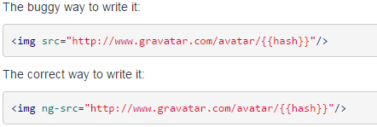
Need for ng-src and ng-href
Only use ng-src and ng-href if you have dynamic links or have to load images dynamically. Use the href and src otherwise.

Slide 28
AJAX : $http Service
$http Functions
$http.get(url, config)
$http.post(url, data, config)
$http.put(url, data, config)
$http.delete(url, config)
$http.head(url, config)

Slide 29
Formatting Filters
Filter | Description
date | Formats the variable as a date according to the given date format
currency | Formats the variable as a number with a currency symbol
number | Formats the variable as a number
lowercase | Converts the variable to lowercase
uppercase | Converts the variable to uppercase
json | Converts the variable to a JSON string

Slide 30
Array Filters
Filter | Description
limitTo | Limits the array to the given size, beginning from some index in the array. The limitTo filter also works on strings.
filter | A general purpose filter.
orderBy | Sorts the array based on provided criteria.

Slide 31
Modules
Keep global namespace clean
Helps in code organization
Factor out common functionality for re-use between applications
Are assembled into an AngularJS application via dependency injection

Slide 32
Dependency Injection
Describes dependencies among objects declaratively
Avoids tight coupling between objects; facilitates re-use
The AngularJS injector finds and wires up collaborating objects, referred to as “services”

Slide 33
$location
The $location service:
Exposes the current URL in the browser address bar, so you can
Watch and observe the URL.
Change the URL.
Maintains synchronization between itself and the browser's URL when the user
Changes the address in the browser's address bar.
Clicks the back or forward button in the browser (or clicks a History link).
Clicks on a link in the page.
Represents the URL object as a set of methods (protocol, host, port, path, search, hash).

Slide 34
 | window.location | $location service
purpose | allow read/write access to the current browser location | same
API | exposes "raw" object with properties that can be directly modified | exposes jQuery-style getters and setters
integration with angular application life-cycle | none | knows about all internal life-cycle phases, integrates with $watch, ...
aware of docroot/context from which the application is loaded | no - window.location.pathname returns "/docroot/actual/path" | yes - $location.path() returns "/actual/path"

Slide 35
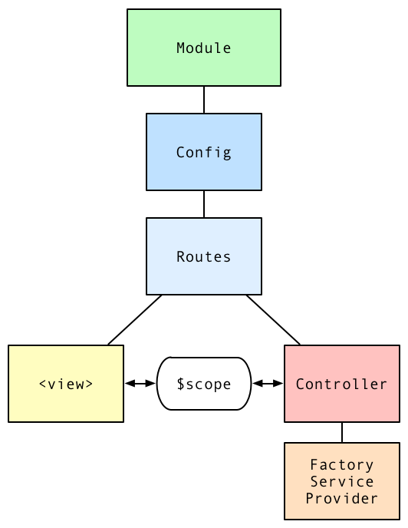
Angular runtime diagram

Slide 36
Controller
<div ng-app="myApp">
<div ng-controller="Ctrl1"> The current number is: {{number}} </div>
<div ng-controller="Ctrl2"> <button ng-click="buttonClick()">Click Me</button> </div>
</div>
<script>
var myApp = angular.module('myApp', []);
myApp.controller('Ctrl1', ['$scope', function ($scope) {
$scope.number = 1;
}]);
myApp.controller('Ctrl2', ['$scope', function ($scope) {
$scope.buttonClick = function () {
console.log('button was clicked');
};
}]);
</script>

Slide 37
Routes
<body ng-app="sampleApp">
<a href="#/route1">Route 1</a><br/>
<a href="#/route2">Route 2</a><br/>
<div ng-view></div>
<script>
var module = angular.module("sampleApp", ['ngRoute']);
module.config(['$routeProvider',
function($routeProvider) {
$routeProvider.
when('/route1', {
templateUrl: 'angular-route-template-1.jsp',
controller: 'RouteController'
}).
when('/route2', {
templateUrl: 'angular-route-template-2.jsp',
controller: 'RouteController'
}).
otherwise({ redirectTo: '/' });
}]);
</script>
</body>

Slide 38
Service
function MyService() {
this.doIt = function() {
console.log("done");
}
}
var myModule = angular.module("myModule", []);
myModule.service("myService", MyService);
myModule.controller("MyController", function($scope, myService) {
myService.doIt();
});

Slide 39
Factory
var myModule = angular.module("myModule", []);
myModule.factory("myFactory", function() {
return "a value";
});
myModule.controller("MyController", function($scope, myFactory) {
console.log(myFactory);
});

Slide 40
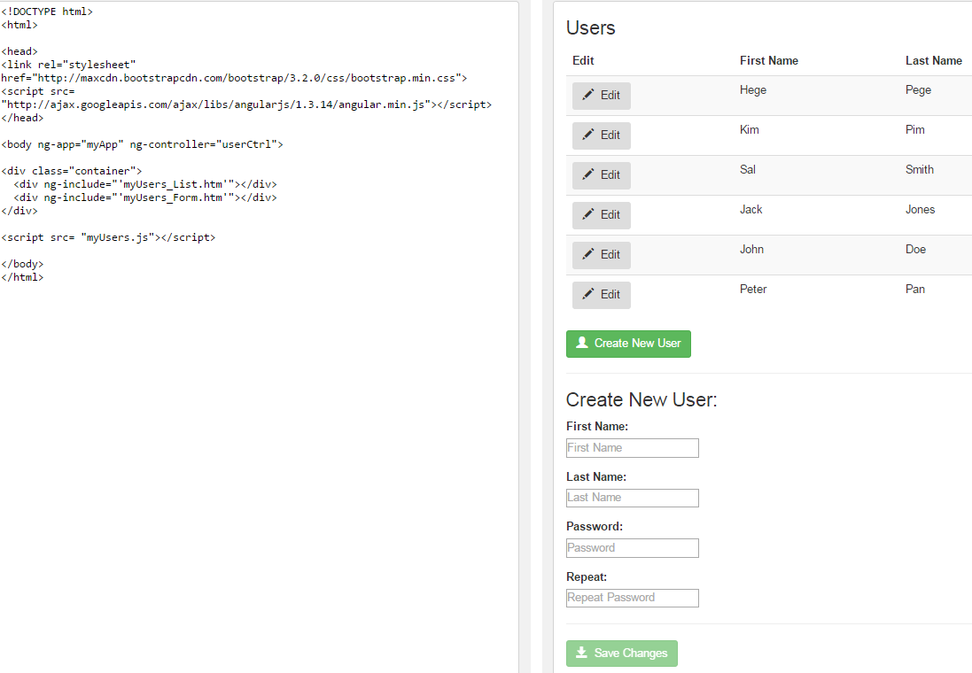
Use of ng-include

Slide 41
Getting around ngApp limitations with ngModule
ngApp directive has two fairly big limitations:
You can only have one ng-app per page.
You can only associate a single module with a single HTML element
Example:
http://jsfiddle.net/kanika/1zog7Lwv/

Slide 42

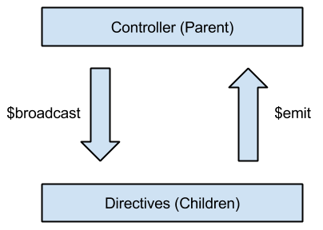
Controller Communication
$broadcast
$emit
$on

Slide 43
Examples
http://jsfiddle.net/kanika/xmhtjumo/8/
angular.copy (): http://plnkr.co/edit/UdHKAaMX9o72FZqKV8IP?p=preview
http://tutorialzine.com/2013/08/learn-angularjs-5-examples/
https://builtwith.angularjs.org/
https://github.com/angular/angular.js/wiki/Projects-using-AngularJS
Companion suite: http://angular-ui.github.io/

Slide 44
References
http://angular-tips.com/
https://www.ng-book.com
http://tutorials.jenkov.com/angularjs/index.html
http://tutorialzine.com/2013/08/learn-angularjs-5-examples/
http://dailyjs.com/2013/06/06/angularjs-1/
http://toddmotto.com/ultimate-guide-to-learning-angular-js-in-one-day/

Slide 45
Any Questions?

Slide 46
Thank You!

