Slide 1
US Candy Distributor
Database Analysis
A T-SQL exploration of sales, products, factories, customers & candy
Course: Intermediate Analytics CAP2761-2263-6206 Database: US Candy Distributor (.bacpac) Platform: Azure SQL Database + VS Code + GitHub
Data Analysts:
Cristopher Tagliarini
Alex Alonso
Christopher Negron

Slide 2
Introduction
2
About the Database
Analysis Goals
US Candy Distributor
A medium-sized database modeling a fictional candy distribution company operating across the United States. 6 Tables • Azure SQL Database Factories, Products, Customers,
Sales, Inventory, SalesTargets
Which candy division drives the most revenue?
Which products are most and least profitable?
Are divisions hitting their monthly sales targets?
Which customer types spend the most?
Which products are the slowest movers?
Which factories generate the highest gross profit?

Slide 3
Process
3
01
Load Database
02
Connect & Explore
Downloaded the US Candy Distributor .bacpac file and uploaded it to an Azure Storage container, then restored it as an Azure SQL Database.
Connected the Azure SQL Database to VS Code and used the DBCode extension to explore tables, schemas, and relationships.
03
Write T-SQL Queries
04
Visualize & Publish
Authored 12+ SELECT queries covering JOINs, GROUP BY / HAVING, subqueries, CTEs, variables, stored procedures, and views.
Created visualizations using DBCode. Exported charts as PNG files, published all deliverables to GitHub, and collaborated with team members.

Slide 4
T-SQL Queries Overview
6
Q1
Top 5 Best-Selling Products
Q2
Total Revenue by Factory (Ranked)
JOIN · GROUP BY · ORDER BY · TOP
JOIN · GROUP BY · ORDER BY · AGGREGATION · RANK
Identifies which individual products generate the most revenue for the distributor.
Ranks factories by revenue contribution to spot top performers and under performers
Q3
Monthly Revenue vs. Sales Targets
Q4
Revenue by Customer Type
JOIN · GROUP BY · HAVING
JOIN · GROUP BY · COUNT DISTINCT
Identifies months where each division missed its sales target — highlights underperformance.
Breaks down spend across Retailer, Wholesaler, and Specialty customers with revenue-per-customer.
Q5
Slow-Moving Products by Factory
Q6
Factory Output & Profitability
3-Table JOIN · GROUP BY · TOP
3-Table JOIN · Margin Calculation
Surfaces the 10 products with the lowest unit sales, paired with their supplying factory info.
Ranks factories by gross profit and margin %, computing COGS from units sold and unit cost.

Slide 5
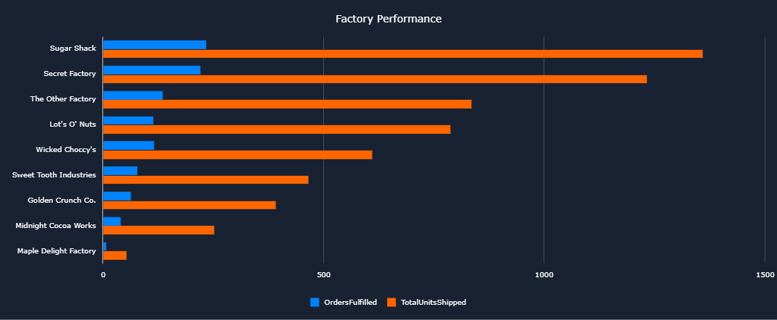
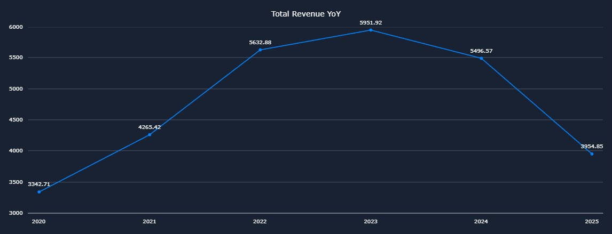
Analysis & Findings
4
Key Findings
Sugar division leads in units sold (2,094), narrowly ahead of Other (2,045) and Chocolate (1,839)
Revenue peaked in 2023 at $5,951.92, with a notable decline into 2025
Lickable Wallpaper is the #1 top-selling product; Nerds is the lowest with only 36 units sold
Wholesalers generate the highest revenue per customer compared to Retailers and Specialty buyers
Several divisions missed monthly sales targets, Chocolate underperformed most frequently
Factory gross margins vary significantly, some factories are far more profitable than others
Factory Performance
Revenue Year-over-Year (2020–2025)

Slide 6
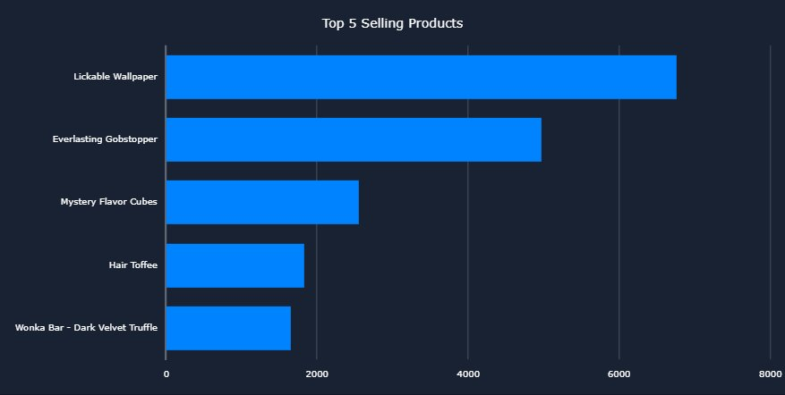
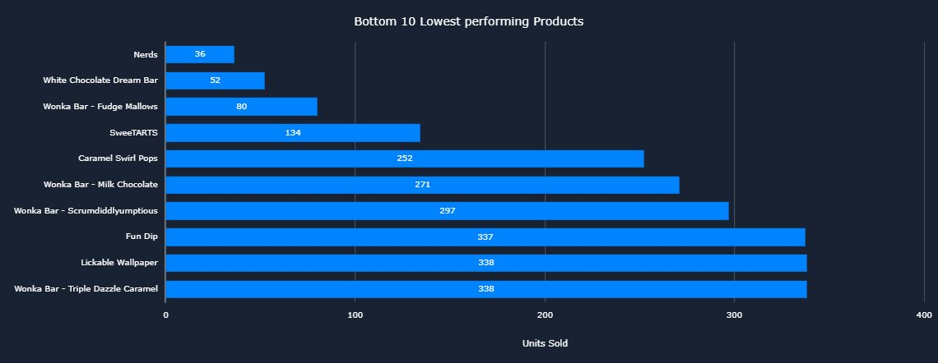
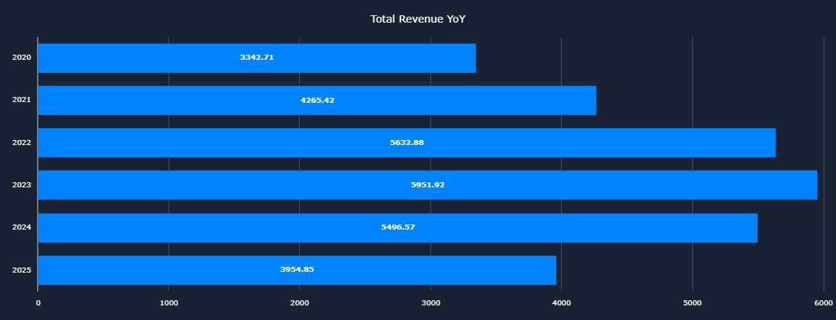
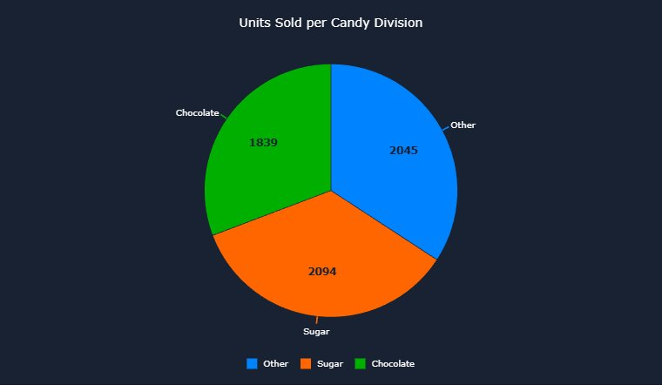
Visualizations
5
Top 5 Selling Products
Bottom 10 Lowest Performing Products
Total Revenue Year-over-Year (Bar)
Units Sold per Candy Division

Slide 7
Conclusions & Recommendations
7
Conclusions
Recommendations
Sugar leads in volume but all three divisions are competitive
Revenue grew steadily 2020–2023 then declined, worth monitoring
A small number of products (Nerds, White Chocolate Dream Bar) account for very low sales
Wholesalers deliver the highest revenue per customer
Several divisions missed monthly targets, particularly Chocolate
#1
Investigate why revenue declined post-2023, determine if it is a data gap or a real trend.
#2
Consider promotional campaigns for slow-moving products like Nerds and White Chocolate Dream Bar.
#3
Review Chocolate division's monthly targets, they may be set too high relative to demand.
#4
Prioritize growing the Wholesaler customer segment given their high revenue-per-customer ratio.
#5
Audit lower-margin factories to identify cost-reduction opportunities in their product lines.

Slide 8
References
Dataset Source Kaggle:
https://mavenanalytics.io/data-playground/us-candy-distributor
Azure SQL Database:
https://portal.azure.com - database hosting platform
GitHub Repository:
https://github.com/aalonso003/US_Candy_Distributor_DB_Analysis - All deliverables published SQL files, charts, presentation, .bacpac file
Gen AI Usage:
Claude (Anthropic) - assisted with query logic review, debugging
Google Gemini - for cleaning and making dataset useful

