Slide 1

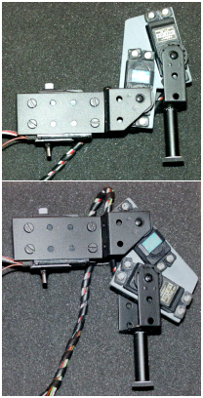
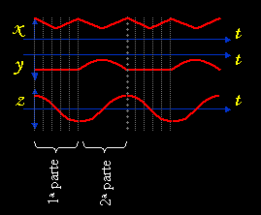
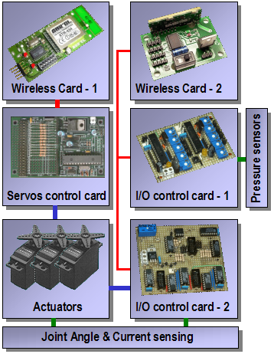
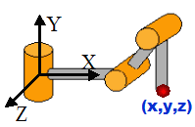
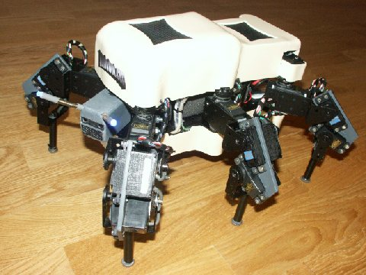


Melanie-III is an hexapod robot of 3 degrees of freedom by leg, that by the novel design of legs which it has, can transport several kilograms on its body without excessive power overload.
The robot has been designed for gait generation research. Equipped with 30 sensors for measuring physical values like joint positions, leg pressure and current consumption at coxa joints, it gives enough feedback from the surrounding surface to work on suitable algorithms for rough terrain walking.
The structure of the legs differs from the typical distribution of joints of an insect leg.
The coxo-trochanter and trochanter-femur joints of an insect practically are fused, while in Melanie III they are quite differentiated (Fig.1)
The robot control is located at an external computer, which keeps the communica-tion with the robot through wireless link.
The application mainly allows two kind of control of the robot: By direct progra-mming of gaits and by rough terrain waves displacement algorithm.
For the first case, the hardware reads the position of the joints at each time. With this values a direct kinematics algorithm is applied and the legs coor-dinates in space are stored (Fig. 2). Therefore it is possible to move individual legs manually and store the different consecutive posi-tions. Then those positions
The way it is done is by identifying obstacles by the touch sensors at the feet. If an obstacle is identified, the leg stops, its position is obtained and the length of the se-cond part of the cycle of the waves of this leg is modi-
Melanie - III
Fig. 3 – Three coordinate generator functions
fied temporarily. Also a small phase out is applied to assure that they move with coordination with the rest of legs. The values of phase and length of the second part of the cycle of this leg return to its normal values in the following cycle, with no disruption in the continuity of the waves during the transition.
Fig. 1 - Leg of Melanie-III
in two different positions.
could be reproduced obtaining custom made gaits or postures that allow both to test them or to use the robot as a simple animatronics.
The electronic cons-truction of Melanie III is modular (Fig. 4), being the modules communicated via I²C and RS232C buses.
For more information of Melanie and other robots, please visit the author’s web site:
The waves displacement gait generation algorithm works by using three different periodical wave functions. These func-tions will be used to obtain the coordinates vector (x,y,z) of each
Fig. 2 - Leg of Melanie-III
leg at any time (Fig. 3). This is combined with inverse kinematics function so actuators could be suitably controlled.
Varying the phase out between the waves of the different legs and the relation between the length from the first (1ª Parte) and second part (2ª Parte) of the cycle, different gaits and behaviors are obtained.
The program is prepared for the detection of obstacles on the ground and to adapt the gait to allow the robot to walk over these obstacles.
Fig. 4 – Modules diagram
Melanie-III was developed by
Alejandro Alonso Puig
http://mundobot.com
alejandro.alonso@mundobot.com
Spain

