Slide 1

Department of Information System Engineering
Do not Touch My Box – Bachelor Dissertation Project
Alper Aktas
20172142
SUPERVISOR: G.Savas Ilgi

Slide 2

PREFACE
This project presentation has been prepared within the scope of the Near East University Engineering Faculty Information Systems Engineering Undergraduate Program. First of all, I would like to thank my Head of Department Boran Sekeroglu for giving me the opportunity to start such a project, my valuable thesis advisor Galip Savas Ilgi , who guided me in my project, and all my other teachers who contributed to me.
BSc in Information Systems Engineering
Alper Aktas

Slide 3
Presentation Agenda
The Project Summary
Project Construction Purpose and Target Group ?
Why Did I Use Unity?
What Language Did I Use?
Why Did I Use Photon ?
Assets for Game Design
BSc in Information Systems Engineering
Alper Aktas

Slide 4
Presentation Agenda
How Does the Game Work ?
Introduction to the Game
How Does the Game Start ?
Endgame
Statistics Records
Unresolved Problem in the Project
What Can Be Added to the Project?
Conclusion
BSc in Information Systems Engineering
Alper Aktas

Slide 5




The Project Summary
Android Based
Online
2D
Multiplayer
BSc in Information Systems Engineering
Alper Aktas

Slide 6

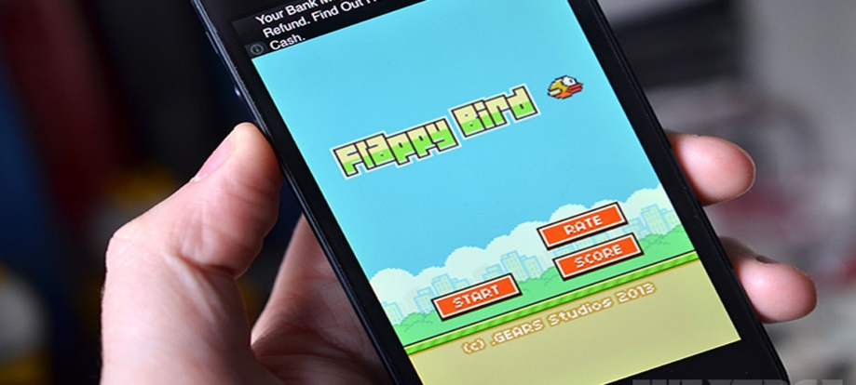
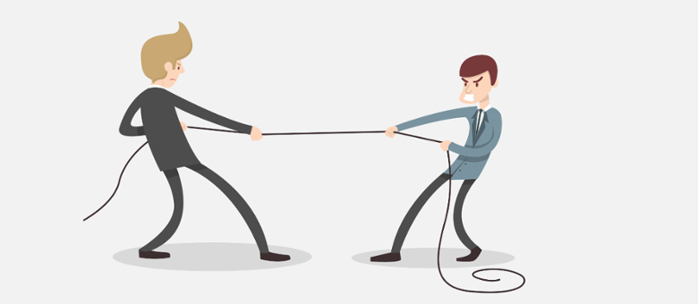
Project Construction Purpose and Target Audience?
Developing a sense of competition.
Individual development.
All age groups are targeted.
BSc in Information Systems Engineering
Alper Aktas

Slide 7


Why Did I Use Unity?
Free
Own Asset Store
Physics advantage.
Compatible with many operating systems.
BSc in Information Systems Engineering
Alper Aktas

Slide 8


What Language Did I Use?
It is easy and understandable.
It has a large community.
Resource access is easy.
BSc in Information Systems Engineering
Alper Aktas

Slide 9

Why Photon?
Free.
There are many available resources.
Positive feedback by users.
BSc in Information Systems Engineering
Alper Aktas

Slide 10
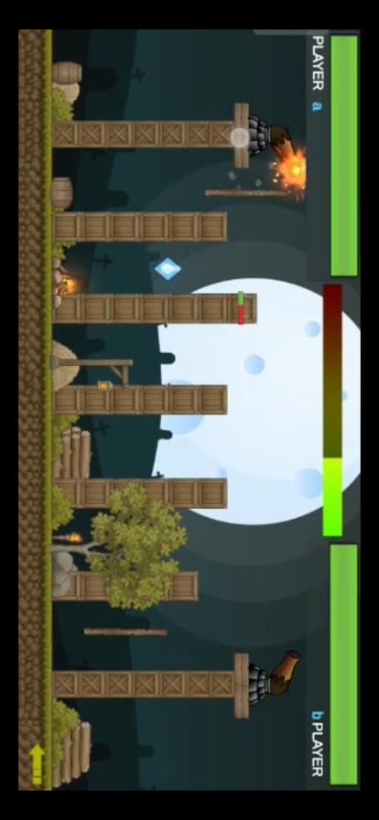
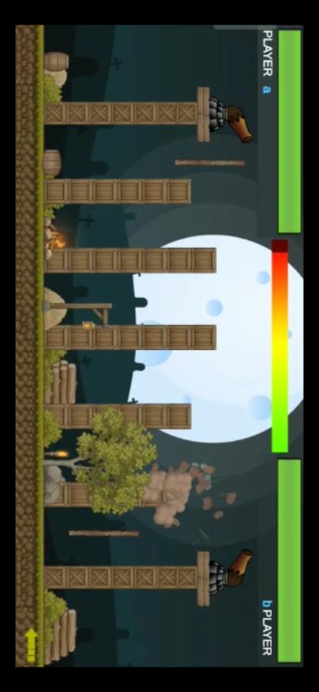
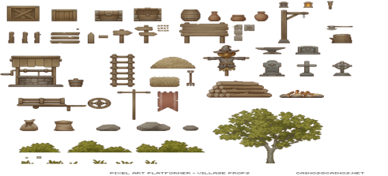
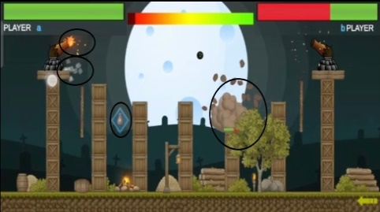


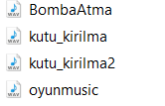




Used for Design
Effects and environment elements from the Assets store.
Taken from Google.
BSc in Information Systems Engineering
Alper Aktas

Slide 11
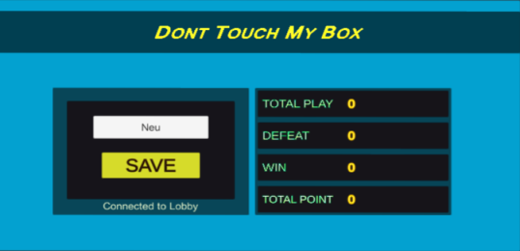
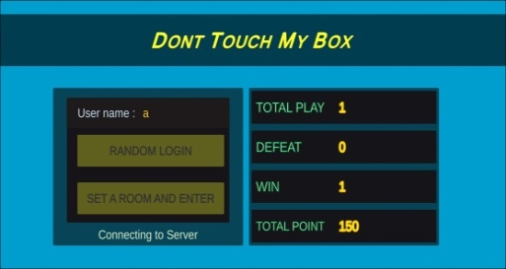
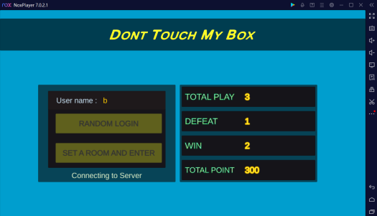
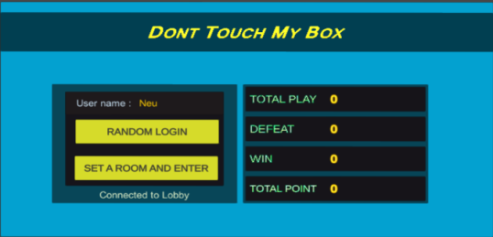
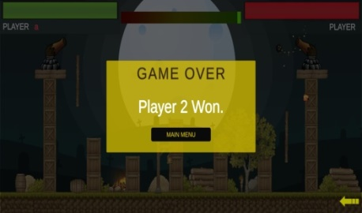
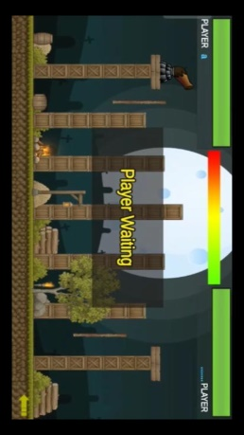
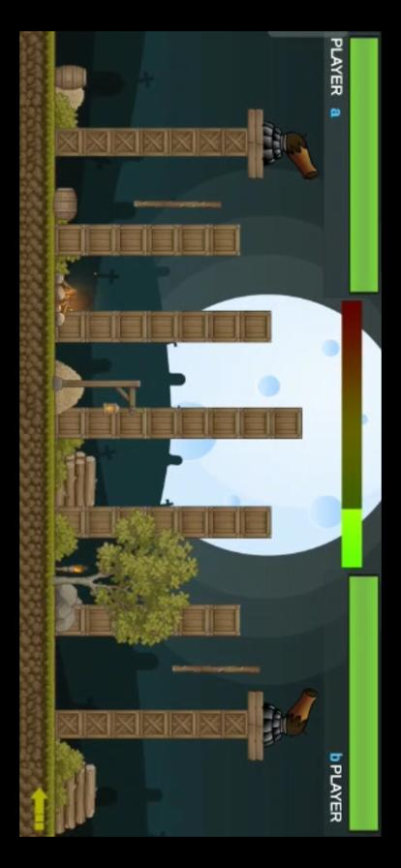
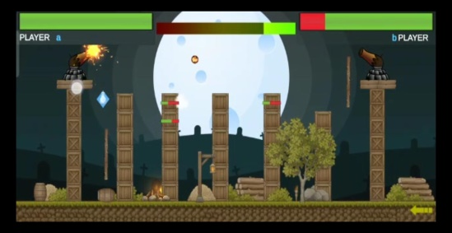
How Does the Game Work?
BSc in Information Systems Engineering
Alper Aktas

Slide 12
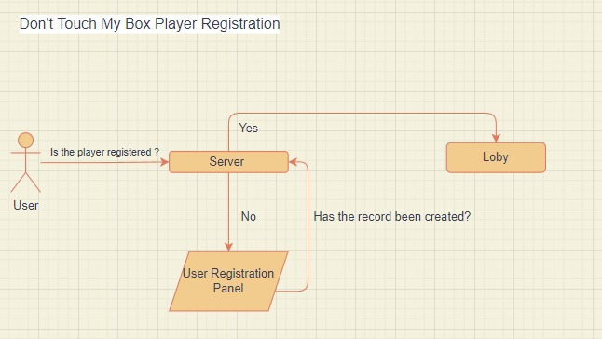
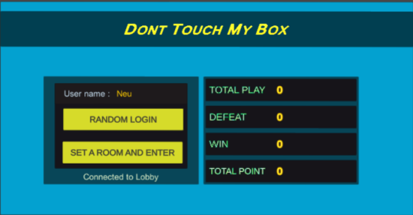
Introduction to the Game
Server control.
Server log review.
BSc in Information Systems Engineering
Alper Aktas

Slide 13
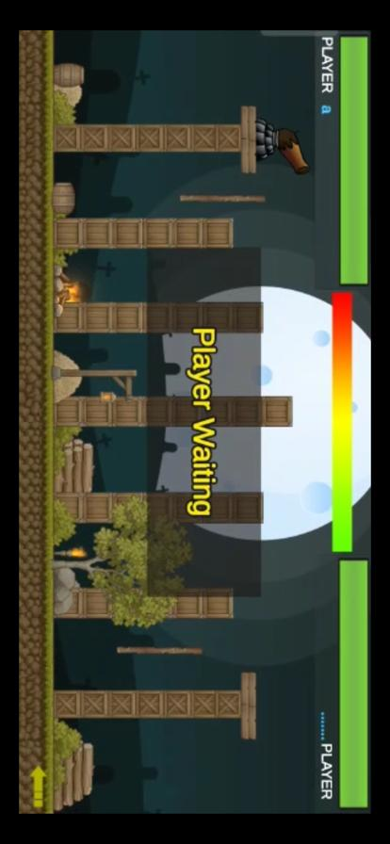
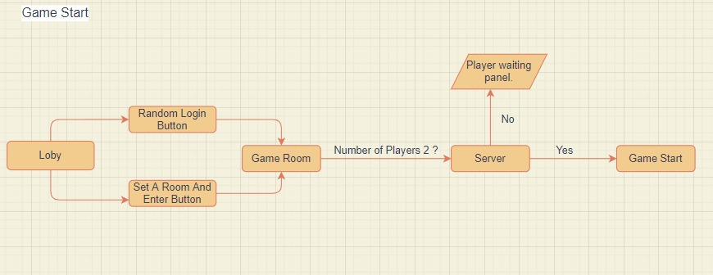
How does the game start?
Checking the number of players in the room.
BSc in Information Systems Engineering
Alper Aktas

Slide 14
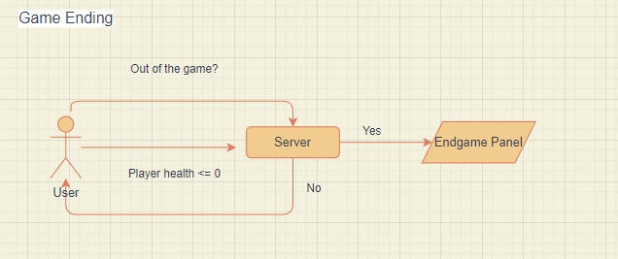

Endgame
Performs 2 checks.
Has any player's health been reset?
Exited the game?
BSc in Information Systems Engineering
Alper Aktas

Slide 15

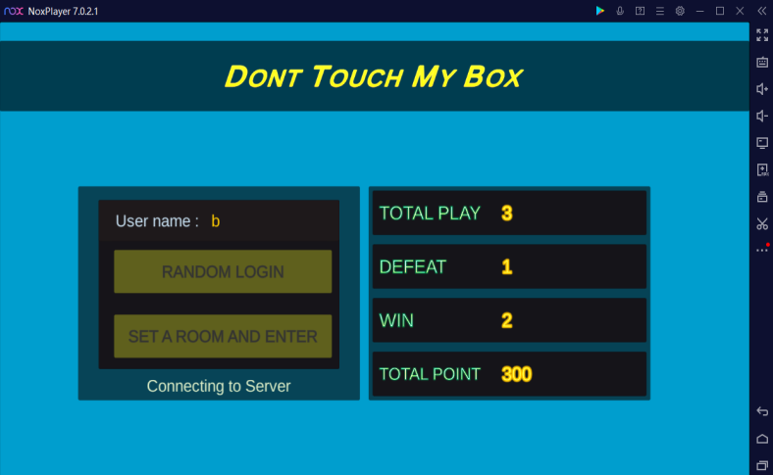
Statistics Records
PlayerPrefs = It is a class that stores Player preferences between game sessions.
BSc in Information Systems Engineering
Alper Aktas

Slide 16
Unsolved Problem in the Project
Bug = First player health not decreasing.
Situations That May Cause Error;
Unity version issue.
System error. (Fault of Core, Ndk,SDK files. )
Server-related error.
BSc in Information Systems Engineering
Alper Aktas

Slide 17
Future Works: What can be added to the project?
Different scenes.
It's a big league for gamers.
Messaging.
Possibility to set up a room with a password.
Using paid assets.
Language support.
BSc in Information Systems Engineering
Alper Aktas

Slide 18
Conclusion
There is a bug in the game that occurred recently but has not been resolved.
There are no errors other than the bug and it works without any problems.
BSc in Information Systems Engineering
Alper Aktas

Slide 19

BSc in Information Systems Engineering
Alper Aktas

Slide 20
Preferences
payment-icon-dollar-exchange-sign-vector-no-stop-finance-symbol-prohibited-ban-pay-money-143847079.jpg
https://guvensahin.com/wp-content/uploads/2015/08/Unity-Logo.png
https://www.sproutwired.com/wp-content/uploads/2021/12/Android-Google-releases-n
https://maviokyanus.net
https://www.sproutwired.com/wp-content/uploads/2021/12/Android-Google-releases-n
https://static.gunnarpeipman.com/wp-content/uploads/2009/10/csharp-featured.png
https://img2.pngindir.com/20180402/opq/kisspng-computer-icons-glyph-community-f
https://blog.photonengine.com/wp-content/uploads/2013/10/x_unitynetworking-520x
https://encrypted-tbn0.gstatic.com/images?q=tbn:ANd9GcTsDAL-mwJdlAxJA81q1AdF
https://encrypted-tbn0.gstatic.com/images?q=tbn:ANd9GcR1xQECwWTZMHgAeMcSXZ
https://europarents.eu/wp-content/uploads/2020/05/Online.jpg
BSc in Information Systems Engineering
Alper Aktas

