Slide 1
Chapter 10
Sockets for Servers
CS 441 – Network Programming

Slide 2
Overview
Server Sockets
Server’s life cycle
The ServerSocket Constructors
Accepting and Closing Connections
Handling Exceptions
Get Methods
Socket Options
setPerformancePreferences()
The Object Methods
Implementation
CS 441 – Network Programming

Slide 3
Server Sockets
client sockets themselves aren’t enough to write a server.
Server does not know when or who the connection is made /made by
ServerSocket class allows server programs to accept TCP connections
A server’s socket listens for connections on a specific port
Connecting clients must know IP address and port number of the server
When a client connects the server:
  Negotiates the connection
  Returns a regular Socket object
All data is sent/received through the socket object
ServerSocket class:
  Contains everything needed to write Java servers
  The constructors creates an object that listens for connections
  various methods exit to modify the options the class
CS 441 – Network Programming

Slide 4
Server’s life cycle
The basic life cycle of a Java server program is serve connecting clients
ServerSocket created using an IP and a port
ServerSocket listens for connections:
  accept() used to accepts client connections
  accept() blocks till a client attempts to connect
  accept() returns a Socket object which is connecting the client with the server
getInputStream( ) and getOutputStream( ) are used for I/O operations
Server and client should have an agreement over the protocol used
Connection is closed by client, server, or both
Server returns to listening for connection
CS 441 – Network Programming

Slide 5
Server’s life cycle
Typically when a client connects, a thread is spawned to handle it’s requests
A thread’s overhead is far less than a complete child-process
Multithreaded servers allow the servicing of multiple clients at the same time
wu-ftpd is a Unix FTP server:
  Generates a process for each client instead of a thread
  Typically slows down considerable after 400 connections
Threads need care. Too many threads can
  Crash the program
  Slow down the system
If requests are quick and do not take time, multithreading may not be needed
CS 441 – Network Programming

Slide 6
Server’s life cycle
ServerSocketChannel
  Java 1.4+
  Non-blocking class
  Channel based rather than stream based
  A single thread can process multiple connections
Client connections are queued by the OS
There is a limit (max) on how many connections are queued depending on the OS
Java programs don’t need to worry about who’s connection is first, second, …
CS 441 – Network Programming

Slide 7
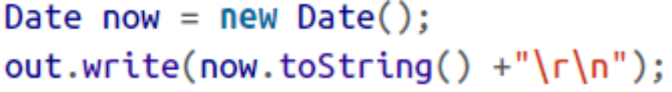
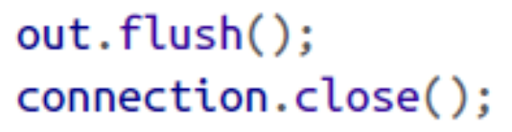
Example: Building a Time Server
First, create a server socket that listens on port 13
Next, accept a connection
get an OutputStream from the socket
chain this to an OutputStreamWriter
get the current time and write it onto the stream
flush the connection and close it:
CS 441 – Network Programming

Slide 8
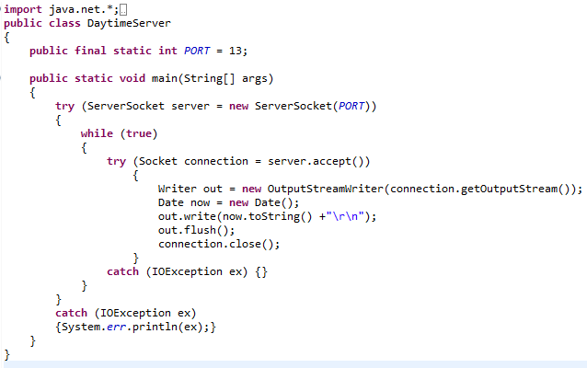
Example9_1:DayTimeServer-Server
CS 441 – Network Programming

Slide 9
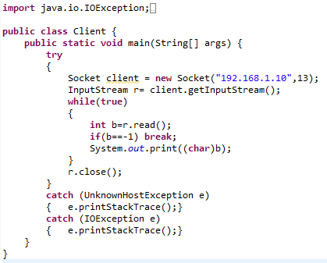
Example9_1:DayTimeServer-Client
CS 441 – Network Programming

Slide 10
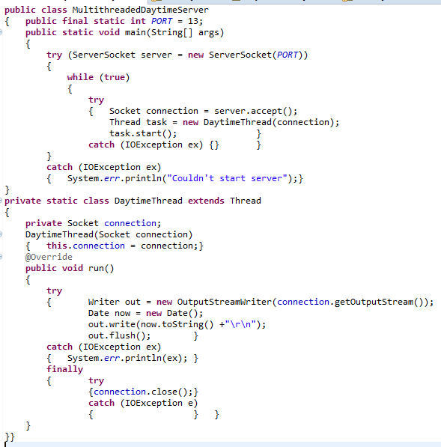
CS 441 – Network Programming

Slide 11
Resting Ports
Open cmd
type in netstat -a -n –o
find TCP [the IP address]:[port number] .... #[target_PID]# (ditto for UDP)
(Btw, kill [target_PID] didn't work for me)
CTRL+ALT+DELETE and choose "start task manager"
Click on "Processes" tab
Enable "PID" column by going to: View > Select Columns > Check the box for PID
Find the PID of interest and "END PROCESS"
Now you can rerun the server on [the IP address]:[port number] without a problem
CS 441 – Network Programming

Slide 12
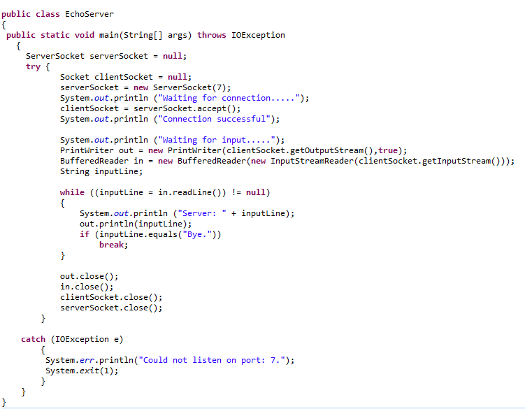
Writing to Servers with Sockets
CS 441 – Network Programming

Slide 13
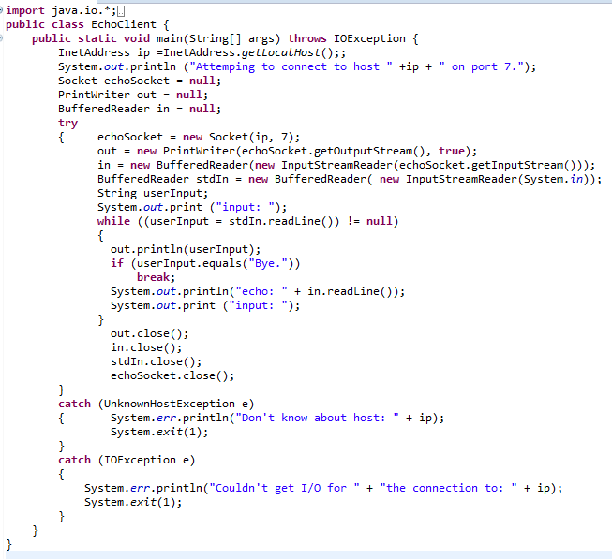
Writing to Servers with Sockets
CS 441 – Network Programming

Slide 14
The ServerSocket Constructors
Four constructors in class ServerSocket
  They do the same thing
  Some use default settings
  Some allow you to override settings
  Specify the port and/or local network interface to bind to (multi-interface)
  A port 0 means auto select a port
public ServerSocket(int port) throws BindException, IOException
  Specify witch port to listen on for clients
  Throws a BindException if the socket cannot be bound to the IP and/or port
  Throws an IOException
    If the port is in use
    Don’t have privileges to use that port (root access on Unix for port 0 – 1,023)
CS 441 – Network Programming

Slide 15
The ServerSocket Constructors
public ServerSocket(int port, int queueLength) throws BindException, IOException
  Works as the previous constructor
  Specifies the queue size (how many requests to queue before refusing the rest)
  If the machine has multiple NICs, then the server will listen on all of them
public ServerSocket(int port, int queueLength, InetAddress bindAddress) throws IOException
  Works as the previous constructor
  However, it only binds to a specific local address
  Connections coming on other addresses are ignored (multi-ip machines)
CS 441 – Network Programming

Slide 16
The ServerSocket Constructors
public ServerSocket( ) throws IOException // Java 1.4
  Creates an object but doesn’t bind it.
  Clients cannot connect to it until just yet
  The bind(InetAddress) should be called
  Used to allow options to be modified before binding
CS 441 – Network Programming

Slide 17
Accepting and Closing Connections
When a client connects, a Socket object is created
Call the close method on the Socket object to end the current transaction only
To stop accepting connections, call the close method on the ServerSocket object
public Socket accept( ) throws IOException
CS 441 – Network Programming

Slide 18
Accepting and Closing Connections
public void close( ) throws IOException
  When finished with the ServerSocket, close it
  Different from Socket.close()
  Releases the port and stops the server from accepting client connections
  Breaks all current Sockets that where opened by this ServerSocket
  Closed sockets cannot be reconnected.
  To test whether a ServerSocket is open:
  ss.isBound() && ! ss.isClosed( );
CS 441 – Network Programming

Slide 19
Handling Exceptions
Handle exception carefully
  Some exceptions don’t require the server to be shutdown (i.e Socket Exceptions)
  Some exceptions are critical enough to shutdown the server (i.e. BindException)
  Separate your try-catch blocks and use nested try-catch blocks
CS 441 – Network Programming

Slide 20
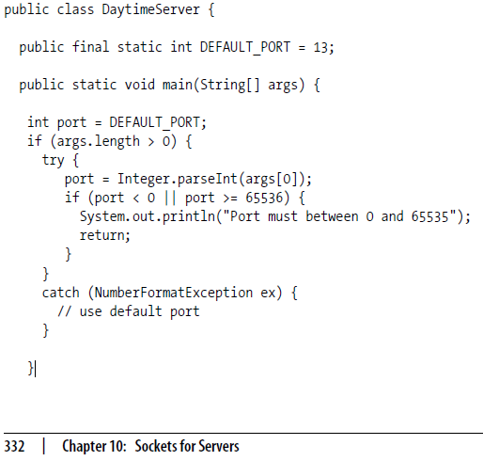
Handling Exceptions
This try-catch traps errors that may be caused by an invalid port. i.e. "ABC"
CS 441 – Network Programming

Slide 21
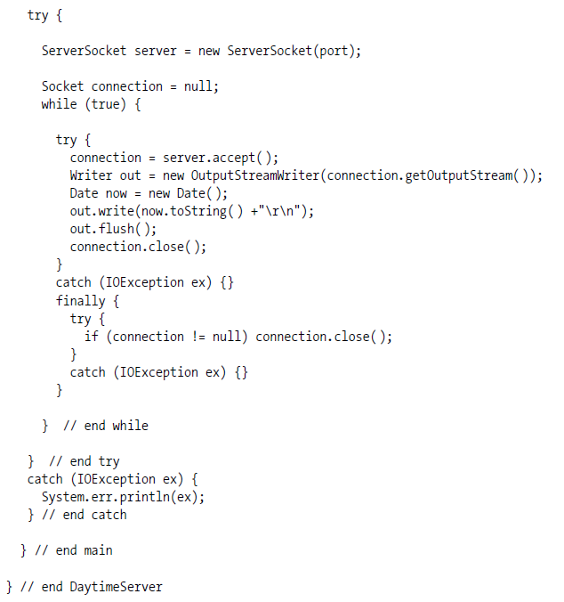
This try-catch traps errors that may arise while the ServerSocket object server is being constructed
This try-catch traps errors that may arise while the connections are accepted and processed
CS 441 – Network Programming

Slide 22
Get Methods
public InetAddress getInetAddress( )
  Returns the address being used by the server (the local host)
  In multi-IP address host, this method returns one of the host’s IP addresses
  Returns null if the server is not yet bound
public int getLocalPort( )
  Returns which port the server is bound to
  Useful if originally the port was not specified
  Returns -1 if the server is not yet bound
CS 441 – Network Programming

Slide 23
Socket Options
SO_TIMEOUT
  Number of milliseconds that accept() waits for before throwing an exception.
  Causes an InterruptedIOException (Java 1.3) or SocketTimeoutException (Java 1.4)
  0 means wait indefinitely
  Rarely used unless the client and server connection must occur within a limited time
  Set before accept() is invoked
Two methods for this field
  public void setSoTimeout(int timeout) throws SocketException
  public int getSoTimeout( ) throws IOException
CS 441 – Network Programming

Slide 24
Socket Options
SO_REUSEADDR
  Similar to SO_REUSEADDR for client sockets
  Specifies if a new socket can reuse an old socket while it still has data in it
  The default value is platform dependent
  Mac OS X and Linux defaults SO_REUSEADDR to true
Two methods
  public void setReuseAddress(boolean on) throws SocketException
  public boolean getReuseAddress( ) throws SocketException
CS 441 – Network Programming

Slide 25
Socket Options
SO_RCVBUF
  Set this option to globally set it for every socket created by the server.
  This option cannot be changed for a socket after it’s been created
  Sets the default receive buffer size (Large buffers for fast connections, small for …)
  Only suggests a value for the size of the individual IP packets in the stream
Two methods
  public void setReceiveBufferSize(int size) throws SocketException
  public int getReceiveBufferSize( ) throws SocketException
CS 441 – Network Programming

Slide 26
setPerformancePreferences()
public void setPerformancePreferences(int connectionTime, int latency, int bandwidth)
  Java 1.5
  Sets the preferences of connection time, latency, and bandwidth
The call setPerformancePreferences(2, 1, 3) means
  Maximum bandwidth is the most important
  Minimum latency is the least important
  Connection time is in the middle.
CS 441 – Network Programming

Slide 27
The Object Methods
Remember that the Object class is the super class for all Java classes
Every class in Java automatically inherits from class Object
ServerSocket overrides only toString() methods from java.lang.Object
  Usually used for debugging
  Not very reliable
  Using the normal hashing for equating servers is problematic
  Returns something like this: ServerSocket[addr=0.0.0.0,port=0,localport=5776]
    Addr is the of the local network interface the socket server is bound to
    Addr is 0.0.0.0 if bound to all interfaces
    Port is always 0
CS 441 – Network Programming

Slide 28
Implementation
ServerSocket provides two methods to change the default impl. of ServerSockets
Primarily used by implementers of a JVM
public static void setSocketFactory(SocketImplFactory factory) throws IOException
  Sets the SocketImplFactory
  This factory is used to create ServerSocket objects
  Different from the client socket object factory
  Call this method once, a second time causes SocketException.
protected final void implAccept(Socket s) throws IOException
  Used to override accept() to return a custom Socket object (subclass of Socket)
CS 441 – Network Programming

