Slide 1
Chapter 6
Internet Addresses
CS 441 – Network Programming

Slide 2
Internet Addresses
Nodes: Devices connected to the Internet.
Hosts: Nodes that are computers.
Each node or host is identified by at least one unique number called an Internet address or an IP address.
IP addresses are:
  4-byte-long IPv4 addresses
  16-byte-long IPv6 addresses.
An IPv4 address is normally written as dotted quad format(four unsigned bytes, each ranging from 0 to 255, with the most significant byte first,152.19.134.132).
An IPv6 address is written as eight blocks of four hexadecimal digits separated by colons, 2400:cb00:2048:0001:0000:0000:6ca2:c665, 2400:cb00:2048:1:0:0:6ca2:c665).
CS 441 – Network Programming

Slide 3
Internet Addresses
IP is for computers, host name for humans
Domain Name System (DNS). DNS associates hostnames that humans can remember (such as login.ibiblio.org) with IP addresses that computers can remember (such as 152.19.134.132).
The URL refers to a website rather than a particular machine.
Every computer connected to the Internet should have access to DNS.
If a client asks for the address of a machine outside the local domain, the local domain name server asks a domain name server at the remote location and relays the answer to the requester.
CS 441 – Network Programming

Slide 4
The InetAddress Class: Creating New InetAddress Objects
The java.net.InetAddress class is Java’s high-level representation of an IP address, both IPv4 and IPv6.
It is used by most of the other networking classes, including Socket, ServerSocket, URL, DatagramSocket, DatagramPacket.
There are no public constructors in the InetAddress class.
Use static methods:
This method actually make a connection to the DNS.
CS 441 – Network Programming

Slide 5
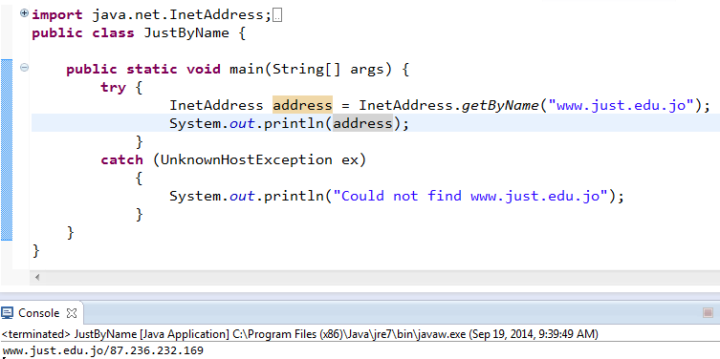
Example6_1
CS 441 – Network Programming

Slide 6
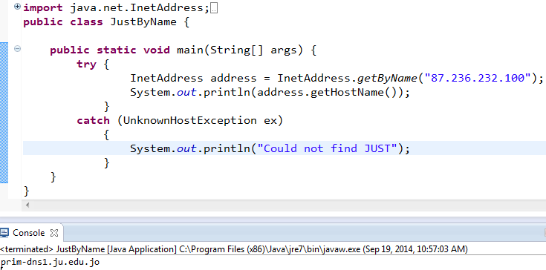
Example6_2
CS 441 – Network Programming

Slide 7
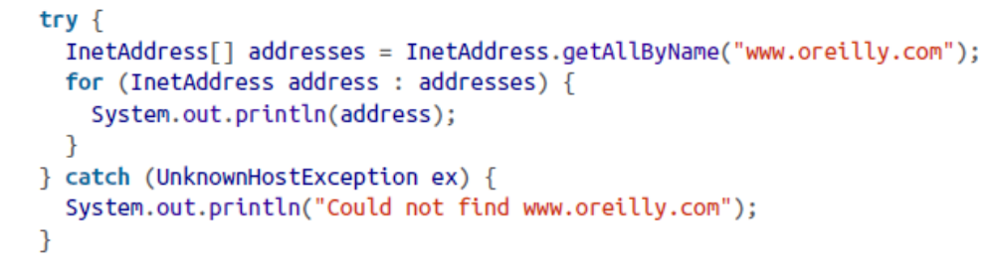
Example6_3
CS 441 – Network Programming

Slide 8
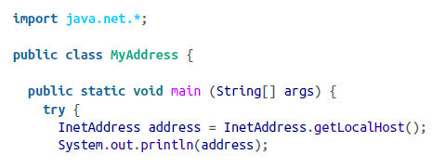
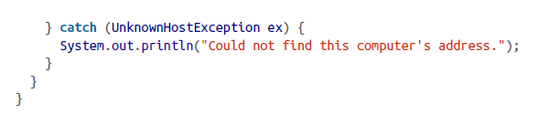
Example6_4
CS 441 – Network Programming

Slide 9
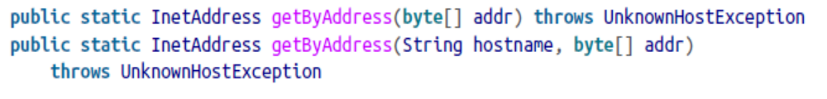
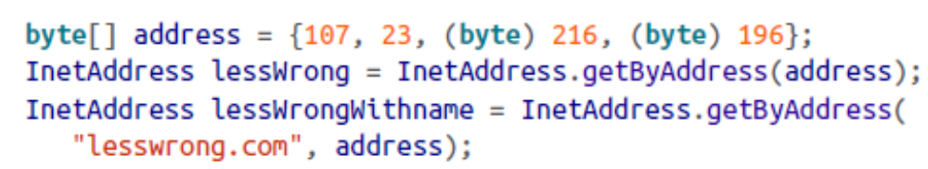
The InetAddress Class: Creating New InetAddress Objects
If you know a numeric address, you can create an InetAddress object from that address without talking to DNS using InetAddress.getByAddress().
CS 441 – Network Programming

Slide 10
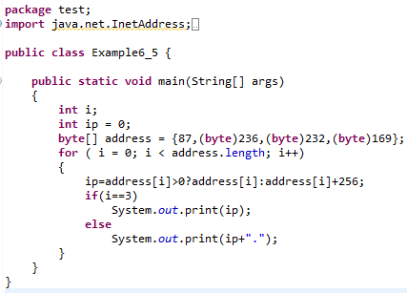
Example6_5
CS 441 – Network Programming

Slide 11
The InetAddress Class: Caching
the InetAddress class caches the results of lookups Because DNS lookups can be relatively expensive.
Java only caches unsuccessful DNS queries for 10 seconds.
These times can be controlled by the system properties networkaddress.cache.ttl and networkaddress.cache.negative.ttl
The first of those, networkad dress.cache.ttl, specifies the number of seconds a successful DNS lookup will remain in Java’s cache.
networkaddress.cache.negative.ttl is the number of seconds an unsuccessful lookup will be cached.
Attempting to look up the same host again within these limits will only return the same value.
CS 441 – Network Programming

Slide 12
The InetAddress Class: Lookups by IP address
Hostnames are much more stable than IP addresses.
always choose the hostname instead of IP address.
CS 441 – Network Programming

Slide 13
The InetAddress Class: Security issues
Creating a new InetAddress object from a hostname is considered a potentially insecure operation because it requires a DNS lookup.
An untrusted applet under the control of the default security manager will only be allowed to get the IP address of the host it came from (its codebase) and possibly the local host.
Untrusted code is not allowed to create an InetAddress object from any other hostname.
CS 441 – Network Programming

Slide 14
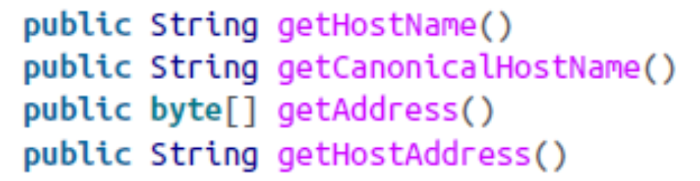
Getter Methods
The InetAddress class contains four getter methods that return the hostname as a string and the IP address as both a string and a byte array:
The InetAddress is immutable and thus its thread safe because there is no set methods.
CS 441 – Network Programming

Slide 15
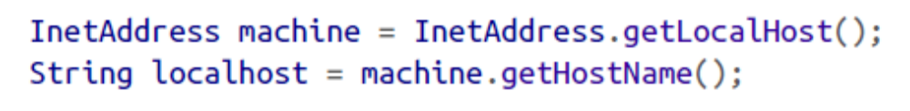
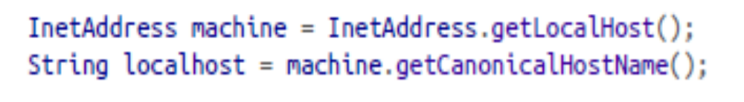
Getter Methods
The getHostName() method returns a String that contains the name of the host with the IP address represented by this InetAddress object.
The getCanonicalHostName(): it calls DNS if it can, and may replace the existing cached hostname.
CS 441 – Network Programming

Slide 16
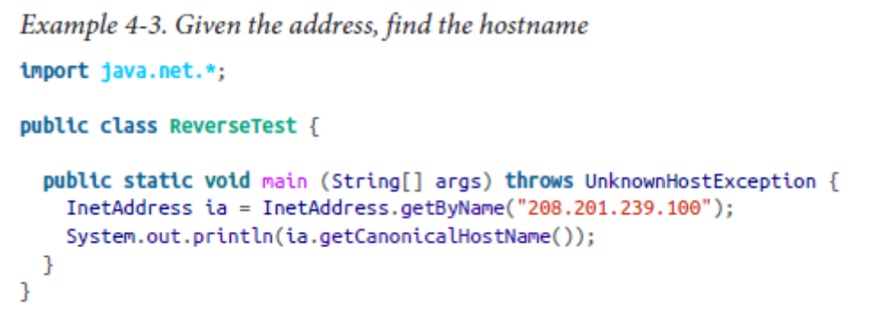
Getter Methods
CS 441 – Network Programming

Slide 17
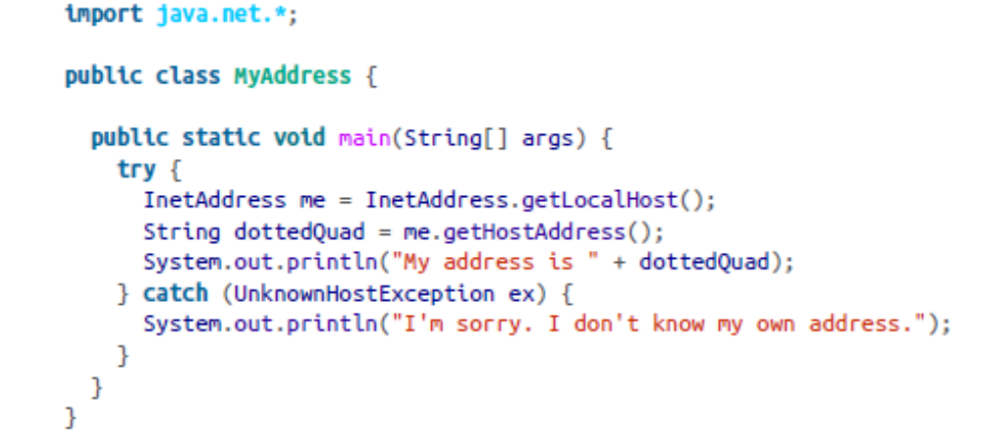
Getter Methods
The getHostAddress() method returns a string containing the dotted quad format of the IP address.
CS 441 – Network Programming

Slide 18
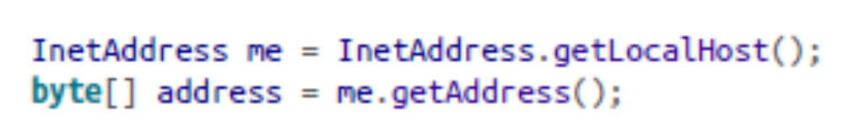
Getter Methods
getAddress() method: returns an IP address of the machine as an array of bytes in network byte order.
Java doesn’t have an unsigned byte primitive data type.
Bytes with values higher than 127 are treated as negative numbers.
you need to promote the bytes to ints and make appropriate adjustments.
CS 441 – Network Programming

Slide 19
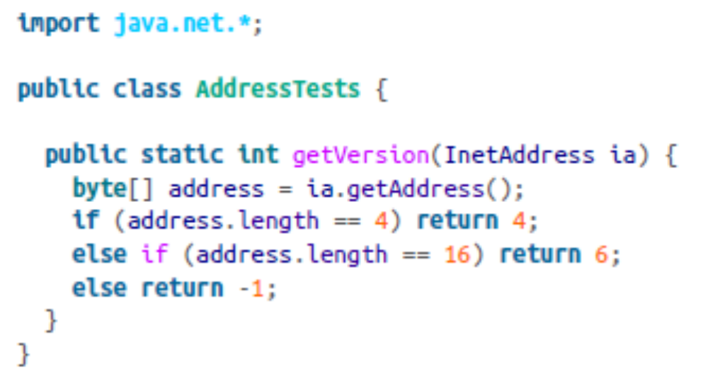
Getter Methods
CS 441 – Network Programming

Slide 20
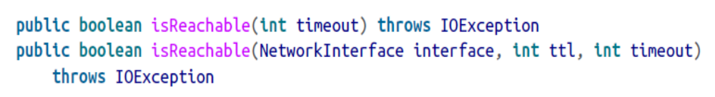
Testing Reachability
The InetAddress class has two isReachable() methods that test whether a particularcnode is reachable from the current host.
These methods attempt to use traceroute (more specifically, ICMP echo requests) to find out if the specified address is reachable.
If the host responds within timeout milliseconds, the methods return true; otherwise, they return false.
The second variant also lets you specify the local network interface the connection is made from and the “time-to-live” (the maximum number of network hops the connection will attempt before being discarded).
CS 441 – Network Programming

Slide 21
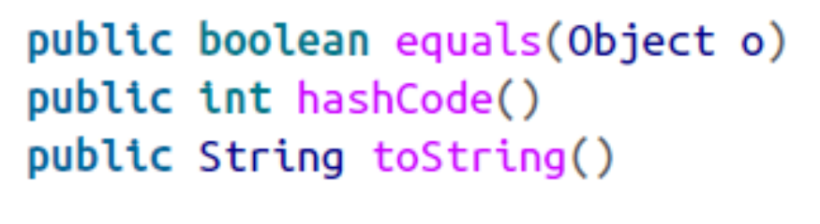
Object Methods
java.net.InetAddress inherits from java.lang.Object.
It overrides three methods to provide more specialized behavior.
An object is equal to an InetAddress object only if it is itself an instance of the InetAd dress class and it has the same IP address. It does not need to have the same hostname.
If two InetAddress objects have the same address, then they have the same hash code, even if their hostnames are different.
a toString() method that returns a short text representation of the object.
hostname/dotted quad address
CS 441 – Network Programming

Slide 22
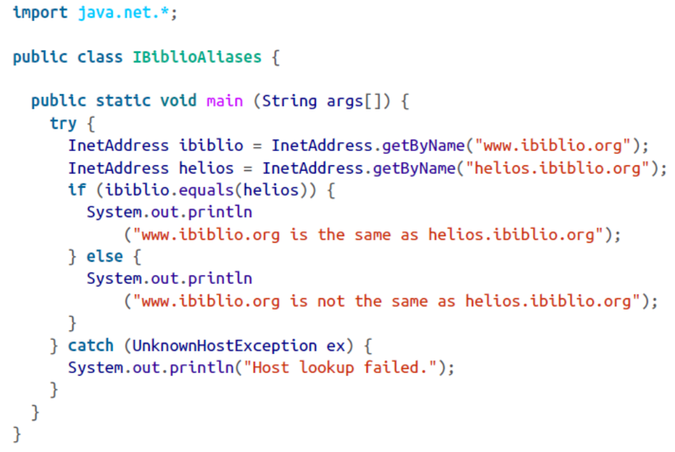
Example
CS 441 – Network Programming

Slide 23
Inet4Address and Inet6Address
Java uses two classes, Inet4Address and Inet6Address, in order to distinguish IPv4 addresses from IPv6 addresses:
you really shouldn’t be concerned with whether an address is an IPv4 or IPv6 address.
if you do need to know:
it’s quicker to check the size of the byte array returned by getAddress().
use instanceof to test which subclass you have.
Inet4Address overrides several of the methods in InetAddress but doesn’t change their behavior.
Inet6Address adds one new method, isIPv4CompatibleAddress().
This method returns true if and only if the address is essentially an IPv4 address stuffed into an IPv6 container
CS 441 – Network Programming

Slide 24
The NetworkInterface Class
The NetworkInterface class represents a local IP address
  Could be a physical interface such as an additional Ethernet card.
  Could be a virtual interface bound to the same physical hardware as the machine’s other IP addresses.
The NetworkInterface class provides methods to enumerate all the local addresses, regardless of interface, and to create InetAddress objects from them
CS 441 – Network Programming

Slide 25
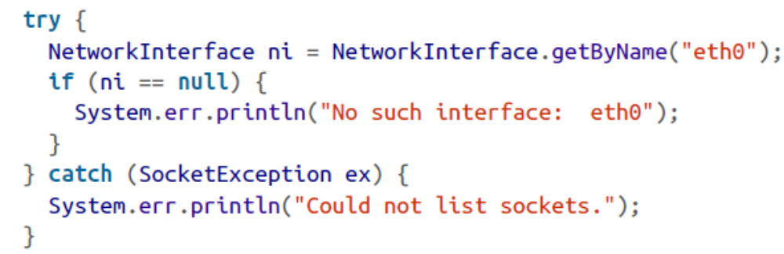
Factory Methods
public static NetworkInterface getByName(String name) throws SocketException
The getByName() method returns a NetworkInterface object representing the network interface with the particular name.
CS 441 – Network Programming

Slide 26
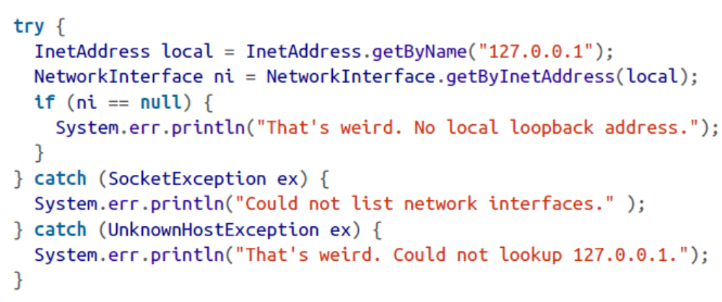
The NetworkInterface Class
public static NetworkInterface getByInetAddress(InetAddress address) throws SocketException.
The getByInetAddress() method returns a NetworkInterface object representing the network interface bound to the specified IP address.
CS 441 – Network Programming

Slide 27
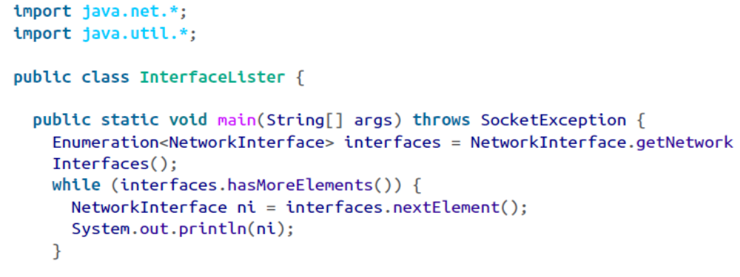
The NetworkInterface Class
public static Enumeration getNetworkInterfaces() throws SocketException
The getNetworkInterfaces() method returns a java.util.Enumeration listing all the network interfaces on the local host.
CS 441 – Network Programming

Slide 28
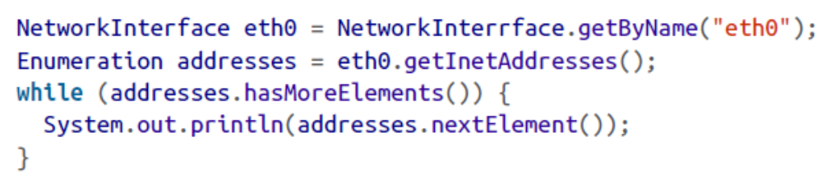
Getter Methods
public Enumeration getInetAddresses()
The getInetAddresses() method returns a java.util.Enumeration containing an InetAddress object for each IP address the interface is bound to.
CS 441 – Network Programming

Slide 29
Getter Methods
public String getName()
The getName() method returns the name of a particular NetworkInterface object, such as eth0 or lo.
public String getDisplayName()
getDisplayName() method allegedly returns a more human-friendly name for the particular NetworkInterface—something like “Ethernet Card 0.”
CS 441 – Network Programming

