Slide 1
Chapter 8
Sockets for Clients
CS 441 – Network Programming

Slide 2
Overview
Sockets
Socket Basics
The Socket Class
Socket Constructors
Socket Information
Closing the Socket
Half-closed sockets
Socket Options
Class of Service
Socket Exceptions
Socket Addresses
CS 441 – Network Programming

Slide 3

What Is a Socket?
Normally, a server runs on a specific computer and has a socket that is bound to a specific port number.
The server just waits, listening to the socket for a client to make a connection request.
On the client-side: The client knows the hostname of the machine on which the server is running and the port number on which the server is listening.
the client tries to meet with the server on the server's machine and port.
The client also needs to identify itself to the server so it binds to a local port number that it will use during this connection. This is usually assigned by the system.
CS 441 – Network Programming

Slide 4

What Is a Socket?
the server accepts the connection.
Upon acceptance, the server gets a new socket bound to the same local port and also has its remote endpoint set to the address and port of the client.
It needs a new socket so that it can continue to listen to the original socket for connection requests while tending to the needs of the connected client.
On the client side, if the connection is accepted, a socket is successfully created and the client can use the socket to communicate with the server.
The client and server can now communicate by writing to or reading from their sockets.
CS 441 – Network Programming

Slide 5
What Is a Socket?
A socket is one end-point of a two-way communication link between two programs running on the network.
Socket classes are used to represent the connection between a client program and a server program.
The java.net package provides two classes--Socket and ServerSocket--that implement the client side of the connection and the server side of the connection, respectively.
URLs and URLConnections provide a relatively high-level mechanism for accessing resources on the Internet. Sometimes your programs require lower-level network communication, for example, when you want to write a client-server application.
CS 441 – Network Programming

Slide 6
Sockets
Data transmitted across the Internet in datagrams (large packets)
Each datagram contains a header an a payload (حمولة)
Header contains destination’s and source’s addresses and ports.
Header contains a checksum to detect data corruption.
The payload contains the data itself
Data in a datagrams must be split into packets and reassembled.
Problems can occur with packets (lost, corrupted, or arrive our of order)
Network programs must account for these problems
Sockets do a lot of this work
Sockets lets you treat network connection as just another stream of bytes
Sockets shield programmers from low-level network details (error detection, packet sizes, packet retransmission, …)
CS 441 – Network Programming

Slide 7
Socket Basics
Socket(مقبس): a connection between two hosts.
Has seven functions:
  Connect to a remote machine
  Send data
  Receive data
  Close a connection
  Bind to a port
  Listen for incoming data
  Accept connections from remote machines on the bound port.
Java’s Socket class, which is used by both clients and servers, has methods that correspond to the first four of these operations.
The last three functions are for server sockets
CS 441 – Network Programming

Slide 8
Socket Basics
Client sockets are used as follows:
  Create a new socket with the constructor
  Attempt to connect the socket to the remote host
Once connected, the local and remote hosts get input and output streams from the socket and use those streams to send data to each other(full-duplex).
Both hosts can send and receive data simultaneously.
What the data means depends on the protocol; different commands are sent to an FTP server than to an HTTP server.
Close the connection (client, server, or both)
CS 441 – Network Programming

Slide 9
The Socket Class
java.net.Socket
  Java’s base class for client-side TCP operations
  Uses native code to communicate with TCP stack
  Provides the familiar stream interface to read/write to the network
Socket Constructors:
  Require specifying the host as a String or an InetAddress object
  Require specifying the port as an int (0 – 65,535)
  Specify the local address and port from which data is sent (multihomed host)
CS 441 – Network Programming

Slide 10
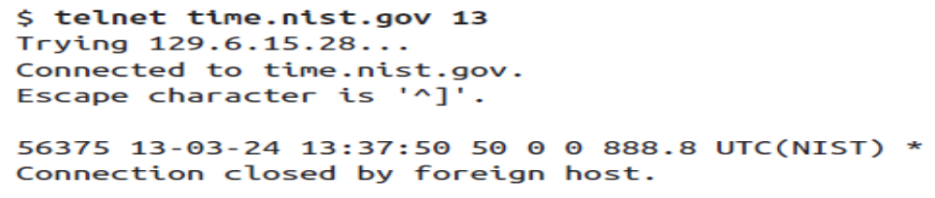
Reading from Servers with Sockets
JJJJJ is the “Modified Julian Date” (i.e., it is the number of whole days since midnight on November 17, 1858).
YY-MM-DD is the last two digits of the year, the month, and the current day of month.
HH:MM:SS is the time in hours, minutes, and seconds in Coordinated Universal Time (UTC, essentially Greenwich Mean Time).
TT indicates 00 means standard time; 50 daylight savings time. Other values count down the number of days until the switchover.
L is a one-digit code that indicates whether a leap second will be added or subtracted at midnight on the last day of the current month: 0 for no leap second, 1 to add a leap second, and 2 to subtract a leap second.
H represents the health of the server: 0 means healthy, 1 means up to 5 seconds off, 2 means more than 5 seconds off, 3 means an unknown amount of inaccuracy, and 4 is maintenance mode.
msADV is a number of milliseconds that NIST adds to the time it sends to roughly compensate for network delays. 888.8
CS 441 – Network Programming

Slide 11
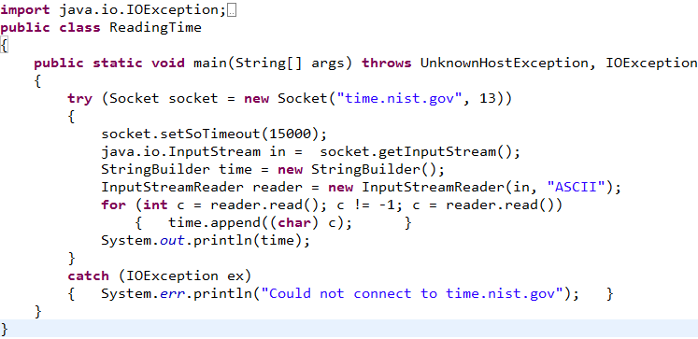
Example8_1
CS 441 – Network Programming

Slide 12
Practice
Try to redo Example8-1 by reading from the ftp servers 172.24.96.20 or drivers.just.edu.jo on port 21
CS 441 – Network Programming

Slide 13
Reading from Servers with Sockets
socket should throw a:
  ConnectException when the server rejects the connection.
  NoRouteToHostException if the routers can’t figure out how to send packets to the server.
  SocketTimeoutException: when the server hangs and the timeout expired.
CS 441 – Network Programming

Slide 14
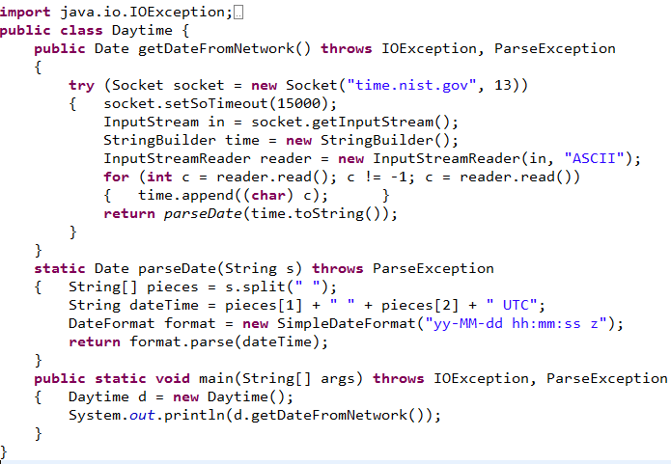
Example8_2
CS 441 – Network Programming

Slide 15
Writing to Servers with Sockets
ask the socket for an output stream as well as an input stream.
the client is either reading or writing over a socket, not both at the same time.
In the most common pattern.
  The client sends a request. Then the server responds.
  The client may send another request, andthe server responds again.
  This continues until one side or the other is done, and closes the connection.
One simple bidirectional TCP protocol is dict
CS 441 – Network Programming

Slide 16
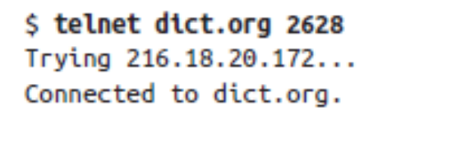
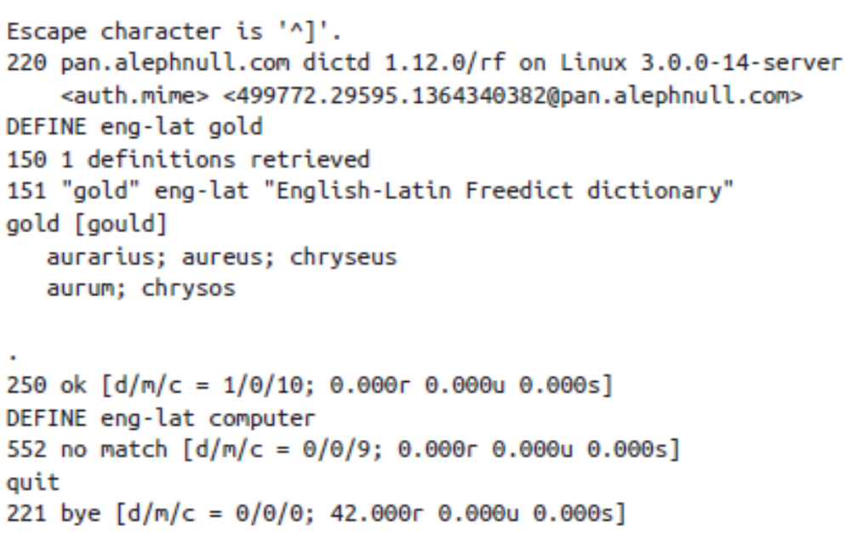
Writing to Servers with Sockets
CS 441 – Network Programming

Slide 17
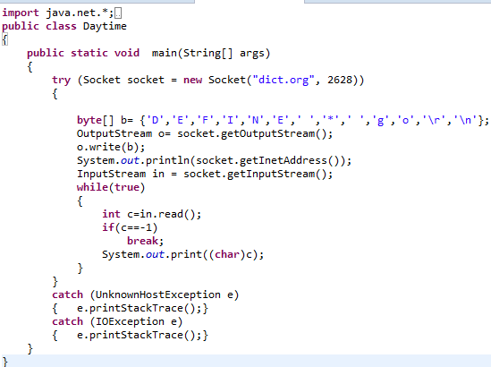
Example8-3:Writing to Servers with Sockets
CS 441 – Network Programming

Slide 18
Practice
Try to redo Example8-3 by reading from the ftp servers 172.24.96.20 or drivers.just.edu.jo on port 21
CS 441 – Network Programming

Slide 19
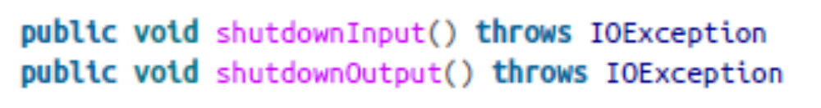
Half-closed sockets
The close() method shuts down both input and output from the socket.
The shutdownInput() and shutdownOutput() methods close only half the connection.
Further read after shutdown the input stream return-1
Further write after shut down the output stream throw an IOException.
even though you shut down half or even both halves of a connection, you still need to close the socket when you’re through with it.
The isInputShutdown() and isOutputShutdown() methods tell you whether the input and output streams are open or closed
CS 441 – Network Programming

Slide 20
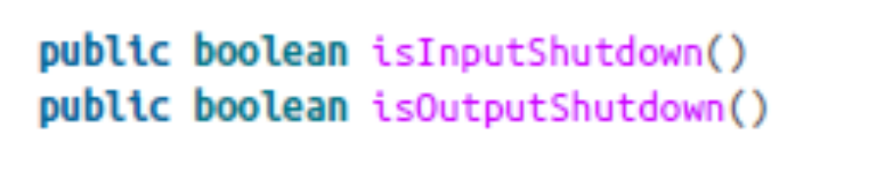
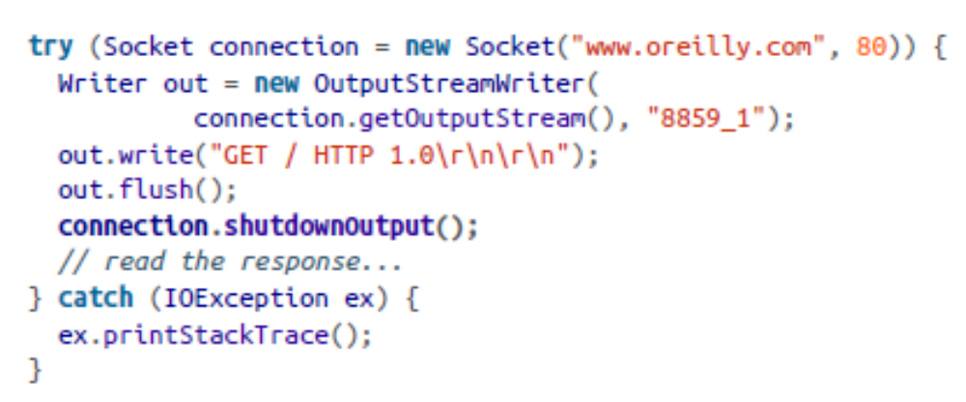
Half-closed sockets: Practice
The isInputShutdown() and isOutputShutdown() methods tell you whether the input and output streams are open or closed
CS 441 – Network Programming

Slide 21
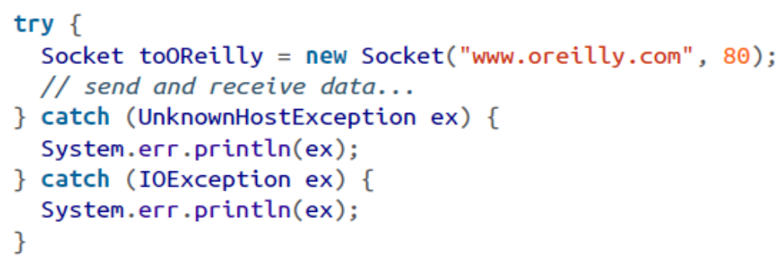
Socket Constructors
The Socket constructs don’t just create the object, they attempt to connect
public Socket(String host, int port) throws UnknownHostException, IOException
  Creates a TCP socket to the host on the specified port
  UnknownHostException is caused by an invalid host (down or DNS cannot resolve …)
  IOException is thrown if the socket cannot be opened (Firewall, port busy …)
CS 441 – Network Programming

Slide 22
Socket Constructors
public Socket(InetAddress host, int port) throws IOException
  Uses the InetAddress class
  Works as the former constructor
  Does not throw an UnknownHostException
  Unknown host problem would have been caught with the InetAddress object
  Best used when opening many sockets to the same host
CS 441 – Network Programming

Slide 23
Socket Constructors
public Socket(String host, int port, InetAddress interface, int localPort) throws IOException, UnknownHostException
public Socket(InetAddress host, int port, InetAddress interface, int localPort) throws IOException
  Work similar to the previous two constructors
  Binds the port from the local network interface and port specified by the last two arguments. This is only used on machines with multiple network interfaces (different cards or multihomed)
There are 3 protected constructors:
  Don’t attempt a connections
  Used for subclasses
CS 441 – Network Programming

Slide 24
Practice
Write a program to scan your local machine and determine which ports are hosting TCP servers (programs). Scan ports 1 though 65,535
Note: Don’t use this program to scan remote machine. Firewalls may block you and port scanning can be considered hostile and illegal.
    for (int i = 1; i <= 65565; ++i) {
    System.out.print("The server at port " + i);
    try {
    Socket socket = new Socket("127.0.0.1", i);
    System.out.println(" is running.");
    } //
    catch (UnknownHostException ex) {
    System.err.println(ex);
    }//
    catch (IOException ex) {
    System.out.println(" is off.");
    }
    }
CS 441 – Network Programming

Slide 25
Practice
After finishing the previous program rewrite your program to use the InetAddress class and compare the total execution times of the two programs.
Note: Don’t use this program to scan remote machine. Firewalls may block you and port scanning can be considered hostile and illegal.
    Socket s1 = null;
    Socket socket = null;
    long startTime;
    startTime = System.currentTimeMillis();
    for (int i = 1; i <= 65535; ++i) {
    try {
    if (s1 == null) {
    s1 = new Socket("127.0.0.1", i);
    } else {
    socket = new Socket(s1.getInetAddress(), i);
    }
    System.out.println("There is server at port # " + i);
    } //
    catch (UnknownHostException ex) {
    System.err.println(ex);
    }//
    catch (IOException ex) {
    System.out.println("There is no server at port # " + i);
    } finally {
    try {
    if (socket != null)
    socket.close();
    socket = null;
    } catch (IOException e) {
    // TODO Auto-generated catch block
    e.printStackTrace();
    }
    }
    }
    System.out.println("Total runtime: "
    + (System.currentTimeMillis() - startTime));
CS 441 – Network Programming

Slide 26
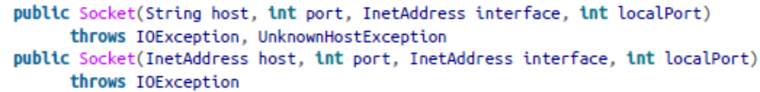
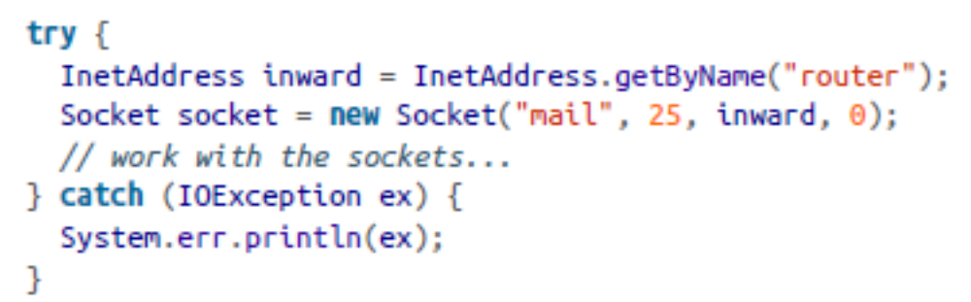
Picking a Local Interface to Connect From
Two constructors specify both the host and port to connect to and the interface and port to connect from:
CS 441 – Network Programming

Slide 27
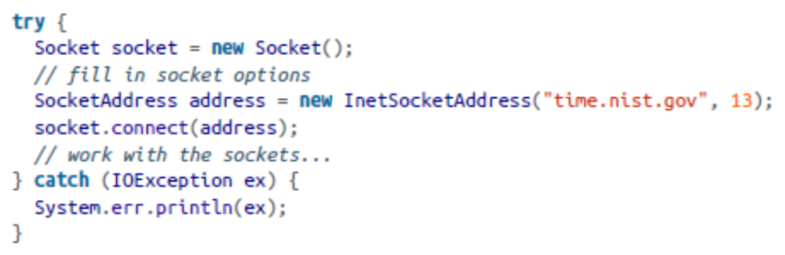
Constructing Without Connecting
We can split the two operations: create the socket and connect to the remote host.
public Socket(): a constructor without connection.
You can connect later by passing a SocketAddress to one of the connect() methods.
CS 441 – Network Programming

Slide 28
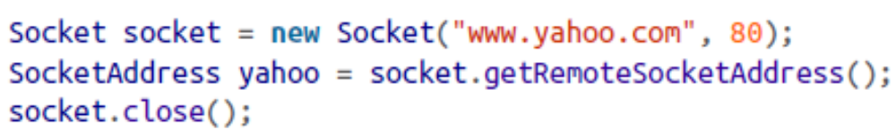
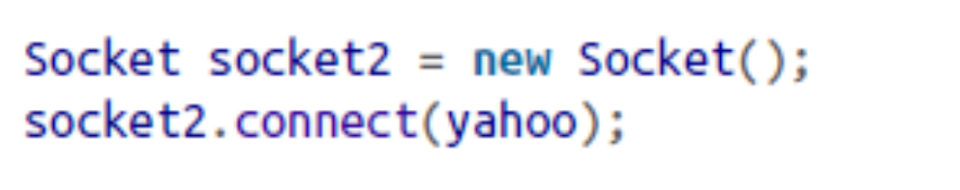
Socket Addresses
Empty abstract class
Represents a connection endpoint
A convenient way to store socket connection information (IP and port)
Used to create new sockets with the same IP and port
Socket class has two methods the return a SocketAddress
  public SocketAddress getRemoteSocketAddress()
  public SocketAddress getLocalSocketAddress()
Both of these methods return null if the socket is not yet connected.
CS 441 – Network Programming

Slide 29
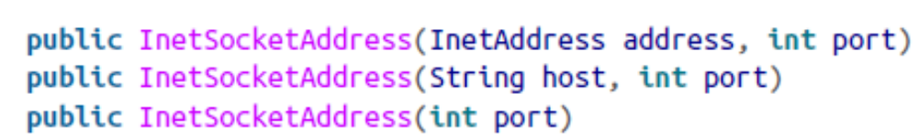
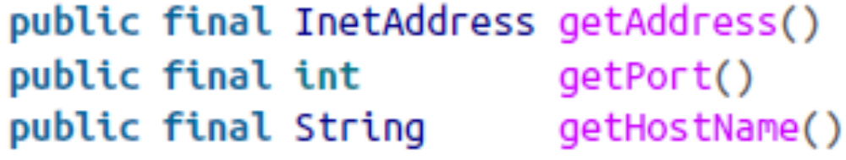
Socket Addresses
The InetSocketAddress class is usually created with a host and a port (for clients) or just a port (for servers):
You can also use the static factory method InetSocketAddress.createUnresolved() to skip looking up the host in DNS.
InetSocketAddress has a few getter methods you can use to inspect the object:
CS 441 – Network Programming

Slide 30
Socket Information
Socket class has one field (SocketImpl)
SocketImpl holds native code necessary for Sockets to work
Methods inside the Socket class use SocketImpl
This is how Socket implementation can change without affecting the program
  Support firewalls
  Support proxy servers
Socket objects have several properties that are accessible through getter methods:
  Remote address
  Remote port
  Local address
  Local port
CS 441 – Network Programming

Slide 31
Socket Information
public InetAddress getInetAddress( )
  Tells which remote host the Socket is connected to or was connected to
public int getPort( )
  Tells which port the Socket is, was, or will be connected to
public int getLocalPort( )
  Tells which random local port the Socket is, was, or will be connected to
public InetAddress getLocalAddress( )
  Tells which network interface a Socket is bound to
  Usefull with a multihomed host or multi NICs
public InputStream getInputStream( ) throws IOException
  Returns an input stream to read data from the Socket into a program
  Usually chained to a filter to read data easily (DataInputStream or InputStreamReader,)
CS 441 – Network Programming

Slide 32
Socket Information
public OutputStream getOutputStream( ) throws IOException
  Returns a row output stream to write data to the other end of the socket
  Usually chained to a filter to write data easily (DataOutputStream or OutputStreamWriter)
  Buffering is a good idea
CS 441 – Network Programming

Slide 33
Practice
Write a program to prints the following information about:
  Remote address
  Remote port
  Local address
  Local port
Write a program that reads the time from a daytime server
  NIST requires that you contact their servers after waiting at least 4 seconds.
  Host: time.nist.gov
  Port: 13
CS 441 – Network Programming

Slide 34
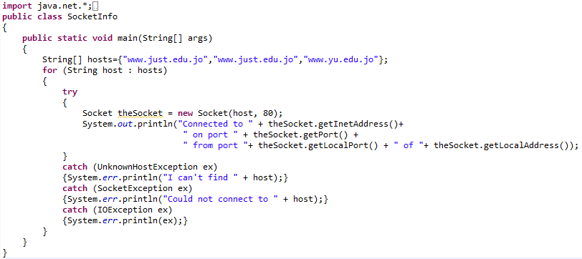
Example8-5:Socket Information
CS 441 – Network Programming

Slide 35
Closing the Socket
In client applications most of the work is done in:
  Handling the stream
  Interpreting the data
A Socket closes automatically when:
  Its input stream closes
  Its output stream closes
  Program ends
  Garbage collected (goes out of memory)
Don’t assume or rely on sockets automatically closing.
  You may reach the maximum number of socket before the GC kicks in
When done with the Socket close it. i.e. finally block
CS 441 – Network Programming

Slide 36
Closing the Socket
Closing a socket means:
  No IO operation can be done → IOException if attempted
  You can call getInetAddress( ), getPort( ), getLocalAddress( ), getLocalPort( ), getInputStream( ), and getOutputStream( )
isClosed()
  Used to avoid risking an IOException
  Returns false even if the socket was never connected
isConnected()
  Returns true if the socket was at one point connected
  Returns true even if the socket was closed
Open socket check
  socket.isConnected() && ! socket.isClosed( )
CS 441 – Network Programming

Slide 37
Closing the Socket
isConnected() refers to the remote end of the socket
isBound() refers to the local end of the socket
CS 441 – Network Programming

Slide 38
Half-closed sockets
close() shuts down both I/O streams
HTTP client can shutdown the output stream ONLY after sending the initial request to the server and then continue reading
shutdownInput()/shutdownOutput() shutdown the input or the output streams but not both.
  Don’t close the socket
  Adjust the stream so that it reaches the end
  Reads from an input stream result in a -1
  Write to an output stream result in an IOException
To check the stream’s state use isInputShutdown() and isOutputShutdown() instead of isConnected() and isClosed()
After finished with the socket you must close it
CS 441 – Network Programming

Slide 39
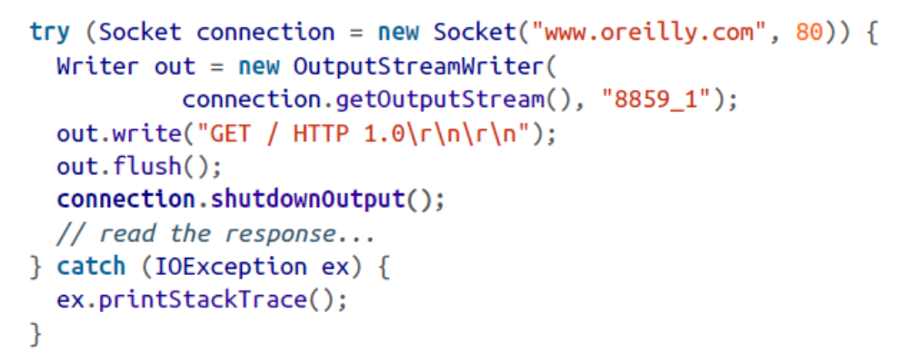
Example
CS 441 – Network Programming

Slide 40
toString()
The Socket class overrides only one of the standard methods from java.lang.Object: toString().
It produces a string that looks like this:
Socket[addr=www.oreilly.com/198.112.208.11,port=80,localport=50055]
All parts of this string are accessible directly through other methods (specificallygetInetAddress(), getPort(), and getLocalPort()).
CS 441 – Network Programming

Slide 41
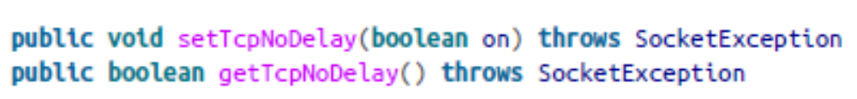
Socket Options
Socket options specify how the native sockets on which the Java Socket class relies send and receive data.
Eight options specify how the native socket class works
TCP_NODELAY
  Set to true to ensure packet are sent as quickly as possible regardless of size
  Don’t wait for a receipt acknowledgment from the remote server
throw a SocketException, which will happen if the underlying socket implementation doesn’t support the TCP_ NODELAY option.
CS 441 – Network Programming

Slide 42
Socket Options
SO_LINGER
  specifies what to do with datagrams that have not yet been sent when a socket is closed.
  Sets the amount of time the close() waits before returning. After that all remaining data is discarded and not sent.
These operastions throw a SocketException and IllegalArgumentException.
The maximum linger time is 65,535 seconds, and may be smaller on some platforms.
CS 441 – Network Programming

Slide 43
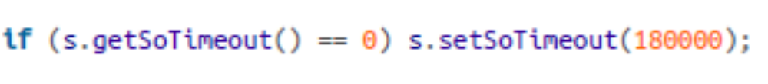
Socket Options
SO_TIMEOUT
  Specifies how long the read() methods blocks before returning
  When the time expires an InterruptedIOException occurs
  Socket is still open and can read again
  Zero timeout means infinite wait (no timeout)
CS 441 – Network Programming

Slide 44
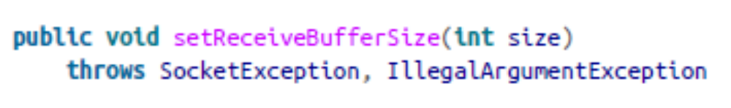
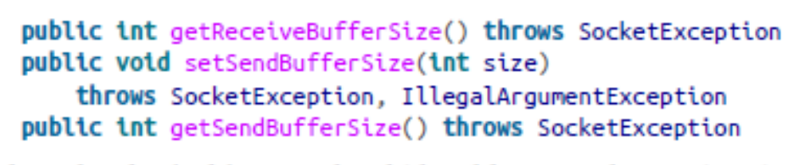
Socket Options
SO_RCVBUF , SO_SNDBUF
  Positive integer value > 0
  Suggests the size of the receiving buffer
  Underlying implementation may ignore it
  Slow networks perform better with small buffers
  Fast networks perform better with large buffers
CS 441 – Network Programming

Slide 45
Socket Options
SO_KEEPALIVE
  Set to true to automatically keep checking if the server is still alive
  If the server doesn’t respond, the socket automatically closes
  Without it, a socket is stays open indefinidetly
  The default for SO_KEEPALIVE is false.
CS 441 – Network Programming

Slide 46
Socket Options
OOBINLINE
  Set to true to turn on the urgent data option
  Use sendUrgentData() to send any urgent data
SO_REUSEADDR
  Set to true to release the local port immediately
  OK to use once you know that no more data will be received on that port
CS 441 – Network Programming

Slide 47
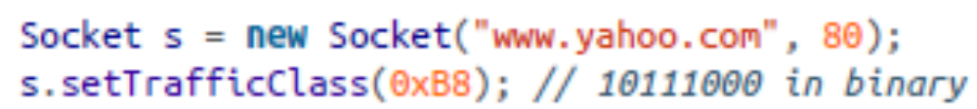
Class of Service
Different types of data can be transferred over the internet:
  Video needs high bandwidth and low latency
  Email can be send over low networks and doesn’t have to arrive quickly
You can set the Socket service type (i.e. minimum delay available + low cost)
public void setTrafficClass(int trafficClass) throws SocketException
  Suggests the service type
  Receives an integer (0 – 255) to indicate the service type (combination bit)
    0x02: Low cost
    0x04: High reliability
    0x08: Maximum throughput
    0x10: Minimum delay
CS 441 – Network Programming

Slide 48
Class of Service
To request a low cost connection:
  Socket s = new Socket("www.yahoo.com", 80);
  s.setTrafficClass(0x02);
To request a connection with maximum throughput and minimum delay:
  Socket s = new Socket("www.yahoo.com", 80);
  s.setTrafficClass(0x08 | 0x10);
Java 1.5 has an impl–dependent method (may or may not be implemented).
  public void setPerformancePreferences(int connectionTime, int latency, int bandwidth)
The call setPerformancePreferences(2, 1, 3) means
  Maximum bandwidth is the most important
  Minimum latency is the least important
  Connection time is in the middle.
CS 441 – Network Programming

Slide 49
Socket Exceptions
A simple IOException is not enough information
We need to know the reason for the exception
This done by using the subclasses of SocketExcpetions
  They don’t have special methods. They are only used to diagnose errors
  public class BindException extends SocketException
    When you cannot connect to the port specified
  public class ConnectException extends SocketException
    Remote host refused the exception
  public class NoRouteToHostException extends SocketException
    Connection time-out
  public class ProtocolException extends IOException
    Data received from the network is not TCP/IP compliant
CS 441 – Network Programming

