Slide 1
Chapter3
Threads

Slide 2
Threads
Ftp servers suffer from heavy loads more than the Http server.
By the time a server is attempting to handle a thousand or more simultaneous connections, performance slows to a crawl.
Solutions:
Reuse processes rather than creating new ones, each separate process has its own block of memory.
Use lightweight threads to handle connections instead of heavyweight processes.
Each separate process has its own block of memory
threads are easier on resources because they share memory.
Using a pool of threads for each connection enhance performance.

Slide 3
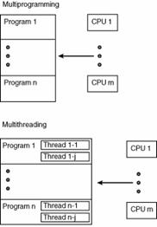

Slide 4
Threads
Multithreaded system increase complexity.
Complexity comes from the need to keep the system safe, and consistence.
each thread must agree to use certain resources only when it’s sure those resources can’t change or that it has exclusive access to them.
Deadlock: two threads are each waiting for resources the other possesses.
Neither thread can proceed without the resources that the other thread has reserved, but neither is willing to give up the resources it has already.

Slide 5
Thread
A thread with a little t is a separate, independent path of execution in the virtual machine.
A Thread with a capital T is an instance of the java.lang.Thread class.
There is a one-to-one relationship between threads executing in the virtual machine and Thread objects constructed by the virtual machine

Slide 6
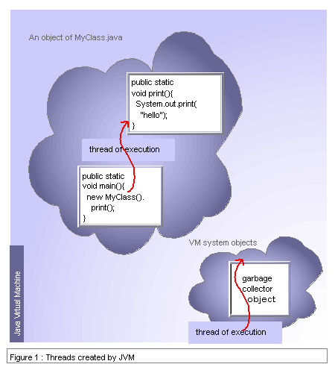
Example

Slide 7
Threads
To start a new thread running in the virtual machine, you construct an instance of the
Thread class and invoke its start() method, like this:
Thread t = new Thread();
t.start()
To give a thread something to do, you either:
subclass the Thread class and override its run() method.
public void run()
implement the Runnable interface and pass the Runnable object to the Thread constructor.

Slide 8
Threads
You’re going to put all the work the thread does in the run method.
the thread starts here and it stops here. When the run() method completes, the thread dies.

Slide 9
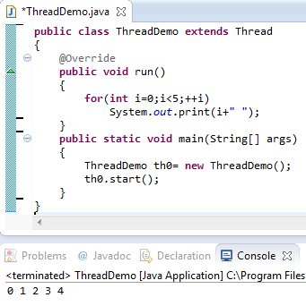
Example3.1: subclass

Slide 10
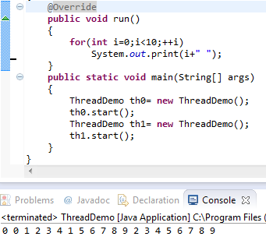
Example3.2: subclass multithread

Slide 11
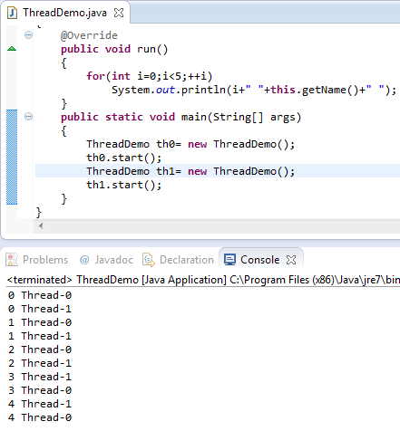
Example3.3: subclass multithread

Slide 12
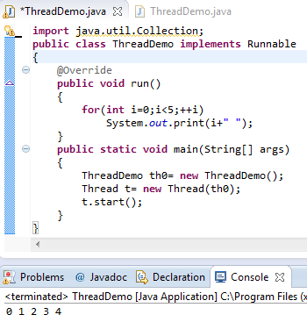
Example3_4: Runnable Interface

Slide 13



Practice5.1
Write a threaded java program that calculates the factorial for the numbers from 2 to 7, in which each number assign a thread.
First Run
Second Run
Third Run

Slide 14
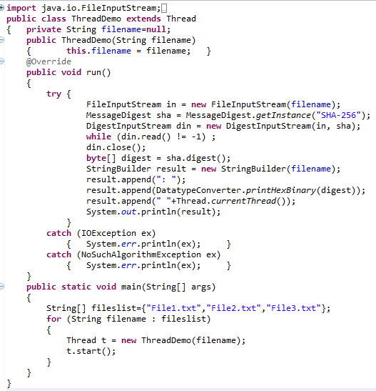
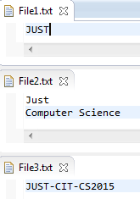

Example3_5:Subclass Thread on Stream

Slide 15
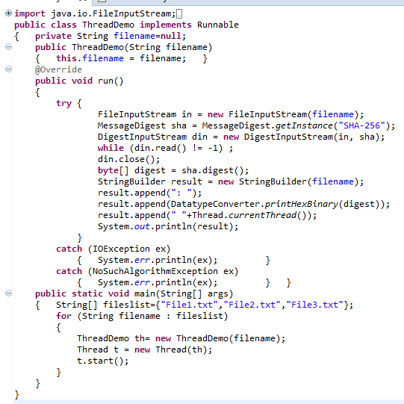

Example3_6:Runnable Interface on stream

Slide 16
Returning Information from a Thread
How to return information from a thread?
The run() method and the start() method don’t return any values.

Slide 17
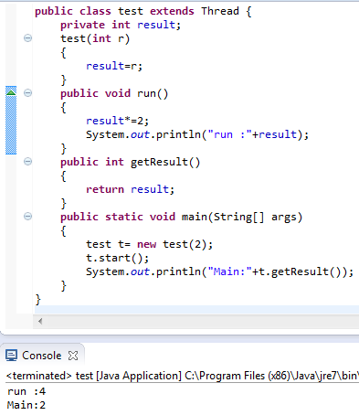
Returning Information from a Thread

Slide 18
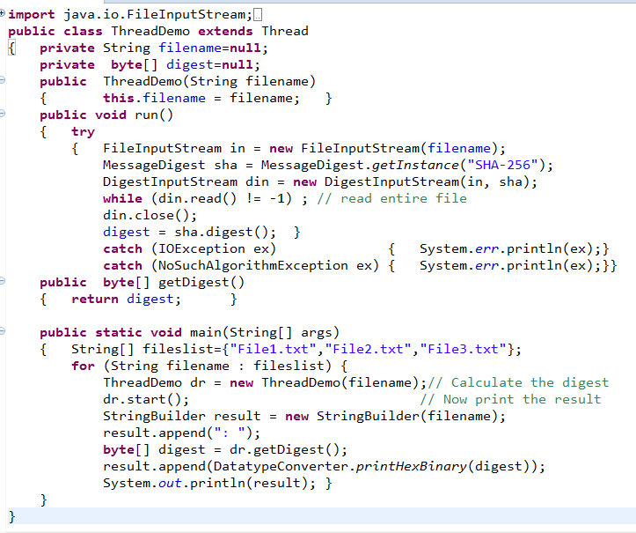
Example3-7:Returning Information from a Thread

Slide 19

Example3-7:Returning Information from a Thread
The problem is that the main program gets the digest and uses it before the thread has had a chance to initialize it.
The calculations that dr.start() kicks off may or may not finish before the main() method reaches the call to dr.getDigest(). If they haven’t finished, dr.getDigest() returns null, and the first attempt to access digest throws a NullPointerException.

Slide 20
Race condition
get the correct results, an exception, or a hung program depends on many factors, including:
Number of threads the program creates
The speed of the CPU and disk.
Number of CPUs
the algorithm the Java virtual machine uses to allot time to different threads.
Getting the correct result depends on the relative speeds of different threads, you have to control this

Slide 21
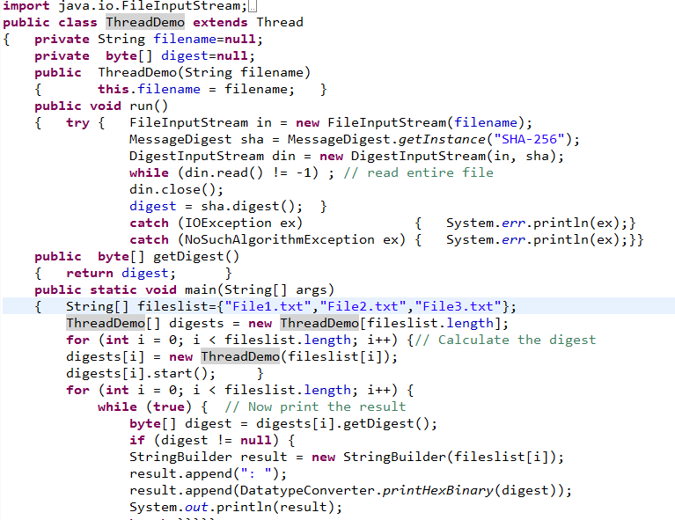
Polling: Example3-8

Slide 22
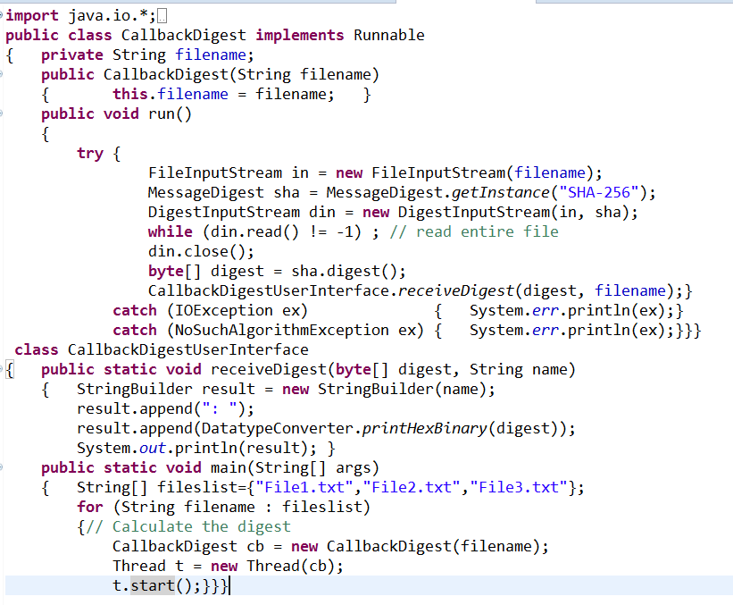
Callbacks: Example3-9-1

Slide 23
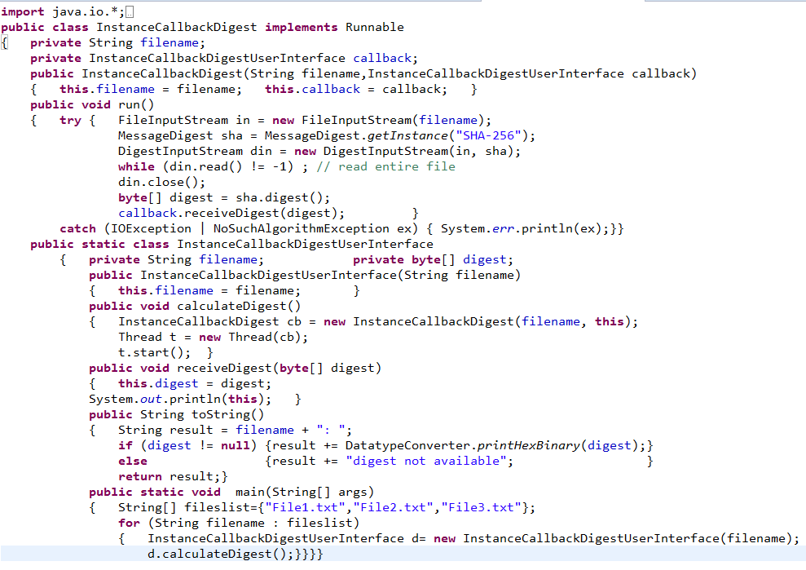
Callbacks: Example3-9-2

Slide 24
Futures, Callables, and Executors
Instead of directly creating a thread, you create an ExecutorService that will create threads for you as needed.
You submit Callable jobs to the ExecutorService and for each one you get back a Future.
you can ask the Future for the result of the job. If the result is ready, you get it immediately.
If it’s not ready, the polling thread blocks until it is ready.
The advantage is that you can spawn off many different threads, then get the answers you need in the order you need them.

Slide 25
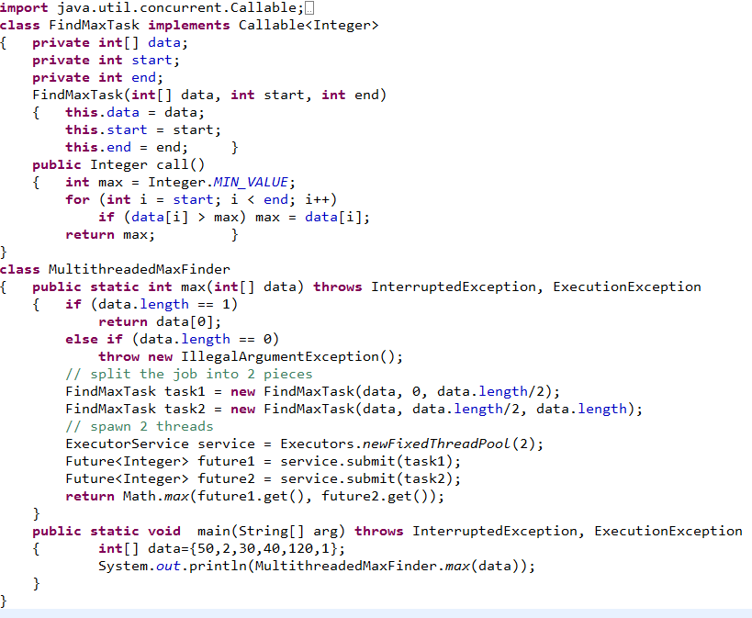
Example3_10: Futures, Callables, and Executors

Slide 26
Synchronization
The advantage of a shared resource is reduce cost.
The disadvantage is the overhead to gain resources
the thread borrows from a central pool of resources
Threads make programs more efficient by sharing memory, file handles, sockets, and other resources.
multithreaded program is much more efficient than the multiprocess alternative, in which each process has to keep its own copy of every resource.
multithreaded program must avoid deadlock.

Slide 27
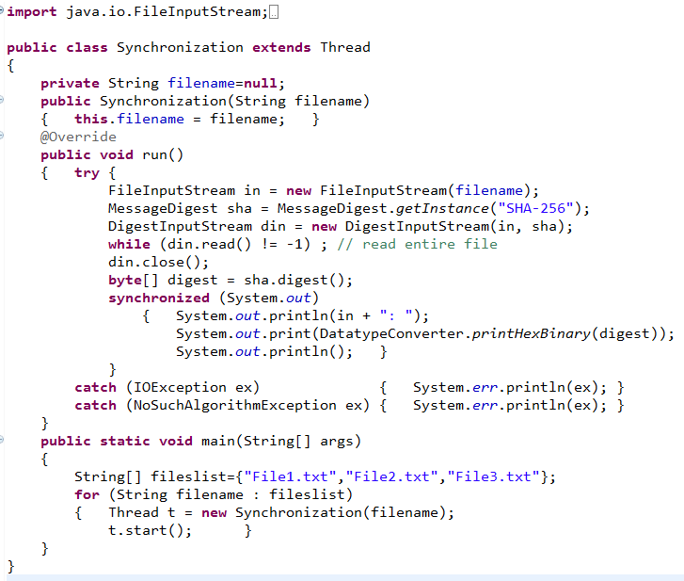
Example3_11: Synchronization

Slide 28
Synchronization
Synchronization forces all code that synchronizes on the same object to run in series, never in parallel.
other code that synchronizes on a different object or doesn’t synchronize at all can still run in parallel with this code.
Java provides no means to stop all other threads from using a shared resource. It can only prevent other threads that synchronize on the same object from using the shared resource.
Synchronization becomes an issue only when two threads both possess references to the same object.

Slide 29
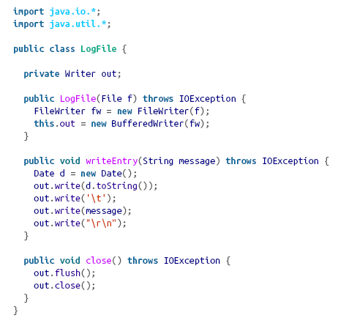
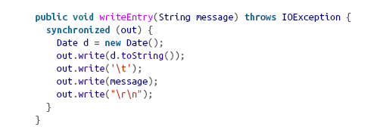
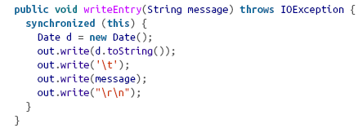
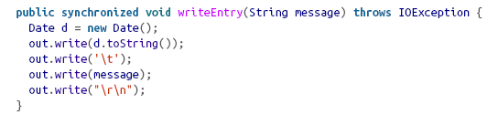
Synchronization

Slide 30
Synchronization
Synchronization is not always the best solution to the problem of inconsistent behavior caused by thread scheduling.
There are a number of techniques that avoid the need for synchronization:
Use local variables.
Method arguments(by value) of primitive types are also safe from modification in separate threads.
String arguments are safe because they’re immutable
StringBuilder arguments are not safe because they’re not immutable;
Use a thread-unsafe class but only as a private field of a class that is thread safe.
An example of this technique might be a web server that uses an unsynchronized LogFile class but gives each separate thread its own separate log so no resources are shared between the individual threads.

Slide 31
Deadlock
Synchronization can lead to another possible problem: deadlock.
Deadlock occurs when two threads need exclusive access to the same set of resources and each thread holds the lock on a different subset of those resources.
If neither thread is willing to give up the resources it has, both threads come to an indefinite halt.
the program is still active and behaving normally from the perspective of the OS, but to a user the difference is insignificant.
The most important technique for preventing deadlock is to avoid unnecessary synchronization.
alternative approach for ensuring thread safety instead of synchronization.

Slide 32
Thread Scheduling
important threads get at least some time to run and that the more important threads get more time.
threads execute in a reasonable order.
Example:
If your web server has 10 queued requests, each of which requires 5 seconds to process, you don’t want to process them in series. If you do, the first request will finish in 5 seconds but the second will take 10, the third 15, and so on until the last request, which will have to wait almost a minute to be serviced.
By running threads in parallel, you might be able to process all 10 requests in only 10 seconds total.

Slide 33
Thread Scheduling:Priorities
Each thread has a priority, specified as an integer from 0 to 10.
the VM will generally run only the highest-priority thread.
In Java, 10 is the highest priority and 0 is the lowest.
The default priority is 5, and this is the priority that your threads will have unless you deliberately set them otherwise.

Slide 34
Priorities
Threads that interact with the user should get very high priorities to increase responsiveness.
On the other hand, threads that calculate in the background should get low priorities.
Tasks that will complete quickly should have high priorities.
Tasks that take a long time should have low priorities so that they won’t get in the way of other tasks.

Slide 35
Priorities
You can change the priority of the thread using the setPriority() method:
public final void setPriority(int newPriority)
Attempting to exceed the maximum priority or set a non-positive priority throws an IllegalArgumentException.

Slide 36
Preemption
There are two main kinds of thread scheduling: preemptive and cooperative.
A preemptive thread scheduler determines when a thread has had its fair share of CPU time, pauses that thread, and then hands off control of the CPU to a different thread.
A cooperative thread scheduler waits for the running thread to pause itself before handing off control of the CPU to a different thread.

Slide 37
Preemption
A virtual machine that uses cooperative thread scheduling is much more susceptible to thread starvation than a virtual machine that uses preemptive thread scheduling, because one high-priority, uncooperative thread can hog an entire CPU.
In preemptive thread scheduling the higher priority thread preempts the lower-priority thread.

Slide 38
Preemption
There are 10 ways a thread can pause in favor of other threads or indicate that it is ready to pause. These are:
It can block on I/O.
It can block on a synchronized object.
It can yield.
It can go to sleep.
It can join another thread.
It can wait on an object.
It can finish.
It can be preempted by a higher-priority thread.
It can be suspended.
It can stop.

Slide 39
Blocking
Blocking occurs any time a thread has to stop and wait for a resource it doesn’t have.
Example:
a thread in a network program will voluntarily give up control of the CPU is by blocking on I/O.
Threads can also block when they enter a synchronized method or block.

Slide 40
Yielding
A thread does this by invoking the static Thread.yield() method.
This signals to the virtual machine that it can run another thread if one is
should make sure that it or its associated Runnable object is in a consistent state that can be used by other objects.ready to run.

Slide 41
Sleeping
gives an opportunity to run not only to other threads of the same priority, but also to threads of lower priorities.
However, a thread that goes to sleep does hold onto all the locks it’s grabbed.
invoking one of two overloaded static Thread.sleep() methods.

Slide 42
Sleeping
wake up the sleeping thread before its time. by invoking the sleeping thread’s interrupt() method.
public void interrupt()

Slide 43
Joining threads
Java provides three join() methods to allow one thread to wait for another thread to finish before continuing. These are:
The joining thread (i.e., the one that invokes the join() method) waits for the joined thread (i.e, the one whose join() method is invoked) to finish.

Slide 44
Joining threads

Slide 46
Waiting on an object
A thread can wait on an object it has locked. While waiting, it releases the lock on the object and pauses until it is notified by some other thread.
Another thread changes the object in some way, notifies the thread waiting on that object, and then continues.
the thread that wants to pause must first obtain the lock on the object using synchronized and then invoke one of the object’s three overloaded wait() methods:

Slide 47
Waiting on an object
the thread that invoked it releases the lock on the object it’s waiting on
It remains asleep until one of three things happens:
The timeout expires.
The thread is interrupted.
The object is notified.

Slide 48
Finish
When the run() method returns, the thread dies and other threads can take over.

Slide 49
Thread Pools and Executors
multiple threads improves performance for network programs.
multiple threads result-in overhead for VM.
Optimal number of threads help make more efficient use of a computer’s limited CPU resources.
The Executors class in java.util.concurrent makes it quite easy to set up thread pools.
You simply submit each task as a Runnable object to the pool, get the future object.

Slide 50
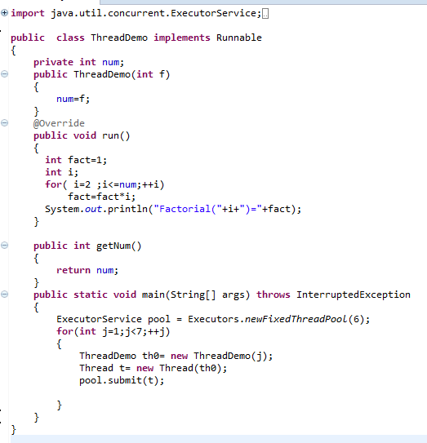
Example3_12

