Slide 1
ClosedFlow: OpenFlow-like Control over Proprietary Devices
Ryan Hand, Eric Keller
University of Colorado at Boulder
8 / 22 / 2014

Slide 2
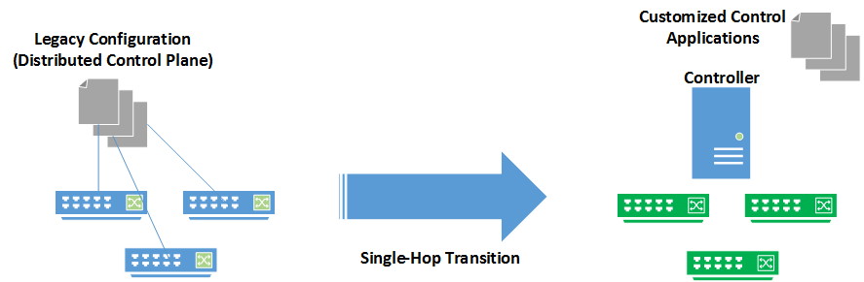
Problem: Abrupt Transition to Using SDN

Slide 3
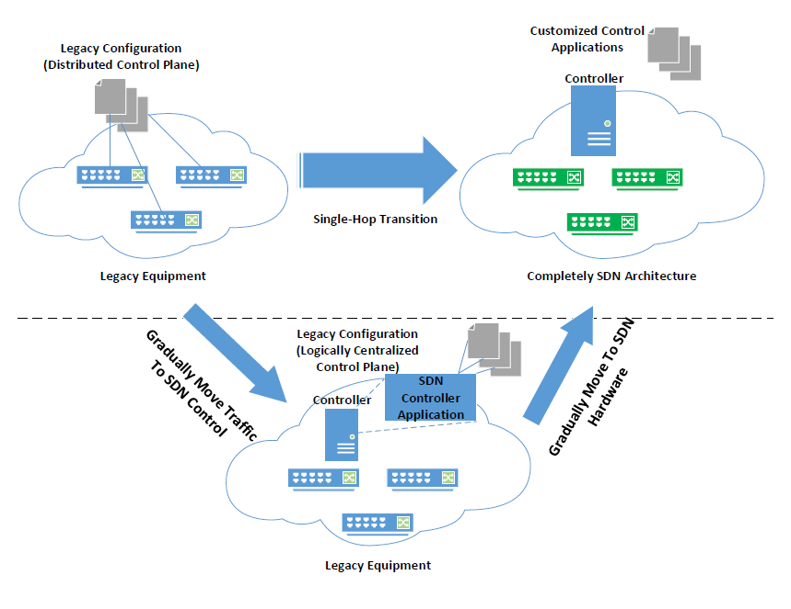
Goal: Smooth Transition to SDN

Slide 4


Just Remote/Central Configuration?
User interface, and integrations into, e.g., OpenStack
Some Product
Configuration interface (Cisco, Juniper, etc.)

Slide 5

Or Switch Programming Interfaces?
User interface(s), and APIs to integrate into, e.g., OpenStack
Layers of abstractions,
and applications
…
Programming interface (e.g., OpenFlow)

Slide 6
ClosedFlow
Allow layers on top of OpenFlow
But use network devices which don’t have OpenFlow support
Learn about OpenFlow in the process
…
Layers of abstractions,
and applications
ClosedFlow
Programming interface (OpenFlow)
Configuration interface (Cisco)

Slide 7
Four Basic Parts of OpenFlow
Controller to switch channel
Topology discovery
Flow abstraction (matching / actions)
Packet In

Slide 8
(1, 2) Channel and Topology
Controller to Switch channel
➔Bootstrap path with OSPF, use SSH
Topology
➔Switch log adjacencies to controller, or controller participate in OSPF

Slide 9
(3) Flow abstraction
Match: src_ip=1.2.3.4, dest_ip=2.3.4.5, action:OUT_PORT_2
Switch1#show access-lists
Extended IP access-list 101
10 permit ip host 1.2.3.4 host 2.3.4.5
Switch1#show route-map route-map SW1_OUTBOUND, permit, sequence 10 Match clauses: ip address (access-lists): 101 Set clauses: ip next-hop 2.0.0.1
Switch1#show run interface vlan 1
interface Vlan1
ip address 1.2.3.1 255.255.255.0
ip policy route-map SW1_OUTBOUND
Specifies:
matches permit/deny
Specifies:
ACLs to apply Forwarding behavior
Specifies:
Inbound interface to apply Route maps (VLAN used for mult)

Slide 10
Challenge: (4) Packet In
Can forward packets out specific ports, or (remote) Log headers and drop packets
Can’t buffer packets and remote log header
(metadata, P.hdr)
(flow table entry, release P)
P
(P.hdr, P.payload)
(buffer P)

Slide 11
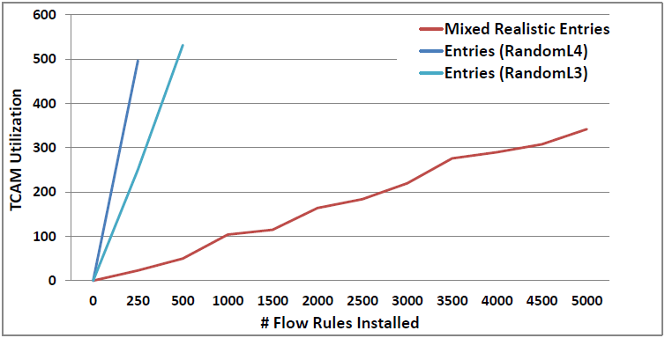
Challenge: Table Transparency
Rule compression – overlapping rules get combined into less TCAM entries

Slide 12
OpenFlow Extensions
Extensions to reduce switch-controller interactions
AvantGuard – security
DevoFlow – monitoring
OF Extensions

Slide 13
OpenFlow Extensions
Extensions to reduce switch-controller interactions
AvantGuard – security
DevoFlow – monitoring
Embedded Event Manager
Several event detectors,
Add TCL scripts for actions
=> Could seemingly implement intent of AvantGuard and DevoFlow
Cisco EEM

Slide 14
Conclusions
ClosedFlow is layer providing OpenFlow like programmability to legacy network configs.
Giving some insight into commonalities/differences
A point in the “Transition to SDN” space
Panopticon (partial deploy), Fabric (edge), others.

Slide 15
Questions?

Slide 16
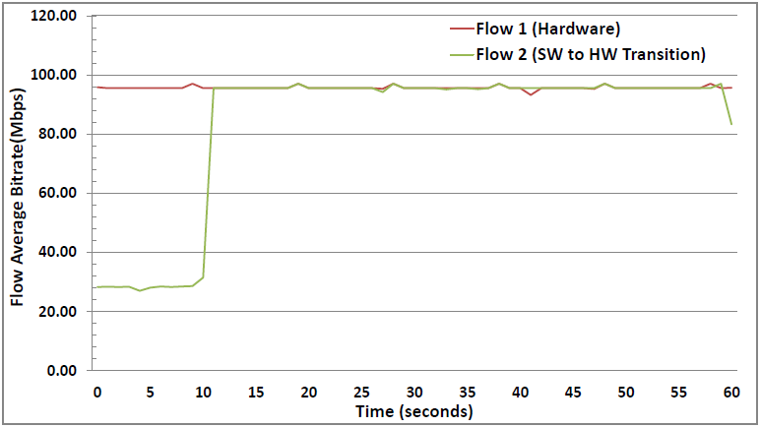
Challenge: Table Transparency (2)
Overflowing table – uses slow memory, or SW

