Slide 1
Framework overview
Goal: solve LP/MILP from natural-language prose.
Core idea: multi-LLM extraction + deterministic validation/repair + solver.
Pipeline (left to right)
Natural-language problem text
ExtractorA (LLM) and ExtractorB (LLM) (JSON)
Deterministic Validator
Candidate selection Critic (LLM) repair loop
Adjudicator (LLM) final consistency pass
Final deterministic validation gate
PuLP/CBC solver
Report generator
ExtractorA: google/flan-t5-base
ExtractorB: google/flan-t5-small
Critic: google/flan-t5-base
Adjudicator: google/flan-t5-small

Slide 2
problem_1 = """A furniture workshop produces two types of products: desks and bookshelves. Each desk sold generates a profit of $55, and each bookshelf generates a profit of $45. The workshop goal is to determine how many units of each product to manufacture in order to maximize total profit.
Production requires two limited resources: carpentry labor hours and finishing hours. Each desk requires 3 hours of carpentry labor and 2 hours of finishing. Each bookshelf requires 2 hours of carpentry labor and 3 hours of finishing. The workshop has at most 90 carpentry labor hours and 100 finishing hours available during the planning period. In addition, due to storage space limitations, no more than 25 desks can be produced during this period. The numbers of desks and bookshelves produced must be nonnegative integers.
Determine the production quantities that maximize total profit while satisfying all resource and capacity constraints."""

Slide 3
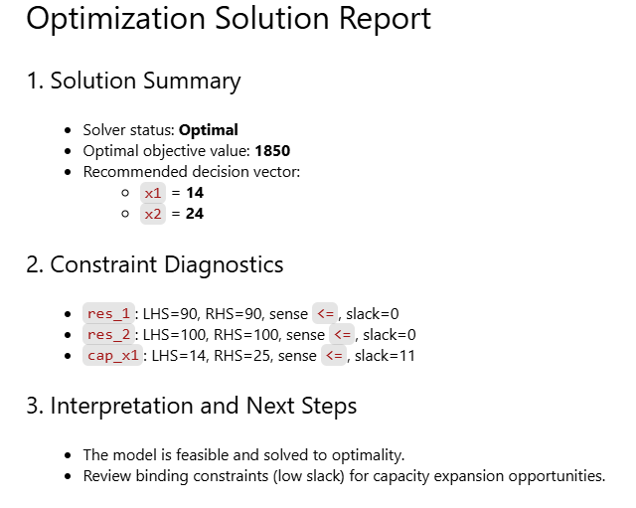
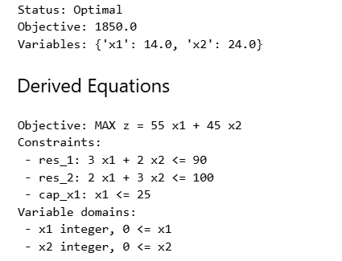

Slide 4
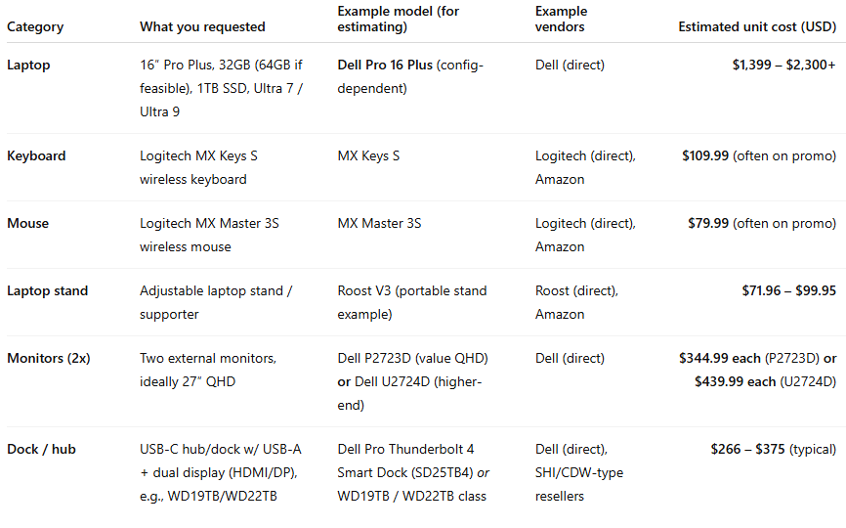
Estimated costs

