Slide 1

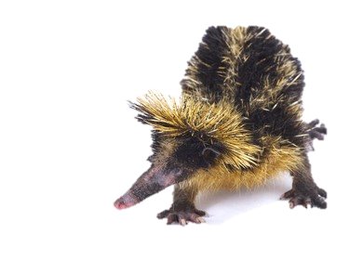
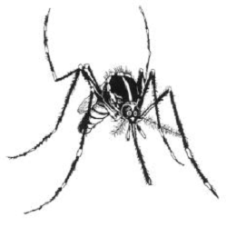
This is an A!
This is a A/B!
This is an A/X

Slide 2
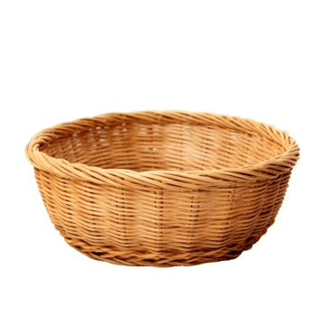


Can you help me put my things in the right place?

