Slide 1

How One of India's Largest Companies Allegedly Misrepresented ₹15.15 Lakh Crore of Revenue between 2020 and 2025
Aditya Mishra
S046

Slide 2
15,15,00,00,00,00,000

Slide 3
15,15,00,00,00,00,000
4.4 % of India’s Annual GDP

Slide 4
15,15,00,00,00,00,000
₹5.8 crore every minute (for 5 years)

Slide 5
The Company

Slide 6
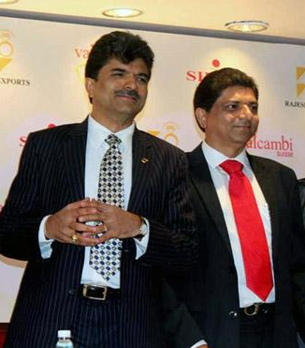
A Brief History of REL
1989–1990: Rajesh (left) and Prashant (right) Mehta established Rajesh Exports, focusing on manufacturing and exporting gold jewelry from Bengaluru.
1995: The company was listed on Indian stock exchanges, using IPO proceeds to expand manufacturing capacity and exports.
2002–2015: Expanded into refining and retail, culminating in the US$400 million acquisition of Swiss gold refiner Valcambi SA, making Rajesh Exports a vertically integrated global gold company.
2016–2024: Became one of India's highest-revenue listed companies, with operations spanning refining, manufacturing, exports, and retail jewelry.

Slide 7
What does REL do?
Gold Refining
Jewellery Manufacturing
Global Trading & Exports
Retail Jewellery
Precious Metals Value Chain Integration

Slide 8
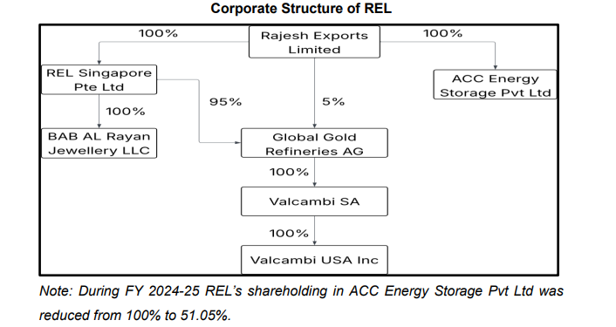

Slide 9
The Irregularities

Slide 10
Revenue Misrepresentation through Consolidation

Slide 11
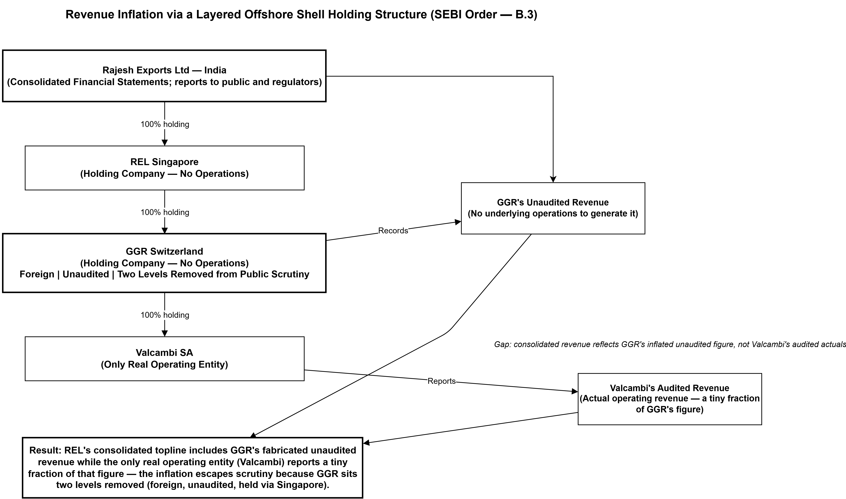

Slide 12
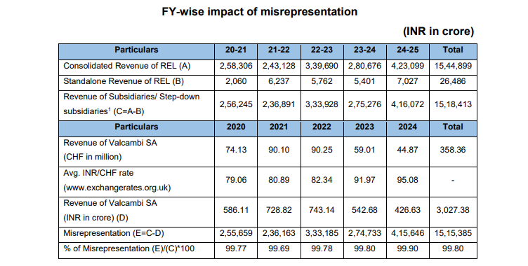

Slide 13
Manufacturing fictitious trade volume

Slide 14
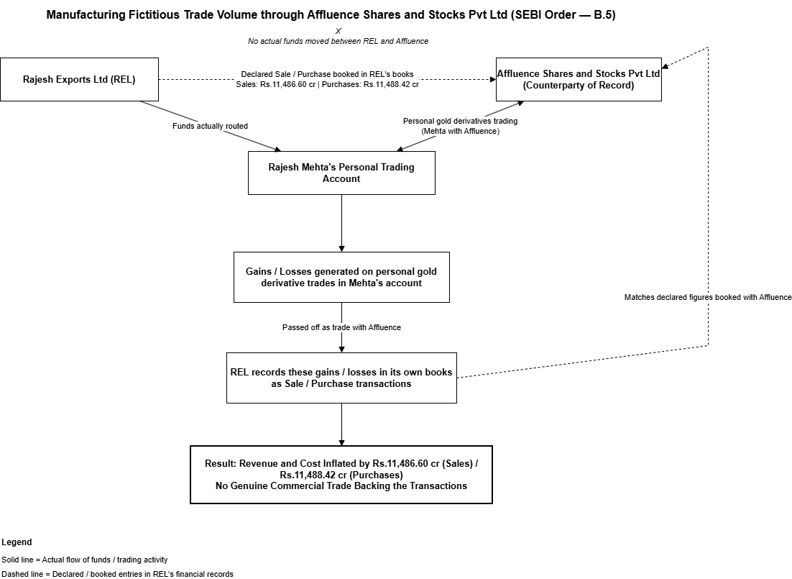

Slide 15
The "Gold Mines in Africa" phantom investment

Slide 16
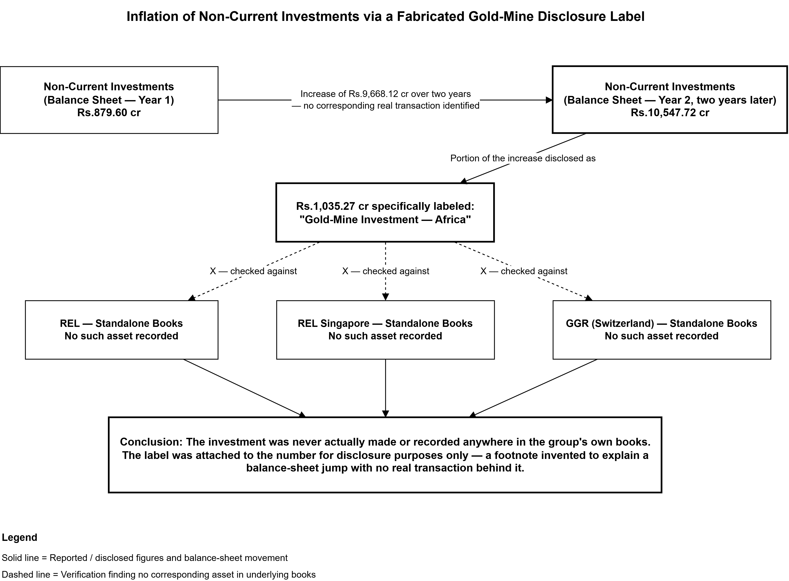

Slide 17
Improper netting of receivables

Slide 18
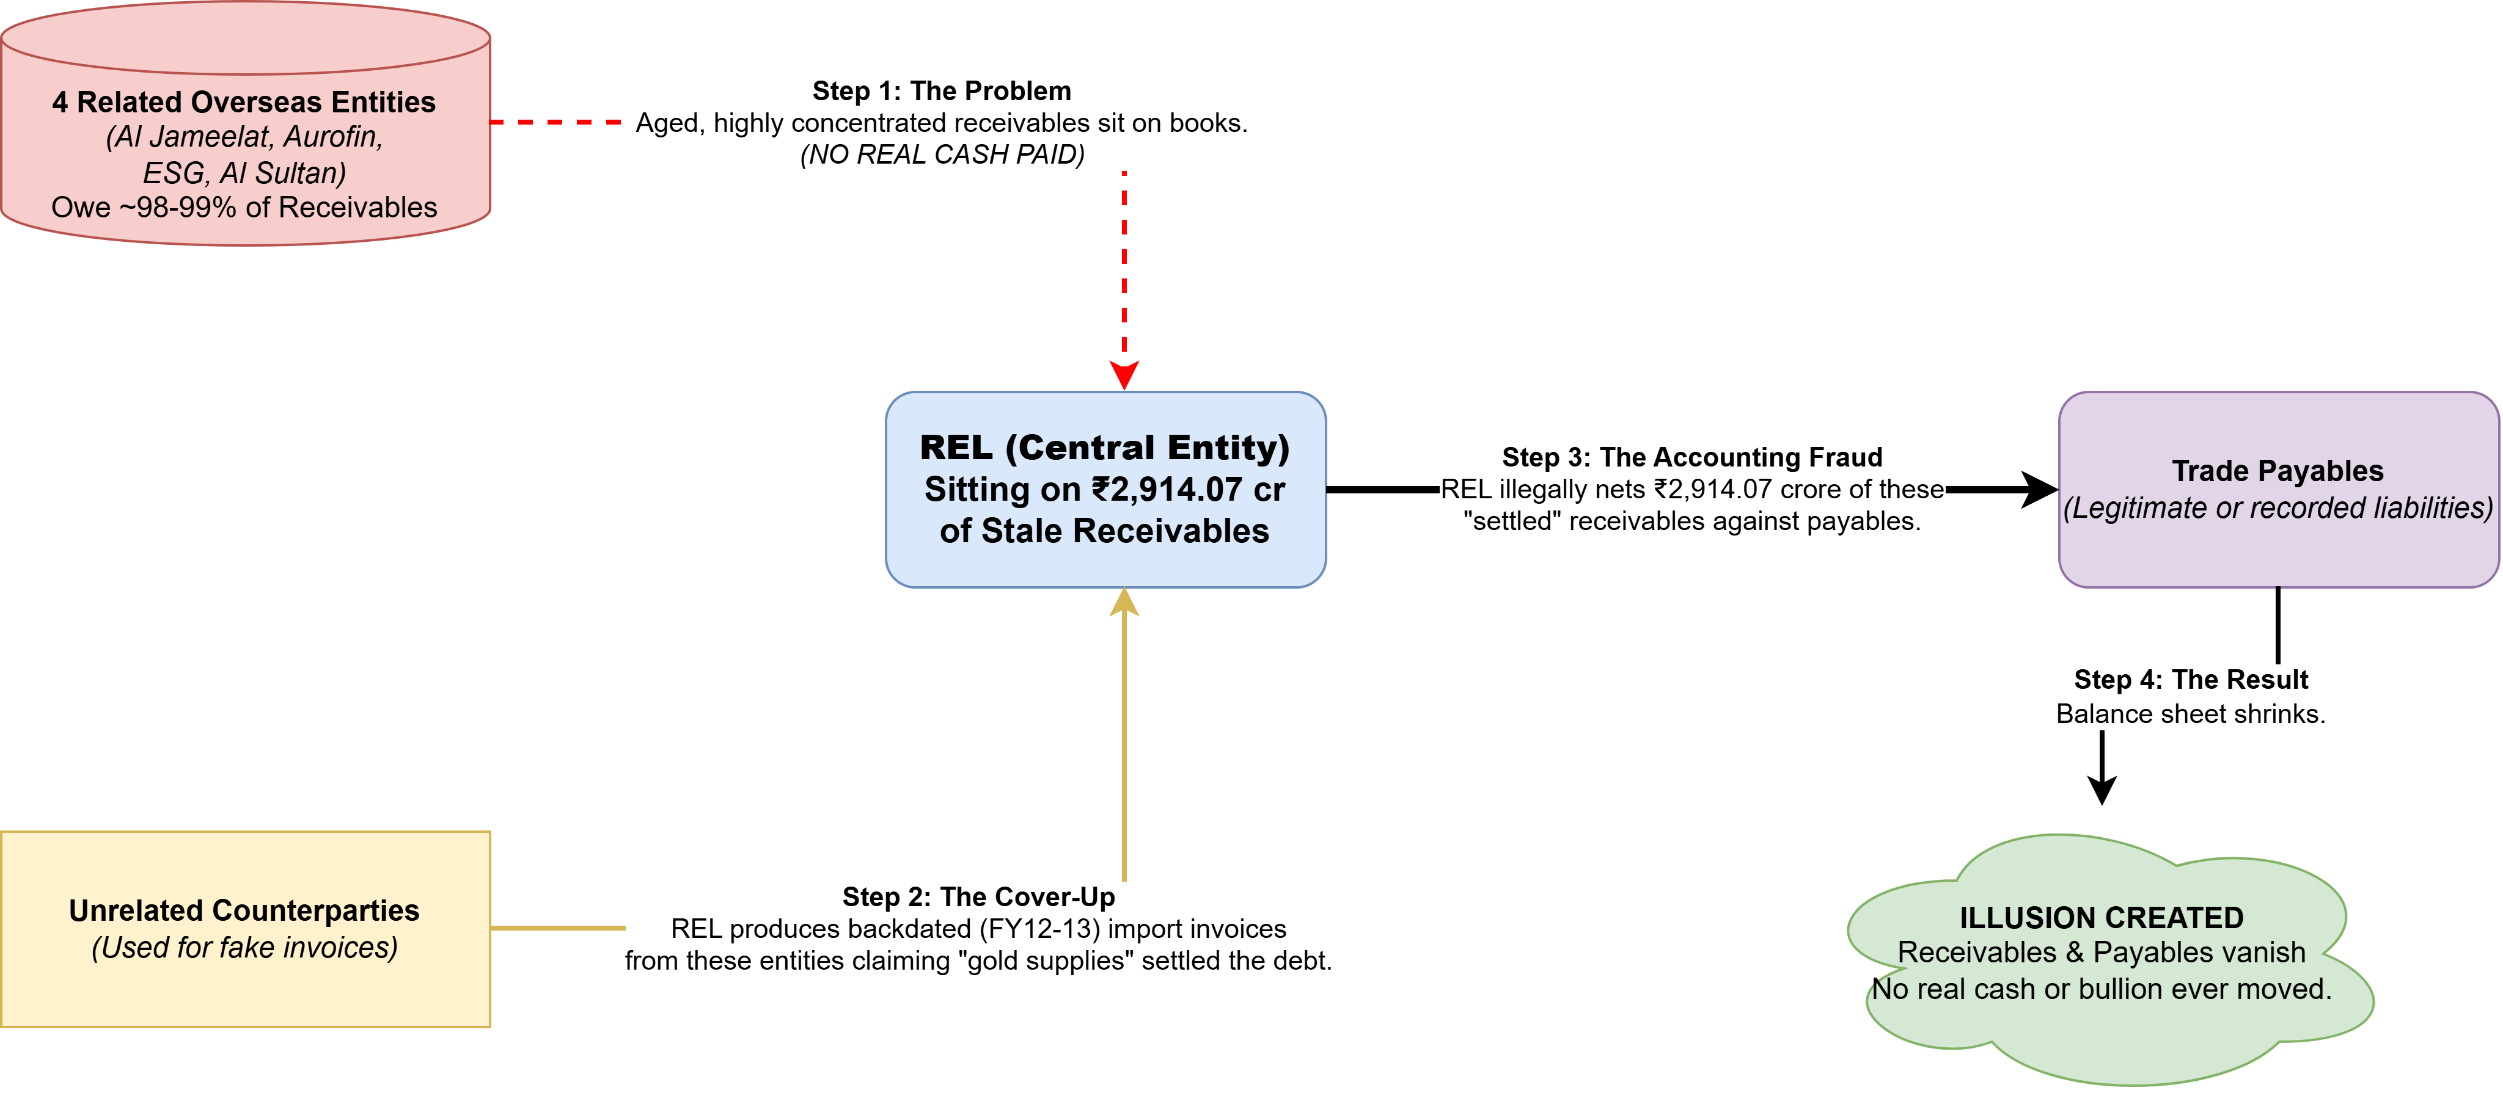

Slide 19
Undisclosed fund diversion to the promoter

Slide 20
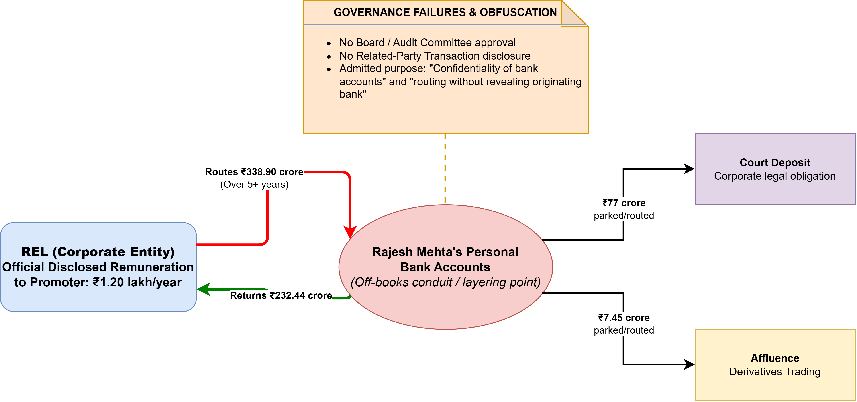

Slide 21
REL’s Response
Denied all allegations
Argued that SEBI misunderstood the consolidation methodology used for its overseas subsidiaries
Stated that it would challenge SEBI's findings through appropriate legal channels
Asserted that it would fully cooperate with the ongoing regulatory proceedings.

Slide 22
Key Takeaways
Alleged revenue inflation through consolidation
Multiple governance concerns identified by SEBI
Proceedings remain subject to legal challenge

Slide 23
Thank You

