Slide 1
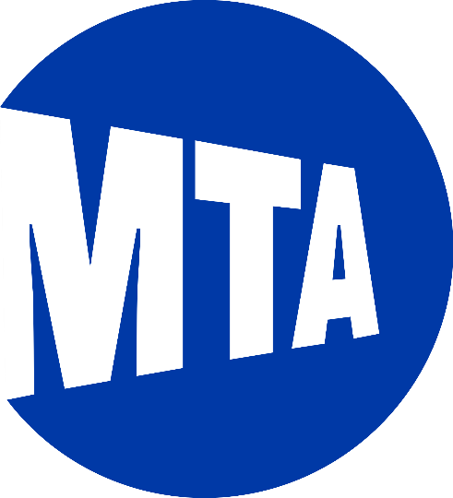

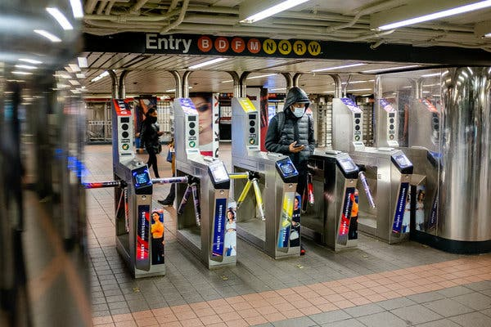
MTA Turnstile Activity Analysis
Alexander Amado
3/23/2022

Slide 2
Introduction
Motivation –
Finance professional, interested in the linkages between unstructured data and the economy.
Objective –
Study the relationship between MTA turnstile data and business activity in NYC.
Goal –
Attempt to find answers to key questions:
Is there a link between turnstile activity and business activity?
How has the pandemic impacted MTA ridership and business activity?
Has business activity and ridership recovered to pre-pandemic levels?

Slide 3
Methodology
Data –
MTA Turnstile data
Metropolitan Transportation Authority
Legally Operating Businesses
Department of Consumer Affairs (DCA)
COVID-19 Daily Counts of Cases, Hospitalizations, and Deaths
Department of Health and Mental Hygiene
Metrics –
COVID-19 NYC daily case count frequency
Business license creation frequency
MTA turnstile activity aggregation

Slide 4






Methodology
Tools –
Python3
pandas
matplotlib
seaborn
SQLite
DB Browser for SQLite
SQLAlchemy
Data Usage –
MTA turnstile activity aggregated at the station and system level
COVID-19 daily case counts measured over time
Legally issued business licenses as a proxy for business activity

Slide 5
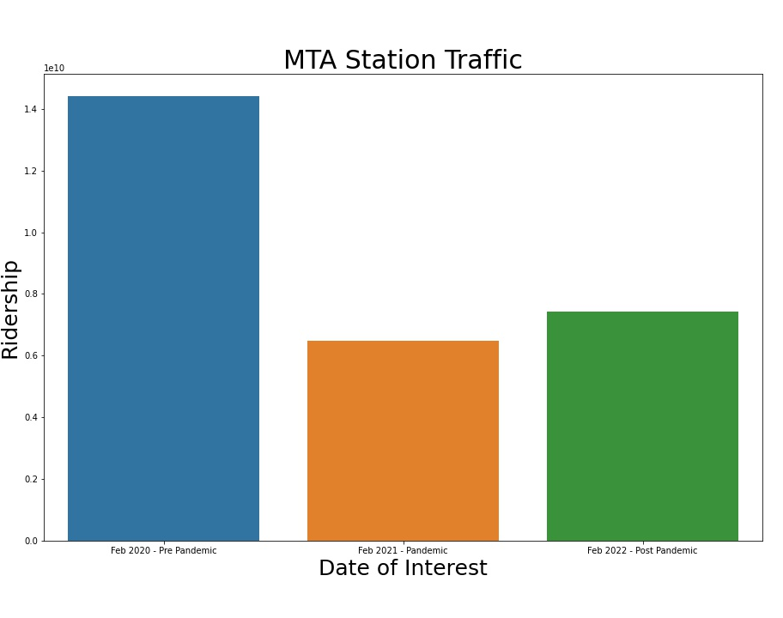
Results
MTA Ridership hasn’t returned to pre-pandemic levels
Measure – turnstile activity aggregated at the station level and then aggregated up to the macro system level
Recovery has been gradual. What gives?

Slide 6
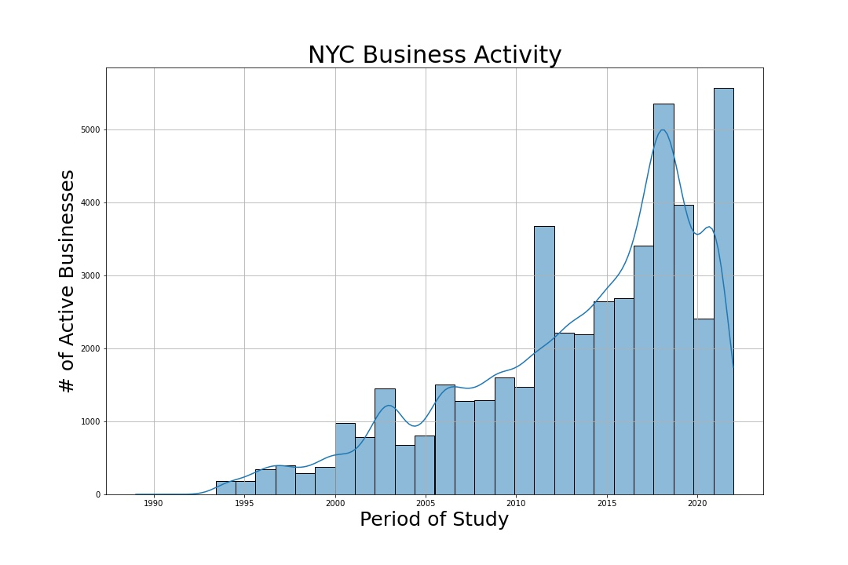
Results
Business activity measured as business license creation, dropped dramatically in 2020
Business activity has rebounded strongly and, surpassed pre-pandemic levels
Why hasn’t MTA ridership experienced the same magnitude of recovery?

Slide 7
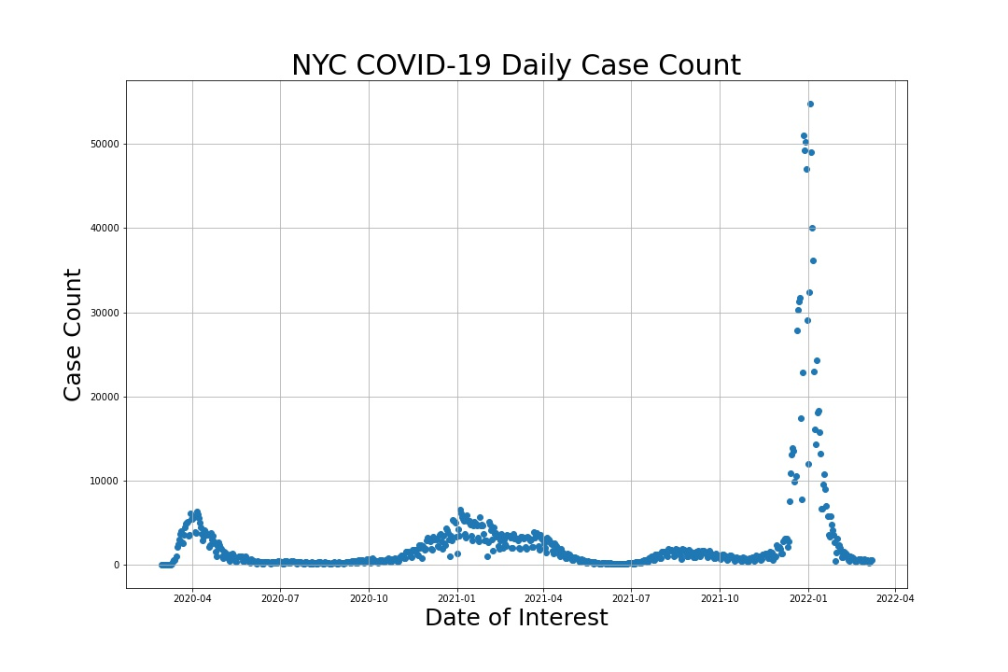
Results
COVID
Delta variant first detected February 23, 2021 in the US.
Omicron variant first detected December 1, 2021
Have MTA riders become more risk averse to public transportation due to prior COVID outbreaks?
Why has the magnitude of change in business activity been so much greater than MTA ridership post-pandemic?

Slide 8
Conclusions
There doesn’t seem to be a strong link between MTA turnstile activity and NYC business activity using legally operating business licenses as a proxy. A correlation study may yield more information.
MTA ridership has not recovered to pre-pandemic levels, however, business activity has rebounded strongly.
The pandemic seems to have impacted ridership recovery to a greater degree.
Is this a trend or an actual shift to alternate modes of transportation?

Slide 9
Future Study
Correlation study between ridership and business activity. Was the correlation greater in the past?
Have new forms of transportation permanently reduced MTA ridership?
Does the relationship look different if the focus is shifted to specific neighborhoods?
How does the increase of Work-From-Home impact ridership in the future?

Slide 10
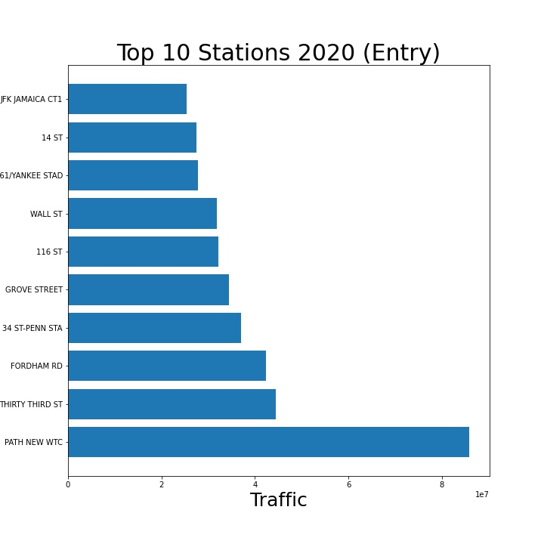
Top 10 Station Analysis
Appendix
Top 10 station composition has changed from pre-pandemic to post.
New WTC is way out ahead in 2020.
Further inspection of data required to verify results.

Slide 11
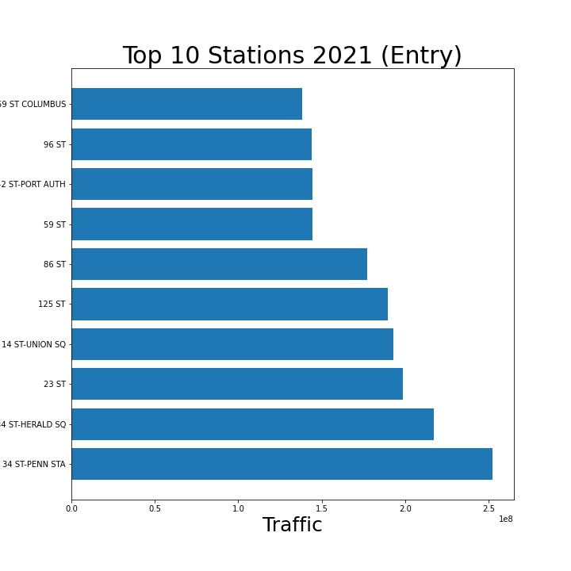
Top 10 Station Analysis
Appendix
2020 # 1 station was WTC.
Why did it change to Penn Station?
Does this imply there are more people traveling to the city for recreational activities?

Slide 12
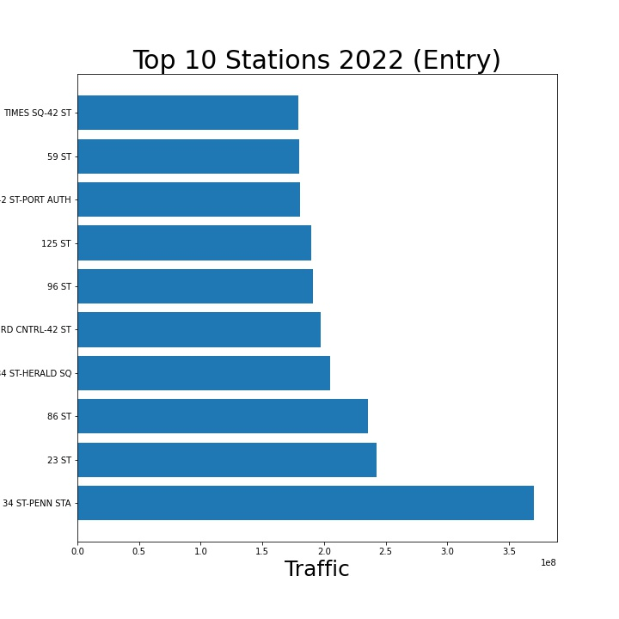
Top 10 Station Analysis
Appendix
2021 # 1 station was also Penn Station.
Times square broke into the top 10 in 2022.
Does this data point support the conclusion that more people are traveling to the city for recreation?

