Slide 1
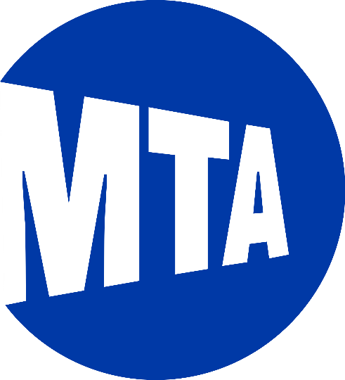

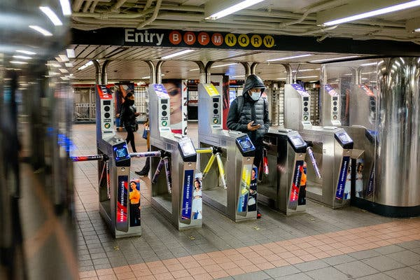
MTA Turnstile Activity Analysis
Alexander Amado

Slide 2
Introduction
Motivation –
Finance professional, interested in the linkages between unstructured data and the economy.
Objective –
Study the relationship between MTA turnstile data and business activity in NYC.
Goal –
Attempt to find answers to key questions:
Is there a link between turnstile activity and business activity?
How has the pandemic impacted MTA ridership and business activity?
Has business activity and ridership recovered to pre-pandemic levels?

Slide 3
Methodology
Data –
MTA Turnstile data
Metropolitan Transportation Authority
Legally Operating Businesses
Department of Consumer Affairs (DCA)
COVID-19 Daily Counts of Cases, Hospitalizations, and Deaths
Department of Health and Mental Hygiene
Metrics –
COVID-19 NYC daily case count frequency
Business license creation frequency
MTA turnstile activity aggregation

Slide 4






Methodology
Tools –
Python3
pandas
matplotlib
seaborn
SQLite
DB Browser for SQLite
SQLAlchemy
Data Usage –
MTA turnstile activity aggregated at the station and system level
COVID-19 daily case counts measured over time
Legally issued business licensees as a proxy for business activity

Slide 5
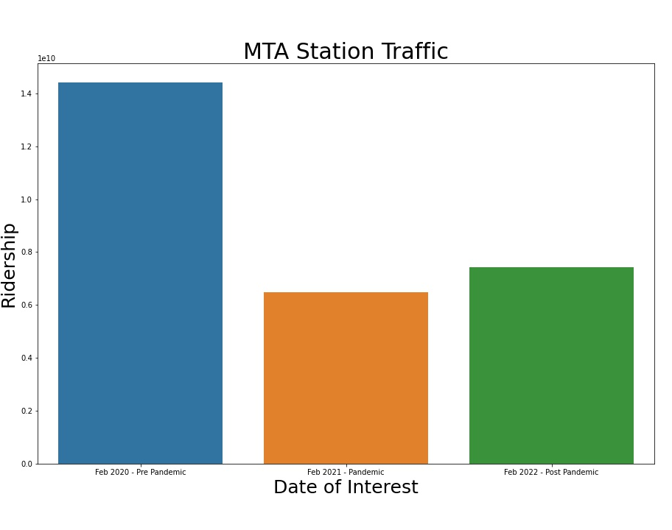
Results
MTA Ridership hasn’t returned to pre-pandemic levels
Measure – turnstile activity aggregated at the station level -> aggregated to macro system level
Recovery has been gradual. What gives?

Slide 6
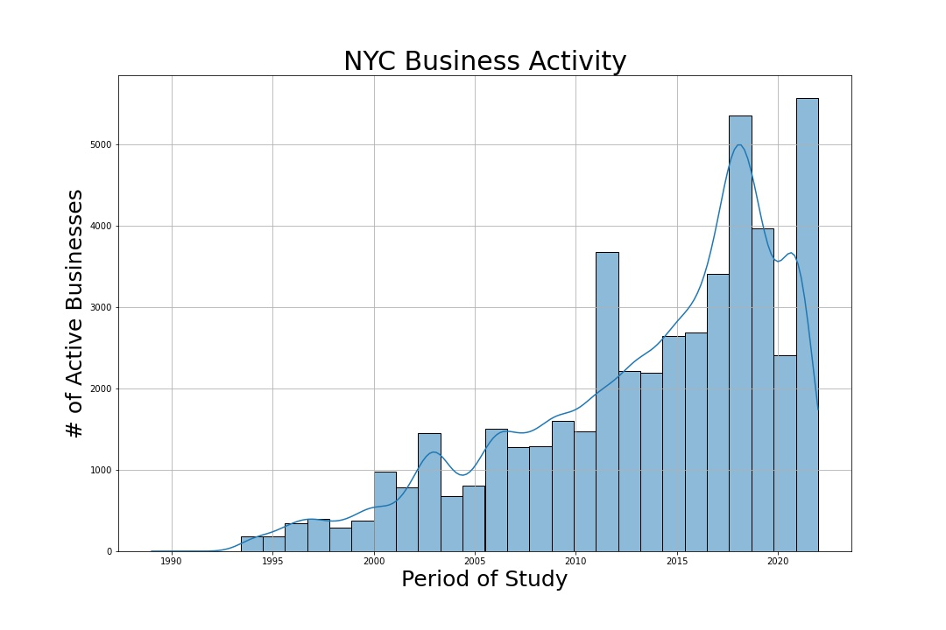
Results
Business activity measured as business license creation, dropped dramatically in 2020
Activity has rebounded strongly and surpassed pre-pandemic levels
Why hasn’t MTA ridership experienced the same magnitude of recovery?

Slide 7
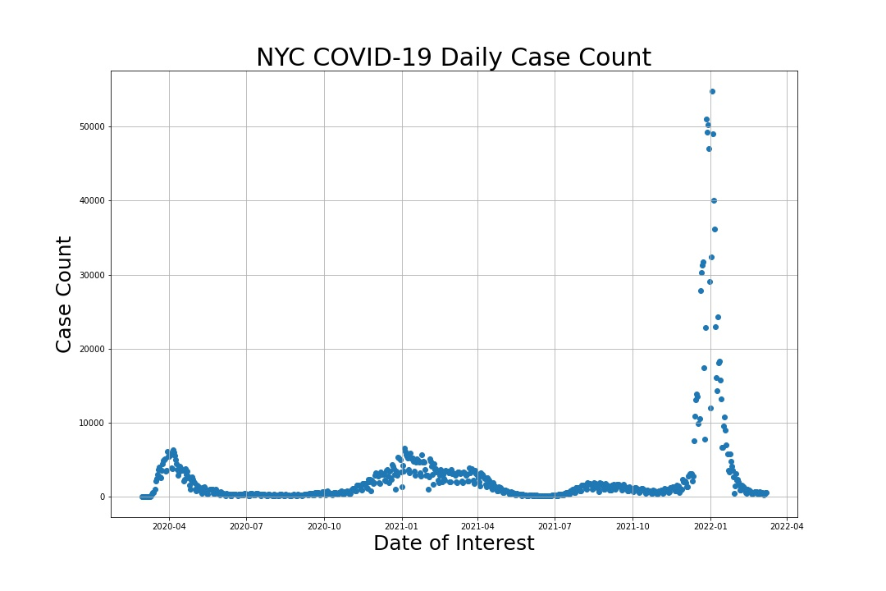
Results
SARS-CoV-2 Delta variant first detected February 23, 2021 in the US
SARS-CoV-2 Omicron variant first detected December 1, 2021
Now that case counts are lower, will we see an increase in ridership?
Why has the magnitude of change in business activity been so much greater than MTA ridership post-pandemic?

Slide 8
Conclusions
There doesn’t seem to be a strong link between MTA turnstile activity and NYC business activity using legally operating business licenses as a proxy. A correlation study may yield more information.
MTA ridership has not recovered to pre-pandemic levels, however, business activity has rebounded strongly.
The pandemic seems to have impacted ridership recovery to a greater degree.
Is this a trend or an actual shift to alternate modes of transportation?

Slide 9
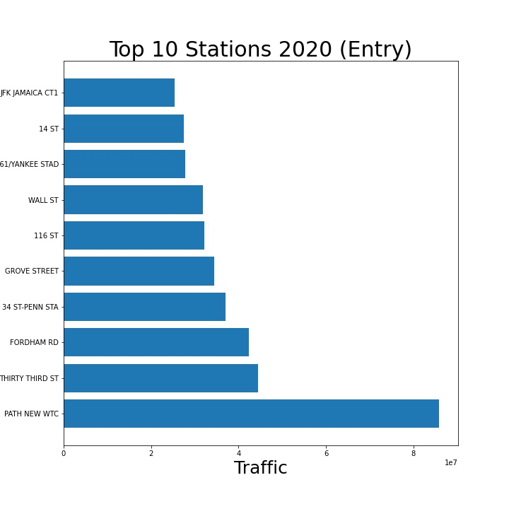
Top 10 Station Analysis
Appendix
Top 10 station composition has changed from pre-pandemic to post.
New WTC is way out ahead
Further inspection of data required to verify reuslts

Slide 10
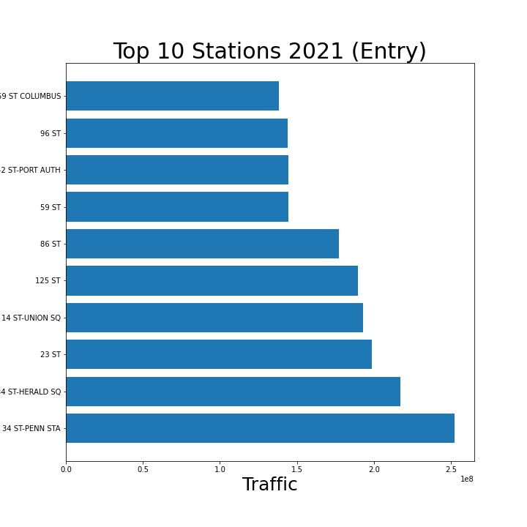
Top 10 Station Analysis
Appendix
Top 10 station composition has changed from pre-pandemic to post.
2020 # 1 station was WTC
Why did it change to Penn Station
Does this imply there are more people traveling to the city for recreational activities?

Slide 11
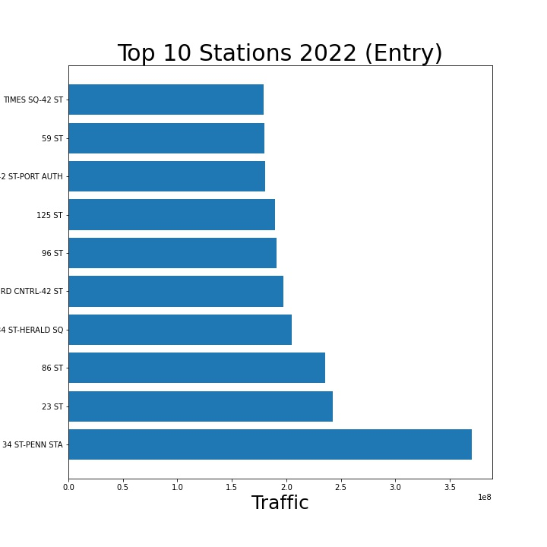
Top 10 Station Analysis
Appendix
Top 10 station composition has changed from pre-pandemic to post.
2021 # 1 station was also Penn Station
Times square broker into the top 10 in 2022
Does this also imply there are more people traveling to the city for recreational activities?

