Slide 1
Benchmark | Clock Cycles | LUT | Flip Flops | Block Ram | DSP
hardh264 | 171,029 cycles | 3034 | 1095 | 1.5 | 2
OpenNOC | 8,941,998 cycles | 4980 | 4017 | 0 | 0
Kyber Server | 34,806 cycles | 7016 | 2985 | 3 | 2
Kyber Client | 20,802 cycles | 7283 | 3002 | 3 | 2
MIPS | 1,341 cycles | 916 | 197 | 7.5 | 0
PNG decoder | 10,181,839 cycles | 2737 | 597 | 22 | 0
Image Processor | 98,303 cycles | 84 | 8 | 0 | 0
NoC | 49,956 cycles | Slide 14 | — | — | —
ECC (too large to fit on specified area) |  | 6265 | 5089

Slide 2
Benchmark | Image | Clock Cycles | LUT | Flip Flops | Block Ram | DSP
PNG decoder | 14 | 10,181,839 cycles | 2737 | 597 | 22 | 0
^ | 10 | 399,996 cycles | 2737 | 597 | 22 | 0
JPEG decoder | 001 | 78,652 cycles | 2334 | 469 | 4.5 | 0
^ | 007 | 4,147,561 cycles | 2334 | 469 | 4.5 | 0
Image Classification | X | Testbench not provided | 1774 | 511 | 9 | 0
FFT | X | 3,274 cycles | 2508 | 6096 | 3 | 32
Trigonometry | X | 1,268 cycles | 1242 | 435 | 0 | 0
Matrix Multiplication | X | 63,108,996 cycles | 557 | 141 | 108 | 2

Slide 3
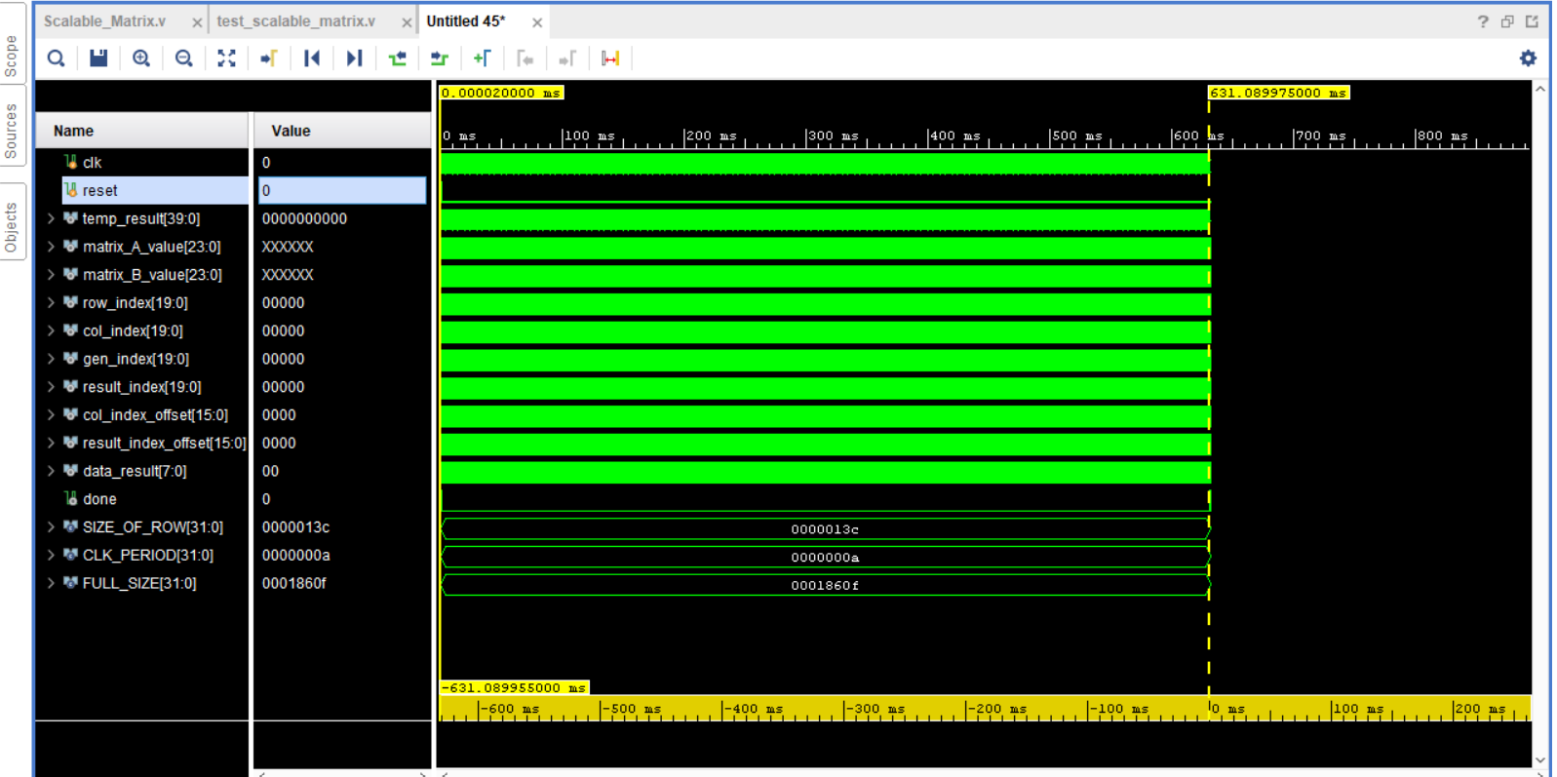

Slide 4
Benchmark | Clock Cycles | LUT | Flip Flops | Block Ram | DSP
fir_filter | 240 cycles | 88 | 41 | 0 | 0
viterbi_decoder | 1,486 cycles | 39 | 11 | 0 | 0
IIR_Filter | 1,031 cycles | 74 | 36 | 0 | 0
RSA | 1,371 cycles | 562 | 26 | 0 | 1
Neural Network Convolution | 128 cycles | 2082 | 730 | 0 | 0
FM Transmitter | 16 cycles | 784 | 739 | 0 | 0
4x4 Matrix Multiplcation | 15 cycles
Simple FSK | 51 cycles | 52 | 25 | 0.5 | 0

Slide 5
Benchmark | Clock Cycles | LUT | Flip Flops | Block Ram | DSP
Median | 6 cycles | 62 | 40 | 0 | 0
HeapSort | 217 cycles | 17 | 15 | 0 | 0
FFT Kernel | 147 cycles | 3867 | 792 | 0 | 0
Image Filter | 20 cycles | 113 | 99 | 0 | 0
FFT | 66 cycles | 1261 | 697 | 0 | 4
Systolic Array Processor | 120 cycles

