Slide 1
YELP Data - An Exploratory Analysis
Review and Rating of Restaurants
Abdullah Al Mamun
Maria Gandur

Slide 2
Data Source: Yelp
Data Description: The data set includes information about local businesses in 12 metropolitan areas across America, with 156,000 business entities and 4.7 million reviews.
The data provided does not include New York City, or some other metropolitan areas such as Miami, or Washington D.C.
We presume these cities would play a significant role in identifying tendencies of reviews of restaurants in the United States, however their data was not available.

Slide 3
Objective
Conduct exploratory and comparative analysis of ratings and reviews sourced from Yelp to find any patterns in reviews/comments for restaurants
Research Questions:
Is rating correlated with number of reviews? Is there any linear relationship? Do ratings and reviews vary across cities?
Are the results of the sentiment analysis consistent or do they vary across cities? What is their relationship with ratings?

Slide 4
WORK FLOW
Gather, clean, and merge data
Two files analyzed:
Business Data and Review Data, merged by business ID
Work of subset data
Business data of 156,000 business entities
Review data of 300,000 reviews
Analyze and compare active and closed restaurants
Key focus : rating, review count, review comment

Slide 5
I. OVERVIEW OF DATA

Slide 6
Data contains 51,613 restaurants in 735 cities (including the US and other countries)
74.9% of the restaurants are currently open
Only 2.6% of the restaurants have 5 stars
In the US, Arizona contained the highest number of restaurants amongst the top 10 rated restaurants.

Slide 7
II. RESTAURANTS and REVIEWS

Slide 8
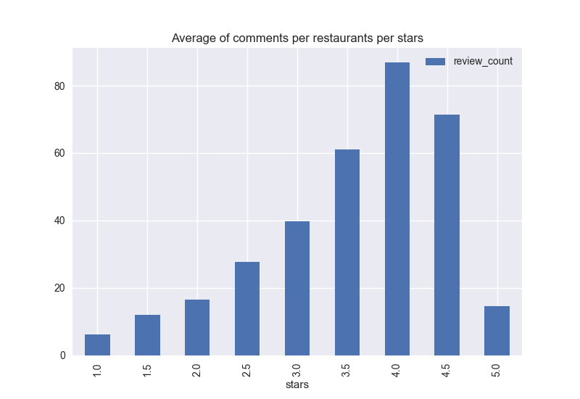
When we take average number of reviews per business id there exists upward slopping line for rating against number of reviews.

Slide 9
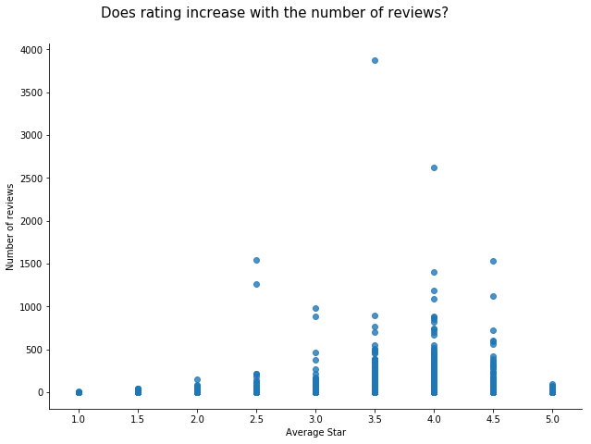
The scatter plot indicates that as the rating increases the number of reviews also goes high, up to a rating of 4. Afterwards the number of reviews drops.

Slide 10
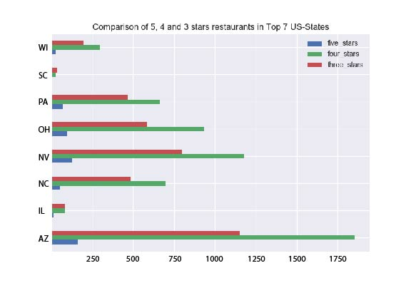

Slide 11
III. OPEN VS CLOSED RESTAURANTS

Slide 12
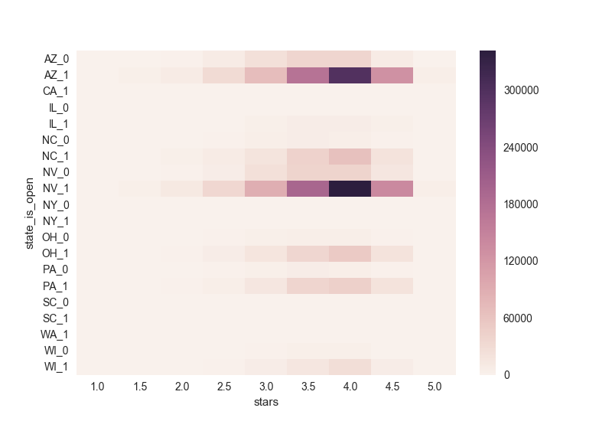
Review Count and Stars in US Cities (Comparison of Open and Closed Restaurants)

Slide 13
Regardless of whether the business is open or closed, Arizona has the highest number of reviews followed by Nevada.

Slide 14
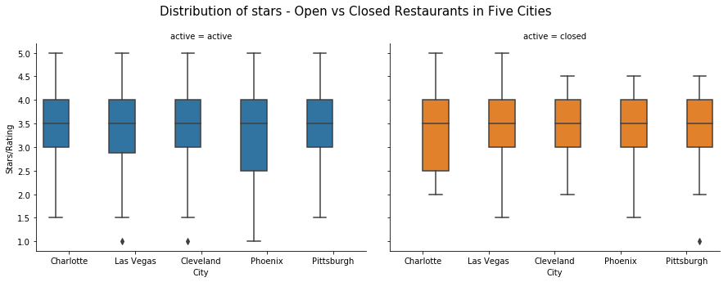
Distribution of Stars
Open vs Closed Restaurants
Most cities have similar distribution in terms of rating, except Phoenix.
Average rating is 3.5 across all cities in open and closed restaurants

Slide 15
IV. Sentiment Analysis How do open and closed restaurants fare?

Slide 16
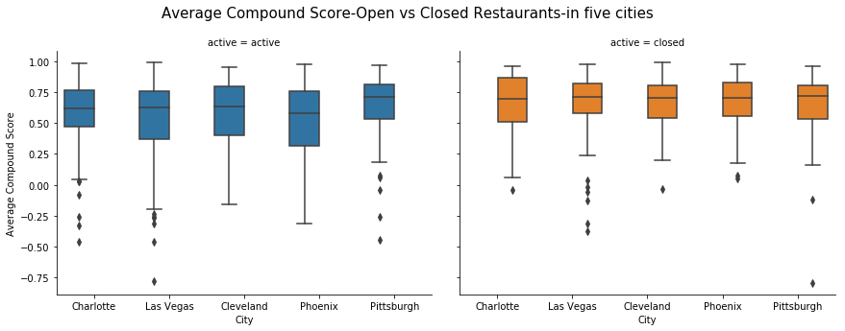
Average Compound Score
Open vs Closed Restaurants in Five US Cities
Notes:
It is observed that closed restaurants have received higher compound score than the ones in open category for most cities in this list.
The city Pittsburgh is found to receive highest compound score. The restaurant goers seem very positive about the restaurants in Pittsburg. Among the closed restaurants, Charlotte has restaurants with higher range of compound score.

Slide 17
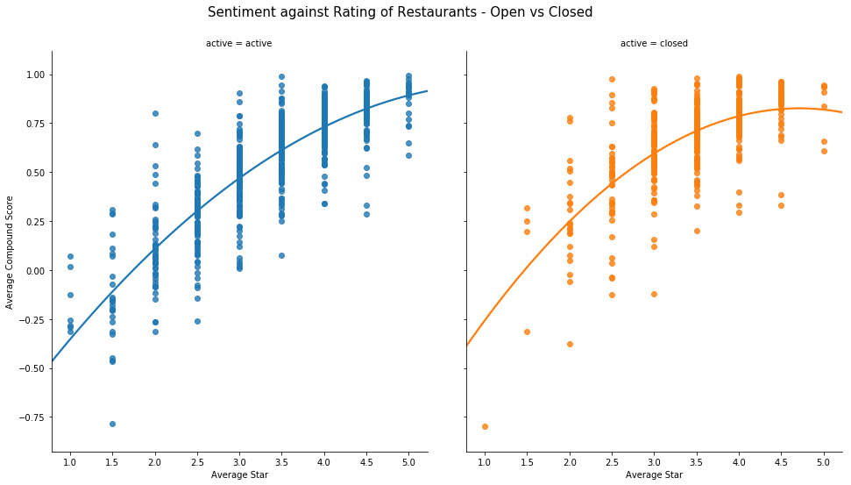
Sentiment vs Rating of Restaurants
Open vs Closed

Slide 18
Scatter plot with a higher order linear regression fit reveals that as the restaurants receive higher ratings, they also received higher average compound scores.
The relationship is more linear in the case of open restaurants as is in the case of closed restaurants.

Slide 19
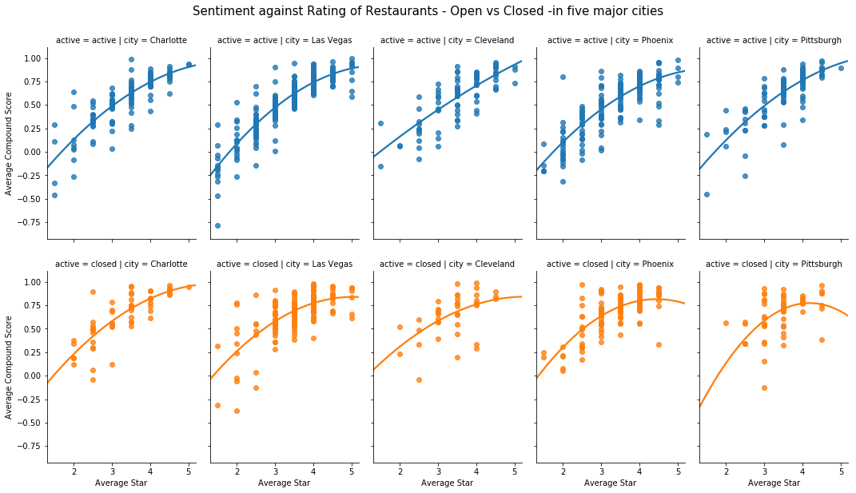
Sentiment vs Rating of Restaurants
Open vs Closed in Five Major US Cities

Slide 20
As seen in the previous graphs, the plots for each city confirms the linear relationship between rating and average compound score.
For open restaurants, the line is more upward slopping. However, for closed restaurants the line is of polynomial type.

Slide 21
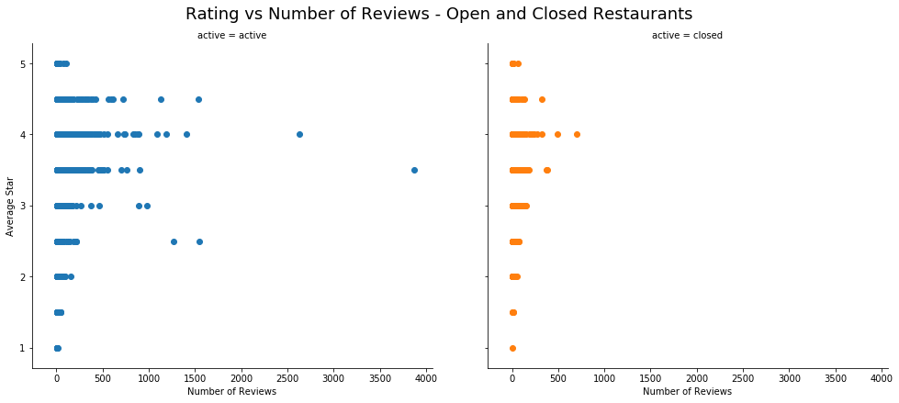

Slide 22
V. Final comments

Slide 23
The sentiment analysis and the plots against rating - at overall level as well for the cities - are consistent with the rating, i.e. increased compound score is associated with higher rating.
Based on the sentiment analysis, we can infer that people are less likely to give a 1 or 5 star review.
There is no discernable difference in results of reviews between open and closed restaurants.
Further analysis of data are required to determine if there is a discernable cause to a restaurant closing, whether that be due to quality of service, value of food, or efficiency of staff.

Slide 24
V. CHALLENGES Faced

Slide 25
The size of the data being too large for Python to load and process rapidly.
The structure of the data (nested dictionaries).

