Slide 1
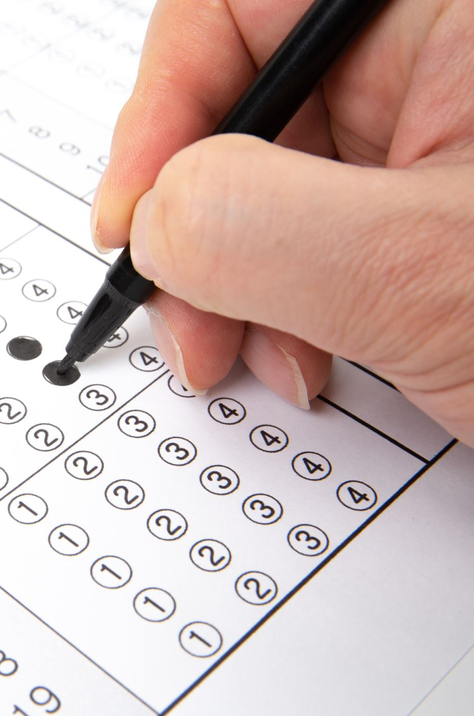

CMPT 140 Lab 4: Midterm Review, Functions

Slide 2
Algorithms
Ordered list of actions
  Solve a problem, perform a task
Actions → imperative, feasible, self-explanatory

Slide 3
Algorithms – Control Statements
Condition under which to perform an action
Example?

Slide 4
Abstraction
Remove irrelevant details
Ex) If we say “write your name on the top of the page”
  Omits details like get a writing instrument, writing each letter of your name etc.
  Need to be careful what to abstract based on who/what is performing a task!

Slide 5
Refinement
Opposite of Abstraction
  Adding more details
Can refine write name:
  Write an L
  Could even refine Write an L → stepwise refinement
    Write a 2cm vertical line
    Write a 1cm horizontal line, going to the right, that touches the bottom of the first line
Refine until algorithm is feasible and self-explanatory for who/what is performing the algorithm

Slide 6
Encapsulation
Grouping (and naming) related actions
Break up tasks (Refinement) but hide the details (Abstraction)

Slide 7
Input and Output
Input → resources or information needed before the algorithm is carried out
Output → the results when the algorithm is finished
In p5 for example an input could be location of the mouse, Output is what is drawn

Slide 8
Visual Output in Python
Programming Language → language programmers use to give instructions to a computer. Ex) Python
  Vocabulary → words that mean specific things. Ex) print
  Syntax → how words and punctuation is combined Ex) print()
Programming Library → Sets of extra commands Ex) p5
Development Environment → application for programmers to write computer code Ex) Thonny
  Not needed, but helpful!

Slide 9
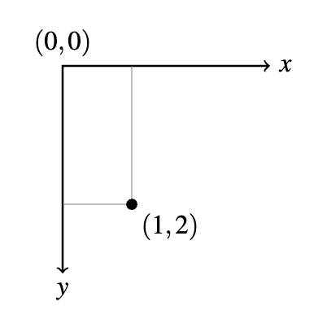
Coordinate System

Slide 10
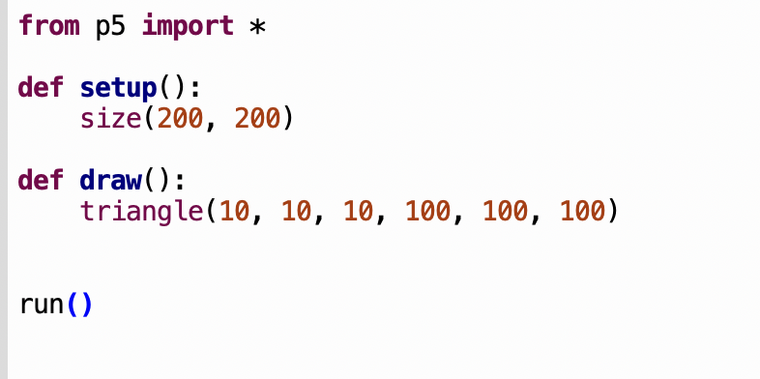
What does this program do?

Slide 11


Slide 12
Text Output
What does the following do:
print(“Hello!”)
How is it different from:
text(“Hello!”)

Slide 13
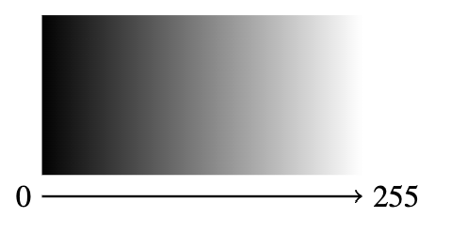
Grayscale Colour

Slide 14
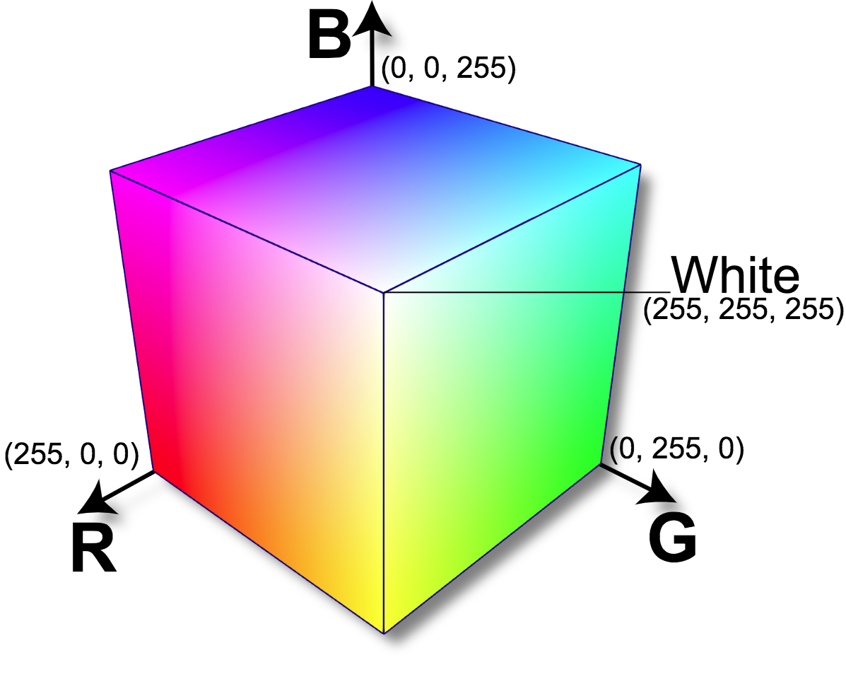
RGB Colour
Red, Green, Blue
Additive colour model
Mixture of light
How would I get grey?

Slide 15
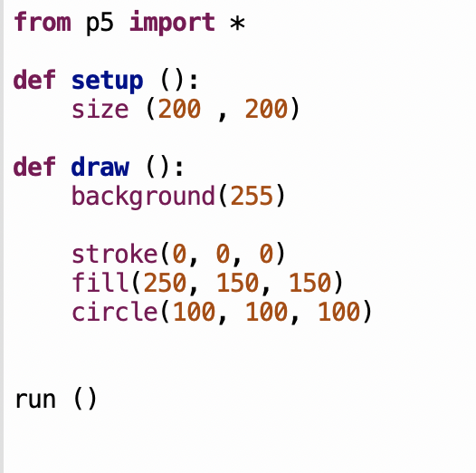
What does this program do?

Slide 16


Slide 17
Variables
A name for a piece of data
Variable names
  Should clearly indicate what the variable is for!
  Can contain letters, digits and underscores, but no other symbols
  Cannot start with a digit
  Cannot be a Python keyword

Slide 18
Special p5 variables
mouse_x
mouse_y
key
width
height

Slide 19
Data Values
data value → a piece of information that has a precise meaning to a computer
Goes on right hand side of variable assignment statement
  Ex) name = “Amanda”
  name is the variable, “Amanda” is the data value

Slide 20
Data Types
Categories that define what kind of operations can be performed on the data
Atomic datatypes
  Integers → whole numbers, no fractional part
  Floating points → numbers that are not whole number
    Sometimes cannot be represented exactly
  Booleans → True False
Compound datatypes
  Strings → sequences of characters enclosed in “” or ‘’
  List → sequence of data items enclosed in []
  Dictionary → unordered sequence of key-value pairs enclosed in {}

Slide 21
Literals
Data value written into the program’s code
Integer literals: numbers without decimal points
Floating point literal: numbers written with a decimal point, or in scientific notation
String literal: A sequence of characters enclosed with
”” or ‘’

Slide 22
Expressions
Combinations of data and operators
Operators → special symbols that have their own meaning
  * ** + - / // %
Literals and variables are examples of expressions too

Slide 23
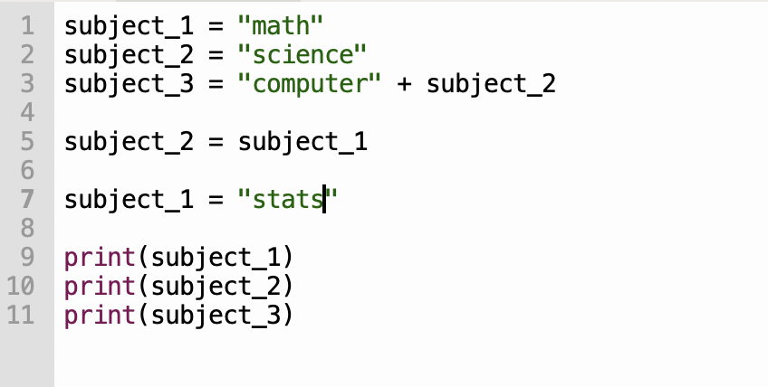
What will this program do?

Slide 24
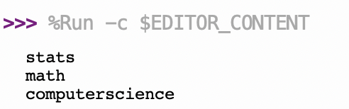

Slide 25
Question!
Imagine you have two Codelab questions where you are given the variable x containing an integer, and y containing another integer
1. write an expression to add x and y together
2. Assign a variable to the sum of x and y
Can you tell the difference between what these are asking?

Slide 26
Interactive Systems
A computer program designed to continually interact with a human user
users → the humans use a computer program
system → the computer program that interacts with the human user
User actions → physical events initiated by the user that the interactive system can detect
System feedback → the mechanism by which the system gives information back to the user
How does this differ from a run to completion system?

Slide 27
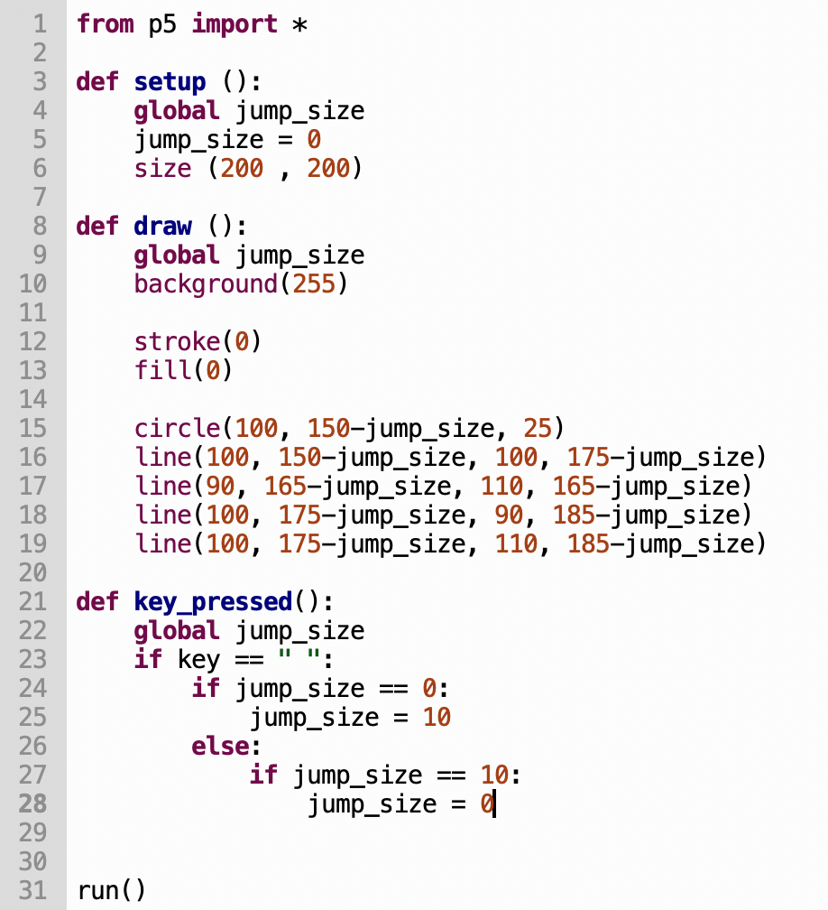
What happens as I hit the space bar?

Slide 28


Slide 29
Functions
A block of code that is given a name
defining the function → writing the code and name
calling the function → executing the function by writing its name in our code

Slide 30
Calling functions
Ex 1
What is the argument when calling
print(“Hello World!”)
Ex 2
Give an example of a function call that takes no arguments

Slide 31
Defining Functions
You already have done this! But now can make your own!
def myFunctionName(parameters):
code
return

Slide 32
Ex 3:
What is the difference between an argument and a parameter?
Ex 4:
Write a function that draws an ”x” out of red lines. Make the function take in the coordinates of the middle of the x and the size of the lines as parameters
Then call your function
Ex 5:
Write a function that returns the square root of a number

