Slide 1
INFRASURE · RISK PLATFORM · VULNERABILITY LAYER
Damage Modeling
From hazard intensity to a damage ratio
A from-the-basics walkthrough of the curve layer: what it is, why it earns its own home, the seven-stage build pipeline, and how it plugs cleanly into hazard modeling.
intensity → DR
per failure-unit
provenance-carried
versioned contract
Internal — modeling team
1

Slide 2
THE ONE JOB
Turn a hazard intensity into a damage ratio
intensity x the asset's vulnerability → damage ratio DR ∈ [0, 1]
DR = repair cost ÷ replacement value — physical destruction only, per thing-that-fails.
What it is NOT
What rides with it
Where it stops
A whole-plant guess, a single literature curve, or a chart in a slide. It is a parameterized, callable function with a contract.
Every parameter maps to a source or a named assumption. Provenance is the deliverable, not an afterthought.
It emits a DR (and a capability declaration). It does not compute EAL, PML, or portfolio loss — that is the consumer's job.
InfraSure · Damage Modeling — From the Basics · Internal
2
docs/damage_curves/SCOPE_AND_STORY.md §1, §5 · AGENTS.md

Slide 3
WHERE IT SITS IN THE PLATFORM
A shared substrate that feeds Hazard's M3 stage
Damage modeling is not a fourth risk tier. It is a substrate the Hazard tier consumes at one point — the M3 (damage) stage.
1 · PERFORMANCE
DAMAGE MODELING
model-gpr — normal ops → P50 / P90 / P99
this repo
intensity → damage ratio
per failure-unit
provenance-carried
versioned curve packages
+ a damage_code() API
2 · HAZARD
M0 → M1 → M2 → [ M3 ] → M4 → asset loss · EAL · PML · VaR
3 · OVERALL
performance + hazard → Total Loss
consumed at M3 only
M3 stops CONTAINING the curve and starts CONSUMING it.
InfraSure · Damage Modeling — From the Basics · Internal
3
docs/damage_curves/SCOPE_AND_STORY.md §3

Slide 4
THE THREE-PHASE ARC
Damage was assumed → now it is built → then it is adjusted
PHASE 1
PHASE 2
PHASE 3
Hazard-first ("IDF")
Damage from the ground up
Adaptation & resiliency
M0→M4 engine stood up end-to-end using a few generic / borrowed damage curves.
Build the curve properly: grain · axis · form · coverage · provenance · value-link · emit object.
Turn the knobs the curve already exposes — stow, feather, hardening, elevation — and price the trade-off.
damage = assumed
damage = built
damage = adjusted
done
we are here
future
Phase 2 ↔ 3 is deliberately blurry: the resiliency levers already live in Phase 2 as conditioners / selectors / exposure modifiers. Phase 3 is evidence + magnitude on knobs the curve already has.
InfraSure · Damage Modeling — From the Basics · Internal
4
docs/damage_curves/SCOPE_AND_STORY.md §2, §8

Slide 5
WHY WE MODEL AT THE FAILURE-UNIT
One cell can be one curve — or many
The grain isn't a style choice. Different hazards concentrate damage differently, so the same asset needs a different number of curves depending on the hazard.
HAIL × SOLAR
FLOOD × SOLAR
Damage collapses onto essentially one thing
Damage spreads across many local-exposure units
PV module glass / cell
primary-nonzero — carries the curve
mounting / inverter / racking / substation
reviewed, tagged DR ≈ 0 for direct hail
inverter · switchgear · transformer controls
combiner / DC protection · SCADA cabinets
cable / conduit · foundation scour · modules
each has its own datum & replacement logic
⇒ one primary curve drives the cell
⇒ a family of curves, composed by summation
InfraSure · Damage Modeling — From the Basics · Internal
5
01_cells/hail_solar · 01_cells/flood_solar (README v1)

Slide 6
THE BUILD PIPELINE
Seven stages, in strict order
Each stage has one decisive question, one input, one output. The order is forced: you can't choose the form before the axis, or the axis before the grain.
1
EVIDENCE
2
GRAIN
3
AXIS
4
FORM
What does the curated base authorize the curve to claim?
At what level is a curve written — and how do levels compose?
What variable indexes damage for each failure-unit?
What shape does the curve take, and where are its anchors?
5
ADJUSTMENTS
6
EMIT
7
SHIP
What does it depend on besides intensity, and how?
What does it return per event — and the capability declaration?
What does the consumer receive, and on what terms?
Collapsing stages hides decisions; splitting them creates sub-stages that share doctrine with their parent. Seven is the minimal honest set.
InfraSure · Damage Modeling — From the Basics · Internal
6
damage_curve_build_methodology.docx §3

Slide 7
1
STAGE 1 EVIDENCE
What does the curated evidence base authorize the curve to claim?
The binding rules
Four evidence tiers — graded per claim
Curated, not fitted — every parameter is attributed to an artifact; the optimizer does not override the curation.
T1
Direct empirical
loss observed on the actual asset × hazard, intensity recorded
Tier per claim — a 2024 paper is T1 for what it tested, T3 for adjacent claims — never graded in the abstract.
T2
Engineering standards
consensus standards & lab tests — IEC, IBHS, ASCE, HAZUS
No silent demotion — mixing a T1 paper with a T3 proxy in one fit quietly demotes the T1. Don't.
T3
Inferred / proxy
related-but-not-identical asset, hazard, or scale
A found curve is just an artifact — never copied as a black box — decomposed into anchors and re-derived.
T4
Expert judgment
documented opinion / OEM notes — not test reports
The weakest-tier parameter gates which metrics are honest downstream.
InfraSure · Damage Modeling — From the Basics · Internal
7
damage_curve_build_methodology.docx §4 · damage_curve_evidence_reference.docx

Slide 8
2
STAGE 2 GRAIN
At what level is a curve written — and how do those levels compose?
The doctrine
The composition rule
Subsystem-default — write at panel-glass / inverter / racking level — not panel-as-monolith.
cell_DR = Σ ( capex_shareᵢ × unit_DRᵢ )
Finer where mechanism concentrates — split only where evidence supports a separate curve.
Capex-weighted summation, each unit's DR capped at its own saturation. No grouping primitive — composition is always explicit, so double-counting can't hide.
Role assigns the effort — primaries get the evidence & care; secondaries get standards shapes; conditioner-only / exposure units carry no curve.
Worked split — hail × solar (illustrative):
panel_glass 0.65
mounting/tracker 0.20 · inverter 0.10 · racking 0.05
Immune ≠ ignored — DR≈0 parts are kept as explicit reviewed records, not dropped.
InfraSure · Damage Modeling — From the Basics · Internal
8
damage_curve_build_methodology.docx §5 · questions/01_granularity.md

Slide 9
3
STAGE 3 AXIS
What variable indexes damage for each failure-unit?
Why it earns its own stage: the indexing variable isn’t given — it’s an evidence-driven choice. Different reports measure damage against different variables, and it’s rarely the one the hazard catalog reports. Pick the variable that actually drives the failure. (Hail is the easy case: just diameter.)
The chain-position rule — index by what HITS the unit, not what the hazard reports
Radar reflectivity
MESH → diameter
Hail diameter (mm)
hazard catalog reports
M3 chain conversion
what hits the panel — THE AXIS
Physical units, always
Valid range, declared
Univariate in v1
wind m/s · hail mm · ground motion g · depth m · flux kW/m². Never normalized, never dimensionless.
outside it the curve does not extrapolate — the emit is undefined, not a best guess.
one axis per unit; a second dependency becomes a conditioner. Multivariate is a major-version event.
InfraSure · Damage Modeling — From the Basics · Internal
9
damage_curve_build_methodology.docx §6 · questions/02_x_axis_intensity_variable.md

Slide 10
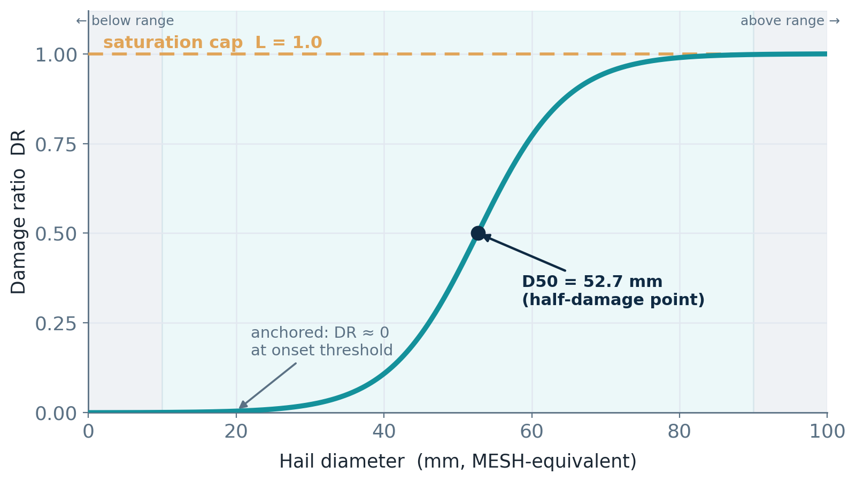
4
STAGE 4 FORM
What shape does the curve take, and where are its anchors?
Curve forms — logistic is the default, not the only option
DR(x) = L / (1 + e^(−k(x − x₀)))
Logistic
default · smooth onset → cap · 3 params
Piecewise-linear
evidence reports sharp damage-state jumps
State-based (fragility)
evidence is in states; consumer wants P(state)
PCHIP (monotone cubic)
dense anchors; smooth, monotone interpolation
Anchored logistic — hail × solar default module (real v1.0 parameters)
Linear
only a slope between two anchors
Whatever the form: anchor the onset · cap at L · no extrapolation past the valid range.
InfraSure · Damage Modeling — From the Basics · Internal
10
damage_curve_build_methodology.docx §7 · hail_solar curve_artifact.json

Slide 11
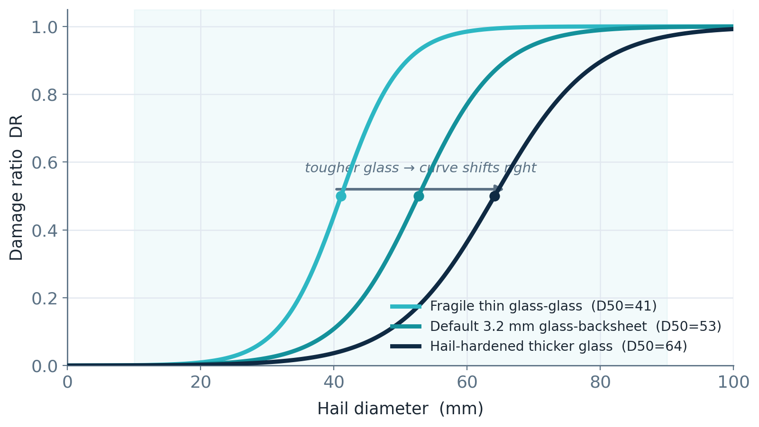
5
STAGE 5 ADJUSTMENTS
What does the curve depend on besides intensity — and how does each enter?
SELECTOR
fixed asset attribute, set at bind-time
e.g. module archetype / glass type
picks the curve
CONDITIONER
event-time state, recomputed per event
e.g. tracker stow when the storm arrives
adjusts the curve
EXPOSURE
value-share touched, set at bind-time
e.g. array exposure fraction
scales to dollars
Selector in action: three module archetypes are three shifted curves — the selector chooses which family applies.
Caveat — exposure is a v2 item. Partial / footprint exposure (f < 1) is in the contract but not yet exercised in the hazard-modeling integration. Today it runs at full site (f = 1.0).
InfraSure · Damage Modeling — From the Basics · Internal
11
damage_curve_build_methodology.docx §8 · questions/… selector_conditioner_exposure

Slide 12
6
STAGE 6 EMIT
What does the curve return per event — and what capability ships with it?
The emit shape is chosen by the FIRST NONLINEARITY downstream the curve must honor.
scalar mean DR
mean + spread
state vector
full distribution
triggered by
triggered by
triggered by
triggered by
linear functional (EAL)
a deductible / limit
state-conditioned repair
tail quantiles (PML, VaR)
sufficient when the consumer integrates a linear functional of DR
needed once a nonlinear financial term bites the distribution
when the consumer applies damage-state repair logic
required to honestly produce deep-tail metrics
Withhold, not caveat.
A scalar curve over the event set still gives an honest expected loss — what it drops is within-event spread, which dominates the deep tail. So a scalar tail would be understated; the curve withholds it rather than shipping it wrong. The consumer literally cannot emit a withheld metric.
InfraSure · Damage Modeling — From the Basics · Internal
12
damage_curve_build_methodology.docx §9 · questions/06_metrics_and_tail_honesty.md

Slide 13
WORKED EXAMPLE · HOW THE CURVE IS ACTUALLY BUILT
Hail × solar (1) — the question comes before the math
STEP 0 · we are NOT asking
STEP 0 · we ARE asking
hail size → whole-plant loss %
hail diameter (mm) → PV module glass / cell DR
Core failure unit: PV_MODULE_GLASS_CELL — hail breaks the exposed module glass/cells; inverters, racking, civil are reviewed but stay DR ≈ 0 in v1 unless a direct-hail mechanism is shown.
The evidence we go looking for — and the role each plays
The anchors it produces
1
NOAA Storm Events / MESH → fixes the x-axis: hail diameter in mm — not energy, not return period
Archetype
anchors (mm → DR)
Default 3.2 GBS
25→1% · 50→39%
2
IEC / DOE-FEMP hail test → the near-zero boundary: a qualified module ≈ 1% DR at 25 mm
Fragile glass-glass
35→18% · 45→61% · 50→89%
3
PVEL / Kiwa lab breakage → the curve-shape anchors — real breakage % at each hail size
Hardened thicker
25→0.5% · 45→7%
4
Field / claims (NREL, VU Amsterdam) → validation & caveats only — not refit into v1 curves
IEC is read as a boundary, not a loss curve: a qualified module shows very low DR near 25 mm — not a literal 0%.
InfraSure · Damage Modeling — From the Basics · Internal
13
hail_solar_curve_derivation_dossier_v1_3.md · 00_curve_curation_walkthrough.ipynb

Slide 14
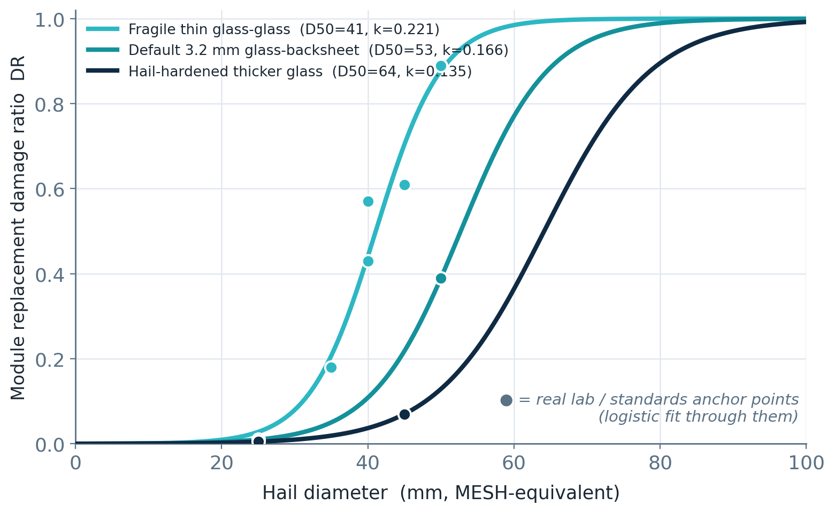
WORKED EXAMPLE · HOW THE CURVE IS ACTUALLY BUILT
Hail × solar (2) — fit, select, condition, value
FIT
Fit a logistic in logit space from the anchors → D50 (half-damage size) and k (steepness) per archetype.
SELECT
Selector module_archetype picks which curve — fixed asset metadata (glass type, thickness, rating).
Conditioner stow_state blends at event time: DR = P·0.90·logistic(D50+8) + (1−P)·logistic(D50).
CONDITION
Source: VDE Americas hail-stow memo · DOE/FEMP hail mitigation — direction only; the +8 mm / ×0.90 magnitude is a T4 placeholder.
VALUE
loss = DR × exposure_fraction × module value — never applied to the whole-plant TIV.
The logistic fit, drawn through the real anchor points — three module archetypes, three curves.
The whole flow: define failure unit → axis evidence → standards boundary → lab anchors → field as caveats → fit logistic → selector → stow conditioner → keep value separate → ship JSON
InfraSure · Damage Modeling — From the Basics · Internal
14
hail_solar__model_v1_0 curve_artifact.json · derivation dossier v1.3

Slide 15
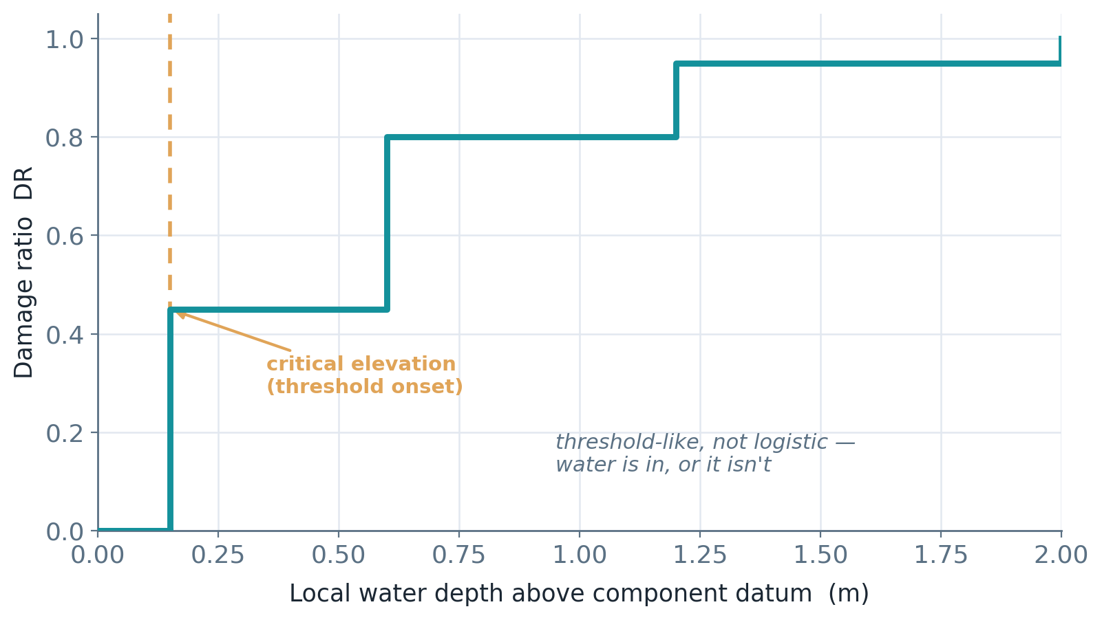
WORKED CONTRAST — WHY THE METHOD GENERALISES
Flood × solar: many failure-units, a different curve form
What changes vs. hail × solar
Grain
many primary units — inverter, switchgear, transformer controls, combiner, SCADA
Axis
local water depth above each component datum (+ a velocity/scour proxy)
Form
piecewise-linear / state — water is in, or it isn't
Flood equipment damage is threshold-like, indexed by local depth above each component's critical elevation — so the form is piecewise / state, not logistic.
Exposure f
site geometry & elevation, not material / BOM share
Same pipeline, same contract — the grain, axis, and form just resolve differently for the hazard. That portability is the whole point.
InfraSure · Damage Modeling — From the Basics · Internal
15
01_cells/flood_solar/current (README v1.0)

Slide 16
THE HONEST STATE OF THE WORK
Method is mature; evidence is young — and that's managed
Method (new work)
Evidence (new work)
The bridge
Deep & right — keep all of it
Young — public-derived, not claims-calibrated
Standard 16 — reference ingestion
CELL → failure-unit architecture
coverage roles
provenance discipline
emit / tail-honesty resolution
all 3 cells public-source-derived
load-bearing placeholders
hail stow +8 mm (T4)
flood scour proxy; wind D50/k partly one case
Absorb the old repo's strong evidence the right way: intake → triage → axis-compatibility → source-to-parameter map → impact → version bump.
Method from the new work; evidence from the old. A maturity badge travels with every runtime curve.
InfraSure · Damage Modeling — From the Basics · Internal
16
docs/damage_curves/SCOPE_AND_STORY.md §7 · standard 16

Slide 17
THE FIVE THINGS TO HOLD ONTO
If you remember nothing else
1
A curve is a callable, not a chart — parameterized, provenance-carried, with a capability declaration.
2
We model at the failure-unit — then assemble by capex-weighted summation — sum, don't group.
3
Build in strict order — EVIDENCE → GRAIN → AXIS → FORM → ADJUSTMENTS → EMIT → SHIP.
4
We declare; the consumer computes — damage owns DR + capability; hazard owns EAL / PML / portfolio.
5
Honesty is the feature — weakest tier gates metrics; withhold, don't caveat; flag every open seam.
Read next: github.com/aamani-ai/Damage_Modeling · SCOPE_AND_STORY.md · the hail & flood worked-reference docs · the notebooks
17

Slide 18
APPENDIX A
Evidence tiers — graded per claim, weakest gates the metric
Tier
Name
What it means
Examples
T1
Direct empirical
Loss observed on the actual asset × hazard with intensity recorded
attributed claims, field campaigns, realistic test stands
T2
Engineering standards
Consensus standards and lab tests
IEC, IBHS, ASCE, HAZUS
T3
Inferred / proxy
A related-but-not-identical asset, hazard, or scale
coupon tests, cross-event transfer
T4
Expert judgment
Documented credentialed opinion or OEM notes that aren't test reports
vendor engineering notes
A tier grades an artifact for the specific claim being made — not in the abstract. The same paper can be T1 for its own specimen and T3 transferred to another asset.
InfraSure · Damage Modeling — From the Basics · Internal
18
damage_curve_evidence_reference.docx · §2.2 of build methodology

Slide 19
APPENDIX C
Glossary — the words this deck assumes
Damage curve
A callable: a parameterized function + capability declaration. Not a chart.
Exposure
The value-share a failure-unit touches; scales DR into dollars.
Failure-unit
The level a curve is written at — the damage-code atom (e.g. panel glass).
Emit object
What the curve returns per event: scalar, mean+spread, state, or distribution.
Cell
A (hazard × asset) pair; ships a family of curves, one per failure-unit.
Capability declaration
Metadata saying which downstream metrics the curve honestly supports.
Selector
Fixed asset attribute that picks a curve variant (bind-time).
Damage ratio (DR)
Repair cost ÷ replacement value, in [0, 1] — physical destruction only.
Conditioner
Event-time state that adjusts parameters (e.g. stow angle).
Cap-binding preflight
The check that gates a scalar EAL: confirms the cap rarely binds.
InfraSure · Damage Modeling — From the Basics · Internal
19
damage_modeling_terminology.docx

