Slide 1
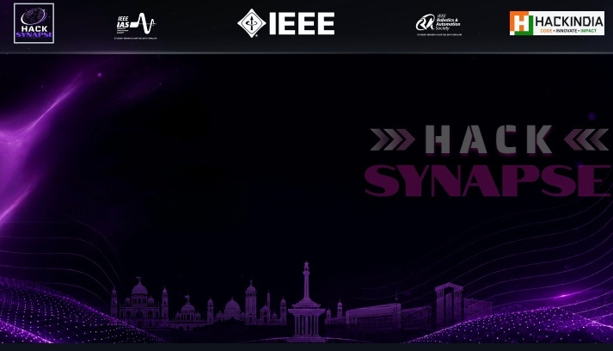














CYBERNOVA
DIVYA KHARE
AMAN MESHRAM
(Team Leader)
RADHIKA PARMAR
AMAN SEMIL
click here to view the video
Combining AI, technology, creativity and problem solving to build practical cybersecurity solutions.

Slide 2

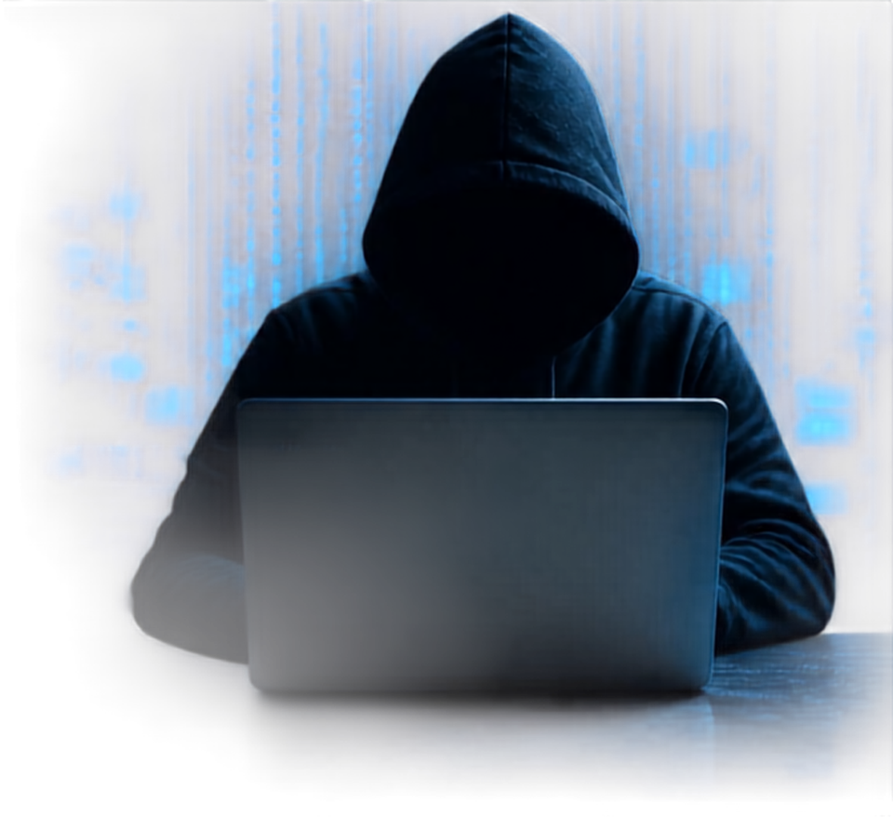



THE SCAM
ISN’T ALWAYS OBVIOUS.
Digital scams are getting harder to spot. They show up in more ways than ever:
Payment Scams
Fake refunds, payment requests and fraudulent transactions.
THE REAL PROBLEM
Phishing Messages
Users don’t just need to know IF something is a scam. They need to know WHY it is dangerous and WHAT they should do next.
Malicious Links & QR Codes
Fake messages designed to steal credentials or personal information.
Deceptive links that redirect users to unsafe destinations.
Job Scams
Impersonation
Fake job offers demanding registration fees or personal details.
Attackers pretending to be banks, companies, friends or authorities.
SUSPICIOUS CONTENT
CONFUSION
CLICK / PAY
DATA OR MONEY LOSS
SCAMHUNT aims to break this chain before the damage happens.

Slide 3









MEET
HOW IT WORKS
THE RESULT
1
SCAMHUNT
SUBMIT
RISK SCORE
Message • URL • Screenshot • QR Code
94 / 100
HIGH RISK
An AI powered digital fraud investigator that helps users understand suspicious content before they click, pay, or share sensitive information.
2
INVESTIGATE
SCAM TYPE
ScamHunt analyzes suspicious signals, language, links, domains and available threat intelligence.
Phishing
EVIDENCE
3
EXPLAIN
Suspicious domain Impersonation Urgency Credential request
OUR USP
Identifies the potential scam type and shows the evidence behind the risk.
WE DON’T JUST DETECT. WE INVESTIGATE.
4
RECOMMENDED ACTION
ACT
Don’t click. Verify through the official channel.
Provides a clear recommendation on what the user should do next.

Slide 4












HOW SCAMHUNT
INVESTIGATES
1
2
3
4
5
6
7
USER INPUT
INPUT
EVIDENCE
THREAT
AI
RISK
INVESTIGATION
PROCESSING
ANALYSIS
INTELLIGENCE
INVESTIGATION
ENGINE
REPORT
Message
URL
Screenshot
QR Code
Extract text, links, domains and other relevant signals.
Analyze language patterns, URLs, domains and suspicious indicators.
Check available reputation and security signals.
AI combines the collected evidence and identifies the likely scan pattern.
Generate a Risk Score and Scam Category based on the evidence.
Risk Score
Scam Type
Evidence
Explanation
Recommended
Action
CORE FLOW
INPUT
ANALYZE
INVESTIGATE
SCORE
EXPLAIN
PROTECT

Slide 5





TECHNOLOGY USED
TECHNOLOGIES USED
📱 Android
Android application
Standalone mobile experience
AndroidX components
🌐 HTML • CSS • JavaScript
Mobile UI
Responsive screens
Application logic
Interactive features
🧠 Rule-Based Threat Analysis
Suspicious pattern detection
Risk scoring
Threat categorisation
Explainable warning signs
🔐 Web Crypto API
SHA-256 hashing
Digital evidence integrity support
📁 Browser File APIs
FileReader
Image / PDF handling
Digital evidence processing
💾 Local Storage
User data
Cases
Evidence information
App preferences

Slide 6


IMPACT & FEASIBILITY
IMPACT
Early Detection: Helps users identify scams before losses occur.
Better Awareness: Explains suspicious signs in simple language.
Faster Response: Guides victims on what to do after an incident.
Evidence Preservation: Helps organize digital proof for reporting.
Wider Reach: Useful for students, families, employees and everyday users.
A practical, privacy-first early-warning system built today, ready to scale tomorrow.
FEASIBILITY
Technically feasible : built using existing web and Android technologies.
Scalable architecture : features can be upgraded independently.
Multi-input support : analyzes messages, URLs, images, files and voice.
Low-cost deployment : can run on existing smartphones.
Future-ready : can integrate stronger AI, threat intelligence and reporting systems.

Slide 7
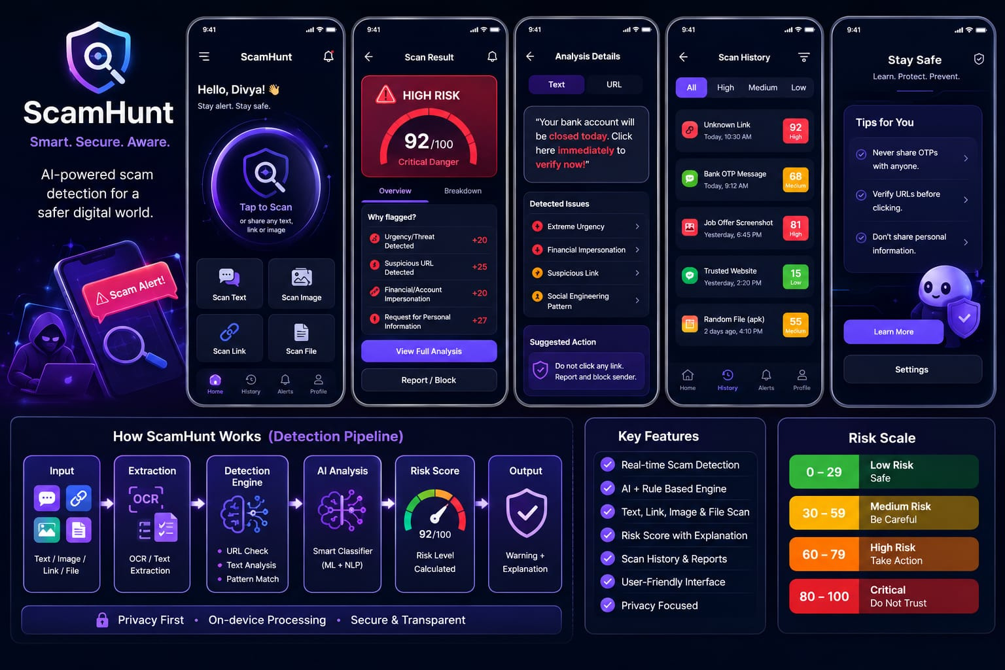
SCAMHUNT PROTOTYPE

Slide 8

THE FUTURE OF
SCAMHUNT
Smarter detection
Advanced AI to catch complex,phishing and fraud
Wider understanding
Detect scams across multiple languages
Always on protection
Real-time safeguards powered by Android
Richer analysis
Understand messages, links, screenshots, and files
Stronger by design
Continuously learning with cloud intelligence and privacy-first security
Built to grow
Expanding beyond Android to more platforms

Slide 9

THANK YOU
SCAMHUNT
Don’t Trust It. Investigate It.
WE DON’T JUST DETECT.
WE INVESTIGATE.
Click here to view video
Presented by:
CyberNova
Divya Khare
Aman Meshram
Radhika Parmar
Aman Semil

