Slide 1

Case Study: Conona Virus
Aman Pandey
MS Business Analytics
The University of Texas at Dallas

Slide 2
The Corona Virus are a large family of viruses that causes not only the common cold but also more serious raspatory illness
The Virus was first identified on 7th of January in Wuhan Seafood Market in China
As per the Dataset, 11,374 confirmed cases has been registered till 31 January 2020, of which 11,221 cases was reported in China
As per the Dataset, 259 patients have died from the virus and 252 patient was reported to have recovered from the virus
Corona Virus

Slide 3
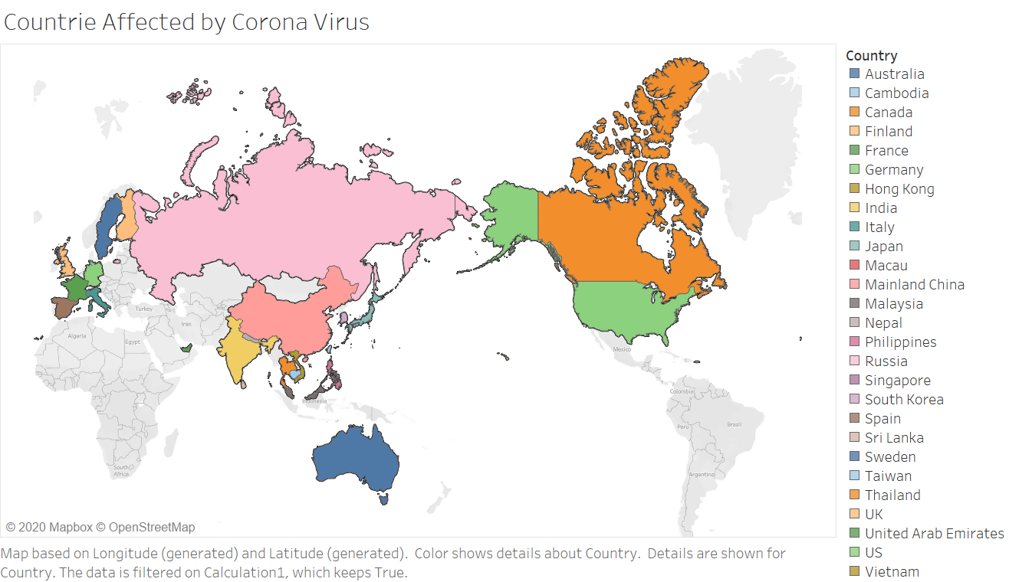
The Spread of Corona Virus Across The Globe
The Corona Virus has affected most part of the world. However, most number of cases has been confirmed in Asia, especially China.
Latin America and Africa have reported no cases of Corona Virus till 31st of January

Slide 4
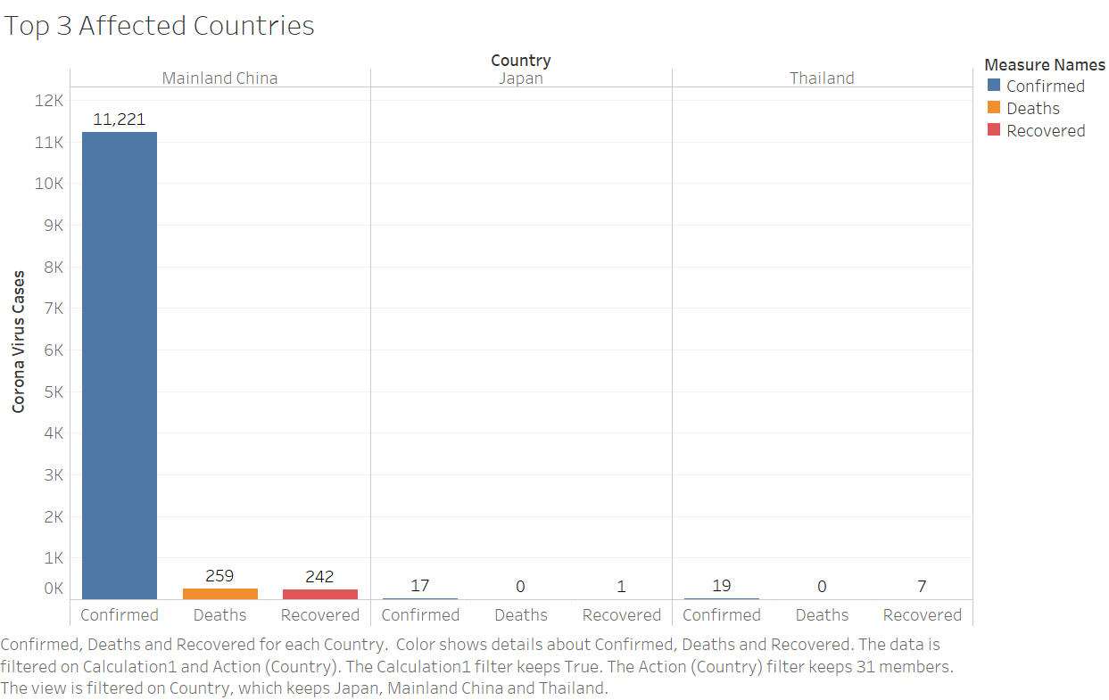
Top Three Affected Countries
98.7% of the Corona Virus cases of the globe have been reported in the China

Slide 5
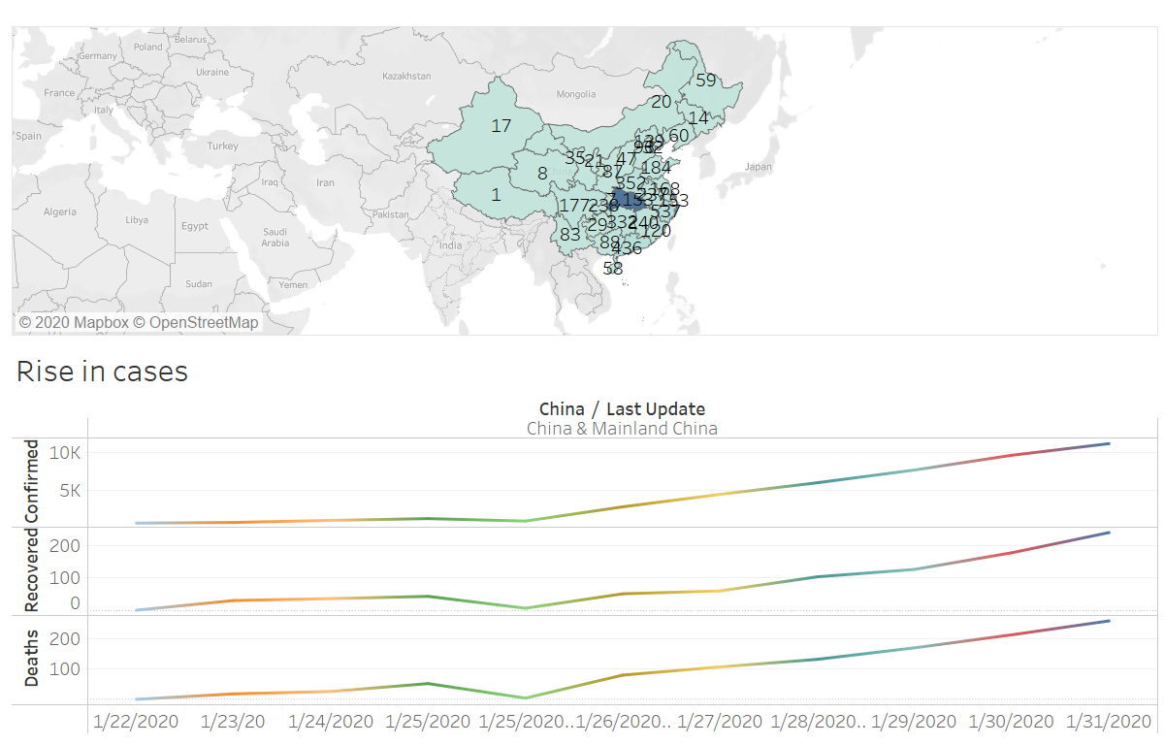
China:
State Wise Analysis of Spread of Corona Virus
There has been steady rise in the number of confirmed Corona Virus cases in China

Slide 6
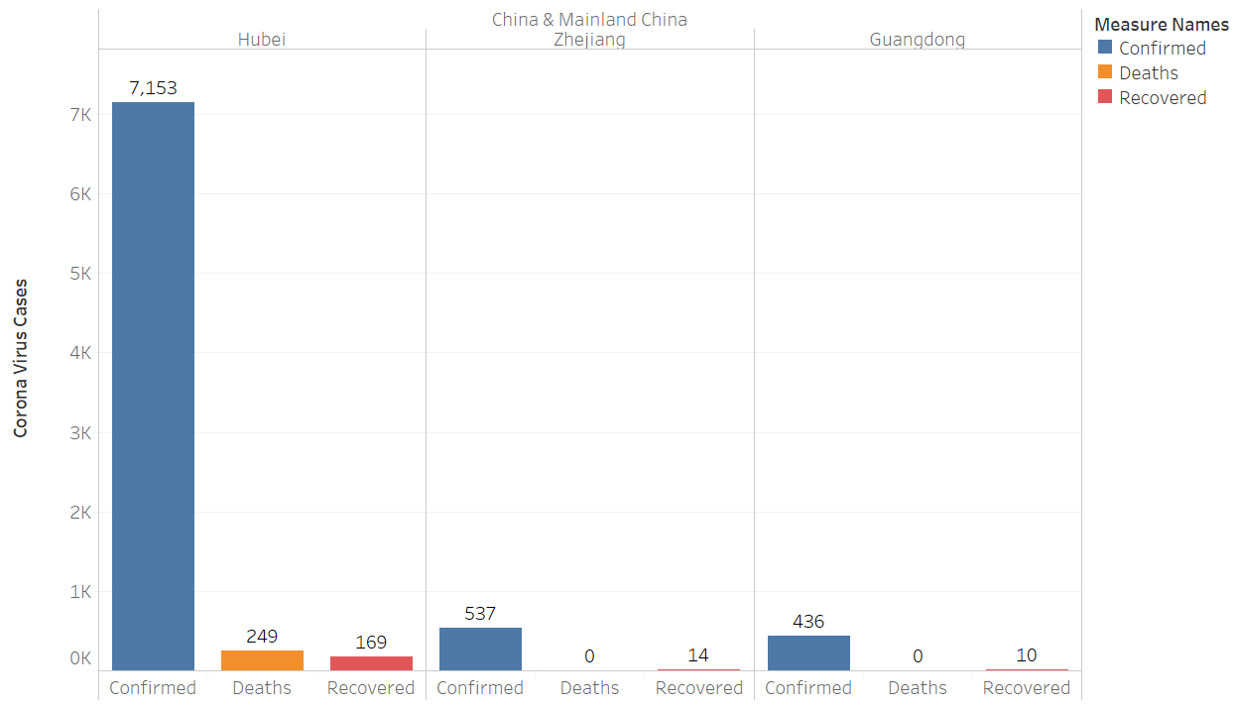
China:
Top Five Affected States
7571 Corona Virus confirmed cases was reported in Hubei State of China, which form 67.5% of the total confirmed cased reported in China

Slide 7

Thank You

