Slide 1
Determining ideal location for Malaysian Restaurant in San Diego
IBM Capstone Project - Battle of the Neighbourhoods

Slide 2
Introduction/Business Problem
Lack of Malaysian Restaurants in San Diego means there is an open market to enter.
Already a large Asian population in San Diego, as well as a wide variety of Asian restaurants.
Restaurants of Korean, Thai, Japanese and Chinese cuisine already proven to be very popular among people in San Diego.
Many Malaysian university students in San Diego with no place to go to have a taste of home.
This project aims to find the ideal location within San Diego to open a Malaysian restaurant.

Slide 3
Data - Existing Restaurants
Manual search of already popular Malaysian/Southeast Asian restaurants in the United States
To analyze the neighbourhoods/areas that they are in, and help find similar neighbourhoods in San Diego.
Restaurants chosen were:
Lukshon in Culver City, California
Kopitiam in New York City, New York
Kedai Makan in Seattle, Washington
Pok Pok in Portland, Oregon
Foursquare API used to gather data on the venues around the restaurants.
Used to find frequencies of venue categories in each location.

Slide 4
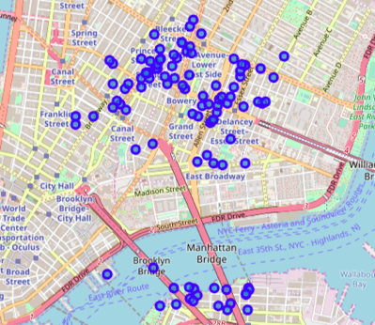
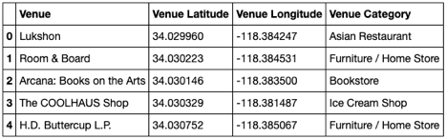
Data - Existing Restaurants
Table showing first 5 rows in dataframe containing venues around Lukshon
Map showing venues around Kopitiam restaurant

Slide 5
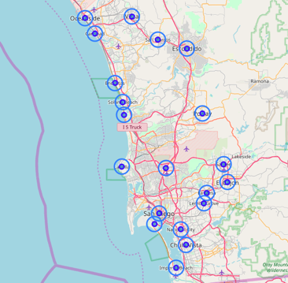
Data - San Diego
Foursquare API was also used to gather venues in the cities of San Diego County.
Similar analysis of venues was performed to get the details of each city, in order to perform comparison with the locations of existing restaurants.
Cities in San Diego County with 2000 meter radius

Slide 6
Methodology
Neighbourhood/Cities were analyzed with a 2000 meter (2km) radius around the centers obtained through Geocoding.
This is done to reduce overlap between the areas analyzed.
First, the locations around the 4 identified existing restaurants were analyzed.
Venue category frequencies were calculated to identify the most common categories within the 2km radius of the restaurants.
From these frequencies, an aggregate was calculated to get an average of the 4 locations.
Mean of frequencies among the 4 locations were taken.
To be used in comparison with the cities in San Diego County.
The same analysis is done on the cities in San Diego County, and each city is compared to the aggregate calculated.
From the “most similar” city in San Diego to the aggregate, k-means clustering was performed to find a cluster of possible locations/cities.

Slide 7
Analysis - One Hot Encoding
One hot encoding was performed in order to find the most common venue categories in each location.
The average of the frequencies calculated were taken to get the aggregate with which to compare to the cities in San Diego.
Similar data was collected on the cities in San Diego county.
Tables containing the most common venues in each location were produced.

Slide 8
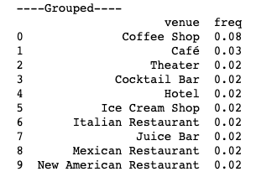
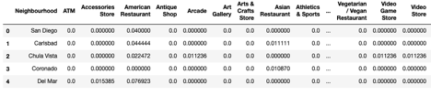
Analysis - One Hot Encoding
First 5 rows of dataframe containing frequencies of San Diego cities
Aggregate frequencies

Slide 9
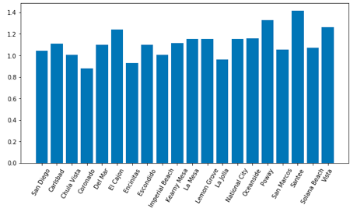
Analysis - Similarity Comparison
The similarity between the aggregate and the San Diego cities were calculated.
The difference between the frequencies were taken to determine the similarities
From this comparison, it was found that Coronado was the city most similar to the aggregate.
Bar chart of the calculated differences for each city in San Diego County

Slide 10
Analysis - Clustering
After identifying Coronado as the most similar city, k-means clustering was performed to find other cities clustered with Coronado.
This was done to identify a few more options for locations
From the clustering, Chula Vista, Coronado, Kearny Mesa, National City, San Marcos, and Santee were identified as options.

Slide 11
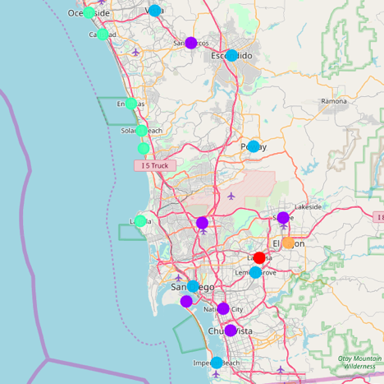
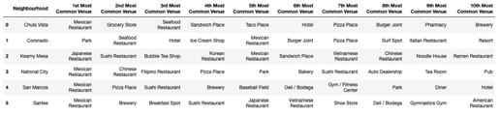
Analysis - Clustering
The results of clustering can be seen here.
Different colored markers on the map indicating different clusters.
Dataframe showing the cluster containing Coronado and its similar cities.

Slide 12
Results, Discussion and Conclusion
It can be seen that most of the cities in the cluster have restaurants as their more common venues.
Especially apparent in Kearny Mesa.
All 10 most common venue categories are food or drink categories.
8 out of 10 most common are Asian venues.
In order to determine the ideal location, additional data would be required
Eg. Demographical data, ratings and popularities of existing venues, customer preference in the area, etc.
Also would need to determine if more beneficial to open in more saturated area or one sparse of Asian restaurants.
The study has provided 6 possible locations, all of which would be good locations nonetheless.

