Slide 1
PARALLEL DATABASE

Slide 2
A database can be modeled as:
A collection of entities.
Relationship among entities.
Steps in design of database:
Requirements collection & analysis.
Conceptual schema design.
Implementing conceptual schema into database.
Logical database design or data model mapping.
Physical database design.
High-level conceptual data model.

Slide 3
DATA BASE SERVER APPROACH:
Database Server
Application
Application
DBMS Server Interface
DBMS Server Interface
Network
Application Server Interface
DBMS function

Slide 4
DISTRIBUTED DATA BASE SERVER APPROACH:
Application
Application
Distributed DBMS Interface
Distributed DBMS Interface
Network
Distributed DBMS Layer
Distributed DBMS Layer
DBMS function
DBMS function

Slide 5
Parallel database systems:
Database server
User task1
User task N
User task2
Session Manager
Request Mgr task1
Request Mgr task2
Request Mgr task N
Data Mgr task1
Data Mgr task2
Data Mgr taskm-1
Data Mgr task M

Slide 6
What you meant by Parallel DBMS:
A DBMS running across multiple processors and disk that is designed to execute operations in parallel whenever possible in order to improve performance.
Parallel Database:
A parallel database system seeks to improve performance through parallelization of various operations, such as loading data, building indexes and evaluating queries.
Although data may be stored in a distributed fashion, the distribution is governed exclusively by performance considerations.
Parallel databases improve processing and input/output speeds by using multiple CPUs and disks in parallel.
Centralized and client–server database systems are not powerful enough to handle such applications.

Slide 7
In parallel processing, many operations are performed simultaneously, as opposite to serial processing, in which the computational steps are performed sequentially.
Parallel databases can be approximately divided into two groups,
the first group of architecture is the multiprocessor architecture, the alternatives of which are the followings :
Shared memory architecture:
where multiple processors share the main memory space, as well as mass storage (e.g. hard disk drives).
Shared disk architecture:
where each node has its own main memory, but all nodes share mass storage, usually a storage area network. In practice, each node usually also has multiple processors.
Shared nothing architecture:
where each node has its own mass storage as well as main memory.
The other architecture group is called hybrid architecture, which includes:
Non-Uniform Memory Architecture (NUMA):
which involves the Non-Uniform Memory Access.
Cluster (shared nothing + shared disk: SAN/NAS):
which is formed by a group of connected computers.

Slide 8
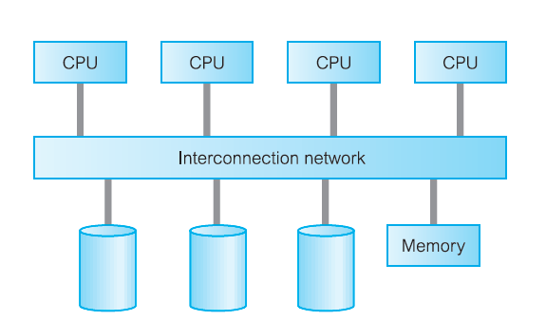
Shared memory architecture:

Slide 9
Shared memory is a tightly coupled architecture in which multiple processors within a single system share system memory.
Known as symmetric multiprocessing (SMP), this approach has become popular on platforms ranging from personal workstations that sup- port a few microprocessors in parallel.
This architecture provides high-speed data access for a limited number of processors, but it is not scalable beyond about 64 processors when the interconnection network becomes a bottleneck.

Slide 10
Advantages:
Simple implementation
Establishes effective communication between processors through single memory addresses space.
Disadvantages:
Higher degree of parallelism cannot be achieved due to the reason that all the processors share the same interconnection network to connect with memory. This causes Bottleneck in interconnection network (Interference), especially in the case of Bus interconnection network.
Addition of processor would slow down the existing processors..
Degree of Parallelism is limited. More number of parallel processes might degrade the performance.

Slide 11
Shared Disk:
P1
Pn
P2
Local
Memory
Local
Memory
Local
Memory
Interconnection Network
Disk
Disk
Disk

Slide 12
Shared disk is a loosely-coupled architecture optimized for applications that are inherently centralized and require high availability and performance.
Each processor can access all disks directly, but each has its own private memory.

Slide 13
Advantages:
Failure of any processors would not stop the entire system (Fault tolerance)
Interconnection to the memory is not a bottleneck. (It was bottleneck in Shared Memory architecture)
Support larger number of processors (when compared to Shared Memory architecture)
Disadvantages:
Interconnection to the disk is bottleneck as all processors share common disk setup.
Inter-processor communication is slow. The reason is, all the processors have their own memory. Hence, the communication between processors need reading of data from other processors’ memory which needs additional software support.

Slide 14
Shared-Nothing Architecture:
Interconnection Network
P1
P2
Pn
Local
Memory
Local
Memory
Local
Memory
Disk
Disk
Disk

Slide 15
Shared nothing, often known as massively parallel processing (MPP), is a multiple processor architecture in which each processor is part of a complete system, with its own memory and disk storage.

Slide 16
Advantages:
Number of processors used here is scalable. That is, the design is flexible to add more number of computers.
Unlike in other two architectures, only the data request which cannot be answered by local processors need to be forwarded through interconnection network.
Disadvantages:
Non-local disk accesses are costly. That is, if one server receives the request. If the required data not available, it must be routed to the server where the data is available. It is slightly complex.
Communication cost involved in transporting data among computers

Slide 17
Hierarchical architectures:
Interconnection network
Disk
P1
Disk
P1
Disk
P1
Disk
P2
P2
Disk
P2
Disk
Disk
P3
P3
Disk
P3
Disk
Disk
Pk
Pm
Disk
Pn
Disk
Memory
Memory
Memory

Slide 18
INTER& INTRA QUERY PARALLELISM

Slide 19
Parallelism:
Components of a task, such as a database query, can be run in parallel to dramatically enhance performance.
The nature of the task, the database configuration, and the hardware environment, all determine how DB2(R) Universal Database (DB2 UDB) will perform a task in parallel.
These considerations are interrelated, and should be considered together when you work on the physical and logical design of a database.
The following types of parallelism are supported by DB2 UDB:
I/O parallelism.
Query parallelism.
Utility parallelism.
Input/output parallelism:
When there are multiple containers for a table space, the database manager can exploit parallel I/O.
Parallel I/O refers to the process of writing to, or reading from, two or more I/O devices simultaneously.
It can result in significant improvements in throughput.

Slide 20
Query parallelism:
There are two types of query parallelism:
Inter query parallelism:
Different queries or transactions execute in parallel with one another.
It increases scale up and throughput.
Intra query parallelism.
It refers to the execution of a single query in parallel on multiple processors and disk.
It is important for speeding up long running queries.
Inter query parallelism refers to the ability of the database to accept queries from multiple applications at the same time.
Each query runs independently of the others, but DB2 UDB runs all of them at the same time.
DB2 UDB has always supported this type of parallelism.
Intra query parallelism refers to the simultaneous processing of parts of a single query, using either intra partition parallelism, inter partition parallelism, or both.
Intra partition parallelism:
Intra partition parallelism refers to the ability to break up a query into multiple parts. Some DB2 UDB utilities also perform this type of parallelism.

Slide 21
Intra partition parallelism subdivides what is usually considered a single database operation,
such as index creation, database loading, or SQL queries into multiple parts, many or all of which can be run in parallel within a single database partition.
The pieces are copies of each other.
To utilize intra partition parallelism, you must configure the database appropriately.
You can choose the degree of parallelism or let the system do it for you.
The degree of parallelism represents the number of pieces of a query running in parallel.

Slide 22
Intra partition parallelism:
Speed up processing of a query by parallelising the execution of each individual operation.
SELECT…….FROM
Database Partition
DATA

Slide 23
Inter partition parallelism:
Inter partition parallelism refers to the ability to break up a query into multiple parts across multiple partitions of a partitioned database, on one machine or multiple machines.
The query is run in parallel.
Some DB2 UDB utilities also perform this type of parallelism.
Inter partition parallelism subdivides what is usually considered a single database operation .
such as index creation, database loading, or SQL queries into multiple parts, many or all of which can be run in parallel across multiple partitions of a partitioned database on one machine or on multiple machines.
The degree of parallelism is largely determined by the number of partitions you create and how you define your database partition groups.

Slide 24
Inter partition parallelism:
Speed up processing of a query by executing in parallel the different operations in a query expression.
SELECT…….FROM
Query
Database Partition
Database Partition
Database Partition
DATA
DATA
DATA

Slide 25
Simultaneous inter partition and intra partition parallelism:
SELECT…….FROM
Query
SELECT…….FROM
SELECT…….FROM
Database Partition
Database Partition
DATA
DATA

Slide 26
DISTRIBUTED DATABASE:
A logically interrelated collection of shared data (and a description of this data), physically distributed over a computer network.
DISTRIBUTED DBMS:
The software system that permits the management of distributed database and makes the distribution transparent to the user.
CONCEPTS:
1. Collection of logically-related shared data.
2. Data split into fragments.
3. Fragments may be replicated.
4. Fragments/replicas allocated to sites.
5. Sites linked by a communications network.
6. Data at each site is under control of a DBMS.
7. DBMSs handle local applications autonomously.
8. Each DBMS participates in at least one global application.

Slide 27






Slide 28
Distributed Processing:
A centralized database that can be accessed over a computer network.

Slide 29
Advantages of DDBMSs:
1. Reflects organizational structure.
Many organizations are naturally distribute over a several locations.
example: DreamHome.
2. Improved shareability and local autonomy.
Geographical distribution of an organiza tion can be refelected in the distribution of the data.
3. Improved availability.
4. Improved reliability.
5. Improved performance.
6. Economics.
7. Modular growth.
Disadvantages of DDBMSs:
1. Complexity.
2. Cost.
3. Security.
4. Integrity control more difficult.
5. Lack of standards.
6. Lack of experience.
7. Database design more complex.

Slide 30
Types of DDBMSs:
Homogeneous DDBMS.
Heterogeneous DDBMS.
Homogeneous DDBMS:
1. All sites use same dbms product.
2. Much easier to design and manage.
3. Approach provides incremental growth .
4. Allows increased performance.
Heterogeneous DDBMS:
Sites may run different DBMS products, with possibly different underlying data models.
When individual sites have implemented their own databases and integration is considered later stage.
Translations are required to allow communication between different DBMS.
Data may be required from another site that may have:
– Different hardware.
– Different DBMS products.
– Different hardware and different DBMS products.

Slide 31
Open Database Access and Interoperability:
Open Group formed a Working Group to provide specifications that will create a database infrastructure environment where there is:
Common SQL API that allows client applications to be written that do not need to know vendor of DBMS they are accessing.
Common database protocol that enables DBMS from one vendor to communicate directly with DBMS from another vendor without the need for a gateway.
A common network protocol that allows communications between different DBMSs.
Most ambitious goal is to find a way to enable transaction to span DBMSs from different vendors without use of a gateway.
Group has now evolved into DBIOP Consortium and are working in version 3 of DRDA (Distributed Relational Database Architecture) standard.

Slide 32
Multidatabase System (MDBS):
a. DDBMS in which each site maintains complete autonomy.
b. DBMS that resides transparently on top of existing database and file systems and presents a single database to its users.
c. Allows users to access and share data without requiring physical database integration.
d. Unfederated MDBS (no local users) and federated MDBS.
Overview of networking:
An interconnected collection of autonomous computers that are capable of exchanging information.

Slide 33
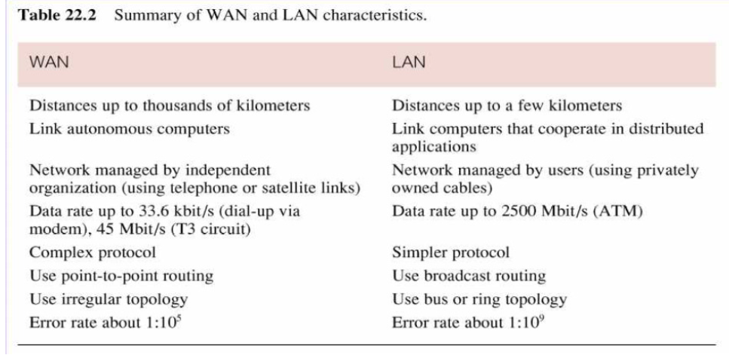

Slide 34
Network protocols:
TCP/IP.
SPX/IPX.
WAP.
Function of a DDBMS:
Extended communication services to provide access to remote sites and allow the transfer of queries and data among the site using a network.
Extended system catalog to store data distribution details.
Distributed query processing including query optimization and remote data access.
Extended security control to maintain appropriate authorization/access privileges to the distributed data.
Extended concurrency control to maintain consistency of replicated data.

Slide 35
Architecture:
The architecture of a system defines its structure:
The components of the system are identified;
The function of each component is specified;
The interrelationships and interactions among the components are defined.
Standardization:
The standardization efforts in databases developed reference models of DBMS.
Reference Model:
A conceptual framework whose purpose is to divide standardization work into manageable pieces and to show at a general level how these pieces are related to each other.
A reference model can be thought of as an idealized architectural model of the system.
A reference model can be described according to 3 different approaches:
– component-based
– function-based
– data-based

Slide 36
Components-based:
– Components of the system are defined together with the interrelationships between
the components.
– Good for design and implementation of the system.
– It might be difficult to determine the functionality of the system from its components.
Function-based:
– Classes of users are identified together with the functionality that the system will provide for each class.
– Typically a hierarchical system with clearly defined interfaces between different layers.
– The objectives of the system are clearly identified.
– Not clear how to achieve the objectives.
– Example: ISO/OSI architecture of computer networks.
Data-based:
– Identify the different types of the data and specify the functional units that will realize and/or use data according to these views.
– The full architecture of the system is not clear without the description of functional
modules.
– Example: ANSI/SPARC architecture of DBM.

Slide 37
ANSI/SPARC Architecture of DBMS:
ANSI/SPARC architecture is based on data.
3 views of data: external view, conceptual view, internal view.
Defines a total of 43 interfaces between these views.

Slide 38
Reference Architecture for DDBMS:
1. A reference architecture consists of:
Set of global external schemas.
Global conceptual schema (GCS).
Fragmentation schema .
Allocation schema.
Set of schemas for each local DBMS conforming to 3-level ANSI/SPARC.
Some levels may be missing, depending on levels of transparency supported.
Global conceptual schema:
The global conceptual schema is logical description of the whole database.
It provides physical data independence from the distributed environment.
Global External Schema:
It provides logical data independence from the distributed environment.

Slide 39
Fragmentation schema :
The fragmentation schema is a description of how the data is to be logically partitioned.
Allocation schema:
The allocation schema is a description of where the data is to be located,taking account of any replication.
Local Schemas:
Each local DBMS has it own set of Schemas.
Its is DBMS independent and is the basis for supporting heterogeneous DBMS.

Slide 40
Example:
Conceptual schema: Provides enterprise view
of entire database.
RELATION EMP [
KEY = {ENO}
ATTRIBUTES = {
ENO : CHARACTER(9)
ENAME: CHARACTER(15)
TITLE: CHARACTER(10)
}
]
RELATION PAY [
KEY = {TITLE}
ATTRIBUTES = {
TITLE: CHARACTER(10)
SAL : NUMERIC(6)
}
]
RELATION PROJ [
KEY = {PNO}
ATTRIBUTES = {
PNO : CHARACTER(7)
PNAME : CHARACTER(20)
BUDGET: NUMERIC(7)
LOC : CHARACTER(15)
}
]

Slide 41
Internal schema: Describes the storage details of the relations.
– Relation EMP is stored on an indexed file.
– Index is defined on the key attribute ENO and is called EMINX.
– A HEADER field is used that might contain flags (delete, update, etc.)
INTERNAL REL EMPL [
INDEX ON E# CALL EMINX
FIELD =
HEADER: BYTE(1)
E# : BYTE(9)
ENAME : BYTE(15)
TIT : BYTE(10)
]
Conceptual schema:
RELATION EMP [
KEY = {ENO}
ATTRIBUTES = {
ENO : CHARACTER(9)
ENAME: CHARACTER(15)
TITLE: CHARACTER(10)
}
]

Slide 42
External view: Specifies the view of different users/applications
Application 1: Calculates the payroll payments for engineers
CREATE VIEW PAYROLL (ENO, ENAME, SAL) AS
SELECT EMP.ENO,EMP.ENAME,PAY.SAL
FROM EMP, PAY
WHERE EMP.TITLE = PAY.TITLE
Application 2: Produces a report on the budget of each project
CREATE VIEW BUDGET(PNAME, BUD) AS
SELECT PNAME, BUDGET
FROM PROJ

Slide 43
…
Global External Schema
S1
S2
Sn
Global External Schema
Global External Schema
Global Conceptual
Schema
Fragmentation
Schema
Allocation
Schema
S1
…
S2
Sn
Local mapping
Schema
Local mapping
Schema
Local mapping
Schema
Local conceptual
Schema
Local conceptual
Schema
Local conceptual
Schema
Local Internal
Schema
Local Internal
Schema
Local Internal
Schema
DB
DB
DB

Slide 44
S1
…
Sn
Sn Reference Architecture for a Federated MDBS
Global External Schema
Global External Schema
Global Conceptual
Schema
S1
Local External
Schema
Local External
Schema
Local External
Schema
Local External
Schema
Local conceptual
Schema
Local conceptual
Schema
Local Internal
Schema
Local Internal
Schema
DB
DB

Slide 45
Reference Architecture for MDBS
1. In DDBMS, GCS is union of all local conceptual schemas.
2. In FMDBS, GCS is subset of local conceptual schemas (LCS), consisting of data that each local system agrees to share.
3. GCS of tightly coupled system involves integration of either parts of LCSs or local external schemas.
4. FMDBS with noGCS called loosely coupled.
Components of DDBMS:

Slide 46
Local DBMS component:
The LDBMS component is a standard DBMS, responsible for controlling the local data at each site that has a database.
It has its own local system catalog that stores information about the data held at that site.
In a homogeneous system, the LDBMS component is the same product, replicated at each site.
In a heterogeneous system, there would be at least two sites with different DBMS products and/or platforms.
Data communications component:
The DC component is the software that enables all sites to communicate with each other.
The DC component contains information about the sites and the links.
Global system catalog:
The GSC has the same functionality as the system catalog of a centralized system.
The GSC holds information specific to the distributed nature of the system, such as the fragmentation, replication, and allocation schemas.
Distributed DBMS component:
The DDBMS component is the controlling unit of the entire system.

Slide 47
Distributed Database Design
Three key issues:
– Fragmentat ion,
– Allocat ion,
– Replicat ion.
Fragmentation
Relation may be divided into a number of sub relations, which are then distributed.
Allocation
Each fragment is stored at site with “optimal" distribution.
Replication
Copy of fragment may be maintained at several sites.

Slide 48
Query Processing:
Query The activities involved in parsing, validating, optimizing, and executing processing a query.
Query Optimization:
Query The activity of choosing an efficient execution strategy for processing optimization a query.

Slide 49
Query Processing:
What is a Query ?
A database query is the vehicle for instructing a DBMS to update or retrieve specific data to/from the physically stored medium.
The actual updating and retrieval of data is performed through various “low-level” operations.
Examples of such operations for a relational DBMS can be relational algebra operations such as project, join, select, Cartesian product, etc.
While the DBMS is designed to process these low-level operations efficiently, it can be quite the burden to a user to submit requests to the DBMS in these formats.
Consider the following request:
“Give me the vehicle ids of all Chevrolet Camaros built in the year 1977.”
While this is easily understandable by a human, a DBMS must be presented with a format it can understand, such as this SQL statement:
select vehicle_id
from vehicles
where year = 1997
Note that this SQL statement will still need to be translated further by the DBMS so that the functions/methods within the DBMS program can not only process the request, but do it in a timely manner.

Slide 50
Basic Steps in Query Processing:
Parsing and translation
Optimization
Evaluation
Relational algebra
Expression
Query
Parser &translator
Optimizer
Query output
Evaluation Engine
Execution Plan
Data
Statistics about data

Slide 51
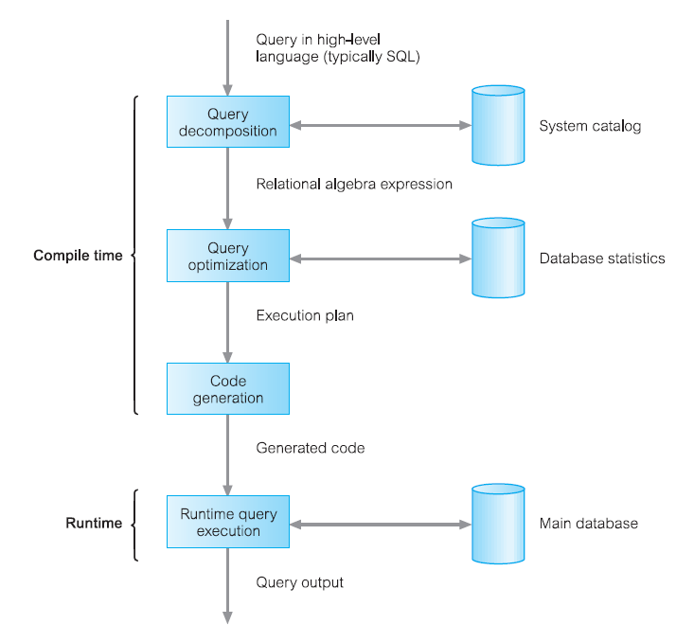

Slide 52

Parsing and translation
Translate the query into its internal form. This is then translated into relational algebra.
Parser checks syntax, verifies relations.
Consider the following SQL query:
select make
from vehicles
where make = “Ford”
This can be translated into either of the following relational algebra expressions:
Which can also be represented as either of the following query trees:

Slide 53
Evaluation
The query-execution engine takes a query-evaluation plan, executes that
plan, and returns the answers to the query.
Optimization
A relational algebra expression may have many equivalent expressions
E.g., balance<2500(balance (account)) is equivalent to
balance (balance<2500(account))
Each relational algebra operation can be evaluated using one of several
different algorithms
Correspondingly, a relational-algebra expression can be evaluated in
many ways.
Annotated expression specifying detailed evaluation strategy is called an
evaluation-plan.
E.g., can use an index on balance to find accounts with balance < 2500, or can perform
complete relation scan and discard accounts with balance >= 2500.

Slide 54
Fragmentation:
Distribution Design Issues
Why fragment at all?
How to fragment?
How much to fragment?
How to test correctness?
How to allocate?
Information requirements?
Can't we just distribute relations?
What is a reasonable unit of distribution?
Relation
views are subsets of relations locality.
extra communication.
Fragments of relations (sub-relations)
concurrent execution of a number of transactions that access different portions of a relation.
views that cannot be defined on a single fragment will require extra processing.
semantic data control (especially integrity enforcement) more difficult.

Slide 55
Why fragment?
Usage:- Apps work with views rather than entire relations.
Efficiency: Data stored close to where most frequently used.
- Data not needed by local applications is not stored.
Security: - And so not available to unauthorized users.
Parallelism: With fragments as unit of distribution, T can be divided into several
subqueries that operate on fragments.
Disadvantages: Performance & Integrity.
Types of Fragmentation: Four types of fragmentation:
– Horizontal,
– Vertical,
– Mixed,
– Derived.

Slide 56


Horizontal Fragmentation:
Splitting the database by rows.
e.g. A-J in site 1, K-S in site 2 and T-Z in site 3.
Primary Horizontal Fragmentation (PHF).
Derived Horizontal Fragmentation (DHF).
Vertical Fragmentation:
Splitting database by columns/fields.
e.g. columns/fields 1-3 in site A, 4-6 in site B.
Take the primary key to all sites.

Slide 57
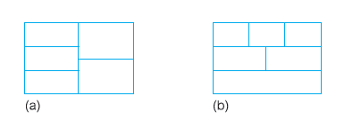
Mixed Fragmentation:
a)Vertical fragments, horizontally fragmented.
b)Horizontal fragments, vertically fragmented.
Horizontal fragment that is vertically fragmented, or a vertical fragment that is horizontally fragmented.
Defined using Selection and Projection operations.
Horizontal fragmentation: Consists of a subset of the tuples of a relation:
Defined using Selection operation.
Determined by looking at predicates used by Ts.
Involves finding set of minimal (complete and relevant) predicates.
Set of predicates is complete, if, any two tuples in same fragment are
referenced with same probability by any application.
Predicate is relevant if there is at least one application that accesses
fragments differently.

Slide 58
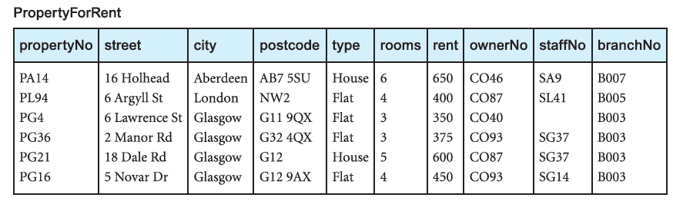
Horizontal fragmentation Cont….
Example:
the tuples are all used by the same application or at the same site. Given a relation R, a horizontal fragment is defined as:
σp(R)
where p is a predicate based on one or more attributes of the relation.
Assuming that there are only two property types, Flat and House, the horizontal fragmentation of PropertyForRent by property type can be obtained as follows:
P1: σ type=‘House’(PropertyForRent)
P2: σ type=‘Flat’(PropertyForRent)

Slide 59
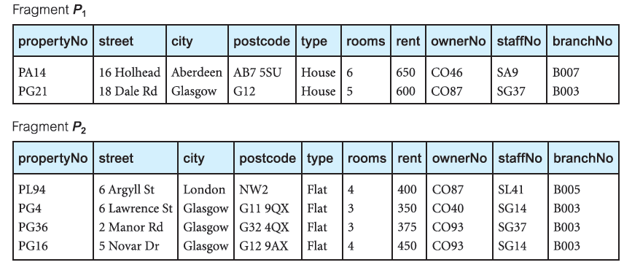
Completeness:
Each tuple in the relation appears in either fragment P1 or P2.
Reconstruction:
The PropertyForRent relation can be reconstructed from the fragments using the Union operation, thus:
P1 ∪ P2 = PropertyForRent
Disjointness:
The fragments are disjoint; there can be no property type that is both ‘House’ and
‘Flat’.

Slide 60
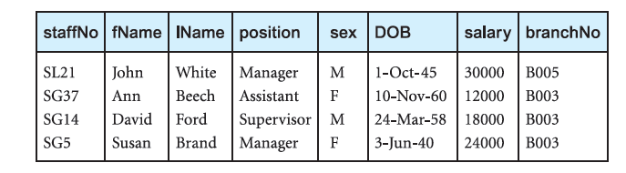
Vertical Fragmentation:
Consists of a subset of attributes of a relation.
Defined using Projection operation of relational algebra:
Given a relation R, a vertical fragment is defined as:
Πa1, . . . , an(R)
where a1, . . . , an are attributes of the relation R.
The DreamHome payroll application requires the staff number staffNo and the position, sex, DOB, and salary attributes of each member of staff;
the personnel department requires the staffNo, fName, lName, and branchNo attributes.
S1: ΠstaffNo, position, sex, DOB, salary(Staff)
S2: ΠstaffNo, fName, lName, branchNo(Staff)

Slide 61
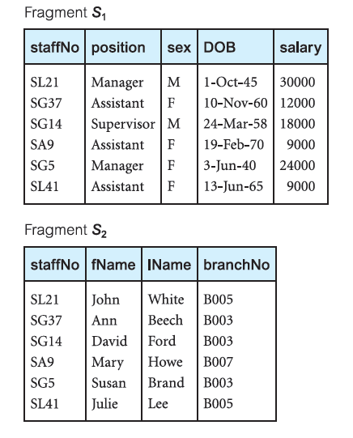
Completeness :Each attribute in the Staff relation appears in either fragment S1 or S2.
Reconstruction: The Staff relation can be reconstructed from the fragments using the
Natural join operation, thus:
Disjointness : The fragments are disjoint except for the primary key, which is necessary
for reconstruction.

Slide 62
Mixed Fragmentation:
Consists of a horizontal fragment that is vertically fragmented, or a vertical fragment that is horizontally fragmented.
Defined using Selection and Projection operations of relational algebra:
Given a relation R, a mixed fragment is defined as:
σ p(Πa1, . . . , an(R))
or
Πa1, . . . , an(σ p(R)) where p is a predicate based on one or more attributes of R and a1, . . . , an are attributes of R.
vertically fragmented Staff for the payroll and personnel departments into:
S1: ΠstaffNo, position, sex, DOB, salary(Staff)
S2: ΠstaffNo, fName, lName, branchNo(Staff)

Slide 63
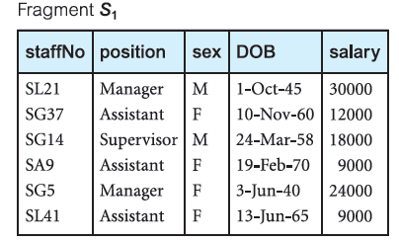
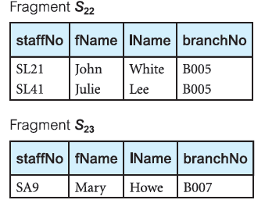
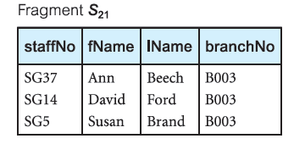
We could now horizontally fragment S2 according to branch number (for simplicity, we
assume that there are only three branches):
S21: σbranchNo=‘B003’(S2)
S22: σbranchNo=‘B005’(S2)
S23: σbranchNo=‘B007’(S2)
Completeness: Each attribute in the Staff relation appears in either fragments S1 or S2;
each (part) tuple appears in fragment S1 and either fragment S21, S22, or S23.

Slide 64

Reconstruction:
The Staff relation can be reconstructed from the fragments using the Union and Natural join operations, thus:
Disjointness :
The fragments are disjoint; there can be no staff member who works in more than one branch and S1 and S2 are disjoint except for the necessary duplication of primary key.

Slide 65

Derived Horizontal fragment:
A horizontal fragment that is based on horizontal fragmentation of a parent relation.
Ensures that fragments that are frequently joined together are at same site.
Defined using Semijoin operation of relational algebra:
Given a child relation R and parent S, the derived fragmentation of R is defined as:
where w is the number of horizontal fragments defined on S and f is the join attribute.
Example:
We may have an application that joins the Staff and PropertyForRent relations together.

Slide 66
For this example, we assume that Staff is horizontally fragmented according to the branch number,
S3 = σ branchNo=‘B003’(Staff)
S4 = σ branchNo=‘B005’(Staff)
S5 = σ branchNo=‘B007’(Staff)

Slide 67
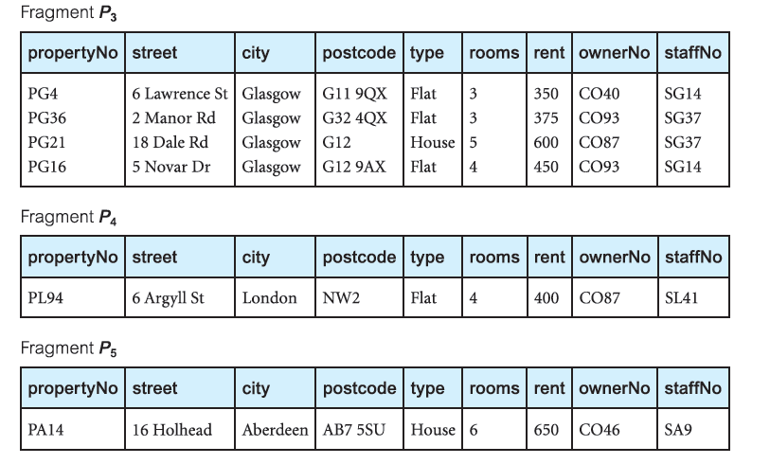

Slide 68
QUERY PROCESSING
using client-server architecture.
user creates query.
client parses and sends to server(s) (SQL?).
servers return appropriate Tables.
client combines into one Table.
Issue of data transfer cost over a network.
optimise the query to transfer the least amount.
High Level User Query
Query Processor
Low Level data manipulation command

Slide 69
Query Processing Components
Query language that is used
SQL: “intergalactic data speak”
Query execution methodology
The steps that one goes through in executing high-level ( declarative) user queries.
Query optimization
How do we determine the “best” execution plan?
Selecting alternative:
EMP(ENO,ENAME,TITLE)
ASG(ENO,PNO,RESP,DUR)
SELECT ENAME
FROM EMP,ASG
WHERE EMP.ENO=ASG.ENO
AND DUR>37

Slide 70
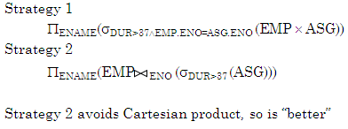
Example:
We assume that relations EMP and ASG are horizontally fragmented as follows:
EMP1= σ Eno<“E3”(Emp)
EMP2= σEno>”E3”(EMP)
ASG1= σEno<”E3”(ASG)
ASG2= σEno>”E3”(ASG)

Slide 71
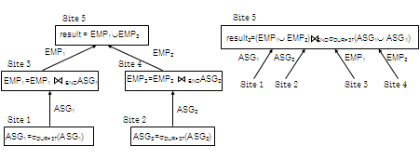
Site1 Site2 Site3 Site 4
ASG1= σEno<”E3”(ASG) ASG2= σEno>”E3”(ASG) EMP1= σ Eno<“E3”(Emp) EMP2= σEno>”E3”(EMP)
Site5
Result

Slide 72
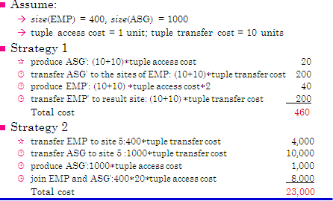
Cost Alternatives:

Slide 73
Query Optimization Objectives:
Minimize a cost function
I/O cost + CPU cost + communication cost.
These might have different weights in different distributed environments
Wide area networks
communication cost will dominate.
low bandwidth.
low speed.
high protocol overhead.
most algorithms ignore all other cost components.
Local area networks
communication cost not that dominant.
total cost function should be considered.
Can also maximize throughput.
Query Optimization Issues – Types of Optimizers:
Exhaustive search
cost-based.
optimal.
combinational complexity in the number of relations.

Slide 74
Heuristics:
not optimal.
regroup common sub-expressions.
perform selection, projection first.
replace a join by a series of semijoins.
reorder operations to reduce intermediate relation size.
optimize individual operations.
Optimization Granularity:
Single query at a time.
cannot use common intermediate results.
Multiple queries at a time.
efficient if many similar queries.
decision space is much larger.
Optimization Timing:
Static
Dynamic
Hybrid

Slide 75
Statistics:
Relation.
Attribute.
Common assumptions.
Decision Sites:
Centralized.
Distributed.
Hybrid.
Network Topology:
Wide area networks (WAN) – point-to-point
Local area networks (LAN)

Slide 76
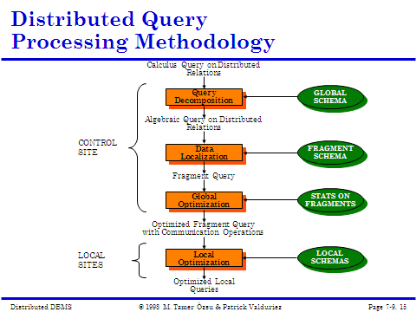

Slide 77
TRANSACTION PROCESSING
Transaction:
A transaction is a collection of actions that make consistent transformations of system states while preserving system consistency.
concurrency transparency.
failure transparency.
Database
In a
consistent state
Database may be temporarily
in an inconsistent state
during execution.
Database in a
Consistent state
Begin Transaction
Execution of Transaction
End Transaction

Slide 78
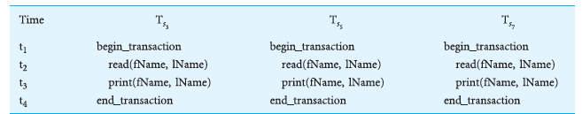
DISTRIBUTED TRANSACTION:
Consider a transaction T that prints out the names of all staff, using the fragmentation
schema defined above as S1, S2, S21, S22, and S23.
We can define three sub transactions TS3, TS5, and TS7 to represent the agents at sites 3, 5, and 7, respectively.
Each sub transaction prints out the names of the staff at that site.

Slide 79
Classification of transactions:
In DRDA, there are four types of transaction, each with a progressive level of complexity in the interaction between the DBMSs:
(1) remote request;
(2) remote unit of work;
(3) distributed unit of work;
(4) distributed request.
Remote request
An application at one site can send a request (SQL statement) to some remote site for execution.
The request is executed entirely at the remote site and can reference data only at the remote site.
Remote unit of work :
An application at one (local) site can send all the SQL statements in a unit of work (transaction) to some remote site for execution.
All SQL statements are executed entirely at the remote site and can only reference data at the remote site.

Slide 80
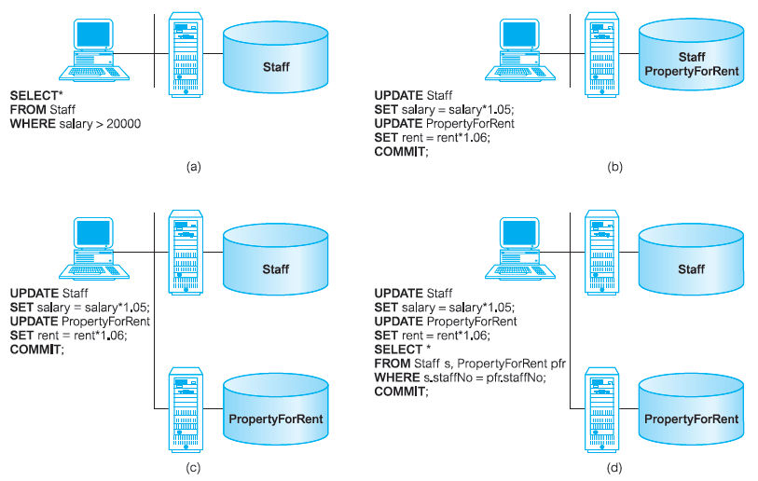
Distributed unit of work :
An application at one (local) site can send some of or all the SQL statements in a transaction to one or more remote sites for execution.
Each SQL statement is executed entirely at the remote site and can only reference data at the remote site.
Distributed request:
An application at one (local) site can send some of or all the SQL statements in a transaction to one or more remote sites for execution.

Slide 81
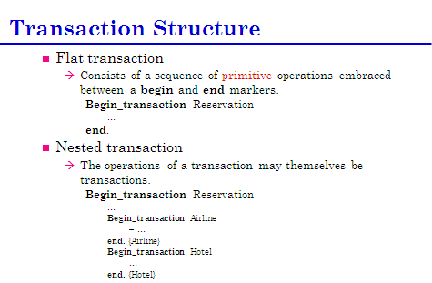

Slide 82
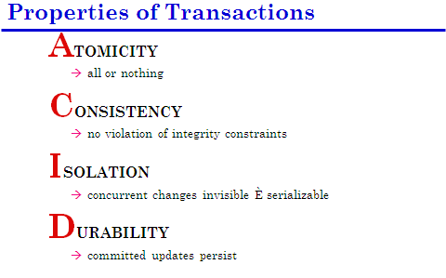

Slide 83
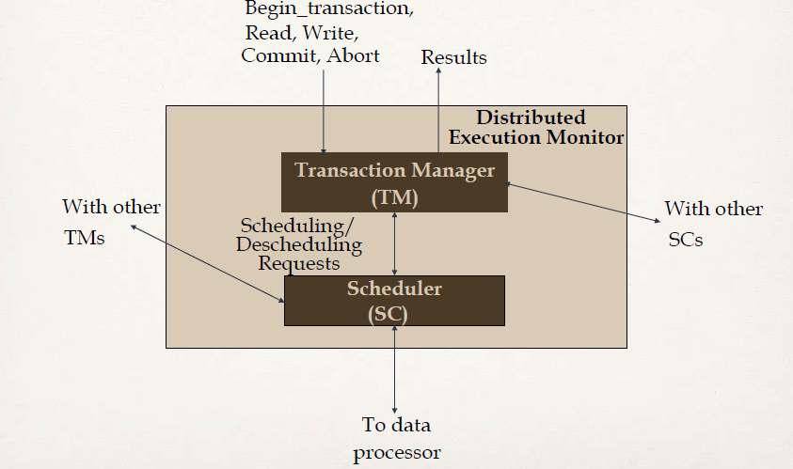

Slide 84
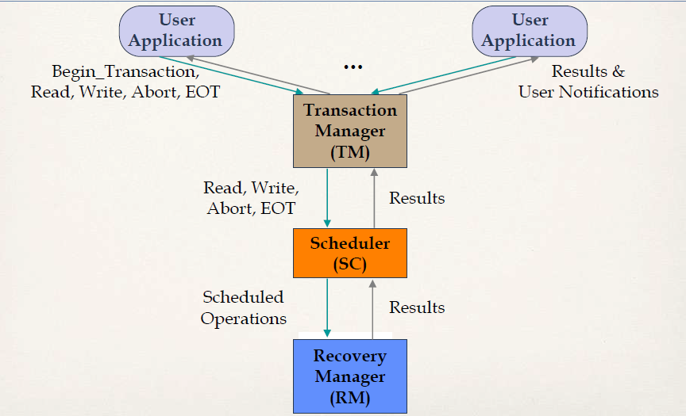

Slide 85
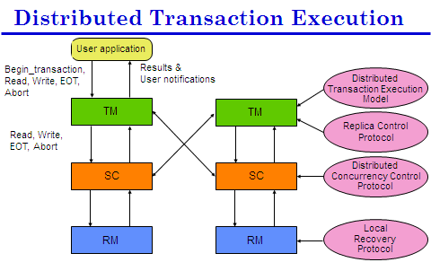

Slide 86
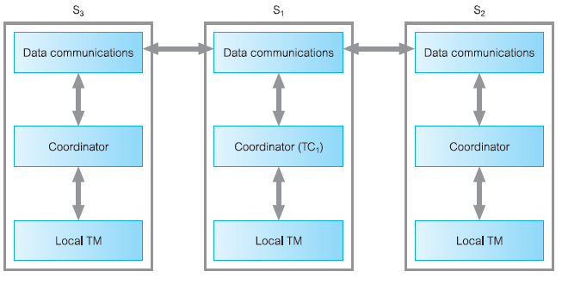
Distributed Transaction Management:
The transaction coordinator (TC1) at site S1 divides the transaction into a number of
subtransactions using information held in the global system catalog.
The data communications component at site S1 sends the subtransactions to the appropriate sites, S2 and S3, say.
The transaction coordinators at sites S2 and S3 manage these subtransactions.
The results of subtransactions are communicated back to TC1 via the data communications components.

Slide 87
CONCURRENCY CONTROL
The problem of synchronizing concurrent transactions such that the consistency of the database is maintained while, at the same time, maximum degree of concurrency is achieved.
Anomalies
Lost updates:
The effects of some transactions are not reflected on the database.
Inconsistent retrievals:
A transaction, if it reads the same data item more than once, should always read the same value.
Extends centralised concurrency mechanisms
Multiple copies of data items
maintain consistency
failures in individual sites/network
continue operations, update and rejoin
distributed commit
2-phase protocol (local and global)

Slide 88
Global serialisation must occur
Locks and time stamping apply
If database not replicated and transactions all local or performable at one remote site then:
Use centralised concurrency mechanisms.
Distributed Locks
The following protocols based on two-phase locking (2PL) that can be employed to ensure serializability for distributed DBMS.
Just like centralised mechanisms.
But we need to consider locks that manage replication and sub-transactions
Centralized 2PL,
Primary copy 2PL
Distributed 2PL,
Majority locking.

Slide 89
Centralized 2PL:
With the centralized 2PL protocol there is a single site that maintains all locking information.
There is only one scheduler, or lock manager, for the whole of the distributed DBMS that can grant and release locks.
The transaction coordinator at site S1 divides the transaction into a number of subtransactions,using information held in the global system catalog.
The coordinator has responsibility for ensuring that consistency is maintained.
If the transaction involves an update of a data item that is replicated, the coordinator must ensure that all copies of the data item are updated.
The coordinator requests exclusive locks on all copies before updating each copy and releasing the locks.
The local transaction managers involved in the global transaction request and release locks from the centralized lock manager using the normal rules for two-phase locking.
The centralized lock manager checks that a request for a lock on a data item is compatible with the locks that currently exist

Slide 90
The advantage of centralized 2PL:
Deadlock detection is no more difficult than that of a centralized DBMS, because one lock manager maintains all lock information.
The disadvantages of centralized 2PL:
As all lock requests go to one central site, that site may become a bottleneck.
The system may also be less reliable since the failure of the central site would cause major system failures.
Example:
A global update operation that has agents (subtransactions) at n sites may require a minimum of 2n + 3 messages with a centralized lock manager:
1 lock request;
1 lock grant message;
n update messages;
n acknowledgements;
1 unlock request.

Slide 91
Primary copy 2PL:
This protocol attempts to overcome the disadvantages of centralized 2PL by distributing the lock managers to a number of sites.
Each lock manager is then responsible for managing the locks for a set of data items.
For each replicated data item, one copy is chosen as the primary copy; the other copies are called slave copies.
Only primary copy locked for updates, slaves updated later.
Distributed 2PL:
This protocol again attempts to overcome the disadvantages of centralized 2PL, this time by distributing the lock managers to every site.
Each lock manager is then responsible for managing the locks for the data at that site.
If the data is not replicated, this protocol is equivalent to primary copy 2PL.
distributed 2PL implements a Read-One-Write-All (ROWA) replica control protocol. This means that any copy of a replicated item can be used for a read operation, but all copies must be exclusively locked before an item can be updated.

Slide 92
This scheme deals with locks in a decentralized manner, thus avoiding the drawbacks of centralized control.
Disadvantages:
This approach are that deadlock handling is more complex owing to multiple lock managers and that communication costs are higher than primary copy 2PL, as all items must be locked before update.
Example:
A global update operation that has agents at n sites, may require a minimum of 5n
messages with this protocol:
n lock request messages;
n lock grant messages;
n update messages;
n acknowledgements;
n unlock requests.
Majority Locking:
Extension of distributed 2PL
Doesn’t lock all copies before update
The system maintains a lock manager at each site to manage the locks for all data at that site.

Slide 93
When a transaction wishes to read or write an data item that is replicated at n sites
Needs more than half of locks on a copy to proceed
If so, it informs other sites.
Otherwise it cancels request.
Only one transaction with an exclusive lock.
Many transactions can hold a majority lock on a shared lock.
Timestamp Protocols:
<15,1>
15=Current Time.
1=Site number.
Distributed deadlock:
Any locking-based concurrency control algorithm (and some timestamp-based algorithms that require transactions to wait) may result in deadlocks.
In a distributed environment, deadlock detection may be more complicated if lock management is not centralized,

Slide 94
Example:
Consider three transactions T1, T2, and T3 with:
T1 initiated at site S1 and creating an agent at site S2;
T2 initiated at site S2 and creating an agent at site S3;
T3 initiated at site S3 and creating an agent at site S1.
The transactions set shared (read) and exclusive (write) locks as illustrated below, where read_lock(Ti, xj) denotes a shared lock by transaction Ti on data item xj and write_lock(Ti, xj) denotes an exclusive lock by transaction Ti on data item xj.
TIME S1 S2 S3
t1 read_lock(T1, x1) write_lock(T2, y2) read_lock(T3, z3)
t2 write_lock(T1, y1) write_lock(T2, z2)
t3 write_lock(T3, x1) write_lock(T1, y2) write_lock(T2, z3)
T1 → T2 → T3 → T1

Slide 95

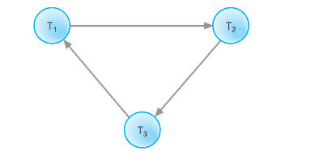
We can construct the wait-for graphs (WFGs) for each site.
Wait-for graphs for sites S1, S2, and S3.
Combined wait-for graphs for sites S1 S2, and S3.

Slide 96
There are three common methods for handling deadlock detection in DDBMSs:
Centralized deadlock detection.
Hierarchical deadlock detection.
Distributed deadlock detection.
Centralized deadlock detection:
With centralized deadlock detection, a single site is appointed as the Deadlock Detection Coordinator (DDC).
The DDC has the responsibility of constructing and maintaining the global WFG. Periodically, each lock manager transmits its local WFG to the DDC.
The DDC builds the global WFG and checks for cycles in it.
If one or more cycles exist, the DDC must break each cycle by selecting the transactions to be rolled back and restarted.
Hierarchical deadlock detection.
With hierarchical deadlock detection, the sites in the network are organized into a hierarchy.
Each site sends its local WFG to the deadlock detection site above it in the hierarchy.

Slide 97
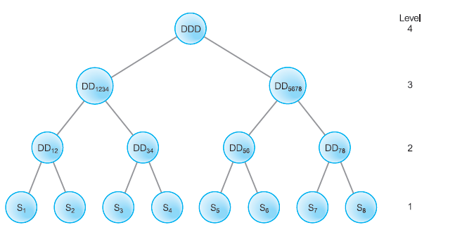
Hierarchical deadlock detection:

Slide 98
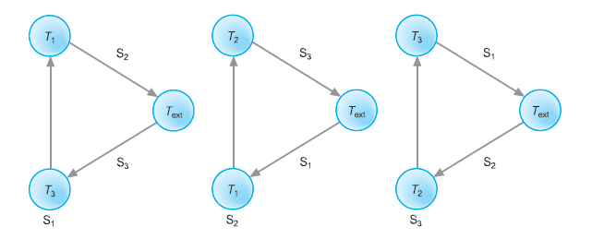
Figure illustrates a possible hierarchy for eight sites,
S1 to S8. The level 1 leaves are the sites themselves, where local deadlock detection is performed.
The level 2 nodes DDij detect deadlock involving adjacent sites i and j.
The level 3 nodes detect deadlock between four adjacent sites.
The root of the tree is a global deadlock detector that would detect deadlock between, for example, sites S1 and S8.
Advantages:
The hierarchical approach reduces the dependence on a centralized detection site,
thereby reducing communication costs.
Distributed deadlock detection:

Slide 99
Distributed deadlock detection:
The three local WFGs in Figure contain cycles:
S1: Text → T3 → T1 → Text
S2: Text → T1 → T2 → Text
S3: Text → T2 → T3 → Text

Slide 100
In this example, we could transmit the local WFG for site S1 to the site for which transaction T1 is waiting: that is, site S2. The local WFG at S2 is extended to include this information and becomes:
S2: Text → T3 → T1 → T2 → Text
This still contains a potential deadlock, so we would transmit this WFG to the site for
which transaction T2 is waiting: that is, site S3. The local WFG at S3 is extended to:
S3: Text → T3 → T1 → T2 → T3 → Text
This global WFG contains a cycle that does not involve the Text node, so we can conclude that deadlock exists and an appropriate recovery protocol must be invoked.

Slide 101
Distributed Reliability Protocols
Commit protocols
How to execute commit command for distributed transactions.
Issue: how to ensure atomicity and durability?
Termination protocols
If a failure occurs, how can the remaining operational sites deal with it.
Non-blocking : the occurrence of failures should not force the sites to wait until the failure is repaired to terminate the transaction.
Recovery protocols
When a failure occurs, how do the sites where the failure occurred deal with it.
Independent : a failed site can determine the outcome of a transaction without having to obtain remote information.

Slide 102
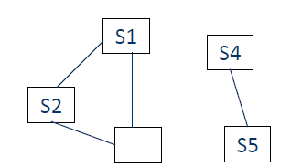
RECOVERY
Failure can occur through
Loss of message
By network protocol
DDBMS deals with it transparently
Loss of a communication link
Network partitioning (see diagram)
Site failure
E.g. S4 out of contact with S1
S4 crashed?
Link down?
Partitioned?
S4 busy?

Slide 103
Classes of failures
1. Site failure.
2. Lost messages.
3. Network partitioning.
4. Busy time failures.
Effects of failures
1. Inconsistent database.
2. Transaction processing is blocked.
3. Failed component unavailable.

Slide 104
MapReduce Algorithm
Introduction to MapReduce Algorithm
MapReduce is a Distributed Data Processing Algorithm, introduced by Google.
MapReduce Algorithm is mainly inspired by Functional Programming Model.
MapReduce algorithm is mainly useful to process huge amount of data in parallel, reliable and efficient way in cluster environments.
It uses Divide and Conquer technique to process large amount of data.
It divides input task into smaller and manageable sub-tasks (They should be executable independently) to execute them in-parallel.

Slide 105
MapReduce Algorithm Steps
MapReduce Algorithm uses the following three main steps:
Map Function.
Shuffle Function.
Reduce Function.
Map Function:
Map Function is the first step in MapReduce Algorithm.
It takes input tasks and divides them into smaller sub-tasks.
Then perform required computation on each sub-task in parallel.

Slide 106
This step performs the following two sub-steps:
Splitting
Mapping
Splitting step takes input DataSet from Source and divide into smaller Sub-DataSets.
Mapping step takes those smaller Sub-DataSets and perform required action or computation on each Sub-DataSet.
The output of this Map Function is a set of key and value pairs as <Key, Value> as shown in the below diagram.

Slide 107
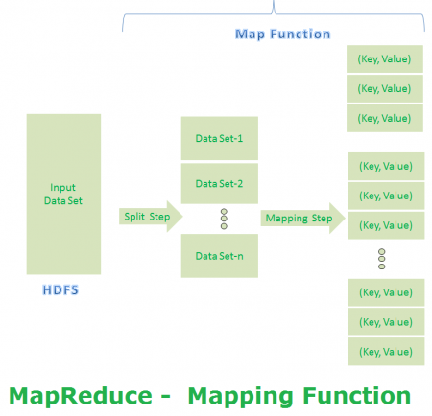

Slide 108
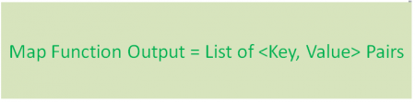
MapReduce First Step Output
Shuffle Function
It is the second step in MapReduce Algorithm. Shuffle Function is also know as “Combine Function”.
It performs the following two sub-steps.
Merging
Sorting
It takes a list of outputs coming from “Map Function” and perform these two sub-steps on each and every key-value pair.

Slide 109
Merging step combines all key-value pairs which have same keys (that is grouping key-value pairs by comparing “Key”). This step returns <Key, List<Value>>.
Sorting step takes input from Merging step and sort all key-value pairs by using Keys.
This step also returns <Key, List<Value>> output but with sorted key-value pairs.
Finally, Shuffle Function returns a list of <Key, List<Value>> sorted pairs to next step.

Slide 110
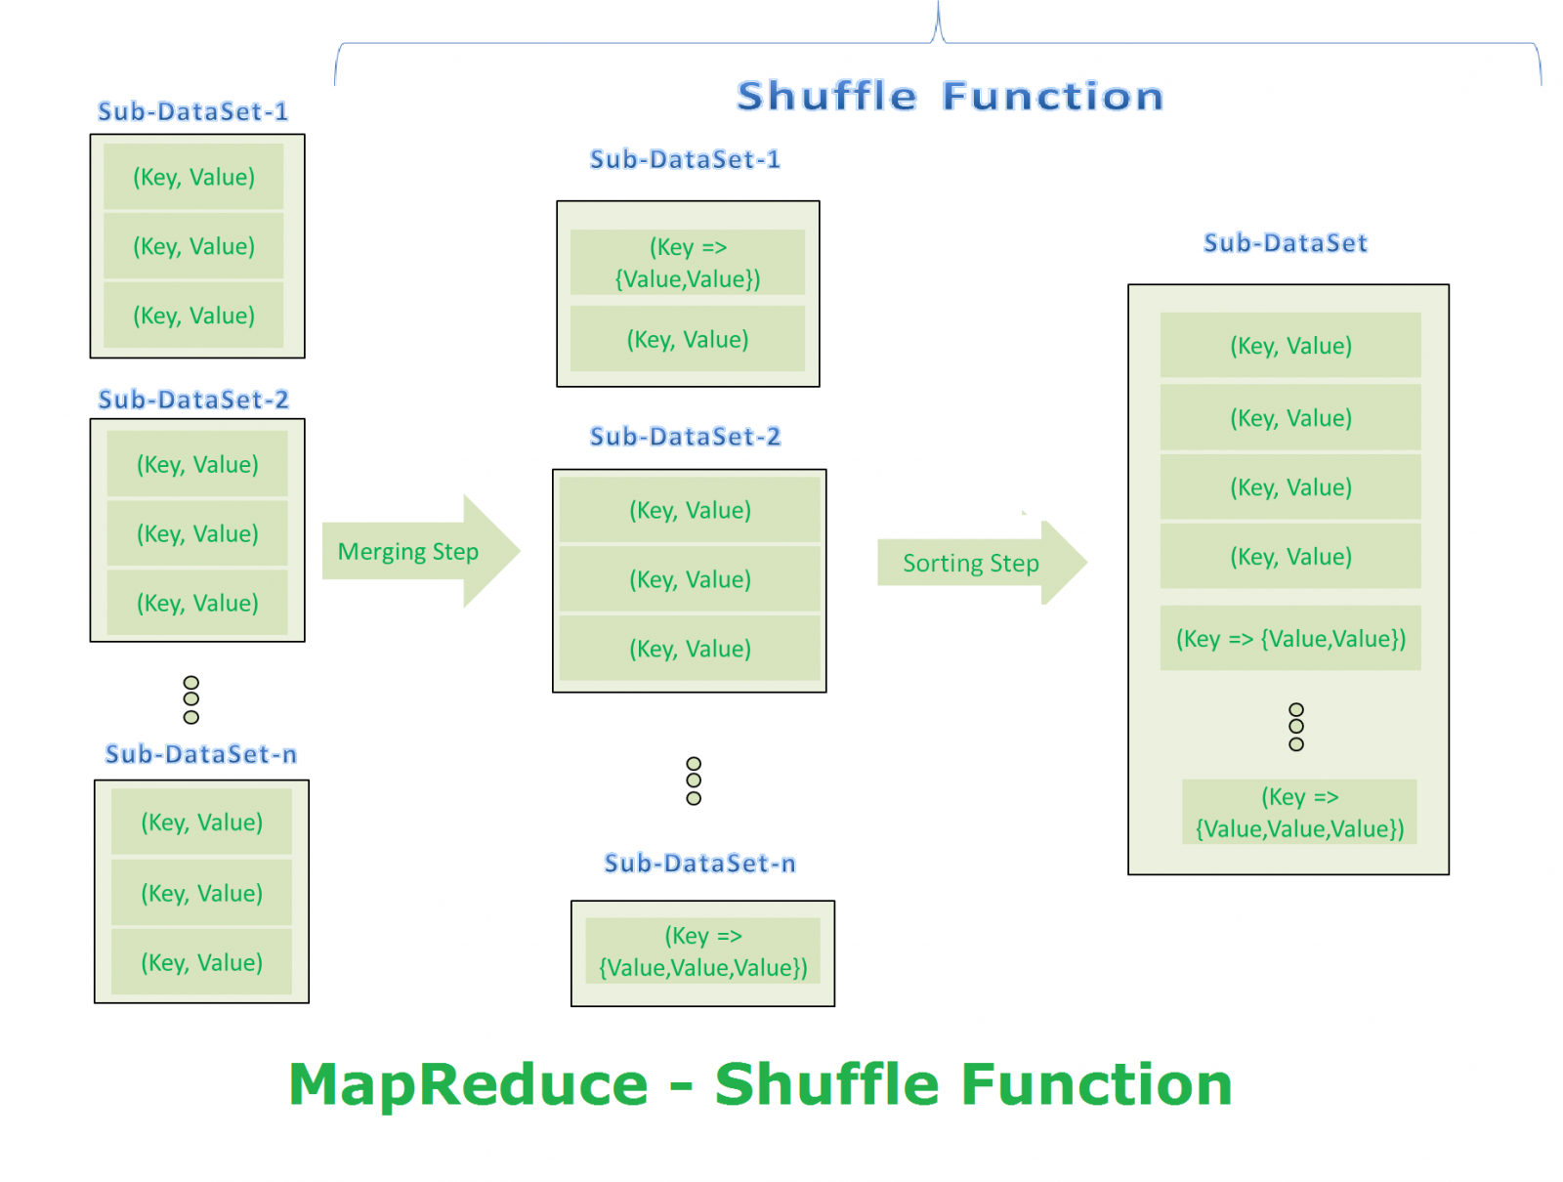

Slide 111

MapReduce Second Step Output
ReduceFunction: It is the final step in MapReduce Algorithm. It performs only one step : Reduce step.
It takes list of <Key, List<Value>> sorted pairs from Shuffle Function and perform reduce operation as shown below.

Slide 112
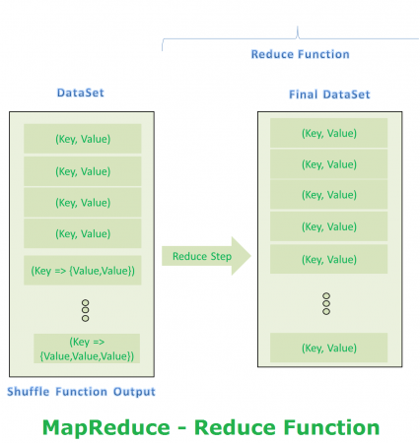

Slide 113

MapReduce Final Step Output
Problem Statement: Count the number of occurrences of each word available in a DataSet.
Input DataSet Please find our example Input DataSet file in below diagram. Just for simplicity, we are going to use simple small DataSet. However, Real-time applications use very huge amount of Data

Slide 114
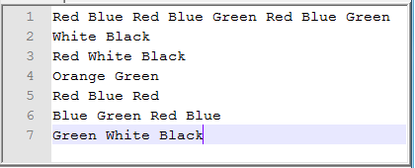
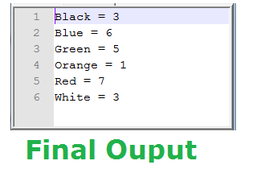
FINAL RESULT

Slide 115
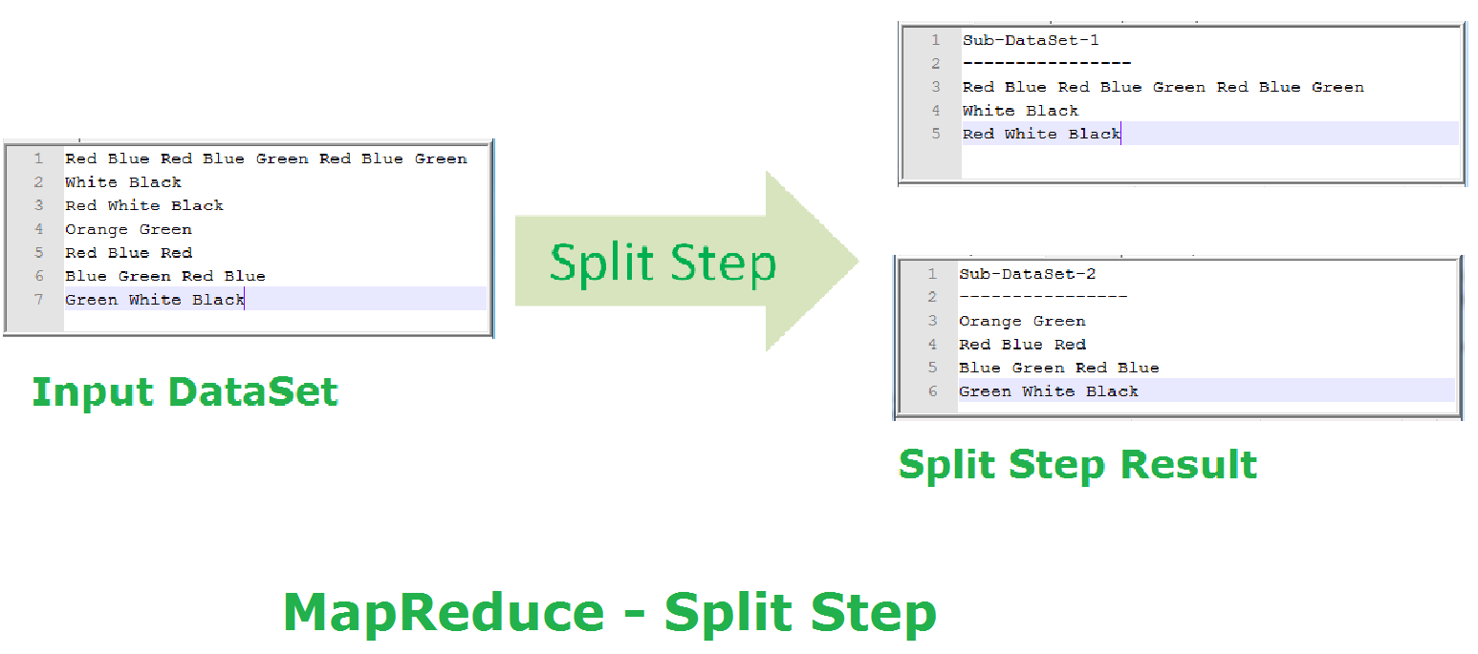
MapReduce – Map Function (Split Step)

Slide 116
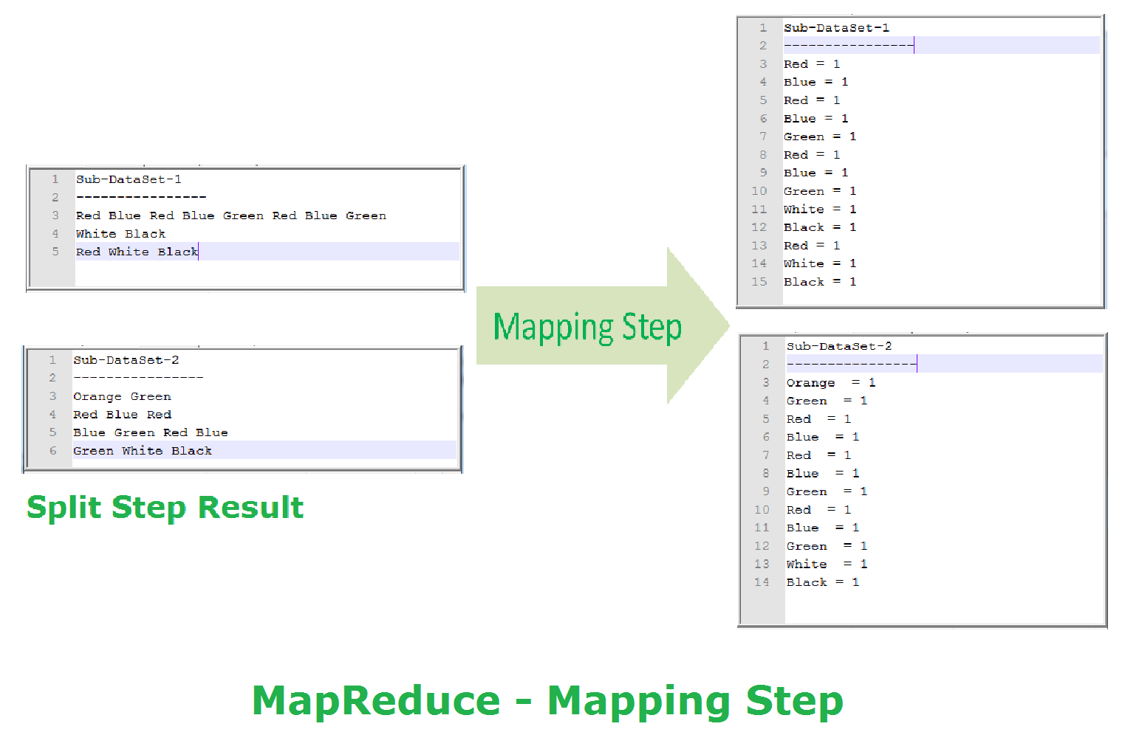
MapReduce – Map Function (Mapping Step)

Slide 117
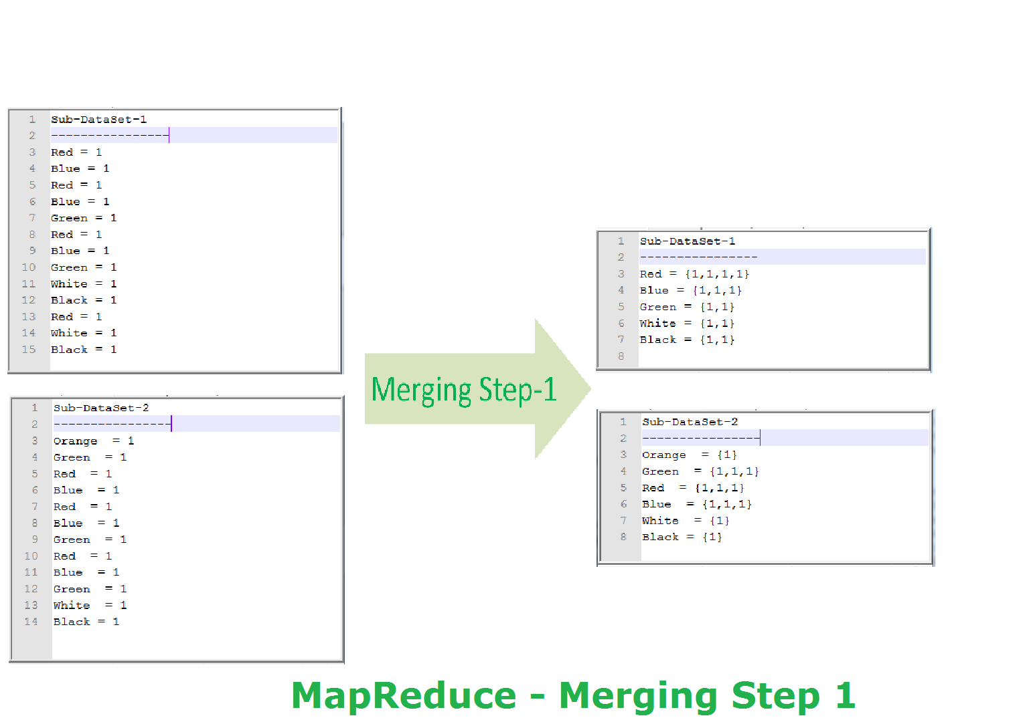

Slide 118
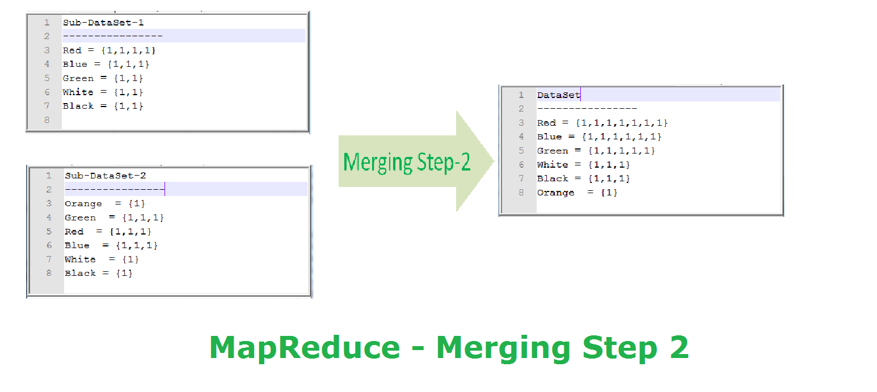

Slide 119
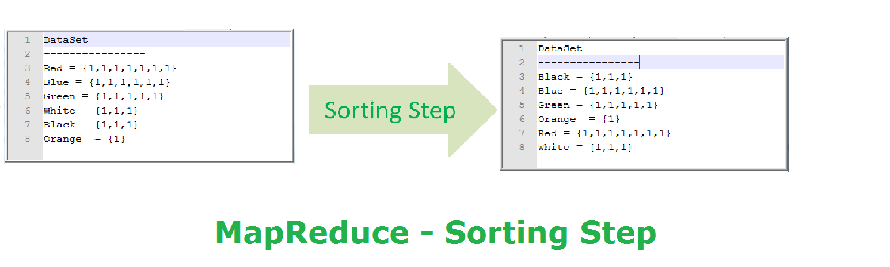
MapReduce – Shuffle Function (Sorting Step)

Slide 120
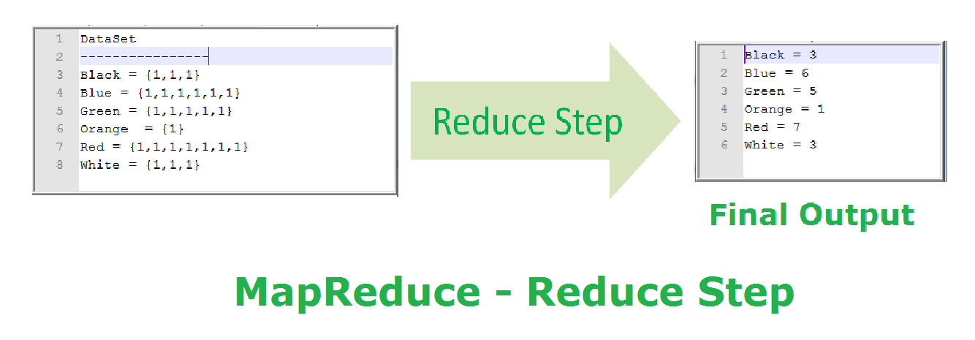
MapReduce – Reduce Function (Reduce Step)

Slide 121
CS6005 –ADVANCED DATABASE SYSTEM

Slide 122
PARALLEL DATABASE:
A parallel database seeks to improve performance through parallelization of various operations, such as loading data, building indexes and evaluating queries.
DISTRIBUTED DATABASE:
A logically interrelated collection of shared data (and a description of this data), physically distributed over a computer network.

Slide 123
Active Database
An active database is a database that includes an event-driven architecture (often in the form of ECA rules) which can respond to conditions both inside and outside the database.
Possible uses include security monitoring, alerting, statistics gathering and authorization.

Slide 124
Temporal database
A temporal database stores data relating to time instances.
It offers temporal data types and stores information relating to past, present and future time.
The temporal database has two major notions or attributes. 1. valid time. 2. transaction time.
More specifically the temporal aspects usually include valid time and transaction time.
These attributes can be combined to form bitemporal data.
Valid time is the time period during which a fact is true in the real world.
Transaction time is the time period during which a fact stored in the database was known.
Bitemporal data combines both Valid and Transaction Time.

Slide 125
Spatial database
A spatial database is a database that is optimized for storing and querying data that represents objects defined in a geometric space.
Most spatial databases allow representing simple geometric objects such as points, lines and polygons.
Some spatial databases handle more complex structures such as 3D objects, topological coverages, linear networks, and TINs

Slide 126
What is Apache Pig?
Apache Pig is an abstraction over MapReduce.
It is a tool/platform which is used to analyze larger sets of data representing them as data flows.
Pig is generally used with Hadoop; we can perform all the data manipulation operations in Hadoop using Apache Pig.
To write data analysis programs, Pig provides a high-level language known as Pig Latin.
This language provides various operators using which programmers can develop their own functions for reading, writing, and processing data.

Slide 127
To analyze data using Apache Pig, programmers need to write scripts using Pig Latin language.
All these scripts are internally converted to Map and Reduce tasks.
Apache Pig has a component known as Pig Engine that accepts the Pig Latin scripts as input and converts those scripts into MapReduce jobs.

Slide 128
Why Do We Need Apache Pig?
Programmers who are not so good at Java normally used to struggle working with Hadoop, especially while performing any MapReduce tasks.
Apache Pig is a help for all such programmers.
Using Pig Latin, programmers can perform MapReduce tasks easily without having to type complex codes in Java.
Apache Pig uses multi-query approach, thereby reducing the length of codes.
For example, an operation that would require you to type 200 lines of code (LoC) in Java can be easily done by typing as less as just 10 LoC in Apache Pig. Ultimately Apache Pig reduces the development time by almost 16 times.

Slide 129
Pig Latin is SQL-like language and it is easy to learn Apache Pig when you are familiar with SQL.
Apache Pig provides many built-in operators to support data operations like joins, filters, ordering, etc.
In addition, it also provides nested data types like tuples, bags, and maps that are missing from MapReduce.

Slide 130
Features of Pig:
Apache Pig comes with the following features −
Rich set of operators − It provides many operators to perform operations like join, sort, filer, etc.
Ease of programming − Pig Latin is similar to SQL and it is easy to write a Pig script if you are good at SQL.
Optimization opportunities − The tasks in Apache Pig optimize their execution automatically, so the programmers need to focus only on semantics of the language.
Extensibility − Using the existing operators, users can develop their own functions to read, process, and write data.

Slide 131
UDF’s − Pig provides the facility to create User-defined Functions in other programming languages such as Java and invoke or embed them in Pig Scripts.
Handles all kinds of data − Apache Pig analyzes all kinds of data, both structured as well as unstructured. It stores the results in HDFS.

Slide 132
Apache Pig | MapReduce
Apache Pig is a data flow language. | MapReduce is a data processing paradigm.
It is a high level language. | MapReduce is low level and rigid.
Performing a Join operation in Apache Pig is pretty simple. | It is quite difficult in MapReduce to perform a Join operation between datasets.
Any novice programmer with a basic knowledge of SQL can work conveniently with Apache Pig. | Exposure to Java is must to work with MapReduce.
Apache Pig uses multi-query approach, thereby reducing the length of the codes to a great extent. | MapReduce will require almost 20 times more the number of lines to perform the same task.
There is no need for compilation. On execution, every Apache Pig operator is converted internally into a MapReduce job. | MapReduce jobs have a long compilation process.

Slide 133
Pig | SQL
Pig Latin is a procedural language. | SQL is a declarative language.
In Apache Pig, schema is optional. We can store data without designing a schema (values are stored as $01, $02 etc.) | Schema is mandatory in SQL.
The data model in Apache Pig is nested relational. | The data model used in SQL is flat relational.
Apache Pig provides limited opportunity for Query optimization. | There is more opportunity for query optimization in SQL.

Slide 134
In addition to above differences, Apache Pig Latin
Allows splits in the pipeline.
Allows developers to store data anywhere in the pipeline.
Declares execution plans.
Provides operators to perform ETL (Extract, Transform, and Load) function
Applications of Apache Pig
Apache Pig is generally used by data scientists for performing tasks involving ad-hoc processing and quick prototyping.
Apache Pig is used to process huge data sources such as web logs.
To perform data processing for search platforms.
To process time sensitive data loads.

Slide 135
Apache Pig – History
In 2006, Apache Pig was developed as a research project at Yahoo, especially to create and execute MapReduce jobs on every dataset.
In 2007, Apache Pig was open sourced via Apache incubator.
In 2008, the first release of Apache Pig came out.
In 2010, Apache Pig graduated as an Apache top-level project.

Slide 136
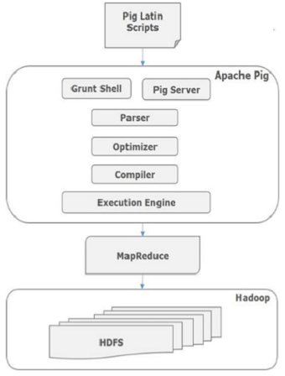
Apache Pig - Architecture

Slide 137
Apache Pig Components:
Parser.
Optimizer.
Compiler.
Execution engine.
Parser:
Initially the Pig Scripts are handled by the Parser.
It checks the syntax of the script, does type checking, and other miscellaneous checks.
The output of the parser will be a DAG (directed acyclic graph), which represents the Pig Latin statements and logical operators.
In the DAG, the logical operators of the script are represented as the nodes and the data flows are represented as edges.

Slide 138
Optimizer
The logical plan (DAG) is passed to the logical optimizer, which carries out the logical optimizations such as projection and pushdown.
Compiler
The compiler compiles the optimized logical plan into a series of MapReduce jobs.
Execution engine
Finally the MapReduce jobs are submitted to Hadoop in a sorted order. Finally, these MapReduce jobs are executed on Hadoop producing the desired results.

Slide 139
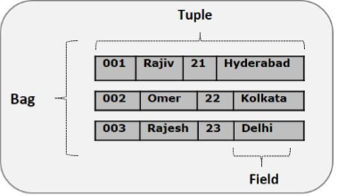
Pig Latin Data Model
The data model of Pig Latin is fully nested and it allows complex non-atomic data types such map and tuple.
Given below is the diagrammatical representation of Pig Latin’s data model.

Slide 140
Atom
Any single value in Pig Latin, irrespective of their data, type is known as anAtom. It is stored as string and can be used as string and number.
int, long, float, double, chararray, and bytearray are the atomic values of Pig.
A piece of data or a simple atomic value is known as a field.
Example − ‘raja’ or ‘30’
Tuple
A record that is formed by an ordered set of fields is known as a tuple, the fields can be of any type. A tuple is similar to a row in a table of RDBMS.
Example − (Raja, 30)
Bag
A bag is an unordered set of tuples.
In other words, a collection of tuples (non-unique) is known as a bag. Each tuple can have any number of fields (flexible schema). A bag is represented by ‘{}’.

Slide 141
HIV E

Slide 142
What is Hive
Hive is a data warehouse infrastructure tool to process structured data in Hadoop.
It resides on top of Hadoop to summarize Big Data, and makes querying and analyzing easy.
Initially Hive was developed by Facebook, later the Apache Software Foundation took it up and developed it further as an open source under the name Apache Hive.
It is used by different companies.
For example, Amazon uses it in Amazon Elastic MapReduce.

Slide 143
Hive is not
A relational database
A design for OnLine Transaction Processing (OLTP)
A language for real-time queries and row-level updates.
Features of Hive
It stores schema in a database and processed data into HDFS.
It is designed for OLAP.
It provides SQL type language for querying called HiveQL or HQL.
It is familiar, fast, scalable, and extensible.

Slide 144
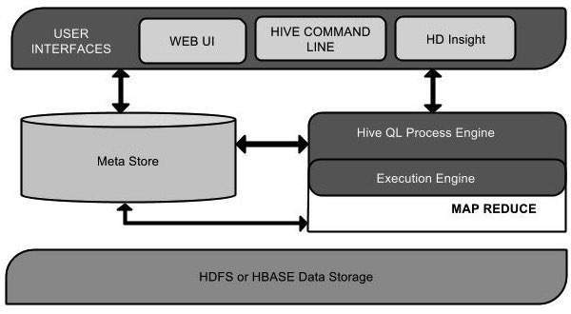
Architecture of Hive
The following component diagram depicts the architecture of Hive:

Slide 145
Unit Name | Operation
User Interface | Hive is a data warehouse infrastructure software that can create interaction between user and HDFS. The user interfaces that Hive supports are Hive Web UI, Hive command line, and Hive HD Insight (In Windows server).
Meta Store | Hive chooses respective database servers to store the schema or Metadata of tables, databases, columns in a table, their data types, and HDFS mapping.
HiveQL Process Engine | HiveQL is similar to SQL for querying on schema info on the Metastore. It is one of the replacements of traditional approach for MapReduce program. Instead of writing MapReduce program in Java, we can write a query for MapReduce job and process it.
Execution Engine | The conjunction part of HiveQL process Engine and MapReduce is Hive Execution Engine. Execution engine processes the query and generates results as same as MapReduce results. It uses the flavor of MapReduce.

Slide 146
Unit Name | Operation
HDFS or HBASE | Hadoop distributed file system or HBASE are the data storage techniques to store data into file system.

Slide 147
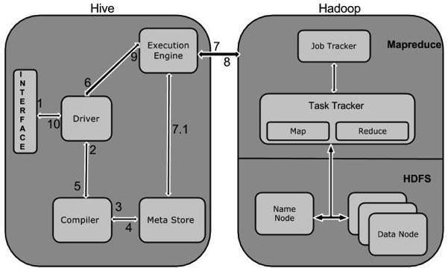
Working of Hive
The following diagram depicts the workflow between Hive and Hadoop.

Slide 148
Execute Query
The Hive interface such as Command Line or Web UI sends query to Driver (any database driver such as JDBC, ODBC, etc.) to execute.
Get Plan
The driver takes the help of query compiler that parses the query to check the syntax and query plan or the requirement of query.
Get Metadata
The compiler sends metadata request to Metastore (any database).

Slide 149
Send Metadata
Metastore sends metadata as a response to the complier.
Send Plan
The compiler checks the requirement and resends the plan to the driver. Up to here, the parsing and compiling of a query is complete.
Execute Plan
The driver sends the execute plan to the execution engine.

Slide 150
Execute Job
Internally, the process of execution job is a MapReduce job.
The execution engine sends the job to JobTracker, which is in Name node and it assigns this job to TaskTracker, which is in Data node.
Here, the query executes MapReduce job
Metadata Ops
Meanwhile in execution, the execution engine can execute metadata operations with Metastore..

Slide 151
Fetch Result
The execution engine receives the results from Data nodes.
Send Results
The execution engine sends those resultant values to the driver.
Send Results
The driver sends the results to Hive Interfaces.

Slide 152
All the data types in Hive are classified into four types, given as follows:
Column Types
Literals
Null Values
Complex Types
Column Types
Column type are used as column data types of Hive. They are as follows:
Integral Types
Integer type data can be specified using integral data types, INT.
When the data range exceeds the range of INT, you need to use BIGINT and if the data range is smaller than the INT, you use SMALLINT.
TINYINT is smaller than SMALLINT.

Slide 153
The following table depicts various INT data types:
Type | Postfix | Example
TINYINT | Y | 10Y
SMALLINT | S | 10S
INT | - | 10
BIGINT | L | 10L

Slide 154
String Types
String type data types can be specified using single quotes (' ') or double quotes (" ").
It contains two data types: VARCHAR and CHAR. Hive follows C-types escape characters.
The following table depicts various CHAR data types:
Data Type | Length
VARCHAR | 1 to 65355
CHAR | 255

Slide 155
Dates
DATE values are described in year/month/day format in the form {{YYYY-MM-DD}}.
Literals
The following literals are used in Hive:
Floating Point Types
Floating point types are nothing but numbers with decimal points. Generally, this type of data is composed of DOUBLE data type.
Decimal Type
Decimal type data is nothing but floating point value with higher range than DOUBLE data type.
The range of decimal type is approximately -10⁻³⁰⁸ to 10³⁰⁸.Null Value

Slide 156
Complex Types
The Hive complex data types are as follows:
Arrays
Arrays in Hive are used the same way they are used in Java.
Syntax: ARRAY<data_type>
Maps
Maps in Hive are similar to Java Maps.
Syntax: MAP<primitive_type, data_type>

Slide 157
Null Value
Missing values are represented by the special value NULL.

Slide 159
Query Optimization in Centralized Systems
In a centralized system, query processing is done with the following aim −
Minimization of response time of query (time taken to produce the results to user’s query).
Maximize system throughput (the number of requests that are processed in a given amount of time).
Reduce the amount of memory and storage required for processing.
Increase parallelism.

Slide 160
Query Parsing and Translation
Initially, the SQL query is scanned. Then it is parsed to look for syntactical errors and correctness of data types.
If the query passes this step, the query is decomposed into smaller query blocks.
Each block is then translated to equivalent relational algebra expression.
Steps for Query Optimization
Query optimization involves three steps, namely query tree generation, plan generation, and query plan code generation.

Slide 161
Step 1 − Query Tree Generation
A query tree is a tree data structure representing a relational algebra expression.
The tables of the query are represented as leaf nodes.
The relational algebra operations are represented as the internal nodes. The root represents the query as a whole.
During execution, an internal node is executed whenever its operand tables are available.
The node is then replaced by the result table.
This process continues for all internal nodes until the root node is executed and replaced by the result table.

Slide 162

For example, let us consider the following schemas −
EMPLOYEE
EmpID Ename Salary DeptNo DateOfJoining
DEPARTMENT
Dno Dname Location
example 1
Let us consider the query as the following.
Π EmpID (σEName="ArunKumar"(EMPLOYEE))
The corresponding query tree will be −

Slide 163
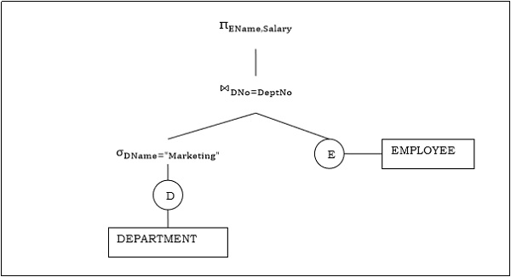
Example 2
Let us consider another query involving a join.
πEName,Salary(σDName="Marketing"(DEPARTMENT))⋈DNo=DeptNo(EMPLOYEE)
Following is the query tree for the above query.

Slide 164
Step 2 − Query Plan Generation
After the query tree is generated, a query plan is made.
A query plan is an extended query tree that includes access paths for all operations in the query tree.
Step 3− Code Generation
Code generation is the final step in query optimization.
It is the executable form of the query, whose form depends upon the type of the underlying operating system.
Once the query code is generated, the Execution Manager runs it and produces the results.

Slide 165
Approaches to Query Optimization
Among the approaches for query optimization, exhaustive search and heuristics-based algorithms are mostly used.
Exhaustive Search Optimization
In these techniques, for a query, all possible query plans are initially generated and then the best plan is selected.
Though these techniques provide the best solution, it has an exponential time and space complexity owing to the large solution space.
For example, dynamic programming technique.

Slide 166
Heuristic Based Optimization
Heuristic based optimization uses rule-based optimization approaches for query optimization.
These algorithms have polynomial time and space complexity, which is lower than the exponential complexity of exhaustive search-based algorithms.
However, these algorithms do not necessarily produce the best query plan.
Some of the common heuristic rules are −
Perform select and project operations before join operations. This is done by moving the select and project operations down the query tree. This reduces the number of tuples available for join.
Perform the most restrictive select/project operations at first before the other operations.
Avoid cross-product operation since they result in very large-sized intermediate tables.

