Slide 1
Expert Systems

Slide 2
Goals of AI
To Implement Human Intelligence in Machines
− Creating systems that understand, think, learn, and behave like humans.
To Create Expert Systems
− The systems which exhibit intelligent behavior, learn, demonstrate, explain, and advice its users.

Slide 3
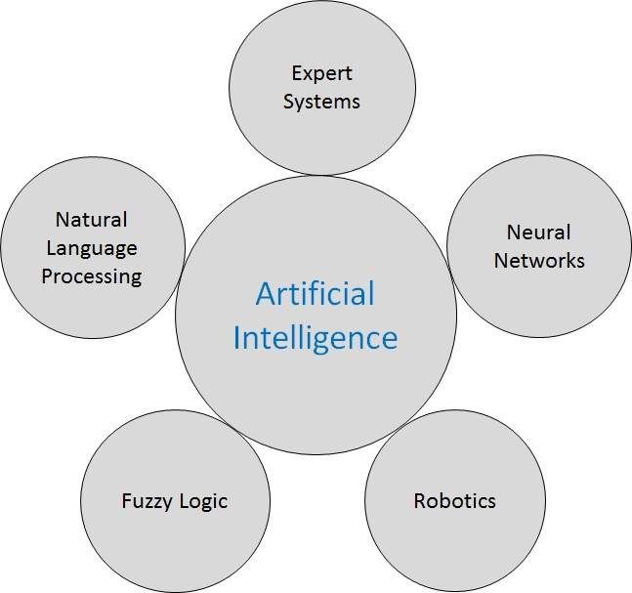
Branches of AI

Slide 4
Data
Collection of raw facts
Information
Processed data
Knowledge
Is the awareness and understanding of data and information
Intelligence
Is the ability to acquire, understand and apply knowledge

Slide 5
Definition
An expert system is software that attempts to reproduce the performance of one or more human experts, most commonly in a specific problem domain.
Represent the expertise knowledge as data or rules within the computer
Can be called upon when needed to solve problems

Slide 6
Capabilities of Expert Systems
Advising
Instructing and assisting human in decision making
Demonstrating
Deriving a solution
Diagnosing
Explaining
Predicting results
Justifying the conclusion
Suggesting alternative options to a problem

Slide 7
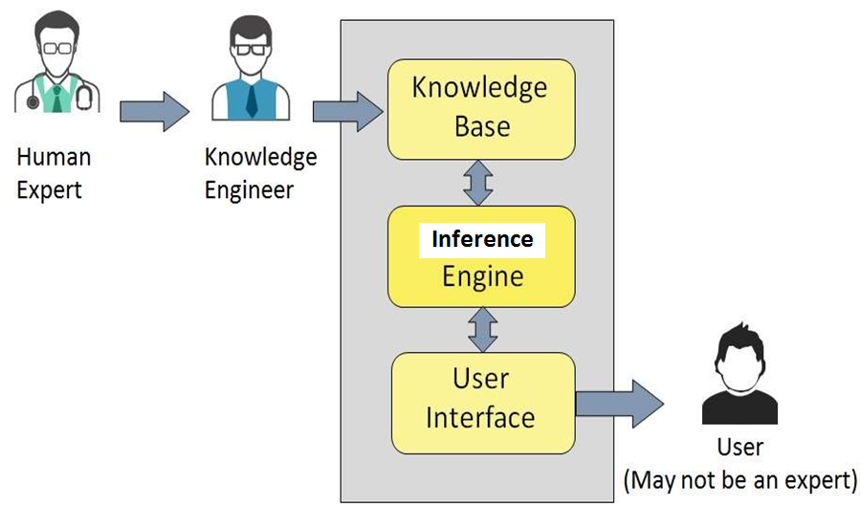
Components of Expert Systems

Slide 8
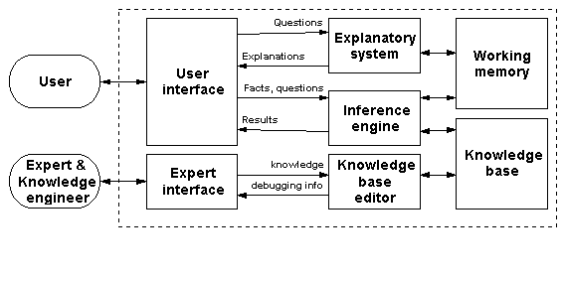
Architecture of an Expert System

Slide 9
Knowledge base
Factual Knowledge − It is the information widely accepted by the Knowledge Engineers and scholars in the task domain.
Heuristic Knowledge − It is about practice, accurate judgement, one’s ability of evaluation, and guessing.
Knowledge representation
IT-THEN-ELSE rules
Knowledge acquisition
Readings from various experts, scholars, and the Knowledge Engineers.
Knowledge engineer
A person with the qualities of empathy, quick learning, and case analyzing skills

Slide 10
Inference Engine
Knowledge-based ES
Inference Engine acquires and manipulates the knowledge from the knowledge base
Rule based ES
Inference Engine Applies rules repeatedly to the facts
Adds new knowledge into the knowledge base if required.
Resolves rules conflict when multiple rules are applicable to a particular case.

Slide 11
Inference Engine…
To recommend a solution, the Inference engine uses the following strategies
Forward Chaining
Backward Chaining

Slide 12
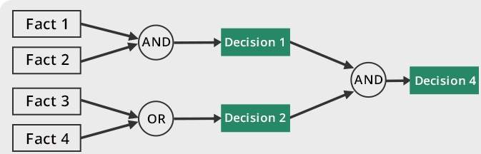
Forward Chaining
“What can happen next?”

Slide 13
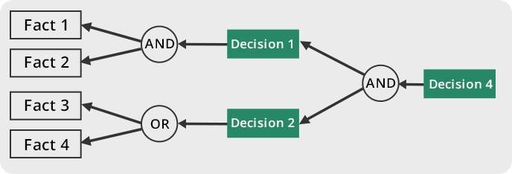
Backward Chaining
“Why this happened?”

