Slide 1
CS6801 MULTI-CORE ARCHITECTURES AND PROGRAMMING
OBJECTIVES:
The student should be made to:
Understand the challenges in parallel and multi-threaded programming.
Learn about the various parallel programming paradigms, and solutions.
OUTCOMES:
At the end of the course, the student should be able to:
Program Parallel Processors.
Develop programs using OpenMP and MPI.
Compare and contrast programming for serial processors and programming for parallel processors.

Slide 2
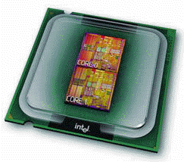
Multi-core Processors
They are multiple, relatively simple, complete processors on a single chip. Such integrated circuits are called multicore processors, and core has become synonymous with central processing unit, or CPU.
In this setting a conventional processor with one CPU is often called a single-core system.
Parallel computing
Parallel computing is the use of a parallel computer to reduce the time needed to solve a single computational problem. Parallel computing is now considered a standard way for computational scientists and engineers to solve problems in areas as diverse as galactic evolution, climate modeling, aircraft design, and molecule dynamics.
Parallel Computers
A parallel computer is a multiple-processor computer system supporting parallel programming.
Two important categories of parallel computers are
i) Multicomputers and
ii) Centralized multiprocessors.

Slide 3
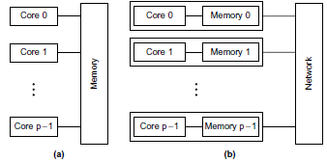
i) Multicomputers
As its name implies,. a multicomputer is a parallel computer constructed out of multiple computers and all interconnection network.
The processors on different computers interact by passing messages to each other.
ii) Centralized multiprocessors.
In contrast, a centralized multiprocessor (also called a symmetrical multiprocessor or SMP) is a more highly integrated system in which all CPUs share access to a single global memory.
This shared memory supports communication and synchronization among processors.

Slide 4
Multi-core Programming
Serial Programs:
Programs that were written to run on a single processor are called as serial programs. Such programs are unaware of the existence of multiple processors, and the performance of such a program on a system with multiple processors will be effectively the same as its performance on a single processor of the multiprocessor system.
Parallel Programming:
Parallel programming is programming in a language that allows you to explicitly indicate how, different portions of the computation may be executed concurrently by different processors.
In 1988 McGraw and Axelrod identified four distinct paths for the development of applications software for parallel computers:
i). Extend an existing compiler to translate sequential programs into parallel programs.
ii). Extend an existing language with new operations that allow users to express parallelism.
iii). Add a new parallel language layer on top of an existing sequential language.
iv). Define a totally new parallel language and compiler system.

Slide 5
Current Status
While work continues to be done on parallelizing compilers and higher-level parallel programming language, the most popular approach to parallel programming continues to be the approach of augmenting an existing sequential language with low-level constructs expressed by function calls or compiler directives.
Parallel programming in C with
MPI – Message Passing Interface
OpenMP – Open Multi-Processing
is an example of this approach.
Low-level parallel programming can produce programs that exhibit high efficiency and are portable to wide range of parallel systems.
MPI – Distributed Memory Programming
OpenMP – Shared Memory Programming

Slide 6
1.1 Single core to Multi-core architectures
1.1.1 Increasing Performance
The vast increases in computational power that we’ve been enjoying for decades now have been at the heart of many of the most dramatic advances in fields as diverse as science, the Internet, and entertainment.
As our computational power increases, the number of problems that we can seriously consider solving also increases. The following are a few examples:
1. Climate modeling.
In order to better understand climate change, we need far more accurate computer models, models that include interactions between the atmosphere, the oceans, solid land, and the ice caps at the poles.
We also need to be able to make detailed studies of how various interventions might affect the global climate.
Protein folding.
It’s believed that misfolded proteins may be involved in diseases such as Huntington’s, Parkinson’s, and Alzheimer’s, but our ability to study configurations of complex molecules such as proteins is severely limited by our current computational power.

Slide 7
Drug discovery.
There are many ways in which increased computational power can be used in research into new medical treatments.
Energy research.
Increased computational power will make it possible to program much more detailed models of technologies such as wind turbines, solar cells, and batteries.
These programs may provide the information needed to construct far more efficient clean energy sources.
Data analysis.
We generate tremendous amounts of data. By some estimates, the quantity of data stored worldwide doubles every two years , but the vast majority of it is largely useless unless it’s analyzed.
These and a host of other problems won’t be solved without vast increases in computational power.

Slide 8
1.1.2 Building parallel systems
Much of the tremendous increase in single processor performance has been driven by the ever-increasing density of transistors—the electronic switches—on integrated circuits.
As the size of transistors decreases, their speed can be increased, and the overall speed of the integrated circuit can be increased.
However, as the speed of transistors increases, their power consumption also increases.
Most of this power is dissipated as heat, and when an integrated circuit gets too hot, it becomes unreliable.
We exploit the continuing increase in transistor density? The answer is parallelism. Rather than building ever-faster, more complex, monolithic processors, the industry has decided to put multiple, relatively simple, complete processors on a single chip. Such integrated circuits are called multicore processors, and core has become synonymous with central processing unit, or CPU.
In this setting a conventional processor with one CPU is often called a single-core system.

Slide 9
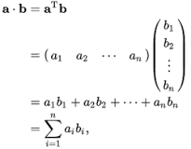
1.1.3 Writing parallel programs
Most programs that have been written for conventional, single-core systems cannot exploit the presence of multiple cores.
We can run multiple instances of a program on a multicore system, but this is often of little help.
For example, being able to run multiple instances of our favorite game program isn’t really what we want—we want the program to run faster with more realistic graphics.
In order to do this, we need to either rewrite our serial programs so that they’re parallel, so that they can make use of multiple cores, or write translation programs, that is, programs that will automatically convert serial programs into parallel programs.
For example, we can view the multiplication of two n x n matrices as a sequence of dot products, but parallelizing a matrix multiplication as a sequence of parallel dot products is likely to be very slow on many systems.
As an example, suppose that we need to compute n values and add them together. We know that this can be done with the following serial code:
sum = 0;
for (i = 0; i < n; i++) {
x = Compute_next_value(. . .);
sum += x;
}

Slide 10
Now suppose we also have p cores and p is much smaller than n. Then each core can form a partial sum of approximately n/p values:
my_sum = 0;
my_first_i = . . . ;
my_last_i = . . . ;
for (my_i = my_first i; my_i < my_last i; my_i++) {
my_x = Compute_next_value(. . .);
my_sum += my_x;
}
Here the prefix my_ indicates that each core is using its own, private variables, and each core can execute this block of code independently of the other cores.
After each core completes execution of this code, its variable my_sum will store the sum of the values computed by its calls to Compute_next_value. For example, if there are eight cores, n =24, and the 24 calls to Compute next value return the values
1, 4, 3, 9, 2, 8, 5, 1, 1, 6, 2, 7, 2, 5, 0, 4, 1, 8, 6, 5, 1, 2, 3, 9, then the values stored in my_sum might be

Slide 11

1, 4, 3, 9, 2, 8, 5, 1, 1, 6, 2, 7, 2, 5, 0, 4, 1, 8, 6, 5, 1, 2, 3, 9,
Here we’re assuming the cores are identified by nonnegative integers in the range
0, 1, ….. ,p-1, where p is the number of cores. When the cores are done computing their values of my_sum, they can form a global sum by sending their results to a designated “master” core, which can add their results:
if (I’m the master core) {
sum = my_x;
for each core other than myself {
receive value from core;
sum += value;
}
} else {
send my_x to the master;
}

Slide 12
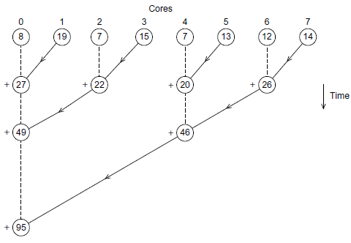
Fig.1.1 Multiple cores forming a global sum
In our example, if the master core is core 0, it would add the values 8+19+7+15+7+13+12+14 = 95.
But you can probably see a better way to do this—especially if the number of cores is large.
Instead of making the master core do all the work of computing the final sum, we can pair the cores so that while core 0 adds in the result of core 1, core 2 can add in the result of core 3, core 4 can add in the result of core 5 and so on.
Then we can repeat the process with only the even-ranked cores: 0 adds in the result of 2, 4 adds in the result of 6, and so on. Now cores divisible by 4 repeat the process, and so on.
Fig. Multiple cores forming a global sum

Slide 13
However, with eight cores, the master will carry out seven receives and adds using the ﬁrst method, while with the second method it will only carry out three.
So the second method results in an improvement of more than a factor of two. The difference becomes much more dramatic with large numbers of cores.
With 1000 cores, the ﬁrst method will require 999 receives and adds, while the second will only require 10, an improvement of almost a factor of 100!

Slide 14
Task-parallelism and Data-parallelism
There are two basic ideas of partitioning the work among the cores are task-parallelism and data-parallelism.
In task-parallelism, we partition the various tasks carried out in solving the problem among the cores.
In data-parallelism, we partition the data used in solving the problem among the cores, and each core carries out more or less similar operations on its part of the data.
MPI, Pthreads and OpenMP
We’ll be focusing on learning to write programs that are explicitly parallel.
Our purpose is to learn the basics of programming parallel computers using the C language and three different extensions to C: the Message-Passing Interface or MPI, POSIX threads or Pthreads, and OpenMP.
MPI and Pthreads are libraries of type definitions, functions, and macros that can be used in C programs.
OpenMP consists of a library and some modifications to the C compiler.

Slide 15
1.3 SIMD and MIMD systems
Parallel Hardware
Multiple issue and pipelining can clearly be considered to be parallel hardware, since functional units are replicated.
However, since this form of parallelism isn’t usually visible to the programmer, we’re treating both of them as extensions to the basic von Neumann model, and for our purposes, parallel hardware will be limited to hardware that’s visible to the programmer.
1.3.1 SIMD systems
In parallel computing, Flynn’s taxonomy is frequently used to classify computer architectures.
It classifies a system according to the number of instruction streams and the number of data streams it can simultaneously manage.
A classical von Neumann system is therefore a single instruction stream, single data stream, or SISD system, since it executes a single instruction at a time and it can fetch or store one item of data at a time.
Single instruction, multiple data, or SIMD, systems are parallel systems. As the name suggests, SIMD systems operate on multiple data streams by applying the same instruction to multiple data items, so an abstract SIMD system can be thought of as having a single control unit and multiple ALUs.
An instruction is broadcast from the control unit to the ALUs, and each ALU either applies the instruction to the current data item, or it is idle.

Slide 16
(1)As an example, suppose we want to carry out a “vector addition.” That is, suppose we have two arrays x and y, each with n elements, and we want to add the elements of y to the elements of x:
for (i = 0; i < n; i++)
x[i] += y[i];
Suppose further that our SIMD system has n ALUs. Then we could load x[i] and y[i] into the ith ALU, have the ith ALU add y[i] to x[i], and store the result in x[i]. If the system has m ALUs and m < n, we can simply execute the additions in blocks of m elements at a time.
For example, if m = 4 and n = 15, we can first add elements 0 to 3, then elements 4 to 7, then elements 8 to 11, and finally elements 12 to 14.
Note that in the last group of elements in our example—elements 12 to 14—we’re only operating on three elements of x and y, so one of the four ALUs will be idle. The requirement that all the ALUs execute the same instruction or are idle can seriously degrade the overall performance of a SIMD system.

Slide 17
(2) For example, suppose we only want to carry out the addition if y[i] is positive:
for (i = 0; i < n; i++)
if (y[i] > 0.0) x[i] += y[i];
In this setting, we must load each element of y into an ALU and determine whether it’s positive. If y[i] is positive, we can proceed to carry out the addition. Otherwise, the ALU storing y[i] will be idle while the other ALUs carry out the addition.
Finally, as our first example shows, SIMD systems are ideal for parallelizing simple loops that operate on large arrays of data. SIMD parallelism can be very efficient on large data parallel problems, but SIMD systems often don’t do very well on other types of parallel problems.

Slide 18
Vector processors
Although what constitutes a vector processor has changed over the years, their key characteristic is that they can operate on arrays or vectors of data, while conventional CPUs operate on individual data elements or scalars.
Typical recent systems have the following characteristics:
Vector registers. These are registers capable of storing a vector of operands and operating simultaneously on their contents. The vector length is fixed by the system, and can range from 4 to 128 64-bit elements.
Vectorized and pipelined functional units. Note that the same operation is applied to each element in the vector, or, in the case of operations like addition, the same operation is applied to each pair of corresponding elements in the two vectors. Thus, vector operations are SIMD.
Vector instructions. These are instructions that operate on vectors rather than scalars. If the vector length is vector_length, these instructions have the great virtue that a simple loop.
Interleaved memory. The memory system consists of multiple “banks” of memory, which can be accessed more or less independently.
Strided memory access and hardware scatter/gather. In strided memory access, the program accesses elements of a vector located at fixed intervals. For example,accessing the first element, the fifth element, the ninth element, and so on, would be strided access with a stride of four. Scatter/gather (in this context) is writing (scatter) or reading (gather) elements of a vector located at irregular intervals

Slide 19
Graphics processing units
Real-time graphics application programming interfaces, or APIs, use points, lines, and triangles to internally represent the surface of an object.
They use a graphics processing pipeline to convert the internal representation into an array of pixels that can be sent to a computer screen. Several of the stages of this pipeline are programmable.
The behavior of the programmable stages is specified by functions called shader functions. The shader functions are typically quite short—often just a few lines of C code.
They’re also implicitly parallel, since they can be applied to multiple elements (e.g., vertices) in the graphics stream.
Since the application of a shader function to nearby elements often results in the same flow of control, GPUs can optimize performance by using SIMD parallelism, and in the current generation all GPUs use SIMD parallelism. This is obtained by including a large number of ALUs (e.g., 80) on each GPU processing core.

Slide 20
Processing a single image can require very large amounts of data—hundreds of megabytes of data for a single image is not unusual. GPUs therefore need to maintain very high rates of data movement, and in order to avoid stalls on memory accesses, they rely heavily on hardware multithreading;
1.3.2 MIMD systems
Multiple instruction, multiple data, or MIMD, systems support multiple simultaneous instruction streams operating on multiple data streams.
Thus, MIMD systems typically consist of a collection of fully independent processing units or cores, each of which has its own control unit and its own ALU.
Furthermore, unlike SIMD systems, MIMD systems are usually asynchronous, that is, the processors can operate at their own pace.
In many MIMD systems there is no global clock, and there may be no relation between the system times on two different processors.
Shared-memory and distributed-memory system
As we noted earlier, there are two principal types of MIMD systems: shared-memory systems and distributed-memory systems

Slide 21
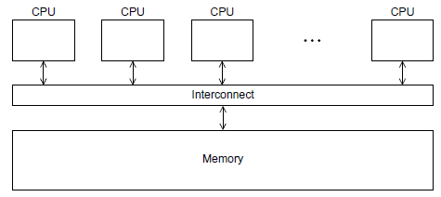
In a shared-memory system a collection of autonomous processors is connected to a memory system via an interconnection network, and each processor can access each memory location.
In a shared-memory system, the processors usually communicate implicitly by accessing shared data structures.
In a distributed-memory system, each processor is paired with its own private memory, and the processor-memory pairs communicate over an interconnection network. So in distributed-memory systems the processors usually communicate explicitly by sending messages or by using special functions that provide access to the memory of another processor.
Fig. 1.2 A shared-memory system

Slide 22
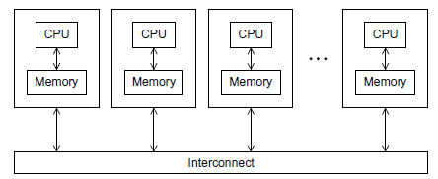
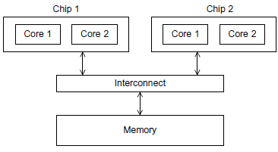
Fig. 1.3 A distributed-memory system
Shared-memory systems
The most widely available shared-memory systems use one or more multicore processors.
A multicore processor has multiple CPUs or cores on a single chip. Typically, the cores have private level 1 caches, while other caches may or may not be shared between the cores.
Fig. 1.4 A UMA multicore system

Slide 23
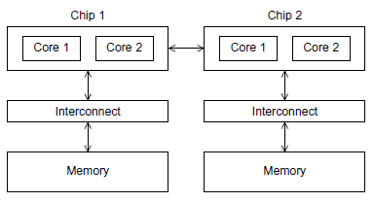
In shared-memory systems with multiple multicore processors, the interconnect can either connect all the processors directly to main memory or each processor can have a direct connection to a block of main memory, and the processors can access each others’ blocks of main memory through special hardware built into the processors. See Figures 1.4 and 1.5.
In the first type of system, the time to access all the memory locations will be the same for all the cores, while in the second type a memory location to which a core is directly connected can be accessed more quickly than a memory location that must be accessed through another chip.
Thus, the first type of system is called a uniform memory access, or UMA, system, while the second type is called a nonuniform memory access, or NUMA, system.
Fig. 1.5 A NUMA multicore system

Slide 24
Distributed-memory systems
The most widely available distributed-memory systems are called clusters. They are composed of a collection of commodity systems—for example, PCs—connected by a commodity interconnection network—for example, Ethernet.
In fact, the nodes of these systems, the individual computational units joined together by the communication network, are usually shared-memory systems with one or more multicore processors.
To distinguish such systems from pure distributed-memory systems, they are sometimes called hybrid systems. Nowadays, it’s usually understood that a cluster will have shared-memory nodes.
The grid provides the infrastructure necessary to turn large networks of geographically distributed computers into a unified distributed-memory system. In general, such a system will be heterogeneous, that is, the individual nodes may be built from different types of hardware.

Slide 25
1.4 Interconnection networks
The interconnect plays a decisive role in the performance of both distributed- and shared-memory systems: even if the processors and memory have virtually unlimited performance, a slow interconnect will seriously degrade the overall performance of all but the simplest parallel program.
1.4.1 Shared-memory interconnects
Currently the two most widely used interconnects on shared-memory systems are buses and crossbars. Recall that a bus is a collection of parallel communication wires together with some hardware that controls access to the bus.
The key characteristic of a bus is that the communication wires are shared by the devices that are connected to it.
Buses have the virtue of low cost and flexibility; multiple devices can be connected to a bus with little additional cost. However, since the communication wires are shared, as the number of devices connected to the bus increases, the likelihood that there will be contention for use of the bus increases, and the expected performance of the bus decreases.
Therefore, if we connect a large number of processors to a bus, we would expect that the processors would frequently have to wait for access to main memory. Thus, as the size of shared-memory systems increases, buses are rapidly being replaced by switched interconnects.
As the name suggests, switched interconnects use switches to control the routing of data among the connected devices. A crossbar is illustrated in Figure 1.6 (a). The lines are bidirectional communication links, the squares are cores or memory modules, and the circles are switches.

Slide 26
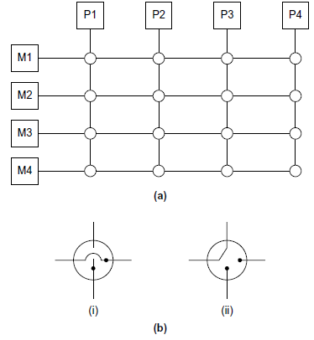
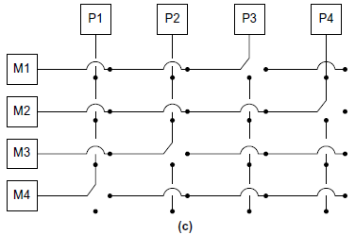
Fig. 1.6 (a) A crossbar switch connecting four processors (Pi) and four memory modules (Mj); (b)configuration of internal switches in a crossbar; (c) simultaneous memory accesses by the processors

Slide 27
The individual switches can assume one of the two configurations shown in Figure 1.6 (b). With these switches and at least as many memory modules as processors, there will only be a conflict between two cores attempting to access memory if the two cores attempt to simultaneously access the same memory module.
For example, Figure 1.6 (c) shows the configuration of the switches if P1 writes to M4, P2 reads from M3, P3 reads from M1, and P4 writes to M2.
Crossbars allow simultaneous communication among different devices, so they are much faster than buses.

Slide 28
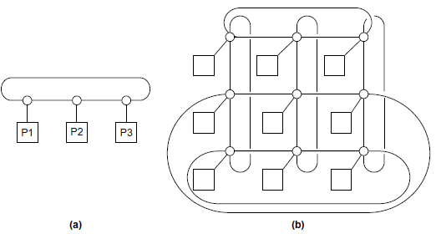
1.4.2 Distributed-memory interconnects
Distributed-memory interconnects are often divided into two groups: direct interconnects and indirect interconnects.
In a direct interconnect each switch is directly connected to a processor-memory pair, and the switches are connected to each other.
Figure 1.7 shows a ring and a two-dimensional toroidal mesh. As before, the circles are switches, the squares are processors, and the lines are bidirectional links. A ring is superior to a simple bus since it allows multiple simultaneous communications.
The toroidal mesh will be more expensive than the ring, because the switches are more complex—they must support five links instead of three—and if there are p processors, the number of links is 3p in a toroidal mesh, while it’s only 2p in a ring.
Fig. 1.7 (a) A ring and (b) a toroidal mesh

Slide 29
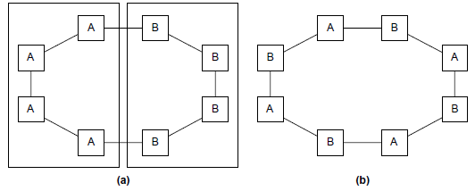
One measure of “number of simultaneous communications” or “connectivity” is bisection width.
To understand this measure, imagine that the parallel system is divided into two halves, and each half contains half of the processors or nodes. How many simultaneous communications can take place “across the divide” between the halves? In Figure 1.8 (a) we’ve divided a ring with eight nodes into two groups of four nodes, and we can see that only two communications can take place between the halves.
However, in Figure 1.8(b) we’ve divided the nodes into two parts so that four simultaneous communications can take place, so what’s the bisection width? The bisection width is supposed to give a “worst-case” estimate, so the bisection width is two—not four.
Fig.1.8 Two bisections of a ring: (a) only two communications can take place between the halves and (b) four simultaneous connections can take place

Slide 30
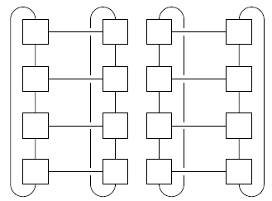
An alternative way of computing the bisection width is to remove the minimum number of links needed to split the set of nodes into two equal halves. The number of links removed is the bisection width.
If we have a square two-dimensional toroidal mesh with p=q² nodes (where q is even), then we can split the nodes into two halves by removing the “middle” horizontal links and the “wraparound” horizontal links. See Figure 2.10. This suggests that the bisection width is at most 2q=2 . In fact, this is the smallest possible number of links and the bisection width of a square two-dimensional toroidal mesh is 2 .
Fig 1.9 A bisection of a toroidal mesh

Slide 31
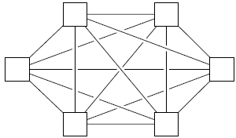
The bandwidth of a link is the rate at which it can transmit data. It’s usually given in megabits or megabytes per second.
Bisection bandwidth is often used as a measure of network quality. It’s similar to bisection width. However, instead of counting the number of links joining the halves, it sums the bandwidth of the links.
The ideal direct interconnect is a fully connected network in which each switch is directly connected to every other switch. See Figure1.9 . Its bisection width is p²/ 4. However, it’s impractical to construct such an interconnect for systems with more than a few nodes, since it requires a total of p²/2 +p/2 links, and each switch must be capable of connecting to p links.
It is therefore more a “theoretical best possible” interconnect than a practical one, and it is used as a basis for evaluating other interconnects.
Fig. 1.9 A fully connected network

Slide 32
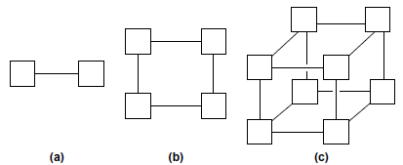
Hypercube
The hypercube is a highly connected direct interconnect that has been used in actual systems. Hypercubes are built inductively:
A one-dimensional hypercube is a fully-connected system with two processors.
A two-dimensional hypercube is built from two one-dimensional hypercubes by joining “corresponding” switches. Similarly, a three-dimensional hypercube is built from two two-dimensional hypercubes. See Figure 1.10.
Thus, a hypercube of dimension d has p = 2^{d} nodes, and a switch in a d-dimensional hypercube is directly connected to a processor and d switches.
The bisection width of a hypercube is p/2, so it has more connectivity than a ring or toroidal mesh, but the switches must be more powerful, since they must support 1+d = 1+log₂ (p) wires, while the mesh switches only require five wires. So a hypercube with p nodes is more expensive to construct than a toroidal mesh.
Fig. 1.10 (a) One-, (b) two-, and (c) three-dimensional hypercubes

Slide 33
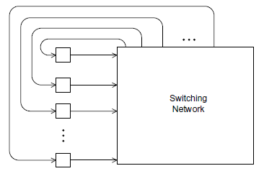
Indirect interconnects
Indirect interconnects provide an alternative to direct interconnects. In an indirect interconnect, the switches may not be directly connected to a processor. They’re often shown with unidirectional links and a collection of processors, each of which has an outgoing and an incoming link, and a switching network.
Fig. 1.11A generic indirect network
Crossbar and Omega network
The crossbar and the omega network are relatively simple examples of indirect networks. We saw a shared-memory crossbar with bidirectional links earlier.
The diagram of a distributed-memory crossbar in Figure 1.12 has unidirectional links. Notice that as long as two processors don’t attempt to communicate with the same processor, all the processors can simultaneously communicate with another processor.

Slide 34
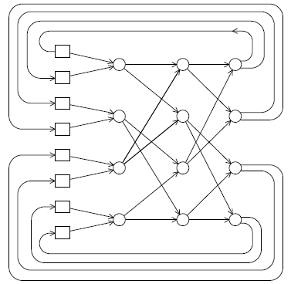
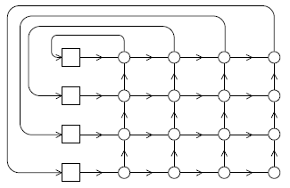
An omega network is shown in Figure 1.13. The switches are two-by-two crossbars Observe that unlike the crossbar, there are communications that cannot occur simultaneously.
For example, in Figure 1.13 if processor 0 sends a message to processor 6, then processor 1 cannot simultaneously send a message to processor 7. On the other hand, the omega network is less expensive than the crossbar.
The omega network uses ½ plog2 (p) of the 2x2 crossbar switches, while the crossbar uses p ².
Fig. 1.13 An omega network Fig. 1.12 A crossbar interconnect for distributed-memory

Slide 35
Latency and bandwidth
The latency is the time that elapses between the source’s beginning to transmit the data and the destination’s starting to receive the first byte.
The bandwidth is the rate at which the destination receives data after it has started to receive the first byte. So if the latency of an interconnect is l seconds and the bandwidth is b bytes per second, then the time it takes to transmit a message of n bytes is
message transmission time = l + n/b.

Slide 36
Cache:
In general a cache is a collection of memory locations that can be accessed in less time than some other memory locations. In our setting, when we talk about caches we’ll usually mean a CPU cache, which is a collection of memory locations that the CPU can access more quickly than it can access main memory.
A CPU cache can either be located on the same chip as the CPU or it can be located on a separate chip that can be accessed much faster than an ordinary memory chip.

Slide 37
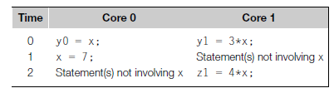
1.5 Cache coherence
Recall that CPU caches are managed by system hardware: programmers don’t have direct control over them. This has several important consequences for shared-memory systems. To understand these issues, suppose we have a shared memory system with two cores, each of which has its own private data cache. See Figure 1.14.
As long as the two cores only read shared data, there is no problem. For example, suppose that x is a shared variable that has been initialized to 2, y0 is private and owned by core 0, and y1 and z1 are private and owned by core 1. Now suppose the following statements are executed at the indicated times:

Slide 38
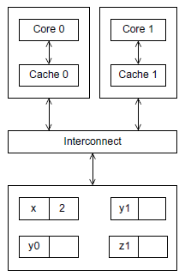
Then the memory location for y0 will eventually get the value 2, and the memory location for y1 will eventually get the value 6. However, it’s not so clear what value z1 will get. It might at first appear that since core 0 updates x to 7 before the assignment to z1, z1 will get the value 4x7 = 28. However, at time 0, x is in the cache of core 1. So unless for some reason x is evicted from core 0’s cache and then reloaded into core 1’s cache, it actually appears that the original value x = 2 may be used, and z1 will get the value 4x2 = 8.
Fig. 1.14 A shared-memory system with two cores and two caches

Slide 39
Note that this unpredictable behavior will occur regardless of whether the system is using a write-through or a write-back policy. If it’s using a write-through policy, the main memory will be updated by the assignment x = 7. However, this will have no effect on the value in the cache of core 1. If the system is using a write-back policy, the new value of x in the cache of core 0 probably won’t even be available to core 1 when it updates z1.
Clearly, this is a problem. The programmer doesn’t have direct control over when the caches are updated, so her program cannot execute these apparently innocuous statements and know what will be stored in z1.
There are several problems here, but the one we want to look at right now is that the caches we described for single processor systems provide no mechanism for insuring that when the caches of multiple processors store the same variable, an update by one processor to the cached variable is “seen” by the other processors. That is, that the cached value stored by the other processors is also updated. This is called the cache coherence problem.

Slide 40
Snooping cache coherence
There are two main approaches to insuring cache coherence: snooping cache coherence and directory-based cache coherence.
The idea behind snooping comes from bus-based systems: When the cores share a bus, any signal transmitted on the bus can be “seen” by all the cores connected to the bus. Thus, when core 0 updates the copy of x stored in its cache, if it also broadcasts this information across the bus, and if core 1 is “snooping” the bus, it will see that x has been updated and it can mark its copy of x as invalid. This is more or less how snooping cache coherence works.
A couple of points should be made regarding snooping. First, it’s not essential that the interconnect be a bus, only that it support broadcasts from each processor to all the other processors. Second, snooping works with both write-through and write back caches.
In principle, if the interconnect is shared—as with a bus—with write through caches there’s no need for additional traffic on the interconnect, since each core can simply “watch” for writes.

Slide 41
Directory-based cache coherence
Unfortunately, in large networks broadcasts are expensive, and snooping cache coherence requires a broadcast every time a variable is updated. So snooping cache coherence isn’t scalable, because for larger systems it will cause performance to degrade.
Snooping cache coherence is clearly a problem since a broadcast across the interconnect will be very slow relative to the speed of accessing local memory.
Directory-based cache coherence protocols attempt to solve this problem through the use of a data structure called a directory. The directory stores the status of each cache line. Typically, this data structure is distributed; in our example, each core/memory pair might be responsible for storing the part of the structure that specifies the status of the cache lines in its local memory.
Thus, when a line is read into, say, core 0’s cache, the directory entry corresponding to that line would be updated indicating that core 0 has a copy of the line.
When a variable is updated, the directory is consulted, and the cache controllers of the cores that have that variable’s cache line in their caches are invalidated.

Slide 43
False sharing
It’s important to remember that CPU caches are implemented in hardware, so they operate on cache lines, not individual variables. This can have disastrous consequences for performance.
As an example, suppose we want to repeatedly call a function f(i,j) and add the computed values into a vector:
int i, j, m, n;
double y[m];
/* Assign y = 0 */
. . .
for (i = 0; i < m; i++)
for (j = 0; j < n; j++)
y[i] += f(i,j);
We can parallelize this by dividing the iterations in the outer loop among the cores. If we have core count cores, we might assign the first m/core_count iterations to the first core, the next m/core_count iterations to the second core, and so on.
/*Private variables */
int i, j, iter_count;
/*Shared variables initialized by one core */
int m, n, core_count
double y[m];

Slide 44
iter_count = m/core_count
/*Core 0 does this */
for (i = 0; i < iter_count; i++)
for (j = 0; j < n; j++)
y[i] += f(i,j);
/*Core 1 does this */
for (i = iter_count+1; i < 2*iter_count; i++)
for (j = 0; j < n; j++)
y[i] += f(i,j);
. . .
Now suppose our shared-memory system has two cores, m = 8, doubles are eight bytes, cache lines are 64 bytes, and y[0] is stored at the beginning of a cache line.
A cache line can store eight doubles, and y takes one full cache line. What happens when core 0 and core 1 simultaneously execute their codes? Since all of y is stored in a single cache line, each time one of the cores executes the statement y[i] += f(i,j), the line will be invalidated, and the next time the other core tries to execute this statement it will have to fetch the updated line from memory! So if n is large, we would expect that a large percentage of the assignments y[i] += f(i,j) will access main memory—in spite of the fact that core 0 and core 1 never access each others’ elements of y. This is called false sharing, because the system is behaving as if the elements of y were being shared by the cores.

Slide 45
1.7 Performance Issues
Speedup and efficiency
Usually the best we can hope to do is to equally divide the work among the cores, while at the same time introducing no additional work for the cores. If we succeed in doing this, and we run our program with p cores, one thread or process on each core, then our parallel program will run p times faster than the serial program.
If we call the serial run-time Tserial and our parallel run-time Tparallel, then the best we can hope for is Tparallel = Tserial/p. When this happens, we say that our parallel program has linear speedup.
In practice, we’re unlikely to get linear speedup because the use of multiple processes/threads almost invariably introduces some overhead.
For example, shared memory programs will almost always have critical sections, which will require that we use some mutual exclusion mechanism such as a mutex. The calls to the mutex functions are overhead that’s not present in the serial program, and the use of the mutex forces the parallel program to serialize execution of the critical section.
Distributed-memory programs will almost always need to transmit data across the network, which is usually much slower than local memory access. Serial programs, on the other hand, won’t have these overheads. Thus, it will be very unusual for us to find that our parallel programs get linear speedup.

Slide 46


Furthermore, it’s likely that the overheads will increase as we increase the number of processes or threads, that is, more threads will probably mean more threads need to access a critical section. More processes will probably mean more data needs to be transmitted across the network.
So if we define the speedup of a parallel program to be
then linear speedup has S = p, which is unusual. Furthermore, as p increases, we expect S to become a smaller and smaller fraction of the ideal, linear speedup p. Another way of saying this is that S/p will probably get smaller and smaller as p increases. Table 1 shows an example of the changes in S and S/p as p increases. This value, S/p, is sometimes called the efficiency of the parallel program. If we substitute the formula for S, we see that the efficiency is

Slide 47


The efficiency of a parallel program is a measure of processor utilization. We
define efficiency to be speedup divided by the number of processors used:

Slide 48
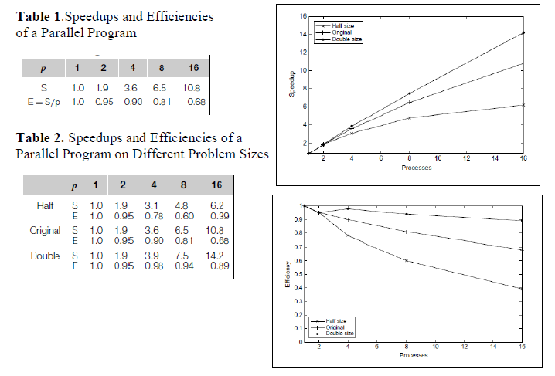

Slide 49
Amdahl’s law
Back in the 1960s, Gene Amdahl made an observation that’s become known as Amdahl’s law. It says, roughly, that unless virtually all of a serial program is parallelized, the possible speedup is going to be very limited—regardless of the number of cores available.
Suppose, for example, that we’re able to parallelize 90% of a serial program. Further suppose that the parallelization is “perfect,” that is, regardless of the number of cores p we use, the speedup of this part of the program will be p.
If the serial run-time is Tserial= 20 seconds, then the run-time of the parallelized part will be 0.9XTserial/p = 18/p and the run-time of the “unparallelized” part will be 0.1XTserial = 2. The overall parallel run-time will be
and the speedup will be

Slide 50
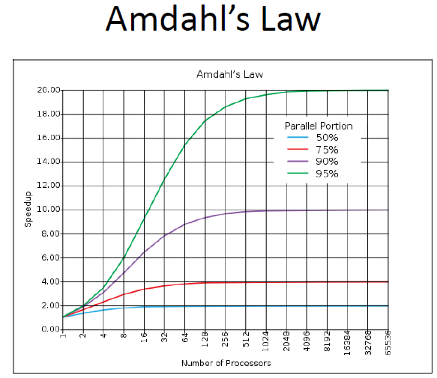

Slide 51
Now as p gets larger and larger, 0.9xTserial/p = 18/p gets closer and closer to 0, so the total parallel run-time can’t be smaller than 0.1xTserial = 2. That is, the denominator in S can’t be smaller than 0.1xTserial = 2. The fraction S must therefore be smaller than
That is, S ≤ 10. This is saying that even though we’ve done a perfect job in parallelizing 90% of the program, and even if we have, say, 1000 cores, we’ll never get a speedup better than 10.
Scalability
Roughly speaking, a technology is scalable if it can handle ever-increasing problem sizes. However, in discussions of parallel program performance, scalability has a somewhat more formal definition.
Suppose we run a parallel program with a fixed number of processes/threads and a fixed input size, and we obtain an efficiency E. Suppose we now increase the number of processes/threads that are used by the program.
If we can find a corresponding rate of increase in the problem size so that the program always has efficiency E, then the program is scalable.

Slide 52
As an example, suppose that Tserial = n, where the units of Tserial are in microseconds, and n is also the problem size. Also suppose that Tparallel = n/p+1. Then
To see if the program is scalable, we increase the number of processes/threads by a factor of k, and we want to find the factor x that we need to increase the problem size by so that E is unchanged.
The number of processes/threads will be kp and the problem size will be xn, and we want to solve the following equation for x:
Well, if x = k, there will be a common factor of k in the denominator xn+kp =
Kn+kp = k(n+p), and we can reduce the fraction to get
In other words, if we increase the problem size at the same rate that we increase the
number of processes/threads, then the efficiency will be unchanged, and our program
is scalable.

Slide 53
Taking timings
There are a lot of different approaches to find Tserial and Tparallel, and with parallel programs the details may depend on the API.
However, there are a few general observations we can make that may make things a little easier.
The first thing to note is that there are at least two different reasons for taking timings. During program development we may take timings in order to determine if the program is behaving as we intend.
Second, we’re usually not interested in the time that elapses between the program’s start and the program’s finish. We’re usually interested only in some part of the program.
Third, we’re usually not interested in “CPU time.” This is the time reported by the standard C function clock. It’s the total time the program spends in code executed as part of the program.
It would include the time for code we’ve written; Thus, when you see an article reporting the run-time of a parallel program, the reported time is usually “wall clock” time. That is, the authors of the article report the time that has elapsed between the start and finish of execution of the code that the user is interested in.

Slide 54
If the user could see the execution of the program, she would hit the start button on her stopwatch when it begins execution and hit the stop button when it stops execution. Of course, she can’t see her code executing, but she can modify the source code so that it looks something like this:
double start, finish;
. .
start=Get_current_time();
/*Code that we want to time */
. . .
finish = Get_current_time();
printf("The elapsed time = %e seconds\n", finish-start);
The function Get_current_time() is a hypothetical function that’s supposed to return the number of seconds that have elapsed since some fixed time in the past. It’s just a placeholder. The actual function that is used will depend on the API.

Slide 55
1.8 Parallel Program Design
To parallelize the serial program, we know that in general we need to divide the work among the processes/threads so that each process gets roughly the same amount of work and communication is minimized.
In most cases, we also need to arrange for the processes/threads to synchronize and communicate.
Unfortunately, there isn’t some mechanical process we can follow; if there were, we could write a program that would convert any serial program into a parallel program,
However, Ian Foster provides an outline of steps in his online book Designing and Building Parallel Programs [19]:
Partitioning. Divide the computation to be performed and the data operated on by the computation into small tasks. The focus here should be on identifying tasks that can be executed in parallel.
Communication. Determine what communication needs to be carried out among the tasks identified in the previous step.
Agglomeration or aggregation. Combine tasks and communications identified in the first step into larger tasks. For example, if task A must be executed before task B can be executed, it may make sense to aggregate them into a single composite task.
Mapping. Assign the composite tasks identified in the previous step to processes/ threads. This should be done so that communication is minimized, and each process/thread gets roughly the same amount of work.
This is sometimes called Foster’s methodology.

Slide 56
An example
Let’s look at a small example. Suppose we have a program that generates large quantities of floating point data that it stores in an array.
In order to get some feel for the distribution of the data, we can make a histogram of the data. Recall that to make a histogram, we simply divide the range of the data up into equal sized subintervals, or bins, determine the number of measurements in each bin, and plot a bar graph showing the relative sizes of the bins. As a very small example, suppose our data are
1.3, 2.9, 0.4, 0.3, 1.3, 4.4, 1.7, 0.4, 3.2, 0.3, 4.9, 2.4, 3.1, 4.4, 3.9, 0.4, 4.2, 4.5, 4.9, 0.9.
Then the data lie in the range 0–5, and if we choose to have five bins, the histogram might look something like Figure 1.15.
A serial program
It’s pretty straightforward to write a serial program that generates a histogram. We need to decide what the bins are, determine the number of measurements in each bin, and print the bars of the histogram.
Since we’re not focusing on I/O, we’ll limit ourselves to just the first two steps, so the input will be
1. the number of measurements, data_count;
2. an array of data_count floats, data;
3. the minimum value for the bin containing the smallest values, min_meas;
4. the maximum value for the bin containing the largest values, max_meas;
5. the number of bins, bin_count;

Slide 57
1.3, 2.9, 0.4, 0.3, 1.3, 4.4, 1.7, 0.4, 3.2, 0.3, 4.9, 2.4, 3.1, 4.4, 3.9, 0.4, 4.2, 4.5, 4.9, 0.9.
Fig.1.15 A histogram
The output will be an array containing the number of elements of data that lie in each bin. To make things precise, we’ll make use of the following data structures:
-bin_maxes. An array of bin_count floats
- bin_counts. An array of bin_count ints
The array bin_maxes will store the upper bound for each bin, and bin_counts will store the number of data elements in each bin. To be explicit, we can define
bin_width = (max_meas – min_meas)/bin_count
Then bin_maxes will be initialized by
for (b = 0; b < bin_count; b++)
bin_maxes[b] = min_meas + bin_width*(b+1);

Slide 58
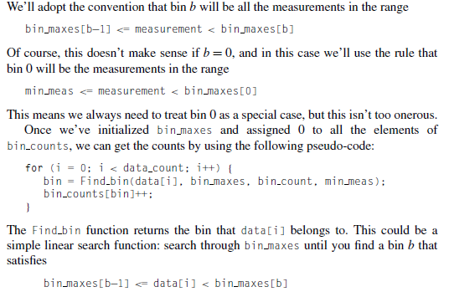

Slide 59
We’ll adopt the convention that bin b will be all the measurements in the range
bin_maxes[b-1] <= measurement < bin_maxes[b]
Of course, this doesn’t make sense if b = 0, and in this case we’ll use the rule that
bin 0 will be the measurements in the range
min_meas <= measurement < bin_maxes[0]
This means we always need to treat bin 0 as a special case, but this isn’t too onerous.
Once we’ve initialized bin_maxes and assigned 0 to all the elements of bin_counts, we can get the counts by using the following pseudo-code:
for (i = 0; i < data count; i++) {
bin = Find_bin(data[i], bin_maxes, bin_count, min_meas);
bin_counts[bin]++;
}
The Find_bin function returns the bin that data[i] belongs to. This could be a
simple linear search function: search through bin_maxes until you find a bin b that
Satisfies
bin_maxes[b-1] <= data[i] < bin_maxes[b]

Slide 60
Parallelizing the serial program
If we assume that data count is much larger than bin_count, then even if we use binary search in the Find_bin function, the vast majority of the work in this code will be in the loop that determines the values in bin_counts.
The focus of our parallelization should therefore be on this loop, and we’ll apply Foster’s methodology to it. The first thing to note is that the outcomes of the steps in Foster’s methodology are by no means uniquely determined, so you shouldn’t be surprised if at any stage you come up with something different.
For the first step we might identify two types of tasks: finding the bin to which an element of data belongs and incrementing the appropriate entry in bin_counts.
For the second step, there must be a communication between the computation of the appropriate bin and incrementing an element of bin_counts.
If we represent our tasks with ovals and communications with arrows, we’ll get a diagram that looks something like that shown in Figure 2.21. Here, the task labelled with “data[i]” is determining which bin the value data[i] belongs to, and the task labelled with “bin counts[b]++” is incrementing bin_counts[b].

Slide 61
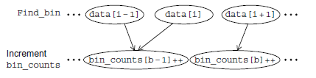
Fig. 1.16 The first two stages of Foster’s methodology
However, when we proceed to the final or mapping step, we see that if two processes or threads are assigned elements of data that belong to the same bin b, they’ll both result in execution of the statement bin_counts[b]++. If bin_counts[b] is shared (e.g., the array bin counts is stored in shared-memory), then this will result in a race condition. If bin_counts has been partitioned among the processes/threads, then updates to its elements will require communication.
An alternative is to store multiple “local” copies of bin_counts and add the values in the local copies after all the calls to Find_bin.
In this setting, we need to update our diagram so that the second collection of tasks increments loc_bin_cts[b].

Slide 62
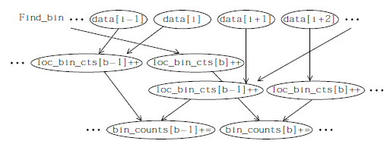
Fig. 1.17 Alternative definition of tasks and communication
Now we see that if we create an array loc_bin_cts for each process/thread, then we can map the tasks in the first two groups as follows:
Elements of data are assigned to the processes/threads so that each process/thread gets roughly the same number of elements.
Each process/thread is responsible for updating its loc_bin_cts array on the basis of its assigned elements.
To finish up, we need to add the elements loc_bin_cts[b] into bin_counts[b]. If both the number of processes/threads is small and the number of bins is small, all of the additions can be assigned to a single process/thread.

Slide 63
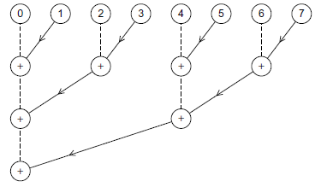
Fig. 1.18 Adding the local arrays

