Slide 1
UNIT IV
DISTRIBUTED MEMORY PROGRAMMING WITH MPI 9
MPI program execution – MPI constructs – libraries – MPI send and receive – Point-to-point and Collective communication – MPI derived datatypes – Performance evaluation

Slide 2
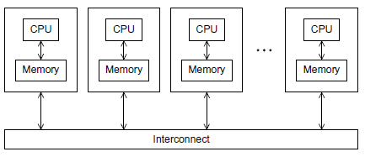
Introduction to MPI:
Recall that the world of parallel multiple instruction, multiple data, or MIMD, computers is, for the most part, divided into distributed-memory and shared-memory systems.
From a programmer’s point of view, a distributed-memory system consists of a collection of core-memory pairs connected by a network, and the memory associated with a core is directly accessible only to that core.
On the other hand, from a programmer’s point of view, a shared-memory system consists of a collection of cores connected to a globally accessible memory, in which each core can have access to any memory location.
In this unit, we’re going to start looking at how to program distributed-memory systems using message-passing.
Fig.4.1A distributed-memory system

Slide 3
Recall that in message-passing programs,a program running on one core-memory pair is usually called a process, and two processes can communicate by calling functions: one process calls a send function and the other calls a receive function.
The implementation of message-passing that we’ll be using is called MPI, which is an abbreviation of Message-Passing Interface.

Slide 4
GETTING STARTED
Perhaps the ﬁrst program that many of us saw was some variant of the “hello, world” program in Kernighan and Ritchie’s classic text [29]:
#include <stdio.h>
int main(void)
{
printf("hello, world\n");
return 0;
}
Let’s write a program similar to “hello, world” that makes some use of MPI. Instead of having each process simply print a message, we’ll designate one process to do the output, and the other processes will send it messages, which it will print.
In parallel programming, it’s common (one might say standard) for the processes to be identiﬁed by nonnegative integer ranks. So if there are p processes, the processes will have ranks 0,1,2,..., p−1. For our parallel “hello, world,” let’s make process 0 the designated process, and the other processes will send it messages. See Program 3.1.

Slide 5
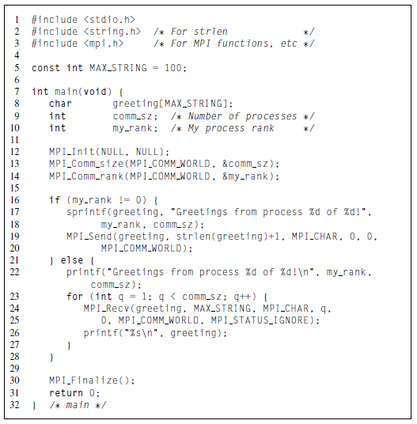
Compilation and execution

Slide 6
we’ll assume that we’re using a text editor to write the program source, and the command line to compile and run. Many systems use a command called mpicc for compilation:1
$ mpicc −o mpii_hello mpi_hello.c
Many systems also support program startup with mpiexec:
$ mpiexec −n <number of processes> ./mpi_hello
So to run the program with one process, we’d type
$ mpiexec −n 1 ./mpi_hello
and to run the program with four processes, we’d type
$ mpiexec −n 4 ./mpi_hello
With one process the program’s output would be
Greetings from process 0 of 1!
and with four processes the program’s output would be
Greetings from process 0 of 4!
Greetings from process 1 of 4!
Greetings from process 2 of 4!
Greetings from process 3 of 4!

Slide 7
MPI programs
Line 3 includes the mpi.h header ﬁle. This contains prototypes of MPI functions, macro deﬁnitions, type deﬁnitions, and so on; it contains all the deﬁnitions and declarations needed for compiling an MPI program.
The second thing to observe is that all of the identiﬁers deﬁned by MPI_ start with the string MPI . The ﬁrst letter following the underscore is capitalized for function names and MPI-deﬁned types.
MPI_Init and MPI_Finalize
In Line 12 the call to MPI_Init tells the MPI system to do all of the necessary setup. For example,it might allocate storage for message buffers, and it might decide which process gets which rank. As a rule of thumb, no other MPI functions should be called before the program calls MPI_Init. Its syntax is
int MPI_Init(
int∗ argc p ,
char∗∗∗ argv p );

Slide 8
In Line 30 the call to MPI_Finalize tells the MPI system that we’re done using MPI, and that any resources allocated for MPI can be freed. The syntax is quite simple:
int MPI_Finalize(void);
In general, no MPI functions should be called after the call to MPI Finalize.
Thus, a typical MPI program has the following basic outline:
. . . #include <mpi.h>
. . . int main(int argc, char∗ argv[])
{
. . .
/∗ No MPI calls before this ∗/
MPI_Init(&argc, &argv);
. . .
MPI_Finalize();
/∗ No MPI calls after this ∗/
. . .
return 0;
}

Slide 9
However,we’ve already seen that it’s not necessary to pass pointers to argc and argv to MPI_Init. It’s also not necessary that the calls to MPI_Init and MPI_Finalize be in main.
Communicators, MPI_Comm_size and MPI_Comm_rank
In MPI a communicator is a collection of processes that can send messages to each other. One of the purposes of MPI_Init is to deﬁne a communicator that consists of all of the processes started by the user when she started the program.
This communicator is called MPI_COMM_WORLD. The function calls in Lines 13 and 14 are getting information about MPI_COMM_WORLD.
int MPI_Comm_size( MPI_Comm comm , int∗ comm_sz_p )
int MPI_Comm_rank( MPI_Comm comm, int∗ my_rank_p);
For both functions, the ﬁrst argument is a communicator and has the special type deﬁned by MPI for communicators,
MPI_Comm. MPI_Comm_size returns in its second argument the number of processes in the communicator, and MPI_Comm_rank returns in its second argument the calling process’ rank in the communicator. We’ll often use the variable comm_sz for the number of processes in MPI_COMM_WORLD, and the variable my_rank for the process rank.

Slide 10


Slide 11
SPMD programs
Notice that we compiled a single program—we didn’t compile a different program for each process—and we did this inspite of the fact that process 0 is doing something fundamentally different from the other processes: it’s receiving a series of messages and printing them, while each of the other processes is creating and sending a message.
Recall that this approach to parallel programming is called single program, multiple data,or SPMD.The if−else statemet in Lines16 through 28 makes our program SPMD.

Slide 12
Communication
In Lines 17 and 18, each process, other than process 0, creates a message it will send to process 0. (The function sprintf is very similar to printf, except that instead of writing to stdout, it writes to a string.)
Lines 19–20 actually send the message to process 0. Process 0, on the other hand, simply prints its message using printf, and then uses a for loop to receive and print the messages sent by processes 1,2,...,comm sz−1.
Lines 24–25 receive the message sent by process q, for q=1,2,...,comm sz−1.
MPI_Send
The sends executed by processes 1,2,...,comm sz−1 are fairly complex, so let’s take a closer look at them. Each of the sends is carried out by a call to MPI Send, whose syntax is
int MPI_Send( void∗ msg_buf_p ,
int msg_size ,
MPI_Datatype msg_type ,
int dest ,
int tag ,
MPI_Comm communicator );

Slide 13
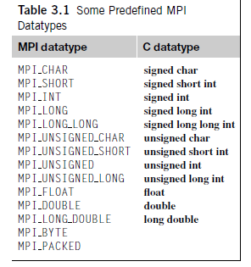
MPI_Recv
The ﬁrst six arguments to MPI Recv correspond to the ﬁrst six arguments of MPI Send:
int MPI_Recv( void∗ msg_buf_p ,
int buf_size ,
MPI_Datatype buf_type,
int source ,
int tag ,
MPI_Comm communicator ,
MPI_Status∗ status p );

Slide 14
Message matching
Suppose process q calls MPI_Send with
MPI_Send(send_buf_p, send_buf_sz, send_type, dest, send_tag, send_comm);
Also suppose that process r calls MPI_Recv with
MPI_Recv(recv_buf_p, recv_buf_sz, recv_type, src, recv_tag, recv_comm, &status);
Then the message sent by q with the above call to MPI Send can be received by r with the call to MPI _Recv if
recv_comm = send_comm,
recv_tag = send_tag,
dest = r, and
src = q.

Slide 15
These conditions aren’t quite enough for the message to be successfully received, however.
The parameters speciﬁed by the ﬁrst three pairs of arguments, send_buf_p/recv_buf_p, send_buf_sz/recv_buf_sz, and send_type/recv_type, must specify compatible buffers.
For detailed rules, see the MPI-1 speciﬁcation [39]. Most of the time, the following rule will sufﬁce: . If recv_type = send_type and recv_buf_sz ≥ send_buf_sz, then the message sent by q can be successfully received by r.
for (i = 1; i < comm sz; i++)
{
MPI_Recv(result, result_sz, result_type, MPI_ANY_SOURCE, result_tag, comm, MPI_STATUS_IGNORE);
Process_result(result);
}

Slide 16
The status_p argument
If you think about these rules for a minute, you’ll notice that a receiver can receive a message without knowing
the amount of data in the message,
the sender of the message, or
the tag of the message.
So how can the receiver ﬁnd out these values? Recall that the last argument to MPI_Recv has type MPI_Status∗. The MPI type MPI_Status is a struct with at least the three members MPI_SOURCE, MPI_TAG, and MPI_ERROR. Suppose our program contains the deﬁnition
MPI_Status status;
Then, after a call to MPI_Recv in which &status is passed as the last argument, we can determine the sender and tag by examining the two members
status.MPI_SOURCE
status.MPI_TAG

Slide 17

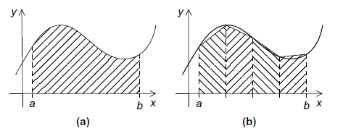
THE TRAPEZOIDAL RULE IN MPI
Printing messages from processes is all well and good, but we’re probably not taking the trouble to learn to write MPI programs just to print messages. Let’s take a look at a somewhat more useful program—let’s write a program that implements the trapezoidal rule for numerical integration.
The trapezoidal rule
Recall that we can use the trapezoidal rule to approximate the area between the graph of a function, y=f(x), two vertical lines, and the x-axis. See Figure 3.3. The basic idea is to divide the interval on the x-axis into n equal subintervals.
The trapezoidal rule: (a) area to be estimated and (b) approximate area using trapezoids

Slide 18
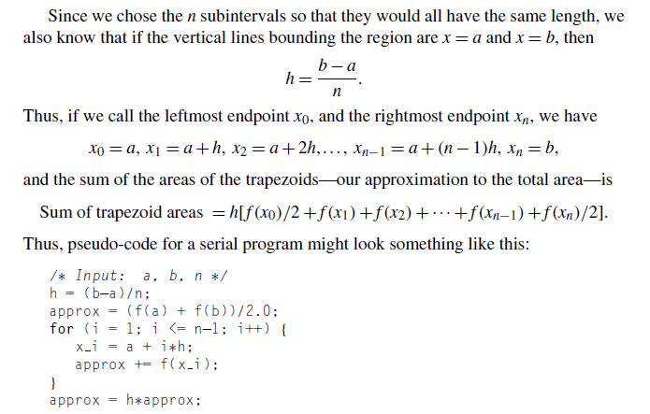

Slide 19
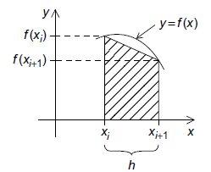
Fig. One trapezoid
Parallelizing the trapezoidal rule
Recall that we can design a parallel program using four basic steps:
Partition the problem solution into tasks.
Identify the communication channels between the tasks.
Aggregate the tasks into composite tasks.
Map the composite tasks to cores.

Slide 20
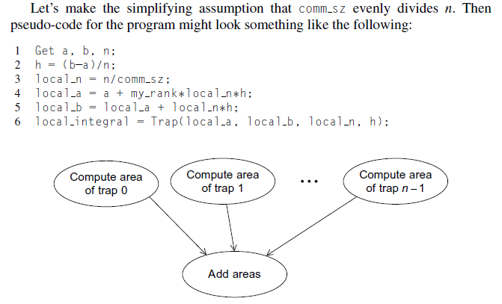
Fig. Tasks and communications for the trapezoidal rule

Slide 21
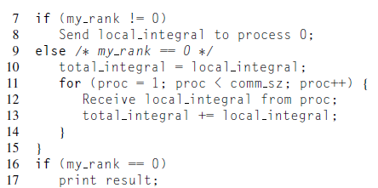

Slide 22
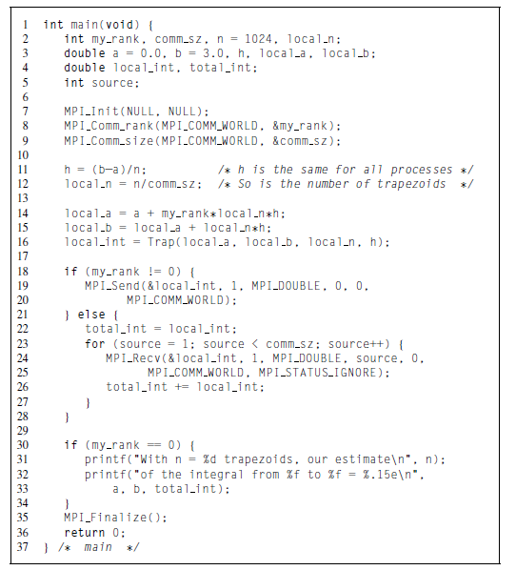

Slide 23
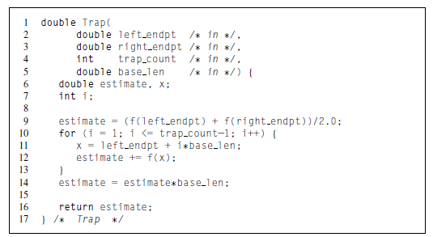

Slide 24
COLLECTIVE COMMUNICATION
One of the most obvious is that the “global sum” after each process has computed its part of the integral.
If we hire eight workers to, say, build a house, we might feel that we weren’t getting our money’s worth if seven of the workers told the ﬁrst what to do, and then the seven collected their pay and went home.
But this is very similar to what we’re doing in our global sum. Each process with rank greater than 0 is “telling process 0 what to do” and then quitting.

Slide 25
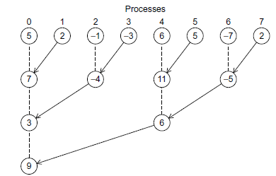
Tree-structured communication
As we already saw in Unit 1 we might use a “binary tree structure” like that illustrated in Figure 3.6. In this diagram, initially students or processes 1, 3, 5, and 7 send their values to processes 0, 2, 4, and 6, respectively.
Then processes 0, 2, 4, and 6 add the received values to their original values, and the process is repeated twice:
1. a. Processes 2 and 6 send their new values to processes 0 and 4, respectively.
b. Processes 0 and 4 add the received values into their new values.
2. a. Process 4 sends its newest value to process 0.
b. Process 0 adds the received value to its newest value.
Fig. A tree-structured global sum

Slide 26
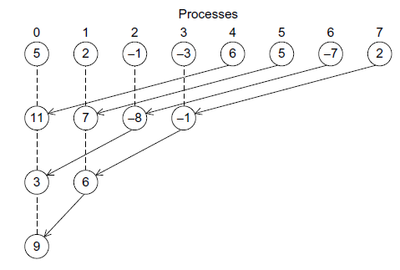
Fig.An alternative tree-structured global sum

Slide 27
MPI_Reduce
Now, a “global-sum function” will obviously require communication. However, unlike the MPI_Send-MPI_Recv pair, the global-sum function may involve more than two processes.
Infact,in our trapezoidal rule program it will involve all the processes in MPI_COMM_WORLD. In MPI parlance, communication functions that involve all the processes in a communicator are called collective communications.
To distinguish between collective communications and functions such as MPI_Send and MPI_Recv, MPI_Send and MPI_Recv are often called point-to-point communications.
In fact, global sum is just a special case of an entire class of collective communications.For example,it might happen that instead of ﬁnding the sum of a collection of comm_sz numbers distributed among the processes.
MPI generalized the global-sum function so that any one of these possibilities can be implemented with a single function:

Slide 28
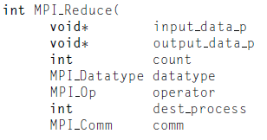
)
The key to the generalization is the ﬁfth argument, operator. It has type MPI_Op, which is a predeﬁned MPI type like MPI Data type and MPI_Comm.There are a number of predeﬁned values in this type. See Table 3.2. It’s also possible to deﬁne your own operators; for details, see the MPI-1 Standard [39].
The operator we want is MPI_SUM.Using this value for the operator argument,we can replace the code in Lines 18 through 28 of Program 3.2 with the single function call
MPI Reduce(&local int, &total int, 1, MPI_DOUBLE, MPI_SUM, 0, MPI_COMM_WORLD);

Slide 29
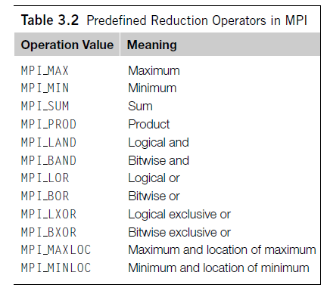

Slide 30
Collective vs. point-to-point communications
It’s important to remember that collective communications differ in several ways
from point-to-point communications:
All the processes in the communicator must call the same collective function. For example, a program that attempts to match a call to MPI_Reduce on one process with a call to MPI_Recv on another process is erroneous, and, in all likelihood, the program will hang or crash.
The arguments passed by each process to an MPI collective communication must be “compatible.” For example, if one process passes in 0 as the dest_process and another passes in 1, then the outcome of a call to MPI_Reduce is erroneous, and, once again, the program is likely to hang or crash.
The output_data_p argument is only used on dest process. However, all of the processes still need to pass in an actual argument corresponding to output_data _p, even if it’s just NULL.
Point-to-point communications are matched on the basis of tags and communicators. Collective communications don’t use tags, so they’re matched solely on the basis of the communicator and the order in which they’re called.

Slide 31
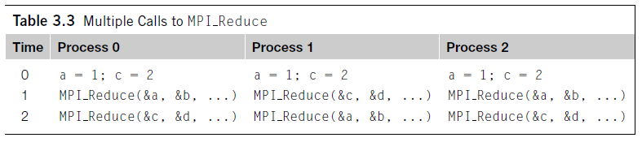
The order of the calls will determine the matching, so the value stored in b will be 1+2+1=4, and the value stored in d will be 2+1+2=5.

Slide 32
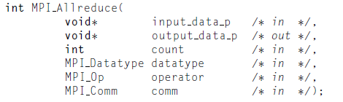
MPI_Allreduce
In our trapezoidal rule program, we just print the result, so it’s perfectly natural for only one process to get the result of the global sum. However, it’s not difﬁcult to imagine a situation in which all of the processes need the result of a global sum in order to complete some larger computation.
In this situation, we encounter some of the same problems we encountered with our original global sum. For example, if we use a tree to compute a global sum, we might “reverse” the branches to distribute the global sum (see Figure 3.8).
Alternatively, we might have the processes exchange partial results instead of using one-way communications. Such a communication pattern is sometimes called a butterﬂy.
The argument list is identical to that for MPI_Reduce except that there is no dest_process since all the processes should get the result.

Slide 33
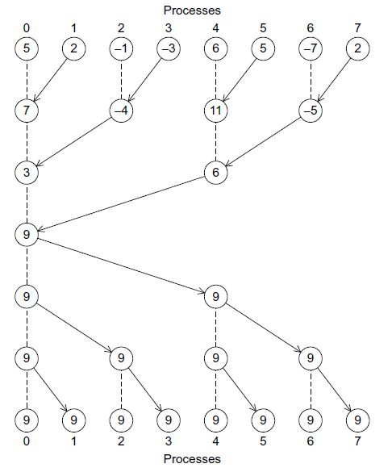
Fig. A global sum followed by distribution of the result

Slide 34
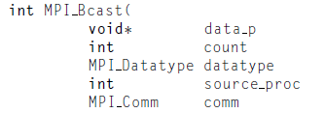
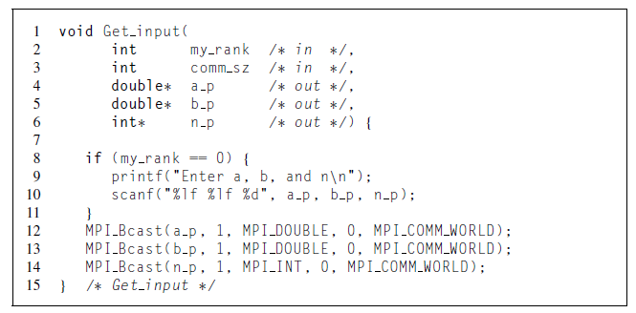
Broadcast
A collective communication in which data belonging to a single process is sent to all of the processes in the communicator is called a broadcast, and you’ve probably guessed that MPI provides a broadcast function:
)

Slide 35
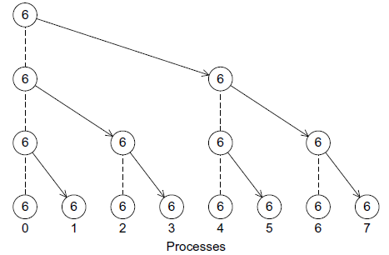

Slide 36
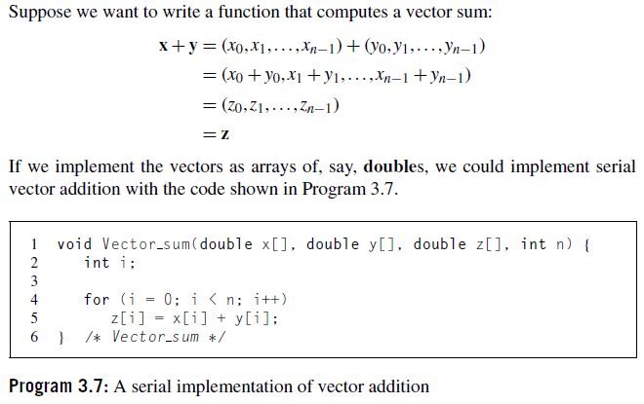
Data distributions

Slide 37
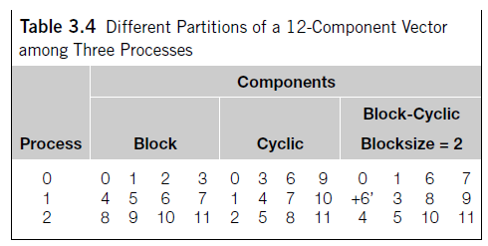
Scatter
We might try something similar with the vectors: process 0 could read them in and broadcast them to the other processes. However, this could be very wasteful. If there are 10 processes and the vectors have 10,000 components, then each process will need to allocate storage for vectors with 10,000 components, when it is only operating on subvectors with 1000 components. If, for example, we use a block distribution, it would be better if process 0 sent only components 1000 to 1999 to process 1, components 2000 to 2999 to process 2, and so on. Using this approach, processes 1 to 9 would only need to allocate storage for the components they’re actually using.

Slide 38
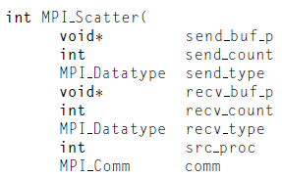
Thus, we might try writing a function that reads in an entire vector that is on process 0 but only sends the needed components to each of the other processes. For the communication MPI provides just such a function:
)

Slide 39
If the communicator comm contains comm_sz processes, then MPI Scatter divides the data referenced by send_buf_p into comm_sz pieces—the first piece goes to process0, the second to process 1, the third to process 2, and so on.
For example, suppose we’re using a block distribution and process 0 has read in all of an n-component vector into Send_buf_p. Then, process 0 will get the first local_n =n/comm_sz components, process 1 will get the next local n components, and so on.
Each process should pass its local vector as the recv_buf_p argument and the recv_count argument should be local n. Both send_type and recv_type should be MPI_DOUBLE and src_proc should be 0.
Perhaps surprisingly, send_count should also be local_n—send_count is the amount of data going to each process; it’s not the amount of data in the memory referred to by send_buf_p.

Slide 40
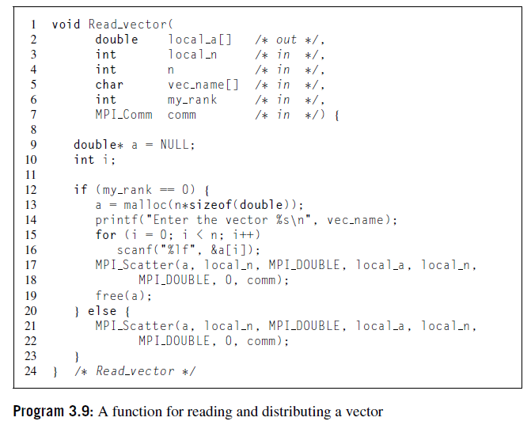

Slide 41
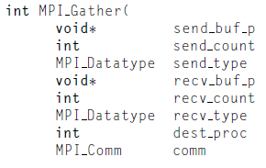
Gather
Of course, our test program will be useless unless we can see the result of our vector addition, so we need to write a function for printing out a distributed vector. Our function can collect all of the components of the vector onto process 0, and then process 0 can print all of the components. The communication in this function can be carried out by MPI Gather,
)
Thedata stored in the memory referred to by send_buf_p on process 0 is stored in the ﬁrst block in recv_buf_p, the data stored in the memory referred to by send_buf_p on process 1 is stored in the second block referred to by recv_buf_p, and so on. So, if we’re using a block distribution, we can implement our distributed vector print function as shown in Program 3.10. Note that recv_count is the number of data items received from each process, not the total number of data items received.

Slide 42
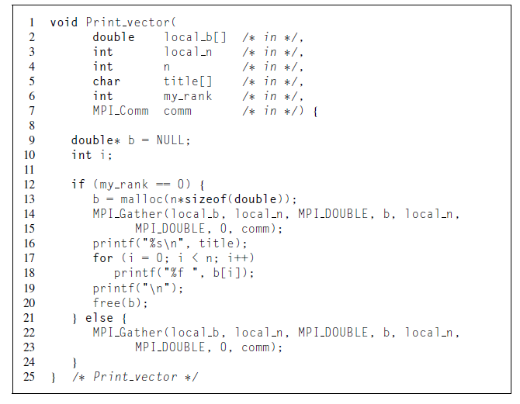

Slide 43
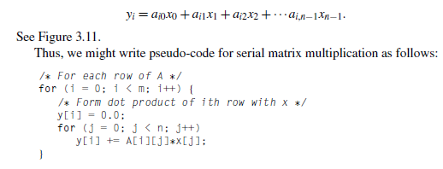
Allgather
As a ﬁnal example, let’s look at how we might write an MPI function that multiplies a matrix by a vector. Recall that if A=(aij) is an m×n matrix and x is a vector with n components, then y=Ax is a vector with m components and we can ﬁnd the ith component of y by forming the dot product of the ith row of A with x:

Slide 44
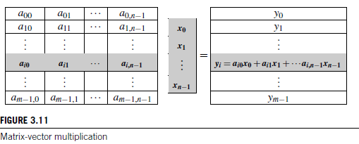
In fact, this could be actual C code. However, there are some peculiarities in the way that C programs deal with two-dimensional arrays (see Exercise 3.14), so C programmers frequently use one-dimensional arrays to “simulate” two-dimensional arrays. The most common way to do this is to list the rows one after another.

Slide 45
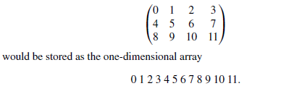
For example, the two-dimensional array
In this example,if we start counting rows and columns from 0,then the element stored in row 2 and column 1 in the two-dimensional array (the 9), is located in position 2×4+1=9 in the one-dimensional array. More generally, if our array has n columns, when we use this scheme, we see that the element stored in row i and column j is located in position i×n+j in the one-dimensional array.
Now let’s see how we might parallelize this function. An individual task can be the multiplication of an element of A by a component of x and the addition of this product into a component of y. That is, each execution of the statement
y[i] += A[i∗n+j]∗x[j];

Slide 46
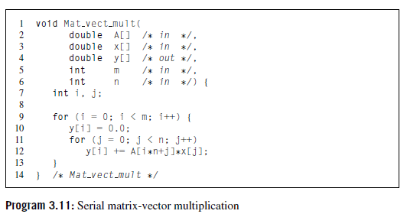

Slide 47
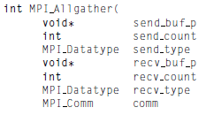
So if x has a block distribution, how can we arrange that each process has access to all the components of x before we execute the following loop?
for (j = 0; j < n; j++)
y[i] += A[i∗n+j]∗x[j];
Using the collective communications we’re already familiar with, we could execute a call to MPI_Gather followed by a call to MPI_Bcast. This would, in all likelihood, involve two tree-structured communications, and we may be able to do better by using a butterﬂy. So, once again, MPI provides a single function:
)
This function concatenates the contents of each process’ send_buf_p and stores this in each process’ recv_buf_p. As usual, recv_count is the amount of data being received from each process, so in most cases, recv count will be the same as send count.

Slide 48
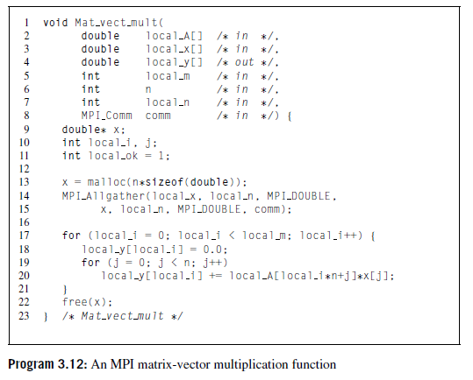

Slide 49

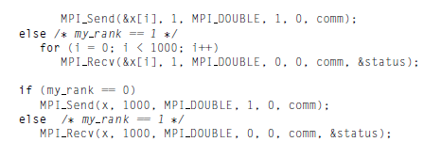
MPI DERIVED DATATYPES
In virtually all distributed-memory systems, communication can be much more expensive than local computation. For example, sending a double from one node to another will take far longer than adding two doubles stored in the local memory of a node.
In fact, on one of our systems, the code with the loops of sends and receives takes nearly 50 times longer. On another system, the code with the loops takes more than 100timeslonger.

Slide 50
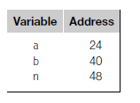
In MPI, a derived datatype can be used to represent any collection of data items in memory by storing both the types of the items and their relative locations in memory. The idea here is that if a function that sends data knows the types and the relative locations in memory of a collection of data items,it can collect the items from memory before they are sent.
As an example, in our trapezoidal rule program we needed to call MPI_Bcast three times: once for the left endpoint a, once for the right endpoint b, and once for the number of trapezoids n. As an alternative, we could build a single derived datatype that consists of two doubles and one int. If we do this, we’ll only need one call to MPI_Bcast. On process 0, a,b, and n will be sent with the one call, while on the other processes, the values will be received with the call.
Formally, a derived datatype consists of a sequence of basic MPI datatypes together with a displacement for each of the datatypes. In our trapezoidal rule example,suppose that on process0 the variables a,b,and n are stored in memory locations with the following addresses:

Slide 51
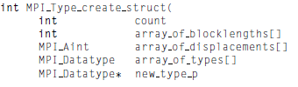
Then the following derived datatype could represent these data items:
{(MPI_DOUBLE,0),(MPI_DOUBLE,16),(MPI_INT,24)}.
The ﬁrst element of each pair corresponds to the type of the data, and the second element of each pair is the displacement of the data element from the beginning of the type. We’ve assumed that the type begins with a, so it has displacement 0, and the other elements have displacements measured, in bytes, from a: b is 40−24=16 bytes beyond the start of a, and n is 48−24=24 bytes beyond the start of a. We can use MPI_Type_create_struct to build a derived datatype that consists of individual elements that have different basic types:
_) ) )

Slide 52
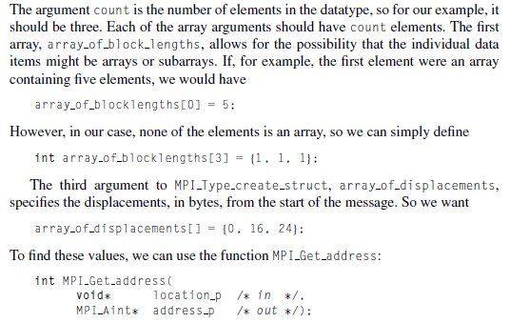

Slide 53
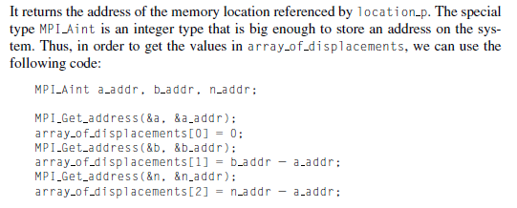

Slide 54
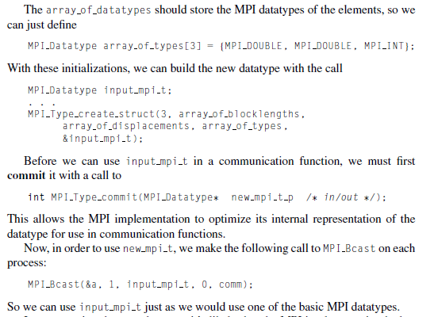

Slide 55
PERFORMANCE EVALUATION OF MPI PROGRAMS
Let’s take a look at the performance of the matrix-vector multiplication program. For the most part we write parallel programs because we expect that they’ll be faster than a serial program that solves the same problem.
Taking timings
We’re usually not interested in the time taken from the start of program execution to the end of program execution. For example, in the matrix-vector multiplication, we’re not interested in the time it takes to type in the matrix or print out the product.
We’re only interested in the time it takes to do the actual multiplication, so we need to modify our source code by adding in calls to a function that will tell us the amount of time that elapses from the beginning to the end of the actual matrix-vector multiplication.
MPI provides a function, MPI_Wtime, that returns the number of seconds that have elapsed since some time in the past:
double MPI_Wtime(void);

Slide 56

Thus, we can time a block of MPI code as follows:
double start, finish;
. . .
start = MPI_Wtime();
/ Code to be timed /
. . .
finish = MPI_Wtime();
printf("Proc %d > Elapsed time = %e seconds\n“ my_rank, finish - start);
In order to time serial code, it’s not necessary to link in the MPI libraries. There’s a C macro GET_TIME defined in the header file timer.h that can be downloaded from the book’s website. This macro should be called with a double argument:

Slide 57
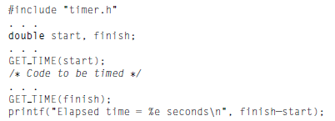
After executing this macro, now will store the number of seconds since some time in
the past. We can get the elapsed time of serial code with microsecond resolution by
Executing
A final note in this connection: Since timer.h is not in the system include file directory, it’s necessary to tell the compiler where to find it if it’s not in the directory where you’re compiling. For example, if it’s in the directory /home/peter/my_include, the following command can be used to compile a serial program that uses GET TIME:

Slide 58
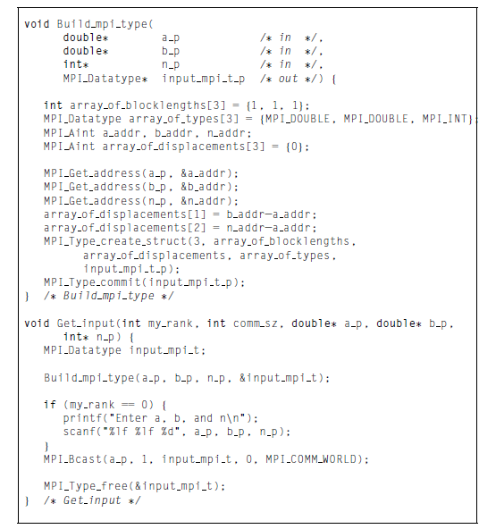

Slide 59
Both MPI_Wtime and GET_TIME return wall clock time.
There are still a few remaining issues. First, as we’ve described it, our parallel program will report comm_sz times, one for each process. We would like to have it report a single time.
Ideally, all of the processes would start execution of the matrix_vector multiplication at the same time, and then, we would report the time that elapsed when the last process finished.
In other words, the parallel execution time would be the time it took the “slowest” process to finish.We can’t get exactly this time because we can’t insure that all the processes start at the same instant.
The MPI collective communication function MPI_Barrier insures that no process will return from calling it until every process in the communicator has started calling it. It’s syntax is
int MPI_Barrier(MPI_Comm comm );

Slide 60
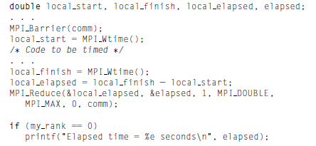
The following code can be used to time a block of MPI code and report a single
elapsed time:
Note that the call to MPI_Reduce is using the MPI_MAX operator; it finds the largest of
the input arguments local elapsed.

Slide 61
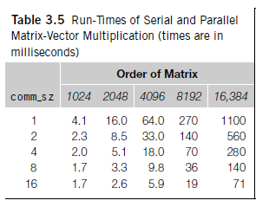
Results
The results of timing the matrix-vector multiplication program are shown in
Table 3.5. The input matrices were square. The times shown are in milliseconds, and we’ve rounded each time to two significant digits.

Slide 62


