Slide 1
UNIT V
PARALLEL PROGRAM DEVELOPMENT
Case studies - n-Body solvers – Tree Search – OpenMP and MPI implementations and comparison.

Slide 2
Introduction
In this unit we’ll look at a couple of larger examples: solving n-body problems and solving the traveling salesperson problem.
For each problem, we’ll start by looking at a serial solution and examining modiﬁcations to the serial solution. As we apply Foster’s methodology, we’ll see that there are some striking similarities between developing shared- and distributed-memory programs.

Slide 3
n-BODY SOLVERS
In an n-body problem, we need to ﬁnd the positions and velocities of a collection of interacting particles over a period of time.
For example, an astrophysicist might want to know the positions and velocities of a collection of stars, while a chemist might want to know the positions and velocities of a collection of molecules or atoms.
An n-body solver is a program that ﬁnds the solution to an n-body problem by simulating the behavior of the particles. The input to the problem is the mass, position, and velocity of each particle at the start of the simulation, and the output is typically the position and velocity of each particle at a sequence of user-speciﬁed times, or simply the position and velocity of each particle at the end of a user-speciﬁed time period.

Slide 4

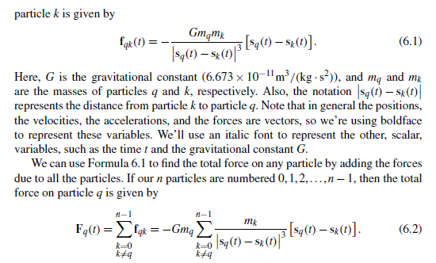
The problem

Slide 5
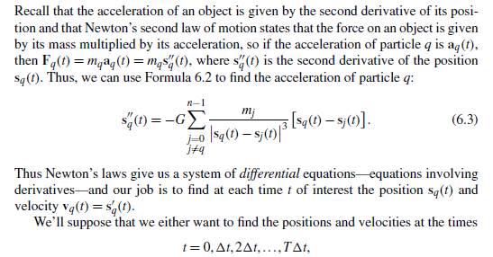
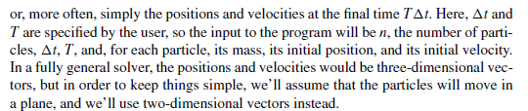

Slide 6
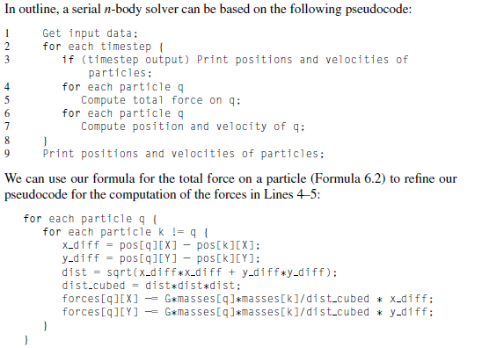
Two serial programs

Slide 7
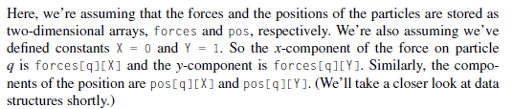
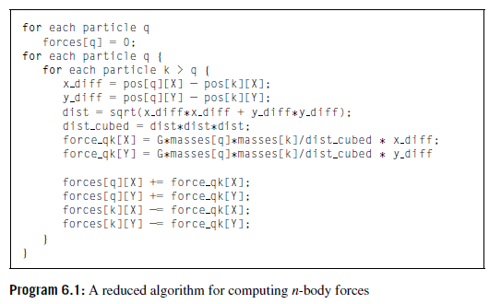

Slide 8

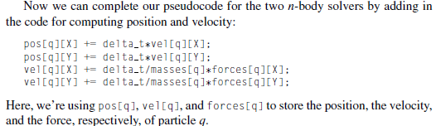

Slide 9
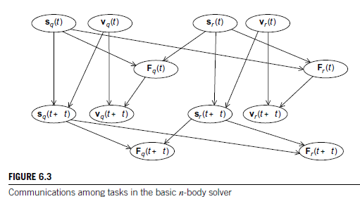
Parallelizing the n-body solver

Slide 10
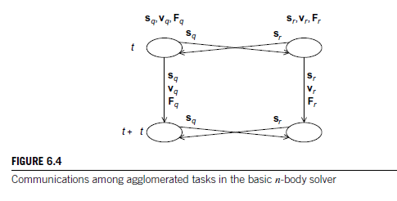

Slide 11
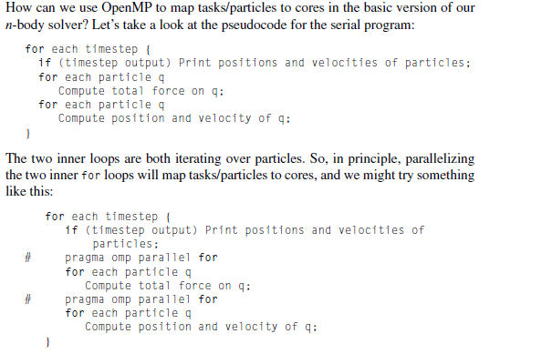
Parallelizing the basic solver using OpenMP

Slide 12
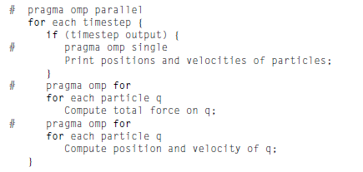

Slide 13
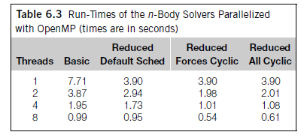

Slide 14
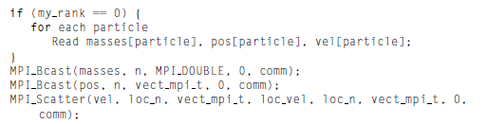
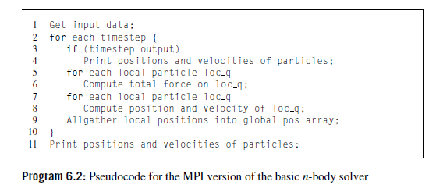
Parallelizing the reduced solver using MPI

Slide 15
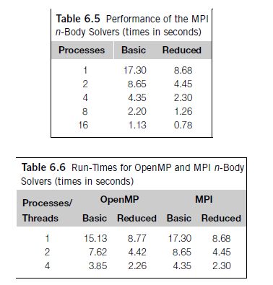
Performance of the MPI solver

Slide 16
TREE SEARCH
Many problems can be solved using a tree search. As a simple example, consider the traveling salesperson problem, or TSP.
In TSP, a salesperson is given a list of cities she needs to visit and a cost for traveling between each pair of cities. Her problem is to visit each city once, returning to her hometown, and she must do this with the least possible cost.
A route that starts in her hometown, visits each city once and returns to her hometown is called a tour; thus, the TSP is to ﬁnd a minimum-cost tour.
The number of possible solutions to TSP grows exponentially as the number of cities is increased. For example, if we add one additional city to an n-city problem, we’ll increase the number of possible solutions by a factor of n−1.
Thus, although there are only six possible solutions to a four-city problem, there are 4×6=24 to a ﬁve-city problem, 5×24=120 to a six-city problem, 6×120=720 to a seven-city problem, and so on.

Slide 17
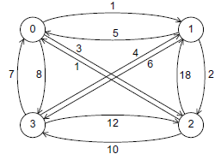
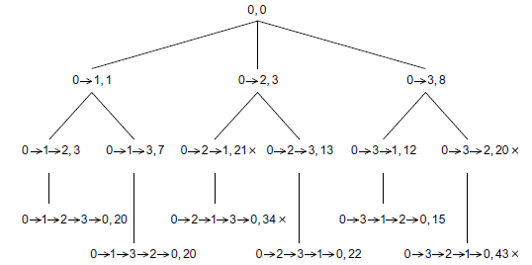
Fig. A four-city TSP
Search tree for four-city TSP

Slide 18
If we choose vertex 0 as the salesperson’s home city, then the initial partial tour consists only of vertex 0, and since we’ve gone nowhere, it’s cost is 0. Thus, the root of the tree in Figure 6.10 has the partial tour consisting only of the vertex 0 with cost 0. From 0 we can ﬁrst visit 1, 2, or 3, giving us three two-city partial tours with costs 1, 3, and 8, respectively.
In Figure 6.10 this gives us three children of the root. Continuing, we get six three-city partial tours, and since there are only four cities, once we’ve chosen three of the cities, we know what the complete tour is. Now, to ﬁnd a least-cost tour, we should search the tree.
There are many ways to do this, but one of the most commonly used is called depth-ﬁrst search. In depthﬁrst search, we probe as deeply as we can into the tree.

Slide 19
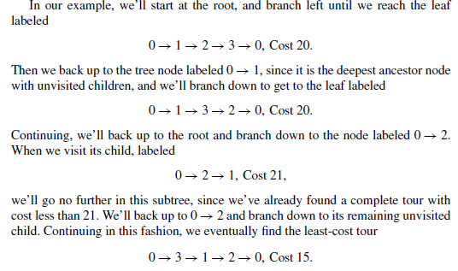

Slide 20
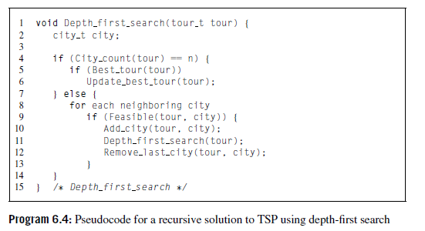
Recursive depth-ﬁrst search
The algorithm makes use of several global variables:.
n: the total number of cities in the problem.
digraph: a data structure representing the input digraph.
hometown: a data structure representing vertex or city 0, the salesperson’s hometown.
best_tour: a data structure representing the best tour so far

Slide 21
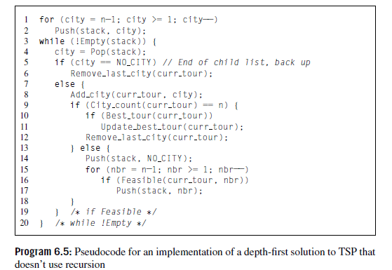
Nonrecursive depth-ﬁrst search

Slide 22
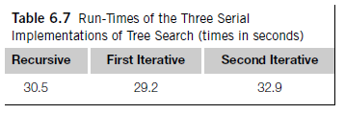

Slide 23
