Slide 1
Mobile Communications
Chapter 3 : Media Access
Types of TDM
Fixed TDMA
Demand Oriented TDMA
Fixed TDM:
This is the simplest algorithm for using TDM.
Here time slots are allocated for channels in the fixed pattern.
Hence the result is fixed bandwidth.
Now external synchronization needed.
Each mobile must know its turn hence no interference will occur.
The pattern is to be assigned by the base stations.
This environment suits well
1) When the band width is fixed.
When the system needs fixed delay.
Constant data rate.- The frequency is same.
Assigning the different slots uplink and downlink with the same frequencyis called as Time Division Multiplex.
Motivation
SDMA, FDMA, TDMA
Aloha, reservation schemes
Collision avoidance, MACA
Polling
CDMA, SAMA
Comparison

Slide 2
Medium Access Control(MAC)
MAC comprrises all the mechanisms that requlate user access to medium using SDM,TDM,FDM,CDM
MAC are needed in wireless because of hidden and exposed terminals or near and far terminals.
One scheme is not purely used in a system but mix of schemes are used in reality.
Example CSMA/CD
  Carrier Sense Multiple Access with Collision Detection
  - A sender senses the medium to see if it is free.
  If the medium is busy the sender waits until the medium is free.
  If found free starts transmitting the data and continous to listen the medium.
  If the sender detects any collision, it stop transmission immediately and sends jamming collisions in the sender side but considers only at the receiver end.
  This is not a problem with wired because the same signal strength is assumed to be present all over the wire.
  If collisions occeu in the wire,it can noticed by all.
Problems in wireless networks
  signal strength decreases proportional to the square of the distance
  the sender would apply CS and CD, but the collisions happen at the receiver
  it might be the case that a sender cannot “hear” the collision, i.e., CD does not work
  furthermore, CS might not work if, e.g., a terminal is “hidden
  More details on why MAC of fired networks fail in wireless scenario
  The fixed MAC when used on wireless faces the following:
  Hidden and exposed terminals 2) Near and far terminals

Slide 3

Motivation - hidden and exposed terminals
Consider 3 Mobile phases as in the figure in next page.
Hidden terminals
  The Transmission range of “A” reaches “B” but not “C”
  The Transmission range of “C” reaches “B” but not “A”
  Transmission range of “B”,reaches “A” and “C”
  “A” starts sending to “B”, and ”C” does not receive this transmission.
  “C” also wants to send to “B” and senses the medium is free “C” also starts sending message to “B” hence resulting in a collision at “B”
  “A” cannot detect the collision at “B” and still continues to send message.
  “A” is hidden for “C”
Exposed terminals
  B sends Message to A, C wants to send a message to some other mobile which is outside the reference of A and B.
  C senses that the medium is busy hence it postpones the transmission until it detects the medium is idle.
  but A is outside the radio range of C, therefore waiting is not necessary
  C is “exposed” to B
A
B
C

Slide 4
Motivation - near and far terminals
Terminals A and B send, C receives
  signal strength decreases proportional to the square of the distance
  the signal of terminal B therefore drowns out A’s signal
  C cannot receive A
The near/far effect is a serve problem of a wireless using CDM.
If C for example was an arbiter for sending rights, terminal B would drown out terminal A already on the physical layer
Also severe problem for CDMA-networks - precise power control needed!
A
B
C

Slide 5
Access methods SDMA/FDMA/TDMA
SDMA (Space Division Multiple Access)
SDMA is used for allocating separated space to users of wireless n/w.
Application is assigning an optimal base station to a mobile phone.
MAC algorithm decides which base station is best taking into consideration FDM,TDM,CDM.
SDMA is never used is isolation but used with one or more schemes.
The SDMA algorithm works on cells and sector zed antenna which form the infrastructure.
FDMA (Frequency Division Multiple Access)
FDMA stands for frequency division multiple access.
Contain algorithm allocating frequencies to transmission channels according to FDM.
Allocation can be fixed or dynamic.
Channels can be assigned to the write Fixed/Dynamic frequency at all times pure FDMA or FDMA with TDMA is the fixed allocation. The vice versa is dynamic.
Sender and receiver need to agree on a hopping pattern otherwise receiver could not tune to the right frequency.
Hopping patterns are fixed at least for a longer period.
FDM is used for simultaneous access to the medium by base station and mobile station cellular networks.
The two partners establish a duplex channel (i.e) a channel that allows transmission in both directions.
The two directions, mobile station to base station and vice versa are separated using different frequencies.
This scheme is called frequency division duplex.
The both partners need to have to know the frequencies in advance.
The two frequencies are also known as uplink and downlink.
The uplink is from mobile station to base station or ground control to satellite.
The downlink is from base station to mobile station or from satellite to ground control.
Notes:
Prof. Dr. Dr. h.c. G. Krüger
E. Dorner / Dr. J. Schiller
Universität Karlsruhe
Institut für Telematik
Mobilkommunikation
SS 1998
15

Slide 6
FDD/FDMA - general scheme, example GSM
960 MHz
124
f
935.2 MHz
1
200 kHz
20 MHz
915 MHz
124
890.2 MHz
1
t
TDMA (Time Division Multiple Access):
TDMA stands for time division multiplex access.
TDMA offers flexible scheme, allocates time slots for communication which controlled by TDM.
The receiver need not tune the frequency, can stay at the same frequency.
Uses only one frequency, many algorithms exist to control the medium access.
Here the system listens to many channels separated in time at the same frequency.
Synchronization b/w the sender and receiver needs to be achieved.
To do the synchronization the channel is allocated a fixed time slot (or) by using dynamic allocation scheme.

Slide 7
TDD/TDMA - general scheme, example DECT
For dynamic allocation identification of each transmission is necessary.
MAC address is used as identification, but inflexible.
This identification makes the receiver identify when any message is inteded for it.
Fixed schemes do not need an identificatio,but inflexible.
-
417 µs
1
2
3
11
12
1
2
3
11
12
downlink
uplink
t

Slide 8
Aloha/slotted aloha
Here the TDMA is applied without controlling the acess.
Each station can access the medium without a central arbitrer controlling the access and without co-ordination.
If two or more stations access the medium at the same time collision occurs and the data transmitted is too destroyed.
Aloha is neither co-ordinated nor resolves contention.
Can be used under light load.
Slotted Aloha
collision
sender A
sender B
sender C
t
collision
sender A
sender B
sender C
t

Slide 9
DAMA - Demand Assigned Multiple Access
Channel efficiency only 18% for Aloha, 36% for Slotted Aloha (assuming Poisson distribution for packet arrival and packet length)
Reservation can increase efficiency to 80%
  a sender reserves a future time-slot
  sending within this reserved time-slot is possible without collision
  reservation also causes higher delays
  typical scheme for satellite links
Examples for reservation algorithms:
  Explicit Reservation according to Roberts (Reservation-ALOHA)
  Implicit Reservation (PRMA)
  Reservation-TDMA

Slide 10
Access method DAMA: Explicit Reservation
Explicit Reservation (Reservation Aloha):
  two modes:
    ALOHA mode for reservation:
    competition for small reservation slots, collisions possible
    reserved mode for data transmission within successful reserved slots (no collisions possible)
  it is important for all stations to keep the reservation list consistent at any point in time and, therefore, all stations have to synchronize from time to time
collision
t
Aloha
reserved
Aloha
reserved
Aloha
reserved
Aloha
Notes:
Prof. Dr. Dr. h.c. G. Krüger
E. Dorner / Dr. J. Schiller
Universität Karlsruhe
Institut für Telematik
Mobilkommunikation
SS 1998
24

Slide 11
Access method DAMA: PRMA
Implicit reservation (PRMA - Packet Reservation MA):
  a certain number of slots form a frame, frames are repeated
  stations compete for empty slots according to the slotted aloha principle
  once a station reserves a slot successfully, this slot is automatically assigned to this station in all following frames as long as the station has data to send
  competition for this slots starts again as soon as the slot was empty in the last frame
reservation
1
2
3
4
5
6
7
8
time-slot
ACDABA-F
frame₁
A
C
D
A
B
A
F
ACDABA-F
frame₂
A
C
A
B
A
AC-ABAF-
frame₃
A
B
A
F
collision at
reservation
attempts
A---BAFD
frame₄
A
B
A
F
D
ACEEBAFD
frame₅
A
C
E
E
B
A
F
D
t
Notes:
Prof. Dr. Dr. h.c. G. Krüger
E. Dorner / Dr. J. Schiller
Universität Karlsruhe
Institut für Telematik
Mobilkommunikation
SS 1998
25

Slide 12
Access method DAMA: Reservation-TDMA
Reservation Time Division Multiple Access
  every frame consists of N mini-slots and x data-slots
  every station has its own mini-slot and can reserve up to k data-slots using this mini-slot (i.e. x = N * k).
  other stations can send data in unused data-slots according to a round-robin sending scheme (best-effort traffic)
e.g. N=6, k=2
N mini-slots
N * k data-slots
reservations
for data-slots
other stations can use free data-slots
based on a round-robin scheme
Notes:
Prof. Dr. Dr. h.c. G. Krüger
E. Dorner / Dr. J. Schiller
Universität Karlsruhe
Institut für Telematik
Mobilkommunikation
SS 1998
26

Slide 13
MACA - collision avoidance
MACA (Multiple Access with Collision Avoidance) uses short signaling packets for collision avoidance
  RTS (request to send): a sender request the right to send from a receiver with a short RTS packet before it sends a data packet
  CTS (clear to send): the receiver grants the right to send as soon as it is ready to receive
Signaling packets contain
  sender address
  receiver address
  packet size
Variants of this method can be found in IEEE802.11 as DFWMAC (Distributed Foundation Wireless MAC)

Slide 14
MACA examples
MACA avoids the problem of hidden terminals
  A and C want to
  send to B
  A sends RTS first
  C waits after receiving
  CTS from B
MACA avoids the problem of exposed terminals
  B wants to send to A, C
  to another terminal
  now C does not have
  to wait for it cannot
  receive CTS from A
RTS
CTS
CTS
A
B
C
RTS
RTS
CTS
A
B
C

Slide 15
MACA variant: DFWMAC in IEEE802.11
sender
receiver
idle
idle
packet ready to send; RTS
data;
ACK
RxBusy
time-out;
RTS
wait for the
right to send
RTS;
CTS
time-out ∨
data;
NAK
ACK
time-out ∨
NAK;
RTS
CTS; data
wait for ACK
wait for
data
ACK: positive acknowledgement
NAK: negative acknowledgement
RxBusy: receiver busy
RTS; RxBusy

Slide 16
Polling mechanisms
If one terminal can be heard by all others, this “central” terminal (a.k.a. base station) can poll all other terminals according to a certain scheme
  now all schemes known from fixed networks can be used (typical mainframe - terminal scenario)
Example: Randomly Addressed Polling
  base station signals readiness to all mobile terminals
  terminals ready to send can now transmit a random number without collision with the help of CDMA or FDMA (the random number can be seen as dynamic address)
  the base station now chooses one address for polling from the list of all random numbers (collision if two terminals choose the same address)
  the base station acknowledges correct packets and continues polling the next terminal
  this cycle starts again after polling all terminals of the list

Slide 17
ISMA (Inhibit Sense Multiple Access)
Current state of the medium is signaled via a “busy tone”
  the base station signals on the downlink (base station to terminals) if the medium is free or not
  terminals must not send if the medium is busy
  terminals can access the medium as soon as the busy tone stops
  the base station signals collisions and successful transmissions via the busy tone and acknowledgements, respectively (media access is not coordinated within this approach)
  mechanism used, e.g.,
  for CDPD
  (USA, integrated
  into AMPS)

Slide 18
Access method CDMA
CDMA (Code Division Multiple Access)
  all terminals send on the same frequency probably at the same time and can use the whole bandwidth of the transmission channel
  each sender has a unique random number, the sender XORs the signal with this random number
  the receiver can “tune” into this signal if it knows the pseudo random number, tuning is done via a correlation function
Disadvantages:
  higher complexity of a receiver (receiver cannot just listen into the medium and start receiving if there is a signal)
  all signals should have the same strength at a receiver
Advantages:
  all terminals can use the same frequency, no planning needed
  huge code space (e.g. 2³²) compared to frequency space
  interferences (e.g. white noise) is not coded
  forward error correction and encryption can be easily integrated
Notes:
Prof. Dr. Dr. h.c. G. Krüger
E. Dorner / Dr. J. Schiller
Universität Karlsruhe
Institut für Telematik
Mobilkommunikation
SS 1998
28

Slide 19
CDMA in theory
Sender A
  sends A_{d} = 1, key A_{k} = 010011 (assign: “0”= -1, “1”= +1)
  sending signal A_{s} = A_{d} * A_{k} = (-1, +1, -1, -1, +1, +1)
Sender B
  sends B_{d} = 0, key B_{k} = 110101 (assign: “0”= -1, “1”= +1)
  sending signal B_{s} = B_{d} * B_{k} = (-1, -1, +1, -1, +1, -1)
Both signals superimpose in space
  interference neglected (noise etc.)
  A_{s} + B_{s} = (-2, 0, 0, -2, +2, 0)
Receiver wants to receive signal from sender A
  apply key A_{k} bitwise (inner product)
    A_{e} = (-2, 0, 0, -2, +2, 0) • A_{k} = 2 + 0 + 0 + 2 + 2 + 0 = 6
    result greater than 0, therefore, original bit was “1”
  receiving B
    B_{e} = (-2, 0, 0, -2, +2, 0) • B_{k} = -2 + 0 + 0 - 2 - 2 + 0 = -6, i.e. “0”

Slide 20
CDMA on signal level I
data A
A_{d}
1
0
1
key A
key
sequence A
0
1
0
1
0
0
1
0
0
0
1
0
1
1
0
0
1
1
A_{k}
data ⊕ key
1
0
1
0
1
1
1
0
0
0
1
0
0
0
1
1
0
0
A_{s}
signal A
Real systems use much longer keys resulting in a larger distance
between single code words in code space.

Slide 21
CDMA on signal level II
signal A
A_{s}
data B
1
0
0
B_{d}
key B
key
sequence B
0
0
0
1
1
0
1
0
1
0
0
0
0
1
0
1
1
1
B_{k}
1
1
1
0
0
1
1
0
1
0
0
0
0
1
0
1
1
1
data ⊕ key
B_{s}
signal B
A_{s} + B_{s}

Slide 22
CDMA on signal level III
data A
A_{d}
1
0
1
A_{s} + B_{s}
A_{k}
(A_{s} + B_{s})
* A_{k}
integrator
output
comparator
output
1
0
1

Slide 23
CDMA on signal level IV
data B
B_{d}
1
0
0
A_{s} + B_{s}
B_{k}
(A_{s} + B_{s})
* B_{k}
integrator
output
comparator
output
1
0
0

Slide 24
CDMA on signal level V
A_{s} + B_{s}
wrong
key K
(A_{s} + B_{s})
* K
integrator
output
comparator
output
(0)
(0)
?

Slide 25
SAMA - Spread Aloha Multiple Access
Aloha has only a very low efficiency, CDMA needs complex receivers to be able to receive different senders with individual codes at the same time
Idea: use spread spectrum with only one single code (chipping sequence) for spreading for all senders accessing according to aloha
collision
sender A
1
0
1
narrow
band
sender B
0
1
1
send for a
shorter period
with higher power
spread the signal e.g. using the chipping sequence 110101 („CDMA without CD“)
t
Problem: find a chipping sequence with good characteristics

Slide 26
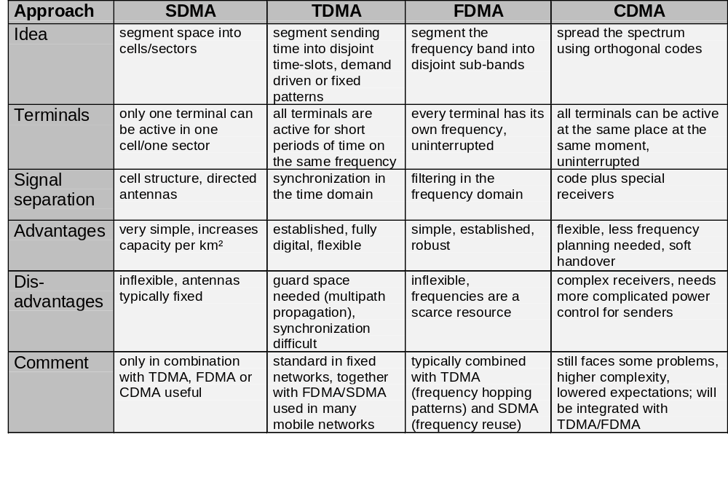
Comparison SDMA/TDMA/FDMA/CDMA

