Slide 1
Mobile Communications
Summer Term 2008
Freie Universität Berlin - Computer Systems & Telematics
Prof. Dr.-Ing. Jochen H. Schiller
www.jochenschiller.de
schiller@computer.org

Slide 2
Overview of the lecture
  Introduction
    Use-cases, applications
    Definition of terms
    Challenges, history
  Wireless Transmission
    Frequencies & regulations
    Signals, antennas, signal propagation
    Multiplexing, modulation, spread spectrum, cellular system
  Medium Access
    SDMA, FDMA, TDMA, CDMA
    CSMA/CA, versions of Aloha
    Collision avoidance, polling
  Wireless Telecommunication Systems
    GSM, HSCSD, GPRS, DECT, TETRA, UMTS, IMT-2000
  Satellite Systems
    GEO, LEO, MEO, routing, handover
  Broadcast Systems
    DAB, DVB
  Wireless LANs
    Basic Technology
    IEEE 802.11a/b/g/…, .15, Bluetooth, ZigBee
  Network Protocols
    Mobile IP
    Ad-hoc networking
    Routing
  Transport Protocols
    Reliable transmission
    Flow control
    Quality of Service
  Support for Mobility
    File systems, WWW, WAP, i-mode, J2ME, ...
  Outlook

Slide 3
Mobile Communications
Chapter 1: Introduction
A case for mobility – many aspects
History of mobile communication
Market
Areas of research

Slide 4
Computers for the next decades?
Computers are integrated
  small, cheap, portable, replaceable - no more separate devices
Technology is in the background
  computer are aware of their environment and adapt (“location awareness”)
  computer recognize the location of the user and react appropriately (e.g., call forwarding, fax forwarding, “context awareness”))
Advances in technology
  more computing power in smaller devices
  flat, lightweight displays with low power consumption
  new user interfaces due to small dimensions
  more bandwidth per cubic meter
  multiple wireless interfaces: wireless LANs, wireless WANs, regional wireless telecommunication networks etc. („overlay networks“)

Slide 5
Mobile communication
Two aspects of mobility:
  user mobility: users communicate (wireless) “anytime, anywhere, with anyone”
  device portability: devices can be connected anytime, anywhere to the network
Wireless vs. mobile Examples
✗ ✗ stationary computer
✗ ✓ notebook in a hotel
✓ ✗ wireless LANs in historic buildings
✓ ✓ Personal Digital Assistant (PDA)
The demand for mobile communication creates the need for integration of wireless networks into existing fixed networks:
  local area networks: standardization of IEEE 802.11
  Internet: Mobile IP extension of the internet protocol IP
  wide area networks: e.g., internetworking of GSM and ISDN, VoIP over WLAN and POTS

Slide 6
Applications I
Vehicles
  transmission of news, road condition, weather, music via DAB/DVB-T
  personal communication using GSM/UMTS
  position via GPS
  local ad-hoc network with vehicles close-by to prevent accidents, guidance system, redundancy
  vehicle data (e.g., from busses, high-speed trains) can be transmitted in advance for maintenance
Emergencies
  early transmission of patient data to the hospital, current status, first diagnosis
  replacement of a fixed infrastructure in case of earthquakes, hurricanes, fire etc.
  crisis, war, ...

Slide 7
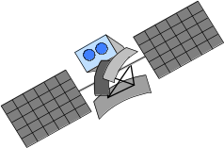
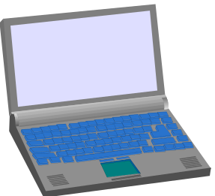

Typical application: road traffic
UMTS, WLAN,
DAB, DVB, GSM,
cdma2000, TETRA, ...
ad hoc
Personal Travel Assistant,
PDA, Laptop,
GSM, UMTS, WLAN,
Bluetooth, ...

Slide 8








Mobile and wireless services – Always Best Connected
UMTS, GSM
115 kbit/s
LAN
100 Mbit/s,
WLAN
54 Mbit/s
DSL/ WLAN
3 Mbit/s
GSM/GPRS 53 kbit/s
Bluetooth 500 kbit/s
UMTS
2 Mbit/s
GSM/EDGE 384 kbit/s,
DSL/WLAN 3 Mbit/s
UMTS, GSM
384 kbit/s
GSM 115 kbit/s,
WLAN 11 Mbit/s

Slide 9

Applications II
Traveling salesmen
  direct access to customer files stored in a central location
  consistent databases for all agents
  mobile office
Replacement of fixed networks
  remote sensors, e.g., weather, earth activities
  flexibility for trade shows
  LANs in historic buildings
Entertainment, education, ...
  outdoor Internet access
  intelligent travel guide with up-to-date
  location dependent information
  ad-hoc networks for
  multi user games
History
Info

Slide 10
Location dependent services
Location aware services
  what services, e.g., printer, fax, phone, server etc. exist in the local environment
Follow-on services
  automatic call-forwarding, transmission of the actual workspace to the current location
Information services
  “push”: e.g., current special offers in the supermarket
  “pull”: e.g., where is the Black Forrest Cheese Cake?
Support services
  caches, intermediate results, state information etc. “follow” the mobile device through the fixed network
Privacy
  who should gain knowledge about the location

Slide 11
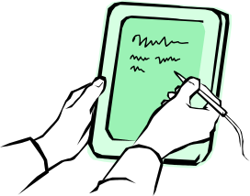

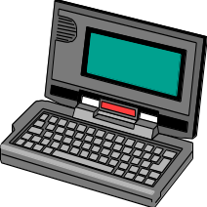
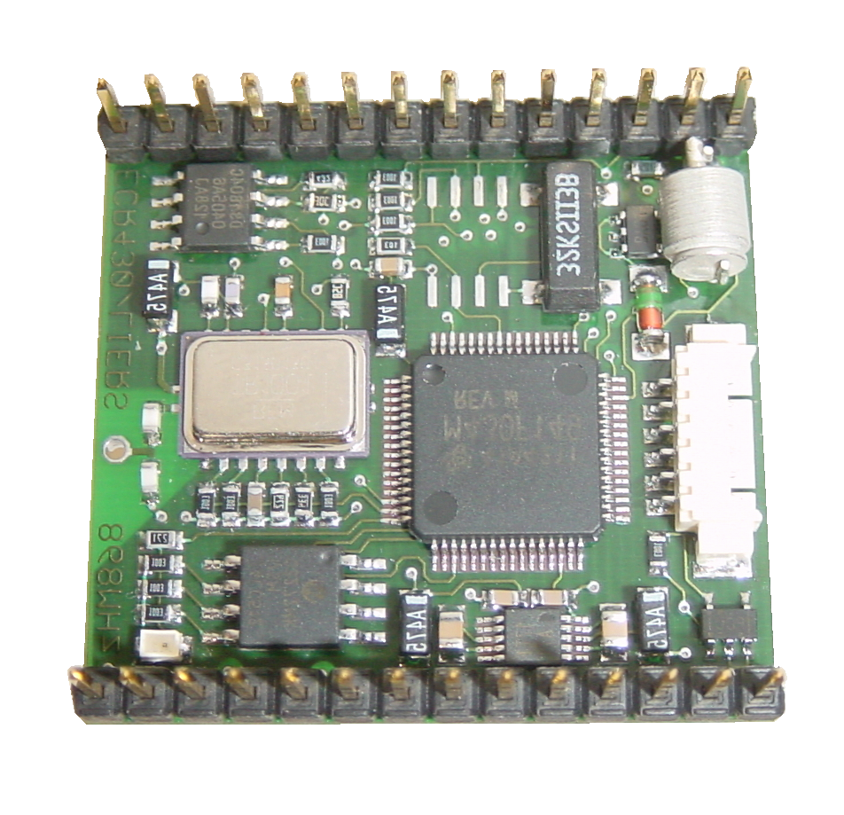
Mobile devices
Pager
receive only
tiny displays
simple text
messages
PDA
graphical displays
character recognition
simplified WWW
Laptop/Notebook
fully functional
standard applications
Sensors,
embedded
controllers
Smartphone
tiny keyboard
simple versions
of standard applications
Mobile phones
voice, data
simple graphical displays
www.scatterweb.net
performance
No clear separation between device types possible
(e.g. smart phones, embedded PCs, …)

Slide 12
Effects of device portability
Power consumption
  limited computing power, low quality displays, small disks due to limited battery capacity
  CPU: power consumption ~ CV²f
    C: internal capacity, reduced by integration
    V: supply voltage, can be reduced to a certain limit
    f: clock frequency, can be reduced temporally
Loss of data
  higher probability, has to be included in advance into the design (e.g., defects, theft)
Limited user interfaces
  compromise between size of fingers and portability
  integration of character/voice recognition, abstract symbols
Limited memory
  limited usage of mass memories with moving parts
  flash-memory or ? as alternative

Slide 13
Wireless networks in comparison to fixed networks
Higher loss-rates due to interference
  emissions of, e.g., engines, lightning
Restrictive regulations of frequencies
  frequencies have to be coordinated, useful frequencies are almost all occupied
Low transmission rates
  local some Mbit/s, regional currently, e.g., 53kbit/s with GSM/GPRS or about 150 kbit/s using EDGE
Higher delays, higher jitter
  connection setup time with GSM in the second range, several hundred milliseconds for other wireless systems
Lower security, simpler active attacking
  radio interface accessible for everyone, base station can be simulated, thus attracting calls from mobile phones
Always shared medium
  secure access mechanisms important

Slide 14
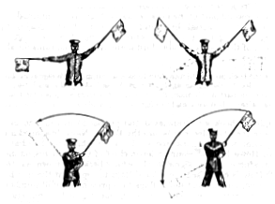
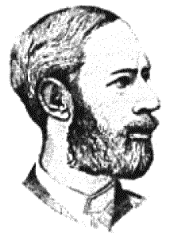
Early history of wireless communication
Many people in history used light for communication
  heliographs, flags (“semaphore”), ...
  150 BC smoke signals for communication;
  (Polybius, Greece)
  1794, optical telegraph, Claude Chappe
Here electromagnetic waves are
of special importance:
  1831 Faraday demonstrates electromagnetic induction
  J. Maxwell (1831-79): theory of electromagnetic Fields, wave equations (1864)
  H. Hertz (1857-94): demonstrates
  with an experiment the wave character
  of electrical transmission through space
  (1888, in Karlsruhe, Germany)

Slide 15
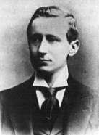
History of wireless communication I
1896 Guglielmo Marconi
  first demonstration of wireless
  telegraphy (digital!)
  long wave transmission, high
  transmission power necessary (> 200kw)
1907 Commercial transatlantic connections
  huge base stations
  (30 100m high antennas)
1915 Wireless voice transmission New York - San Francisco
1920 Discovery of short waves by Marconi
  reflection at the ionosphere
  smaller sender and receiver, possible due to the invention of the vacuum tube (1906, Lee DeForest and Robert von Lieben)
1926 Train-phone on the line Hamburg - Berlin
  wires parallel to the railroad track

Slide 16
History of wireless communication II
1928 many TV broadcast trials (across Atlantic, color TV, news)
1933 Frequency modulation (E. H. Armstrong)
1958 A-Netz in Germany
  analog, 160MHz, connection setup only from the mobile station, no handover, 80% coverage, 1971 11000 customers
1972 B-Netz in Germany
  analog, 160MHz, connection setup from the fixed network too (but location of the mobile station has to be known)
  available also in A, NL and LUX, 1979 13000 customers in D
1979 NMT at 450MHz (Scandinavian countries)
1982 Start of GSM-specification
  goal: pan-European digital mobile phone system with roaming
1983 Start of the American AMPS (Advanced Mobile Phone System, analog)
1984 CT-1 standard (Europe) for cordless telephones

Slide 17
History of wireless communication III
1986 C-Netz in Germany
  analog voice transmission, 450MHz, hand-over possible, digital signaling, automatic location of mobile device
  was in use until 2000, services: FAX, modem, X.25, e-mail, 98% coverage
1991 Specification of DECT
  Digital European Cordless Telephone (today: Digital Enhanced Cordless Telecommunications)
  1880-1900MHz, ~100-500m range, 120 duplex channels, 1.2Mbit/s data transmission, voice encryption, authentication, up to several 10000 user/km², used in more than 50 countries
1992 Start of GSM
  in D as D1 and D2, fully digital, 900MHz, 124 channels
  automatic location, hand-over, cellular
  roaming in Europe - now worldwide in more than 200 countries
  services: data with 9.6kbit/s, FAX, voice, ...

Slide 18
History of wireless communication IV
1994 E-Netz in Germany
  GSM with 1800MHz, smaller cells
  as Eplus in D (1997 98% coverage of the population)
1996 HiperLAN (High Performance Radio Local Area Network)
  ETSI, standardization of type 1: 5.15 - 5.30GHz, 23.5Mbit/s
  recommendations for type 2 and 3 (both 5GHz) and 4 (17GHz) as wireless ATM-networks (up to 155Mbit/s)
1997 Wireless LAN - IEEE802.11
  IEEE standard, 2.4 - 2.5GHz and infrared, 2Mbit/s
  already many (proprietary) products available in the beginning
1998 Specification of GSM successors
  for UMTS (Universal Mobile Telecommunications System) as European proposals for IMT-2000
  Iridium
    66 satellites (+6 spare), 1.6GHz to the mobile phone

Slide 19
History of wireless communication V
1999 Standardization of additional wireless LANs
  IEEE standard 802.11b, 2.4-2.5GHz, 11Mbit/s
  Bluetooth for piconets, 2.4GHz, <1Mbit/s
  decision about IMT-2000
    several “members” of a “family”: UMTS, cdma2000, DECT, …
  Start of WAP (Wireless Application Protocol) and i-mode
    first step towards a unified Internet/mobile communication system
    access to many services via the mobile phone
2000 GSM with higher data rates
  HSCSD offers up to 57,6kbit/s
  first GPRS trials with up to 50 kbit/s (packet oriented!)
  UMTS auctions/beauty contests
    Hype followed by disillusionment (50 B$ paid in Germany for 6 licenses!)
  Iridium goes bankrupt
2001 Start of 3G systems
  Cdma2000 in Korea, UMTS tests in Europe, Foma (almost UMTS) in Japan

Slide 20
History of wireless communication VI
2002
  WLAN hot-spots start to spread
2003
  UMTS starts in Germany
  Start of DVB-T in Germany replacing analog TV
2005
  WiMax starts as DSL alternative (not mobile)
  first ZigBee products
2006
  HSDPA starts in Germany as fast UMTS download version offering > 3 Mbit/s
  WLAN draft for 250 Mbit/s (802.11n) using MIMO
  WPA2 mandatory for Wi-Fi WLAN devices
2007
  over 3.3 billion subscribers for mobile phones (NOT 3 bn people!)
2008
  “real” Internet widely available on mobile phones (standard browsers, decent data rates)
  7.2 Mbit/s HSDPA, 1.4 Mbit/s HSUPA available in Germany, more than 100 operators support HSPA worldwide

Slide 21
Wireless systems: overview of the development
cellular phones
satellites
cordless
phones
wireless LAN
1980:
CT0
1981:
NMT 450
1982:
Inmarsat-A
1983:
AMPS
1984:
CT1
1986:
NMT 900
1987:
CT1+
1988:
Inmarsat-C
1989:
CT 2
1991:
CDMA
1991:
D-AMPS
1991:
DECT
1992:
GSM
1992:
Inmarsat-B
Inmarsat-M
199x:
proprietary
1993:
PDC
1994:
DCS 1800
1997:
IEEE 802.11
1998:
Iridium
1999:
802.11b, Bluetooth
analog
2000:
GPRS
2000:
IEEE 802.11a
2001:
IMT-2000
digital
200?:
Fourth Generation
(Internet based)
4G – fourth generation: when and how?

Slide 22
Worldwide wireless subscribers (old prediction 1998)
700
600
500
Americas
400
Europe
Japan
300
others
total
200
100
0
1996
1997
1998
1999
2000
2001

Slide 23
Mobile phones per 100 people 1999
Germany
Greece
Spain
Belgium
France
Netherlands
Great Britain
Switzerland
Ireland
Austria
Portugal
Luxemburg
Italy
Denmark
Norway
Sweden
Finland
0
10
20
30
40
50
60
2005: 70-90% penetration in Western Europe

Slide 24
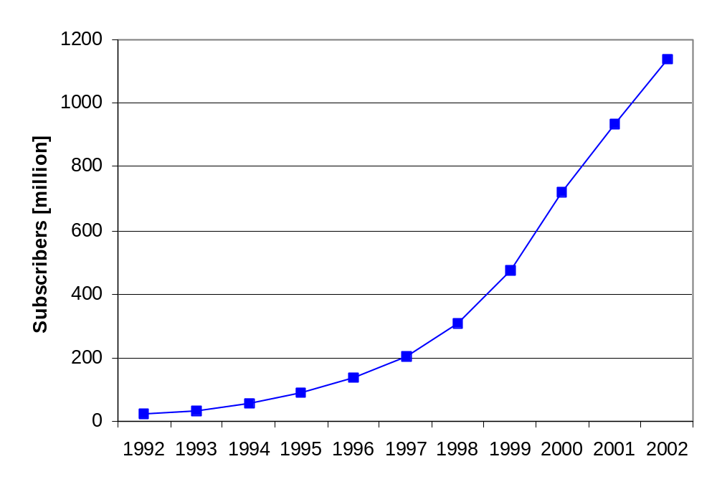
Worldwide cellular subscriber growth
Note that the curve starts to flatten in 2000 – 2008: over 3.3 billion subscribers

Slide 25
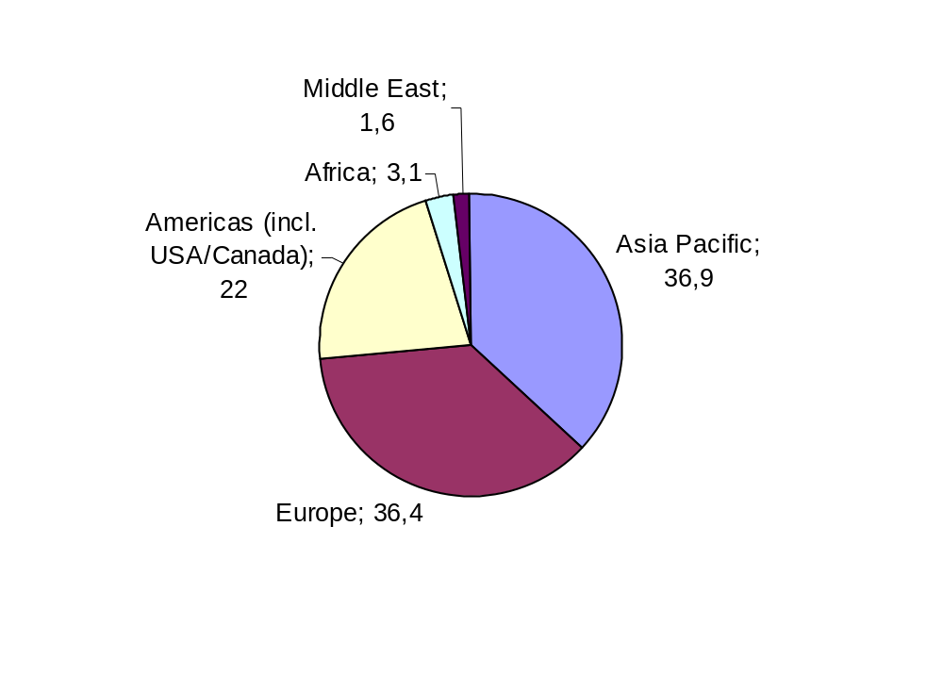
Cellular subscribers per region (June 2002)
2004: 715 million mobile phones delivered

Slide 26
Mobile statistics snapshots (09/2002 / 12/2004 / 04/2006 / Q4/2007
Total Global Mobile Users
869M / 1.52G / 2G / 3.3G
Total Analogue Users 71M / 34M / 1M
Total US Mobile users 145M / 140M
Total Global GSM users 680M / 1.25G 1.5G / 2.7G
Total Global CDMA Users 127M / 202M
Total TDMA users 84M / 120M
Total European users 283M / 343M
Total African users 18.5M / 53M / 83M
Total 3G users 130M / 130M
Total South African users 13.2M / 19M / 30M
European Prepaid Penetration 63%
European Mobile Penetration 70.2%
Global Phone Shipments 2001 393M / 1G 2008
Global Phone Sales 2Q02 96.7M
www.cellular.co.za/stats/
stats-main.htm
www.gsmworld.com/news/statistics/
index.shtml
#1 Mobile Country China (139M / 300M)
#1 GSM Country China (99M / 282M / 483M)
#1 SMS Country Philipines
#1 Handset Vendor 2Q02 Nokia (37.2%)
#1 Network In Africa Vodacom (6.6M / 11M)
#1 Network In Asia Unicom (153M)
#1 Network In Japan DoCoMo
#1 Network In Europe T-Mobile (22M / 28M)
#1 In Infrastructure Ericsson
SMS Sent Globally 1Q 60T / 135G / 235G / 650 G
SMS sent in UK 6/02 1.3T / 2.1G
SMS sent Germany 1Q02 5.7T
GSM Countries on Air 171 / 210 / 220
GSM Association members 574 / 839
Total Cost of 3G Licenses in Europe 110T€
SMS/month/user 36
The figures vary a lot depending on the statistic, creator of the statistic etc.!

Slide 27
Areas of research in mobile communication
Wireless Communication
  transmission quality (bandwidth, error rate, delay)
  modulation, coding, interference
  media access, regulations
  ...
Mobility
  location dependent services
  location transparency
  quality of service support (delay, jitter, security)
  ...
Portability
  power consumption
  limited computing power, sizes of display, ...
  usability
  ...

Slide 28
Simple reference model used here
Application
Application
Transport
Transport
Network
Network
Network
Network
Data Link
Data Link
Data Link
Data Link
Physical
Physical
Physical
Physical
Radio
Medium

Slide 29
Influence of mobile communication to the layer model
Application layer
Transport layer
Network layer
Data link layer
Physical layer
service location
new/adaptive applications
multimedia
congestion/flow control
quality of service
addressing, routing
device location
hand-over
authentication
media access/control
multiplexing
encryption
modulation
interference
attenuation
frequency

Slide 30
Overview of the main chapters
Chapter 10:
Support for Mobility
Chapter 9:
Mobile Transport Layer
Chapter 8:
Mobile Network Layer
Chapter 4:
Telecommunication
Systems
Chapter 5:
Satellite
Systems
Chapter 6:
Broadcast
Systems
Chapter 7:
Wireless
LAN
Chapter 3:
Medium Access Control
Chapter 2:
Wireless Transmission

Slide 31




Overlay Networks - the global goal
integration of heterogeneous fixed and
mobile networks with varying
transmission characteristics
regional
vertical
handover
metropolitan area
campus-based
horizontal
handover
in-house

